Slide 1
Performance Testing

Slide 2
Introduction
Performance Testing is a type of software testing that ensures software applications to perform properly under their expected workload.
It is a testing technique carried out to determine system performance in terms of sensitivity, reactivity and stability under a particular workload.

Slide 3
Definition of performance testing:-
Performance Testing is the process of analyzing the quality and capability of a product. It is a testing method performed to determine the system performance in terms of speed, reliability and stability under varying workload.

Slide 4
Why we need and when we need Performance Testing:-
Software cannot be considered ‘good’ when its performance is poor, even if it fulfills the required functionality. Therefore, it is necessary to conduct performance tests.
To build a high performance software system, the performance should be considered at earlier phase. e.g., technical design phase. and the performance of every program unit is the basis of the whole software system.
A formal Performance Test should be conducted after the Assembly Test.
However, it is also sometimes necessary to check the performance during the Unit Test phase.

Slide 5
Attributes of Performance testing:-
Speed: It determines whether the software product responds rapidly.
Scalability: It determines amount of load the software product can handle at a time.
Stability: It determines whether the software product is stable in case of varying workloads.
Reliability: It determines whether the software product is secure or not.

Slide 6
Objective of Performance Testing:-
The objective of performance testing is to eliminate performance congestion.
It uncovers what is needed to be improved before the product is launched in market.
The objective of performance testing is to make software rapid.
The objective of performance testing is to make software stable and reliable.

Slide 7
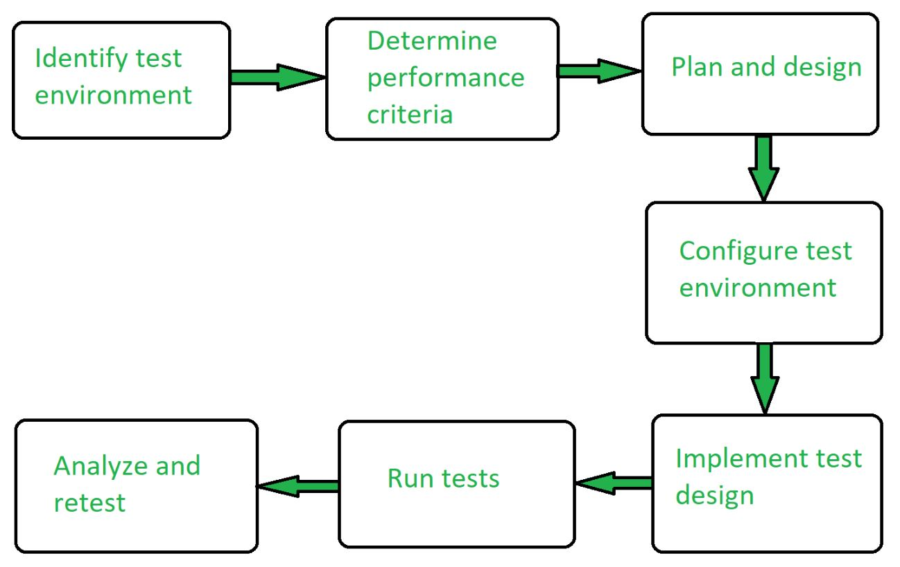
Performance testing process:-

Slide 8
Types of Performance Testing:-
Load testing: It checks the product’s ability to perform under anticipated user loads. The objective is to identify performance congestion before the software product is launched in market.
Stress testing: It involves testing a product under extreme workloads to see whether it handles high traffic or not. The objective is to identify the breaking point of a software product.
Endurance testing: It is performed to ensure the software can handle the expected load over a long period of time.

Slide 9
Spike testing: It tests the product’s reaction to sudden large spikes in the load generated by users.
Volume testing: In volume testing large number of data is saved in a database and the overall software system’s behavior is observed. The objective is to check product’s performance under varying database volumes.
Scalability testing: In scalability testing, software application’s effectiveness is determined in scaling up to support an increase in user load. It helps in planning capacity addition to your software system.

Slide 10
Performance testing tools:-
Jmeter
Open STA
Load Runner
Web Load

Slide 11
Jmeter
The Apache JMeter application is open source software, a 100% pure Java application designed to load test functional behavior and measure performance. It was originally designed for testing Web Applications but has since expanded to other test functions.
Apache JMeter may be used to test performance both on static and dynamic resources, Web dynamic applications.
It can be used to simulate a heavy load on a server, group of servers, network or object to test its strength or to analyze overall performance under different load types.

Slide 12
Features of Jmeter
Easy correlation through ability to extract data from most popular response formats, HTML, JSON , XML or any textual format.
Ability to load and performance test many different applications/server/protocol types:
Web - HTTP, HTTPS (Java, NodeJS, PHP, ASP.NET, …)
SOAP / REST Webservices
FTP
Database via JDBC
Mail - SMTP(S), POP3(S) and IMAP(S)
Native commands or shell scripts
TCP
Java Objects

Slide 13
Thank You

