Slide 1
Iot based smart library automation
Task:- PCB Designing
Name:- Darshan Mistry.
ID:- C749864.
Sem:- 4th Sem. (Project).
Assignment:- 13

Slide 2
Content:-
Introduction.
EasyEDA PCB Designing Tool.
Schematic Design to PCB.
Auto Routing.
DRC errors.
3D View.
Generate Gerber file.
References.

Slide 3
Introduction:-
Electrical connection, Mechanical support to the electrical components.
Design can be created manually as well as automatically.
Cad Drafting are used in the manual layout designing.
Automatic routing help to generate automatic design.
Designing software have DRC rules checking feature ,help to reduce short circuit errors.

Slide 4
Designing tools.
PCB Layout Features:-
Design Rules Checking(DRC).
Mutil-Layer, 6 copper layer supported.
BOM export.
Photo view.
3D View.
Generate the fabrication file(Gerber).
Export Pick and Place file.
Auto Router.
PCB module.
Document recovery.

Slide 5
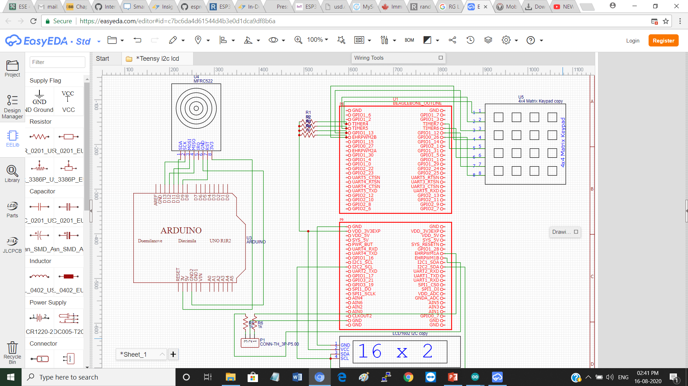
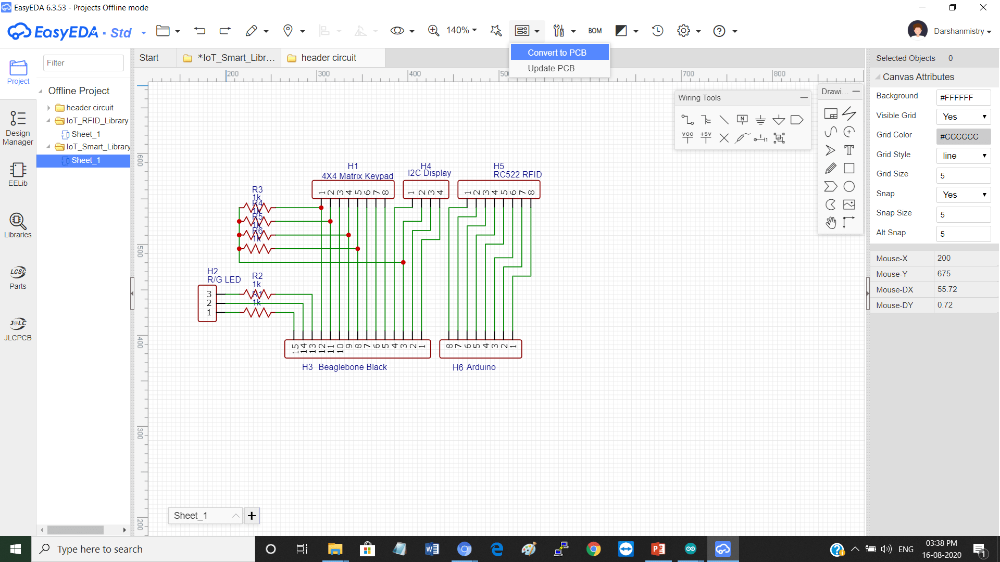
Schematic design to pcb:-

Slide 6
Create PCB design:-
Click here..

Slide 7
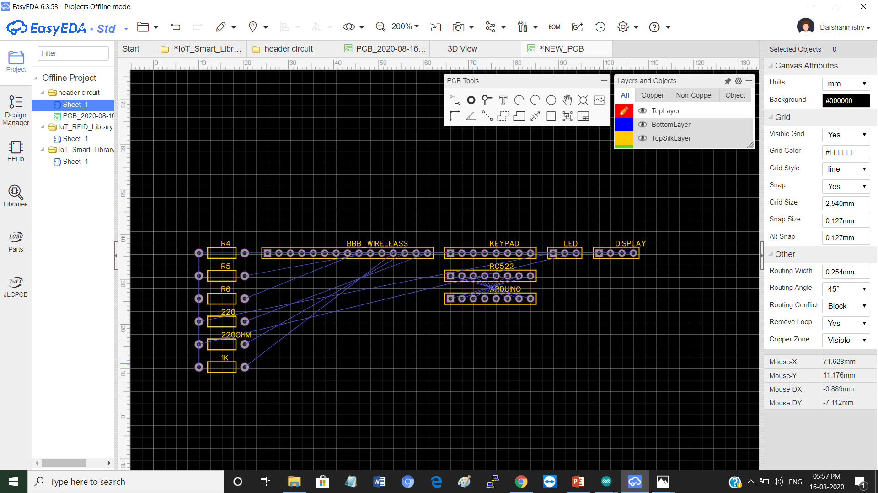
Schematic Pcb:-

Slide 8
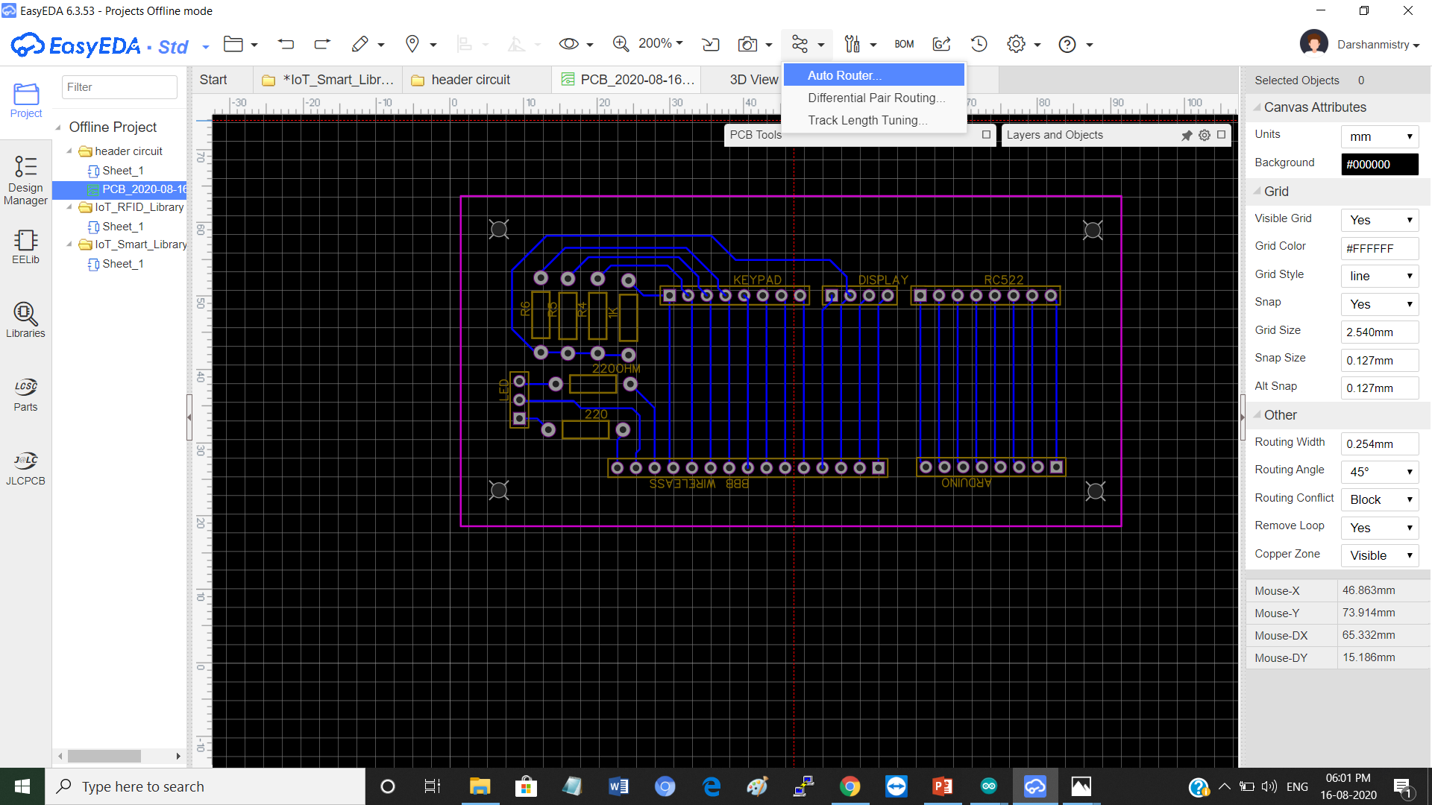
Auto router:-
Click here..

Slide 9
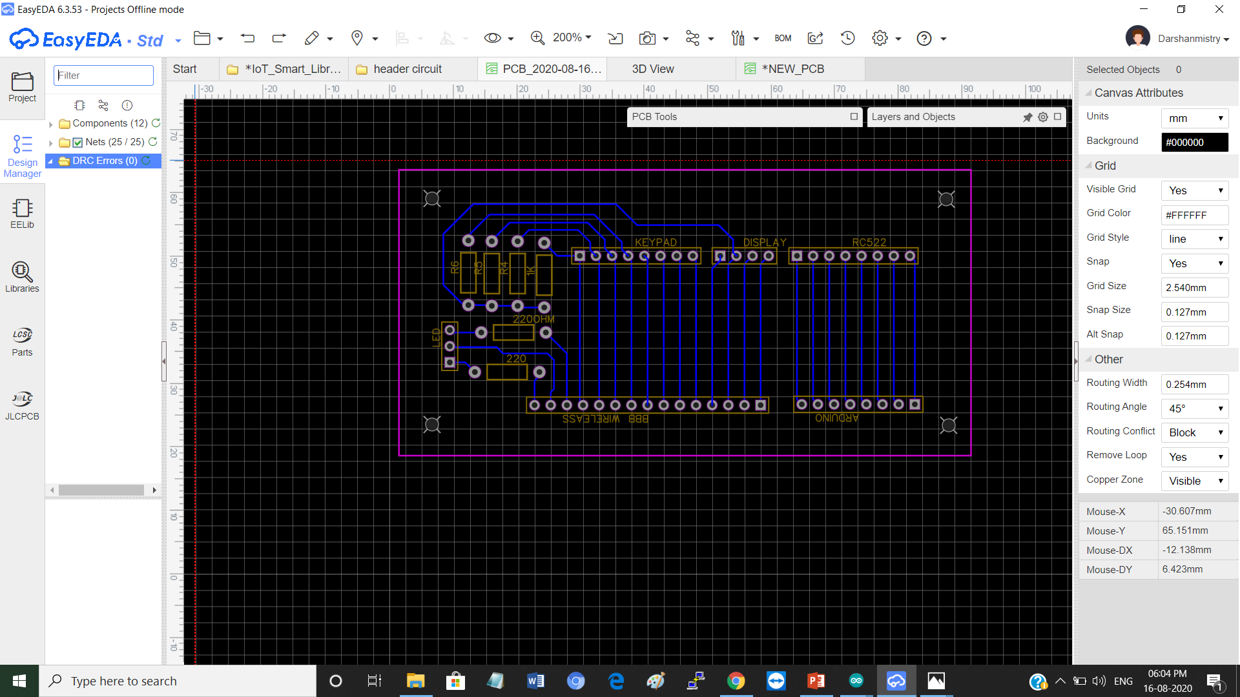
DRC Error checking:-
DRC Error..

Slide 10
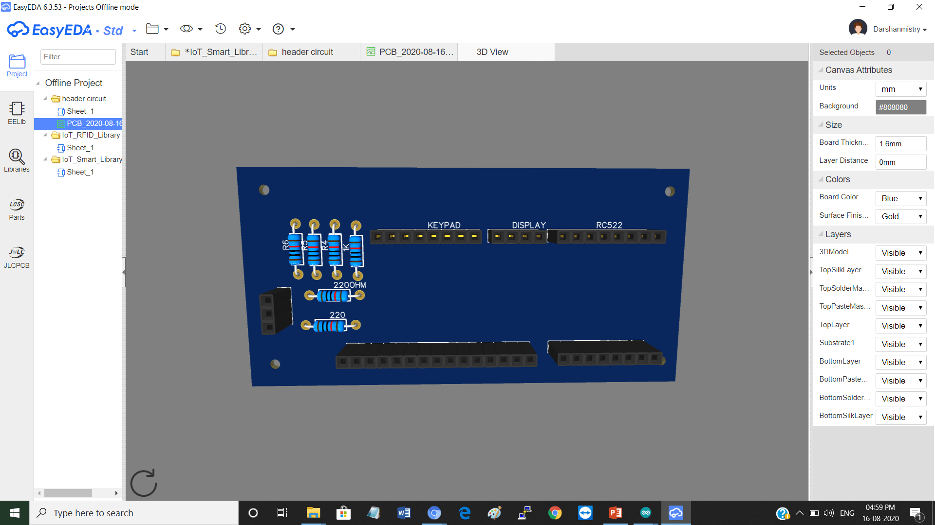
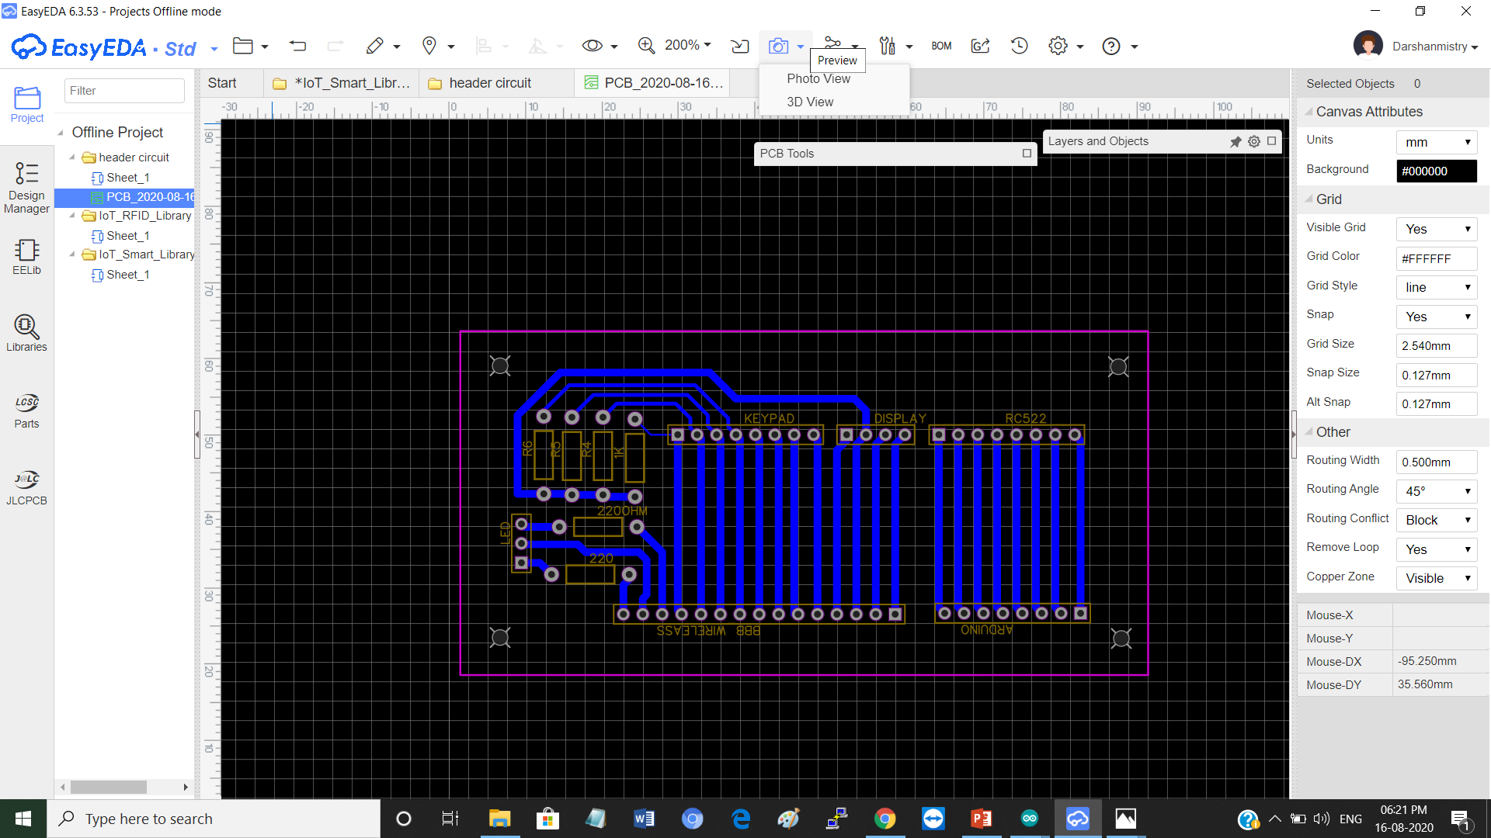
3D View:-
Click here..

Slide 11
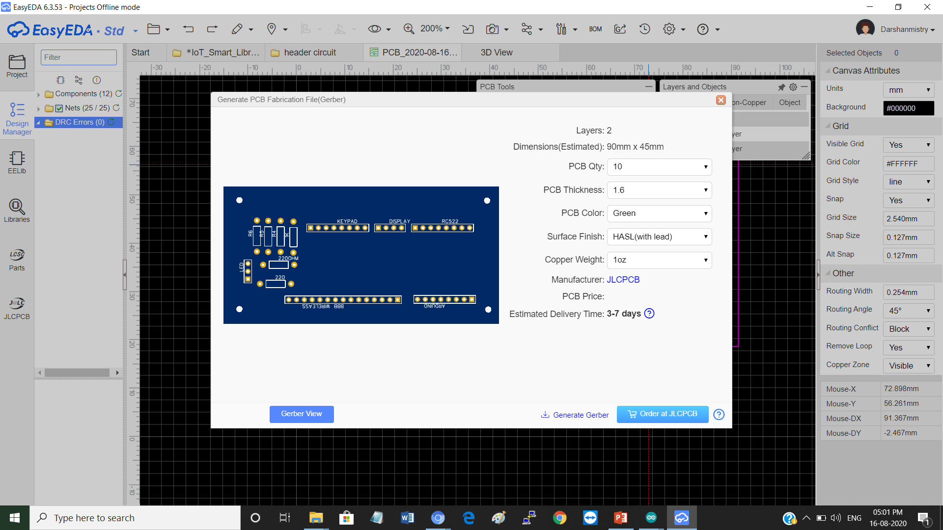
Gerber File:-

Slide 12
References:-
EasyEDA Designer (2020).
https://docs.easyeda.com/en/Introduction/Introduction-to-EasyEDA/index.html
Instructables Circuit by Autodesk_(2020).
https://www.instructables.com/id/How-to-Make-a-Circuit-Board-With-EasyEDA/

