Slide 1

Bapuji Educational Association ®
BAPUJI INSTITUTE OF ENGINEERING AND TECHNOLOGY DAVANGERE, KARNATAKA-577004
DEPARTMENT OF ELECTRONICS & COMMUNICATION ENGINEERING
Mini Project Presentation On
“WATER LEVEL MONITORING SYSTEM”
MINI PROJECT ASSOCIATES
DARSHAN S K 4BD22EC028
AMOGH H S 4BD22EC008
AFSHAN S K 4BD22EC059
SHAHID S K 4BD22EC084
Mahendrachari _{M.tech}
Project Guide
Dr.G S Sunitha _{B.E,M.tech,Ph.D}
Program Coordinator

Slide 2
Vision
To be in the forefront in providing quality technical education and research in Electronics & Communication Engineering to produce skilled professionals to cater to the challenges of the society.
Mission
M1. To facilitate the students with profound technical knowledge through effective teaching learning process for a successful career. challenges in the program. conducive environment.
M2. To impart quality education to strengthen students to meet the industry standards and face confidently the
M3. To develop the essence of innovation and research among students and faculty by providing infrastructure and a
M4. To inculcate the student community with ethical values, communication skills, leadership qualities, entrepreneurial skills and lifelong learning to meet the societal needs

Slide 3
WATER LEVEL MONITORING SYSTEM
Solution For Efficient Water Management

Slide 4
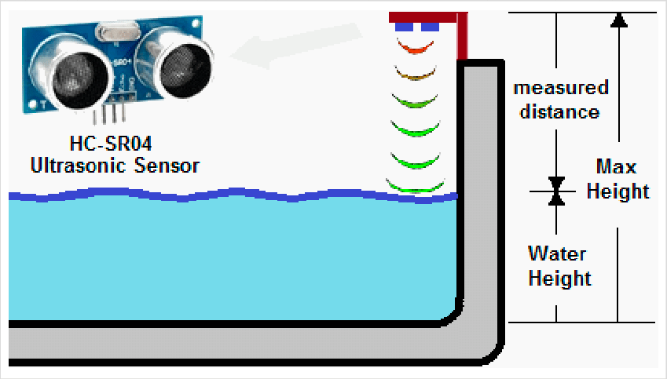
Abstract
This project introduces an IoT-based water filling machine designed to automate water dispensing with precision and efficiency. The system integrates an Arduino Uno microcontroller with sensors, a relay module, and a user interface. It employs an ultrasonic sensor to monitor water levels, a flow sensor for accurate measurement, and a 4x4 keypad for user-defined input. Real-time data is transmitted to Thing Speak for remote monitoring and analytics. The machine ensures minimal water wastage, providing a sustainable solution for controlled water usage. This innovation demonstrates the potential of IoT in achieving efficient resource management.

Slide 5
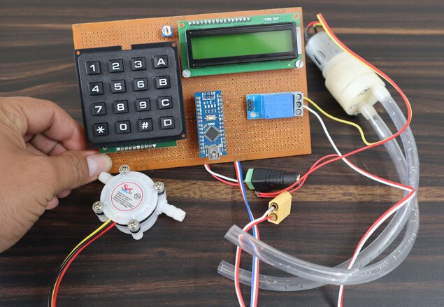
Introduction
Water management is essential in various fields like agriculture, industrial processes, and household water systems. Traditional water filling systems are often manual, requiring human intervention. This project explores automating the water filling process using an IoT-based system. The system utilizes various sensors and actuators to automatically control the filling process and provides real-time monitoring and control via IoT platforms like Thing Speak and Blynk.

Slide 6
Objectives
To design an automated water filling system using Arduino Uno.
To monitor the water level and control the water filling process automatically.
To integrate sensors like the ultrasonic sensor for real-time feedback.
To utilize a submersible pump, motor driver, and other components for effective water control.

Slide 7
Methodology
Block Diagram
Motor Driver (d8,d9)
PUMP
MOTOR
Arduino Uno
Ultrasonic Sensor
(Water Level)
LCD Display
(16*2).
LED
(d3,d4,d5)
Buzzer
(d10)

Slide 8
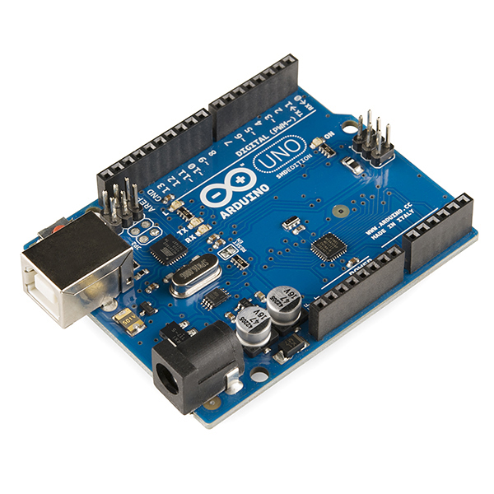
Hardware Components
Arduino Uno
Central Controller: Manages the system’s sensors and actuators.
I/O Pins: Connects to sensors and devices (flow sensor, keypad, etc.).
Programming: Uses Arduino IDE and C/C++ for programming.
Power Supply: Powered through USB or an external adapter (9V-12V).
Versatile: Works with a wide range of sensors and modules.

Slide 9
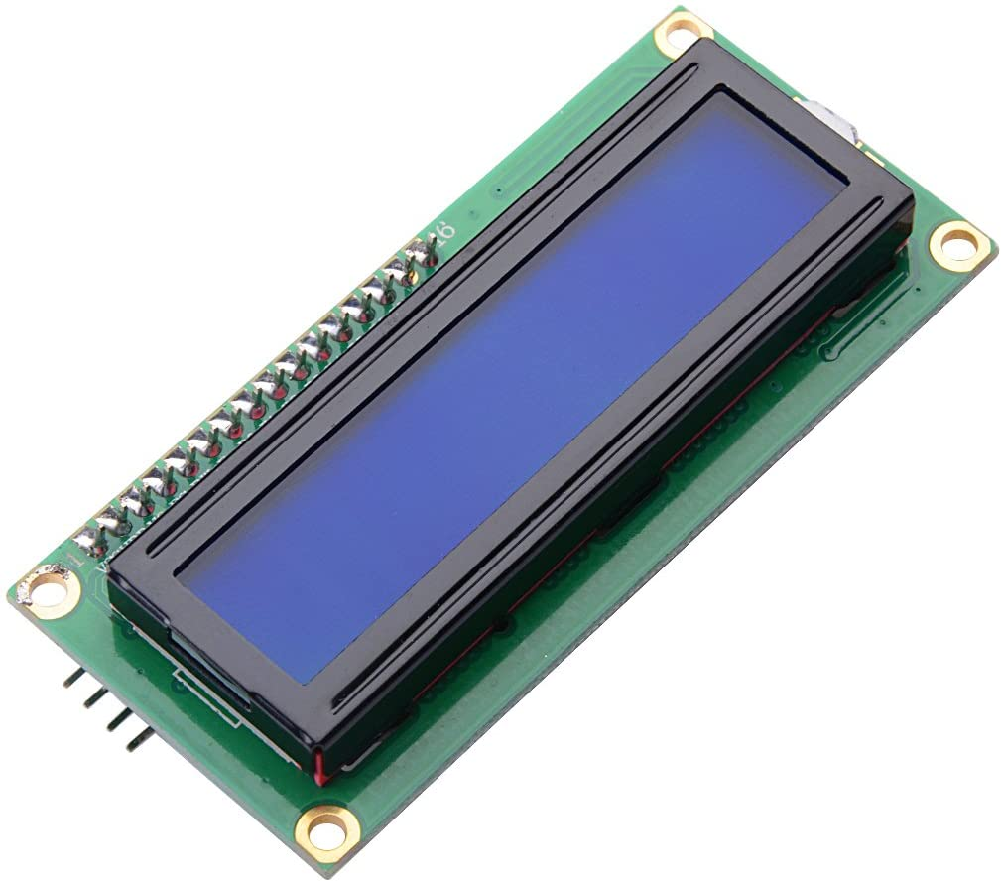
4. LCD I2C
I2C Communication: Uses 2-wire connection (SDA, SCL).
Compact Display: Usually 16x2 or 20x4 for basic data display.
Low Power: More power-efficient than parallel LCDs.
Simple Wiring: Only 4 pins required for connection.
User Feedback: Displays real-time data (water level, flow, status).

Slide 10
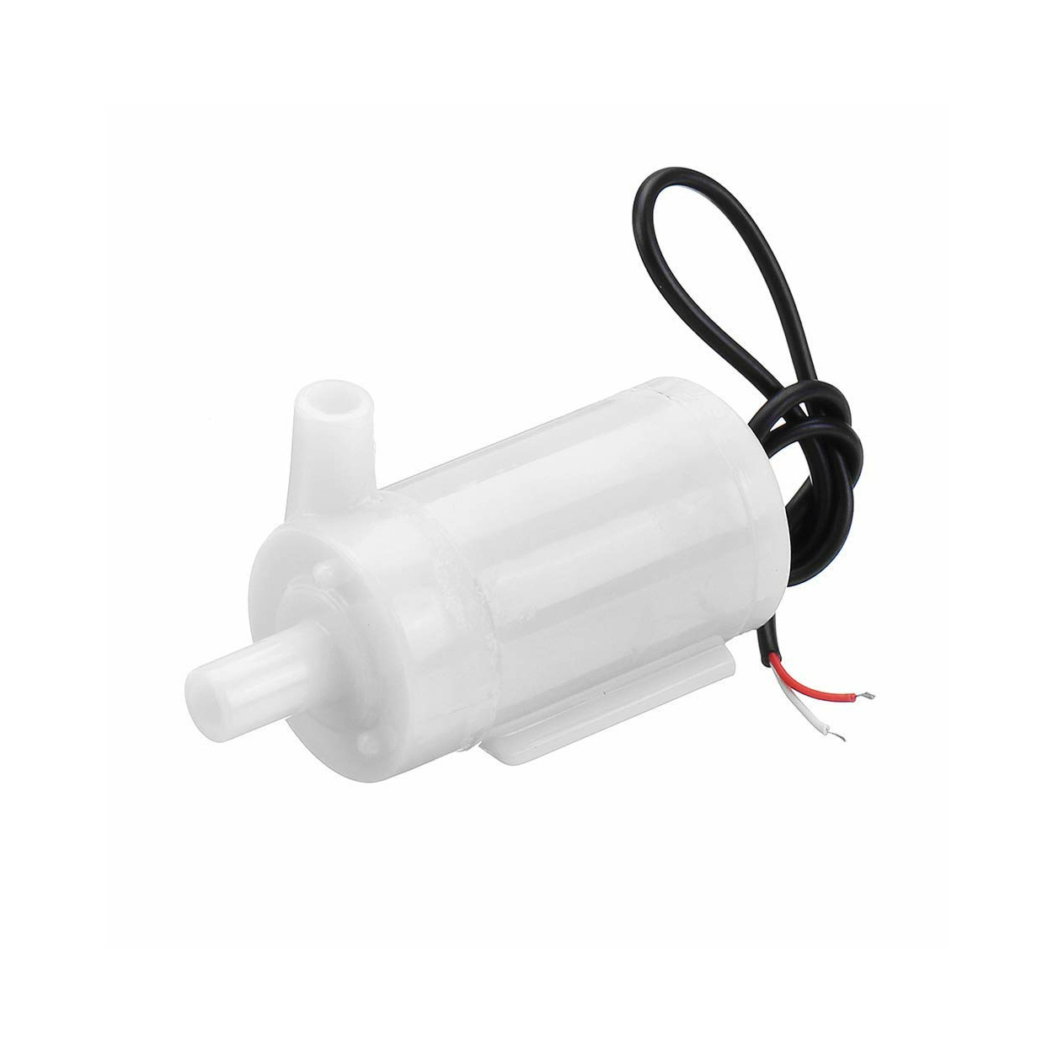
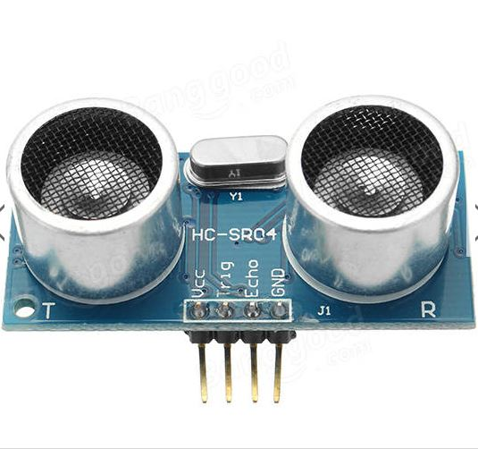
6. Submersible Pump
Water Pumping: Moves water from a source into the container.
Submersible Design: Operates underwater for water pumping applications.
Power Supply: Typically runs on 12V DC power.
Control: Controlled via relay module based on Arduino signals.
Efficient: Designed for continuous use in wet environments.
7. Ultrasonic Sensor
Distance Measurement: Measures the distance to the water surface.
Non-contact: Operates without touching the water.
Accuracy: Provides measurements with minimal error.
Signal Type: Sends and receives sound waves to calculate distance.
Water Level Detection: Used to monitor the water level in the tank.

Slide 11
Software Description
Arduino IDE: The development environment for writing and uploading code to the Arduino Uno.
Programming Language: Uses C/C++ for programming the Arduino to handle sensor inputs, control actuators, and communicate with other components.
Libraries: Utilizes libraries LiquidCrystal_I2C.h for LCD display,
Control Logic: The software implements logic to monitor water flow, control the pump, and display real-time data on the LCD or mobile app.

Slide 12
Working
1. Water Level Detection
The ultrasonic sensor measures the distance between the sensor and the water surface to determine the water level.
This ensures accurate monitoring of the current water level in the container.
2. Water Filling
When the water level drops below a set threshold, the relay module activates the submersible pump.
The pump fills the container until the desired water level is reached.
3. Flow Control
The flow sensor monitors the water flow rate through the pipe to detect abnormalities.
It ensures the system operates efficiently and avoids overfilling or leaks.

Slide 13
PSEUDO CODE
START
Initialize pins for ultrasonic sensor, LEDs, buzzer, motor, and LCD
Set initial pump status to OFF
LOOP forever:
Measure distance from ultrasonic sensor
Display distance on LCD
IF distance > 10 cm:
Turn ON Empty LED
Turn OFF Medium LED
Turn OFF Full LED
Turn OFF buzzer
Turn ON pump

Slide 14
ELSE IF distance > 3 cm AND distance <= 10 cm:
Turn OFF Empty LED
Turn ON Medium LED
Turn OFF Full LED
Turn OFF buzzer
Keep pump ON (if already running)
ELSE IF distance <= 2 cm:
Turn OFF Empty LED
Turn OFF Medium LED
Turn ON Full LED
Turn ON buzzer
Turn OFF pump
WAIT 1 second
END LOOP

Slide 15
Result and Discussion
Result
Accurate Water Level Detection: The ultrasonic sensor reliably measured water levels, ensuring precise pump activation.
Efficient Water Filling: The relay-controlled pump successfully maintained desired water levels without overflows.
Manual Control Success: The Blynk app allowed seamless manual operation of the system.
Flow Monitoring: The flow sensor accurately tracked water flow to prevent leaks or wastage.

Slide 16
Discussion
System Reliability: The integration of sensors and IoT platforms ensured consistent and error-free performance.
User Interaction: The Blynk app provided an intuitive interface for remote and manual control, enhancing user experience.
Data Insights: Thing Speak enabled long-term monitoring and analysis of water usage trends, aiding in resource optimization.
Limitations: Ultrasonic sensors may show inaccuracies in turbulent water conditions or if obstacles are present.
Future Improvements: Adding a secondary alert system (e.g., SMS or email) and advanced analytics could enhance functionality further.

Slide 17
Advantages
Household Water Management:
Automatically maintains water levels in overhead or underground tanks.
Prevents water wastage due to overflows and ensures timely refilling.
Agriculture and Irrigation:
Monitors and controls water flow for irrigation systems.
Optimizes water usage to support sustainable farming practices.
Industrial Water Systems:
Manages water levels in industrial processes like cooling systems and boilers.
Ensures consistent water supply for operations.
Public Utilities:
Used in water distribution systems to monitor reservoir levels.
Supports efficient water management for municipalities.

Slide 18
Applications
Household Water Tanks: Automates water level monitoring and prevents tank overflows.
Agriculture: Manages water supply for irrigation, reducing water wastage.
Industrial Usage: Ensures water availability for industrial cooling or processes.
Public Utilities: Monitors and controls water levels in reservoirs or water supply systems.
Smart Homes: Integrates into smart home systems for efficient water management.

Slide 19
Limitations
Dependency on Internet Connectivity: The system relies on a stable internet connection for IoT functionality, which may not be available in remote areas.
Ultrasonic Sensor Accuracy: Ultrasonic sensors can be affected by turbulence, obstacles, or environmental factors, leading to inaccurate readings.
Power Dependency: The system requires continuous power for sensors, Wi-Fi modules, and pumps, which may cause issues during power outages.
Maintenance Requirements: Components like the flow sensor and submersible pump may need regular cleaning and maintenance for optimal performance.

Slide 20
Conclusion
The IoT-based water filling machine demonstrates an efficient, automated solution for water management. By integrating sensors, a relay-controlled pump, and IoT platforms like Blynk and Thing Speak, the system ensures accurate water level detection, real-time monitoring, and user-friendly control. This innovation minimizes water wastage, reduces manual intervention, and enhances operational reliability in various applications, including households, agriculture, and industries. Despite challenges like dependency on power and internet connectivity, the system's benefits in promoting sustainable water usage and remote access make it a valuable addition to modern water management practices. Future enhancements can focus on improving sensor accuracy and incorporating additional alert mechanisms for better reliability

Slide 21


