Slide 1



Bapuji Educational Association (R)
Bapuji Institute of Engineering and Technology, Davangere
Department of Electronics & Communication Engineering
2024-2025
Mini Project Presentation On
WASTE CLASSIFICATION USING ARDUINO UNO
MINI PROJECT ASSOCIATES
DARSHAN N S 4BD22EC026
DARSHAN S K 4BD22EC028
GAGANA K B 4BD22EC030
GANESH TM 4BD22EC032
Bhagya Shantha Kumar
_{M.Tech}
Project guide
Dr G S Sunitha
M.TECH(DEAC).,Ph.D,MISTE,FIETE,FIE
Program coordinator

Slide 2
Vision of Department
“To be in the fore front of providing quality technical education and research in Electronics & Communication Engineering to produce skilled professionals to cater to the challenges of the society.”
Mission of Department
M1. To facilitate the students with profound technical knowledge through effective teaching learning process for a successful career.
M2. To impart quality education to strengthen students to meet the industry standards and face confidently the challenges in the programme.
M3. To develop the essence of innovation and research among students and faculty by providing infrastructure and a conducive environment.
M4.To inculcate the student community with ethical values, communication skills, leadership qualities, entrepreneurial skills, and lifelong learning to meet the societal needs

Slide 3
COURSE LEARNING OBJECTIVES
This course will enable us to:
1)Understand and analyze an engineering problem.
2)Acquire technical knowledge and collect the information.
3)Enhance communication, technical presentation and report preparation skills.
4)Provide an opportunity to exercise the creative and innovative ideas in group.

Slide 4

CONTENTS
1
8
ABSTRACT
Circuit and simulation
2
9
INTRODUCTION
RESULT AND DISCUSSIONS
3
10
OBJECTIVES
APPLICATIONS
4
BLOCK DIAGRAM AND
METHODOLOGY
11
ADVANTAGES AND
LIMITATIONS
5
12
HARDWARE DESCRIPTION
CONCLUSION
13
6
SOFTWARE DESCRIPTION
FUTURE SCOPE
7
14
WORKING
REFERENCES

Slide 5
ABSTRACT
This project proposes an automated waste classification system aimed at sorting waste into three categories: dry, wet, and metal, using software logic and data analysis. The system processes input data to classify the waste based on predefined thresholds without the need for physical components such as sensors or motors. The software logic implemented in the Arduino Uno interprets sensor readings to classify waste and decides the appropriate sorting mechanism. The system also integrates with the Blynk IoT platform to display real-time waste classification status remotely, allowing users to monitor and control the process from a distance. The project highlights the potential of automated waste sorting systems and IoT integration to enhance waste management efficiency, reduce manual intervention, and optimize sorting processes through real-time data analysis. Future improvements can include more sophisticated data analysis techniques to improve classification accuracy and scale the system for larger waste management tasks.

Slide 6
INTRODUCTION
Overview:
The project aims to create an automated waste classification system using logic to categorize waste, eliminating the need for physical sensors or components and ensuring more efficient sorting.
By incorporating IoT for real-time monitoring, the system enables management, promoting environmental sustainability and reducing errors in waste sorting methods.
Motivation:
Traditional methods are time-consuming, error-prone, and labor-intensive.
Automation ensures accurate and consistent waste sorting.
Promotes environmental sustainability and recycling efforts.
Contributes to cleaner cities and smarter waste management practices.

Slide 7
OBJECTIVES
To design and develop an automated waste classification system.
To reduce human effort and error in waste sorting.
To promote environmental sustainability by improving recycling practices.
To provide an easy-to-use system that can be scaled for larger applications.

Slide 8

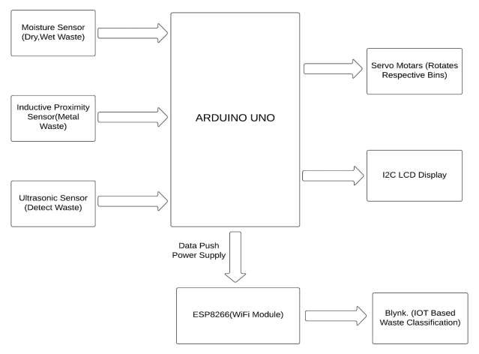
BLOCK DAIGRAM
ESP32

Slide 9
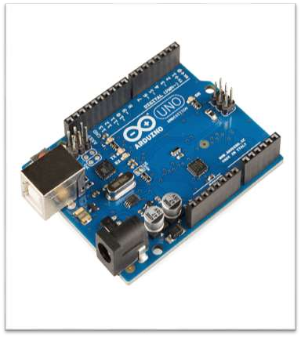
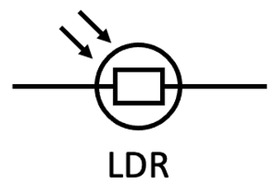
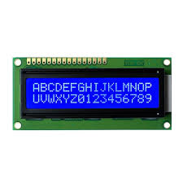
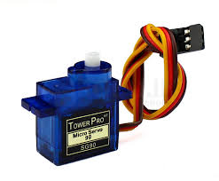
METHODOLOGY
ARDUINO UNO
SENSORS
LCD DISPLAY
SERVOMOTOR
Acts as the central controller that processes sensor inputs and controls actuators based on predefined logic.
Measure various parameters like moisture content, metal presence, and waste distance to classify waste.
Provides real time waste classification status
Servo motor that sorts waste into bins based on classification determined by sensor data.

Slide 10
HARDWARE REQUIREMENTS:
ARDUINO UNO:
The Arduino Uno acts as a microcontroller that processes inputs from sensors and controls outputs like motors, displays, and other devices.
SPECIFICATIONS:
Microcontroller: ATmega328P.
Operating Voltage: 5V.
Input Voltage (recommended): 7-12V.
Digital I/O Pins: 14 (6 of which are PWM-capable).
Analog Input Pins: 6.
USB connection: Type-B USB for programming and power supply.
Communication: UART, SPI, I2C.

Slide 11
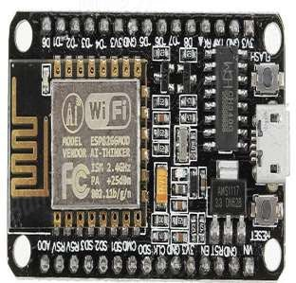
HARDWARE REQUIREMENTS:
ESP8266 Wi-Fi MODULE:
It handles Wi-Fi connectivity, allowing remote monitoring and control of waste classification data through the Blynk cloud platform.
SPECIFICATIONS:
Wi-Fi Standard: 802.11 b/g/n.
Operating Voltage: 3.3V.
Serial Communication: UART, SPI, and I2C.
GPIO Pins: 17 configurable General Purpose I/O pins.
Range: Varies by environment (usually around 50-100 meters).

Slide 12
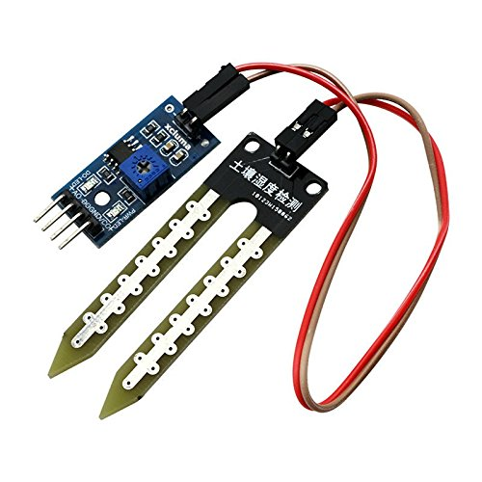
HARDWARE REQUIREMENTS:
SOIL MOISTURE SENSOR:
The soil moisture sensor detects the level of moisture in waste to classify it as wet or dry.
SPECIFICATIONS:
Operating Voltage: 3.3V–5V DC.
Output:Analog (A0): Proportional voltage to moisture level (0–3V).
Digital (D0): High/Low based on threshold.
Current Consumption: <20mA.
Dimensions: Probe ~60mm x 20mm, Control Board ~30mm x 20mm.

Slide 13
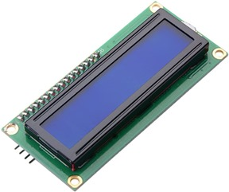
HARDWARE REQUIREMENTS:
I2C LCD:
The I2C LCD display shows waste classification results and system status using the I2C protocol for efficient data transfer.
SPECIFICATIONS:
Size: 16x2 or 20x4 characters (16 or 20 columns and 2 or 4 rows).
Voltage: 5V or 3.3V.
Interface: I2C communication (uses only 2 data lines: SDA for data and SCL for clock).
Display: LCD (Liquid Crystal Display) with backlight.
Current consumption: Typically 20-40mA (depending on the display size and backlight).
Resolution: 5x8 dot matrix per character.

Slide 14
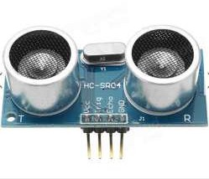
HARDWARE REQUIREMENTS:
ULTRASONIC SENSOR:
The ultrasonic sensor measures the distance to an object by emitting sound waves and timing how long it takes for the waves to return.
SPECIFICATIONS:
Operating Voltage: 5V.
Measuring Range: 2 cm to 400 cm.
Interface: Digital (uses two pins: Trigger and Echo).
Trigger Pulse Width: 10 µs.
Echo Pulse Width: Proportional to the distance measured.

Slide 15
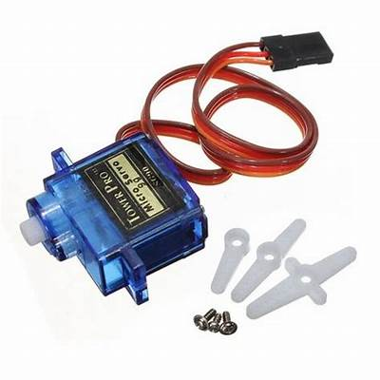
HARDWARE REQUIREMENTS:
SERVO MOTOR:
The servo motor precisely controls the rotation of an object within a specified angle, based on PWM signals.
SPECIFICATIONS:
Rotation Angle: Typically 0° to 180° (for standard servo motors).
Speed: 0.12s/60°.
Operating Voltage: 4.8V to 6.0V (varies with the model).
Control Signal: Pulse-width modulation (PWM).
Weight: Around 9-15 grams.

Slide 16
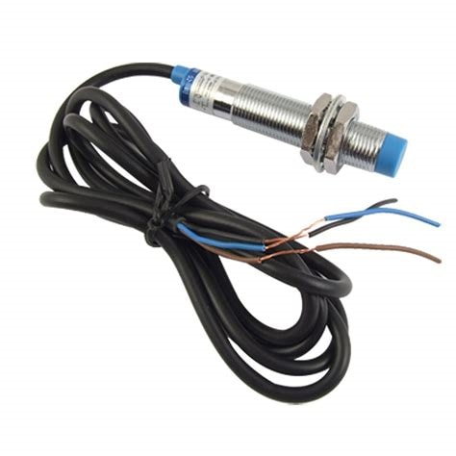
HARDWARE REQUIREMENTS:
INDUCTIVE PROXIMITY SENSOR:
The inductive proximity sensor detects the presence of metallic objects by sensing changes in the electromagnetic field when the object comes near.
SPECIFICATIONS:
Operating Voltage: 10V to 30V DC (varies by model).
Output Type: Digital.
Sensing Range: Typically 2 mm to 10 mm.
Frequency: 1 kHz to 5 kHz.
Response Time: Typically 1 ms to 2 ms.

Slide 17
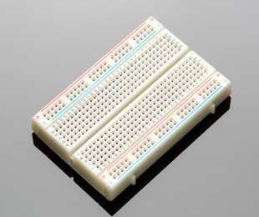
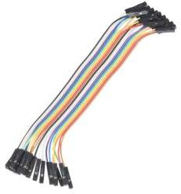
HARDWARE REQUIREMENTS:
Breadboard and Jumper Wires :
Used for prototyping and testing circuits before final soldering.
Specifications:
Breadboard Size: Medium (e.g., 830 tie-points).
Jumper Wires: Male-to-male, female-to-female, and male-to-female.
Key Features:
Facilitate quick and easy circuit assembly.
Reusable for multiple projects.

Slide 18
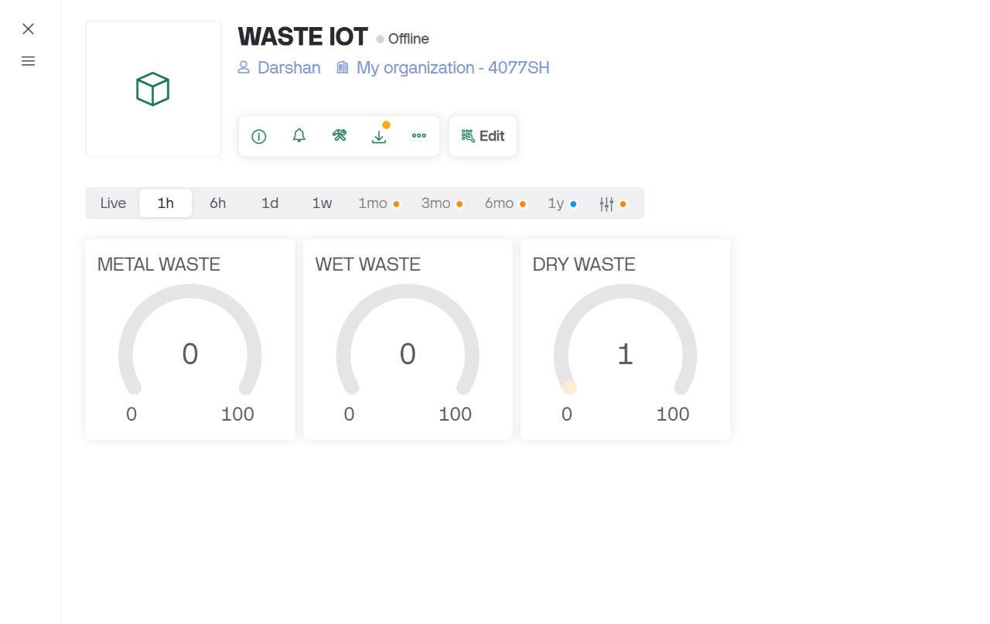
SOFTWARE REQUIREMENTS:
Arduino IDE :
The Arduino IDE (Integrated Development Environment) is a software application used to write, compile, and upload code to Arduino microcontrollers. It is a user-friendly interface that simplifies the process of programming and prototyping electronic devices. The IDE is open-source and available for free download on the Arduino website.
Blynk:
Blynk is a platform designed for building IoT (Internet of Things) applications that allows users to control and monitor hardware remotely. It is widely used in DIY projects, smart home systems, and industrial IoT applications due to its ease of use, versatility, and compatibility with various microcontrollers and IoT devices.

Slide 19
WORKING:
1. Waste Detection:
• Soil Moisture Sensor: Measures the moisture content of the waste. If moisture is detected, it classifies the waste as wet; otherwise, it is dry.
• Proximity (Metal) Sensor: Detects the presence of metal objects in the waste. This sensor works as a
proximity sensor, activating when it detects nearby metal objects, classifying them as metal waste.
• Ultrasonic Sensor: Measures the volume of waste and detects its presence, ensuring waste is properly processed.
2. Data Processing (Arduino Uno):
The Arduino Uno receives data from all the sensors and determines the waste type based on predefined thresholds. The processing logic identifies whether the waste is wet, dry, or metal, and sends the appropriate signal to the servo motor.
3. Sorting Mechanism (Servo Motor):
The servo motor rotates to a specific angle to position the correct bin (dry, wet, or metal) based on waste type:
• Dry Waste: Servo rotates to 0 degrees to place the dry waste bin.
• Wet Waste: Servo rotates to 90 degrees for the wet waste bin.
• Metal Waste: Servo rotates to 180 degrees to position the metal waste bin.

Slide 20
WORKING:
4.Real-time Monitoring (I2C LCD & Blynk IoT):
•I2C LCD: Displays the current waste type being processed (dry, wet, or metal).
•Blynk IoT Platform: Provides remote monitoring, allowing users to track and control the system from a
smartphone or computer.
5.Operation Flow:
•Waste is placed in the sorting area.
•The sensors detect the type of waste.
•The Arduino processes the sensor data and controls the servo motor to rotate to the correct bin.
•The waste is sorted automatically, with updates sent to the LCD and the Blynk platform.

Slide 21
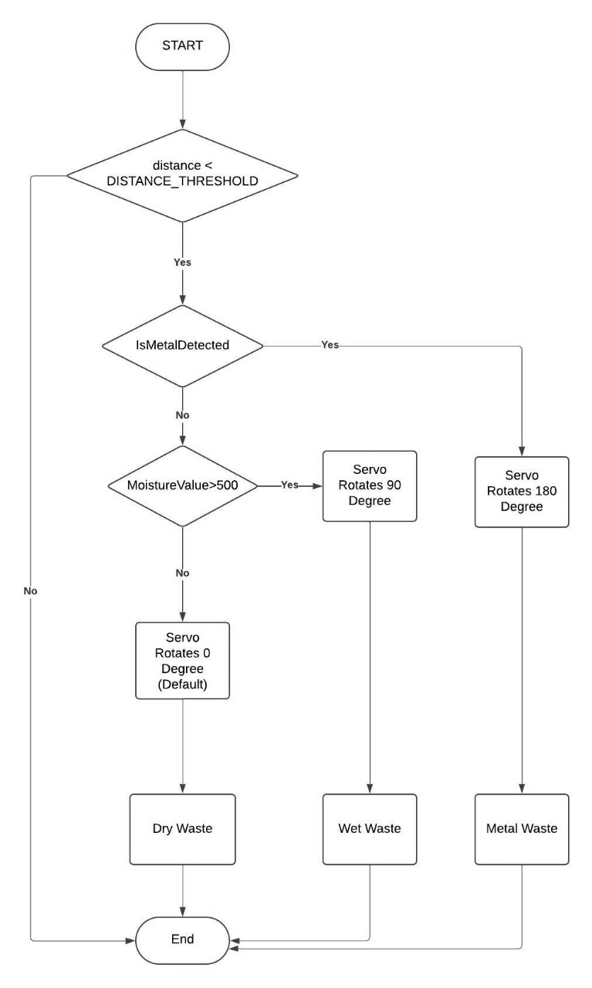
FLOW CHART

Slide 22
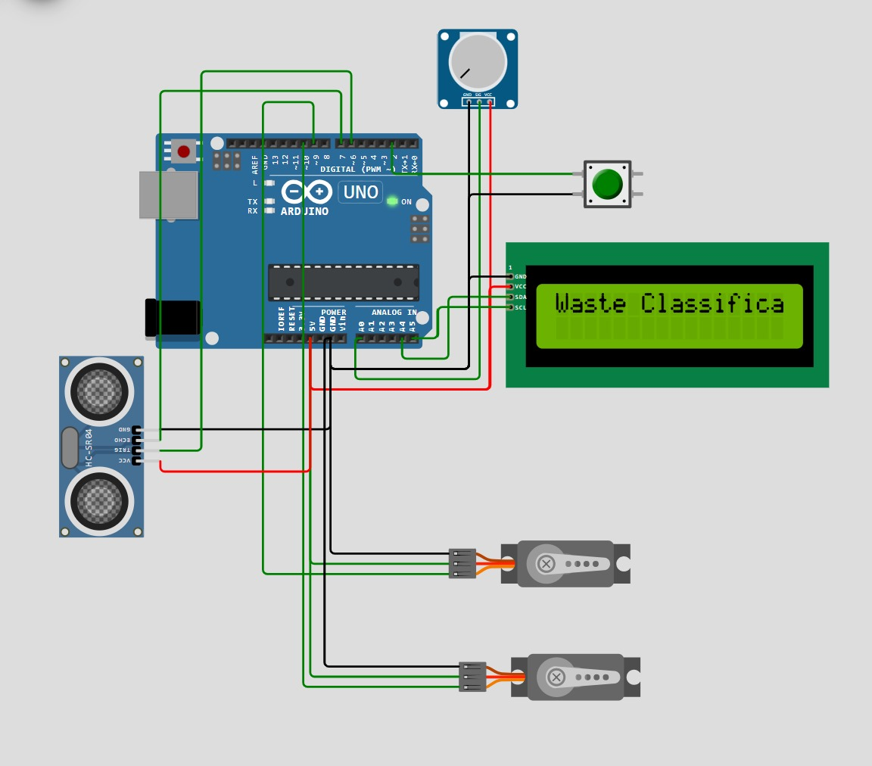
CIRCUIT AND SIMULATION

Slide 23
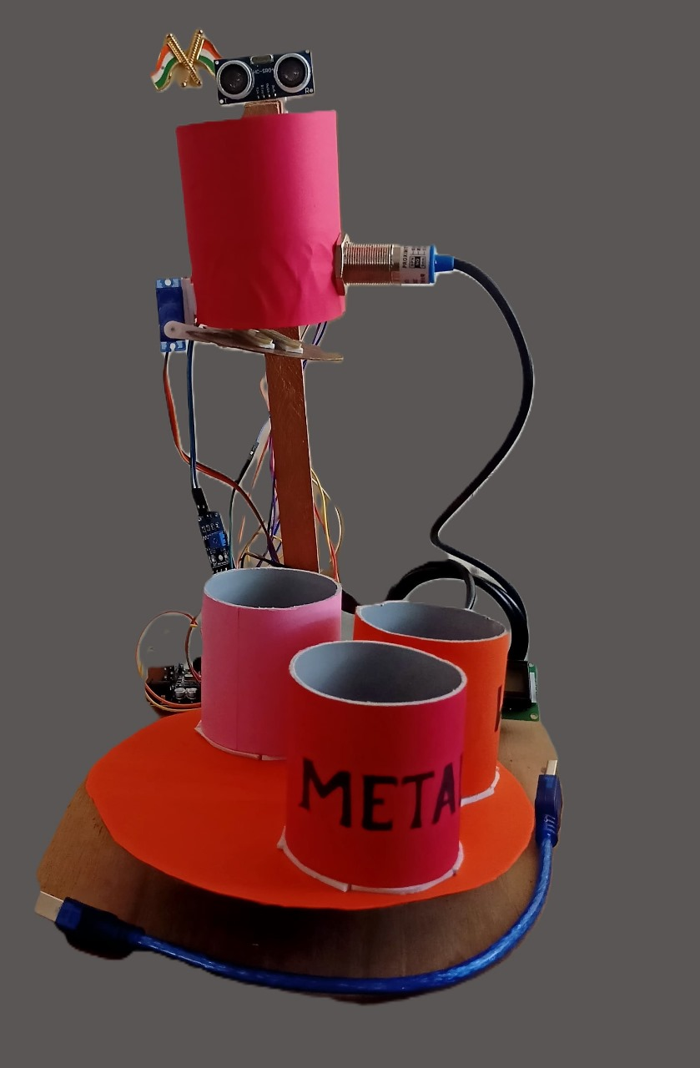
RESULT AND DISCUSSIONS
This project involves waste classification using a soil moisture sensor to detect wet or dry waste, a metal sensor to identify metal waste, and an ultrasonic sensor to detect the presence of waste.
The waste is then sorted into respective bins using a servo motor.
The results are displayed on an I2C LCD, and the waste classification data is monitored and controlled through a cloud platform via Blynk, utilizing the ESP8266 as the main controller.
This setup provides real-time tracking and management of waste classification, ensuring efficient sorting and monitoring remotely.

Slide 24
APPLICATIONS
Smart Home Waste Management.
Municipal Waste Management.
Smart Cities.
Retail Stores and Supermarkets.
Event Waste Management.•

Slide 25
ADVANTAGES
Automated Waste Sorting.
Labor and Cost Reduction.
Efficient Waste Management.
Real-Time Monitoring.
Environmental Impact.•
LIMITATIONS
Limited Waste Type Classification: The current system can only classify waste into three categories
dry, wet, and metal. It lacks the ability to classify other types of waste, such as plastics, glass, or e-waste.
Sensor Accuracy: Sensor sensitivity might lead to incorrect classification due to varying waste properties or environmental conditions.
Environmental Impact: External factors like temperature and humidity can affect sensor readings,
reducing system reliability.

Slide 26
CONCLUSION
This project successfully demonstrates an automated waste classification system designed to categorize waste into dry, wet, and metal types. By integrating multiple sensors and utilizing a microcontroller, the system classifies and sorts waste effectively, ensuring accurate disposal. The results are displayed for real-time monitoring, and the system can be remotely accessed via an IoT platform for convenient tracking and management.
The project shows how automation and smart technologies can be leveraged to address waste management challenges, providing an efficient and sustainable solution for sorting waste in an environmentally friendly manner. This system can be further developed and implemented in various settings, contributing to more organized and effective waste disposal processes.

Slide 27
FUTURE SCOPE
Integration with Smart City Systems: Extend the project to work with city-level waste management systems, allowing real-time monitoring of waste levels, smart scheduling for collection, and optimizing waste disposal routes.
Automated Waste Sorting Enhancement: Implement additional sorting methods using advanced sensors, like infrared or near-infrared spectroscopy, to classify materials based on their composition, such as plastics, glass, or organic waste.
Mobile Application Integration: Develop a mobile app that allows users to track waste classification results in real-time, receive notifications, and provide feedback, promoting user engagement and better waste management practices in households or communities.
Real-Time Data Analytics and Reporting: Enhance the cloud platform (like Blynk) to provide more in-depth analytics on waste patterns, trends, and environmental impact, offering actionable insights to improve waste management processes.

Slide 28
REFERENCES
Gouda, M. M., & El-Sayed, H. A. (2020).
"Smart Waste Management System: A Survey of IoT-based Solutions and Future Directions." Waste
Management & Research, 38(2), 137-153. https://doi.org/10.1177/0734242X19892368
Venkataramanan, V., & Pradeep, M. (2020).
"IoT-Based Smart Waste Management System: A Review." Journal of Environmental Science and
Technology,13(3), 1-13. https://doi.org/10.1007/s11869-020-00832-4
Mohanraj, K., & Kumaravel, A. (2020).
"Automated Waste Management Using IoT and Arduino." Journal of Environmental Engineering &
Technology, 9(1), 45-56. https://doi.org/10.14456/jeet.2020.21
Ghimire, S., & Baral, S. (2020).
"A Smart Waste Management System Using Arduino and IoT." Journal of Engineering and Applied
Sciences, 15(1), 45-55. https://www.jeasjournal.com/article/21

Slide 29
COURSE OUTCOMES
On completion of this course, students are able to:
1)Solve the identified problems.
2)Analyze the available resources and their utilization.
3)Present the work carried out and prepare the report.
4)Work in a team to find the solutions for societal and technical problems.

Slide 30


