Slide 1


Particle System Simulation Mini-Project: The Jackfruit Problem
Problem Statement: To develop a console-based particle system simulation that manages dynamic particles using a Doubly Linked List and implements an ordered Binary Search Tree (BST) for rendering particles based on their lifetime (sorting) and enabling efficient memory management.
Team Details:
Darshan P Pawar (PES2UG24CS143) Ganavi Purushothama (PES2UG24CS167) Deepthi N Reddy (PES2UG24CS149)
A particle system is a graphics technique used to simulate natural phenomena like fire, smoke, or rain. Our project implements its core mechanics — adding, deleting, updating, and rendering — using optimised C data structures.

Slide 2

Data Structures Used and Rationale 📊
Primary Data Structure – Doubly Linked List (DLL)
Structure Name: ParticleList and ParticleCell
Secondary Data Structure – Binary Search Tree (BST)
Structure Name: BSTNode
Purpose: Manage active particles dynamically.
Purpose: Used temporarily during rendering for sorting particles by lifetime.
Why DLL?
Why BST?
Supports frequent insertions/deletions efficiently. Allows O(1) deletion once a node is found.
Ideal for real-time dynamic data management.
Natural ordered traversal through Inorder Traversal.
Average-case complexity O(N log N) for building + rendering.
Visual Flow: ParticleList (Dynamic Management) → BST (Sorted Rendering)

Slide 3
Abstract Data Type (ADT) – Doubly Linked List 🔗
ADT Name: ParticleList
Data
Particle: x, y, dx, dy, lifetime ParticleCell: data (Particle), prev, next ParticleList: head, tail, size
Operations
initParticleList, addParticle, removeParticle, updateParticles, cleanupParticles
Core Operations:
Operation
Description
Time Complexity
initParticleList()
Initialises empty list
O(1)
addParticle()
Appends new particle to end
O(1)
removeParticle()
Removes given particle and re-links nodes
O(1) (once found)
updateParticles()
Updates positions, decrements lifetime, deletes expired
O(N)
cleanupParticles()
Frees all allocated nodes
O(N)

Slide 4
Abstract Data Type (ADT) – Binary Search Tree (BST) 🌲
ADT Name: BSTNode
Data
Particle: x, y, dx, dy, lifetime
BSTNode: data (Particle), left, right
Operations
insertIntoBST, inorderBSTRender, freeBST
Core Operations:
Operation
Description
Complexity
insertIntoBST()
Inserts a particle using lifetime as key
Avg: O(log N), Worst: O(N)
inorderBSTRender()
Prints particles sorted by lifetime
O(N)
freeBST()
Frees all nodes recursively
O(N)
renderParticlesUsingBST()
Builds temporary BST, traverses for ordered rendering, frees memory
Avg: O(N log N)

Slide 5
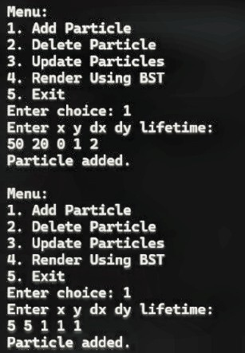
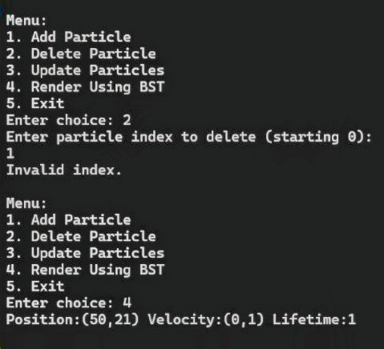
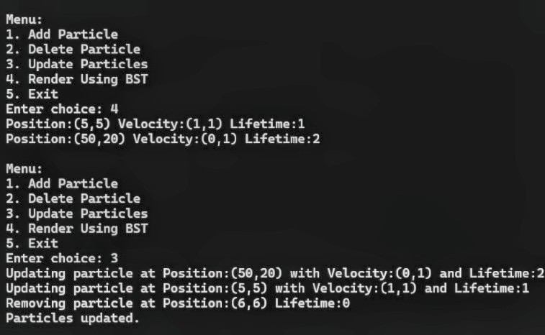
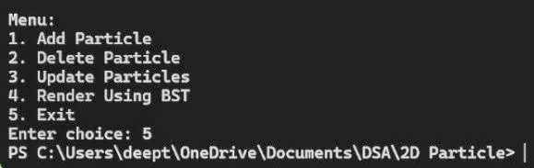
Input and Output Screenshots 🖥
Functionality 1 & 3: Add and Update Particles
Functionality 2 & 4: Delete and Render Using BST
Menu: 1. Add ParticleEnter x y dx dy lifetime: 100 200 5 -5 10Particle added.Menu: 3. Update ParticlesUpdating particle at (100,200) → (105,195), Lifetime: 9...Particles updated.
Menu: 4. Render Using BSTLifetime: 5 | Lifetime: 8 | Lifetime: 10Menu: 2. Delete Particle (Index 0)Removing particle at (100,200), Lifetime: 5Particle deleted.Menu: 4. Render Using BSTLifetime: 8 | Lifetime: 10

Slide 6
Concluding Remarks and Work Division 🤝
Concluding Remarks:
Demonstrates effective use of Doubly Linked List for dynamic management.
Implements Binary Search Tree for sorted rendering.
Modular multi-file C design (main.c, particle.c, particle.h).
Ensured no memory leaks and adherence to PES coding guidelines.
Division of Work:
Member Core Responsibilities
Ganavi Purushothama Particle List Management (init, add, remove, cleanup).
Darshan P Pawar Particle Dynamics, main logic, input handling, updates.
Deepthi N Reddy BST rendering, integration, and freeing functions.
Final Line: All members were actively involved and understand the complete implementation.
Thank you!

