Slide 1
GTU | PROBLEM-BASED LEARNING (PBL) | FINAL PRESENTATION
Design and Development of a Fuzzy Logic-Based Automatic Braking System
Vc (m/s)
Mamdani Fuzzy Inference System in Python (scikit-fuzzy)
D (m)
Subject: Fuzzy Logic and Genetic Programming (BE05000461)
Department: Automobile Engineering
Institute: L.D. College of Engineering (LDCE), Ahmedabad
University: Gujarat Technological University (GTU)
Ego vehicle
Vehicle ahead
Inputs: D and Vc → Fuzzy controller → Braking command B (0–100 %)
Darshan Kantibhai Prajapati (Enrollment No: 250283102033)
Parth Sanjaybhai Parmar (Enrollment No: 250283102028)
Faculty Guide: [Name] | Academic Year: [Academic Year] | Date: [Date]
Illustrative schematic only – not project evidence
Notes:
Introduce project, team, and subject. Educational software simulation.

Slide 2
Problem Statement and Motivation
The problem
Why two inputs?
Motivation and scope
Drivers can react late to a closing obstacle because of distraction, fatigue or misjudged gaps. Braking decisions are vague: “near” and “fast” have no sharp boundary, which suits fuzzy logic better than crisp thresholds.
Distance alone ignores how quickly the gap is closing; speed alone ignores how much gap remains. A 20 m gap is relaxed at 2 m/s closing but urgent at 20 m/s. Together they approximate time-to-collision (TTC ≈ D / Vc).
Show how IF–THEN rules capture driver-like judgement and output a braking command (0–100 %). Scope: educational PBL software simulation. It does not claim to prevent collisions or replace production ADAS.
2
1
9
Mamdani
Inputs: D, Vc
Output: braking %
Fuzzy rules
Inference type

Slide 3
Objectives and System Architecture
1
Define 2 inputs and 1 output with ranges and units
2
Design 9 triangular membership functions (3 per variable)
3
Build a 9-rule Mamdani rule base (brief requires ≥ 6–8)
4
Hand-calculate one worked example (D = 20 m, Vc = 15 m/s)
5
Implement in Python with scikit-fuzzy; test ≥ 10 input pairs
6
Analyse behaviour, limitations and improvements
Inputs
D (m), Vc (m/s)
Fuzzification
μ values
Rule evaluation
min (AND)
Aggregation
max
Centroid defuzzification
Braking command
B (0–100 %)
Fig. 1 – Mamdani FIS processing chain implemented in the simulation.
Simulation architecture only: no sensors, ECU, brake actuator or vehicle dynamics are modelled.

Slide 4
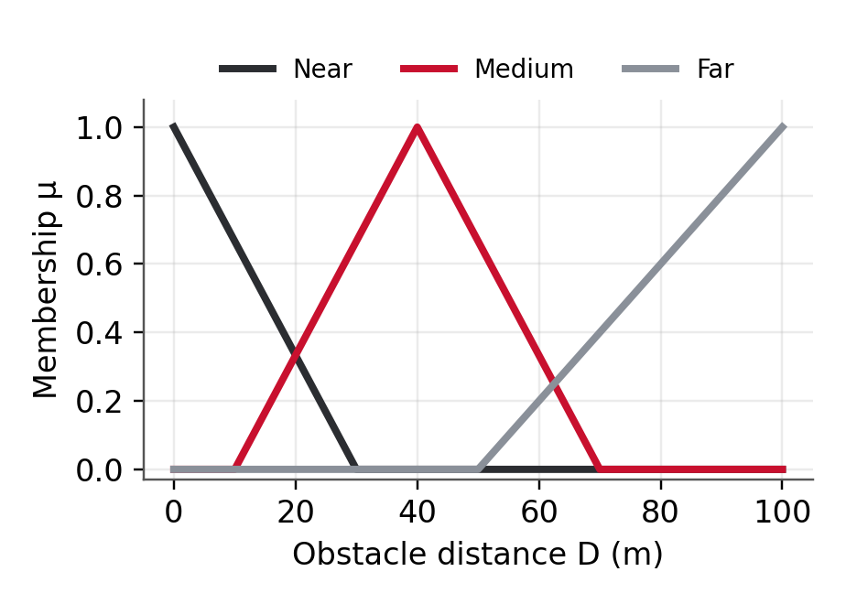
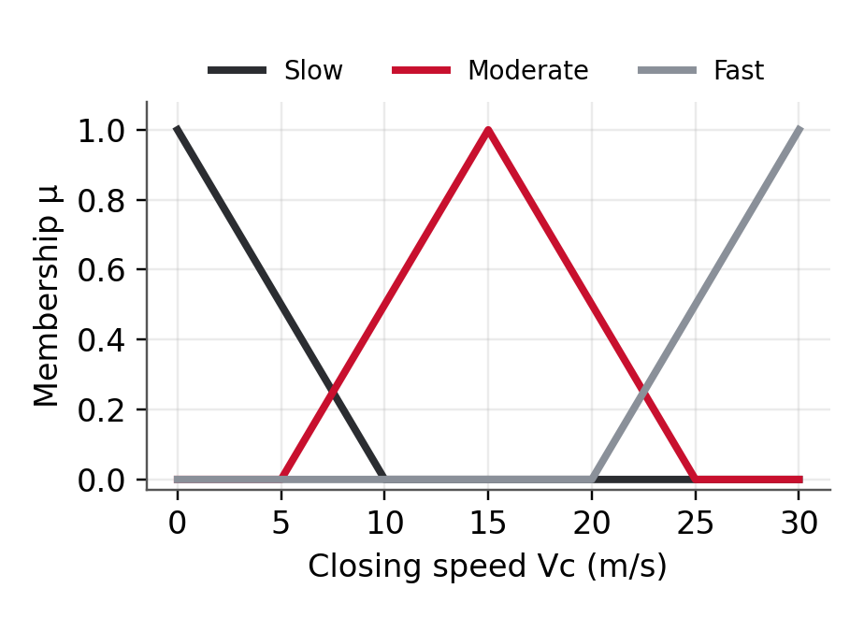
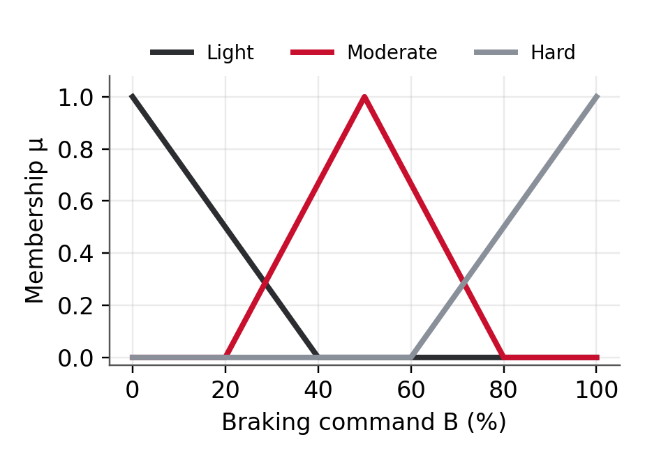
Variables and Membership Functions
Variable | Role | Unit | Universe | Terms and triangular MF [a, b, c]
Obstacle distance D | Input 1 | m | 0–100 | Near [0,0,30] · Medium [10,40,70] · Far [50,100,100]
Closing speed Vc | Input 2 | m/s | 0–30 | Slow [0,0,10] · Moderate [5,15,25] · Fast [20,30,30]
Braking command B | Output | % | 0–100 | Light [0,0,40] · Moderate [20,50,80] · Hard [60,100,100]
Fig. 2 – Distance MFs
Fig. 3 – Closing-speed MFs
Fig. 4 – Braking-command MFs
Triangular MFs chosen for simplicity (Triangular / Trapezoidal / Gaussian allowed by brief). Edge-degenerate shapes suit a classroom demo; thresholds need engineering validation before real use.

Slide 5
Mamdani Fuzzy Inference Methodology
1
2
3
4
Fuzzification
Rule evaluation
Aggregation
Defuzzification
Crisp D and Vc → membership degrees μ in each linguistic term
Antecedents combined with AND = min; output set clipped at α (min implication)
Clipped output sets of all rules combined with max
Centroid of the aggregated set gives crisp braking command B*
Rule firing strength
Symbols
αᵢ – firing strength of rule i
μAᵢ, μBᵢ – membership of D and Vc in rule i’s terms
μagg(b) – aggregated output membership at braking level b
B* – crisp braking command (%)
Operators: AND = min, implication = min, aggregation = max
αᵢ = min( μAᵢ(D), μBᵢ(Vc) )
Centroid defuzzification
B* = ∫ b · μagg(b) db / ∫ μagg(b) db
Evaluated numerically on a 1 % grid (exact piecewise-linear centroid, as in scikit-fuzzy).

Slide 6
Fuzzy Rule Base (9 Rules)
Distance ↓ / Vc → | Slow | Moderate | Fast
Near | R1 Moderate | R2 Hard | R3 Hard
Medium | R4 Light | R5 Moderate | R6 Hard
Far | R7 Light | R8 Light | R9 Moderate
Design logic
Nearer obstacle and higher closing speed → stronger braking
Far obstacle with low closing speed → light braking
Near + Slow gives Moderate (not Hard): small closing rate leaves time to react
Far + Fast gives Moderate: high speed warrants early action
Table 1 – Rule matrix: IF Distance is … AND Closing speed is … THEN Braking is …
A simplified demonstration rule base: it does not guarantee safe or optimal braking and must be validated against stopping-distance and vehicle-dynamics data before any real-world use.

Slide 7
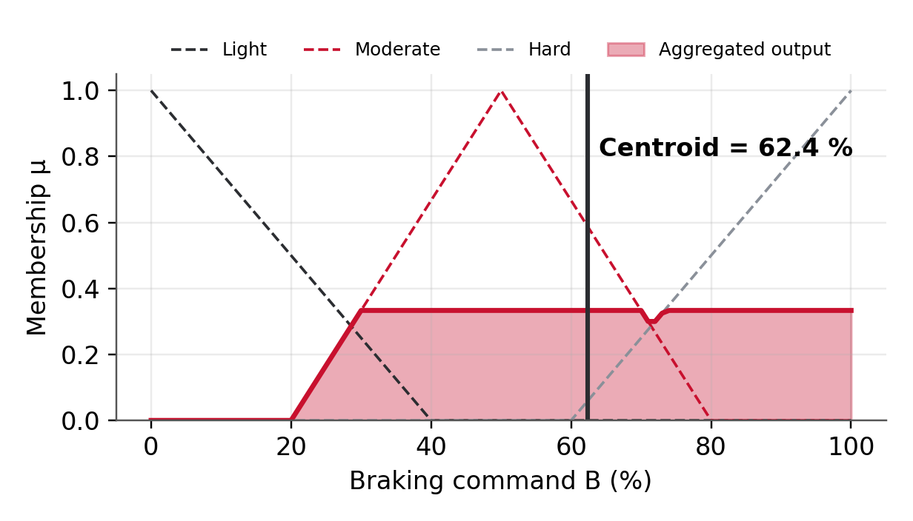
Worked Example: D = 20 m, Vc = 15 m/s
Step | Calculation
Fuzzify D = 20 | Near = (30−20)/(30−0) = 0.333 Medium = (20−10)/(40−10) = 0.333 Far = 0
Fuzzify Vc = 15 | Slow = 0 · Moderate = 1 (peak) · Fast = 0
Rules fired | R2: Near ∧ Moderate → Hard α = min(0.333, 1) = 0.333 R5: Medium ∧ Moderate → Moderate α = min(0.333, 1) = 0.333 All other rules: α = 0
Aggregate | max of Hard clipped at 0.333 and Moderate clipped at 0.333
Defuzzify | Centroid of aggregated set (executed model) = 62.4 %
Fig. 5 – Aggregated output set and centroid from the executed model.
Why not a simple weighted average?
Averaging the label peaks (100 and 50) would give 75 %. The Mamdani centroid uses the full clipped shapes, so the true output is 62.4 %.

Slide 8
Python Implementation (scikit-fuzzy)
import numpy as np
import skfuzzy as fuzz
from skfuzzy import control as ctrl
dist = ctrl.Antecedent(np.arange(0,101,1),'distance')
speed = ctrl.Antecedent(np.arange(0,31,1),'closing_speed')
brake = ctrl.Consequent(np.arange(0,101,1),'brake')
dist['Near'] = fuzz.trimf(dist.universe,[0,0,30])
dist['Medium'] = fuzz.trimf(dist.universe,[10,40,70])
dist['Far'] = fuzz.trimf(dist.universe,[50,100,100])
speed['Slow'] = fuzz.trimf(speed.universe,[0,0,10])
speed['Moderate'] = fuzz.trimf(speed.universe,[5,15,25])
speed['Fast'] = fuzz.trimf(speed.universe,[20,30,30])
brake['Light'] = fuzz.trimf(brake.universe,[0,0,40])
brake['Moderate'] = fuzz.trimf(brake.universe,[20,50,80])
brake['Hard'] = fuzz.trimf(brake.universe,[60,100,100])
rules = [
ctrl.Rule(dist['Near'] & speed['Slow'],
brake['Moderate']), # R1
ctrl.Rule(dist['Near'] & speed['Moderate'],
brake['Hard']), # R2
# ... R3 - R8 as in rule table ...
ctrl.Rule(dist['Far'] & speed['Fast'],
brake['Moderate']), # R9
]
system = ctrl.ControlSystem(rules)
sim = ctrl.ControlSystemSimulation(system)
sim.input['distance'] = 20
sim.input['closing_speed'] = 15
sim.compute()
print(sim.output['brake']) # centroid
Defaults in scikit-fuzzy: AND = min, aggregation = max, Consequent defuzzification = centroid. Full file: abs_fuzzy_skfuzzy.py
Verification note: scikit-fuzzy could not be installed in the build environment, so the numbers in this deck came from a NumPy re-implementation of the same operations (abs_numpy_check.py). Re-run the .py in your environment to confirm.

Slide 9
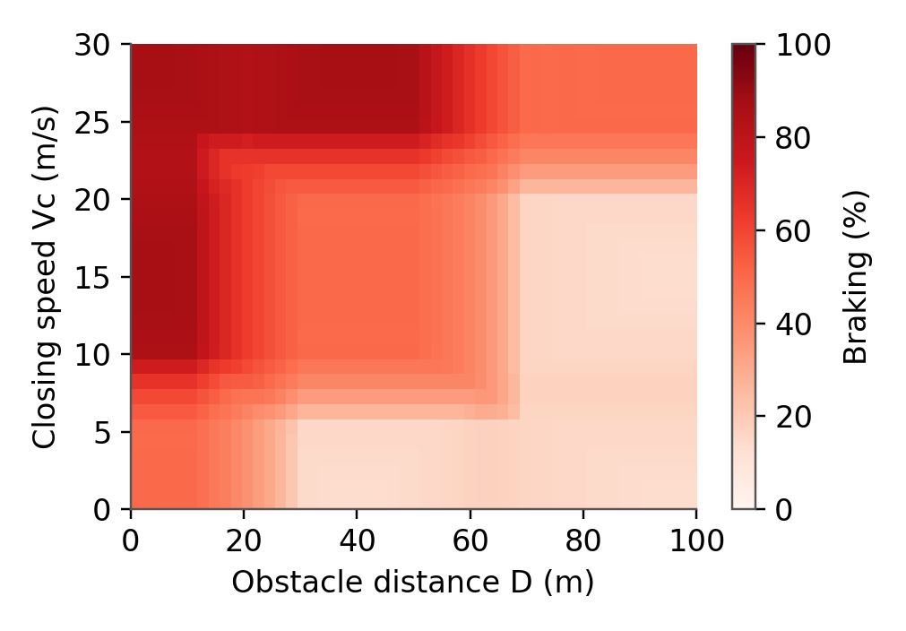
Simulation Interface and Demonstration
DESIGN CONCEPT – not a working simulator
Obstacle distance D (m)
20
Closing speed Vc (m/s)
15
Fig. 7 – Output set, D=20, Vc=15
Compute braking
Fig. 6 – Braking surface (executed model)
Braking command: [shown after compute]
What the genuine plots show
Output stays within 13.3–86.7 % over the whole input grid: centroids of clipped triangles never reach 0 % or 100 %.
Braking rises smoothly toward short distance and high closing speed.
+ MF and output plots
UI status (Phase 6): [pending – insert real Jupyter / Tkinter / Streamlit screenshot here]

Slide 10
Testing and Results (10 Input Combinations)
ID | D (m) | Vc (m/s) | Expected | Output (%) | Observation
T01 | 5 | 25 | Hard | 84.4 | Near + Fast: Hard, clipped
T02 | 10 | 10 | Hard | 84.4 | Near, partly Moderate: Hard
T03 | 15 | 5 | Moderate | 44.5 | Near/Slow vs Medium/Slow mix
T04 | 20 | 15 | Moderate–Hard | 62.4 | Worked example: Moderate–Hard blend
T05 | 40 | 5 | Light | 15.6 | Medium + Slow: Light
T06 | 40 | 15 | Moderate | 50.0 | Medium + Moderate: peak of Moderate
T07 | 40 | 25 | Hard | 84.4 | Medium + Fast: Hard
T08 | 70 | 5 | Light | 16.3 | Far + Slow: Light
T09 | 70 | 15 | Light | 16.3 | Far + Moderate: Light (same as T08)
T10 | 90 | 28 | Moderate | 50.0 | Far + Fast: Moderate
All outputs lie within 0–100 % and follow the rule base. T08 = T09 because Far gives α = 0.4 in both; the Light set is clipped identically. “Expected” is qualitative; outputs are computed (NumPy equivalent; see slide 8).

Slide 11
Analysis, Limitations and Future Improvements
Strengths
Limitations observed
Readable IF–THEN rules close to human reasoning
Smooth transitions, no abrupt threshold jumps
Easy to tune and extend with more inputs
Simplified 9-rule base; edge-degenerate MFs
Output limited to 13.3–86.7 % (centroid effect)
Far/Slow and Far/Moderate give identical output
Sensitive to sensor noise in D and Vc
Not modelled
Future work
Stopping distance, road friction, tyre grip
Vehicle mass, actuator delay, brake dynamics
Driver intent, road and weather conditions
Add time-to-collision and acceleration inputs
Validate against a physics-based vehicle model
Compare with PID or tune MFs with a genetic algorithm
Add noise-filtering and a real simulator UI
Proof-of-concept educational simulation – not ready for installation in a real vehicle.

Slide 12
Conclusion, Status and References
Conclusion
A 9-rule Mamdani FIS maps distance and closing speed to a braking command that rises with urgency across 10 test cases.
Worked example (D=20, Vc=15) gives 62.4 %, between Moderate and Hard as expected.
Unvalidated: real stopping distances, vehicle dynamics, sensor noise, safety certification.
References
[1] L.D. College of Engineering, “PBL: Design and Development of a Fuzzy Controller for Real-World Engineering Problem,” BE05000461, course brief, 2026.
[2] scikit-fuzzy developers, “scikit-fuzzy documentation.” https://scikit-fuzzy.github.io/scikit-fuzzy/
[3] L. A. Zadeh, “Fuzzy sets,” Information and Control, vol. 8, no. 3, pp. 338–353, 1965.
[4] E. H. Mamdani and S. Assilian, “An experiment in linguistic synthesis with a fuzzy logic controller,” Int. J. Man-Machine Studies, vol. 7, no. 1, pp. 1–13, 1975.
[5] T. J. Ross, Fuzzy Logic with Engineering Applications, 4th ed. Chichester, U.K.: Wiley, 2016.
Deliverable | Status
Presentation | This file
Report | [Status to be updated]
Python source | abs_fuzzy_skfuzzy.py (run to confirm)
GitHub repository | [URL]
Short video | [Link]
LinkedIn post | [Link]

