Slide 1
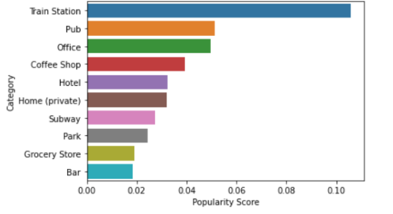
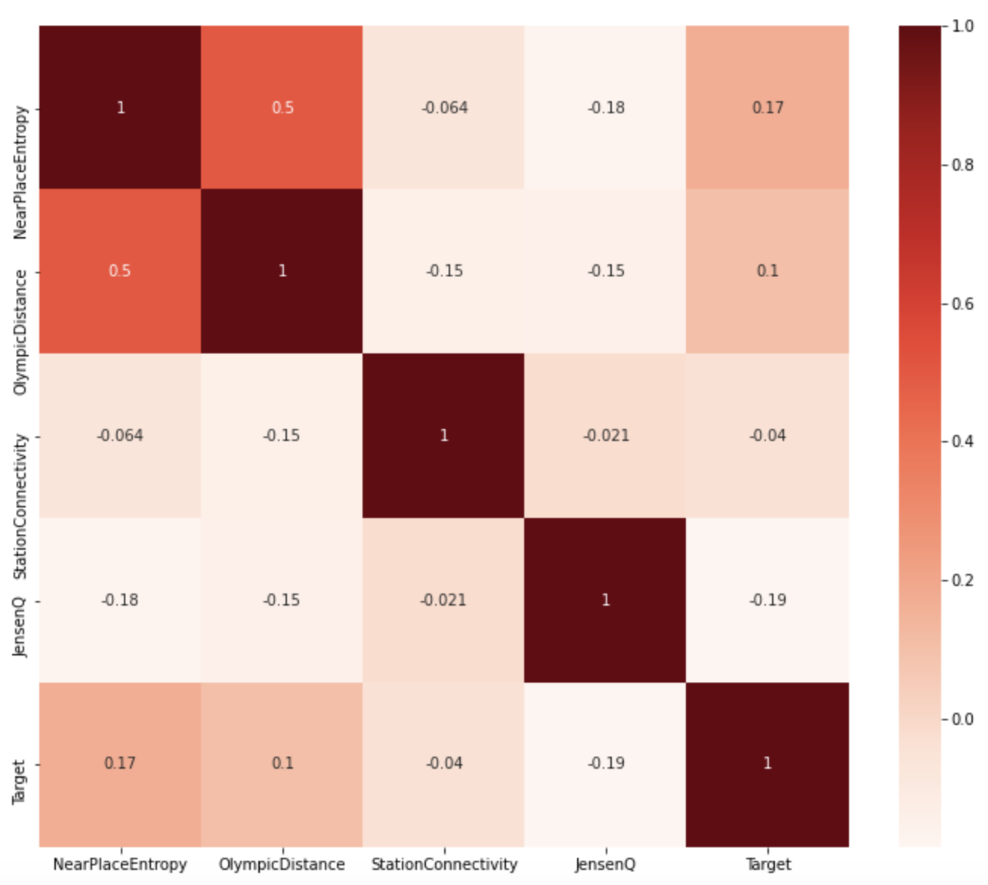
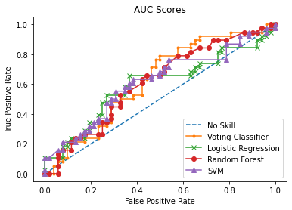
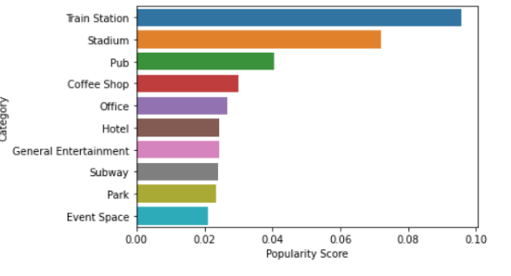
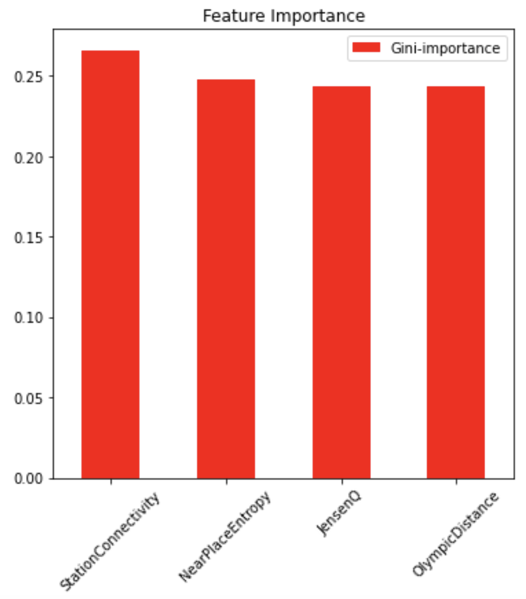
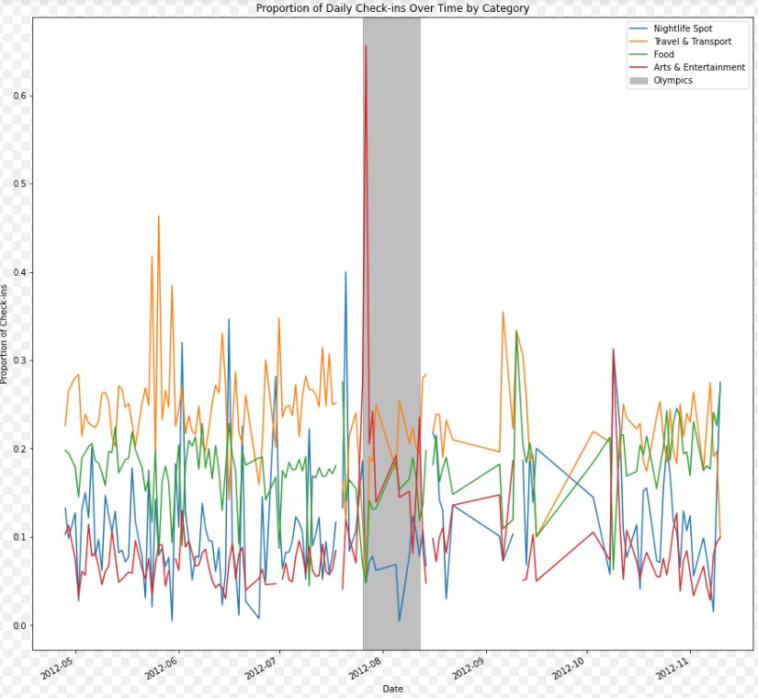
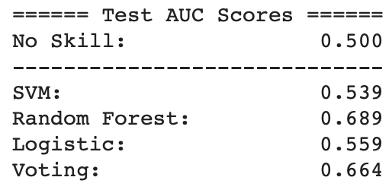
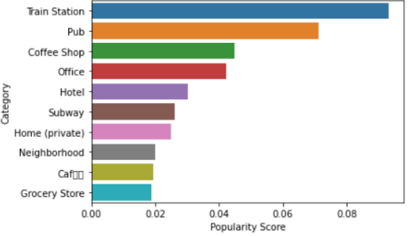
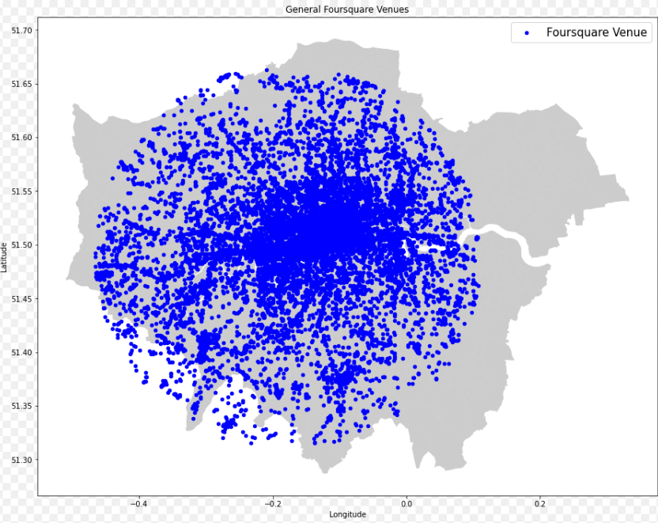
Predicting Local Business Popularity during the Olympics through Geospatial Features
Executive Summary
Transport connectivity is the most important factor
Diversity of neighborhood is the second most important factor
Jensen Attractiveness alpha is the third most important factor
Closeness to Olympic event locations is the least important factor
Shizhuo Duan, Vivek Gupta, Xu Han, Darshan Solanki
Background
By understanding which factors impact a local business’ popularity during the Olympics, business owners can properly adapt to changes in customer flow that would have been unexpected otherwise.
Model Results
Exploratory
Data
Analysis
Data
Foursquare checkin data for London venues in period around Olympics 2012. Also used Olympic events’ location data and London underground station data. To predict the importance of the venue we extracted features like Olympic Distance, Station Connectivity,neighborhood diversity and accessed the quality of neighborhood qualities using Jenson Attractiveness.Moreover, The EDA helps us to support the POC on the features selected.These features are then used for predictive model training to determine effect on local businesses.
The diagrams above show that we were able to create a soft-voting classifier that is able to somewhat accurately identify which local businesses will see an increase in popularity from the Olympics
We also see that StationConnectivity feature seems to have the greatest importance while OlympicDistance has the least, suggesting that at a major even like this, more traffic is coming from transport stations instead of walking. Also it’s worth exploring other kinds of geospatial features, mobility features and user social network features.
People are engaging in entertainment activities during olympics. This thrives the impact on local business around those venues
Pre,During,Post Olympics Analysis for granular venues with relative popularity score calculation
Model
We perform a binary classification task. We experimented with SVM, Random Forest and Logistic Regression classifiers. Finally, we achieved the best AUC score using a soft-voting ensemble of all 3 classifiers. We prioritized the AUC score for analysis.
Geographic factors like transport connectivity, neighborhood diversity, venue attractiveness and closeness to an event venue -- all contribute to change in popularity of a business during Olympics
Notes:
Notes:
In Powerpoint, click View > Guides
Keep text within gutter guides.
Author list: Don’t split names onto two lines (e.g., “Jimmy [break] Smith”). If that happens, use a new line, unless you need the space. Bold the first names of anybody who’s presenting in person.
Intro/methods/result: Do not drop below font size 28, but if you have extra space, jack up the font size until the space is full.
Do not use color in the sidebars except in graphs/figures. It’ll pull attention from the center and slow interpretation for passersby.

