Slide 1

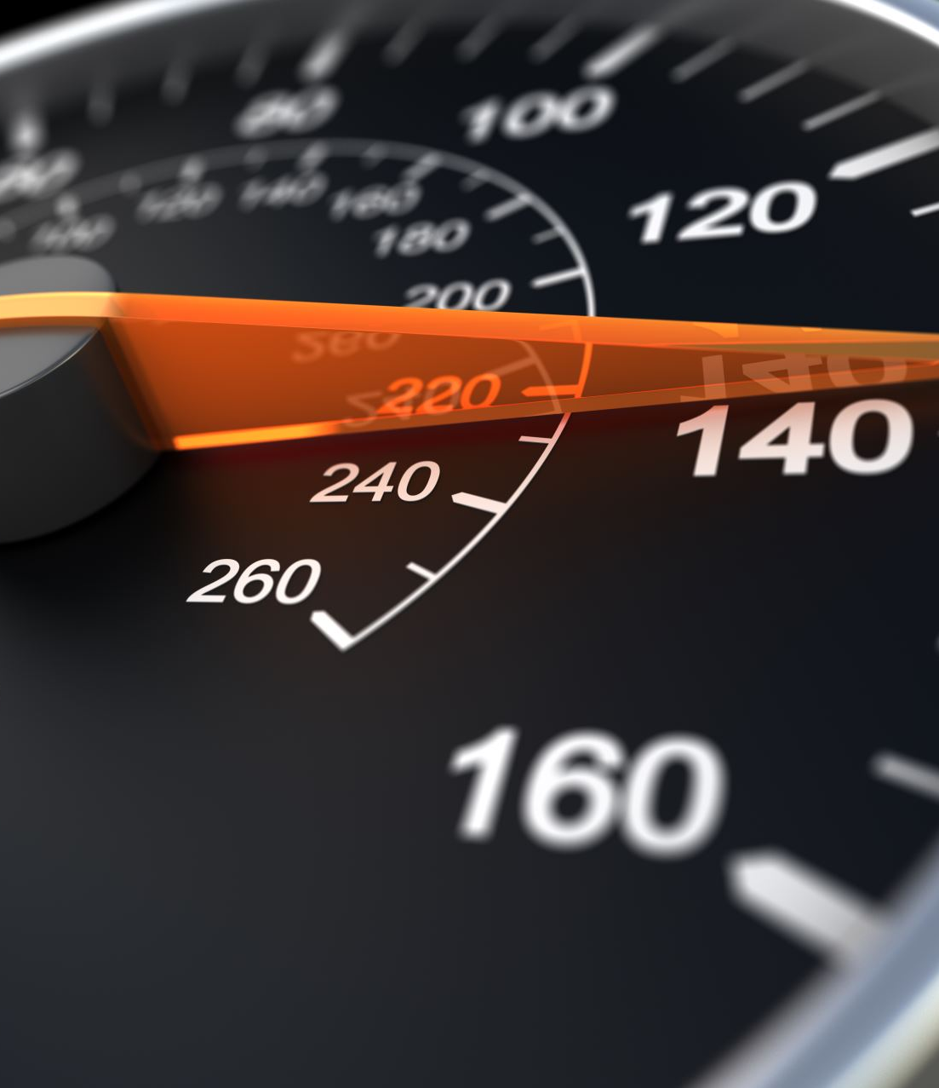
Securo Drive
Ankush Jain (aj2885)
Darshan Solanki (das968)
Smit Sheth (shs257)
Vishnu Thakral (vvt223)

Slide 2
MOTIVATION
20% car crashes caused by fatigue^{[1]}
Drowsy driving caused 100,000 car crashes in USA as per 2019 statistics.^{[2]}
Steps by companies like Volvo to detect if person is departing from lane.^{[3]}
Crash can be dangerous for an innocent person who was at the wrong place wrong time.
Sources:
1. Virginia Tech study
2. CDC study
3. Volvo driver alert

Slide 3
KEY AWS SERVICES
AWS Rekognition: Rekognizes the authenticity of user behind the wheel.
AWS Kinesis Video Stream: Uploads live stream of user for drowsiness monitoring.
EC2: Performs model training on live kinesis video streams (core of the project)
ElasticSearch: Stores user’s trip data points in real-time for kibana visualization
Kibana: Shows users in-progress summary along with aggregated graphs on the UI
Polly: Alert User with audio recommendation to ensure user is awake and focused
WebSocket API Gateway: Establish bidirectional workflow for sending alerts of drowsiness to front-end
SageMaker: Responsible for training on user video frames to supplant current model in existence in future.

Slide 4
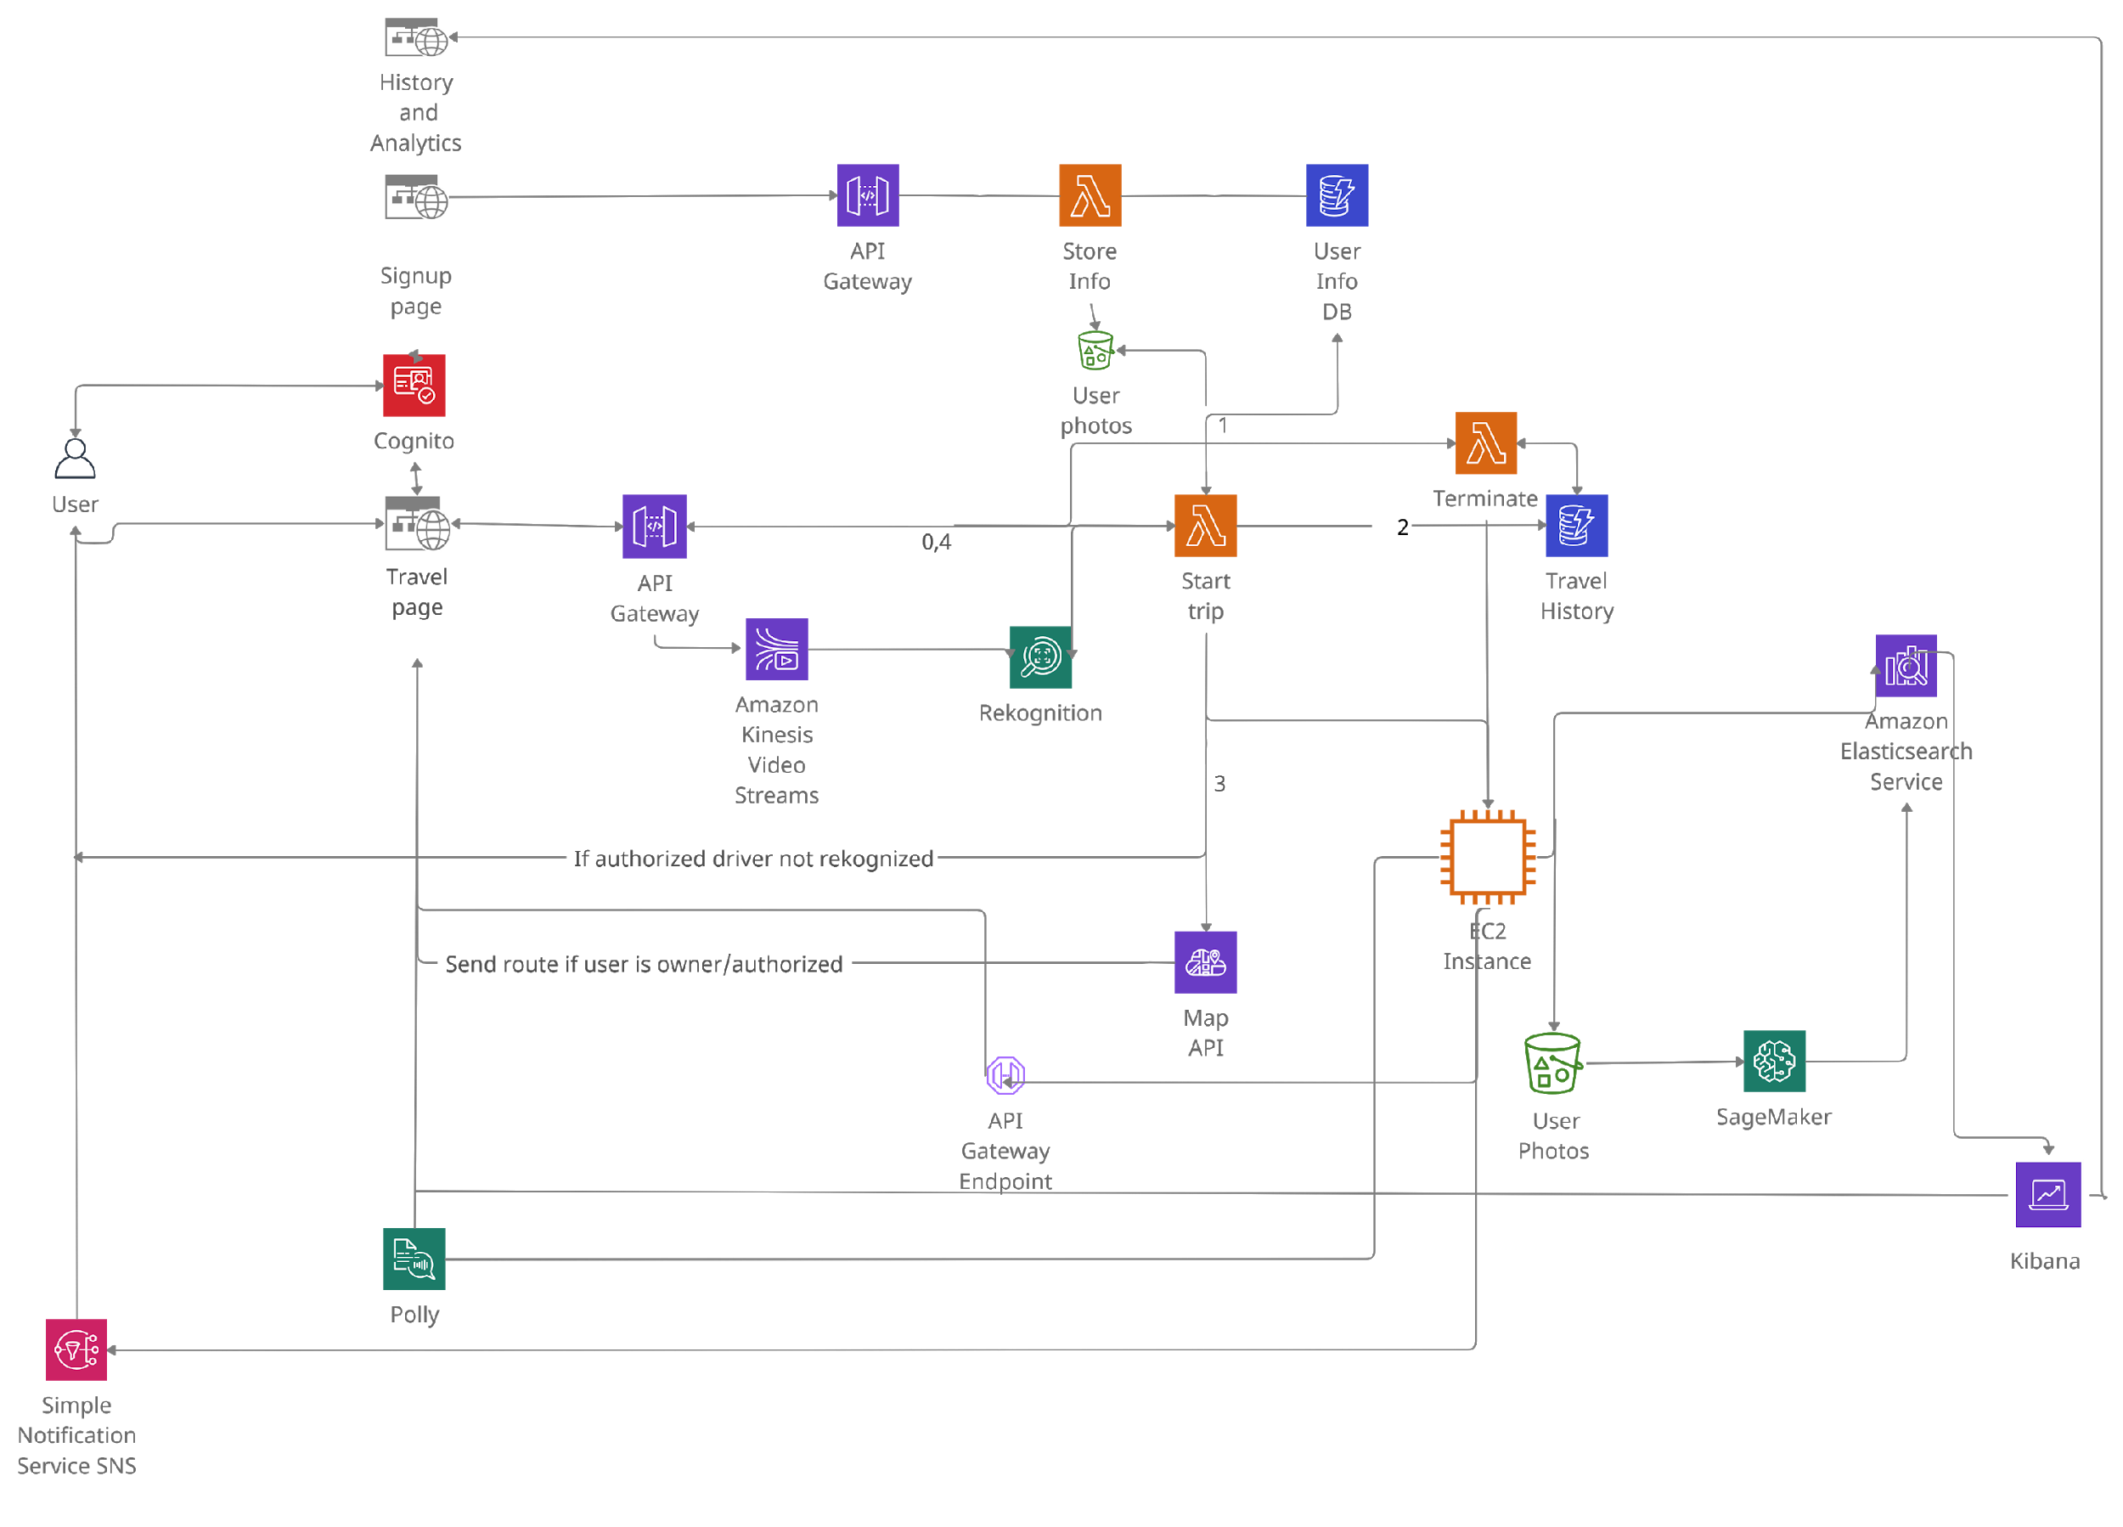
ARCHITECTURE

Slide 5
WORKFLOW
The user signs up on the portal (with authentication) to use the Securodrive service.
User profile picture is indexed in the collection.
To travel, the user enters the source and destination and receives a route after user verification.
The user is continuously monitored for signs of drowsiness (eyes blink and yawn).
User alerted in real time with audio if the user appears to be drowsy and sent a notification to stop at a nearby rest area to refresh if the user is extremely drowsy (frequent instances detected).
On selection a rest area, the user is guided with a route to the stop, followed by corresponding route to the actual destination.
The user is also presented with real time personalized statistics using Kibana.
The user is also provided snapshots of drowsing instances.

Slide 6
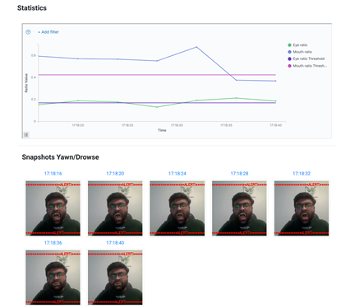
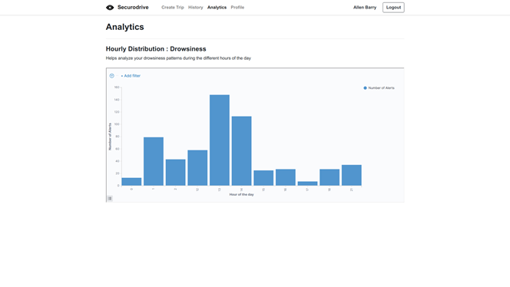
ANALYTICAL RESULTS
Hourly distribution of drowse alerts for the user
Plot for amount of Eyes and Mouth open
Snapshots of drowse or yawn instances

Slide 7
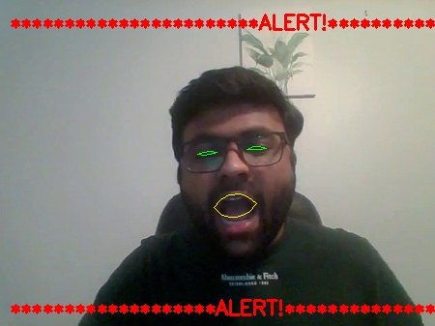
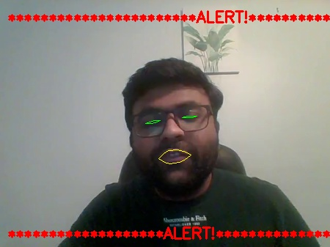
SNAPSHOTS FROM LIVE VIDEO STREAM
Snapshot of yawn
Snapshot of closed eyes (for more than 2 seconds)

Slide 8
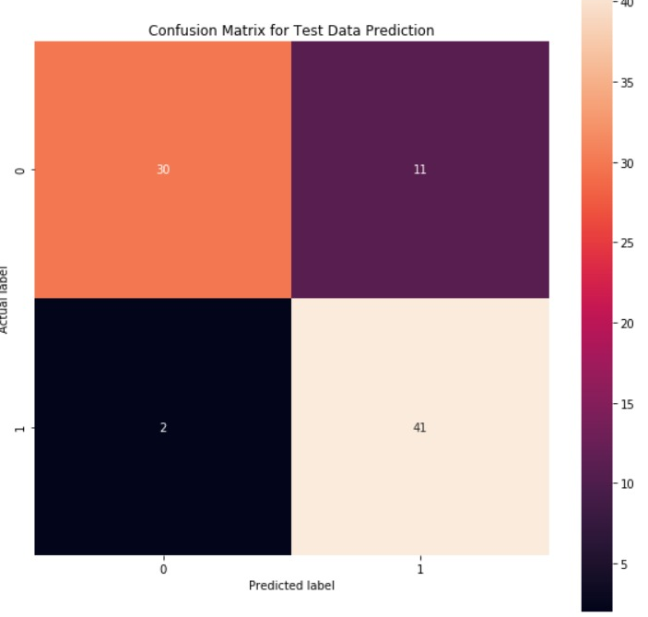
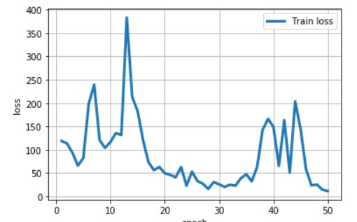
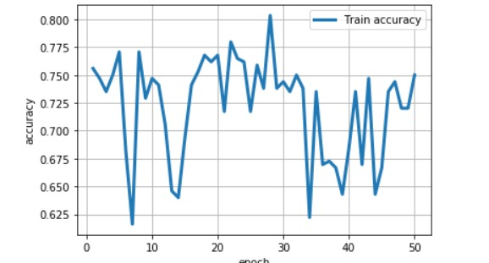
CUSTOM TRAINED MODEL RESULTS
Standard model of Dlib involve standard threshold to detect eye and mouth ratio.
We trained a NN model on data/predictions generated from standard Dlib library thus making our system more robust and customized for each individual user.
Fig 1: Loss vs Epoch
Fig 2: Accuracy vs Epoch
Results from Model Training
Accuracy: 0.79 | Precision: 0.78
Recall: 0.95 | F1 score: 0.86
The custom model has a very high recall. This ensures that we rarely miss the instances in which the user was drowsy.
Fig 3: Confusion Matrix

Slide 9
DEMO
App Link: http://project-frontend-web.s3-website-us-east-1.amazonaws.com/

Slide 10
THANK YOU

