Slide 1
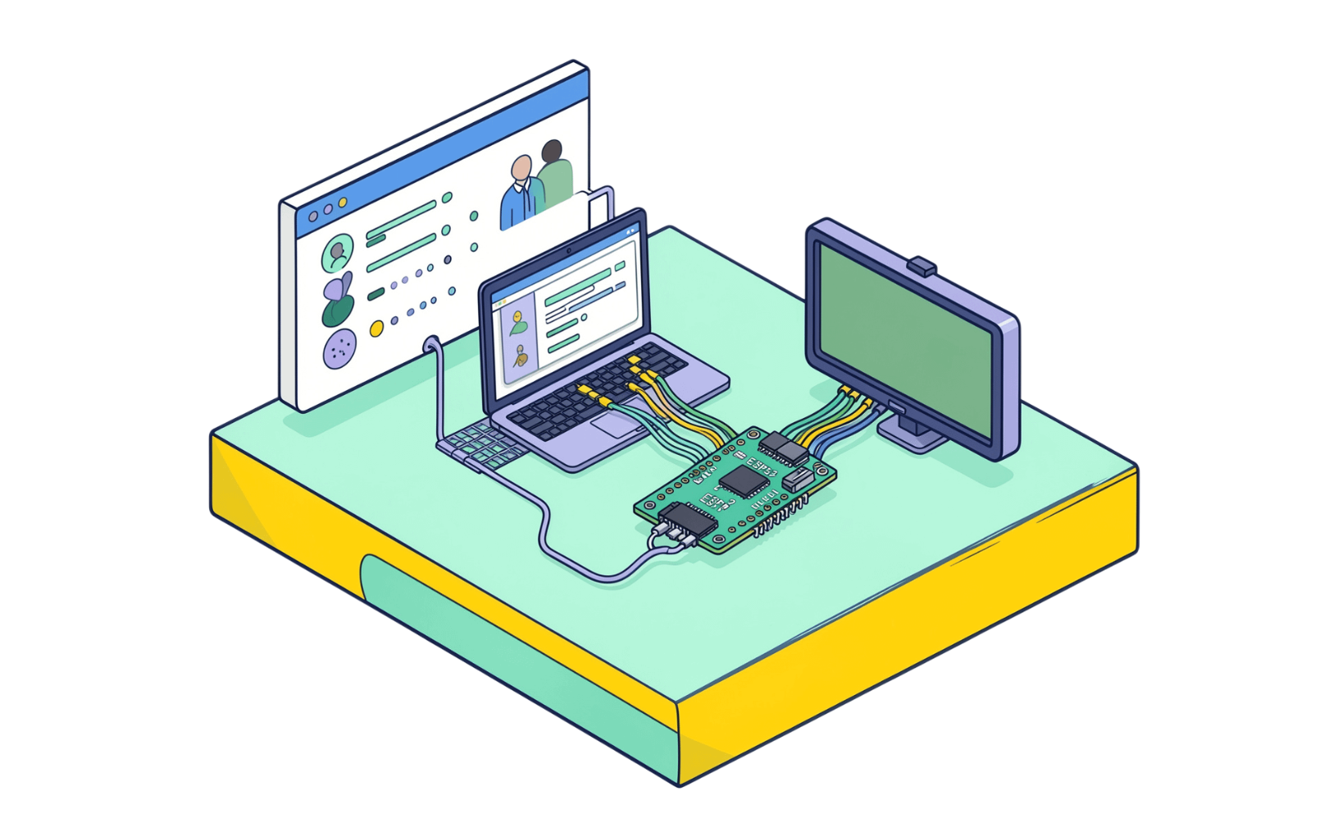







Healthcare × AI/ML × IOT
What if we could identify high-risk patients before they return?
Hospital ReAdmission Risk Prediction
Target users — Doctors, care teams, and Patiants
The workload — Many patients, limited attention, and hidden readmission risk
Decision-support problem — Surface who may need attention next, before they return
Predict. Prioritize. Prevent.
Team :CareX
Team Members : 1.Mahesh 2.Junjappa 3. basavaraj
Patient Data → Hidden Risk → AI Prediction → Physical / Digital Display → Follow-Up
ESP32 + LCD are a prototype output layer, not a medical device. ReAdmission AI supports follow-up prioritization; it does not replace clinical judgment.
4 darshan 5 Nagaraj 6.Jayant

Slide 2













THE END-TO-END SIGNAL
From healthcare data to a physical risk signal
One patient record becomes a risk classification that can be seen in software and on the prototype device.
Patient data
Preprocessing
ML model
Risk class
Dashboard
ESP32 → LCD
Demographics, diagnoses, previous encounters, medical information, procedures/treatments, hospitalization information
Prepare healthcare data for analysis
Learn patterns connected to readmission risk
LOW · MEDIUM · HIGH
Patient-level software view for follow-up prioritization
Physical prototype output layer
Predict
Prioritize
Simplify
Demonstrate
Identify patient-level risk
Focus follow-up attention
Make the signal easy to read
Connect software to hardware

Slide 3


WHY THIS APPROACH
Predictive analysis becomes physical risk awareness
Approach | Signal | Unit | Output | Action
Manual clinical assessment | Experience and review | Patient context | Human judgment | Follow-up decision
Rule-based / traditional scoring | Defined rules | Score or category | Static threshold | Guideline-driven action
Descriptive analytics | What happened | Population or cohort | Reports and trends | Retrospective understanding
ReAdmission AI | Predictive, data-driven | Patient level | Software + hardware | Action-oriented prioritization
“We don’t just analyze what happened — we identify who may need attention next, and demonstrate the result through both software and hardware.”
A decision-support prototype for follow-up prioritization, not a certified clinical system.

Slide 4
HACKATHON MVP · SYSTEM ARCHITECTURE
Healthcare data → ML → dashboard → ESP32 → LCD
01
02
03 · CORE INTELLIGENCE
04
05
Healthcare Dataset
Data Preprocessing
Risk Prediction Engine
Doctor / Care Team
Machine Learning
Patient information and encounter history
Prepare features for modeling
Model learns the predictive signal
Returns LOW / MEDIUM / HIGH
Uses the signal for prioritization
SOFTWARE PATH
HARDWARE PATH · INTERFACE LAYER
Application / Dashboard
ESP32 → LCD
Patient-level risk visibility and follow-up prioritization
Physical prototype output, not a medical device
Enter patient data
Preprocess
Run ML model
Generate risk
Display signal
Prioritize follow-up

Slide 5



BUILD PLAN
A practical stack and five-phase MVP plan
SOFTWARE STACK
HARDWARE STACK
Python · Pandas + NumPy + GitHub
ESP32 · LCD display · generic supporting components
Why this stack: accessible, collaborative, and suited to an end-to-end AI/ML prototype.
ESP32
LCD
The hardware is an interface layer for demonstration, not a medical device.
TEAM OWNERSHIP
FIVE-PHASE MVP PLAN
[MAHESH]
[JUNJAPPA]
[BASAVARAJ]
Understand — Frame the problem
Prepare — Clean the data
Model — Train and evaluate
Integrate — Connect dashboard and ESP32
Test & Demo — Run the full path
Data
Model
Evaluation
Dataset and preprocessing
ML workflow
To be evaluated
[DARSHAN]
[NAGARAJ]
[JAYANT]
Dashboard
Hardware
Integration
Streamlit interface
ESP32 + LCD
Demo and delivery

Slide 6



THE LIVE DEMO
One prediction. Two interfaces. One working prototype.
DEMO JOURNEY
01 Select / Enter Patient Data → 02 Preprocess → 03 Run ML Model → 04 Generate Risk: LOW / MEDIUM / HIGH → 05 Software Display → 06 ESP32 → LCD → 07 Follow-Up Prioritization
EXPECTED DELIVERABLES
RISKS / DEPENDENCIES
Data pipeline · ML model · evaluation · software dashboard · hardware prototype · end-to-end MVP
Data quality · preprocessing choices · model evaluation · dashboard-to-hardware integration · available components
Evaluation metrics and predictive performance: To be evaluated.
MVP BOUNDARY → FUTURE ENHANCEMENTS
MVP: decision-support prototype with software and ESP32/LCD output. Future: enhancements after evaluation, without claiming clinical deployment or certified medical-device status.
SUCCESS CRITERIA
Complete patient-to-signal flow · clear LOW/MEDIUM/HIGH output · usable dashboard · visible ESP32/LCD result · reproducible demo
PREDICT THE RISK. PRIORITIZE THE PATIENT. DEMONSTRATE THE FUTURE OF DATA-DRIVEN CARE.
ReAdmission AI | Healthcare × AI/ML × IoT | Hackfest 2026

