Slide 1








Database Systems Project
STUDENT MESS
MENU MANAGEMENT SYSTEM USING ORACLE DATABASE
Made By: DARSH SONI (24BRS1207)

Slide 2



INTRODUCTION
Hostel mess management at VIT Chennai involves complex monthly timetables
Students find it hard to understand daily menu items
Messes operate across multiple blocks and multiple mess types
Manual handling leads to confusion, poor planning, and wastage
This project proposes a database-driven solution using Oracle

Slide 3
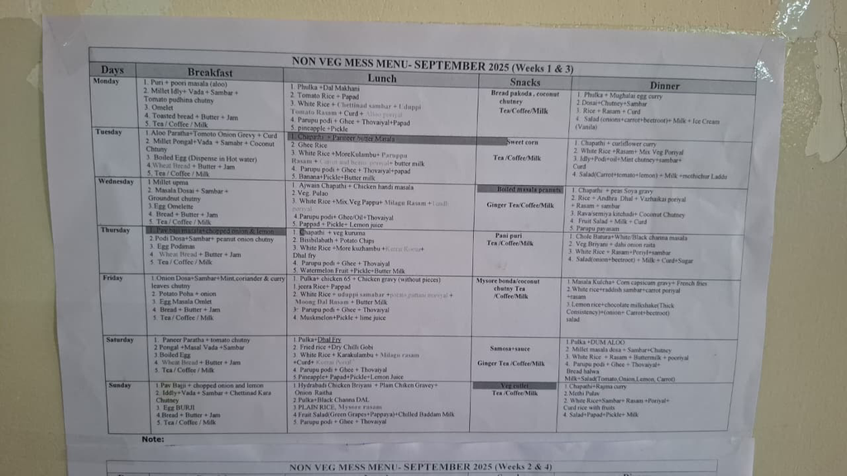
PROBLEM STATEMENT
Monthly mess menu is displayed in dense tabular format
Students struggle to:
Identify today’s menu
Compare menus across messes
Mess contractors face:
Poor visibility of student preferences
Inefficient food planning
No centralized system to manage:
Blocks
Multiple messes
Day-wise menu data

Slide 4
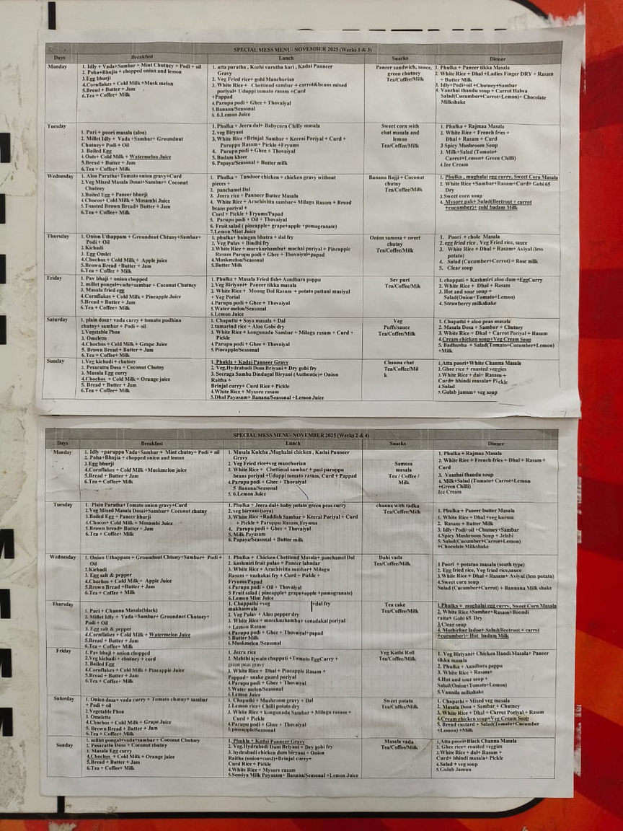
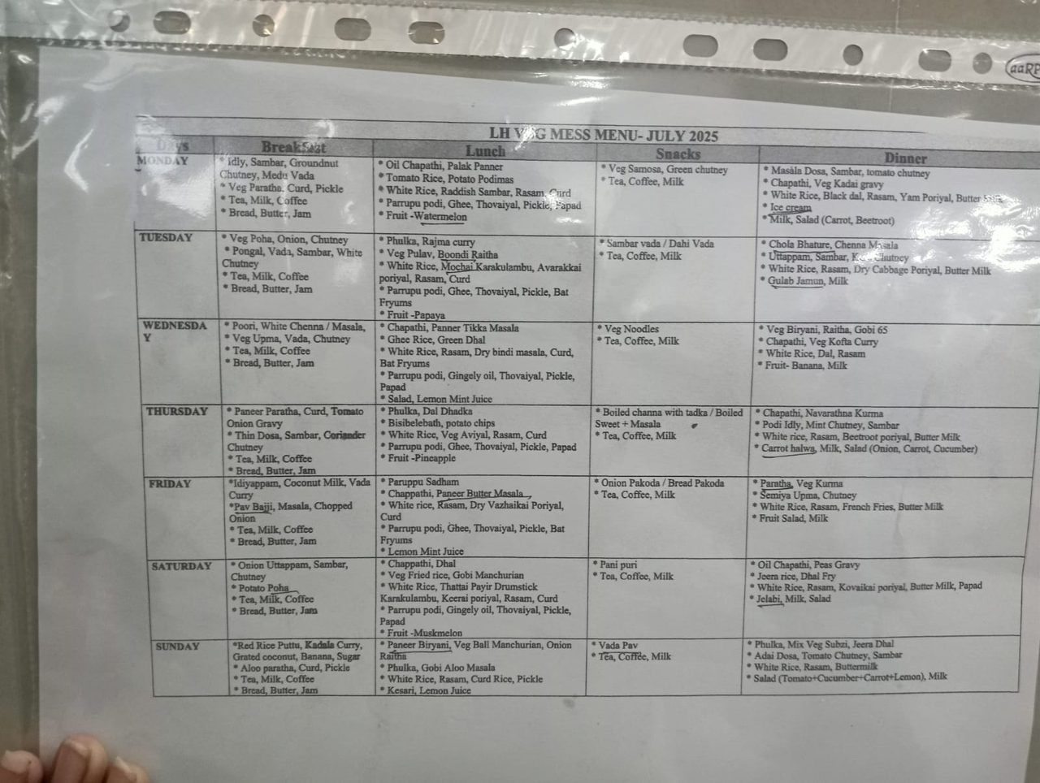

Slide 5

PROPOSAL SOLUTION
Develop an Oracle-based Smart Mess Menu Management System
Convert monthly mess timetable → simple daily menu
Supports:
Multiple messes
Multiple hostel blocks
Provide:
Clear day-wise menu display
Centralized database management
Easy updates by admin

Slide 6

SCOPE OF PROJECT
APPLICABLE TO VIT CHENNAI HOSTELS
SUPPORTS:
VEG / NON-VEG / SPECIAL MESSES WITH ALL CATERERS
MULTIPLE BLOCKS (BOTH MEN/WOMEN)
FOCUS ON:
DAILY MENU MANAGEMENT
DATA ORGANISATION USING ORACLE DATABASE
INTERACTIVE UI WITH THEMES
REPORTS AND ANALYTICS FOR MESS PLANNING
ISSUE REPORT TO STAFF DIRECTLY
SPECIAL REMINDER FOR FEAST

Slide 7
TECH STACK
Database: Oracle DB
Languages: SQL
Tools: Oracle SQL Developer
Design: ER Diagram, Relational Schema
Frontend: Mobile / Web app to display daily menus
React based frontend

Slide 8
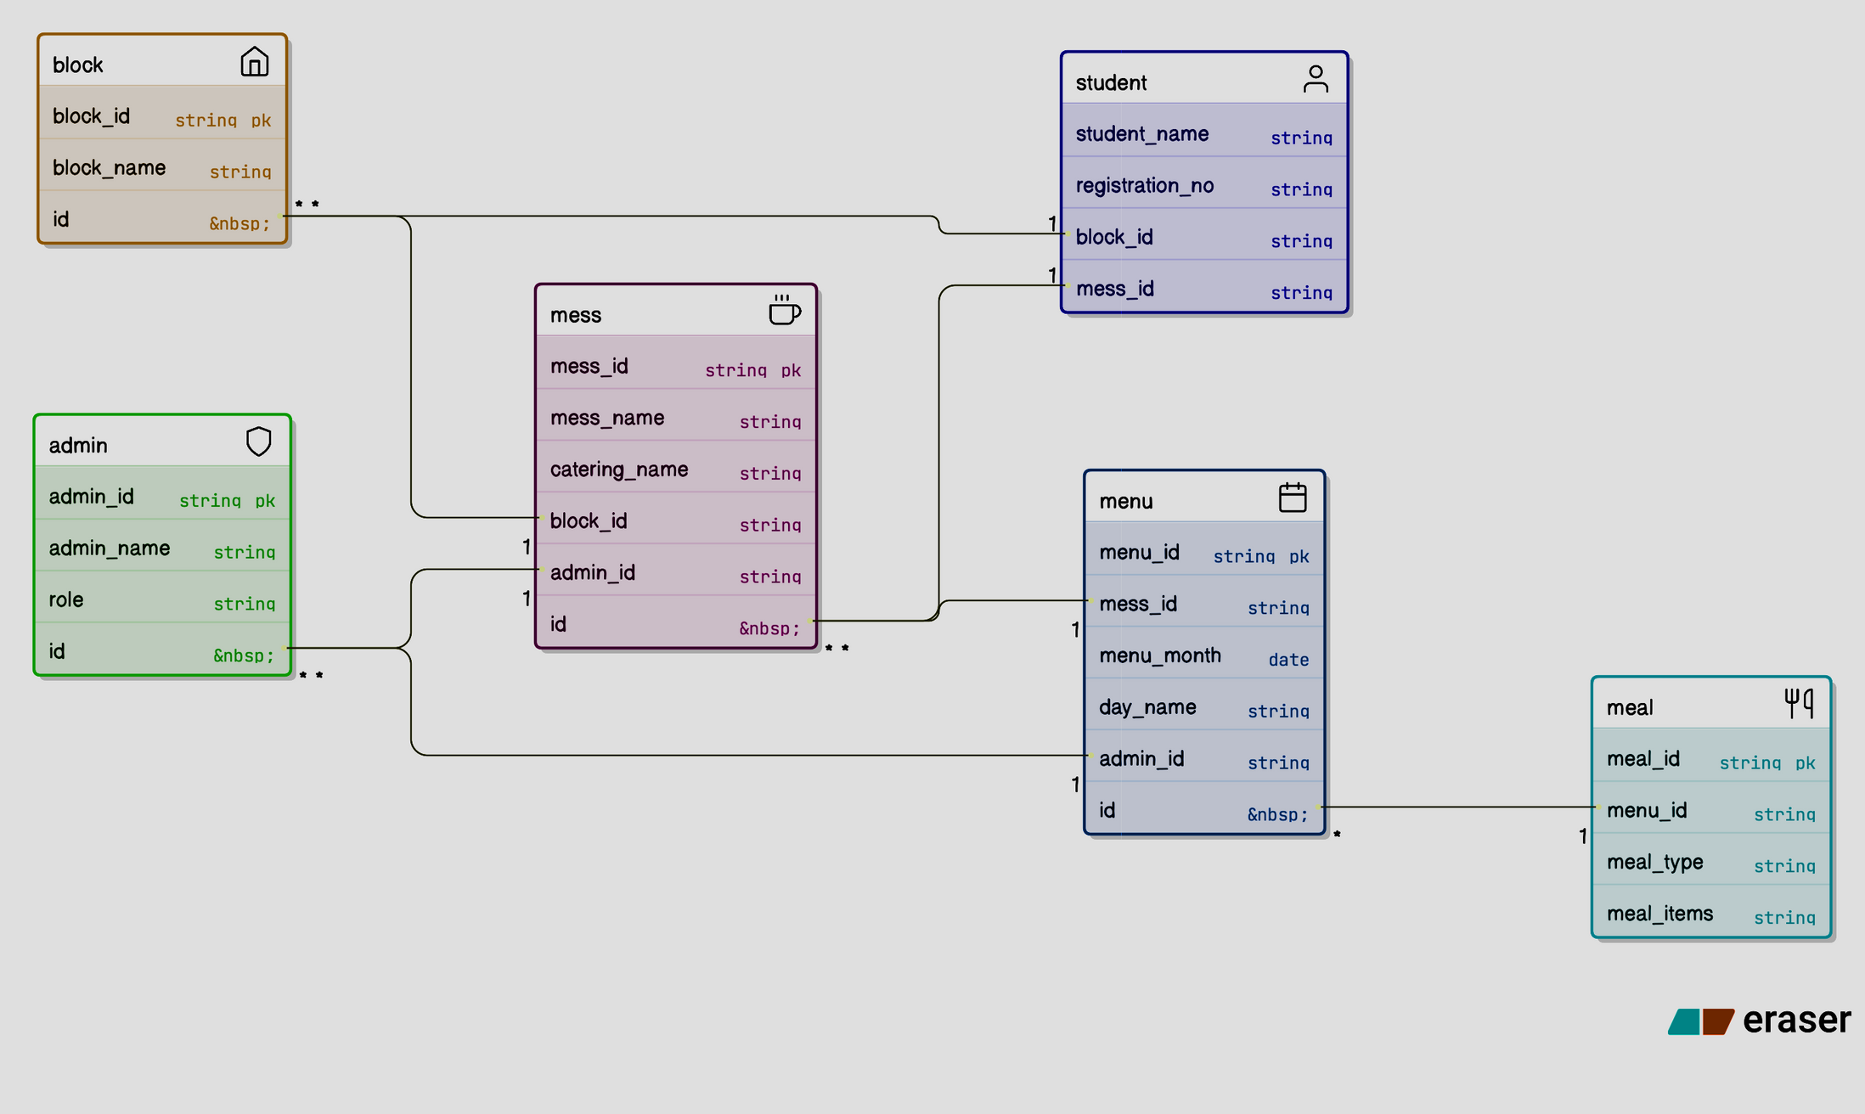

DIAGRAM

Slide 9

TABLE CODE
BLOCK table
CREATE TABLE block (
block_id VARCHAR2(20) PRIMARY KEY,
block_name VARCHAR2(50) NOT NULL
);
ADMIN table
CREATE TABLE admin (
admin_id VARCHAR2(20) PRIMARY KEY,
admin_name VARCHAR2(50) NOT NULL,
role VARCHAR2(30)
);
MESS table
CREATE TABLE mess (
mess_id VARCHAR2(20) PRIMARY KEY,
mess_name VARCHAR2(50) NOT NULL,
catering_name VARCHAR2(50),
block_id VARCHAR2(20),
admin_id VARCHAR2(20),
CONSTRAINT fk_mess_block
FOREIGN KEY (block_id)
REFERENCES block(block_id),
CONSTRAINT fk_mess_admin
FOREIGN KEY (admin_id)
REFERENCES admin(admin_id)
);
STUDENT table
CREATE TABLE student (
registration_no VARCHAR2(20) PRIMARY KEY,
student_name VARCHAR2(50) NOT NULL,
block_id VARCHAR2(20),
mess_id VARCHAR2(20),
CONSTRAINT fk_student_block
FOREIGN KEY (block_id)
REFERENCES block(block_id),
CONSTRAINT fk_student_mess
FOREIGN KEY (mess_id)
REFERENCES mess(mess_id)
);
MENU table
CREATE TABLE menu (
menu_id VARCHAR2(20) PRIMARY KEY,
mess_id VARCHAR2(20),
menu_month DATE,
day_name VARCHAR2(15),
admin_id VARCHAR2(20),
CONSTRAINT fk_menu_mess
FOREIGN KEY (mess_id)
REFERENCES mess(mess_id),
CONSTRAINT fk_menu_admin
FOREIGN KEY (admin_id)
REFERENCES admin(admin_id)
);
MEAL table
CREATE TABLE meal (
meal_id VARCHAR2(20) PRIMARY KEY,
menu_id VARCHAR2(20),
meal_type VARCHAR2(20),
meal_items VARCHAR2(200),
CONSTRAINT fk_meal_menu
FOREIGN KEY (menu_id)
REFERENCES menu(menu_id)
);

Slide 10


ADVANTAGES
Students can easily view daily menus
Reduces confusion from monthly timetables
Centralized Oracle DB for mess management
Better planning for mess contractors
FUTURE ENHANCEMENTS
Mobile application with push notifications
Feedback system for meals
Direct menu pic to database update system using AI

Slide 11

THANKYOU
MADE BY: DARSH SONI (24BRS1207)

