Slide 1


Data Acquisition and Data Wrangling
By: Darshika Dudhat

Slide 2

Key Components
DATA ACQUISITION
DATA WRANGLING

Slide 3
Primary Objective
Data Collection
Import Datasets
Data Cleaning
Remove Rows/columns
Data Transformation
Merging Datasets
Merging and Concatenate Dataset
Impute Values
Forward/Backward Fill
Data Exploration
Handle Missing Data
Data Type Conversion
Skewness and Outlier Check

Slide 4
Data Cleaning
Check Data Types
Remove Unnecessary Columns
Rename the improper Column names
Check for null values
Find the Definition and shape of the Data

Slide 5
Data Wrangling
Descriptive Statics
Get mean, median and mode of the Data
Find maximum or minimum value of the Data to see how data reacts

Slide 6
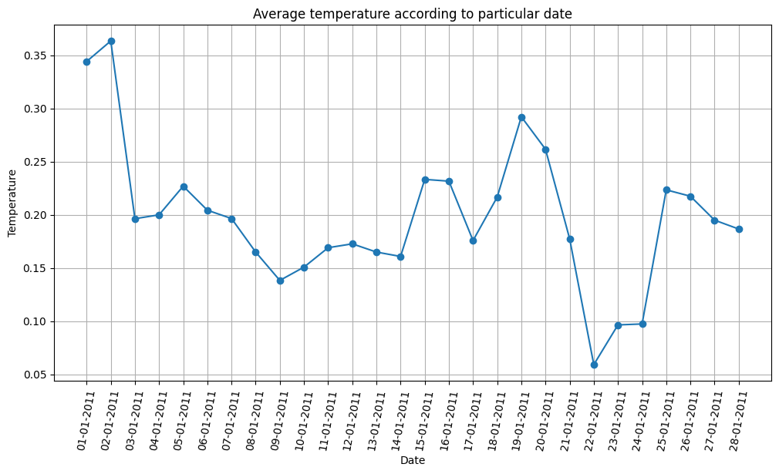
Project Insights
Shows how temperature varies according to the date.
Temperature is decrease till end of the month.
Based on it Humidity and windspeed also varies

Slide 7
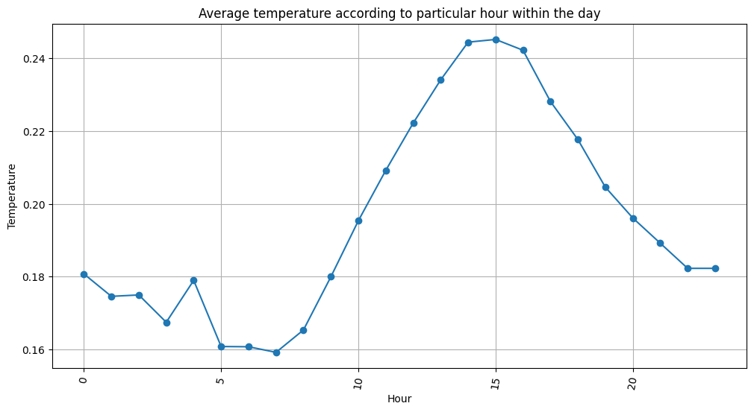
Shows how temperature varies from hour to hour.
Temperature is decrease till end of the month, but there is sudden increase in the afternoon period.

Slide 8
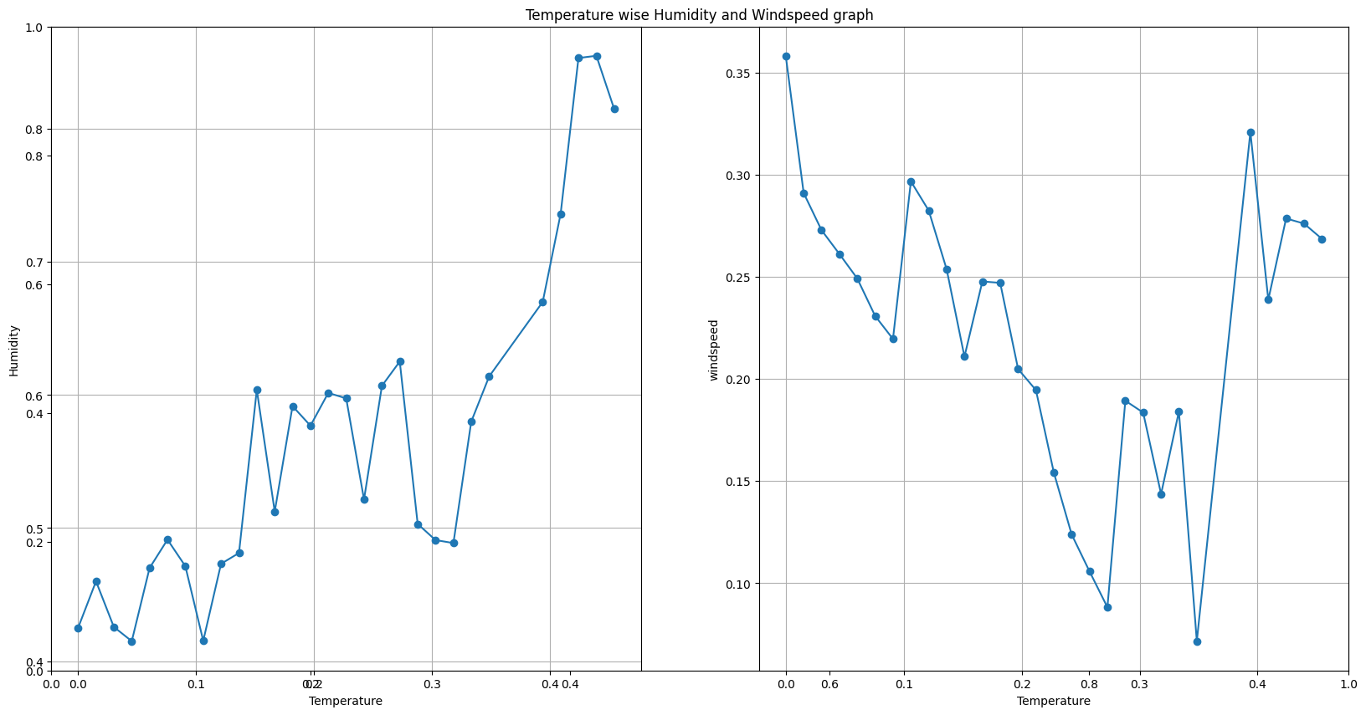
It Shows that with respect to temperature when Temperature increases humidity increases and windspeed decreases and vice a versa.

Slide 9
It Shows that with respect to temperature when Temperature increases humidity increases and windspeed decreases and vice a versa.

Slide 10
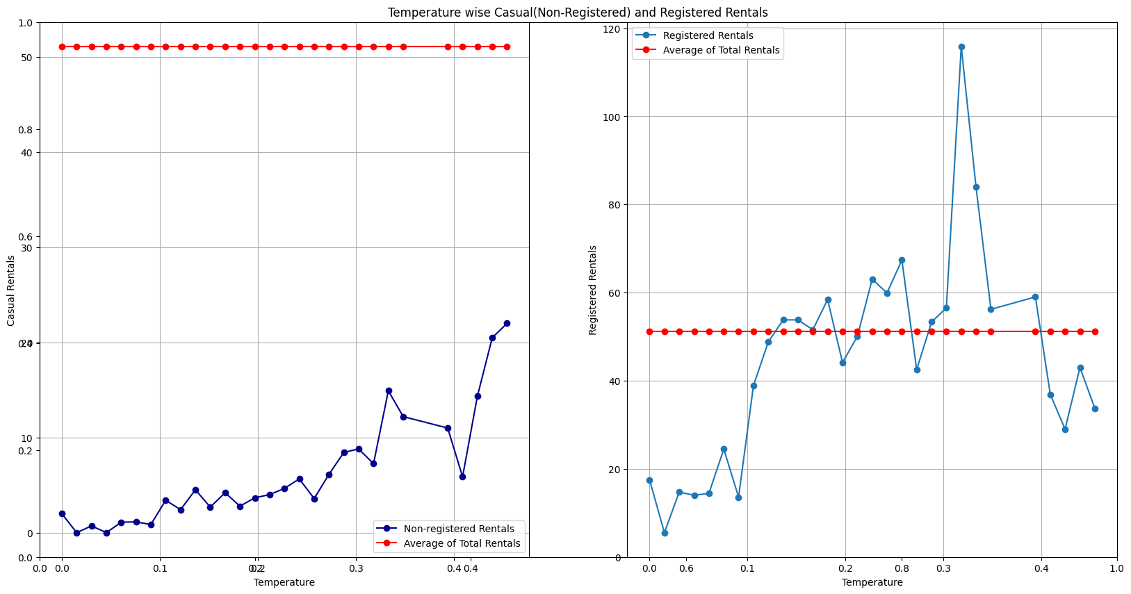
Most of the rentals are registered compared to casual(Non-registered) rentals.
Casual rentals are far more away from the average rentals(as shown in the graph).

Slide 11
Evaluation
Merge Data
(Dataset_1+
Dataset_2)
Most of the Days in January Have clear weather
Dataset_3
There is no Holiday on month of February.
Average Temperature : 0.19
Average Humidity : 0.56
Average Windspeed : 0.20
Same temperature, Humidity, windspeed relation.
And Same for Registered and Non-registered Rentals

Slide 12
Evaluation
Concatenate Dataset
(Merge Dataset +
Dataset 3)
Data set has same features of Merge Dataset and the Dataset_3.
Relationship between temperature, humidity, and Windspeed are same.
Casual Rentals have low count than Registered Rentals.

Slide 13
Difficulties in Concatenation
Both of the Dataset has different Data Types.
Date Format is not proper for further analysis.
Values are not arranged in order.
Have to split data into two categories:
Continues Data
Categorical Data

Slide 14
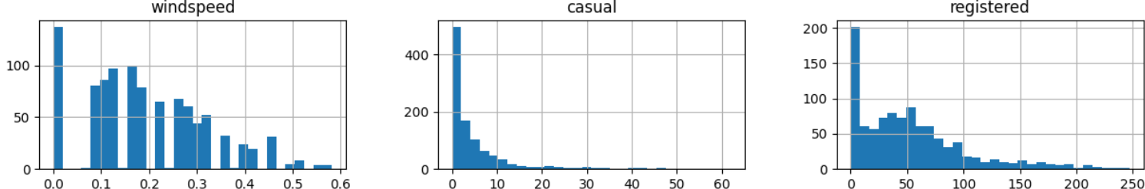
Skewness Check
Above Field has right skew means most of the data points are concentrated on the left, with a few larger values pulling the mean to the right.

Slide 15
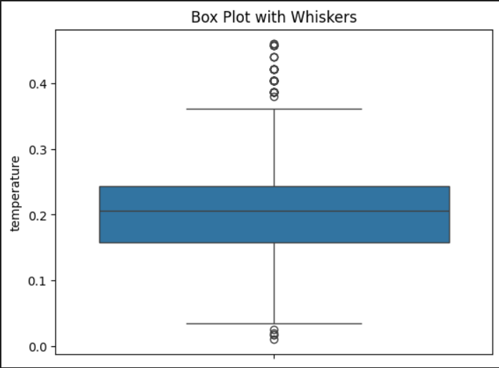
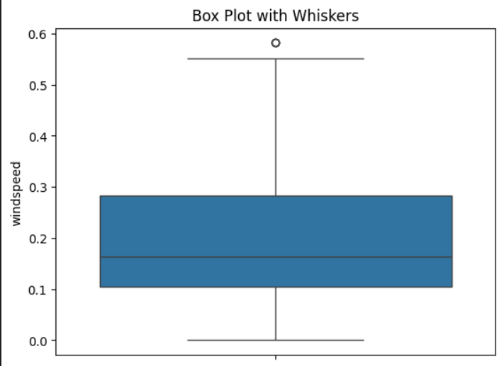
Outlier Check
Temperature and Windspeed has some data points, which are not in range of mean.
Outliers play a significant role in data analysis and identifying them is crucial for accurate interpretation and modeling. Depending on the context, outliers may provide valuable insights or may need to be addressed to improve the quality of the analysis.

Slide 16
Conclusion
Data acquisition and wrangling are foundational steps in the data analysis process, ensuring that the data is clean, well-structured, and ready for analysis. By effectively acquiring and wrangling data, you set a solid groundwork for subsequent analysis and insights extraction.

