Slide 1


Investigating Key Features and Their Impact on housing data

Slide 2
PROJECT OBJECTIVES:
Exploring Factors That Affect House Prices
How do different property features correlate with sale price?
Which features are the best predictors of house prices?
Are there any seasonal trends in the sale prices?
Approach
Cleaning and Preparing the data.
Perform Univariant and Multivariant Analysis.
Feature Engineering.
Visualize the finding.

Slide 3
DATA OVERVIEW
Dataset Size:
The dataset consists of 1,460 rows (properties) and 81 columns (features).
Key Features:
Numerical: 'SalePrice', 'LotArea', 'YearBuilt','GrLivArea’
Categorical: 'Neighborhood', 'ExterCond', 'CentralAir'
Missing Values:
Some features contain missing data, such as 'MasVnrArea' and 'BsmtQual', which will be addressed during data cleaning.
Descriptive Statistics:
The average sale price ('SalePrice') is $180,000 with a standard deviation of $70,000. The most common neighborhood is 'CollgCr'.

Slide 4
DATA CLEANING AND PREPROCESSING
Outlier Detection and Removal:
Outliers in 'GrLivArea' were detected using Z-scores and removed as they were far beyond the range of typical values for square footage."
Data Type Conversion:
'YrSold' column to a datetime object and ensured that categorical columns, such as 'Neighborhood', were treated as categorical data."

Slide 5
Feature Engineering:
Total_lot_area_coverage = LotFrontage + LotArea
age_of_house = current year – yearRemodAdd
price_per_square_feet = SalePrice / LotArea

Slide 6
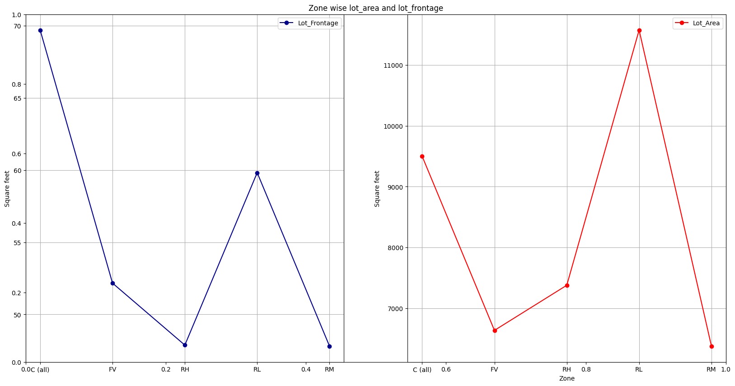
Exploratory Data Analysis (EDA):
Univariant Analysis:

Slide 7
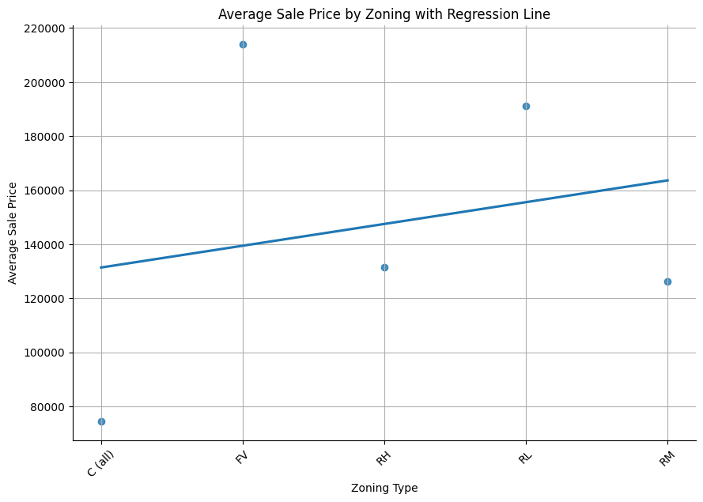
Exploratory Data Analysis (EDA):
Univariant Analysis:

Slide 8
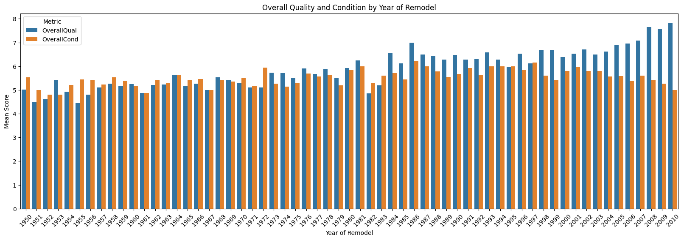
Exploratory Data Analysis (EDA):
Multivarient Analysis:

Slide 9
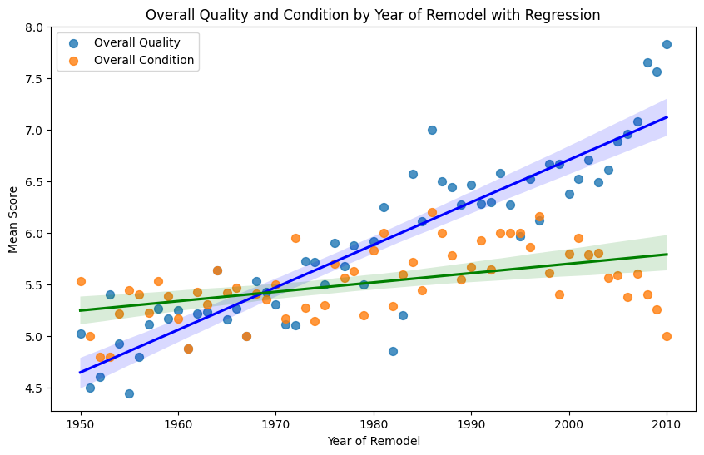
Exploratory Data Analysis (EDA):
Multivarient Analysis:

Slide 10
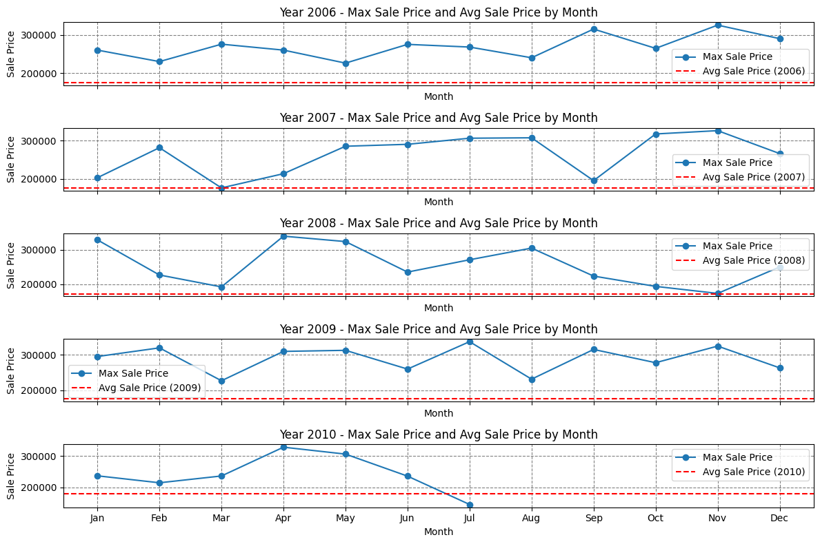
Exploratory Data Analysis (EDA):
Multivarient Analysis:

Slide 11
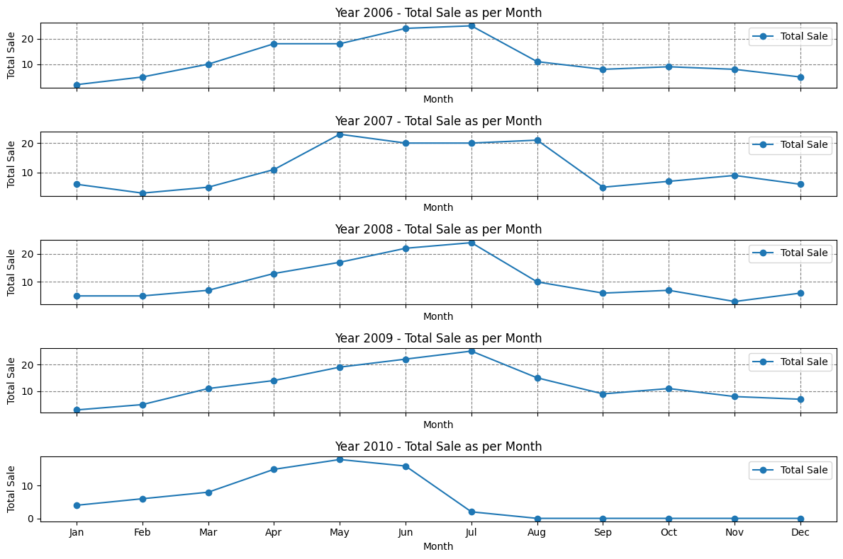
Exploratory Data Analysis (EDA):
Multivarient Analysis:

Slide 12
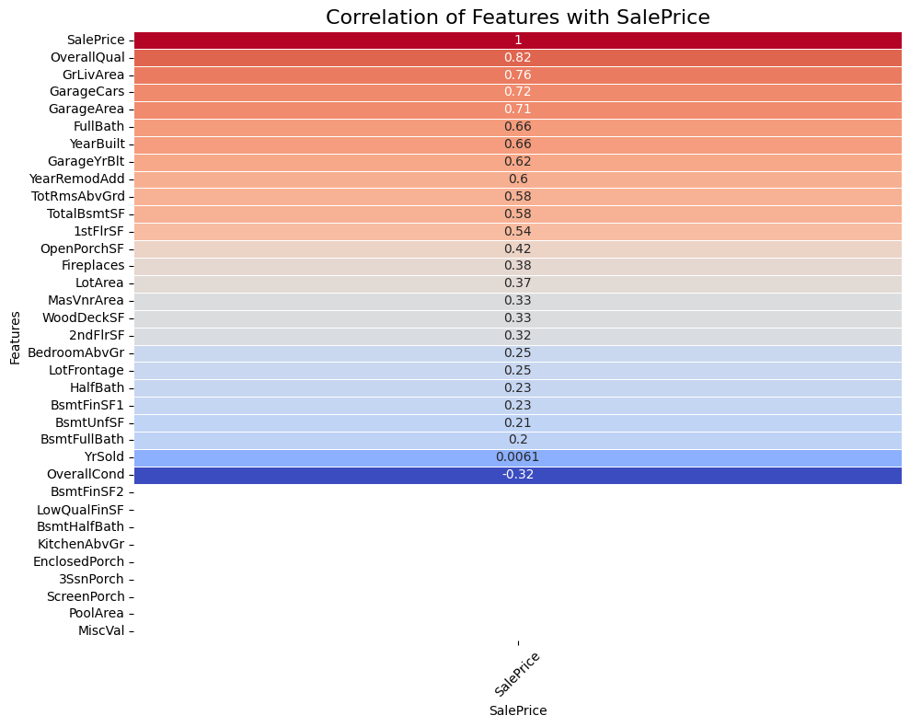
Exploratory Data Analysis (EDA):
Multivarient Analysis:

Slide 13
Exploratory Data Analysis (EDA):
As per the visulization there is major correlation between OversllQual, GrLivArea, GarageCars,GarageArea.
- And BsmtFinSF2,LowQualFinSF,BsmtHalfBath,KitchenAbvGr,EnclosedPorch,3SsnPorch,ScreenPorch,PoolArea,MiscVal these has no Correlation with the Sale Price.

Slide 14
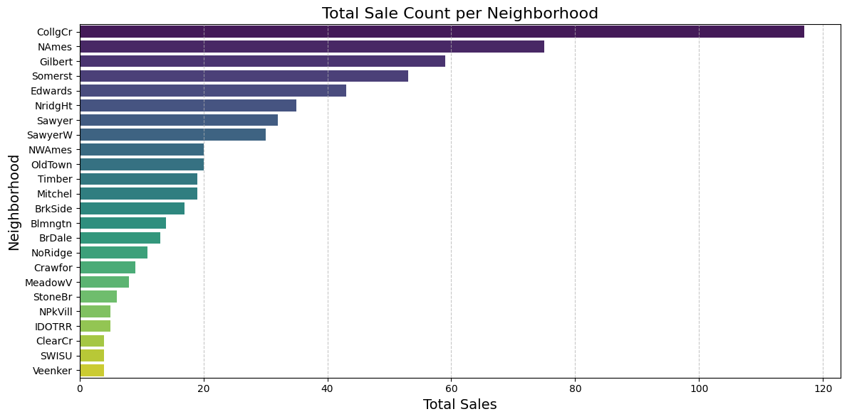
Exploratory Data Analysis (EDA):
As per the visulization there is major correlation between OversllQual, GrLivArea, GarageCars,GarageArea.
- And BsmtFinSF2,LowQualFinSF,BsmtHalfBath,KitchenAbvGr,EnclosedPorch,3SsnPorch,ScreenPorch,PoolArea,MiscVal these has no Correlation with the Sale Price.

Slide 15
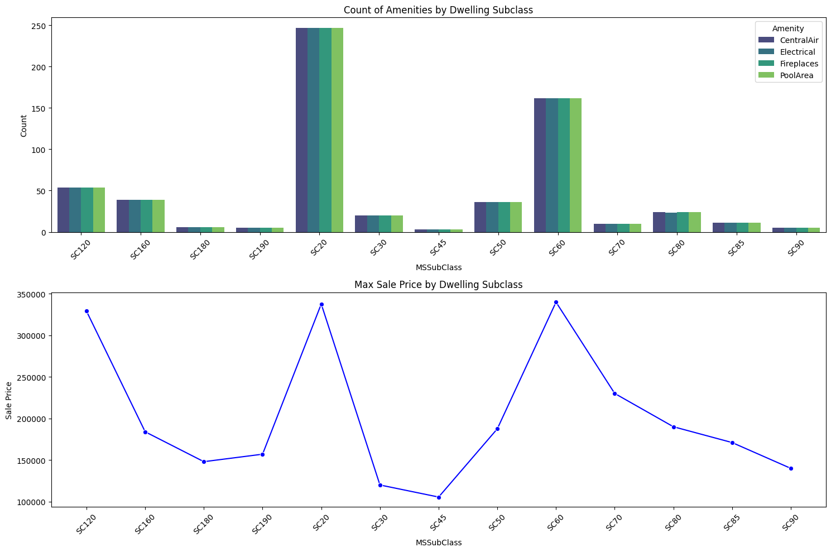
Exploratory Data Analysis (EDA):
As per the visulization there is major correlation between OversllQual, GrLivArea, GarageCars,GarageArea.
- And BsmtFinSF2,LowQualFinSF,BsmtHalfBath,KitchenAbvGr,EnclosedPorch,3SsnPorch,ScreenPorch,PoolArea,MiscVal these has no Correlation with the Sale Price.

Slide 16
"Thank You!"
"Thank you for your time and attention. I hope you found the analysis insightful."

