Slide 1
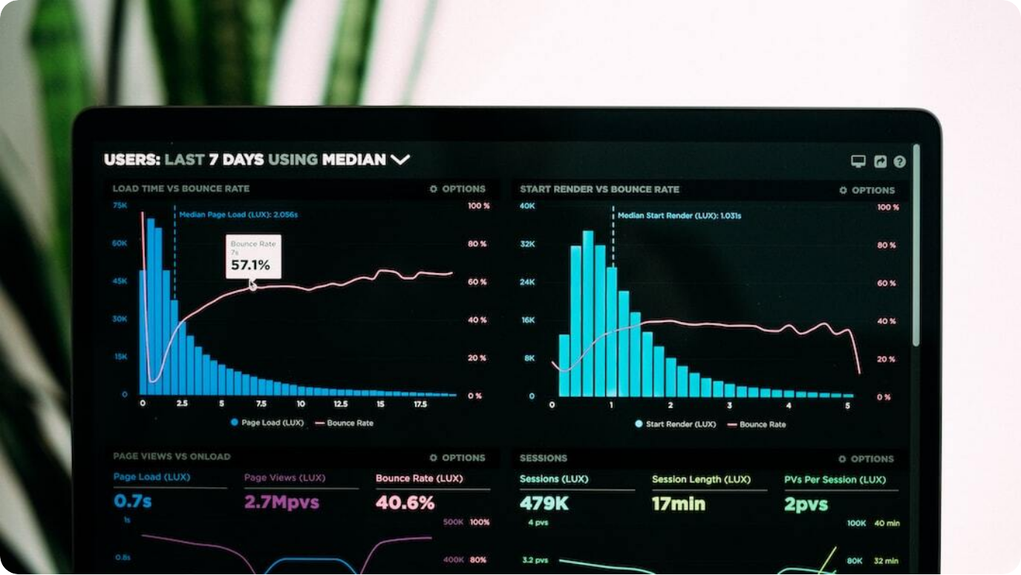
LLM-Powered News Research Tool
Project Overview and Implementation
Real-time News Insights: Harnesses LangChain, Groq LLM, and NewsAPI to generate instant summaries of global news.
Designed for Equity Research: Tailored to support analysts with AI-generated concise, data-driven news digests.
Secure and Interactive Tool: Streamlit-based interface with user authentication, PDF exports, and query history.
Photo by Luke Chesser on Unsplash
Notes:
Welcome to the presentation on our AI-powered News Research Tool. This project combines the power of LangChain's orchestration, Groq's LLM capabilities, and NewsAPI's real-time news feed to deliver concise, actionable news insights. Specifically designed to assist equity research analysts, the tool generates AI-curated summaries of relevant news, streamlining their research process. The user interface, built with Streamlit, offers secure access, intuitive interaction, PDF exports, and query history tracking—making it a robust solution for modern news analysis.

Slide 2



Project Overview
AI-Powered News Research Tool
End-to-End Research Support
Delivers real-time, AI-generated news summaries tailored for equity analysts.
Integrated Technologies
Combines LangChain, Groq LLM, Streamlit UI, and NewsAPI for seamless functionality.
Enhanced User Features
Includes secure login, PDF export, visual charts, and query history for better usability.
Notes:
This project focuses on building a comprehensive news research tool, tailored for equity research analysts and knowledge workers. It integrates LangChain's orchestration, Groq LLM's generative power, and NewsAPI's real-time feed to produce accurate, AI-powered news digests. The Streamlit interface ensures interactive user experience with secure login, PDF report generation, and visual data presentation. By merging these technologies, the system simplifies the research workflow, transforming scattered news into concise, structured summaries.

Slide 3
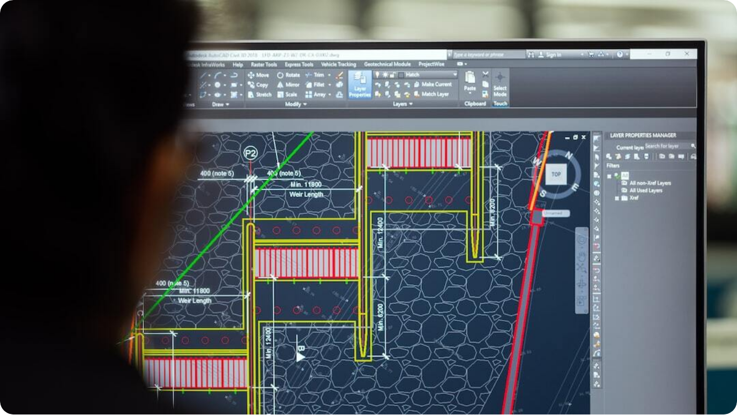
Technology Stack (Technical View)
Modules and Components Used
LangChain Orchestration: Uses `langchain_groq` with `PromptTemplate`, `RunnableLambda`, and `StrOutputParser` for LLM pipelines.
Groq LLaMA 3 LLM: `ChatGroq` model (e.g., `llama3-8b-8192`) invoked via `llm_chain.invoke()` with structured prompts.
Streamlit Web Application: `streamlit` for forms, interactive UI, state management (`st.session_state`), PDF exports via `FPDF`.
NewsAPI Integration: `newsapi-python` retrieves global articles with filters: query, date range, language='en', sorted by recency.
Photo by ThisisEngineering RAEng on Unsplash
Notes:
From a technical perspective, the project leverages modular tools for scalable AI research workflows. LangChain integrates Groq's LLaMA 3 via structured `PromptTemplate` pipelines. The Groq model executes through `llm_chain.invoke()` calls, generating human-like summaries. The frontend uses Streamlit components with `st.session_state` to manage sessions and `FPDF` for PDF generation. NewsAPI connects to live news data sources, filtering results by query, date range, and language, ensuring real-time and relevant content for summarization.

Slide 4




System Architecture (Technical View)
Data Flow and Integration Logic
User Input Layer
Streamlit form captures query via `st.text_input()`, user authenticated through `.env`-based credentials.
Data Aggregation
`get_news_articles(query, days_back)` fetches articles using NewsAPI, applying filters: query, date range, language='en'.
Summarization Pipeline
Articles summarized via `summarize_articles()`, passed with query to `llm_chain.invoke()` for AI-generated output.
Output Presentation
Summaries displayed with `st.success()`, visual trends via `st.bar_chart()`, and optional PDF reports generated by `FPDF`.
Notes:
This technical breakdown illustrates the project's complete system architecture. User authentication relies on environment variables loaded via `dotenv`. After login, Streamlit's input form collects queries, invoking `get_news_articles()` with time filters for real-time news fetching. Summaries are generated through `summarize_articles()`, with both query and summaries structured into prompts and processed by `llm_chain.invoke()`. Results are displayed in the frontend alongside frequency charts, with an option to export AI-generated reports as PDFs for offline reference.

Slide 5



LangChain & LLM Configuration
Prompt Engineering and Model Orchestration
LangChain Prompt Templates
Custom prompts crafted to structure AI responses with context and clarity.
Groq LLaMA 3 Integration
Powerful large language model generating concise, relevant summaries.
Summarization Pipeline
Query and news summaries combined to produce final AI-driven outputs.
Notes:
LangChain forms the core of the orchestration layer in this project, using advanced prompt templates to guide AI responses. These prompts combine user queries with summarized news inputs, ensuring the output is contextually accurate and actionable. The system integrates Groq's LLaMA 3 model, a powerful large language model capable of generating human-like summaries. Together, LangChain and Groq LLM form a reliable pipeline, transforming raw news data into concise, insightful summaries optimized for research needs.

Slide 6



Streamlit Frontend
Secure and User-Friendly Interface
User Authentication
Credential-based login system ensures only authorized access.
Interactive Layout
Streamlit-based forms, buttons, and visual components for smooth interaction.
Session Management
Tracks user sessions and maintains query history across interactions.
Notes:
The project utilizes a secure Streamlit-based frontend to deliver an intuitive user experience. The login system restricts tool access to authorized users, improving security for sensitive research tasks. Once logged in, users can interact with forms to submit queries, view AI-generated summaries, and access additional resources. The interface also maintains session history, allowing users to revisit previous queries and responses seamlessly. This combination of security, interactivity, and convenience forms the foundation of the user interface.

Slide 7



NewsAPI Integration
Real-Time News Aggregation and Insights
Live News Fetching
Searches global news sources using NewsAPI with custom time filters.
Article Summarization
Extracts key points from news articles to feed AI-generated summaries.
Visual Data Insights
Displays article frequency charts for temporal trend analysis.
Notes:
The tool integrates NewsAPI to fetch real-time, relevant news articles based on user queries. Users can filter results by date range, ensuring they access the most recent information. Once articles are retrieved, the system summarizes key points, which are passed to the Groq LLM for further refinement. Additionally, visual insights like frequency charts illustrate how news volume fluctuates over time, helping users quickly identify peaks in coverage and stay informed on market-moving events.

Slide 8

Enhancements and Features
Advanced Capabilities for Improved Research
PDF Report Generation: Users can download AI summaries as professionally formatted PDF documents.
Visual Trend Analysis: Charts display article frequency over time for quick identification of news surges.
External Resource Integration: Quick links to Google search for expanded exploration beyond AI summaries.
Photo by Hitesh Choudhary on Unsplash
Notes:
Beyond core summarization, this tool incorporates several advanced features to enhance research workflows. Users can instantly download AI-generated summaries as PDF reports for easy sharing and archiving. Visual trend charts help track news volume fluctuations, aiding in spotting critical coverage spikes. Additionally, integrated links allow users to quickly search their query on Google for further investigation. These enhancements transform the tool into a comprehensive research assistant, supporting deeper, data-driven decision-making.

Slide 9



Optional Improvements
Future Enhancements for Greater Functionality
Advanced Authentication
Implement role-based access and stronger security protocols.
Enhanced UI/UX
Improve visual components and interactivity for a polished user experience.
Historical Data Storage
Enable query history tracking, saving summaries, and long-term research logs.
Notes:
While the tool already delivers substantial functionality, there are several potential areas for future improvement. Advanced authentication mechanisms can be introduced to provide finer-grained access control and stronger security. The user interface and experience can be enhanced with modern Streamlit components, animations, and layout refinements to make the tool more engaging. Additionally, introducing persistent historical data storage would allow users to save summaries, track research queries over time, and build comprehensive news archives—all elevating the tool's research capabilities.

Slide 10



Conclusion
AI-Powered Research for the Future
Efficient News Summarization
Combines AI and real-time data to streamline news research workflows.
Tailored for Analysts
Provides concise, data-rich insights designed for equity research needs.
Foundation for Expansion
Future-ready architecture allows for easy integration of new features and capabilities.
Notes:
In conclusion, this AI-powered News Research Tool delivers real-time, summarized insights tailored for equity research and beyond. By integrating LangChain, Groq LLM, Streamlit, and NewsAPI, it transforms fragmented news content into structured, actionable summaries. The tool empowers analysts to access relevant information quickly, supported by features like visual charts, secure login, and PDF reporting. With a scalable architecture, the system is primed for future enhancements, ensuring continued innovation in AI-driven research solutions.

