Slide 1



Job Market Analysis and Recommendation System
Data-Driven Insights for the Future of Work
Objective
Develop a system to analyze job trends and provide personalized job recommendations using real-time data.
Scope
Covers salary trends, emerging job categories, predictive modeling, and a web-based dashboard with Docker deployment.
Outcome
Interactive tools and insights to support job seekers and recruiters in making data-informed decisions.

Slide 2
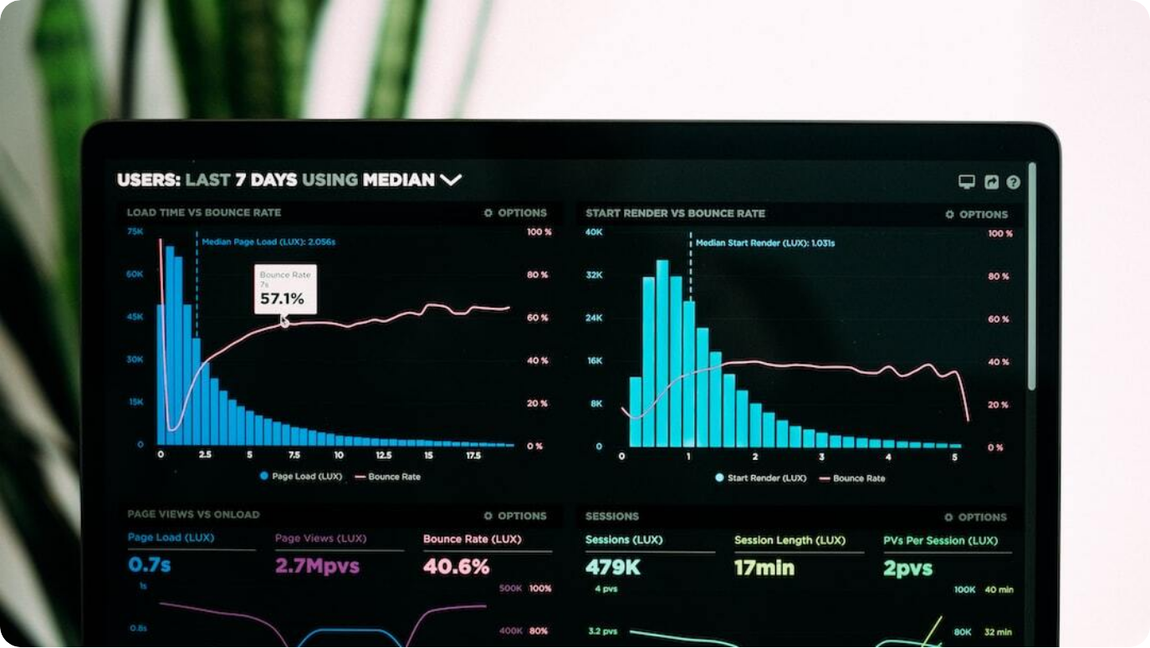
Future Job Market Predictions
Insights from Forecasting Models and Predictive Analytics
High-Demand Roles: Developer, designer, and analyst roles forecasted to see significant demand growth through mid-2024.
Stable Yet Niche Remote Work: Remote jobs maintain steady demand; influenced by economic and organizational trends.
Career Guidance: Seekers advised to focus on tech-centric roles and remote collaboration skills.
Photo by Luke Chesser on Unsplash

Slide 3



Project Objective
Empowering Job Seekers with Data-Driven Career Insights
Trend Analysis
Leverage job postings data to extract demand, salary, and category insights using statistical and ML techniques.
Personalized Recommendations
Provide job seekers with tailored job suggestions based on trends and real-time data.
Deployment-Ready System
Build a scalable, containerized web application for end users to interact with dashboards and recommendations.

Slide 4
Situational Overview
Understanding the Dynamics of the Modern Job Market
Market Volatility: Job availability fluctuates with economic shifts, tech advancements, and global events.
Data Opportunity: Large-scale job postings data enables granular analysis of real-time trends.
Stakeholder Benefits: Helps job seekers, recruiters, and analysts make timely, data-informed decisions.
Photo by Luke Chesser on Unsplash

Slide 5



Technology and Tools
Frameworks and Platforms Powering the System
Data & ML Stack
Python, Pandas, Scikit-Learn, and TensorFlow used for preprocessing, modeling, and analysis.
Web Interface
Streamlit powers an interactive dashboard and user input modules for job insights.
Deployment & Scaling
Docker containerization ensures consistent environments across development and production.

Slide 6



Task 1: Job Title Keywords vs Salary
Analyzing Correlation Between Title Terminology and Pay
Keyword Extraction
Parsed job titles to identify high-frequency terms and job-specific keywords.
Statistical Correlation
Analyzed relationship between specific keywords and offered salaries using regression models.
Findings
Technical titles (e.g., 'Engineer', 'Developer') correlate with higher pay. Creative or support roles tend to offer less.

Slide 7

Task 2: Identifying Emerging Job Categories
Tracking Frequency Patterns in Job Postings
Trend Detection: Analyzed monthly frequency of job titles to identify upward-trending categories.
Growth Indicators: Tech, design, and freelance roles show rising occurrence over multiple timeframes.
Implications: These trends inform curriculum design, workforce planning, and job seeker focus.
Photo by Isaac Smith on Unsplash

Slide 8

Task 3: Predicting High-Demand Job Roles
Forecasting Using Historical Posting Patterns
Time-Series Modeling: Used historical job posting data to train predictive models forecasting future role demand.
Accuracy Metrics: Models evaluated using RMSE and MAE to ensure reliability.
Forecast Outcomes: Developer, analyst, and creative tech roles projected to lead market through Q3 2024.
Photo by ThisisEngineering RAEng on Unsplash

Slide 9



Task 4: Comparing Hourly Rates by Country
Geographical Insights into Job Market Compensation
Data Aggregation
Collected hourly rate data from job postings across multiple regions and normalized for comparison.
Cross-Country Analysis
Visualized disparities in hourly wages using choropleth maps and boxplots.
Findings
Western countries tend to offer higher rates, while emerging economies are more competitive in remote gigs.

Slide 10



Task 5: Job Recommendation Engine
AI-Driven Personalized Suggestions Based on Market Data
User Profiling
Extracted preferences and skillsets to match relevant job postings.
Filtering Logic
Engine ranks postings by relevance, location, rate, and category match.
Prototype Interface
Streamlit-based UI enabling real-time user interaction with live job feeds.

Slide 11


Task 6: Tracking Monthly Job Market Trends
Live Dashboard for Dynamic Trend Monitoring
Real-Time Insights
Monthly updates reflect the most recent shifts in job demand and categories.
Interactive Dashboard
Streamlit app displays visual summaries of category trends by month.
Use Case
Ideal for recruiters, educators, and job seekers tracking market changes.

Slide 12


Task 7: Remote Work Trends
Analyzing the Rise and Stability of Remote Employment
Category Monitoring
Tracked remote-specific postings to evaluate growth and market share.
Stability vs. Growth
Remote roles show consistent presence; minor fluctuations linked to policy and economic shifts.
Strategic Advice
Seekers should enhance digital collaboration skills and prepare for hybrid roles.

Slide 13
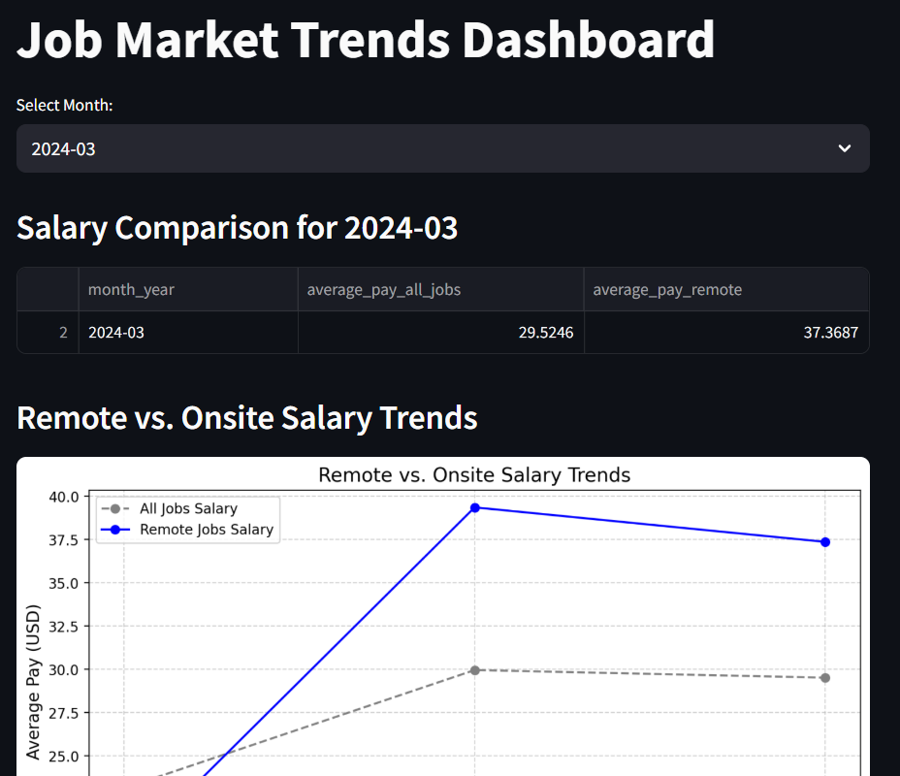
Visual Forecasts and Interactive Dashboards
Screenshots from Streamlit Interfaces and Predictive Models
Demand Trend Visuals: Line graphs display projected demand per role including sharp growth for analysts.
Salary Comparison Views: Streamlit dashboards visualize remote vs onsite salary trends by month.
Comprehensive Report Interface: Text-based predictive analysis embedded in a dynamic web dashboard.

Slide 14



Task 8: Predicting Future Job Market Trends
Projecting Growth Using Predictive Analytics
Model Output
AI models forecast increased demand in tech and creative fields through August 2024.
Strategic Recommendations
Focus on AI, content, and analytics roles; remote work remains essential.
Insight Delivery
Textual reports and visualizations integrated into final Streamlit dashboards.

Slide 15
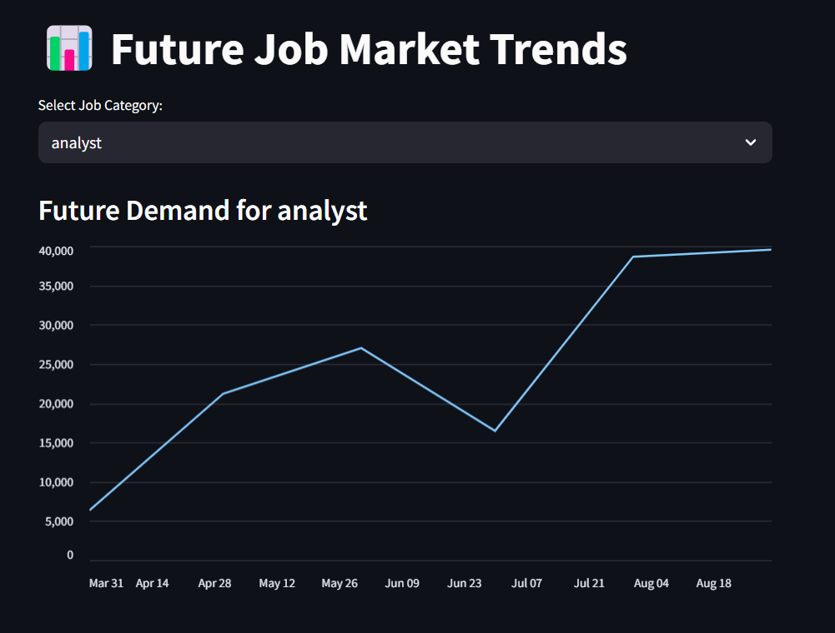
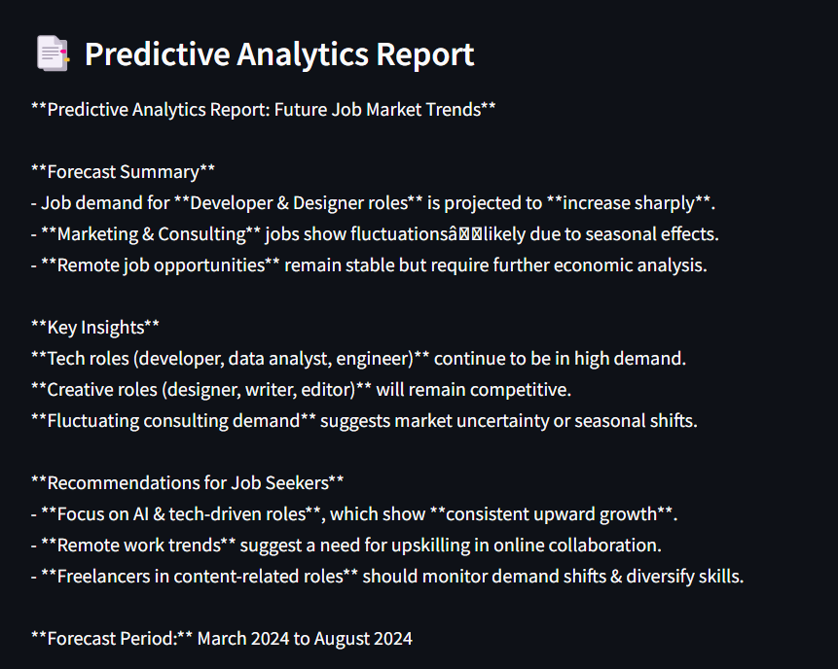
Visual Forecasts and Interactive Dashboards
Screenshots from Streamlit Interfaces and Predictive Models

Slide 16



Conclusion and Thank You
Empowering the Future of Work Through Data
Comprehensive Insights
From trend detection to recommendations, the project delivers a full-spectrum view of the job market.
Impact & Utility
Supports job seekers, recruiters, and educators with real-time, actionable insights.
Future Directions
Scalable dashboards, enhanced AI models, and broader dataset integration ahead.

