Slide 1
VOICE ASSISTANT USING PYTHON
Rohan Ajmera, 1911002 – A1
Darshil Mehta, 1911007 - A1
Yash Dedhia, 1911008 – A1

Slide 2
INTRODUCTION
AI has come into significance as in today’s world there as been a significant amount of propagation of Internet Of Things(IOT). IOT means the physical “things” that have some kind of software or a sensor that first interacts with the human and gets some kind of raw data and then it would connect to other devices on the “internet” and would exchange data with them and pass on the data to the human.
Thus, the products are becoming more and more smarter day by day in terms of having a better connection with humans and similar devices/software's like themselves.
One of the interesting implementation of AI is the voice assistant.

Slide 3
Some famous examples of existing voice-assistant that are being already used by various systems are:
SIRI from Apple.
ALEXA from Amazon (Amazon Echo).
Cortana from Microsoft.
Google from Google Assistant. and AVIA that was recently appeared in 2018.
Earlier the humans had to adapt to the machines and learn and understand what the machine needs, but now the machines have started adapting the human nature and they react according to their habits, actions and behaviour. Thus, getting a step closer to be the humans personalized assistant.

Slide 4
PROBLEM DEFINITION
Artificial Intelligence, which was deemed as impossible to implement in the earlier times, has now become a lifestyle. Earlier, humans had to adapt the way in which machines worked to understand machines in a better way. But, the progressing technology has given rise to AI by which machines can now perceive how humans think and perform activities. Due to the development and continuous updating technology in AI, the human and machine interaction has become very popular. It has been created with the intent to help humans by making their day-to-day life easier and enjoyable. One way in which AI can help humans is by processing and implementing the commands that the humans give. Nowadays, it is easier to implement a simple AI using an easy to understand programming language known as Python(along with some modules). This project – Voice Assistant – will help us in achieving this goal as it will process our voice commands and perform them in just a fraction of seconds.

Slide 5
SCOPE OF THE PROJECT
The Scope of the project lies within our implementation as follows:
General Search Engine using Voice commands
API calls using Voice Commands – live Stock Market
Daily helpful data – date, time, etc.
Currency Convertor
Implementation of Dictionary

Slide 6
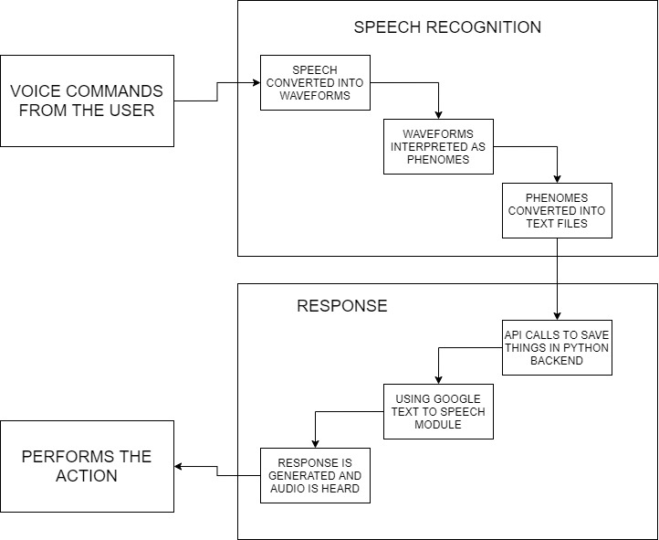
FLOW DIAGRAM

Slide 7
PACKAGES AND API
The Packages and API used in our project are:
speech_recognition
google text to speech (gtts)
playsound
yfinance
webbrowser
os
tkinter
Pyaudio
Difficulties:
The pyaudio package was not being installed with basic pip install command so we had to download the package(wheel file) externally.

Slide 8
CONCLUSION
Thus this project helped us in understanding how python modules like google text to speech, yfinance and tkinter work in a better way.
Overall, this mini project was successful and we have a working voice assistant with us.

Slide 9
THANKYOU!

