Slide 1
Wacky Wheels Control Tower
Hitachi Hack the Highway - an event-driven multi-agent operations control tower
• Reads 15 messy operational messages, works out who is affected, fixes the schedule through the company system, and explains every step
• 961 tool calls, 0 failed, 15/15 events green in an independent self-check
• LLM reads, code decides: one 3B local model call per event; ids, dates, slots, loaners and tool arguments are computed and verified by code

Slide 2
The problem
A just-in-time automaker with no parts inventory
• Supplier delays, plant outages and quality holds arrive as emails, chats and bulletins
  – Names are informal ("the Texas plant", "Volt"), dates relative ("next Friday")
  – Some messages are noise (brochure requests), some are rumors, one is a two-item digest
• Each real incident needs exactly the right actions, no more and no less
  – reschedule / transfer orders, notify dealers, assign loaners, hold lots, stop sale, contact owners
• Personas: Production Planner, Dealer Relations, Customer Care, Quality Engineer, Auditor

Slide 3
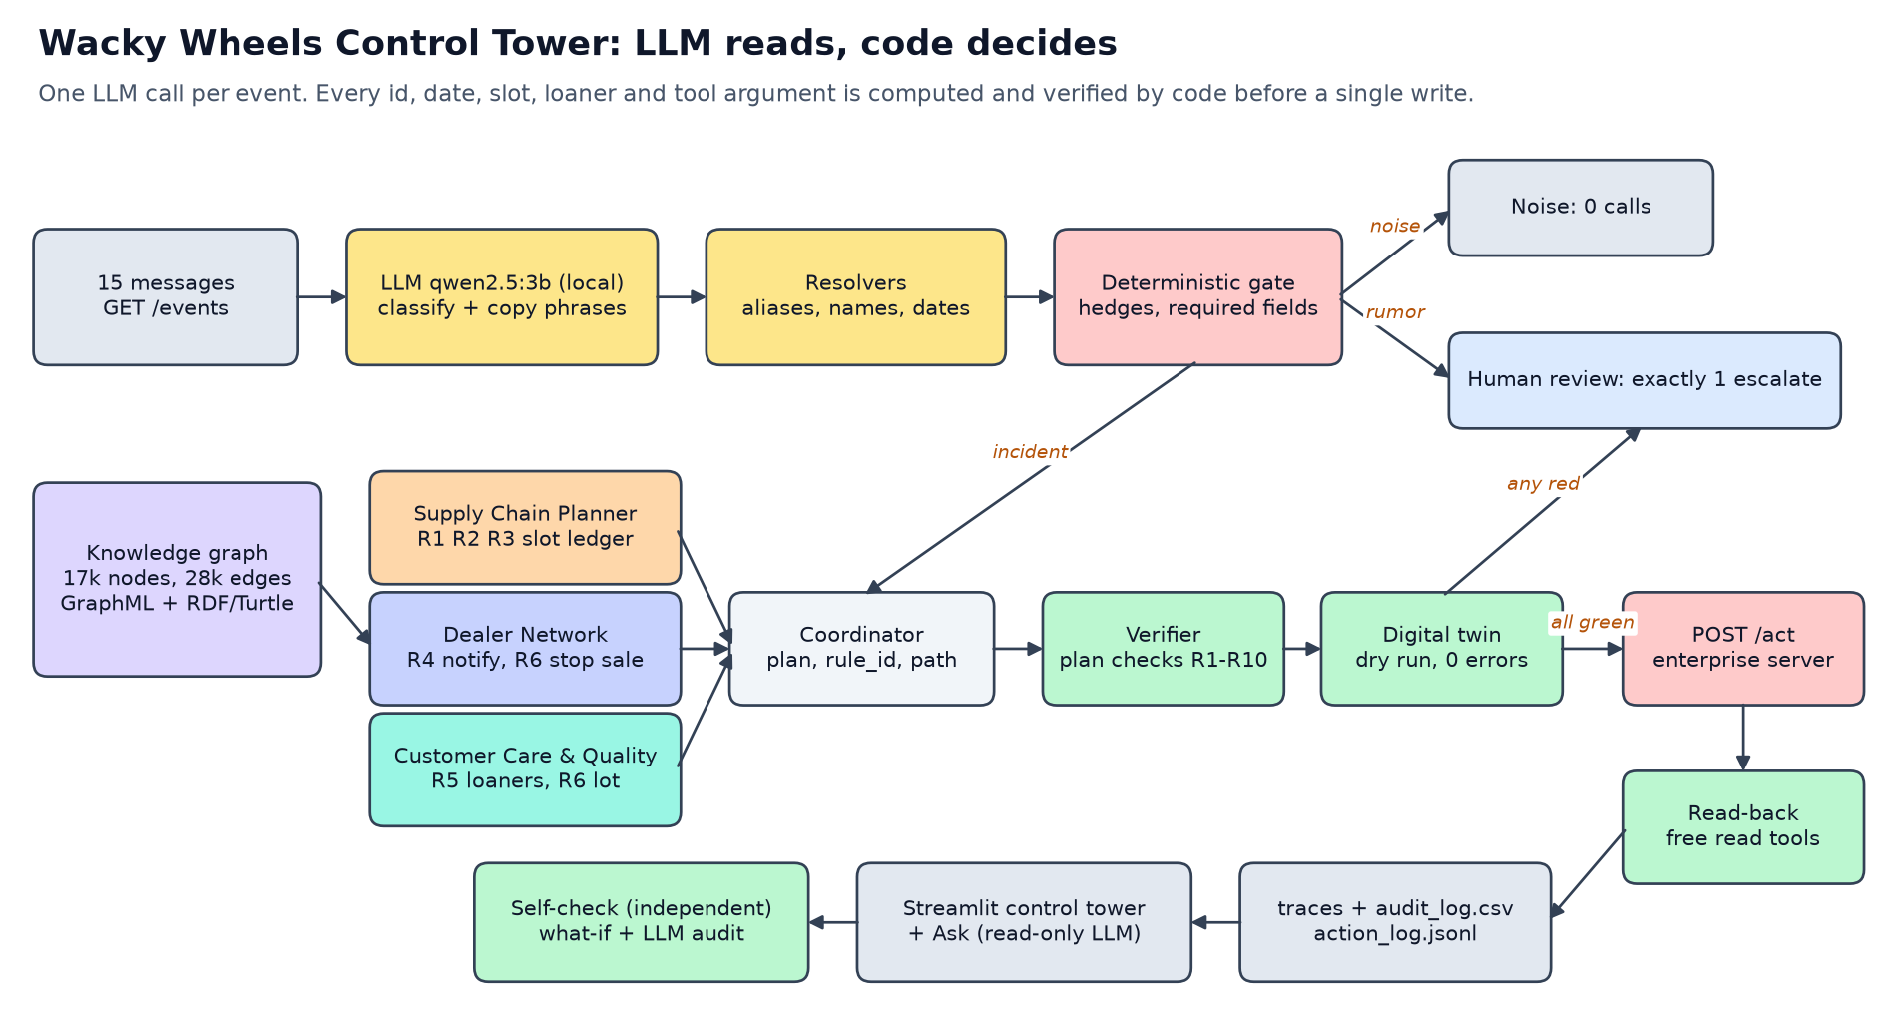
Architecture

Slide 4
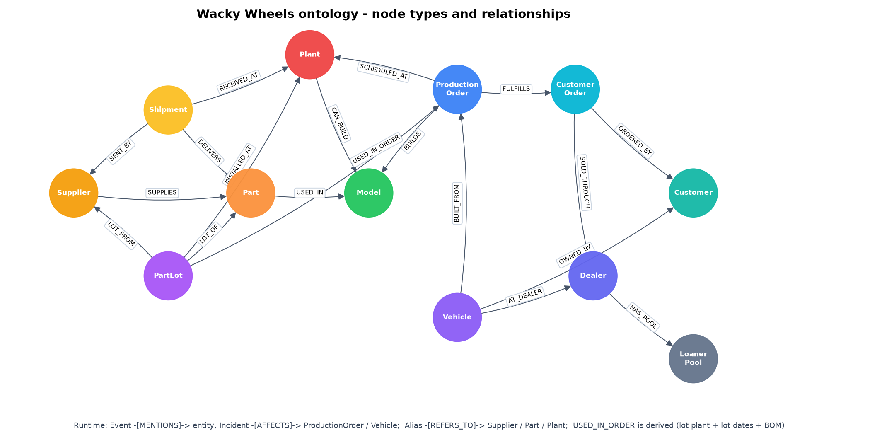
Knowledge graph and ontology
17,090 nodes, 28,301 edges; exported as GraphML and RDF/Turtle
• Every action cites a graph path
  – delay: Shipment -> Part -> Model <- ProductionOrder -> CustomerOrder -> Dealer
  – quality: Lot -[USED_IN_ORDER]-> PO <- Vehicle -> Dealer / Customer
• USED_IN_ORDER is derived from the handbook rule (lot plant + lot dates + BOM)
• Hash-seed independent traversal: the same path on every run

Slide 5
Guardrails: plan -> twin -> verify -> execute
• LLM output: pydantic schema, one retry, rule-based fallback, every phrase must be in the message
• Deterministic gate: hedge words, required fields, weekday/date consistency
• Write guard: noise and rumor events physically cannot call a write tool
• Verifier recomputes affected sets from the tables and checks R1-R10 before any write
• Digital twin dry run of the whole plan must have zero errors
• Live read-back after execution (193 free read calls), human-in-the-loop inbox for escalations
• Independent self-check re-grades the action log with separate code

Slide 6
Results
Real run against the organizer server
Check | Result
Tool calls | 961 (766 writes, 193 reads, 2 escalations)
Failed calls | 0
Self-check (independent) | 15/15 events green
Noise E-05, E-06, E-07 | 0 calls
Rumors E-02, E-13 | exactly 1 escalate each
Unit tests | 92 passed
LLM | qwen2.5:3b-instruct, 15 calls, 17,149 prompt + 2,267 completion tokens

Slide 7
Where the LLM hallucinated, and what caught it
Finding | Caught by | Effect
E-01 plant extracted as "the line" | resolver: did not resolve, re-scanned quote | P_TX from "San Antonio"
11 fields left empty by the LLM | code scans the evidence quote | filled from the text
4/15 rationales ungrounded ("menu line", non-existent "other" item) | grounding check | decision reasons written by code
Ask panel: "Thursday Apr 1" -> 2023-04-01 | argument grounding | code corrected to 2027-04-01
Graph path changed between runs | hash-seed test | sorted BFS, deterministic
• 0 invented ids, 0 phrases that are not in the message, 0 wrong writes

Slide 8
Thought process: open questions as switches
Each alternative re-planned and diffed (eval/what_if.py); all stay 15/15 green
Question | Our default | Alternative | Writes changed
Transfer before the disruption ends? | earliest slot from today | only after restart | 5 transfers
Earliest day or plant by plant? | earliest day | plant by plant | 0
Competing orders for one slot | original build date | delivery (promise) first | 2 (E-11)
Dealer hit by both digest incidents | 1 notify per event | 1 per incident | +15 (E-01)
"next Friday" on Mon Mar 8 | Mar 19 | Mar 12 | 140 (E-01 invalid)
• Real-world prioritisation across incidents: weigh units at risk, promises inside the disruption, Platinum/Gold exposure

Slide 9
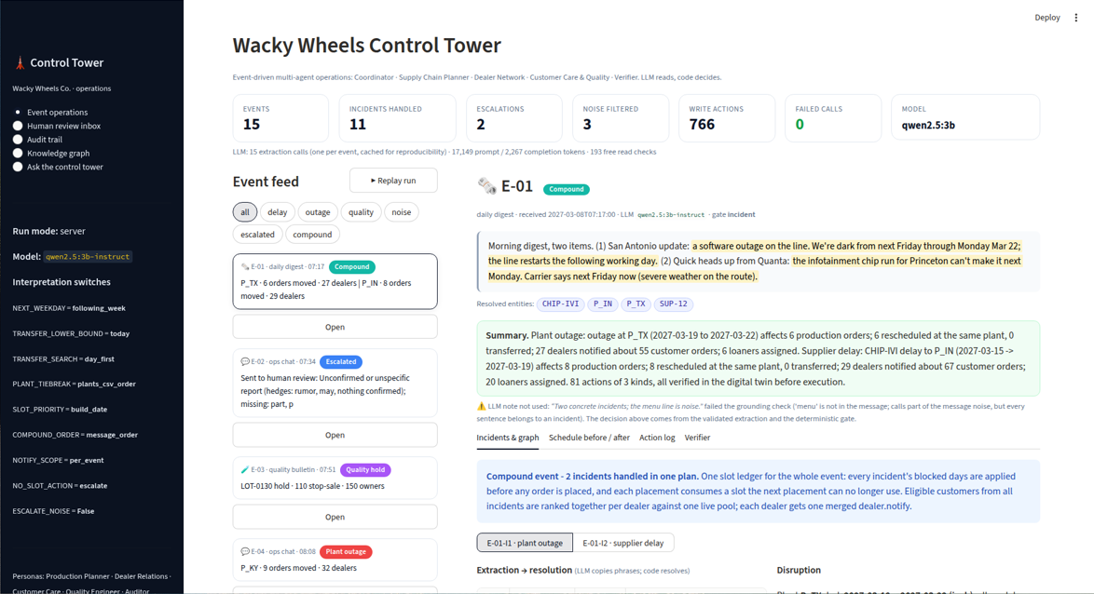
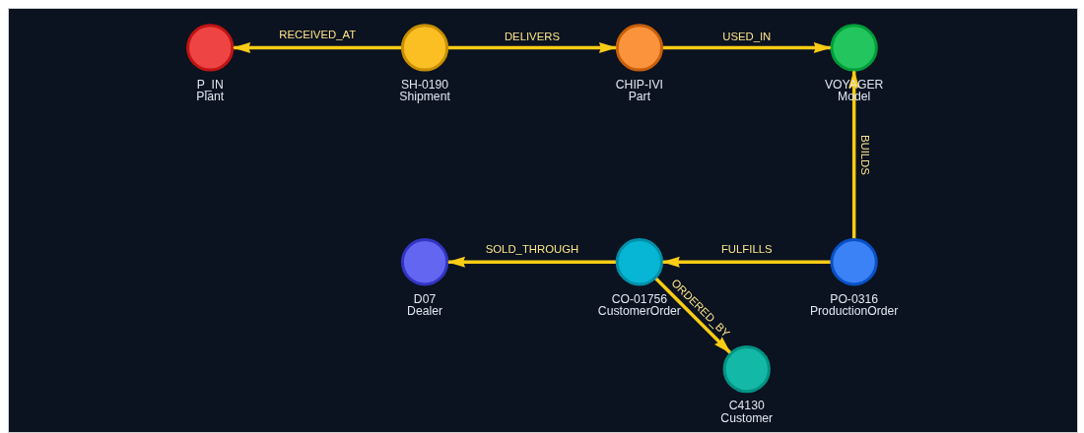
The control tower UI
Event feed, graph path, schedule before/after, action log, verifier, audit trail, Ask

Slide 10
DevOps and reproducibility
• One command per step: pytest, dry run, real run, self-check, UI
• LLM outputs cached by hash of model + prompt + message: re-runs are bit-identical
• Every trace records the interpretation switches it ran with
• Local model via Ollama, any OpenAI-compatible endpoint via env vars, rule-based fallback
• Next: CI that runs dry run + self-check on every change, approval gate for high-impact actions, metrics on calls/latency per agent

