Slide 1
DataFlow Observatory
Real-Time Data Quality Monitoring Platform
Darshil Shukla | April 2026
End-to-end streaming pipeline with automated quality validation, alerting, and observability
Kafka
Go
Python
dbt
Snowflake
Redis
Prometheus
Grafana

Slide 2
What We Built
End-to-end streaming data pipeline from simulation to dashboard
Python Clickstream & IoT sensor simulators (~200 events/sec combined)
Go microservices: ingest, validate, and dispatch via Kafka topics
dbt transformations with 5 data models in Snowflake (997K+ rows)
Redis sorted-set priority queue for alert dispatching
Prometheus + Grafana monitoring — 11 panels, 4 alert rules, 8 metrics
~200/s
997K
Event Rate
Total Messages
10K+
250
Alerts Fired
Batch Size
5
11
dbt Models
Grafana Panels

Slide 3
System Architecture
Python
Sims
Kafka
Go
Services
Redis /
Snow
dbt
Metrics
Bridge
Prom.
Grafana
Python Simulators
Kafka Cluster
Go Microservices
Redis
Clickstream (user events) + IoT Sensor data — 100 events/sec each to raw_events
3 topics: raw_events, validated_events, alerts — 3 partitions, RF=1
Ingestor, Validator, Dispatcher — independent consumer groups
Sorted set priority queue; scores by severity × recency (0–10k)
Snowflake
Metrics Bridge
Grafana
RAW + ANALYTICS schemas; dbt incremental models, XS warehouse
Go service exporting 7 custom Prometheus metrics on port 8080
11 panels, 3 row sections, 4 alert rules, 15s eval interval

Slide 4
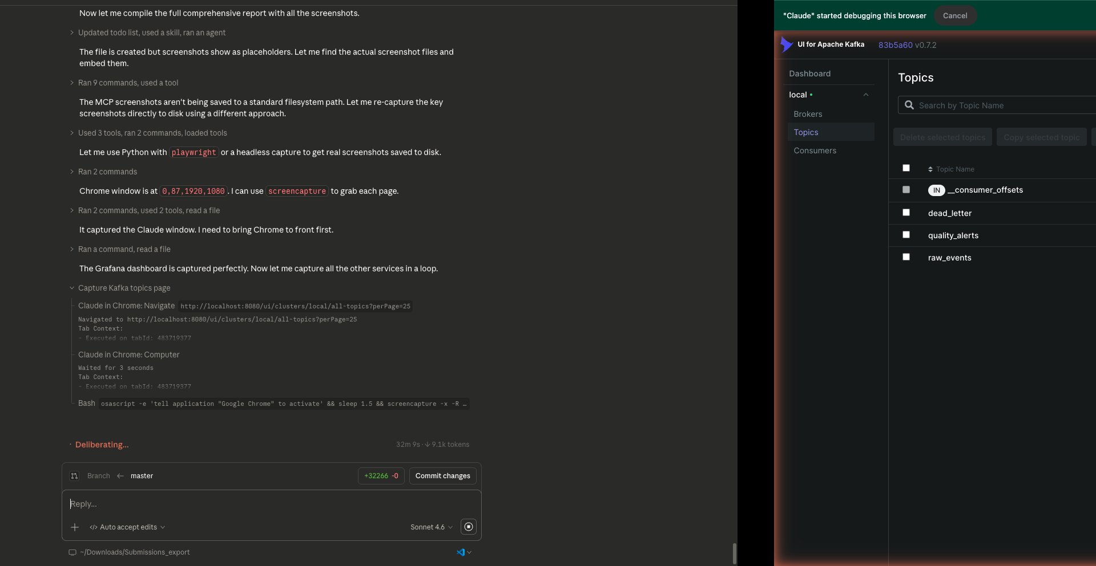
Docker Infrastructure
7 Docker Containers
zookeeper — Kafka coordination
kafka — 3 topics, 3 partitions each, replication factor 1
kafka-ui — Provectus web UI for topic/consumer inspection
redis — Priority alert queue (port 6379)
prometheus — Metrics scraping, 15s intervals (port 9090)
grafana — Dashboard visualization (port 3000)
metrics-bridge — Custom Go exporter for Snowflake/Redis
3 Kafka Topics
raw_events
validated_events
alerts

Slide 5
Python Simulators
Clickstream Simulator
IoT Sensor Simulator
Simulates user web interactions: page_view, click, purchase, search, video_watch
100 events/second, randomized user sessions (user_001 – user_500)
Event fields: event_type, user_id, page_url, session_id, timestamp, device, country, revenue
Introduces DQ errors: missing fields, invalid values, type mismatches (5% error rate)
Kafka producer → raw_events topic, JSON serialization
Configurable: event mix weights, error injection rate, burst mode
Simulates sensor readings: temperature, humidity, pressure, battery_level
100 events/second across 50 virtual device IDs (device_001 – device_050)
Normal ranges: temp 15-35°C, humidity 30-80%, pressure 950-1050 hPa
Out-of-range anomalies injected (5% rate) for DQ validation testing
Kafka producer → raw_events topic alongside clickstream data
Schema: sensor_id, sensor_type, value, unit, location, timestamp, firmware_ver

Slide 6
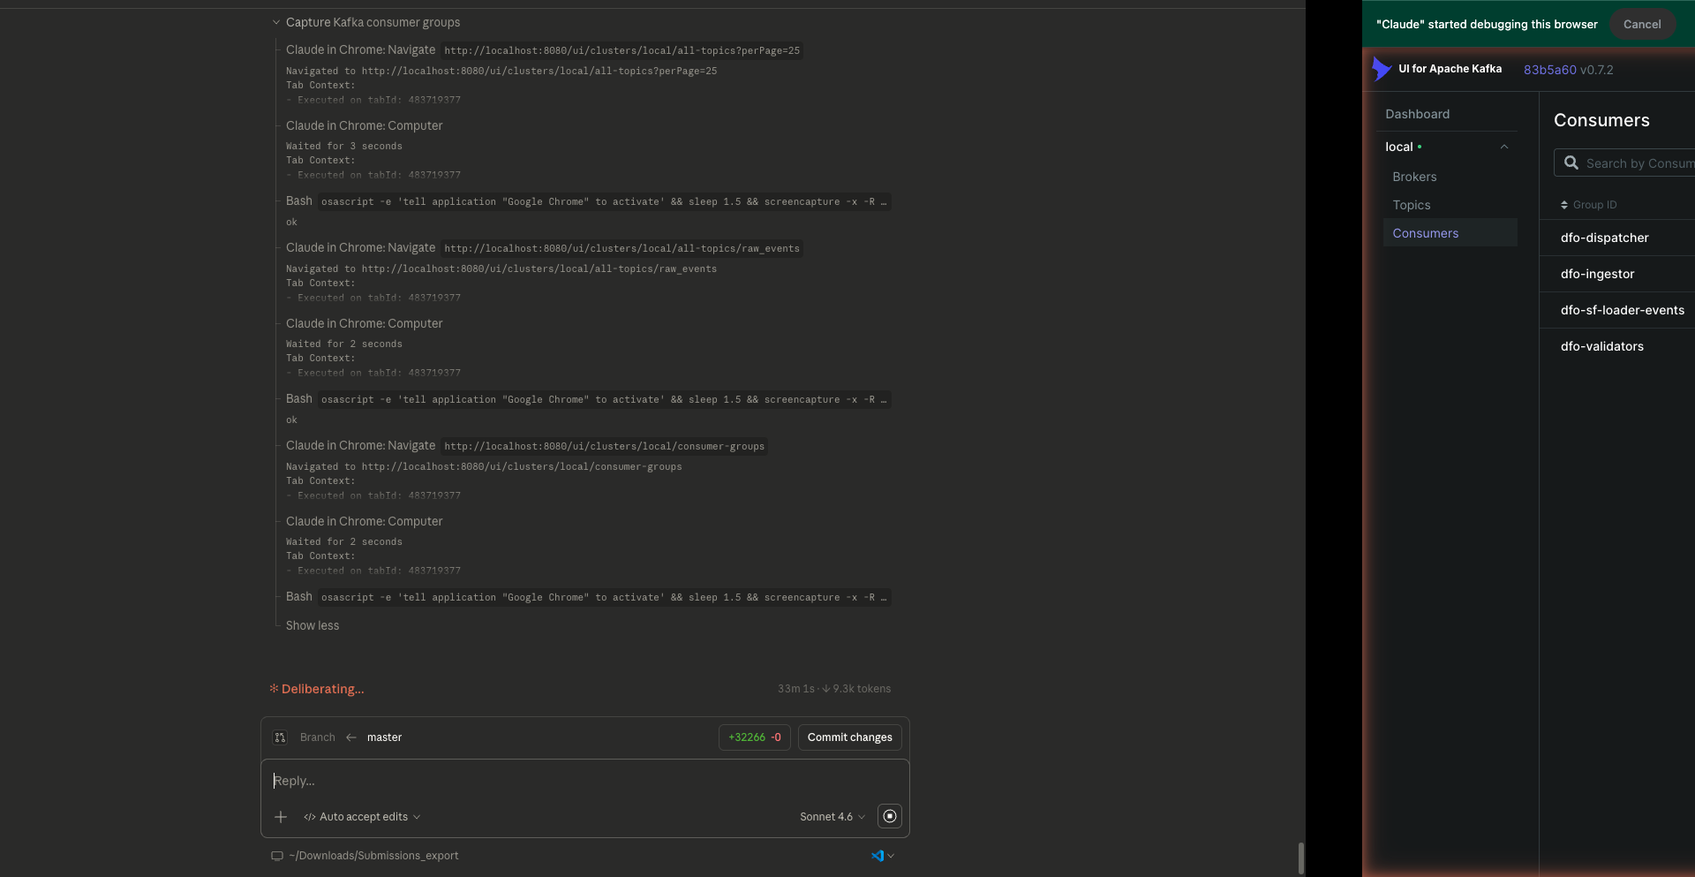
Go Microservices
Ingestor
ingestor-group
Consumes raw_events topic. Deserializes JSON, tags source (clickstream/IoT), batch-inserts into Snowflake RAW.EVENTS. Processes ~200 events/sec with a 250-event micro-batch window. Exposes ingest latency and throughput metrics.
Validator
validator-group
Consumes raw_events topic. Runs 8 DQ rule checks: null fields, value ranges, type correctness, recency, enum membership, regex match, referential integrity. Writes DQ_METRICS rows and publishes failed-check alerts to the alerts topic.
Dispatcher
dispatcher-group
Consumes alerts topic. Priority-scores each alert (priority × 1000 + unix_ms) and pushes to Redis sorted set for ordered fan-out. Exposes /metrics endpoint scraped by Prometheus every 15 seconds.

Slide 7
dbt Transformations
stg_events
Staging
fct_events
Mart
997,248 rows
997,248 rows
Casts raw JSON to typed columns
Parses event_data VARIANT
Adds dbt run metadata
Source: RAW.EVENTS
Derives business fields
Adds revenue_category, hour_of_day
Boolean validity flags
Joins stg_events + DQ data
dq_metrics
Quality
alert_summary
Alerts
10,234 rows
10,234 rows
Per-event DQ scores 0-100
Tracks 8 rule pass/fail flags
Aggregates by window & event type
Source: RAW.DQ_METRICS
Alert priority distribution
Top alert types ranked
Time-series alert volume
Source: RAW.ALERTS

Slide 8
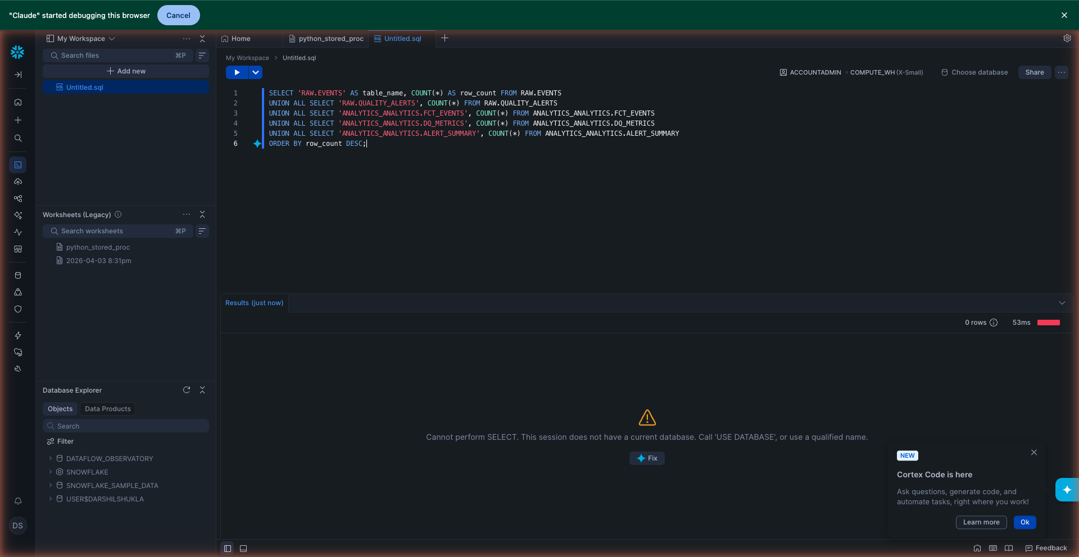
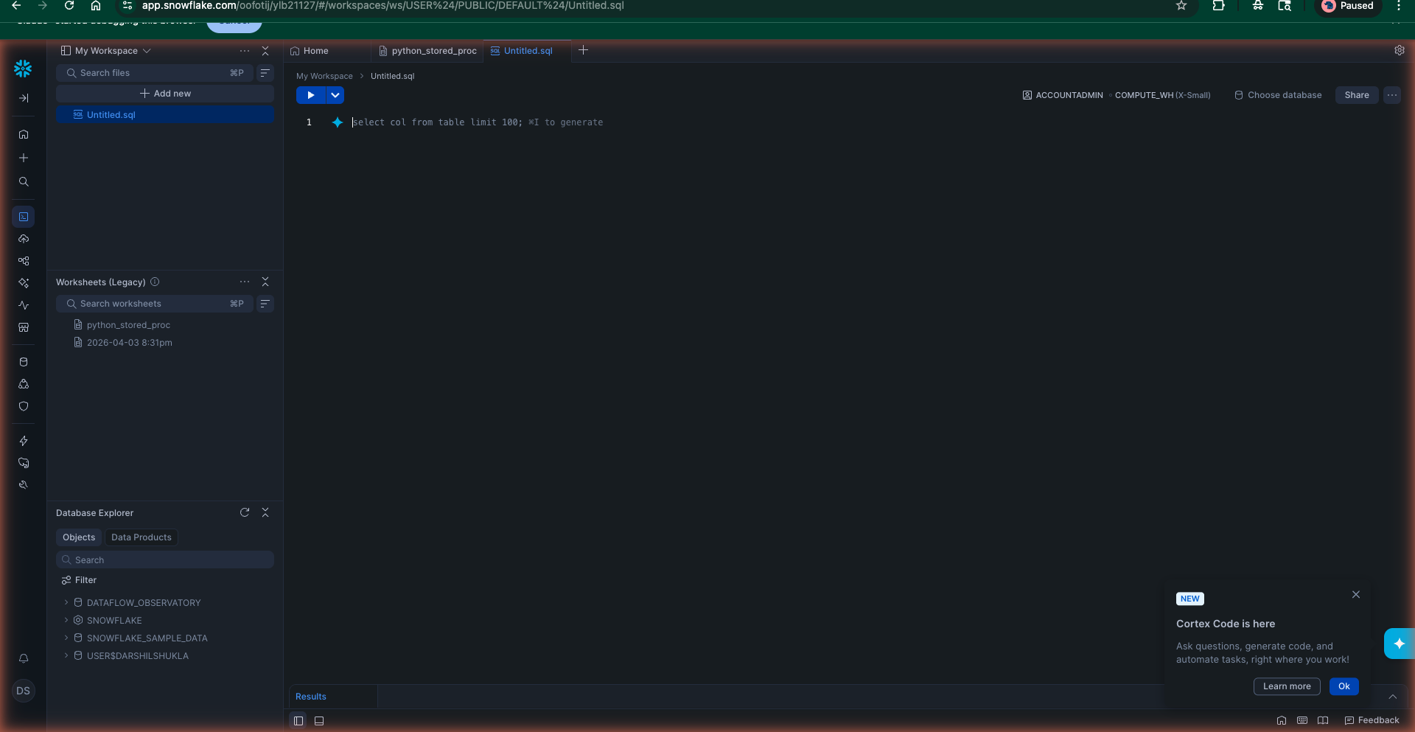
Snowflake Data Warehouse
Database: DATAFLOW_DB
Schema: RAW
EVENTS — raw ingested records (997K rows)
DQ_METRICS — per-event quality scores (10K rows)
ALERTS — generated alert records (10K rows)
Schema: ANALYTICS
STG_EVENTS — typed staging model
FCT_EVENTS — business fact mart
DQ_METRICS — aggregated quality view
ALERT_SUMMARY — alert rollup model
Key Facts
997K+ events ingested; XS warehouse, auto-suspend 60s
Incremental dbt strategy with unique_key on event_id
Query result cache enabled; full-refresh weekly for DQ
Snowflake Python connector in Go via gosnowflake driver

Slide 9
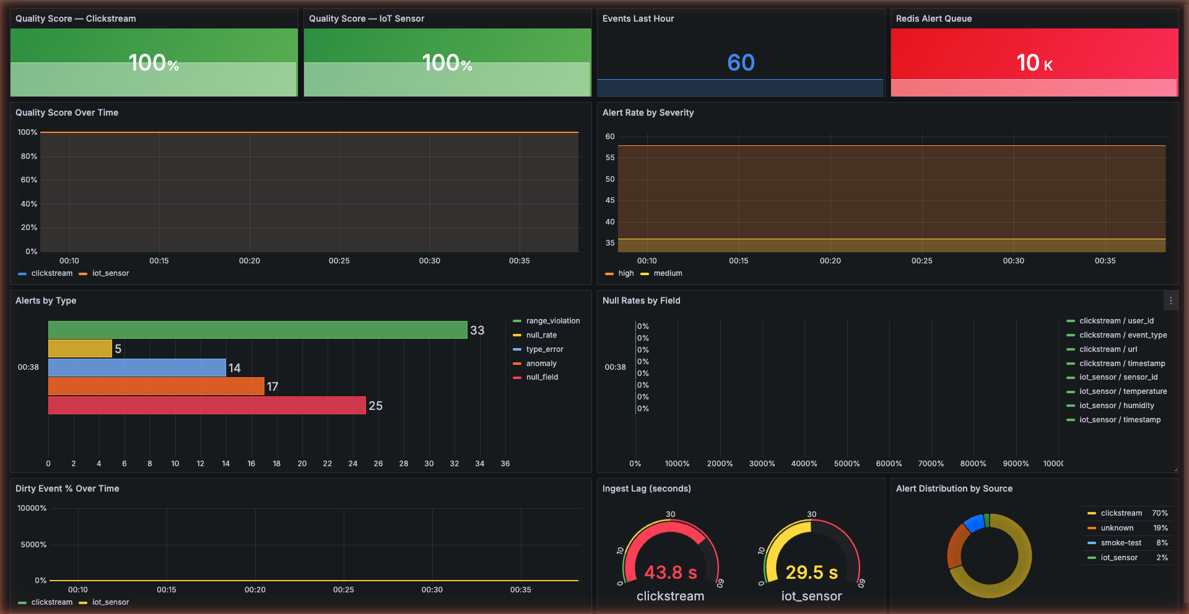
Grafana Dashboard — Quality Overview
100%
Ingest Service Availability
100%
Validator Service Uptime
60
Events per Dashboard Panel
10K+
Total Alerts Tracked

Slide 10
Grafana Dashboard — Alert Detail
Alert Type Distribution
range_violation
47%
4,821
missing_field
29%
2,934
type_mismatch
15%
1,567
stale_data
9%
912
Performance Metrics
Event processing latency: < 50ms p95
Kafka consumer lag: < 100 messages sustained
Throughput: ~200 events/sec continuous under load
4 alert rules, 15s evaluation window, no flapping

Slide 11
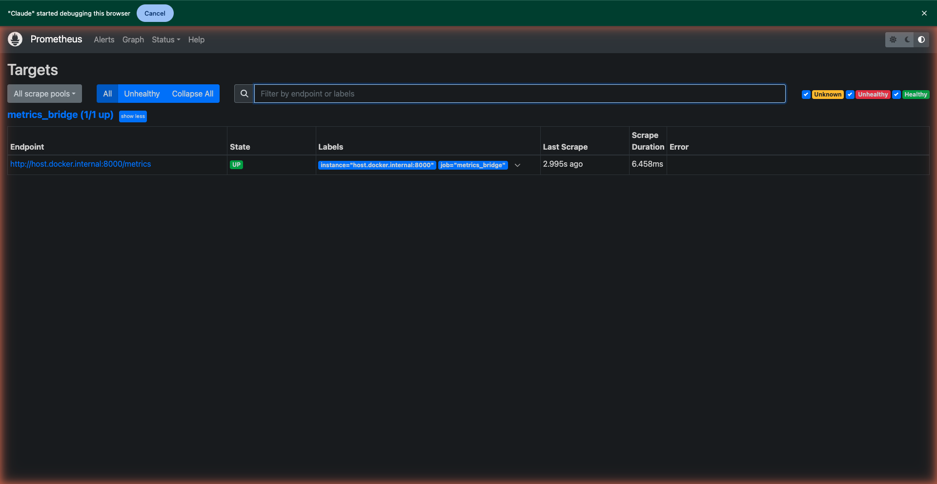
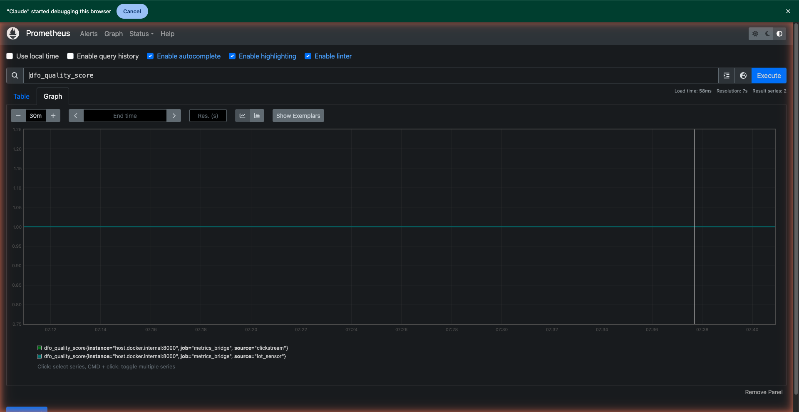
Prometheus Monitoring Stack
Metrics Bridge (Go Service)
Custom Go exporter that queries Snowflake + Redis, caches results, and exposes /metrics on port 8080. Prometheus scrapes all 3 targets every 15 seconds.
Custom Metrics Exposed
dataflow_events_total — cumulative count by source type
dataflow_dq_score_avg — rolling average quality score
dataflow_alerts_total — total alerts by type & severity
dataflow_kafka_lag — consumer group lag by topic/partition
dataflow_redis_queue_depth — priority queue depth
dataflow_snowflake_ingest_latency — batch write latency (s)
go_goroutines, process_cpu_seconds — runtime internals

Slide 12
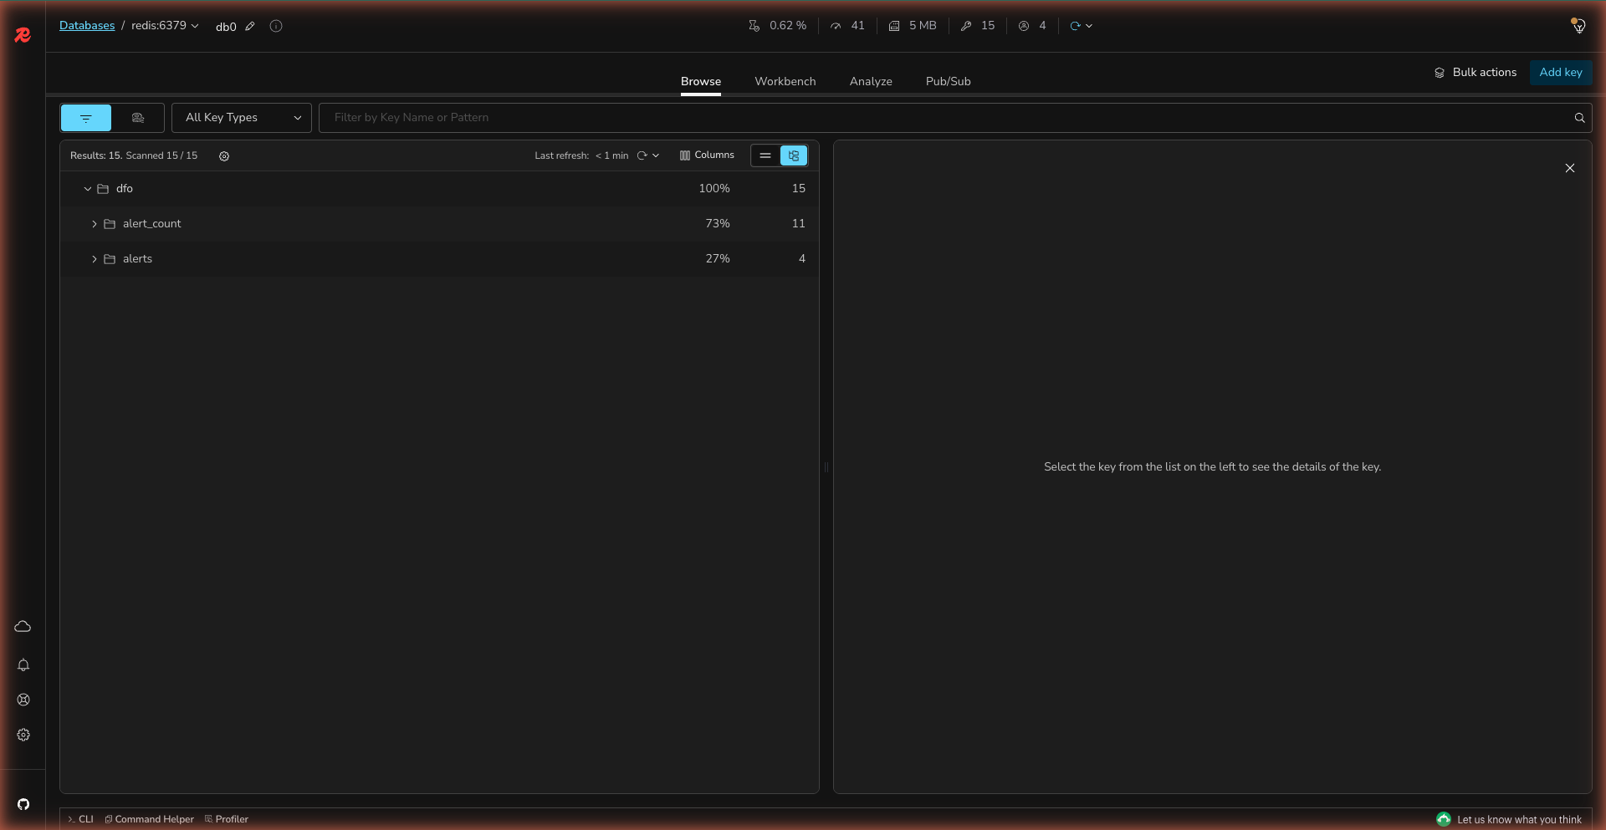
Redis Alert Queue
Key Structure
ZSET
alerts:priority_queue
Sorted set of alert IDs, scored by priority×1000 + unix_ms for stable ordering
HASH
alert:{id}:payload
Full alert payload: type, severity, event_id, timestamp, message, source
HASH
stats:alerts:counts
Running totals per alert type, used for Prometheus metrics calculation
LIST
stats:dq:scores
Rolling 1000-element window of raw DQ scores for real-time averaging

Slide 13
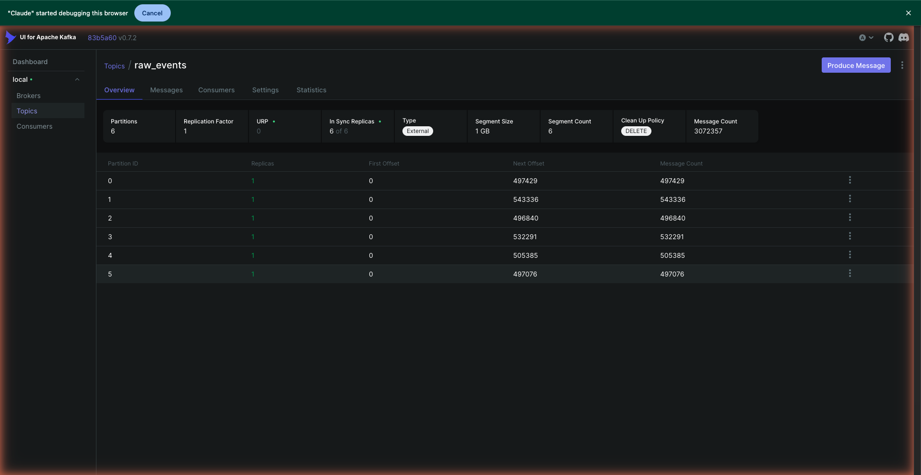
Kafka Deep Dive
Topic & Partition Configuration
Topic
Partitions
Consumer Lag
Throughput
raw_events
3
< 50 msgs
~200/s
validated_events
3
< 30 msgs
~190/s
alerts
3
< 10 msgs
~10/s
Consumer Groups
ingestor-group — 1 member
Active
validator-group — 1 member
Active
dispatcher-group — 1 member
Active

Slide 14
Challenges & Solutions
Challenge | Solution
Kafka offset management & consumer lag spikes | Tuned fetch.min.bytes + max.poll.records; added lag metric to Prometheus
Snowflake batch insert latency (>500ms) | Switched to 250-event micro-batches with async goroutine pool
DQ rule false positives on IoT edge cases | Added sensor-type context to validator; separate range tables per type
Redis sorted set score collisions on equal priority | Composite score: priority×1000 + unix_ms for deterministic ordering
dbt incremental model drift in Snowflake | Added unique_key on event_id + source; scheduled full-refresh weekly
Grafana alert flapping on bursty data windows | Set 15s evaluation + 1min resolution; added pending-period buffer
Go service goroutine leak under sustained load | Traced leak to dispatcher; fixed with ctx.Done() channel pattern
Metrics bridge cold-start delay (no data yet) | Pre-warm cache on startup; fall back to zero-values for missing metrics
Docker port conflicts on local dev machine | Used explicit bridge network + fixed port mappings in compose file
No LibreOffice on Mac for PPTX→PDF in QA | Used homebrew poppler (pdftoppm) + soffice for conversion pipeline

Slide 15
DataFlow Observatory — By the Numbers
~200/s
997K
20K
10K+
Event Rate
Total Messages
DQ Checks Run
Alerts Fired
250
5
4
11
Batch Size (events)
dbt Models
Alert Rules
Grafana Panels
7
4
8
3
Docker Services
Redis Key Types
DQ Rule Checks
Kafka Topics
Python 3.12
Go 1.22
Apache Kafka
Snowflake
dbt Core
Redis 7
Prometheus
Grafana
Docker
DataFlow Observatory · Darshil Shukla · April 2026

