Slide 1

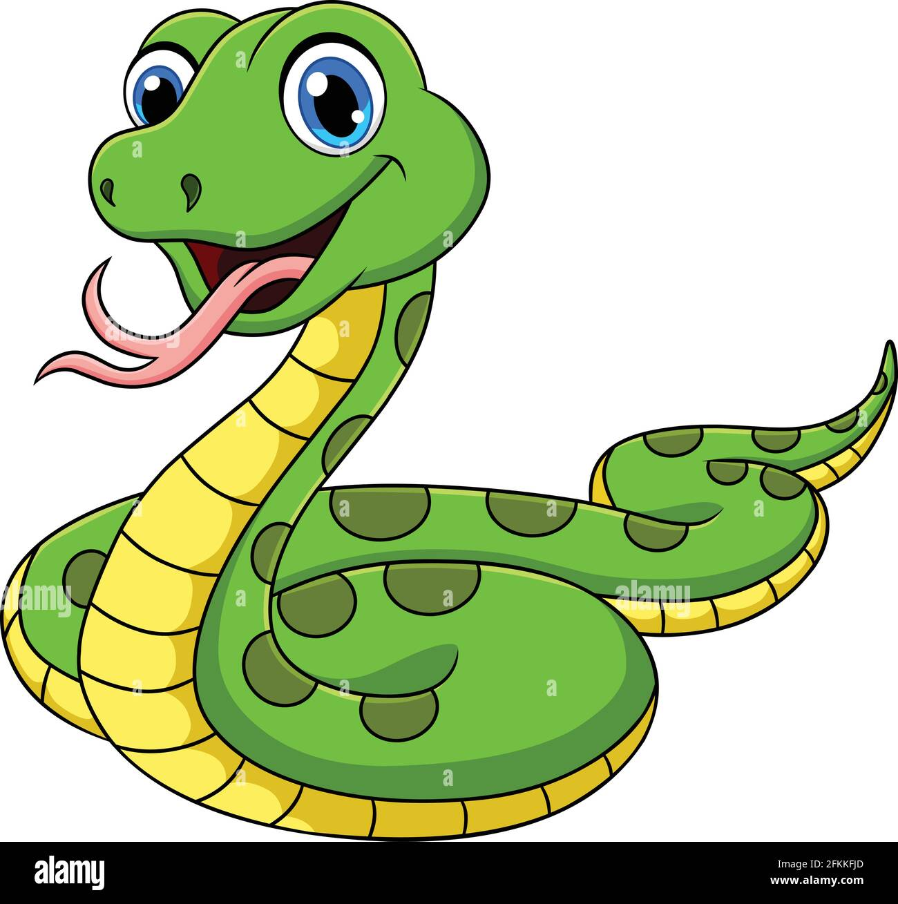
Snack game
Name : Darshit Dandnayak
Class : B3
Roll Number : 87
Branch : CSE

Slide 2
Overview about snackgame
The Snake game in Python is controlled with the four direction buttons on our keyboard concerning the direction in which the snake runs with the clear goal of eating maximum food and eventually scoring maximum points until the snake strikes the wall or itself.
The Snake game in Python has a clear objective of catching the maximum number of fruits without hitting the cross border or the wall as they say.

Slide 3
Concepts
In this game, we use mainly three module :
os module =>for creating the ‘highscore .txt’ file ,
random module =>food at random place over the display, and
Pygame.events =>to hadle the events!

Slide 4
Concepts
Here, We mainly use some basic python concepts like list!
Whenever, the snake is eating fruit, we add one extra pixel (or you can say rectangle) to it with the help of list!
For collision detection, we just simply check that whether the snake_list have and co-ordinates which are already in the list or not!

Slide 5
Workings
Controls :
Up arrowkey => for going in upper direction
Down arrowkey => for going in down direction
Left arrowkey => for going in left direction
Right arrowkey => for going in right direction
Cheat Control :
Press any control key two times for double speed!

Slide 6
Thank you

