Slide 1
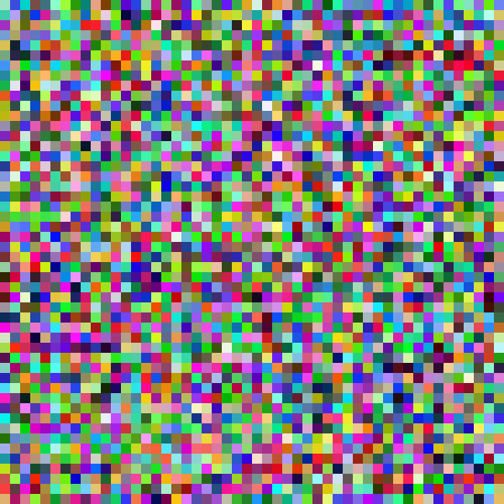


LINE 3 · APPLIED GENERATIVE VISION + MULTIMODAL
Generative Adversarial Networks
Class 1 · The GAN framework: generator, discriminator and the minimax objective
random noise in → a brand-new flower out
Generative Models · GANs · Notebook: CV-Week4-Lecture1.ipynb · 85 min concepts + 60 min notebook + 5 min exit ticket
Notes:
BEFORE CLASS: open CV-Week4-Lecture1.ipynb, run the first cell once so MNIST is already downloaded, and keep this deck in Present mode. Every animated slide advances on click; notes mark each [CLICK]. TIME: 0:00–0:30. SAY: "Good morning. Today we start a new unit: Generative Models. Over the next three classes we study GANs. Today is the foundation: what a GAN is, the two networks inside it, and the game they play. In the last hour you will run and explore a real GAN in the notebook." Point at the picture on the right: "By the end of today you will understand how a network can turn a square of random noise like this into a brand-new picture, and why that works." Mention the plan quickly: about 85 minutes of ideas (including the MNIST dataset), 60 minutes of hands-on notebook, 5 minutes of exit ticket. Ask students to keep laptops closed until the notebook section, so they follow the story first. NOTE ON VISUALS: all flowers in this deck are drawn illustrations made for teaching. They are not outputs from a trained GAN. Say that once, early, so nobody is misled.

Slide 2




WARM-UP QUESTION
Can a computer paint a flower that never existed?
What we show the computer: examples of real flowers
A new one it makes
Copying is easy. Creating new samples that look like they came from the same collection is the hard part, and it is exactly what a GAN learns to do.
Notes:
TIME: 0:30–2:00. SAY: "Here are four flowers. Imagine thousands of photos like these. Question: can a computer paint a fifth flower that is not in the collection, but looks like it belongs there?" Let two or three students answer. Accept ideas like "copy and mix", "average them", "use a neural network". [CLICK 1] The irregular orange flower pops in. "This one is new. It is not any of the four. But it clearly looks like a flower from the same garden." [CLICK 2] Read the sentence. Stress two points: - Copying a training photo is trivial and useless. Averaging photos gives a blurry mess. - The real goal is to make new samples that look as if they came from the same collection. In ML language we will soon call the collection a "data distribution". Bridge: "Today we learn one of the most famous ideas for doing this: the Generative Adversarial Network, or GAN, introduced by Ian Goodfellow and colleagues in 2014." Reminder: these flowers are illustrations drawn for this class, not GAN outputs.

Slide 3
TODAY'S ROUTE · ABOUT 150 MINUTES
One story, told in seven steps
01
02
03
04
05
06
07
What GAN stands for
Meaning of adversarial
One running example
The Generator
The Discrim­inator
Training and losses
MNIST + notebook
min 4–15
min 15–27
min 27–30
min 30–42
min 42–53
min 53–81
min 81–145
Name → meaning → one example → the two players → how they train → run it in code. Then a 5-minute exit ticket (min 145–150).
Notes:
TIME: 2:00–3:00. SAY: "Here is our route. It is one story, not seven topics." [CLICK 1] 01, what the letters G-A-N stand for. [CLICK 2] 02, the word "adversarial", because it is the most important and most misunderstood word in the name. [CLICK 3] 03, one running example we will use all class: a flower forger. [CLICK 4] 04, the Generator in detail. [CLICK 5] 05, the Discriminator in detail. [CLICK 6] 06, how the two are trained together: losses and the minimax objective. [CLICK 7] 07, first a short introduction to the MNIST dataset, then 60 minutes in the notebook CV-Week4-Lecture1.ipynb, where the same game is played on handwritten digits. [CLICK 8] Read the one-line summary. "Every step builds on the previous one. If you get lost, come back to the flower forger." Further-study resources are on the last slide.

Slide 4
LEARNING OUTCOMES
By the end of today you can…
1
Expand GAN and explain what each word, especially adversarial, means.
2
Describe the generator and the discriminator: input, output and goal.
3
Read the minimax objective and say which network pushes each term up or down.
4
Run a small GAN on MNIST and point to the D step and the G step in the code.
GAN Class 1 · Opening · min 3–4
Notes:
TIME: 3:00–4:00. SAY: "These four things are what the exit ticket at the end will check. Keep them in mind." [CLICK 1] Outcome 1: the name. Sounds simple, but "adversarial" is where most confusion comes from. [CLICK 2] Outcome 2: the two players. Notice the colours: BLUE is always the generator, ORANGE is always the discriminator for the whole deck. Point this out explicitly. It helps students track who is who on every diagram. [CLICK 3] Outcome 3: the minimax equation. "It looks scary. By the time we reach it you will already know what it says in words." [CLICK 4] Outcome 4: code. "You will see that the whole GAN is about 40 lines of PyTorch." Prerequisites to check with a quick show of hands: a neural network forward pass, a loss function, backpropagation and an optimizer step. If many students are unsure about binary cross-entropy, promise that we will revise it in section 06.

Slide 5
01
What does GAN stand for?
Three words, three ideas. We take them one at a time.
GAN Class 1 · min 4–15
Notes:
TIME: 4:00. Section 01 runs from minute 4 to minute 15. SAY: "Before any maths, let's decode the name. G, A, N. Each letter tells us something real about how the model works. If you remember the name properly, you already remember half of the idea." Ask the class: "Has anyone heard the term GAN before? Where?" (Typical answers: deepfakes, AI-generated faces, "This person does not exist", image apps.) Take one or two answers, then move on.

Slide 6
01 · THE FULL FORM
GAN = Generative Adversarial Network
G
A
N
Generative
Adversarial
Network(s)
It creates new data: new images, not labels. Output is a picture.
It learns through a contest between two opponents.
Both players are neural networks, trained with backpropagation.
Question it answers: "What could a new sample look like?"
Section 02 unpacks this word.
Not one network: two.
GAN Class 1 · 01 What GAN stands for · min 4–6
Notes:
TIME: 4:00–6:00. SAY: "GAN is short for Generative Adversarial Network. You will also see Generative Adversarial Networks in the plural, because a GAN always contains two networks. Write the full form in your notebook now." [CLICK 1] G, Generative. "The model's job is to generate: to create new data. The output is a new image, not a label like 'cat' or 'digit 7'. The question it answers is: what could a new sample look like?" [CLICK 2] A, Adversarial. "This is the heart of the idea. The model learns through a contest between two opponents. An adversary is an opponent. We spend all of section 02 on this word, so just hold on to 'contest' for now." [CLICK 3] N, Network. "Both players are ordinary neural networks: layers, weights, activations, trained by backpropagation and gradient descent. Nothing new here. The new part is how the two are wired together and trained against each other." Quick check: "So how many neural networks are inside one GAN?" Expected answer: two, a generator and a discriminator. Historical note (optional): Ian Goodfellow and colleagues introduced GANs in the 2014 paper "Generative Adversarial Nets".

Slide 7


01 · THE G IN GAN
Discriminative models label. Generative models create.
DISCRIMINATIVE (WHAT YOU KNOW)
Input: an image
Output: a label
Learns p(label | image)
Classifier
"flower"
GENERATIVE (TODAY)
Input: random numbers
Output: a new image
Learns to sample like p(image)
Generator
GAN Class 1 · 01 What GAN stands for · min 6–9 · notebook cell 1
Notes:
TIME: 6:00–9:00. This matches the first markdown cell of CV-Week4-Lecture1.ipynb ("Discriminative models classify inputs; Generative models synthesize new ones"). SAY (top row, already visible): "Everything you have built so far in this course is discriminative. You give a classifier an image, it gives you back a label: 'flower', 'cat', 'digit 7'. Mathematically it learns p(label | image): given this image, how likely is each label?" [CLICK 1] The noise square appears. "A generative model starts from something very different: a handful of random numbers." [CLICK 2] The generator box. "It passes them through a network we call the Generator." [CLICK 3] A new flower pops out. "And the output is a whole new image. Not a label: every pixel." KEY POINT: "A classifier answers 'what is this?'. A generator answers 'show me a new one'. The second is much harder: the output has thousands of numbers (every pixel), and they all have to agree with each other to look like a flower." ASK: "If a model outputs the word 'seven', has it generated a digit?" Expected answer: no, it has only labelled one. "What must the output contain instead?" Expected: all the pixel values, e.g. 28×28 = 784 numbers for an MNIST digit. We will see exactly this 784 in the notebook. Applications from the notebook: image synthesis, data augmentation, creative AI. Others: predicting the next frame of a video and image enhancement (super-resolution).

Slide 8
01 · WHY LEARN GANS?
What GANs are used for
New images
Image-to-image
Super-resolution
Realistic faces, objects and scenes that never existed (e.g. the StyleGAN family).
Sketch → photo, day → night, horse → zebra (pix2pix, CycleGAN).
Low-resolution photo → sharper, higher-resolution version (SRGAN).
Data augmentation
Video and art
A caution
Extra synthetic training images when real ones are rare or private.
Predicting the next video frame; creative tools and generative art.
The same power makes "deepfakes" possible. Detecting fakes is itself a research area.
GAN Class 1 · 01 What GAN stands for · min 9–11
Notes:
TIME: 9:00–11:00. Motivation slide: why this topic matters. [CLICK 1] New images. "GANs became famous for photo-realistic faces of people who do not exist. The best-known family is StyleGAN from NVIDIA." [CLICK 2] Image-to-image translation. "Instead of noise, give the generator an image as input and ask for a transformed image: a sketch becomes a photo, a daytime street becomes night. pix2pix learns this from paired examples; CycleGAN learns it without pairs, e.g. horses to zebras." [CLICK 3] Super-resolution. "SRGAN turns a small, blurry photo into a sharper, larger one. The adversarial loss pushes it to produce realistic texture instead of blur." [CLICK 4] Data augmentation. "When real data is scarce or private (rare diseases, rare defects in factories), synthetic samples can add variety to a training set. The notebook lists this as an application." [CLICK 5] Video and art. "Predicting what the next frame of a video looks like, and creative tools for artists." [CLICK 6] A caution. "The same technology can produce convincing fake faces and videos. That is why detecting generated media is an active research area, and why we should use these tools responsibly." CONTEXT FOR STUDENTS: "Today, text-to-image systems mostly use diffusion models, which we study later in this module. But the adversarial idea is still used widely, for example in super-resolution and as an extra loss inside other generators. And GANs are the clearest way to learn how a network can be trained to generate." ASK: "Which of these could help a hospital that has only 200 X-rays of a rare condition?" Expected: data augmentation.

Slide 9
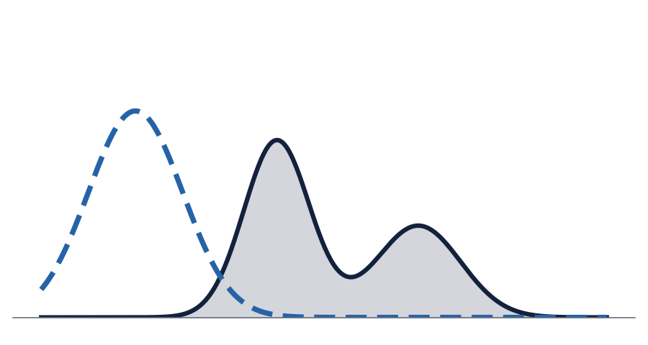
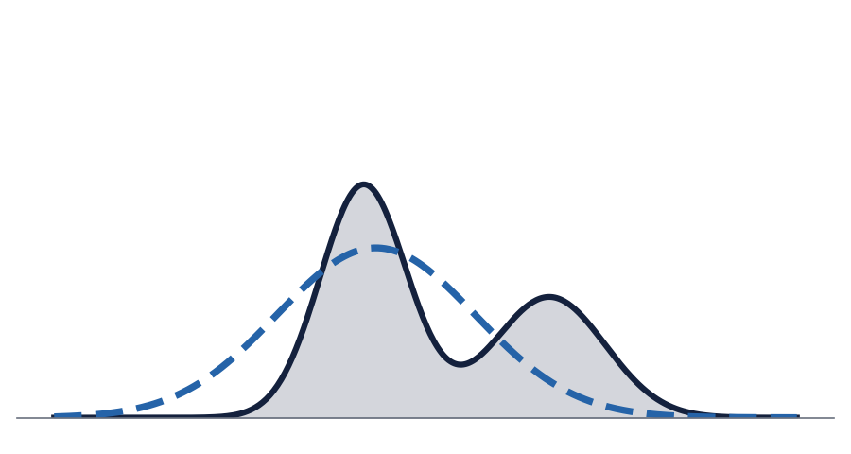
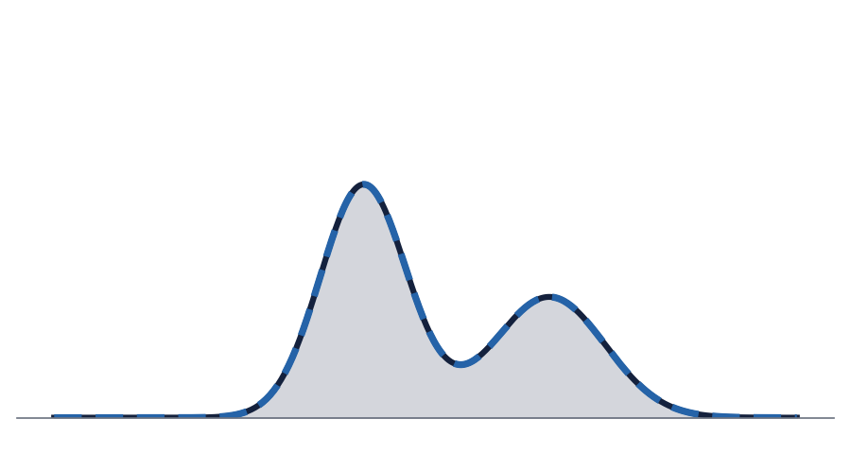
01 · WHAT "GENERATE" REALLY MEANS
Goal: make the model's samples follow the data's distribution
Every real flower photo is one sample from an unknown distribution p_data. We never see the formula, only examples.
The generator defines its own distribution p_g: whatever comes out when we feed it random noise.
Training = moving p_g until it sits on top of p_data. Then every new sample looks like it came from the real collection.
Solid navy = p_data (real flowers)
Dashed blue = p_g (generator)
GAN Class 1 · 01 What GAN stands for · min 11–13
Notes:
TIME: 11:00–13:00. SAY: "Let me make 'generate' precise. Think of all possible flower photos in the world. Some kinds are common (yellow daisies), some are rare. That pattern of what is common and what is rare is a probability distribution. We call it p_data. We never get its formula. We only get samples: our dataset." Point to the navy curve with two bumps: "Think of this as a 1-D cartoon of the real data: two popular kinds of flower." Stress that real images live in thousands of dimensions; this is a sketch. [CLICK 1] Dashed blue curve appears far away. "The generator also defines a distribution, p_g: whatever comes out when you feed it random noise. At the start of training it is nowhere near the real data. Its samples look like noise." [CLICK 2] "As training goes on, p_g moves towards p_data." [CLICK 3] The curves overlap. "Our goal: p_g sits on top of p_data. Then any sample from the generator is statistically like a real flower. It is new, but it fits." ASK: "Why not just memorise the training images?" Expected: memorising gives no new images; we want new samples, i.e. generalisation. TRANSITION: "So how do we move p_g when we do not even know the formula for p_data? That is exactly where the 'adversarial' idea comes in. But first, the N."

Slide 10
01 · THE N IN GAN
Two ordinary neural networks, wired together
Generator · G
Discriminator · D
Random numbers in → image out.
In our notebook: a small MLP with 100 inputs and 784 outputs.
Image in → one number out.
In our notebook: a small MLP with 784 inputs and 1 output.
Nothing exotic inside: Linear layers, activations, a loss, backprop, Adam. The new idea is the training game between them.
Origin: Goodfellow et al., "Generative Adversarial Nets", NeurIPS 2014.
GAN Class 1 · 01 What GAN stands for · min 13–15
Notes:
TIME: 13:00–15:00. SAY: "The N is the least surprising letter. A GAN is built from two completely ordinary neural networks." [CLICK 1] The Generator, G. Blue. "Takes random numbers, returns an image. In today's notebook it is tiny: 100 inputs, one hidden layer of 256, and 784 outputs, which become a 28 by 28 image." [CLICK 2] The Discriminator, D. Orange. "Takes an image, returns one number. In the notebook: 784 inputs, a hidden layer of 256, and 1 output through a sigmoid, so it is a probability." [CLICK 3] "Inside there is nothing you have not seen: Linear layers, ReLU, a loss function, backprop, the Adam optimizer. The invention is how we train them: against each other." [CLICK 4] Origin: Ian Goodfellow and colleagues, NeurIPS 2014. "It is one of the most influential ideas in deep learning of the last decade. Later versions like DCGAN and StyleGAN made the famous realistic faces. We will reach DCGAN in class 3." RECAP OF SECTION 01 (ask the class to say it back): "GAN = Generative Adversarial Network. Generative = makes new samples. Network = two neural nets. And adversarial? Let's find out."

Slide 11
02
What does "adversarial" mean?
The word that makes a GAN a GAN.
GAN Class 1 · min 15–27
Notes:
TIME: 15:00. Section 02 runs from minute 15 to minute 27. SAY: "We said the generator has to move its distribution towards the real data, but we do not know the formula of the real data. Nobody can write down the equation for 'all flower photos'. So who tells the generator how it is doing? The answer is: an adversary. Let's understand that word properly." ASK before clicking on: "In everyday English, what is an adversary?" Collect a few words: enemy, opponent, rival, competitor.

Slide 12
02 · THE DICTIONARY MEANING
An adversary is an opponent in a contest
ad·ver·sary (noun)
One who opposes you; an opponent. From Latin adversus, "turned against". Adversarial = involving two sides who oppose each other.
Chess: each move is chosen to beat the other player.
Courtroom: prosecution and defence argue opposite sides.
Sparring partner: they fight you, and that makes you better.
In a GAN: two networks with opposite goals on the same question: "is this image real or fake?"
GAN Class 1 · 02 Adversarial · min 15–17
Notes:
TIME: 15:00–17:00. SAY: "An adversary is simply an opponent in a contest. The word comes from Latin 'adversus', meaning 'turned against'. So 'adversarial' means two sides turned against each other." [CLICK 1] Chess. "Every move is chosen to beat the other player. Your best move depends on what the opponent does." [CLICK 2] Courtroom. "The legal system is literally called 'adversarial' in many countries: prosecution and defence argue opposite sides, and the truth is supposed to come out of the contest." [CLICK 3] Sparring partner. "This is the most useful picture for GANs. A boxer's sparring partner tries to hit them. That is opposition. But the result is that the boxer gets better. Opposition drives improvement." [CLICK 4] The GAN version. "In a GAN the two opponents are two neural networks. They argue about one single question, over and over: is this image real, or is it fake? One network wants the answer to be 'real' for its images; the other wants to catch them as fake." EMPHASISE: "Adversarial here does NOT mean hacking, attacking or anything malicious. It is about opposite objectives during training. We will contrast it with 'adversarial attacks' in a few slides."

Slide 13


02 · THE ANALOGY FROM THE ORIGINAL GAN PAPER
The counterfeiter and the police
Counterfeiter
Police
Prints fake banknotes and tries to spend them without being caught.
vs
Inspects notes and tries to detect the fakes.
= the Generator (G)
= the Discriminator (D)
"Competition in this game drives both teams to improve their methods until the counterfeits are indistinguishable from the genuine articles." Goodfellow et al., 2014
GAN Class 1 · 02 Adversarial · min 17–20
Notes:
TIME: 17:00–20:00. This analogy is from the original paper, Goodfellow et al. 2014, "Generative Adversarial Nets", Introduction. [CLICK 1] The counterfeiter slides in. "Imagine a counterfeiter who prints fake banknotes. Their goal: spend them without getting caught." [CLICK 2] The police slide in, with "vs". "The police inspect banknotes. Their goal: catch every fake." ASK: "Which of these two is like our generator, and which is like the discriminator?" Let students answer before clicking. [CLICK 3] The mapping appears. Counterfeiter = Generator (blue), makes fakes. Police = Discriminator (orange), judges real vs fake. [CLICK 4] Read the quote slowly. It is taken from the paper: "Competition in this game drives both teams to improve their methods until the counterfeits are indistinguishable from the genuine articles." KEY POINTS to say out loud: 1. The counterfeiter never gets to see the official printing plates. It only learns from whether its notes got caught. Same for G: it never copies a real image directly. (We come back to this in section 04.) 2. The police learn from two piles: genuine notes and seized fakes. Same for D: it sees real images and generated images. 3. Neither side can win permanently. When the police improve, the counterfeiter must improve, and vice versa. That is the adversarial loop. Where the analogy breaks: real police do not share notes with the counterfeiter. In a GAN, D's gradients are literally passed to G. The "opponent" is also the teacher. Mention this now; it becomes important in the generator section.

Slide 14
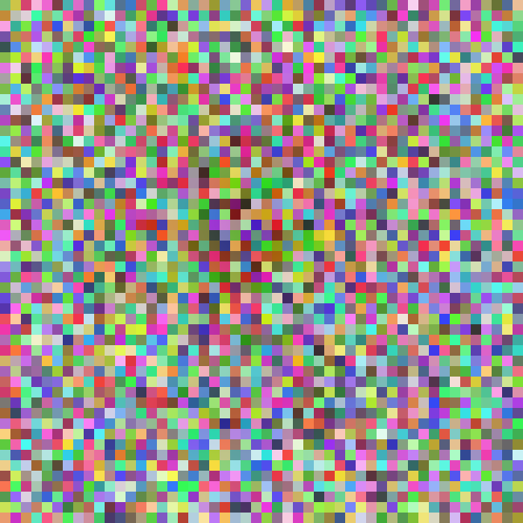
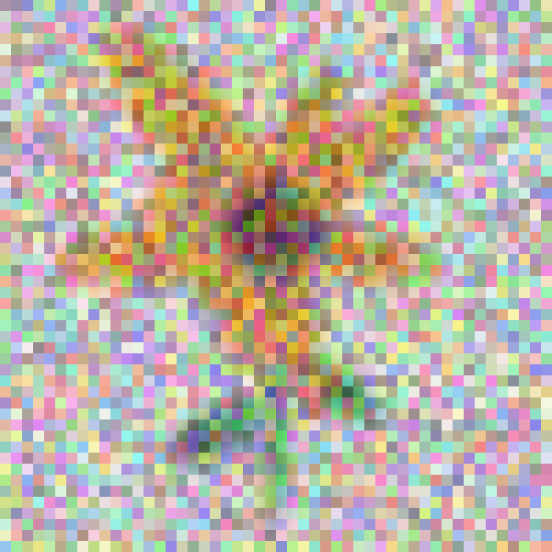
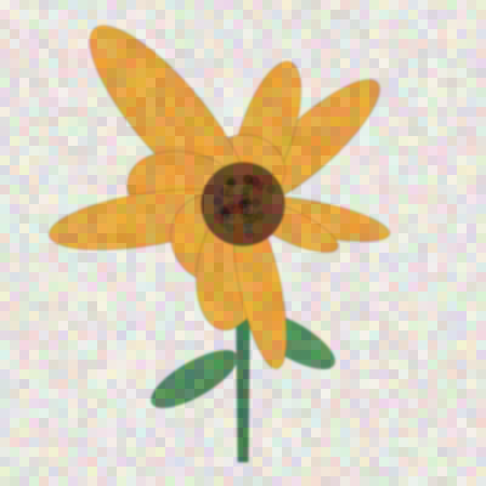
02 · THE CONTEST OVER TIME
Round after round, both sides get better
Round 1
Round 2
Round 3
Round N
G: random scribble
D: catches it easily
G: learns "flowers are colourful blobs"
D: learns to check shape
G: petals and a centre
D: checks petal detail
G: convincing flowers
D: can only guess, about 50/50
Each side's improvement forces the other to improve. That feedback loop is the "adversarial" training signal.
GAN Class 1 · 02 Adversarial · min 20–22 · images are illustrations, not real GAN outputs
Notes:
TIME: 20:00–22:00. SAY: "Let's watch the contest over many rounds, using our flower story." [CLICK 1] Round 1. "At the start the generator's weights are random, so it outputs random pixel noise. The discriminator catches it instantly." [CLICK 2] Round 2. "The generator gets feedback and learns the cheapest trick first: flowers have warm colours in the middle. So it paints colourful blobs. The discriminator then has to look at something harder: shape." [CLICK 3] Round 3. "The generator learns petals around a centre. The discriminator now has to look at finer details: petal edges, the stem, the texture." [CLICK 4] Round N. "Eventually the fakes are so good that the discriminator can only guess. It says 'real' about half the time for both real and fake. We will see in section 06 that this 50/50 point is the theoretical equilibrium." [CLICK 5] Read the takeaway. ASK: "What would happen if the discriminator were terrible from the start, e.g. always says 'real'?" Expected: the generator gets no useful pressure and does not improve. "And if the discriminator is perfect and way ahead?" Expected: the generator gets very little useful signal (we will see the vanishing-gradient issue later). So the two need to improve together. The notebook uses the same learning rate for both. Stress: these four images are hand-made illustrations of the idea, not real training snapshots.

Slide 15
02 · WINNERS AND LOSERS
A zero-sum game: one side's gain is the other's loss
CASE 1 · D CATCHES THE FAKE
CASE 2 · G FOOLS D
D wins this round. G is the loser, so G must update its weights to make better fakes.
G wins this round. D is the loser, so D must update to spot fakes better.
PRECISE VERSION, AS IN OUR NOTEBOOK
"Winner and loser" is an intuition. In code, both networks take one gradient step on every batch: first D, then G. How much each changes depends on how badly it did, which the loss measures.
GAN Class 1 · 02 Adversarial · min 22–24
Notes:
TIME: 22:00–24:00. SAY: "A simple way to picture a GAN is as a zero-sum game: there is always a winner and a loser. The total is fixed, so one side's gain is exactly the other side's loss." [CLICK 1] Case 1. "If the discriminator correctly spots the fake, the discriminator wins. In this picture the winner stays unchanged. The loser, the generator, has to update its model to make better fakes." [CLICK 2] Case 2. "If the generator fools the discriminator, the generator wins, and now the discriminator is the one that must update, to get better at telling fakes apart." [CLICK 3] IMPORTANT CLARIFICATION. "This winner/loser story is a great intuition, but the code is slightly different, and I want you to know the precise version. In our notebook, on every mini-batch, BOTH networks take one gradient step: first the discriminator, then the generator. Nobody 'sits still' because they won. What the loss does is decide how big and in which direction each update is: if D was already right, its loss is small and its update is small. If G was badly caught, G's loss is big and its update is big. So the intuition survives as 'the one that did worse changes more'." Also useful: the discriminator is first shown real flower images so it learns what flowers look like (colours, shading, shapes), and the generator starts from a random input vector. We use exactly these ideas in sections 04 and 05. Zero-sum link to maths: in the minimax objective (section 06) there is ONE value V(D, G). D tries to push it up; G tries to push it down. That is what makes it zero-sum.

Slide 16
02 · COMMON CONFUSIONS
What "adversarial" does and doesn't mean here
It does mean
It does not mean
Two networks with opposite objectives on the same score
Opponents during training, but partners in the result: D's job is to push G to improve
After training we usually keep G and set D aside
Hacking, attacking or anything malicious
"Adversarial examples/attacks": a different topic, where tiny input changes fool a trained classifier
That one network destroys the other: they improve together
GAN Class 1 · 02 Adversarial · min 24–25
Notes:
TIME: 24:00–25:30. [CLICK 1] What it DOES mean. "Two networks, opposite objectives, on the same score: D's output on fake images. They are opponents during training. But like the sparring partner, the purpose of D is to make G better. And after training, in most applications we keep the generator, because that is the thing that makes images. The discriminator was the coach." [CLICK 2] What it does NOT mean. - Not hacking or malicious behaviour. - Students will meet the phrase "adversarial examples" or "adversarial attacks" in other courses: adding tiny, carefully chosen noise to an image so that a trained classifier gets it wrong. Same word, different topic. Don't mix them up. - Not "one network wins and destroys the other". If D wins completely, training actually gets worse for G, as we will see. ASK: "After training, which network would a company ship in an image-generation app?" Expected: the generator.

Slide 17
CHECKPOINT · TURN TO YOUR NEIGHBOUR · 60 SECONDS
Can you explain GAN in one breath?
Q1. What does GAN stand for?
Generative Adversarial Network(s)
Q2. In the counterfeiter story, who is G and who is D?
Counterfeiter = G (makes fakes). Police = D (detects fakes).
Q3. Why is it called "adversarial"?
They have opposite goals on the same score: D wants fakes scored "fake"; G wants them scored "real".
GAN Class 1 · 02 Adversarial · min 25–27
Notes:
TIME: 25:30–27:00. Quick think-pair-share. SAY: "Turn to your neighbour. One of you explains the answers to the other in 60 seconds. Then swap." Give them 60 seconds. Then cold-call 2 to 3 pairs. [CLICK 1] Answer 1: Generative Adversarial Network (or Networks). [CLICK 2] Answer 2: Counterfeiter = Generator, Police = Discriminator. [CLICK 3] Answer 3: Opposite goals on the SAME score. For a generated image, D wants its score to go down (towards 0, "fake") and G wants it to go up (towards 1, "real"). If anyone answers "because they attack each other", gently correct: opposite objectives, not attacks. TRANSITION: "Good. Now let's stop switching analogies. From here to the end of the theory, we use ONE example: the flower forger."

Slide 18
03
Our running example: the flower forger
We keep this one story until the notebook.
GAN Class 1 · min 27–30
Notes:
TIME: 27:00. Section 03 is short (minutes 27 to 30), but important: it fixes ONE example for the rest of the theory. SAY: "Many GAN explanations jump between money, faces, cats and digits, and students lose track. We will use one example until the notebook: a flower forger. The goal: a model that generates new pictures of flowers." "Every idea from now on (generator, discriminator, losses, the minimax equation) will be explained with this same flower story. In the notebook we simply swap flowers for handwritten digits; the game stays identical."

Slide 19
03 · THE CAST OF OUR STORY
Same two players, many names
In our story | Original GAN paper (2014) | Notebook code
Real flower photos (the dataset) | genuine money | train_loader (MNIST)
The forger = Generator | counterfeiter | Generator()
The inspector = Discriminator | police | Discriminator()
The verdict, P(real) | caught / not caught | Sigmoid, 0 to 1
Original GAN paper: Goodfellow et al., "Generative Adversarial Nets", NeurIPS 2014 · arxiv.org/abs/1406.2661
One rule for the rest of the deck: blue = forger = Generator, orange = inspector = Discriminator.
GAN Class 1 · 03 Running example · min 27–30
Notes:
TIME: 27:30–30:00. PAPER: Goodfellow et al., "Generative Adversarial Nets", NeurIPS 2014, https://arxiv.org/abs/1406.2661 (the link is on the slide). This is the paper that introduced GANs. PURPOSE: the same two players appear under different names. This table ties our flower story to the original paper's analogy and to the exact class names in the notebook, so students can follow along when they reach the code. Walk across each row: - Row 1, the dataset. Our story: a large collection of real flower photos. The paper's analogy: genuine money. The notebook: train_loader with MNIST digits. - Row 2 (blue), the forger = Generator. Paper: the counterfeiter. Notebook: the Generator class. - Row 3 (orange), the inspector = Discriminator. Paper: the police. Notebook: the Discriminator class. - Row 4, the verdict: a number between 0 and 1. Close to 1 means "I think this is real", close to 0 means "I think this is fake". In the notebook it is the output of a Sigmoid. [CLICK 1] The colour rule. "From now on: blue is always the forger, the Generator. Orange is always the inspector, the Discriminator." ASK: "The inspector outputs 0.9 for an image. What does that mean?" Expected: it believes the image is real, i.e. from the dataset.

Slide 20
04
The Generator: the forger
What goes in, what comes out, and how it learns without ever seeing a real flower.
GAN Class 1 · min 30–42
Notes:
TIME: 30:00. Section 04 runs from minute 30 to minute 42. SAY: "Let's zoom into the forger: the Generator, G. We will answer four questions. What goes in? What comes out? What does it look like before training? And the surprising one: how can it learn to paint flowers if it never looks at a real flower?"

Slide 21

04 · GENERATOR · ITS JOB
G turns a random vector into an image
0.41
−1.07
0.88
−0.25
⋮
1.62
Input
a random vector, not a photo, not a label
G(z)
trainable weights θ_G
Output
every pixel of a new image
z (noise)
fake image G(z)
In one line: the generator takes a random input vector and uses it to create its own fake flower.
GAN Class 1 · 04 Generator · min 30–33
Notes:
TIME: 30:30–33:00. Build the diagram left to right, one click at a time, and narrate. [CLICK 1] z. "The input is a vector of random numbers. We call it z, the noise vector or latent vector. In the notebook it has 100 numbers drawn from a standard normal distribution, torch.randn(batch_size, 100)." [CLICK 2] G. "These numbers go into the generator network G. It has weights; we call them theta-G. At the start they are random. Training changes them." [CLICK 3] The fake image. "Out comes an image: every single pixel value. We write it G(z): G applied to z. In our story, a painted flower." [CLICK 4] Input / output summary. Stress what the input is NOT: it is not a real flower photo that G copies, and it is not a label like 'sunflower'. (That would be a conditional GAN, which is class 3.) [CLICK 5] Summary line: the generator takes a random input vector and uses it to create its own fake flower. ASK: "If G's weights are fixed and we feed in the same z twice, do we get the same image?" Expected: yes, G is a deterministic function. The randomness comes only from z. "So how do we get a different flower?" Expected: sample a different z. That is the next slide.

Slide 22

04 · GENERATOR · WHY RANDOM INPUT?
Different z, different flower: noise is the source of variety
z₁ = [0.4, −1.1, …]
G
Why this works
G is deterministic. All the randomness comes from z.
Sampling z is easy: torch.randn(64, 100)
G learns to map this simple cloud of points onto the complicated set of "all flowers". The space z lives in is the latent space.
z₂ = [−0.7, 0.2, …]
G
z₃ = [1.3, 0.9, …]
G
GAN Class 1 · 04 Generator · min 33–35 · flowers are illustrations
Notes:
TIME: 33:00–35:00. Core idea: sample from a simple distribution, then transform it with a network. SAY: "Here is the trick that makes GANs generative. The generator itself is a fixed function once trained: the same input always gives the same output. So where does variety come from? From z." The first row is visible: z1 goes in, a yellow flower comes out. [CLICK 1] "A different random vector z2 gives a different flower." [CLICK 2] "z3 gives yet another. Every time you want a new flower, you just draw new random numbers." [CLICK 3] Why this works: - "We choose z from a distribution that is trivially easy to sample: a standard Gaussian. In PyTorch, torch.randn(64, 100) gives 64 vectors of 100 numbers each, exactly as in our notebook." - "The generator's job is to learn a mapping that bends and stretches this simple Gaussian cloud into the complicated shape of 'all flowers'. That is how p_g, from section 01, is created." - "The space where z lives is called the latent space. 'Latent' means hidden: these 100 numbers are hidden controls that, after training, often correspond to things like colour or petal shape. We explore latent spaces properly with VAEs later in the module." ASK: "What would go wrong if we fed G the same z every time during training?" Expected: it would learn to produce one image only, no variety (a hint of mode collapse). Note: the three flowers are illustrations of the mapping idea, not outputs of a trained model.

Slide 23

04 · GENERATOR · BEFORE AND AFTER TRAINING
Same z every time; only G's weights change
Keep one noise vector z_fixed and look at G(z_fixed) as training goes on:
Step 0
random weights → noise
Early
colour in the right place
Middle
shape appears
Late
convincing flower
Tip for the notebook: this "fixed z" view is the best way to watch a GAN learn.
GAN Class 1 · 04 Generator · min 35–37 · illustrations, not real training snapshots
Notes:
TIME: 35:00–37:00. The generator initially outputs a random noise image, and training turns it into a convincing fake. SAY: "Let's look at the generator very concretely: at the start it outputs pure noise. Why? Because its weights are random numbers, so the output is random numbers too." Point at Step 0: "This is what G(z) looks like before training." [CLICK 1] Early. "After some feedback, the colour starts to appear in roughly the right place." [CLICK 2] Middle. "Structure appears: something like petals and a centre." [CLICK 3] Late. "Finally, a convincing flower." EMPHASISE: "In this sequence the input z is the SAME vector every time. The input did not change. The generator's weights changed. That is what learning means for G." [CLICK 4] Practical tip: "In the notebook, if you want to see progress, create one fixed batch of noise at the start, e.g. fixed_noise = torch.randn(16, 100), and generate images from it after every epoch. Changes in the pictures are then only due to learning, not due to new random inputs." This will be one of the notebook tasks. Say again that the four pictures are drawn to illustrate the idea; real GAN snapshots vary.

Slide 24




04 · GENERATOR · THE SURPRISING PART
G never sees a real flower. It learns only from D's reaction.
0.08
G's loss is high because it wanted this near 1
z
G
D
"probably fake"
gradient flows backwards through D into G (D's weights are not updated here)
The gradient tells each of G's weights: "move this way and D's score for your image goes up." There is no target flower and no pixel-by-pixel comparison: D is G's only teacher.
GAN Class 1 · 04 Generator · min 37–40
Notes:
TIME: 37:00–40:00. This is the most important idea about the generator, so slow down. SAY: "Here is something that surprises everyone. Look at the diagram. Where do real flowers appear? Nowhere. The generator never looks at a real flower. Not once. So how can it learn to paint them?" Trace the forward path on screen: z goes into G, G paints an image, the image goes into D, and D outputs a score: 0.08, meaning "probably fake". [CLICK 1] "The generator wanted that score to be close to 1, to be taken as real. Its single mission: take p close to 1. So its loss is high." [CLICK 2] The yellow arrow sweeps back. "Backpropagation computes the gradient of G's loss, and that gradient flows backwards: through D, and into G's weights. D is used here like a fixed measuring instrument: we do NOT change D's weights in this step; we only use D to compute the direction G should move." [CLICK 3] "The gradient effectively says to every weight in G: nudge yourself this way, and D will think your image is a bit more real. Repeat this thousands of times and G ends up painting things D believes are real. And D's opinion was formed by looking at real flowers. So knowledge about real flowers reaches G indirectly, through D." Counterfeiter analogy: the forger never gets the official printing plates; they only learn from what the police catch. The difference in a GAN: the 'police' hand over a precise gradient, not just 'caught / not caught'. That is why G can learn efficiently. ASK: "What would happen if D were a random, untrained network?" Expected: its gradients would be meaningless, and G would learn nothing useful about flowers. So D must be trained on real data too, which is section 05.

Slide 25
04 · GENERATOR · IN OUR NOTEBOOK
The notebook's G: 100 numbers in, a 28×28 image out
class Generator(nn.Module):
def __init__(self):
super().__init__()
self.fc = nn.Sequential(
nn.Linear(100, 256),
nn.ReLU(),
nn.Linear(256, 784),
nn.Tanh())
def forward(self, x):
return self.fc(x).view(-1, 1, 28, 28)
100 → 256 → 784: noise vector → hidden layer → one value per pixel
Tanh squashes outputs to −1…1, the same range as the real images after Normalize((0.5,), (0.5,))
.view(-1, 1, 28, 28) reshapes 784 numbers into a 1-channel 28×28 image
Flowers → digits: the role of G is unchanged.
GAN Class 1 · 04 Generator · min 40–42 · CV-Week4-Lecture1.ipynb, exercise cell
Notes:
TIME: 40:00–42:00. This code is copied from the exercise cell of CV-Week4-Lecture1.ipynb. SAY: "Let's look at the real generator you'll run in 30 minutes. It is only a few lines." [CLICK 1] Shapes. "nn.Linear(100, 256): the 100-number noise vector goes into a hidden layer of 256 units, with ReLU. Then nn.Linear(256, 784): 784 outputs. Why 784? Because MNIST images are 28 by 28, and 28 × 28 = 784. One output per pixel." [CLICK 2] Tanh. "The last activation is Tanh, which outputs values between −1 and 1. Why? Look at the data loading code: transforms.Normalize((0.5,), (0.5,)) maps pixel values from the range 0…1 to −1…1. If real images live in −1…1, fake images must live there too. Otherwise D could spot fakes just by their pixel range, which is a useless shortcut." [CLICK 3] Reshape. ".view(-1, 1, 28, 28) turns each row of 784 numbers into an image with 1 channel (grayscale), height 28, width 28. The -1 means 'whatever the batch size is'." [CLICK 4] "Our flower forger becomes a digit forger. Same job, different data." ASK: "If we wanted 64×64 colour images, what would change in the last Linear layer?" Expected: 64 × 64 × 3 = 12,288 outputs, and the view would be (-1, 3, 64, 64). (In practice we'd switch to a convolutional generator: DCGAN, class 3. The notebook already has a DCGANGenerator skeleton for later.)

Slide 26
05
The Discriminator: the inspector
A binary classifier whose labels come for free, and whose opinion teaches the generator.
GAN Class 1 · min 42–53
Notes:
TIME: 42:00. Section 05 runs from minute 42 to minute 53. SAY: "We just saw that the generator's only teacher is the discriminator. So the discriminator had better be a good judge. Let's zoom into the inspector." Good news for students: "The discriminator is something you already know how to build: a binary classifier. Real or fake. Only two twists: where its labels come from, and the fact that its opponent keeps changing."

Slide 27
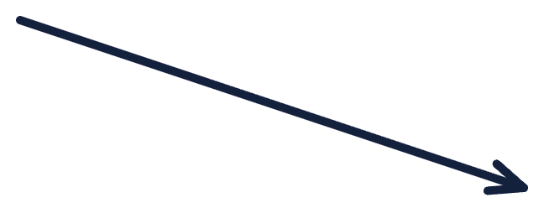

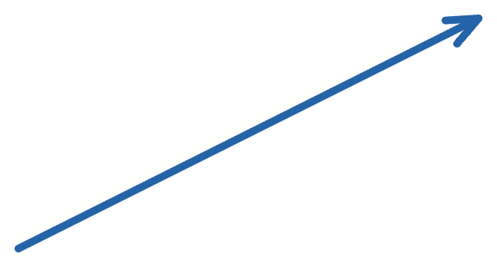
05 · DISCRIMINATOR · ITS JOB
D looks at an image and outputs one number: P(real)
0.97
D(x)
"I'm fairly sure this is real"
real (from dataset)
trainable weights θ_D
0.04
"I'm fairly sure this is fake"
D learns from real flowers what they look like: colours, shading and shapes.
fake (from G)
GAN Class 1 · 05 Discriminator · min 42–45
Notes:
TIME: 42:30–45:00. SAY: "The discriminator, D, is the inspector. It takes ONE image and returns ONE number between 0 and 1: its estimate of the probability that the image is real, i.e. came from the dataset." [CLICK 1] A real flower from the dataset goes in. D outputs 0.97: "I'm fairly sure this one is real." [CLICK 2] A generated flower from G goes in. D outputs 0.04: "I'm fairly sure this one is fake." Make these points: - D is the SAME network for both inputs. It does not know where the image came from; it has to guess from the pixels. - D's output is not a flower type and not an image. It is one probability. - Notation: we write D(x) for a real image x, and D(G(z)) for a generated image. [CLICK 3] The discriminator is trained on real flower pictures so it learns what a flower looks like: the colours, the shading, the shapes. Then it can compare the generator's fakes against that. ASK: "D outputs 0.5 for an image. What does that mean?" Expected: D cannot tell; it's a coin flip. Keep this in mind for the equilibrium discussion in section 06.

Slide 28
05 · DISCRIMINATOR · WHERE ITS LABELS COME FROM
D's labels come for free: we know where each image came from
Picked from the dataset
Painted by G just now
label = 1 (real)
label = 0 (fake)
labels_real = torch.ones(batch_size, 1)
labels_fake = torch.zeros(batch_size, 1)
No human labelling. The label means "which pile did this come from", not "is it pretty". A beautiful fake is still label 0 when training D.
GAN Class 1 · 05 Discriminator · min 45–47
Notes:
TIME: 45:00–47:00. SAY: "A classifier needs labels. Who labels the images for D? Nobody. We get the labels for free." [CLICK 1] Real pile. "Any image we took from the dataset gets label 1, 'real'. In the notebook: labels_real = torch.ones(batch_size, 1)." [CLICK 2] Fake pile. "Any image the generator just painted gets label 0, 'fake'. labels_fake = torch.zeros(batch_size, 1)." [CLICK 3] "So GANs need no human labels at all. That is why GANs are often called unsupervised: we only need a pile of real images. The labels the code uses are about SOURCE, not quality. Even if G paints a perfect flower, when we train D it is still labelled 0, because it came from G." Common confusion to pre-empt: "Is label 1 'flower' and label 0 'not a flower'?" No. Both piles are flowers (or trying to be). The label only says which pile. ASK: "In the generator's training step we will later use label 1 for fake images. Is that cheating?" Tease it: "Hold that thought; it's the trick in section 06."

Slide 29




05 · ONE NUMBER, TWO MISSIONS
A tug-of-war over p = D(G(z))
For a generated flower, D outputs p = the probability it thinks the image is real.
At the start of training, p is tiny, e.g. p = 0.001.
D's mission: keep p near 0 for fakes
G's mission: push p to 1
0
0.5
1
"fake"
"real"
If G becomes perfect, the best D can do is p = 0.5 for everything: a coin flip. That is where the tug-of-war settles in theory.
GAN Class 1 · 05 Discriminator · min 47–50
Notes:
TIME: 47:00–50:00. The numbers are illustrative. SAY: "We can explain the whole GAN with just one number. The generator makes an image; the discriminator looks at it and outputs p: the probability that it is the real thing." [CLICK 1] The marker appears at the far left. "At the very beginning, G's image is pure noise, so D easily says p is tiny, something like 0.001." [CLICK 2] "D's mission, for fake images: keep p close to 0. Catch the fake." [CLICK 3] "G's mission: push p close to 1. Make D believe the fake is real." "Same number. Opposite directions. THAT is 'adversarial', in one picture. This is the most important slide for remembering what a GAN is." [CLICK 4] The marker jumps to the middle. "What happens if the generator becomes perfect, so fakes are identical in distribution to real flowers? Then D literally cannot tell them apart, and its best possible answer is 0.5 for every image. The tug-of-war balances in the middle. We'll prove this in section 06." CAUTION (common mix-up): be precise about loss directions: G's loss is LOW when p is close to 1; D's loss on fakes is LOW when p is close to 0. Use the "mission" wording to avoid confusion. ASK: "If p = 0.8 for a fake image, who is happier?" Expected: the generator. D's loss on this fake is high.

Slide 30
05 · DISCRIMINATOR · IN OUR NOTEBOOK
The notebook's D: a 28×28 image in, one probability out
class Discriminator(nn.Module):
def __init__(self):
super().__init__()
self.fc = nn.Sequential(
nn.Linear(784, 256),
nn.LeakyReLU(0.2),
nn.Linear(256, 1),
nn.Sigmoid())
def forward(self, x):
return self.fc(x.view(-1, 784))
x.view(-1, 784) flattens the image; 784 → 256 → 1
LeakyReLU(0.2) lets a small gradient through for negative inputs, so G keeps getting a signal
Sigmoid turns the score into a probability between 0 and 1
The two networks are mirror images: G is 100 → 256 → 784, D is 784 → 256 → 1.
GAN Class 1 · 05 Discriminator · min 50–51 · CV-Week4-Lecture1.ipynb, exercise cell
Notes:
TIME: 50:00–51:30. Copied from the exercise cell of CV-Week4-Lecture1.ipynb. [CLICK 1] "x.view(-1, 784) flattens each 1×28×28 image back into 784 numbers. Then 784 → 256 → 1." [CLICK 2] "LeakyReLU with slope 0.2. A normal ReLU outputs exactly 0 for negative inputs, and its gradient there is 0. LeakyReLU outputs 0.2 × x instead, so a small gradient always flows. Why does that matter? Remember: G learns ONLY through gradients that pass back through D. Dead ReLUs in D would block G's learning signal. LeakyReLU in the discriminator is a standard GAN practice." [CLICK 3] "Sigmoid squashes the final score into 0…1 so we can read it as the probability 'real'. It pairs with nn.BCELoss, binary cross-entropy, which we meet in section 06." [CLICK 4] "Notice the symmetry: the generator expands 100 → 784, the discriminator compresses 784 → 1." ASK: "Why does D not need Tanh at the end?" Expected: D outputs a probability, not pixels, so Sigmoid is the right choice.

Slide 31
05 · CHECKPOINT · SIDE BY SIDE
Generator vs Discriminator at a glance
 | Generator G (forger) | Discriminator D (inspector)
Input | random noise z (100 numbers) | an image (real or fake)
Output | an image G(z) | one probability: P(real)
Sees real data? | never | yes, half of what it sees
Wants on fakes | D(G(z)) → 1 | D(G(z)) → 0
Wants on reals | (not involved) | D(x) → 1
Kept after training? | yes: it makes the images | usually discarded
Cover the right two columns and try to say each cell from memory.
GAN Class 1 · 05 Discriminator · min 51–53
Notes:
TIME: 51:30–53:00. Recap of sections 04 and 05. Go row by row; ask the class to answer each cell BEFORE you point at it. - Input: G gets noise; D gets an image. - Output: G gives an image; D gives a probability. - Sees real data? G never; D does (in the notebook, each D step uses one real batch and one fake batch of the same size). - Wants on fakes: opposite directions. This row IS the word "adversarial". - Wants on reals: only D cares; G's loss does not involve real images at all. - After training: we keep G to generate new images; D is usually thrown away (though its features are sometimes reused). [CLICK 1] Study tip for students. TRANSITION: "We know the players and their goals. Now: how exactly do we train them? That's the rules of the game, and the maths."

Slide 32
06
Training: the rules of the game
Alternating steps → binary cross-entropy → the minimax objective → where it settles.
GAN Class 1 · min 53–81
Notes:
TIME: 53:00. Section 06 runs from minute 53 to minute 81. This is the most technical part; keep returning to the flower story. SAY: "You already know the goals in words: D wants fakes near 0 and reals near 1; G wants fakes near 1. In this section we turn those words into (1) a training loop, (2) loss functions, and (3) one famous equation. If you understood the tug-of-war slide, you already understand the equation. We just need to read it." Structure: the training loop → loss function → game theory view → optimal discriminator and generator → training dynamics and the practical generator loss (17:26) → what goes wrong (22:13, 23:39).

Slide 33
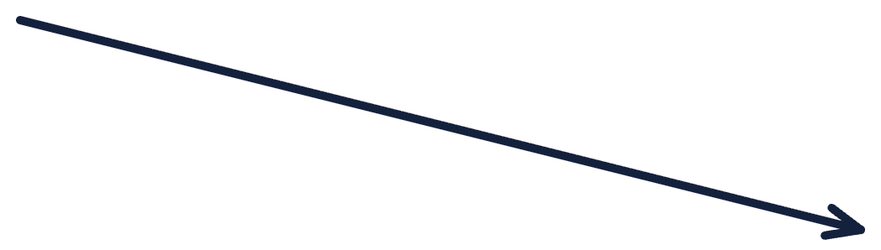




06 · THE WHOLE FRAMEWORK
The full GAN in one picture
real data x
D
p = P(real)
0 … 1
BCE loss
z
G
Step 1: update D (real → 1, fake → 0)
Step 2: update G (make D say "real")
fake G(z)
Repeat for every mini-batch. Two players, two losses, one shared score.
GAN Class 1 · 06 Training · min 53–56
Notes:
TIME: 53:30–56:00. This is the "master diagram". Build it slowly; every later slide zooms into part of it. [CLICK 1] Real data: a mini-batch of real images x from the dataset (in the notebook, 64 MNIST digits from train_loader). [CLICK 2] The generator path: sample noise z, G paints fakes G(z), a batch of the same size. [CLICK 3] Both kinds of images flow into the SAME discriminator D. [CLICK 4] D outputs a probability for each image, and we compare these probabilities to targets with a loss function: binary cross-entropy (BCE). [CLICK 5] Step 1, orange dashed arrow: use the loss to update D only. Targets: real → 1, fake → 0. [CLICK 6] Step 2, blue dashed arrow: use a second loss to update G only. The gradient passes back through D into G. Target: we want D to say 1 ("real") for the fakes. [CLICK 7] "And we repeat that pair of steps for every mini-batch, for every epoch." This matches Algorithm 1 in the original paper, where D gets k steps per G step. The paper used k = 1 in its experiments, and so does our notebook. ASK: "Which arrows exist only during training, and which path do we use after training to make new flowers?" Expected: after training we only need z → G → image.

Slide 34
06 · STEP 1 OF EACH BATCH
Step 1: train the inspector, G is frozen
# Train Discriminator
optimizer_d.zero_grad()
outputs_real = discriminator(real)
loss_real = criterion(outputs_real, labels_real)
noise = torch.randn(batch_size, 100)
fake = generator(noise)
outputs_fake = discriminator(fake.detach())
loss_fake = criterion(outputs_fake, labels_fake)
loss_d = loss_real + loss_fake
loss_d.backward()
optimizer_d.step()
Real batch → target 1. Penalise D if it calls real flowers fake.
Fake batch → target 0. Penalise D if it calls fakes real.
.detach() cuts the wire back to G, and only optimizer_d steps. So this step changes D's weights only.
GAN Class 1 · 06 Training · min 56–58 · notebook training loop, lines 1–12
Notes:
TIME: 56:00–58:00. This is the first half of the training loop in the notebook, verbatim. Walk through the code top to bottom, then use the clicks. "optimizer_d.zero_grad() clears old gradients. Then two mini-exams for the inspector." [CLICK 1] Real exam: discriminator(real) gives probabilities for the 64 real digits; BCE against labels_real (all ones). If D says 0.2 for a real image, it gets a big penalty. [CLICK 2] Fake exam: sample fresh noise, G paints 64 fakes, D judges them; BCE against labels_fake (all zeros). If D says 0.9 for a fake, big penalty. "loss_d = loss_real + loss_fake: D's total mistake on both piles. backward() computes gradients; optimizer_d.step() updates D." [CLICK 3] The two safety details: 1. fake.detach(): "detach" cuts the computation graph between the fake images and G. So when we call loss_d.backward(), no gradients flow into the generator. We are training the inspector, not the forger. 2. Only optimizer_d.step() is called, and optimizer_d holds only D's parameters. So G is frozen in this step. In the flower story: "The inspector studies a pile of genuine flowers and a pile of today's forgeries, and sharpens their eye. The forger is not in the room." ASK: "What would happen without .detach()?" Expected: gradients would also be computed for G's weights (wasted work). G is still not updated because optimizer_g does not step here, but the unused gradients would sit in G's parameters until optimizer_g.zero_grad() clears them. Detach keeps the D step clean and cheaper.

Slide 35
06 · STEP 2 OF EACH BATCH
Step 2: train the forger, D is not updated
# Train Generator
optimizer_g.zero_grad()
outputs_fake = discriminator(fake)
loss_g = criterion(outputs_fake, labels_real)
loss_g.backward()
optimizer_g.step()
Same fakes, no detach: gradients flow through D back into G.
Target = labels_real (1) for fakes: "loss is low when D is fooled".
Not cheating: the label 1 here does not claim the image is real. It states what G wants D to say. Only optimizer_g steps, so D is used as a fixed judge in this step.
GAN Class 1 · 06 Training · min 58–60 · notebook training loop, lines 13–18
Notes:
TIME: 58:00–60:00. Second half of the notebook's loop, verbatim. "optimizer_g.zero_grad() clears G's gradients (this also clears any leftovers). Now D, which has just been updated in step 1, judges the same fake images again." [CLICK 1] "This time there is NO .detach(). We WANT the gradient to flow from the loss, back through D, into G's weights. That is the path from the 'G never sees a real flower' slide." [CLICK 2] The trick students asked about earlier: "The target is labels_real: all ones. We are saying: 'G, your loss is low only if D says these fakes are real.' So minimising this BCE pushes D(G(z)) towards 1. That's the generator's mission from the tug-of-war slide." [CLICK 3] "Is that cheating? No. The labels in this line are not facts about the images; they are G's goal. When we train D, fakes are labelled 0 (the truth about their source). When we train G, we ask for 1 (G's wish)." "loss_g.backward() computes gradients for both D and G's parameters (the graph goes through both), but only optimizer_g.step() is called, so only G changes. D's stale gradients are cleared by optimizer_d.zero_grad() at the start of the next iteration." ASK: "In one sentence each: what does step 1 teach, and what does step 2 teach?" Expected: step 1 teaches D to tell real from fake; step 2 teaches G to fool the current D.

Slide 36
06 · THE LOSS: NN.BCELOSS
Binary cross-entropy: small when confident and right
BCE(p, y) = −[ y·log p + (1 − y)·log(1 − p) ]
y = 1 → loss is −log p · y = 0 → loss is −log(1 − p) · natural log
Case | y | p | loss
D, real flower, confident | 1 | 0.9 | 0.105
D, real flower, wrong | 1 | 0.1 | 2.303
D, fake flower, confident | 0 | 0.2 | 0.223
G, same fake (wants y = 1) | 1 | 0.2 | 1.609
D's loss for one real (0.9) + one fake (0.2):
0.105 + 0.223 = 0.328 (low: D is doing well)
G's loss on that same fake:
−log 0.2 = 1.609 (high: G must improve)
GAN Class 1 · 06 Training · min 60–63 · criterion = nn.BCELoss() in the notebook
Notes:
TIME: 60:00–63:00. The notebook uses criterion = nn.BCELoss(). The GAN loss is built from exactly this. SAY: "Binary cross-entropy is the standard loss for a yes/no prediction. y is the target (1 or 0), p is the predicted probability of 1. Only one of the two terms is active at a time: if y = 1 the loss is −log p; if y = 0 the loss is −log(1 − p)." Intuition: "−log of a number close to 1 is close to 0. −log of a small number is big. So BCE is small when you are confident AND right, and huge when you are confident and wrong." Table walk-through (numbers are natural logs; check them live on a calculator if students doubt): - D sees a real flower, says 0.9 → −ln 0.9 = 0.105. Small. - D sees a real flower, says 0.1 → −ln 0.1 = 2.303. Big penalty. - D sees a fake, says 0.2 → target 0 → −ln(0.8) = 0.223. Small. - G, same fake, same 0.2, but G's target is 1 → −ln 0.2 = 1.609. Big. [CLICK 1] D's total loss, just like loss_d = loss_real + loss_fake in the code: 0.105 + 0.223 = 0.328. D is doing well. [CLICK 2] G's loss on the same fake: 1.609. G is doing badly. "Same image, same score 0.2, one player is happy and the other is not. That's the adversarial setup in numbers." Note: in the notebook each loss is the MEAN over the 64 images in the batch (BCELoss default reduction='mean').

Slide 37
06 · WORKED EXAMPLE · ONE ROUND WITH NUMBERS
One round of the game, step by step
One real flower x and one fake flower G(z). Scores are illustrative; losses use natural log.
Moment | D(x) | D(G(z)) | D's loss | G's loss
Start of round | 0.60 | 0.40 | 0.511 + 0.511 = 1.022 | −ln 0.40 = 0.916
After D step | 0.70 | 0.30 | 0.357 + 0.357 = 0.713 | −ln 0.30 = 1.204
After G step | 0.70 | 0.45 | 0.357 + 0.598 = 0.955 | −ln 0.45 = 0.799
D step: D raises D(x) and lowers D(G(z)). Its loss falls 1.022 → 0.713. Side effect: G's loss rises 0.916 → 1.204.
G step: G changes its painting so D(G(z)) rises to 0.45. G's loss falls 1.204 → 0.799. D's loss rises again. Neither wins for good.
GAN Class 1 · 06 Training · min 63–66 · numbers are illustrative, not from a real run
Notes:
TIME: 63:00–66:00. A worked round that joins the loop (step 1, step 2) with the BCE numbers. The scores are invented for teaching; the arithmetic is exact (natural log). Walk through the table row by row. Ask students to compute one or two cells themselves before you reveal the explanation boxes. Row 1, start: D(x) = 0.60, D(G(z)) = 0.40. - D's loss = −ln 0.60 (real, target 1) + −ln(1 − 0.40) (fake, target 0) = 0.511 + 0.511 = 1.022. - G's loss (notebook version) = −ln D(G(z)) = −ln 0.40 = 0.916. Row 2, after the D step. D becomes more confident: D(x) = 0.70, D(G(z)) = 0.30. - D's loss = −ln 0.70 + −ln 0.70 = 0.357 + 0.357 = 0.713. Down: D improved. - G's loss = −ln 0.30 = 1.204. Up: G did NOT change, but its opponent got better, so G looks worse. [CLICK 1] D step explanation. Row 3, after the G step. G's weights change so its fake is judged more real: D(G(z)) = 0.45. D's weights did not change. - G's loss = −ln 0.45 = 0.799. Down. - D's loss = 0.357 + −ln 0.55 = 0.357 + 0.598 = 0.955. Up: D did not change, but its opponent got better. [CLICK 2] G step explanation. KEY LESSON: "Each player's loss depends on BOTH players. One side improving makes the other side's loss go up, even if the other side did nothing. That's why GAN loss curves do not simply go down like a classifier's." ASK: "In row 2, G's loss went up. Did G get worse?" Expected: no, G was not updated; D got better. This prepares students for the "reading your results" slide in the notebook part.

Slide 38
06 · THE MINIMAX OBJECTIVE · GOODFELLOW ET AL. 2014
One value V(D, G). D pushes it up, G pushes it down.
min_G max_D
E_x[ log D(x) ] + E_z[ log(1 − D(G(z))) ]
Term 1: real flowers. Average of log D(x). Largest (0) when D(x) = 1. D maximises it by saying "real" to real data. G can't touch it.
Term 2: fake flowers. D maximises it by pushing D(G(z)) → 0. G minimises it by pushing D(G(z)) → 1.
Minimax = G minimises what the best D can maximise. This is the zero-sum game: D's gain is G's loss. Note: maximising V = minimising the notebook's loss_d.
GAN Class 1 · 06 Training · min 66–70
Notes:
TIME: 66:00–70:00. This is outcome 3 of the class. Take your time. SAY: "Here is the equation from the original 2014 paper. Don't panic; you already know everything in it. Read it as: min over G, max over D, of V(D, G), where V is the sum of two averages." 𝔼 means "average over": over real images x from the dataset, and over noise vectors z. [CLICK 1] Term 1, real flowers: the average of log D(x). log of a probability is always ≤ 0, and it reaches its maximum, 0, when D(x) = 1. So D makes this term as large as possible by saying "real" to real images. The generator does not appear in this term at all, so G can't affect it. [CLICK 2] Term 2, fake flowers: the average of log(1 − D(G(z))). D wants D(G(z)) → 0, which makes 1 − D close to 1 and the log close to 0: large. G wants D(G(z)) → 1, which makes 1 − D close to 0 and the log go to minus infinity: small. So the same term is pushed UP by D and DOWN by G. That is the tug-of-war slide written as maths. [CLICK 3] "Minimax means G is trying to minimise the value that the best possible D can achieve. There is only ONE number V, and one player's gain is exactly the other's loss: a zero-sum game." Connection to code: BCE is the negative of these log terms. The notebook's loss_d = BCE(real, 1) + BCE(fake, 0) = −[log D(x) + log(1 − D(G(z)))], averaged. So minimising loss_d is the same as maximising V. (The notebook's G loss is slightly different; see two slides ahead.) ASK: "Which term carries the gradient for G?" Expected: only term 2.

Slide 39
06 · WHERE THE GAME SETTLES
At the ideal end point, D can only say 0.5
BEST D FOR A FIXED G
BEST G
D*(x) = p_data(x) / (p_data(x) + p_g(x))
p_g = p_data → D*(x) = ½
"How much of the probability at x comes from real data?"
Fakes are statistically identical to real flowers. D can do no better than a coin flip.
REFERENCE NUMBERS FOR THE NOTEBOOK PRINTOUT
If D outputs 0.5 everywhere: loss_d = 2 × ln 2 ≈ 1.386 and loss_g = ln 2 ≈ 0.693.
Also this point is a Nash equilibrium: neither player can improve by changing alone. Real training only approximates it.
GAN Class 1 · 06 Training · min 70–72 · Goodfellow et al. 2014, Proposition 1 and Theorem 1
Notes:
TIME: 70:00–72:00. These results are Proposition 1 and Theorem 1 of the original paper. No proof needed in class 1; focus on meaning. [CLICK 1] Best discriminator for a fixed generator. "Imagine a specific image x. Real data puts some probability p_data(x) on it, the generator puts p_g(x). The best possible inspector outputs the fraction that comes from real data. If fakes never look like x, D* = 1. If only fakes look like x, D* = 0." [CLICK 2] Best generator. "The generator wins the game when p_g equals p_data. Then the fraction is always one half. The best inspector is reduced to a coin flip. This is the 50/50 point from the arms-race slide and the middle of the tug-of-war." In the paper, at this point the value of the game is V = −log 4. [CLICK 3] Practical numbers for the notebook. "If D says 0.5 for everything: each BCE term is −ln 0.5 = ln 2 ≈ 0.693. The notebook's loss_d adds a real term and a fake term, so ≈ 1.386; loss_g has one term, so ≈ 0.693. When you run the notebook, compare the printed losses to these references. But warning: an untrained D also outputs about 0.5! So losses near these numbers do NOT automatically mean G is good. Always look at the generated images too." Game theory note: this ideal point is a Nash equilibrium: neither player can improve by changing its strategy alone. In practice, with finite networks and alternating gradient steps, training may hover around it, oscillate, or never reach it. That is the topic of next class.

Slide 40
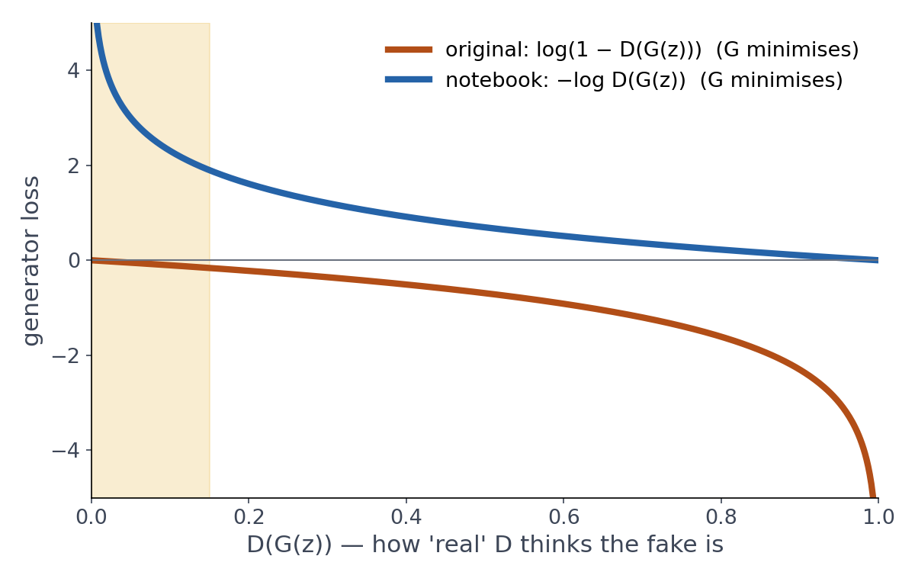
06 · A PRACTICAL FIX USED IN OUR NOTEBOOK
Why the notebook's G uses labels_real, not the minimax term
Early training (yellow band): fakes are bad, so D(G(z)) ≈ 0.
Original term log(1 − D(G(z))) is almost flat there → tiny gradient → G barely learns.
Notebook's term −log D(G(z)) is steep there → strong gradient exactly when G needs it.
Same goal (D(G(z)) → 1). This is the non-saturating loss: criterion(outputs_fake, labels_real).
GAN Class 1 · 06 Training · min 72–75 · also suggested in Goodfellow et al. 2014, Section 3
Notes:
TIME: 72:00–75:00. The fix is suggested in Section 3 of the original paper. SAY: "There's a small but important difference between the minimax equation and the notebook code. In the equation, G minimises log(1 − D(G(z))). In the notebook, G minimises BCE with target 1, which equals −log D(G(z)). Why the change?" Point at the plot. X-axis: how real D thinks the fake is. Both curves go down as D(G(z)) goes up, so both push G in the same direction. [CLICK 1] "At the start of training G's fakes are awful, and D easily spots them: D(G(z)) is near 0. That's the yellow region." [CLICK 2] Orange curve (original term): "Look how flat it is near 0. A flat curve means a tiny gradient. So exactly when G is worst and needs the most help, it gets almost no learning signal. We say the loss 'saturates'." [CLICK 3] Blue curve (notebook): "−log D(G(z)) shoots up near 0. Steep curve, big gradient. G gets a strong push when it most needs it." [CLICK 4] "Both have the same goal: make D(G(z)) go to 1. This version is called the non-saturating generator loss, and it is what 'criterion(outputs_fake, labels_real)' computes. So now you know why that line says labels_real." Link to D being too strong: if D becomes nearly perfect very early, the original G loss gives vanishing gradients. The non-saturating loss reduces this problem but does not solve every training problem.

Slide 41
06 · PREVIEW OF CLASS 2
When the game goes wrong
Mode collapse
Non-convergence
D too strong
G fixes one weakness, D learns a new check, G switches trick, D switches back… The players chase each other in circles instead of settling at 0.5.
D rejects every fake with total confidence. With the original loss G's gradient vanishes, so G stops learning. Balance matters.
G finds one flower that fools D and paints only that. Every z → the same kind of output. Looks good; no variety.
GAN Class 1 · 06 Training · min 75–77 · notebook cell 2: "Challenges: mode collapse, instability"
Notes:
TIME: 75:00–77:00. Keep this short: it is a preview. Class 2 covers these in depth (Nash equilibrium, mode collapse, instability). The notebook's theory cell lists "Challenges: mode collapse, instability". [CLICK 1] Mode collapse. "Suppose G discovers that one particular yellow flower always fools D. The cheapest strategy is to paint only that flower, for every z. D sees good images, but the variety is gone: it's as if the garden only has one flower. On MNIST, collapse would look like a generator producing mostly one or two digits." [CLICK 2] Non-convergence. "Because each player's best move depends on the other's current state, the two can chase each other in circles instead of settling at the 50/50 point. Losses go up and down without the images steadily improving." [CLICK 3] D too strong. "If D becomes perfect very fast, the original generator loss gives almost zero gradient; the generator stops learning. That's why the notebook uses the non-saturating loss, and why balance between the two matters." In the notebook, ask students to LOOK for these: are all 16 samples the same digit? Do the printed losses swing wildly?

Slide 42
06 · THE BIGGER PICTURE · COMING LATER IN THIS MODULE
GANs among other generative models
 | GAN (today) | VAE | Diffusion model
How it learns | A generator vs a discriminator game | Encode, then decode; reconstruction + KL loss | Learn to remove noise, a little at a time
Making a sample | One forward pass: fast | One decoder pass: fast | Many denoising steps: slower
Typical images | Sharp | Often blurrier | Sharp and varied
Main difficulty | Unstable training, mode collapse | Blur; quality vs latent structure trade-off | Slow sampling, heavy compute
All three answer the same question: how do we draw new samples that follow p_data?
GAN Class 1 · 06 Training · min 77–79 · notebook wrap-up: "GANs vs VAEs comparison"
Notes:
TIME: 77:00–79:00. The notebook's wrap-up cell asks for a "GANs vs VAEs comparison"; this table gives students the map. Keep it at overview level: VAEs and diffusion are later topics in this module. Walk the rows: - How it learns. GAN: the adversarial game we studied today. VAE (notebook cell 3): an encoder squeezes an image into a small latent code, a decoder rebuilds it; the loss combines reconstruction error and a KL term that keeps the latent space well organised. Diffusion: add noise to images step by step, and train a network to undo one step of noise at a time. - Making a sample. GAN and VAE: one pass through a network, so very fast. Diffusion: many denoising steps, so slower (though there are speed-up tricks). - Typical images. GANs are known for sharp images; VAEs often look blurrier; diffusion models give sharp and diverse images and power most modern text-to-image systems. - Main difficulty. GAN: training instability and mode collapse (next class). VAE: blur and trade-offs. Diffusion: sampling cost and compute. These are general tendencies, not strict rules: modern variants of each family blur these lines. ASK: "If you needed to generate images in real time on a phone, which family looks attractive from this table, and why?" Expected: GAN (or VAE), because a sample takes one forward pass.

Slide 43
RECAP · STORY, MATHS AND CODE
Everything so far, in three languages
Flower story | Maths | Notebook code
Real flower photos | x ~ p_data | for real, _ in train_loader
Forger's blank idea | z ~ N(0, I) | torch.randn(batch_size, 100)
Forger paints a flower | G(z) | fake = generator(noise)
Inspector's verdict | D(x), D(G(z)) | discriminator(real), (fake)
Inspector studies | max_D V | loss_d = loss_real + loss_fake
Forger improves | min_G (non-saturating) | criterion(outputs_fake, labels_real)
Fakes pass as real | p_g = p_data, D = ½ | loss_d ≈ 1.386, loss_g ≈ 0.693
GAN Class 1 · 06 Training · min 79–81 · end of the conceptual part
Notes:
TIME: 79:00–81:00. End of the 70-minute conceptual block. SAY: "Here is the whole lesson in one table. Read each row across: the story, the maths, and the exact line you will see in the notebook in a minute." Go quickly row by row, asking students to fill in the maths or code column from memory where possible. Final message before the notebook: "When you look at the code, don't read it as 40 unrelated lines. Look for the two players, the two piles of images, the two losses and the two optimizer steps. That's the whole GAN." If running short on time: skip this slide's details and just say "This table is your revision sheet". Switch to the notebook now. Ask students to open CV-Week4-Lecture1.ipynb.

Slide 44
07
MNIST and the notebook
Meet the data, then 60 minutes hands-on with CV-Week4-Lecture1.ipynb.
GAN Class 1 · min 81–145
Notes:
TIME: 81:00. Section 07: minutes 81 to 145 (5 minutes on the MNIST dataset, then about 60 minutes in the notebook). Plan: - 81–82: bridge from flowers to digits - 82–86: what MNIST is, and how a digit becomes numbers (last theory slides) - 86–88: map of the notebook (what we use today, what we skip) - 88–94: short code walk (setup, then the loop you already know) - 94–104: Task 1, run and observe - 104–112: Task 2, read the code and answer - 112–127: Task 3, one experiment (predict first) + short debrief - 127–138: Task 4, explore the latent space - 138–145: reading your results, whole-class debrief Logistics: students open the notebook (Colab or local Jupyter). If the MNIST download is slow on the network, have a pre-downloaded ./data folder ready to share, or pair students up. Students who finish early can raise epochs to 10–20 and compare samples.

Slide 45

07 · BRIDGE
From flower forger to digit forger
 | Flower story | Notebook (MNIST)
Real data | flower photos | 60,000 digits, 28×28, grey
Forger G | paints flowers | 100 noise values → 784 pixels
Inspector D | real or fake flower? | 784 pixels → P(real)
Unconditional | any flower | any digit: we can't choose which
GAN Class 1 · 07 Notebook · min 81–82 · digit strip is an illustration in MNIST style
Notes:
TIME: 81:00–82:00. SAY: "Everything we did with flowers now happens with handwritten digits. The MNIST dataset: 60,000 training images of digits 0 to 9, each 28 by 28 pixels, greyscale." [CLICK 1] Flowers become digits. [CLICK 2] The mapping table. Walk the rows quickly: real data, the forger, the inspector. Last row, important: "This GAN is unconditional. The generator gets only noise, no label. So we cannot ask it for 'a 7'. It produces whatever digit its z leads to. Notice the training loop even throws the labels away: 'for real, _ in train_loader'. The underscore is the digit label, ignored. Asking for a specific digit is the Conditional GAN, which is the assignment at the end of the notebook and our topic in class 3." (The digit strip on this slide is drawn in MNIST style for illustration.)

Slide 46

07 · MEET THE DATA
What is MNIST?
MNIST = Modified National Institute of Standards and Technology database: a collection of handwritten digits 0–9.
Fact | Value
Images | 70,000: 60,000 train + 10,000 test
Size | 28 × 28 pixels = 784 pixels
Colour | Greyscale, 0 (black) to 255 (white)
Labels | The digit shown, 0 to 9 (10 classes)
Writers | Census Bureau staff, high-school students
Published | LeCun, Cortes and Burges, 1998
Each digit is size-normalised and centred. It is often called the "hello world" of machine learning.
One digit = 28 × 28 grid (illustration)
GAN Class 1 · 07 Data and notebook · min 82–84
Notes:
TIME: 82:00–84:00. MNIST explained for students who have not met it before. This slide is also study material. SAY: "Before we open the code, let's meet the data. MNIST stands for Modified National Institute of Standards and Technology database. NIST is a US government standards agency that collected handwriting samples; the 'Modified' version was prepared by Yann LeCun, Corinna Cortes and Christopher Burges and released in 1998." [CLICK 1] Walk through the facts: - 70,000 images in total: 60,000 for training and 10,000 for testing. Our notebook uses train=True, so the 60,000 training images. - Each image is 28 by 28 pixels, so 784 numbers. That is where the 784 in both our networks comes from. - Greyscale: one channel. Each pixel is stored as a whole number from 0 (black background) to 255 (white ink). MNIST digits are white strokes on a black background. - Each image has a label: which digit it shows. Classifiers use the label. Our GAN ignores it. - The handwriting came from US Census Bureau employees and American high-school students. [CLICK 2] Size-normalised and centred: every digit was scaled to fit and placed in the middle of the 28×28 frame, so models do not have to deal with position or size. Because it is small, clean and fast to train on, MNIST is the standard first dataset: the "hello world" of machine learning. Point at the grid on the right: "This is one digit, drawn as its 28 by 28 pixels. Each square is one number." (The picture is an MNIST-style illustration, not an image taken from the dataset.) WHY MNIST FOR A FIRST GAN: it trains in minutes on a laptop CPU, and anyone can judge by eye whether a generated digit looks right. ASK: "How many numbers does the discriminator receive for one MNIST image?" Expected: 784.

Slide 47
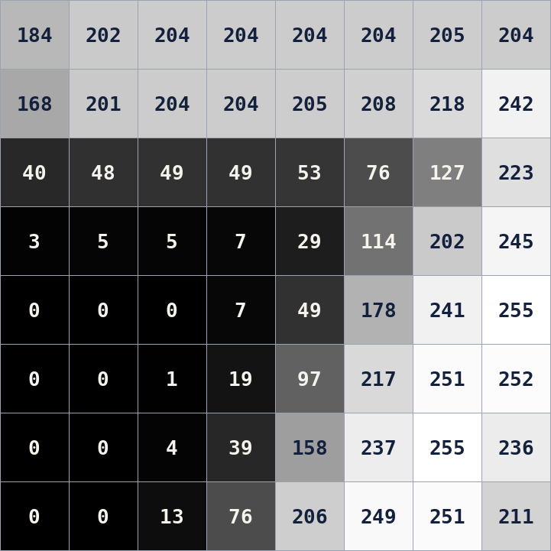
07 · MEET THE DATA · FROM PICTURE TO NUMBERS
How an MNIST digit becomes numbers for the network
1
Stored: whole numbers 0–255 per pixel (left: a zoomed 8 × 8 corner).
2
ToTensor(): divide by 255 → values 0.0–1.0, shape (1, 28, 28).
3
Normalize((0.5,), (0.5,)): (v − 0.5) / 0.5 → values −1 to +1, the same range as G's Tanh.
4
DataLoader(batch_size=64): 64 digits at a time → shape (64, 1, 28, 28). D flattens each to 784.
Example: pixel 204 → 0.8 → +0.6. Pixel 0 → 0.0 → −1.0.
GAN Class 1 · 07 Data and notebook · min 84–86 · pixel values shown are from an MNIST-style illustration
Notes:
TIME: 84:00–86:00. This connects the dataset to the first lines of the notebook. Point at the grid: "This is an 8 by 8 corner of one digit, zoomed in. Every square is a pixel, and the number on it is its brightness: 0 is black, 255 is white. The full image has 28 × 28 = 784 of these." [CLICK 1] Stored format: integers 0 to 255. [CLICK 2] transforms.ToTensor() converts the image to a PyTorch tensor and divides by 255, so values are between 0.0 and 1.0. The shape is (1, 28, 28): 1 channel, 28 rows, 28 columns. [CLICK 3] transforms.Normalize((0.5,), (0.5,)) subtracts 0.5 and divides by 0.5. Result: −1 to +1. We need this because the generator ends with Tanh, which outputs −1 to +1. Real and fake images must live in the same range, otherwise D could tell them apart by range alone. [CLICK 4] DataLoader groups 64 images into a batch: shape (64, 1, 28, 28). Inside D, x.view(-1, 784) flattens each image into a row of 784 numbers. [CLICK 5] Worked example: pixel 204 → 204/255 = 0.8 → (0.8 − 0.5)/0.5 = 0.6. Pixel 0 → 0.0 → −1.0. White ink becomes near +1, black background becomes −1. ASK: "What will a pixel of value 255 become?" Expected: 1.0, then +1.0. The values in the picture come from an MNIST-style illustration drawn for this deck.

Slide 48
07 · MAP OF THE NOTEBOOK
What we use today, and what waits for later
# | Cell | Today | When
1 | Introduction: generative vs discriminative | read | covered in section 01
2 | Theory: GANs | read | sections 04–06
3 | Theory: VAEs | skip | VAE classes
4–5 | Exercise: GAN on MNIST (code) | run + modify | now, 60 min
6–7 | Mini-project: DCGAN on CelebA | skip | class 3 (DCGAN)
8 | Wrap-up and Conditional GAN assignment | glance | homework / class 3
The whole exercise is one code cell: data → G → D → loss and optimizers → training loop → plot 16 samples.
GAN Class 1 · 07 Notebook · min 86–88
Notes:
TIME: 86:00–88:00. SAY: "Open CV-Week4-Lecture1.ipynb. It has eight cells. Today we only need the exercise." - Cells 1–2: markdown intro and GAN theory. We covered them in sections 01 to 06; students can reread them. - Cell 3: VAE theory. Skip; that's our next topic after GANs. - Cells 4–5 (highlighted): the exercise heading and the ONE code cell with the whole GAN. This is our 60 minutes, plus one extra cell we add ourselves in Task 4. - Cells 6–7: the DCGAN mini-project on CelebA faces. Only a generator skeleton; it needs a training loop and a dataset. That is class 3 material. Don't run it today. - Cell 8: wrap-up, including the assignment "Extend GAN to Conditional GAN". Mention it as upcoming homework. Tell students: "Because everything is in one cell, when you change something, you rerun the whole cell. That retrains from scratch. It's fine; the model is tiny."

Slide 49
07 · CODE WALK, PART 1 · THE SETUP
Data, the two players, one loss, two optimizers
# Dataset
transform = transforms.Compose([
transforms.ToTensor(),
transforms.Normalize((0.5,), (0.5,))])
train_data = datasets.MNIST(root='./data', train=True,
transform=transform, download=True)
train_loader = DataLoader(train_data, batch_size=64, shuffle=True)
generator = Generator()
discriminator = Discriminator()
criterion = nn.BCELoss()
optimizer_g = optim.Adam(generator.parameters(), lr=0.0002)
optimizer_d = optim.Adam(discriminator.parameters(), lr=0.0002)
Normalize maps pixels 0…1 to −1…1, to match G's Tanh.
64 images per batch → about 938 batches per epoch.
One loss (BCE) used for both players, with different targets.
Two optimizers: each only updates its own network. That is what keeps the steps separate.
GAN Class 1 · 07 Notebook · min 88–91 · exercise cell, top half
Notes:
TIME: 88:00–91:00. Show this slide while students scroll to the same lines in their own notebook. [CLICK 1] Normalize((0.5,), (0.5,)): subtract 0.5, divide by 0.5. Pixel 0 → −1, pixel 1 → +1. Matches the Tanh range of the generator's output. [CLICK 2] batch_size=64, shuffle=True. 60,000 / 64 ≈ 938 mini-batches per epoch, and each batch does one D step and one G step. So one epoch ≈ 938 rounds of the counterfeiter-police game. [CLICK 3] One criterion, nn.BCELoss, for both networks. What differs is the target we give it. [CLICK 4] Two separate Adam optimizers, both with learning rate 0.0002 (a common GAN choice from the DCGAN paper). optimizer_g only knows G's parameters and optimizer_d only knows D's. That is the mechanism that lets us "freeze" one player while updating the other. The Generator and Discriminator classes sit between the loader and these lines; we already studied them in sections 04 and 05. Note: everything runs on CPU in this notebook (no .to(device)). That's fine for this small MLP.

Slide 50
07 · CODE WALK, PART 2 · THE GAME LOOP
The loop you already understand
for epoch in range(epochs): # epochs = 2
for real, _ in train_loader:
labels_real = torch.ones(batch_size, 1)
labels_fake = torch.zeros(batch_size, 1)
# Step 1: D on real (→1) and fake.detach() (→0)
loss_d = loss_real + loss_fake
loss_d.backward(); optimizer_d.step()
# Step 2: G via D(fake) with labels_real (→1)
loss_g.backward(); optimizer_g.step()
print(f"Epoch …, Loss D: …, Loss G: …")
# Visualise 16 new digits
noise = torch.randn(16, 100)
fake_images = generator(noise).detach()
… plt.subplots(1, 16) … imshow(…, cmap='gray')
The printed losses are from the last batch of each epoch, not an average.
After training we only need G: new noise → 16 brand-new digits.
Heads-up: the last MNIST batch has 32 images, so real.size(0) is used for batch_size.
GAN Class 1 · 07 Notebook · min 91–94 · condensed; full lines on the step 1 and step 2 slides
Notes:
TIME: 91:00–94:00. The code here is condensed (step details are on the "Step 1" and "Step 2" slides). Ask students to find each part in their own notebook. Point out the structure: two nested loops (epochs, then batches); inside each batch, labels are created, then Step 1 (D), then Step 2 (G). One print per epoch. Then after training: 16 fresh noise vectors → generator → plot in one row. [CLICK 1] "The print statement is OUTSIDE the batch loop, so loss_d.item() and loss_g.item() are the values from the LAST mini-batch of the epoch. They're noisy snapshots, not averages. Don't over-read them." [CLICK 2] "The visualisation uses only the generator. That's the 'after training' path: z → G → image. .detach() here just says we don't need gradients for plotting." [CLICK 3] Detail for curious students: 60,000 is not divisible by 64, so the last batch has 60,000 − 937 × 64 = 32 images. That's why the code sets batch_size = real.size(0) inside the loop instead of using the constant 64: the labels and the noise must match the actual batch size. Then: "Enough reading. Let's run it."

Slide 51
TASK 1 OF 4 · 10 MINUTES · INDIVIDUALLY
Run the GAN and observe
1
Run the exercise cell as it is (epochs = 2). While it trains, predict: what will the 16 digits look like?
2
Write down Loss D and Loss G for each epoch. Compare with the reference 1.386 and 0.693.
3
Look at the 16 samples. How many look like digits? How many different digits do you see?
4
Run just the plotting lines again. Why do you get different digits without retraining?
GAN Class 1 · 07 Notebook · min 94–104
Notes:
TIME: 94:00–104:00. Instructions: run the exercise cell unchanged. It downloads MNIST the first time (about 10 MB), then trains for 2 epochs. Check the run time on the classroom machines before class; CPU is enough for this small model. While it trains, ask for predictions out loud: "Sharp digits? Blurry? Noise?" Expected observations (describe, don't promise exact numbers; results vary per run): - After only 2 epochs of this small fully connected GAN, samples are usually rough, blotchy, digit-like shapes. Some are recognisable, some are not. That's normal. - Losses: compare to 1.386 (D) and 0.693 (G), the "D says 0.5" references. Typically D's loss is below 1.386 and G's is above 0.693, meaning D is still winning. They are last-batch snapshots, so they are noisy. - Diversity: if many of the 16 look like the same digit, that's a hint of mode collapse. Ask students to report their count. Question 4 answer: the plotting code samples NEW noise with torch.randn(16, 100); G is a fixed function after training, and new z gives new digits. That's the "different z, different flower" slide. (To rerun only the plot, students can copy the last 7 lines into a new cell.) Walk around; the most common issue is the MNIST download. Pair students if needed.

Slide 52
TASK 2 OF 4 · 8 MINUTES · IN PAIRS
Read the code like a GAN detective
a. Which line gives D its "fake" targets? What value?
labels_fake = torch.zeros(…): all 0
b. Why .detach() in the D step but not in the G step?
D step: stop gradients into G. G step: we need them to reach G.
c. Why does the G loss use labels_real?
G wants D(G(z)) → 1 (non-saturating loss).
d. What is the shape of fake in a full batch?
(64, 1, 28, 28)
GAN Class 1 · 07 Notebook · min 104–112
Notes:
TIME: 104:00–112:00. Pairs answer a–d in the notebook (as a markdown cell or on paper). After about 6 minutes, reveal answers one click at a time and cold-call pairs. [CLICK 1] a. labels_fake = torch.zeros(batch_size, 1). All zeros: "these came from G". [CLICK 2] b. In the D step, fake.detach() stops gradients from flowing back into the generator; we are training only D. In the G step we need the gradient to go through D into G, so no detach. [CLICK 3] c. labels_real (all ones) in the G step expresses G's goal: make D output 1 for fakes. Minimising BCE with target 1 = minimising −log D(G(z)), the non-saturating generator loss. [CLICK 4] d. generator(noise) returns .view(-1, 1, 28, 28), so for a full batch: (64, 1, 28, 28). (The last batch: (32, 1, 28, 28).) Bonus for fast pairs: "Which variable holds the discriminator's opinion of real images?" (outputs_real.) "Where does the generator see a real image?" (Nowhere.)

Slide 53
TASK 3 OF 4 · 15 MINUTES · PICK ONE, PREDICT FIRST
One experiment: change one thing, predict, run
A · Watch G learn
B · Smaller latent space
Before the loop: fixed_noise = torch.randn(16, 100). After each epoch, plot generator(fixed_noise).detach(). Set epochs = 5.
Change 100 → 10 in all three places: nn.Linear(100, 256) and both torch.randn(…, 100). Does variety drop?
C · Unbalanced players
D · A common GAN setting
Give D lr = 0.002 (10× larger), keep G at 0.0002. Who wins? What happens to Loss G and to the samples?
Add betas=(0.5, 0.999) to both Adam optimizers (the DCGAN recommendation). Compare samples after 2 epochs.
GAN Class 1 · 07 Notebook · min 112–127 · write your prediction before you press run
Notes:
TIME: 112:00–127:00. Each pair picks ONE experiment (assign by row to get a mix). Rule: write the prediction first, then run, then compare. A. Watch G learn (recommended for most students). Code to add: before the epoch loop: fixed_noise = torch.randn(16, 100) at the end of each epoch (after the print): imgs = generator(fixed_noise).detach(), then plot 16 images as in the final cell. With epochs = 5 they see the same 16 z's evolve, which is the "same z, only weights change" slide. Warn: 5 epochs takes about 2.5× as long as 2. B. Latent size 10. Must change nn.Linear(100, 256) in Generator AND torch.randn(batch_size, 100) in the loop AND torch.randn(16, 100) in the plot; otherwise a shape error. That error is itself a good lesson. Typical outcome: it still trains; discuss whether variety changes. Don't promise a specific result. C. D learning rate 10× larger. Prediction to discuss: D gets stronger faster, Loss D tends to drop and Loss G rises; G may learn more slowly or samples may be worse. Ties to the "D too strong" slide. Results vary. D. betas=(0.5, 0.999): recommended in the DCGAN paper (Radford et al., 2015) for stable GAN training. Syntax: optim.Adam(generator.parameters(), lr=0.0002, betas=(0.5, 0.999)). Debrief at 124:00: one pair per experiment reports prediction vs result in 20 seconds.

Slide 54
TASK 4 OF 4 · 11 MINUTES · IN PAIRS
Explore the latent space: walk from one digit to another
1. Run it. Does the digit change smoothly or jump?
# new cell, after training
z1 = torch.randn(1, 100)
z2 = torch.randn(1, 100)
steps = 8
fig, axes = plt.subplots(1, steps, figsize=(16, 2))
for i in range(steps):
t = i / (steps - 1)
z = (1 - t) * z1 + t * z2
img = generator(z).detach()
axes[i].imshow(img[0][0], cmap='gray')
axes[i].axis('off')
plt.show()
2. Run it 3 times. Find a pair whose endpoints are different digits. What do the middle images look like?
3. Generate 64 samples. Count how many of each digit you see. Any sign of mode collapse?
GAN Class 1 · 07 Notebook · min 127–138
Notes:
TIME: 127:00–138:00. A new cell that uses the TRAINED generator from the exercise cell. Students must have run the exercise cell first (ideally with more epochs from Task 3A). What the code does: picks two random noise vectors z1 and z2, then makes 8 vectors on the straight line between them: t goes 0, 1/7, 2/7 … 1, and z = (1 − t)·z1 + t·z2. Each is passed through G and plotted in a row. This is called latent-space interpolation. Question 1. Expected: after enough training, images usually change gradually, which shows G has learned a smooth mapping from noise to images. After only 2 epochs results can be rough; that is fine. Question 2. When endpoints are different digits, the middle images are often blends or ambiguous shapes, sometimes passing through a third digit. Discuss: "the latent space is continuous; digits are regions in it." Question 3. Code hint: noise = torch.randn(64, 100); imgs = generator(noise).detach(); plot with plt.subplots(8, 8). Counting by eye is fine. If one or two digits dominate, that is a sign of mode collapse (class 2 topic). Note that with short training, some samples won't be recognisable. Links to theory: "different z, different flower" (g-latent slide) and "mode collapse" (wrong slide). Interpolation also returns in the VAE topic. If time is short, do questions 1 and 3 only.

Slide 55
07 · READING YOUR RESULTS
What your results mean
You see… | It probably means…
Blotchy, half-formed digits | Normal for 2 epochs of a small MLP GAN
Loss D well below 1.386, Loss G above 0.693 | D is still ahead; G has more to learn
Losses jump around between runs | Last-batch snapshots, and a moving target
Many samples are the same digit | Possible mode collapse: look at more samples
Loss G keeps rising, samples look like noise | D may be too strong (try experiment D)
Shape mismatch error | Noise size and nn.Linear input size disagree
Rule of thumb: GAN losses alone do not tell you quality. Always look at the images.
GAN Class 1 · 07 Notebook · min 138–145
Notes:
TIME: 138:00–145:00. Use this slide during the debrief, or keep it on screen while students work so they can self-diagnose. Key message: "In a normal classifier, lower loss means better. In a GAN, the loss is measured against an opponent who is also changing. D's loss going down could mean D is getting better OR G getting worse. G's loss going up could mean D is getting better, not that G got worse. So always look at the images." Row notes: - Blotchy digits: expected after 2 epochs; more epochs or a convolutional GAN (DCGAN, class 3) help. - Losses vs references: from the equilibrium slide. - Same digit repeated: hint of mode collapse; one grid of 16 isn't proof, so sample more. - Rising Loss G with noisy samples: D may be dominating. - Shape error: usually from experiment B when not all three 100s were changed.

Slide 56
EXIT TICKET · 3 MINUTES · ON PAPER, NO NOTES
Before you leave, answer four questions
1
Write the full form of GAN. Explain "adversarial" in one sentence.
2
For a generated image, D(G(z)) = 0.3. Which way does D want it to move? Which way does G?
3
In the notebook, what does fake.detach() do in the discriminator step?
4
One thing that is still confusing (your "muddiest point").
Answers: 1 Generative Adversarial Network; two networks with opposite goals on the same score · 2 D → 0, G → 1 · 3 stops gradients flowing into G, so only D learns
Notes:
TIME: 145:00–148:00, then 2 minutes of discussion on the next slide. Hand out slips (or use a quick form). Students answer from memory, no notes. Collect the slips; they tell you what to revise at the start of class 2. Expected answers: 1. Generative Adversarial Network(s). Adversarial: two networks, a generator and a discriminator, are trained with opposite objectives on the same score, so each one's improvement forces the other to improve. 2. D wants 0.3 to go DOWN towards 0 (it's a fake). G wants it to go UP towards 1. Bonus: D's BCE on this fake = −ln 0.7 ≈ 0.357; G's = −ln 0.3 ≈ 1.204. 3. .detach() cuts the computation graph between the fake image and the generator, so during D's update no gradient flows into G: only the discriminator learns in that step. 4. Muddiest point: read these before class 2 and start next class by addressing the top two. [CLICK 1] Reveal the short answers only AFTER collecting the slips.

Slide 57
DISCUSSION, NEXT CLASS AND REFERENCES
Next: why GAN training is hard
DISCUSS (2 MIN)
FURTHER STUDY: WATCH AT HOME
If D is thrown away after training, why do we need it at all? Could we train G some other way?
DeepBean, Understanding GANs: 01:28 generative modelling · 04:46 GAN approach · 07:37 loss · 12:14 game theory · 13:18 / 15:33 optimal D and G · 17:26 dynamics · 22:13 non-convergence · 23:39 mode collapse
IBM Technology (Martin Keen), What are GANs?: flower example, zero-sum game
CLASS 2
Nash equilibrium, mode collapse and instability. Class 3: DCGAN and conditional GAN.
Vizuara, Build a simple GAN from scratch: NN1/NN2 and the probability p
Read: Goodfellow et al., Generative Adversarial Nets, 2014 · Notebook: CV-Week4-Lecture1.ipynb
GAN Class 1 · min 148–150 · all flower images in this deck are teaching illustrations
Notes:
TIME: 148:00–150:00. Discussion prompt: "If we throw D away after training, why do we need it at all?" Guide towards: we have no formula for p_data, so we cannot directly compute how far G's images are from real ones. D is a learned, adaptive measure of that difference; its gradients are the only signal that carries information about real images to G. (Other generative models use different signals: VAEs use reconstruction plus a KL term; diffusion models learn to remove noise. Those are coming later in this module.) Next class (class 2): training dynamics: Nash equilibrium, mode collapse, instability. Class 3: DCGAN and conditional GAN, including the notebook's DCGAN generator and the conditional-GAN assignment. Homework suggestion: watch the DeepBean video from 12:14 to the end before class 2 (about 14 minutes). Optional: rerun the notebook with experiment A for 10 epochs and bring the grid of images. References: - DeepBean, "Understanding GANs (Generative Adversarial Networks)": https://www.youtube.com/watch?v=RAa55G-oEuk - IBM Technology, "What are GANs (Generative Adversarial Networks)?": https://www.youtube.com/watch?v=TpMIssRdhco - Vizuara, "Let us build a simple Generative Adversarial Network (GAN) from scratch": https://www.youtube.com/watch?v=FVcnuayhU-k - Goodfellow et al., "Generative Adversarial Nets", 2014: https://arxiv.org/abs/1406.2661 - Radford et al., DCGAN, 2015 (source of Adam betas=(0.5, 0.999)): https://arxiv.org/abs/1511.06434

