Slide 1
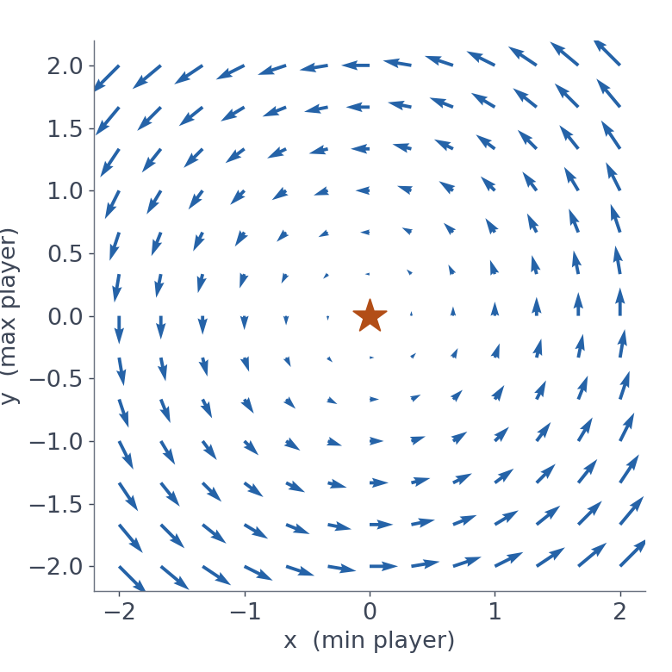
LINE 3 · APPLIED GENERATIVE VISION + MULTIMODAL
GAN Class 2 & 3: Training Dynamics
Nash equilibrium, instability and mode collapse: why the game is hard to win, and how to tell.
Gradients circle the equilibrium instead of pointing at it
85 min concepts + 85 min notebook + 5 min exit ticket · Notebook: GAN-Class-2-3-Training-Dynamics.ipynb
Notes:
BEFORE CLASS: copy GAN-Class-2-3-Training-Dynamics.ipynb to the students. Run Part 0 and the MNIST download cell (Part 5.1) once on the classroom machines so ./data already exists. Every animated slide advances on click; notes mark each [CLICK]. TIME: 0:00–0:30. SAY: "In Class 1 we built a GAN and learned the rules of the game: a generator, a discriminator and the minimax objective. Today we look at how that game behaves while it is being played. Why do GAN losses jump around? Why can training go in circles? And why does a generator sometimes make only one kind of image?" Point at the picture: "This picture is the whole lesson in one image. The red star is the perfect solution of a simple game. The arrows show where gradient descent pushes the two players. They don't point at the star; they go round it. By the end of today you'll know why." Plan: about 85 minutes of ideas, 85 minutes hands-on in the notebook, and a 5-minute exit ticket.

Slide 2
WARM-UP · RECAP OF CLASS 1 · ANSWER ALOUD
Three questions from last class
1. What do G and D each take in, and give out?
G: noise z → an image. D: an image → P(real), a number from 0 to 1.
2. Write the minimax objective. Who pushes it up, who down?
min_G max_D E[log D(x)] + E[log(1 − D(G(z)))]
D pushes it up; G pushes it down.
3. If G were perfect, what would the best D output?
0.5 for every image: it can only guess.
Today's question: does training actually reach that 0.5 point, and what goes wrong on the way?
Notes:
TIME: 0:30–4:00. Retrieval practice. Ask each question, wait for 2–3 answers, THEN click to reveal. [CLICK 1] Q1. G: random noise vector z (100 numbers in the notebook) in, an image out. D: an image in, one probability out, P(real). [CLICK 2] Q2. The minimax objective. D maximises it (says 1 to real images, 0 to fakes); G minimises it (wants D to say 1 to its fakes). Remind students that the notebook's G actually minimises −log D(G(z)), the non-saturating version, with the same goal. [CLICK 3] Q3. If p_g = p_data, the best discriminator is D*(x) = 1/2 everywhere. That is the equilibrium of the game. [CLICK 4] Bridge: "Last class we described the ideal end point. Today's question: does gradient training actually get there? Spoiler: not always. It can circle, oscillate, or get stuck producing one kind of output. Understanding why is what separates someone who can run a GAN from someone who can debug one." If students struggle with Q2, spend an extra minute: it is needed for section 02.

Slide 3
TODAY'S ROUTE · ABOUT 175 MINUTES
Five ideas, then 85 minutes of experiments
01
02
03
04
05
06
Why GAN training is different
Games and Nash equilibrium
Instability
Mode collapse
The fixes toolbox
Notebook experiments
min 7–17
min 17–40
min 40–55
min 55–72
min 72–85
min 85–170
Why it's different → the game → what goes wrong (instability, collapse) → how to fix it → try it yourself. Then a 5-minute exit ticket (min 170–175).
Notes:
TIME: 4:00–5:00. SAY: "Today has two halves. First, about 85 minutes of ideas. Second, 85 minutes where you run the experiments yourself and see each idea happen on screen." [CLICK 1] 01: why training a GAN is not like training a classifier. [CLICK 2] 02: a little game theory: what a game is, what a Nash equilibrium is, and why gradient steps circle it. [CLICK 3] 03: instability: why losses oscillate and training can fail. [CLICK 4] 04: mode collapse: when the generator makes only one kind of output. [CLICK 5] 05: the toolbox of fixes researchers use, and which ones actually worked in our tests. [CLICK 6] 06: the notebook. Every idea from 01–05 has an experiment. [CLICK 7] One-line summary, and the exit ticket at the end.

Slide 4
LEARNING OUTCOMES
By the end of today you can…
1
Define a Nash equilibrium and name the one a GAN is aiming for.
2
Explain why two players following gradients can circle an equilibrium.
3
Recognise instability and mode collapse in plots and samples.
4
Match common fixes to the problem each one targets, and test them.
5
Diagnose a real GAN with D(x) / D(G(z)) plots, fixed-noise grids and a class histogram.
GAN Class 2 & 3 · Opening · min 5–7
Notes:
TIME: 5:00–7:00. [CLICK 1] Nash equilibrium. Everyday idea first, then the GAN version (p_g = p_data, D = 0.5). [CLICK 2] The circling behaviour: the single most useful picture for understanding GAN instability. [CLICK 3] Recognising the two classic failures by LOOKING at outputs, not only at losses. [CLICK 4] Fixes: there are many tricks. Each targets something specific; none is magic. Students will test five. [CLICK 5] Diagnostics: three tools professionals use, all built in Part 5 of the notebook. Colour rule from Class 1 still applies: BLUE = generator, ORANGE = discriminator.

Slide 5
01
Why GAN training is different
A classifier chases a fixed target. A GAN chases a moving one.
GAN Class 2 & 3 · min 7–17
Notes:
TIME: 7:00. Section 01 runs from minute 7 to minute 17. SAY: "You have trained many classifiers. You know the drill: loss goes down, accuracy goes up, stop when it's good. GANs break that intuition. Let's see exactly why."

Slide 6
01 · FIXED TARGET VS MOVING TARGET
A classifier's target never moves. G's target is D, and D keeps learning.
Training a classifier
Training a generator
The labels are fixed: a 7 is always a 7.
One loss, one network: going downhill always means getting better.
Like hiking down a valley that stays still.
G's "label" is D's opinion, and D is updated every batch.
A move that helped G a minute ago can hurt it now.
Like hiking down a valley while someone reshapes the ground.
GAN Class 2 & 3 · 01 Why it's different · min 7–10
Notes:
TIME: 7:00–10:00. [CLICK 1] Classifier. "When you train a digit classifier, the correct answer for each image never changes. A 7 is a 7 in epoch 1 and in epoch 50. The loss surface is fixed; gradient descent walks downhill on a landscape that stays still." [CLICK 2] Generator. "In a GAN, the generator's learning signal comes from the discriminator. But D is also being trained, every single batch. So the landscape G is walking on changes under its feet. A direction that lowered G's loss a moment ago may raise it after D's next update." Analogy: "Imagine hiking down into a valley, but every few steps someone moves the hills. You can walk correctly and still end up going in circles." Also true for D: its fake examples come from G, which keeps changing. Both players face a moving target. This single fact is behind almost every problem we discuss today. ASK: "In Class 1's notebook, which line creates the moving target for G?" Expected: discriminator training (optimizer_d.step()) inside the same loop; D changes every batch.

Slide 7
01 · WHAT DOES "CONVERGED" MEAN HERE?
Two players, two losses: no single number goes down
 | Classifier | GAN
What is optimised | one loss, minimised | one value V: D maximises, G minimises
Goal | the lowest point (a minimum) | a balance point (an equilibrium)
"Done" looks like | loss low and flat | D ≈ 0.5 and good, varied samples
Loss going up means | something got worse | maybe the other player got better
A GAN is not searching for the bottom of a valley. It is searching for a saddle point: lowest in G's direction, highest in D's direction. Gradient descent is built for valleys, not saddles.
GAN Class 2 & 3 · 01 Why it's different · min 10–13
Notes:
TIME: 10:00–13:00. Walk the table row by row: - A classifier minimises one loss. A GAN has one value V that D tries to maximise and G tries to minimise. - The classifier's goal is a minimum. The GAN's goal is an equilibrium: a balance where neither side can improve. - "Done" for a classifier: loss low and flat. "Done" for a GAN: D around 0.5 AND samples that look good and varied. D at 0.5 alone isn't enough; an untrained D also says about 0.5 (as we saw in Class 1). - A rising loss in a GAN is ambiguous: it might mean the opponent improved (remember Class 1's worked round with numbers). [CLICK 1] The saddle point. "Picture a horse saddle. Along the horse's back (front to back) the middle is a low point; across the horse (side to side) the middle is a high point. The GAN solution is like the middle of the saddle: lowest along G's direction, highest along D's direction. Gradient descent is designed to roll to the bottom of valleys. It has no built-in way to 'balance' on a saddle. That's why we need special care." ASK: "Why can't we just add G's loss and D's loss and minimise the sum?" Expected: they're opposite goals on the same score; minimising both together isn't a meaningful single objective (in the minimax form, one is literally the negative of the other).

Slide 8
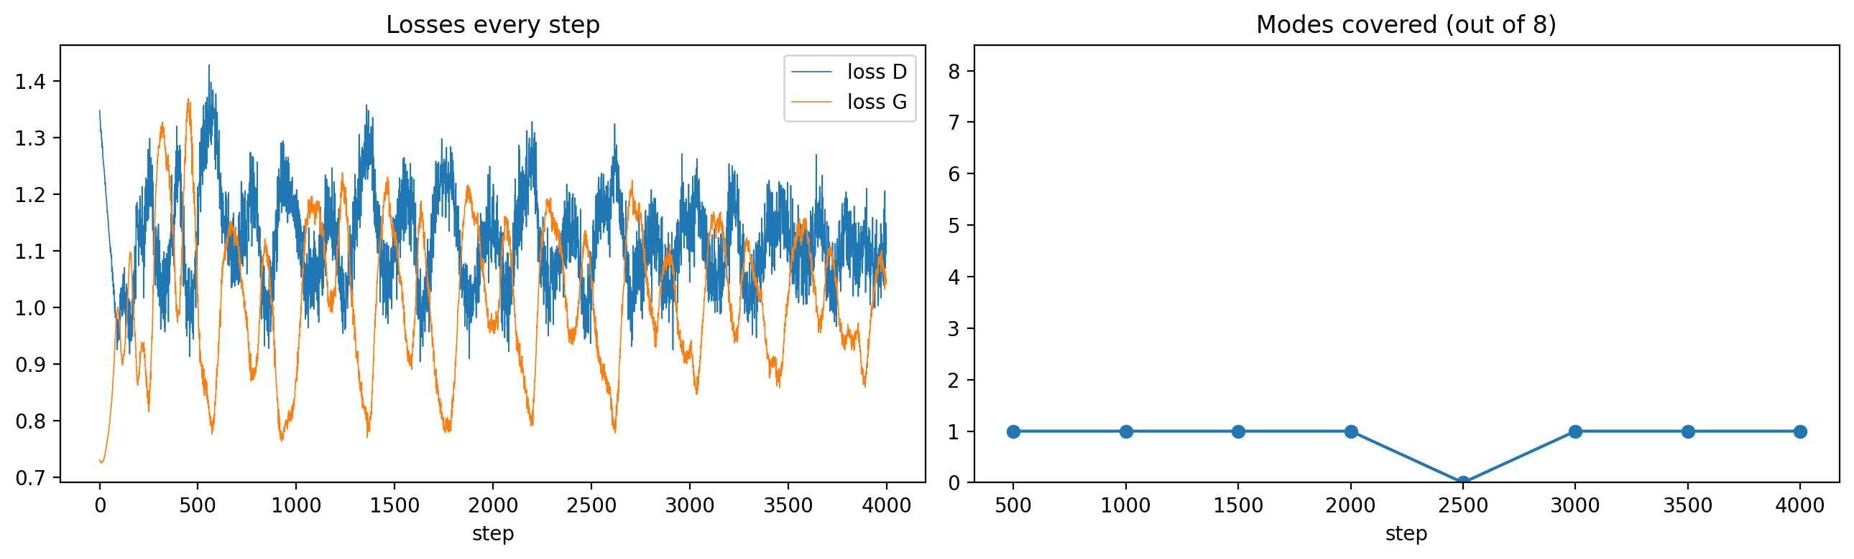
01 · REAL RUN FROM TODAY'S NOTEBOOK (PART 3, BASELINE)
The losses just wobble. The generator is failing.
Left: rhythmic wobbles in a normal range. Right: the generator covers at most 1 of 8 kinds of data the whole time. Loss curves do not measure sample quality or variety.
GAN Class 2 & 3 · 01 Why it's different · min 13–15 · 2-D ring data, 4,000 steps, seed 0
Notes:
TIME: 13:00–15:00. These plots come from an actual run of the notebook's Part 3 baseline (2-D data with 8 clusters, 4,000 steps, seed 0). Students will reproduce this themselves. Explain the setup in one sentence: "The real data here is 8 small clusters of points arranged in a ring. A good generator should produce points in all 8." Left plot: D and G losses at every step. Ask: "Does anything look wrong here?" Most students will say no: they wobble, with a regular rhythm, but stay between about 0.8 and 1.4. (Sharp-eyed students may spot the rhythm: that regular up-and-down is the circling from section 02. We come back to it on the mode-hopping slide.) [CLICK 1] Right plot: how many of the 8 clusters the generator covers, measured every 500 steps. It never covers more than 1. The generator is badly failing, yet the losses gave no warning. KEY MESSAGE: "With classifiers, you can mostly trust the loss curve. With GANs, you must look at the samples, and ideally measure variety directly. We'll build those measurements in the notebook." This is also a preview of mode collapse (section 04).

Slide 9
CHECKPOINT · THINK, PAIR, SHARE · 90 SECONDS
True or false?
a. If G's loss goes up, G has become worse.
False. D may have improved while G stayed the same.
b. D's training labels change during training.
False. Real → 1, fake → 0 always. But the fakes D sees keep changing.
c. A GAN is finished when both losses are as low as possible.
False. Both can't be low at once: one's gain is the other's loss. We want a balance plus good samples.
GAN Class 2 & 3 · 01 Why it's different · min 15–17
Notes:
TIME: 15:00–17:00. Students discuss in pairs for 60 seconds, then vote with thumbs up (true) / down (false) for each statement before you reveal. [CLICK 1] a. False. Remember the worked round from Class 1: after the D step, G's loss rose from 0.916 to 1.204 although G had not changed at all. [CLICK 2] b. False, with a twist: the labels are fixed (real = 1, fake = 0), but the fake images themselves keep changing because G keeps changing. So D's task is still a moving target. [CLICK 3] c. False. In a zero-sum game, one player's gain is the other's loss; they cannot both reach their lowest possible loss. We aim for a balance point, confirmed by looking at samples. Bridge to section 02: "So if the goal isn't 'lowest loss', what exactly is it? We need a precise word for 'balance point'. That word comes from game theory: the Nash equilibrium." If you are short on time, skip this checkpoint.

Slide 10
02
Games and Nash equilibrium
The precise meaning of "balance point", and why gradients struggle to find it.
GAN Class 2 & 3 · min 17–40
Notes:
TIME: 17:00. Section 02 runs from minute 17 to minute 40. It is the longest theory section and the foundation for everything after it. SAY: "Game theory is the mathematics of situations where your best choice depends on someone else's choice. Economists use it for markets, biologists for evolution, and we use it for GANs. We only need a few ideas from it today."

Slide 11
02 · VOCABULARY
A game has players, strategies and payoffs
Players
Strategies
Payoffs
Who makes decisions.
GAN: G and D.
The choices each player can make.
GAN: the values of each network's weights.
What each player gets for a pair of choices.
GAN: D gets V(D, G); G gets −V.
Zero-sum game: the payoffs always add to zero. Whatever one player wins, the other loses. A GAN's minimax objective is a zero-sum game.
GAN Class 2 & 3 · 02 Nash equilibrium · min 17–20
Notes:
TIME: 17:00–20:00. [CLICK 1] Players: the decision makers. In a GAN there are two: the generator and the discriminator. [CLICK 2] Strategies: what each player can choose. For a network, "choosing a strategy" means choosing values for all its weights. So a GAN is a game with millions of possible moves per player. [CLICK 3] Payoffs: the reward each player gets for a combination of choices. In the minimax objective, D's payoff is V(D, G), and G's payoff is minus V: G does well exactly when V is small. [CLICK 4] Zero-sum: because G's payoff is −V and D's is +V, the two always add to zero. Examples: chess (one wins, one loses), a penalty kick. Non-zero-sum examples for contrast: trade, where both can gain. ASK: "Is a football match zero-sum? Is a business partnership zero-sum?" Expected: match yes (win/lose), partnership usually no (both can gain).

Slide 12
02 · THE KEY DEFINITION
Nash equilibrium: nobody gains by changing alone
A choice for every player such that no player can do better by changing only their own choice, while the others keep theirs.
Named after mathematician John Nash, who proved in 1950 that such points exist in a wide class of games.
Everyday example: which side of the road?
A test you can use: "no regrets"
If everyone drives on the left, you switching to the right only hurts you. So "everyone drives on the left" is an equilibrium. (So is "everyone on the right".)
Ask each player: "Knowing what the others did, would you change your move?" If every player says no, you are at a Nash equilibrium.
GAN Class 2 & 3 · 02 Nash equilibrium · min 20–23
Notes:
TIME: 20:00–23:00. Read the definition slowly and have students repeat the key phrase: "no player can do better by changing only their own choice". Background: John Nash (the mathematician from the film "A Beautiful Mind") proved in 1950 that every finite game has at least one such equilibrium if players are allowed to randomise (mixed strategies, next slide). He later received the Nobel Memorial Prize in Economics (1994). [CLICK 1] Road example. "In India we drive on the left. If everyone does, and you alone switch to the right, you crash. So you don't want to change. Nobody does. That's a Nash equilibrium. Note: 'everyone on the right' is ALSO an equilibrium; games can have more than one." Important nuance: an equilibrium is not necessarily the best outcome for everyone; it is only stable against one player changing alone. [CLICK 2] The no-regrets test: freeze everyone else, ask one player if they'd switch; repeat for every player. If nobody would switch, it's an equilibrium. ASK: "In a penalty kick, is 'the kicker always shoots left' an equilibrium?" Expected: no; the goalkeeper would then always dive left, so the kicker would regret it. This leads to the next slide.

Slide 13
02 · A ZERO-SUM GAME WITH NO FIXED ANSWER
The penalty kick: the equilibrium is to be unpredictable
Kicker ↓ / Keeper → | dives left | dives right
shoots left | saved | goal
shoots right | goal | saved
Always left? The keeper learns it and always dives left. Kicker regrets it.
Chasing: the kicker switches right, the keeper follows… they go round in circles.
Simplified: the keeper saves every shot they guess right, and misses every shot they guess wrong.
Equilibrium: both choose at random, 50/50. Then nobody can exploit anybody.
Two lessons for GANs: chasing a best response can cycle forever, and at equilibrium the guesser is left at a coin flip, just like D = 0.5.
GAN Class 2 & 3 · 02 Nash equilibrium · min 23–26
Notes:
TIME: 23:00–26:00. This is the classic game "matching pennies", told as a football penalty. Explain the table: the keeper wants to match the kicker's side; the kicker wants to mismatch. It's zero-sum: a goal for one is a failure for the other. [CLICK 1] "Suppose the kicker always shoots left. The keeper notices and always dives left. The kicker would regret that choice, so it's not an equilibrium." [CLICK 2] "So the kicker switches to right. Then the keeper switches to right. Then the kicker switches back… Each player keeps reacting to the other's last move. They chase each other in circles. Remember this; we'll see exactly this circling in a GAN in two slides." [CLICK 3] "The only stable solution: both players randomise, 50/50. If the kicker is truly random, the keeper can't do better than guessing, and vice versa. This is a mixed-strategy Nash equilibrium." (Real footballers are studied for this; professional penalty takers and keepers behave close to this kind of randomisation. Mention only as a curiosity.) [CLICK 4] The two lessons: 1. Best-response chasing can cycle: GAN mode hopping and oscillation. 2. At equilibrium, the "guessing" player is at a coin flip. In a GAN the discriminator is the guesser, and at equilibrium it outputs 0.5. (The table is simplified: real keepers don't save every correctly guessed shot.)

Slide 14
02 · THE GAN'S EQUILIBRIUM · GOODFELLOW ET AL. 2014
The GAN's Nash equilibrium: p_g = p_data and D = ½
min_G max_D V(D, G) = E_x[log D(x)] + E_z[log(1 − D(G(z)))]
D's no-regret check. For a fixed G, D's best reply is
D*(x) = p_data(x) / (p_data(x) + p_g(x)).
G's no-regret check. Against that best D, G does best when p_g = p_data: its samples are indistinguishable from real ones.
Put together: p_g = p_data, so D*(x) = ½ everywhere and V = −log 4 ≈ −1.386. Neither player can improve alone: a Nash equilibrium. The theory guarantees it exists, not that gradient training will reach it.
GAN Class 2 & 3 · 02 Nash equilibrium · min 26–29 · Goodfellow et al. 2014, Proposition 1 and Theorem 1
Notes:
TIME: 26:00–29:00. Source: Goodfellow et al. 2014, "Generative Adversarial Nets", Proposition 1 (optimal D) and Theorem 1 (global optimum at p_g = p_data with value −log 4). Recap the objective from Class 1 (on screen). [CLICK 1] D's no-regret check. "Freeze G. What should D do? The best possible D outputs, at every image x, the share of probability that comes from real data. If real data is 3 times as likely at x as fake data, D* says 0.75." [CLICK 2] G's no-regret check. "Now freeze D at its best reply. The paper proves that G can do no better than making its distribution equal to the real one." [CLICK 3] Put together. "Then D* = p/(p+p) = ½ everywhere, and V = log ½ + log ½ = −log 4 ≈ −1.386. Neither player wants to change: that's the GAN's Nash equilibrium. Connection to the notebook: the D loss in the Class 1 notebook adds two BCE terms, so at this point it is 2 × ln 2 ≈ 1.386 (positive, since BCE is the negative log)." KEY CAVEAT (say it clearly): "The proof shows the equilibrium EXISTS, under ideal assumptions: infinite capacity, optimising over whole distributions, D trained to optimum. It does NOT say that alternating gradient steps with finite networks will GET there. The rest of today is about that gap."

Slide 15
02 · THE SMALLEST GAN-LIKE GAME · NOTEBOOK PART 1
A two-number game: V(x, y) = x · y
Player x wants V small (like G).
Player y wants V large (like D).
Equilibrium: (0, 0). If y = 0, V = 0 whatever x does; if x = 0, V = 0 whatever y does. No regrets.
Gradient play:
x ← x − lr · y (descent)
y ← y + lr · x (ascent)
Arrows: where one step of gradient play pushes (x, y). Star: the equilibrium.
GAN Class 2 & 3 · 02 Nash equilibrium · min 29–32
Notes:
TIME: 29:00–32:00. This toy game is in Part 1 of the notebook; students will run it themselves. SAY: "A real GAN has millions of weights. To see the dynamics clearly, we shrink it to the smallest possible min-max game: each player controls one number. Player x wants x·y small, like the generator. Player y wants x·y large, like the discriminator." [CLICK 1] Equilibrium at (0, 0). Apply the no-regret test: at (0, 0), whatever x does, V stays 0 because y = 0, so x can't gain. Same for y. So (0, 0) is a Nash equilibrium. It is also a saddle point, as in section 01: the surface V = x·y is shaped like a saddle at the origin. [CLICK 2] Gradient play. The derivative of x·y with respect to x is y, and with respect to y is x. So x does gradient descent: x ← x − lr·y. y does gradient ascent: y ← y + lr·x. Exactly what our GAN loop does, with two numbers instead of two networks. [CLICK 3] The arrow field. "Each arrow shows the direction one gradient step moves the pair. Look: the arrows don't point towards the star. They go AROUND it. Near the star or far from it, they circle." ASK: "Before the next slide: if we start at (1, 1) and follow the arrows, where do we end up?" Take guesses.

Slide 16
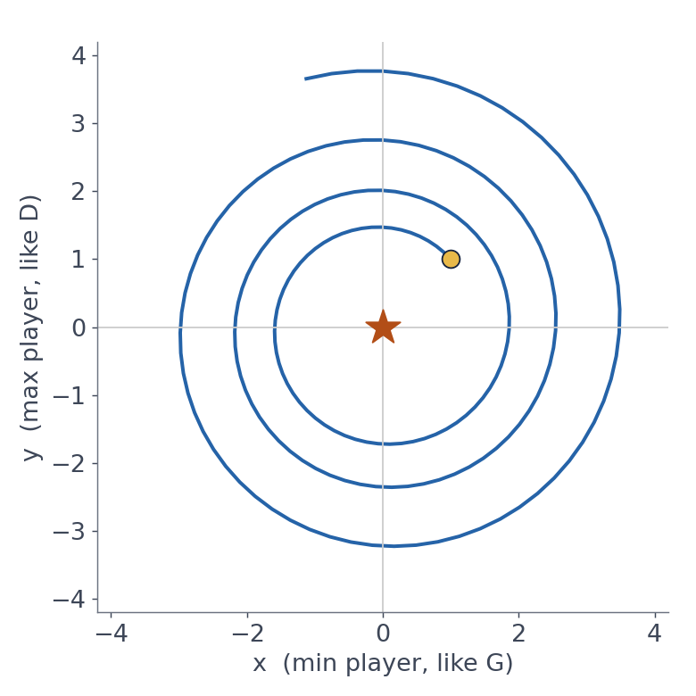
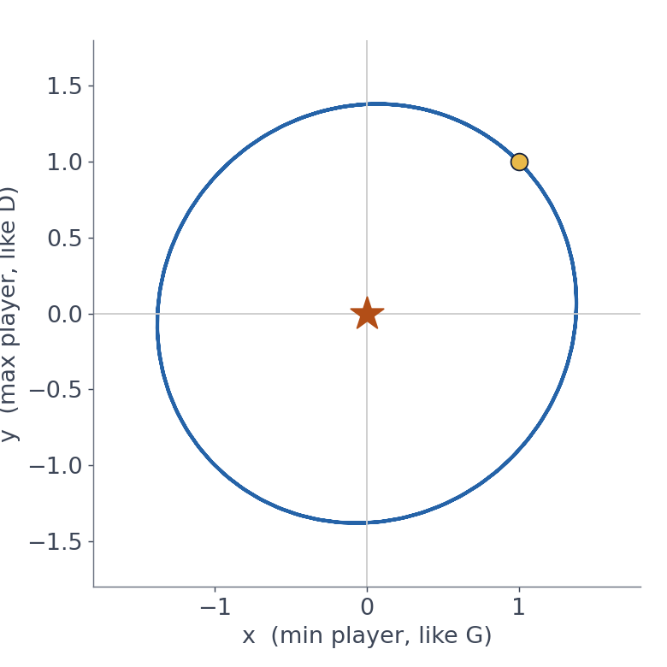
02 · 200 STEPS FROM (1, 1), LR = 0.1 · COMPUTED WITH THE NOTEBOOK'S CODE
Gradient play never lands on the equilibrium
Both move at once: spirals outwards. Distance 1.41 → 3.83.
Take turns (like our GAN): orbits for ever.
GAN Class 2 & 3 · 02 Nash equilibrium · min 32–35 · yellow dot = start, orange star = equilibrium
Notes:
TIME: 32:00–35:00. These two plots were produced by the same play_game function students run in Part 1 of the notebook (200 steps, lr = 0.1, start (1, 1)). [CLICK 1] Simultaneous updates: both players update using the OLD values of the other. The pair spirals OUTWARDS. The distance from the equilibrium grows every step by a factor sqrt(1 + lr²). After 200 steps it goes from about 1.41 to about 3.83. The players are moving away from the answer even though each follows its own gradient perfectly. [CLICK 2] Alternating updates: x moves first, then y reacts to the NEW x. This is what our GAN code does: D step, then G step. Now the path orbits in a closed loop around the equilibrium. It doesn't blow up, but it never arrives either. KEY MESSAGE: "Each player is doing the 'right' thing for itself, and together they circle. This is the mathematical heart of GAN instability. It is the penalty-kick chase, made precise." ASK: "What if we use a smaller learning rate?" Let them guess; the next slide answers (it slows the circling down but does not remove it). Students test this in Exercise 1 of the notebook.

Slide 17
02 · WHY DOES IT CIRCLE?
Each player's best move depends on the other's position
Where they are | x (minimiser) moves… | y (maximiser) moves…
x > 0, y > 0 | left (to make x·y smaller) | up (to make x·y larger)
x < 0, y > 0 | left | down
x < 0, y < 0 | right | down
x > 0, y < 0 | right | up
Follow the rows: up-left, down-left, down-right, up-right… a rotation. Nobody's step aims at (0, 0).
A smaller learning rate only makes the circles slower. Fixing it needs a change to the game or the optimiser, which is what the toolbox in section 05 is about.
GAN Class 2 & 3 · 02 Nash equilibrium · min 35–38
Notes:
TIME: 35:00–38:00. Walk the table as a story, starting top-left quadrant: - At (1, 1): x·y = 1 is positive. x wants it smaller, so x moves left. y wants it larger, so y moves up. Combined move: up-left. - Once x becomes negative (with y still positive): x·y is negative. x still wants it smaller, keeps moving left. y now wants it larger, which means making y smaller (a negative times a smaller positive is less negative), so y moves down. Combined: down-left. - And so on round the four quadrants. [CLICK 1] "Put the four moves together: up-left, down-left, down-right, up-right. That's a circle. At no point does either player's gradient point at the equilibrium, because each gradient depends only on the OTHER player's position." In a GAN: G's best move depends on D's current state (what D currently accepts), and D's best move depends on G's current samples. Same structure, millions of dimensions. [CLICK 2] Learning rate. "Smaller steps mean smaller, slower circles. It doesn't turn the circle into a straight path. Real fixes change something: add damping (e.g. less optimiser momentum), change the loss, regularise D, or give D more information. We'll see those in section 05." Advanced note (optional): mathematically, the "game Jacobian" at (0, 0) has purely imaginary eigenvalues, which is exactly the signature of rotation. Only mention it if the class has seen eigenvalues.

Slide 18
CHECKPOINT · 2 MINUTES · IN PAIRS
Explain it to your neighbour
1. Define Nash equilibrium in one sentence.
A set of choices where no player can do better by changing only their own choice.
2. What is the GAN's equilibrium?
p_g = p_data, and D outputs ½ for every image.
3. Why might gradient training never reach it?
Each gradient depends on the other player, so the steps circle the equilibrium instead of aiming at it.
GAN Class 2 & 3 · 02 Nash equilibrium · min 38–40
Notes:
TIME: 38:00–40:00. Pairs explain to each other (one question each, then swap). Cold-call two pairs, then reveal. [CLICK 1] Definition. Listen for "changing ALONE / only their own choice". Without that phrase the definition is wrong. [CLICK 2] p_g = p_data and D = ½ everywhere. [CLICK 3] The circling/rotation argument from the x·y game. A good student answer also mentions finite networks and non-ideal optimisation (the existence proof assumes ideal conditions). TRANSITION: "Circling is one kind of trouble. In real GANs, it shows up as instability. Let's look at the symptoms and causes."

Slide 19
03
Instability
What it looks like, why it happens, and how to read the two players' scores.
GAN Class 2 & 3 · min 40–55
Notes:
TIME: 40:00. Section 03 runs from minute 40 to minute 55. SAY: "Instability is the umbrella word for 'the training doesn't settle down nicely'. We'll look at the symptoms first, then two main causes: a discriminator that is too strong, and momentum that makes the players overshoot."

Slide 20
03 · WHAT INSTABILITY LOOKS LIKE
Four symptoms of an unstable GAN
1 · Oscillating losses
2 · Quality goes backwards
D and G losses swing up and down in turn and never settle: the circling from section 02.
Samples look good at one epoch and worse at the next. More training is not always better.
3 · One player wins outright
4 · Fragile settings
D's loss drops near 0, G's loss climbs, samples stay noise. G has stopped learning.
A small change of learning rate, optimiser setting or random seed turns success into failure.
GAN Class 2 & 3 · 03 Instability · min 40–43
Notes:
TIME: 40:00–43:00. [CLICK 1] Oscillating losses. Losses trade places: D does well, then G, then D. This is the circling from the x·y game, in a real GAN. Some oscillation is normal; wild swings that never calm down are a warning sign. [CLICK 2] Quality goes backwards. Unlike a classifier, where a later checkpoint is usually at least as good, a GAN can produce better images at epoch 10 than at epoch 15. Practitioners save samples regularly and pick the best checkpoint by looking. [CLICK 3] One player wins. Most often the discriminator becomes nearly perfect: its loss goes towards 0, G's loss rises, and samples stop improving. Next slide explains why G gets stuck. [CLICK 4] Fragility. GANs are famous for being sensitive to hyperparameters. The same code can succeed with one seed and fail with another. In the notebook, students will run the same experiment with two seeds to see this. ASK: "In Class 1's notebook, which of these could you have detected from the printed output alone?" Expected: only a rough version of 1 and 3, because the print showed one last-batch loss per epoch. That's why Part 5 of today's notebook adds better diagnostics.

Slide 21
03 · CAUSE 1 · ARJOVSKY AND BOTTOU, 2017
A discriminator that is too good gives G nothing to learn from
1
2
3
Early on, fakes and real images look completely different. D can separate them perfectly: D(G(z)) ≈ 0.
A perfect D is flat around the fakes: nudging a fake slightly still scores ≈ 0. A flat function has ≈ 0 gradient.
G only learns through D's gradient. No gradient, no learning: the vanishing gradient problem.
Class 1's non-saturating loss (−log D(G(z))) softens this, but a D that is far ahead can still stall G. Balance matters.
GAN Class 2 & 3 · 03 Instability · min 43–47 · Arjovsky and Bottou, "Towards Principled Methods for Training GANs", 2017
Notes:
TIME: 43:00–47:00. Source: Arjovsky and Bottou (2017), "Towards Principled Methods for Training Generative Adversarial Networks", which analyses why gradients vanish when D becomes (near) perfect. [CLICK 1] "At the start, G makes noise, and real images are digits. They look nothing alike. In high-dimensional space the two sets barely overlap, so D can learn to separate them almost perfectly." [CLICK 2] "A perfect D says 'fake' with full confidence in the whole region around the fakes. If G moves a fake a tiny bit, D still says 0. The function is flat there, and the gradient of a flat function is zero." [CLICK 3] "Remember from Class 1: G never sees real data. Its ONLY teacher is D's gradient. If that gradient is zero, G can't tell which way to improve. This is the vanishing gradient problem." [CLICK 4] "In Class 1 we met the partial fix: the non-saturating loss −log D(G(z)) is steep where D(G(z)) is near 0, so G still gets a push. But if D becomes extremely confident, even that can stall. That's why the two players must stay roughly balanced, and why methods like WGAN (section 05) redesign the loss." Common student question: "So should we train D less?" Answer: "Not simply. A weak D gives a bad teacher, with gradients pointing the wrong way. We want D good, but not so saturated that it stops giving useful gradients. Many fixes aim at exactly that: label smoothing, instance noise, gradient penalties, spectral normalisation."

Slide 22
03 · CAUSE 2 · MOMENTUM AND STEP SIZE
Momentum makes a player chase where the opponent used to be
Adam's β1 sets how much of the previous steps' direction is kept in each new step. β1 = 0.9 (the PyTorch default, used in Class 1) remembers a lot; β1 = 0.5 remembers less.
Fixed landscape (classifier): momentum helps. The downhill direction stays the same, so building up speed gets you there faster.
Moving opponent (GAN): momentum can hurt. The best direction keeps changing, and a player with lots of momentum overshoots, widening the circles.
That's why the DCGAN paper recommends Adam with lr = 0.0002 and β1 = 0.5. You'll compare 0.9 vs 0.5 on MNIST in Part 5.
GAN Class 2 & 3 · 03 Instability · min 47–50 · Radford, Metz and Chintala, DCGAN, 2015
Notes:
TIME: 47:00–50:00. Source for the recommended setting: Radford, Metz and Chintala (2015), "Unsupervised Representation Learning with Deep Convolutional GANs" (DCGAN). They report that β1 = 0.9 caused oscillation and instability in their setup, while 0.5 helped stabilise training. Explain β1 simply: Adam keeps a running average of recent gradients (like a heavy ball rolling). β1 is how much of the old average survives each step. With 0.9, roughly the last 10 steps' directions are still influencing the move; with 0.5, only the last couple. [CLICK 1] On a fixed landscape, that memory is useful: the ball speeds up in a consistent downhill direction. [CLICK 2] In a GAN, the best direction changes because the opponent keeps updating. A heavy ball keeps rolling towards where the good direction USED to be, overshoots, and has to swing back. That makes the circles from the x·y game bigger. [CLICK 3] The practical recipe from DCGAN: Adam, lr = 0.0002, β1 = 0.5. Class 1's notebook used lr = 0.0002 but the default β1 = 0.9. In Part 5 students compare the two directly on MNIST. In our test run on real MNIST, the β1 = 0.9 run collapsed to a single noisy output, while β1 = 0.5 (plus label smoothing) produced all ten digits. One run is not proof, but it is a striking example. Also mention the learning rate: too large a step overshoots in the same way; too small slows everything. The x·y game showed that lr alone can't remove the circling.

Slide 23
03 · A BETTER DIAGNOSTIC THAN THE LOSS · NOTEBOOK PART 5
Track D's average opinion of real and fake images
mean D(x) | mean D(G(z)) | Meaning | What to check next
≈ 1 | ≈ 0 | D is winning easily | Is G stuck? Vanishing gradient risk
≈ 0.6–0.8 | ≈ 0.2–0.4 | Healthy contest, D slightly ahead | Are samples improving epoch by epoch?
≈ 0.5 | ≈ 0.5 | D can't tell, or D is broken | Look at samples: good and varied?
swinging | swinging | Oscillation | Try β1 = 0.5 or a smaller learning rate
These two numbers are already computed in the training loop (outputs_real, outputs_fake). Averaging and plotting them costs nothing.
GAN Class 2 & 3 · 03 Instability · min 50–52
Notes:
TIME: 50:00–52:00. This is the "who is winning?" plot students build in Part 5 of the notebook. Explain why these numbers are easier to read than losses: they are probabilities with a clear meaning. D(x) = D's average belief that real images are real. D(G(z)) = D's average belief that fakes are real. Row by row: - D(x) near 1 and D(G(z)) near 0: D wins easily. Risk: G's gradient vanishes (previous slides). Check whether samples are still changing. - Around 0.7 and 0.3: a normal, healthy fight in which D is a bit ahead. Most of a good run looks like this. - Both near 0.5: either the ideal equilibrium, or D is weak or broken. Only the samples can tell you which. (Same warning as Class 1.) - Both swinging up and down: oscillation. Try the momentum fix (β1 = 0.5) or a smaller learning rate. [CLICK 1] "In the Class 1 code, outputs_real and outputs_fake are already there in every batch. We just take .mean() and store it every 100 steps. Part 5 does exactly this." These ranges are rules of thumb, not strict thresholds. Stress "then look at the samples" every time.

Slide 24
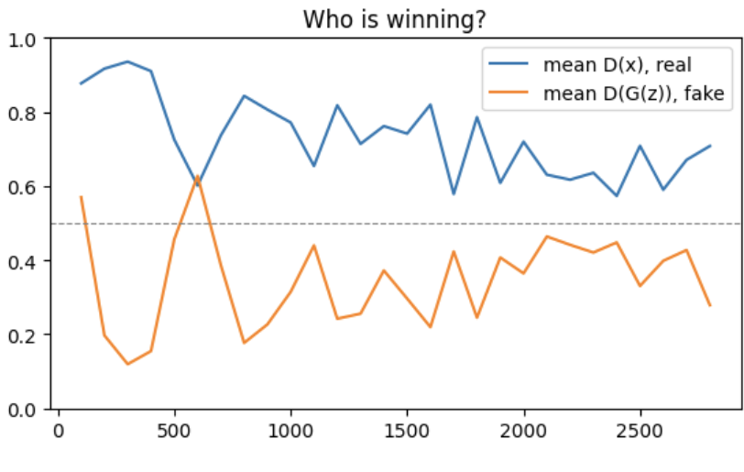
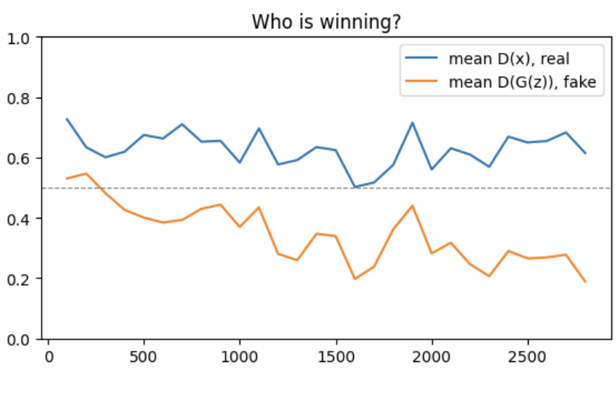
03 · REAL RUN FROM TODAY'S NOTEBOOK (PART 5, MNIST)
Same model, two optimiser settings
Run A · Class 1 settings (β1 = 0.9)
Run B · β1 = 0.5 + label smoothing 0.9
A: D dominates early, a big swing near step 600, then zigzags. B: steadier, smaller swings. But after step 1,000, A's numbers look "healthy" too. What did A's samples look like? Section 04.
GAN Class 2 & 3 · 03 Instability · min 52–54 · one test run: real MNIST, 3 epochs, seed 0
Notes:
TIME: 52:00–54:00. These are real outputs from one test run of the notebook's Part 5 (real MNIST, 3 epochs, seed 0). Students will make these same plots themselves. Their curves will differ in detail. Left, Run A (the Class 1 settings, Adam β1 = 0.9): read it with the table from the previous slide. Around step 300, D(x) is about 0.93 and D(G(z)) about 0.12: D is winning easily. Near step 600 the lines cross (fakes briefly rated MORE real than real images), then the contest zigzags up and down. That big early swing is the oscillation we blamed on momentum two slides ago. [CLICK 1] Right, Run B (β1 = 0.5, plus one-sided label smoothing with real label 0.9): D(x) stays around 0.55–0.7, D(G(z)) drifts from about 0.5 to 0.2–0.4. Smaller, calmer swings. Note: label smoothing deliberately stops D(x) from going to 1, so D(x) values sit a bit lower than without it. [CLICK 2] The twist to set up: after step 1,000, Run A's numbers are in the "healthy contest" band (0.6–0.8 vs 0.2–0.4) too. If this plot were all you had, you might call A fine. Ask: "Is A fine?" Take a guess from the room, then say we will see A's actual samples in section 04. (Answer, don't reveal yet: A collapsed completely.) Lesson: the D plot is better than the losses, but it is still not enough on its own. You need the samples too.

Slide 25
03 · SUMMARY
Instability in one table
Cause | What you see | Typical fix
Circling (game structure) | Losses and D scores swing in turn | Damping: β1 = 0.5, lower lr, better losses
D too strong | D(x) ≈ 1, D(G(z)) ≈ 0, G stuck | Non-saturating loss, smoothing, noise, WGAN-GP
Momentum overshoot | Wide swings, quality goes backwards | Adam β1 = 0.5 (DCGAN)
Fragile settings | Works with one seed, fails with another | Test several seeds; keep checkpoints
GAN Class 2 & 3 · 03 Instability · min 54–55
Notes:
TIME: 54:00–55:00. Quick summary; students can photograph this slide as a revision sheet. Go through the rows in one sentence each. Emphasise the pattern: every fix targets a specific cause. There is no single switch that "makes GANs stable". TRANSITION: "Instability is about the training process. The next problem is about the RESULT: even when training looks calm, the generator can quietly give up on variety. That's mode collapse."

Slide 26
04
Mode collapse
When the generator finds one answer that works and stops exploring.
GAN Class 2 & 3 · min 55–72
Notes:
TIME: 55:00. Section 04 runs from minute 55 to minute 72. SAY: "Mode collapse is the most famous GAN failure. The original 2014 paper already warned about it, calling it the 'Helvetica scenario'. Let's define the word 'mode' first."

Slide 27
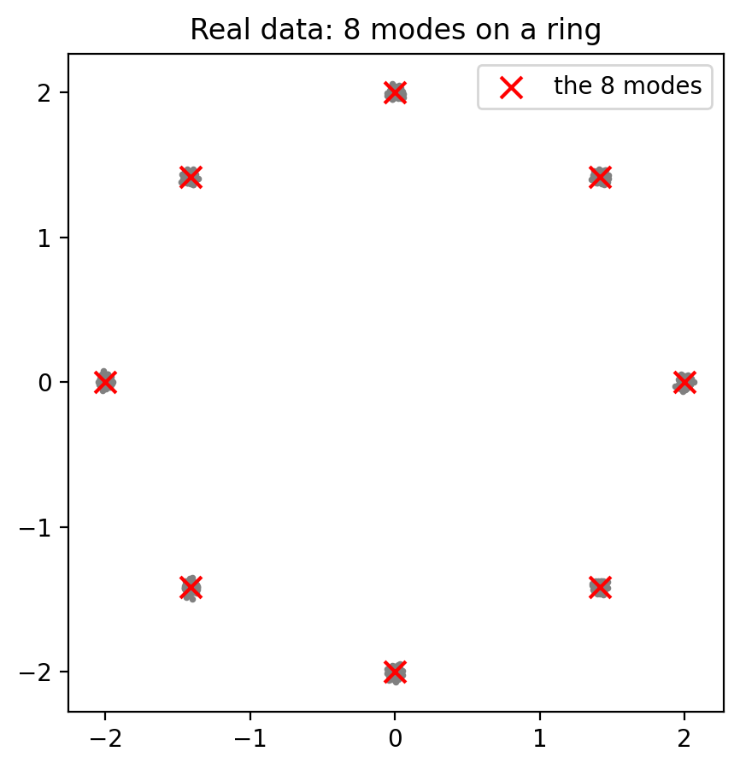
04 · VOCABULARY
A mode is a peak of the data distribution: one "kind" of sample
Notebook's 2-D data: 8 clusters on a ring = 8 modes (right).
MNIST: roughly 10 big modes, one per digit, plus smaller ones for writing styles (slanted 7s, crossed 7s…).
Faces: ages, hair styles, poses, lighting… many modes.
Mode collapse: G produces only one or a few modes. Each sample may look real, but the variety is missing.
GAN Class 2 & 3 · 04 Mode collapse · min 55–58 · plot from the notebook, Part 2
Notes:
TIME: 55:00–58:00. Define "mode" in statistics: the most frequent value, or a peak of a probability distribution. Real data distributions have many peaks: many distinct kinds of samples. [CLICK 1] The notebook's toy data: 8 tight clusters on a circle. Easy to see; we know exactly how many modes there are (8). This is why researchers use it to study mode collapse. [CLICK 2] MNIST: about 10 big modes, the digits. Within each digit, smaller modes: styles of writing. [CLICK 3] Real images like faces have enormous numbers of modes. [CLICK 4] Definition of mode collapse: the generator covers only one or a few modes. The dangerous part: every individual sample can look perfectly real. You only notice by looking at MANY samples together. ASK: "If a digit generator produces perfect 1s and nothing else, will D catch it by looking at one image?" Expected: no, a perfect 1 looks real. This is the key to why collapse happens (two slides ahead).

Slide 28
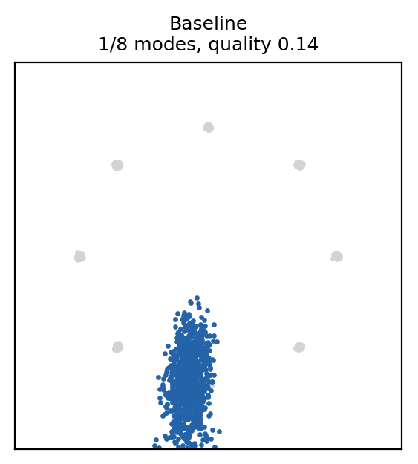
04 · REAL RESULT FROM THE NOTEBOOK · PART 3
Mode collapse, seen directly: 1,000 samples, one region
Grey: real data, 8 clusters.
Blue: 1,000 generated points from 1,000 different noise vectors.
Almost every z is mapped to the same small region, near one cluster. G has settled on "one answer" instead of eight.
The original paper calls this the "Helvetica scenario": G collapses too many values of z to the same x.
GAN Class 2 & 3 · 04 Mode collapse · min 58–61 · baseline: z_dim 256, lr 1e-4, 4,000 steps, seed 0
Notes:
TIME: 58:00–61:00. This is the final snapshot (step 4,000) of the baseline run in Part 3 of the notebook: 256-number noise vector, learning rate 1e-4 for both players, Adam β = (0.5, 0.999), seed 0. [CLICK 1] Explain the picture: grey is real data; blue is 1,000 generated points, each from a different random z. [CLICK 2] "1,000 different inputs, almost the same output. The generator has collapsed its whole input space onto one small region, here sitting just below one of the clusters. It isn't even an accurate copy of a cluster: its quality score is low too. But the key failure is variety: one region instead of eight." [CLICK 3] Historical note: Goodfellow et al. (2014) warned that G must not be trained too much without updating D, "in order to avoid 'the Helvetica scenario' in which G collapses too many values of z to the same value of x". (Helvetica is a typeface; the name is a joke from the authors.) ASK: "Is this generator useless?" Expected: for generating varied data, yes; it gives one kind of point only. Students will reproduce this exact experiment in Part 3; results can differ a little with other seeds.

Slide 29
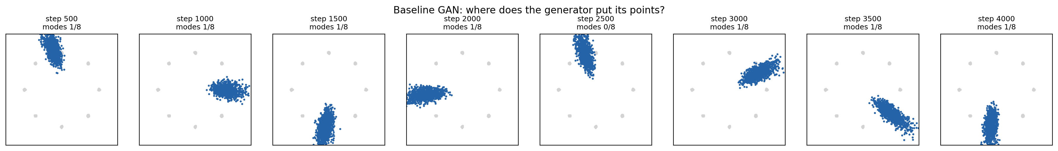
04 · SAME RUN, SNAPSHOTS EVERY 500 STEPS
Mode hopping: the blob jumps around the ring
G sits on a cluster → D learns "points here are fake" → G jumps somewhere else → D follows…
It is the penalty-kick chase from section 02, happening inside a real GAN.
GAN Class 2 & 3 · 04 Mode collapse · min 61–64 · from the notebook's show_snapshots(), fixed noise
Notes:
TIME: 61:00–64:00. These are the snapshots from the same baseline run (the show_snapshots output in Part 3), using the same fixed 1,000 noise vectors at every snapshot. Point along the strip from left to right: "At each moment, the generator covers about one cluster, sometimes sitting between clusters. But never the same place for long. It jumps: top-left, right, bottom, left, top, and so on." [CLICK 1] The cycle: 1. G concentrates on one cluster that D currently accepts. 2. D sees lots of fakes there, and learns that points in that cluster are probably fake. 3. The cluster is now "burned", so G's gradient pushes it to somewhere D still likes: another cluster. 4. D follows, and the cycle repeats. [CLICK 2] Link to section 02: this is the best-response chasing from the penalty kick. No player settles, because each player keeps reacting to the other's latest move. The stable solution would be the "mixed strategy": G spreading over all 8 clusters, like the kicker randomising. ASK: "Why doesn't G simply spread out over all 8 clusters, which would be the equilibrium?" Guide: nothing in the standard loss directly rewards spreading out. Next slide.

Slide 30
04 · WHY IT HAPPENS
Three reasons the generator gives up on variety
D judges one sample at a time
G optimises against today's D
Nothing rewards spreading out
A perfect "1" looks real on its own. D never sees that all the samples are 1s, so it can't penalise missing variety.
G's gradient says "move towards what D likes right now". The fastest way is to send every z to D's current favourite spot.
The standard loss scores each fake separately. Covering all modes earns no extra reward in any single step.
GAN Class 2 & 3 · 04 Mode collapse · min 64–67
Notes:
TIME: 64:00–67:00. [CLICK 1] D is a one-at-a-time judge. It receives one image and outputs one number. A generator producing only perfect 1s passes this test image by image. D has no way to say "you're only making 1s!", because it never looks at the batch as a whole. [CLICK 2] G is short-sighted. Its update is the gradient of its loss against the CURRENT D. The locally best move is to push every z towards the region D currently rates most real. If one region is best right now, everything gets pulled there. [CLICK 3] The loss doesn't pay for variety. Each fake's loss is computed separately and averaged. Spreading out over all modes doesn't lower G's loss in any given step; it only matters over time, in the "mixed strategy" sense from the penalty kick. Theory note (optional, for strong students): in the ideal minimax game, D is at its best for every G, and a collapsed G would be punished. In practice we alternate single gradient steps, closer to a "max-min" ordering where G moves against a fixed D, and G's best response to a fixed D is to collapse onto D's favourite point. Goodfellow's 2016 NeurIPS tutorial discusses this ordering argument. This slide sets up the fixes: minibatch features (fix 1), better losses and regularisation (fix 2), and training tricks.

Slide 31
04 · KINDS AND DETECTION
How to catch mode collapse
Kind | Example (MNIST)
Complete | Every sample is the same "1"
Partial | Only 3, 7 and 1 appear; other digits missing
Within a mode | All 7s, but every one in the same style
Hopping | All 1s now, all 8s an epoch later
1 · Look at a grid of 64+ samples, not one image.
2 · Fixed-noise grid each epoch: spot hopping.
3 · Count classes with a pretrained classifier: a flat histogram is good; a few tall bars means collapse.
4 · Coverage metrics such as our "modes covered", or FID in research papers.
GAN Class 2 & 3 · 04 Mode collapse · min 67–69 · tools 2 and 3 are built in notebook Part 5
Notes:
TIME: 67:00–69:00. Left table, kinds of collapse: - Complete: one output for every z (like our 2-D baseline). - Partial: some modes covered, others missing. Very common in practice. - Within-mode: all digits present, but little style variety inside each. Hardest to spot by eye. - Hopping: coverage changes over time (we saw it on the ring). Right, detection tools: [CLICK 1] Grids: always look at many samples at once. One nice image proves nothing about variety. [CLICK 2] Fixed noise: the same z every epoch. If the whole grid suddenly changes to another digit, that is hopping. [CLICK 3] Class histogram: run a pretrained classifier on 1,000 generated images and count predictions. On MNIST a healthy generator gives roughly 100 of each digit. Students build this in Part 5 (a quick classifier trained for one epoch). [CLICK 4] Metrics: our "modes covered" works because we know the true modes of the toy data. For real images, researchers use statistics such as FID (Fréchet Inception Distance), which compares feature statistics of real and generated images and drops when diversity is missing. Just name it; details belong to later classes.

Slide 32
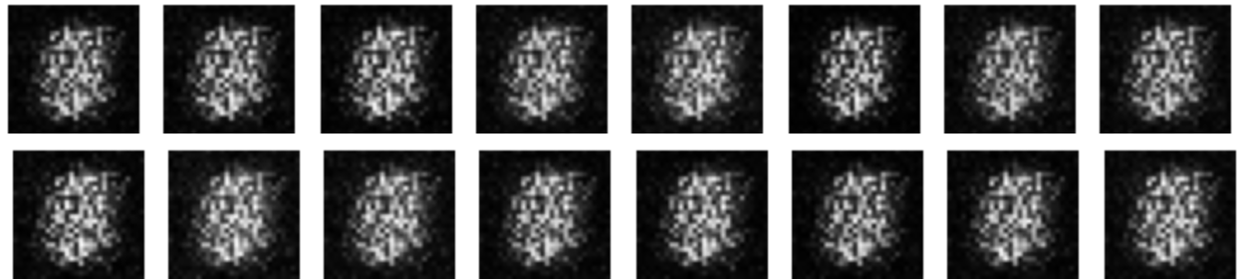
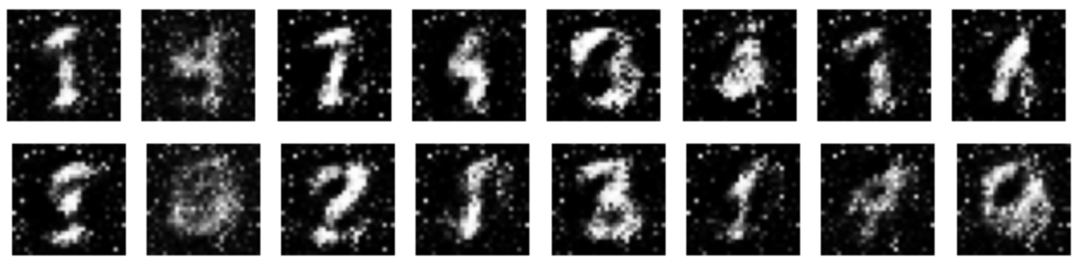
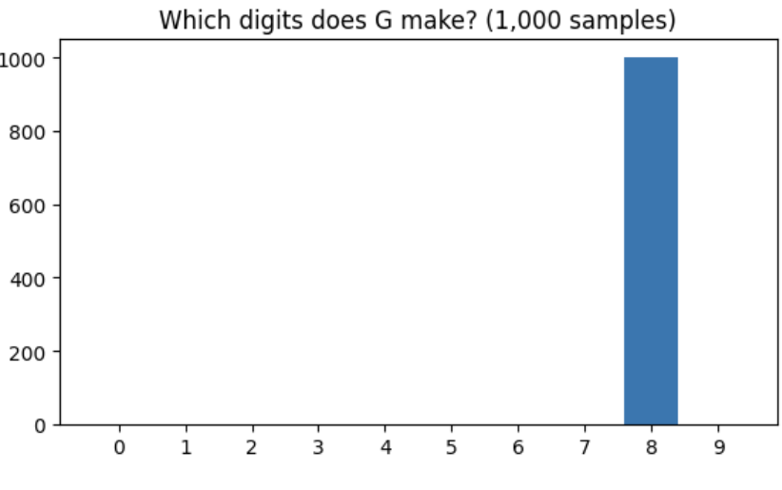
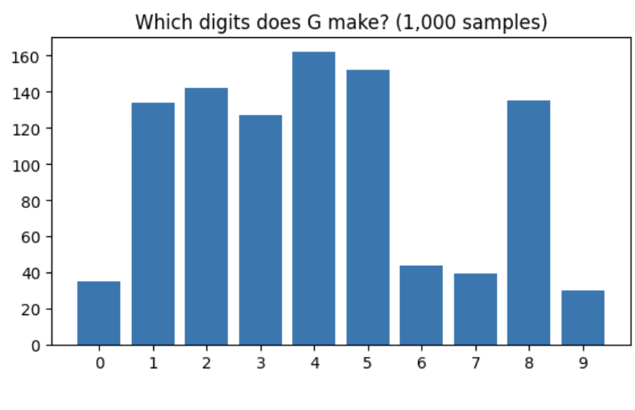
04 · REAL RUN FROM TODAY'S NOTEBOOK (PART 5, MNIST)
Run A collapsed completely. Run B made all ten digits.
Run A · β1 = 0.9 · 16 fixed-noise samples
Run B · β1 = 0.5 + smoothing · same 16 noises
GAN Class 2 & 3 · 04 Mode collapse · min 69–71 · one test run: real MNIST, 3 epochs, seed 0
Notes:
TIME: 69:00–71:00. The payoff from the "who is winning?" slide in section 03. Same test run: real MNIST, 3 epochs, seed 0, same 16 fixed noise vectors for both runs. Left top, Run A samples: 16 DIFFERENT noise vectors, and every output is the same noisy grey blob. This is complete mode collapse, the first row of the table on the previous slide. Remind students: A's D plot looked "healthy" for most of training. [CLICK 1] Run A's digit histogram: all 1,000 samples labelled "8". THE TRAP: read alone, this says "the generator only makes eights". But the grid shows it doesn't make digits at all. The classifier must always output some digit, so it picks the closest one for the blob. A histogram measures variety, not quality. Grid + histogram + D plot together tell the true story. [CLICK 2] Run B, the same 16 noise vectors: varied, recognisable digits. Its histogram covers all ten digits (roughly 30 to 160 per digit rather than a perfect 100 each; some digits are rarer, and the quick classifier also mislabels some ugly samples). Partial imbalance, but no collapse. Framing: this is ONE run with one seed. It does not prove β1 = 0.9 always collapses. It is a vivid example of what the DCGAN recipe is meant to prevent. In Part 5 students run both and compare their own results; theirs may differ. Question to the room: "Which of our four detection tools would have caught Run A? Which would have fooled you?" (Grid catches it immediately; the histogram alone misleads; losses and D plot alone looked unremarkable.)

Slide 33
CHECKPOINT · DIAGNOSE IT · 2 MINUTES
Instability, mode collapse, or healthy?
a. Losses calm; D(x) ≈ 0.6, D(G(z)) ≈ 0.4; histogram: 600 × "1", 400 × "7".
Partial mode collapse. Calm losses can hide it.
b. D(x) → 1.0, D(G(z)) → 0.0, samples still noise after 5 epochs.
Instability: D too strong; vanishing gradients for G.
c. Losses wobble; roughly 100 of each digit; samples improve each epoch.
Healthy. Some wobble is normal.
GAN Class 2 & 3 · 04 Mode collapse · min 71–72
Notes:
TIME: 71:00–72:00. Give pairs 60 seconds, then take answers for each case before revealing. [CLICK 1] a. Partial mode collapse: only two digits. The D scores and losses look fine; only the histogram (or a sample grid) reveals it. [CLICK 2] b. D is winning completely; G gets no useful gradient. Instability, specifically the "D too strong" cause. Fixes: β1 = 0.5, label smoothing, instance noise, a gradient penalty. [CLICK 3] c. Healthy: wobbling losses are normal for a two-player game; the histogram is even and samples improve. TRANSITION: "We've seen what goes wrong. Now, what can we do about it?"

Slide 34
05
The stabilisation toolbox
Each fix targets a specific problem. None of them is magic.
GAN Class 2 & 3 · min 72–85
Notes:
TIME: 72:00. Section 05 runs from minute 72 to minute 85. SAY: "Since 2014, researchers have proposed many tricks to tame GAN training. We'll map the most common ones to the problems they target, look at what happened when we tested five of them on the ring data, and finish with the idea behind WGAN, the best-known redesign of the GAN loss."

Slide 35
05 · FIX → PROBLEM IT TARGETS
Common fixes and what each one is for
Fix | How it works | Targets
Non-saturating G loss (2014) | G minimises −log D(G(z)) | Vanishing gradients early
Adam β1 = 0.5 (DCGAN, 2015) | Less momentum | Oscillation, overshoot
One-sided label smoothing (2016) | Real target 0.9 instead of 1 | Over-confident D
Instance noise (2016–17) | Add noise to real and fake inputs of D | D separates too easily
TTUR (2017) | Different learning rates for D and G | D lagging behind G
Minibatch discrimination / std (2016, 2018) | D sees statistics of the whole batch | Mode collapse
Spectral normalisation (2018) | Limits how steep D can be | Unstable D gradients
WGAN / WGAN-GP (2017) | New loss: a distance, not a probability | Vanishing gradients, instability
GAN Class 2 & 3 · 05 Toolbox · min 72–76 · full references on the last slide
Notes:
TIME: 72:00–76:00. Go row by row; one or two sentences each. The references are on the last slide. - Non-saturating loss (Goodfellow et al. 2014): we already use it. Strong gradients when fakes are bad. - Adam β1 = 0.5 (Radford et al., DCGAN, 2015): less momentum, less overshoot. - One-sided label smoothing (Salimans et al. 2016, "Improved Techniques for Training GANs"): train D with real target 0.9 instead of 1.0 so it can't become infinitely confident on real data. "One-sided" because fake targets stay 0. - Instance noise (Sønderby et al. 2016; analysed by Arjovsky and Bottou 2017): add a little noise to both real and fake inputs of D, so the two distributions overlap and D's gradients stay informative. - TTUR, two time-scale update rule (Heusel et al. 2017): give D and G different learning rates, typically D faster. Under assumptions it is proven to converge to a local Nash equilibrium. The same paper introduced the FID metric. - Minibatch discrimination (Salimans et al. 2016) and the simpler minibatch standard deviation layer (Karras et al. 2018, Progressive GANs): D gets information about the whole batch, so it can detect a lack of variety. This directly targets mode collapse, the reason from the "D judges one sample at a time" slide. - Spectral normalisation (Miyato et al. 2018): constrains each layer of D so its output can't change too sharply. Smoother, more reliable gradients. - WGAN (Arjovsky, Chintala and Bottou 2017) and WGAN-GP (Gulrajani et al. 2017): replace the probability-based loss with a distance between distributions. Next-but-one slide. KEY MESSAGE: "When you read about a trick, ask: which problem does it target? That tells you when it will help."

Slide 36
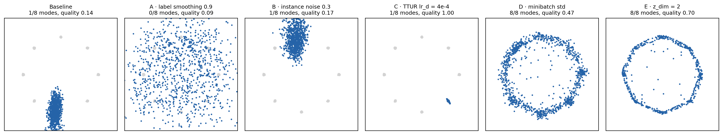
05 · WE TESTED FIVE FIXES ON THE COLLAPSED RING GAN · NOTEBOOK PART 4
Only the fixes aimed at variety fixed the collapse
Baseline | A · smoothing | B · noise | C · TTUR | D · mb-std | E · z_dim 2
1/8 modes | 0/8, scattered | 1/8 | 1/8, precise | 8/8 | 8/8
Minibatch std lets D see variety, which attacks the cause. Smoothing and noise calm an over-confident D, a different problem.
GAN Class 2 & 3 · 05 Toolbox · min 76–79 · one run each, seed 0, 4,000 steps; your results may differ
Notes:
TIME: 76:00–79:00. These are real results from running Part 4 of the notebook while preparing the class (seed 0, 4,000 steps each, starting from the collapsed baseline settings). Students will run the same experiments. Left to right: - Baseline: one blob. Collapsed. - A, one-sided label smoothing (real target 0.9): did NOT fix it. The generator never settled; points ended up scattered over the whole plane, missing the clusters. - B, instance noise: still one blob. - C, TTUR (D learns 4× faster): sharper points but still only one mode in this run. On another machine with the same seed it reached 2 of 8 as a short arc, so expect 1–3. Better quality, collapse not fixed. - D, minibatch standard deviation: all 8 modes. D can now detect that the batch has too little spread, so collapsing is punished. Some points still fall between clusters. - E, a 2-number noise vector instead of 256: all 8 modes, drawn as a thin ring. G maps a smooth 2-D input onto the ring, so a few points sit on the bridges between clusters. [CLICK 1] Summary table. [CLICK 2] Lesson: "Match the fix to the cause. Collapse happens because D can't see variety, so the fix that lets D see variety worked. Tricks designed for an over-confident D didn't." A second run on a different machine (same seed) gave nearly the same pattern: baseline 1/8, A 0/8, B 1/8, C 2/8, D 8/8, E 8/8. Honesty note for students: one run per setting is not a scientific study. In the notebook they will re-run the best setting with a second seed to check whether it's reliable.

Slide 37
05 · INTUITION ONLY · ARJOVSKY ET AL. 2017; GULRAJANI ET AL. 2017
WGAN: measure how far apart, not just "real or fake"
Standard GAN discriminator
WGAN "critic"
Outputs a probability. When fakes are far from real data it just says "0, fake", however far away they are. Near-zero gradient: G doesn't know which way to go.
Outputs an unbounded score estimating the earth mover's distance: how much "earth" must move to turn the fake pile into the real pile. Farther away, bigger score: always a useful slope.
The critic must be "smooth" (1-Lipschitz). WGAN enforces this by clipping weights; WGAN-GP adds a gradient penalty, the more reliable choice. Not a cure-all: in our short test it did not fix the ring collapse.
GAN Class 2 & 3 · 05 Toolbox · min 79–82
Notes:
TIME: 79:00–82:00. Keep this at the intuition level. The full maths is beyond class 2. [CLICK 1] "Recall the 'D too strong' problem: once fakes and real images are clearly separated, a probability-based D is flat: it just says 'fake'. Its gradient doesn't tell G how far off it is, or in which direction." [CLICK 2] "WGAN changes what D measures. Instead of 'probability of real', the network, now called a critic, estimates the Wasserstein-1 distance, also called the earth mover's distance. Picture the real data as a pile of earth and the fake data as another pile: the distance is the minimum work needed to move one pile into the shape of the other. If the fakes are far away, the distance is large; move them closer and it shrinks smoothly. So G always gets a slope to follow." [CLICK 3] "For the maths to work, the critic must not change too steeply (it must be 1-Lipschitz). The original WGAN clipped the weights to a small range, which was crude. WGAN-GP instead adds a penalty that keeps the critic's gradient norm close to 1, and is the standard choice." HONEST NOTE: "When we tried WGAN-GP on the collapsed ring setup for 4,000 steps, it did not recover the modes. It is slower (5 critic steps per generator step) and has its own settings to tune. Every tool has costs; test, don't assume." (This test was run while preparing the course; WGAN-GP is not part of the students' notebook.) References: Arjovsky, Chintala and Bottou (2017) "Wasserstein GAN"; Gulrajani et al. (2017) "Improved Training of Wasserstein GANs".

Slide 38
RECAP · END OF THE THEORY
Today's theory in five sentences
1. A GAN chases a moving target, so its losses don't show quality.
2. Its goal is a Nash equilibrium: p_g = p_data and D = ½, where no player gains by changing alone.
3. Gradient play circles that point, so training can oscillate, overshoot or stall (instability).
4. G can fool a one-sample-at-a-time D with a few outputs: mode collapse and hopping.
5. Fixes target specific causes. Diagnose with D scores, fixed-noise grids and histograms, then test.
Now: see all five happen in the notebook.
GAN Class 2 & 3 · Recap · min 82–85
Notes:
TIME: 82:00–85:00. Ask a different student to read each sentence aloud as it appears, then ask the class: "Which slide or example showed this?" Expected: 1 → loss-lies ring plot; 2 → penalty kick and the GAN game; 3 → x·y spiral; 4 → ring collapse and hopping; 5 → toolbox and experiment results. [CLICK 6] "Everything we just discussed has an experiment in the notebook. Open GAN-Class-2-3-Training-Dynamics.ipynb." This ends the 85-minute theory block.

Slide 39
06
Hands-on: GAN-Class-2-3-Training-Dynamics.ipynb
85 minutes. Every idea from today, as an experiment you run yourself.
GAN Class 2 & 3 · min 85–170
Notes:
TIME: 85:00. Notebook block: minutes 85 to 170. Plan (matches the notebook's own table): - 85–90: Part 0, setup - 90–102: Part 1, the x·y game and Nash equilibrium (+ Exercise 1) - 102–110: Part 2, the 8-cluster ring data and the two players - 110–122: Part 3, watching mode collapse (+ Exercise 2) - 122–142: Part 4, stabilisation experiments (+ Exercise 3) - 142–164: Part 5, MNIST diagnostics (+ Exercise 4) - 164–170: Part 6, wrap-up and reflection questions Logistics: - Everything runs on CPU. Ring experiments take about 40–60 s each on a typical laptop; the MNIST runs about 1–3 minutes each. Times vary by machine, so check on a classroom machine beforehand. - MNIST downloads the first time (about 10 MB) into ./data. If the network is slow, share a pre-downloaded data folder. - Students type answers into the "Your answer" markdown cells; ask them to submit the notebook at the end if you want to grade it. - Show the next slides as each part begins.

Slide 40
06 · MAP OF THE NOTEBOOK
Six parts, 85 minutes, one idea each
Part | What you do | Links to theory | Time
0 | Setup: imports and seeds | — | 5 min
1 | Play the x·y game; watch it spiral and orbit | 02 Nash equilibrium | 12 min
2 | Meet the 8-cluster ring data and the two players | 04 What is a mode | 8 min
3 | Train a GAN and watch it collapse and hop | 01, 04 Mode collapse | 12 min
4 | Test five fixes; fill in the results table | 05 Toolbox | 20 min
5 | MNIST with diagnostics: D scores, grids, digit counts | 03 Instability | 22 min
6 | Wrap-up and reflection questions | all | 6 min
Run cells top to bottom. At every ✏️ Predict, write your guess before running.
GAN Class 2 & 3 · 06 Notebook · min 85–90 (Part 0: setup)
Notes:
TIME: 85:00–90:00. While students open the notebook and run Part 0, walk through the map. Each part is designed to show one idea from the theory: - Part 1 is the x·y game exactly as on the slides; students change the learning rate. - Part 2 builds the 8-cluster ring and the mode_coverage measurement. - Part 3 is the collapsed baseline from the "loss-lies", "collapse" and "hopping" slides. - Part 4 is the five-fix experiment from the "our results" slide. Students fill in a results table. - Part 5 returns to MNIST with the diagnostics from sections 03–04: D(x)/D(G(z)) plot, fixed-noise grid per epoch, and a digit-count histogram from a small classifier. Run A uses Class 1 settings; Run B uses β1 = 0.5 and one-sided label smoothing. - Part 6: reflection questions (good for homework if time runs short). Stress the "Predict first" rule: it is what turns the notebook from copy-paste into learning.

Slide 41
PART 1 · 12 MINUTES · INDIVIDUALLY
The x·y game: find the equilibrium, watch gradients miss it
1
Predict, then run play_game: simultaneous vs alternating updates. Compare the distances printed.
2
Run the arrow-field cell. Where do the arrows point?
3
Exercise 1: try lr = 0.01, 0.1, 0.5 and 2,000 alternating steps. Does a smaller lr fix it, or only slow it?
4
Write one sentence: why is "each player descends its own loss" not "minimise one loss"?
GAN Class 2 & 3 · 06 Notebook · min 90–102
Notes:
TIME: 90:00–102:00. Expected results (from our run of the notebook): - Simultaneous, lr 0.1, 200 steps: distance grows from 1.41 to 3.83. - Alternating: distance stays around the start (it ends at 1.36 after 200 steps) because the path orbits. - Exercise 1 printout: lr 0.01 → 1.428 (barely moves outward: slower spiral), lr 0.1 → 3.825, lr 0.5 → about 6.9 × 10⁹ (explodes). - 2,000 alternating steps: still orbiting, never reaching (0, 0). Answers for 3 and 4: - A smaller lr only slows the spiral; it doesn't change its direction. - Two players each minimising their OWN loss is not a single optimisation: each gradient depends on the other player, which produces rotation. A single loss has gradients that always point downhill on one fixed surface. Walk around and check that students actually write predictions before running.

Slide 42
PARTS 2 AND 3 · 20 MINUTES · INDIVIDUALLY, THEN COMPARE WITH A NEIGHBOUR
A GAN you can see: watch it collapse
1
Part 2: plot the 8-cluster data; check that real data scores 8/8 modes.
2
Part 3: predict, then train the baseline (about a minute). Study the snapshots and the two plots.
3
Exercise 2: how many modes? Did the blob move? Re-run with seed=1.
4
Explain in your own words why D doesn't punish G for ignoring 7 clusters.
GAN Class 2 & 3 · 06 Notebook · min 102–122
Notes:
TIME: 102:00–122:00 (Part 2: 102–110, Part 3: 110–122). Part 2 checkpoints: - Real data should score (8, 1.0): 8 modes, quality 1.0. - Make sure students understand the two numbers of mode_coverage: modes covered, and quality (fraction of points near any cluster). - Mention BCEWithLogitsLoss: same maths as Sigmoid + BCELoss from Class 1, just numerically safer. Part 3 expected (seed 0): one blob at every snapshot, jumping around the ring; modes covered stays at 0–1; the loss plot wobbles in a rhythm but gives no warning. These are the plots from the "loss-lies", "collapse" and "hopping" slides. Exercise 2 answers: 1. Usually 1 of 8, with the blob moving between snapshots. 2. Other seeds typically show the same collapse, sometimes in a different place. 3. D judges one point at a time. A point sitting in or near a real cluster looks real on its own, so D has no signal about the missing variety. Timing tip: the baseline takes about a minute on a laptop. Use the waiting time to ask students to predict what the snapshots will show.

Slide 43
PART 4 · 20 MINUTES · IN PAIRS
Five fixes, one task: which ones really work?
Experiment | Change in train_ring_gan(…) | Predict: fixes collapse?
A · label smoothing | real_label=0.9 | yes / no / partly
B · instance noise | instance_noise=0.3 | yes / no / partly
C · TTUR | lr_d=4e-4 | yes / no / partly
D · minibatch std | mbstd=True | yes / no / partly
E · smaller noise | z_dim=2 | yes / no / partly
1. Write predictions. 2. Run all five (about 5 minutes). 3. Fill in the results table in the notebook. 4. Re-run the best with seed=1. 5. Challenge: combine two fixes.
GAN Class 2 & 3 · 06 Notebook · min 122–142
Notes:
TIME: 122:00–142:00. Pairs: one student runs while the other records predictions and results. Ask for predictions BEFORE the runs and write a quick tally on the board ("who thinks A fixes it?"). Many students will predict label smoothing works; the result is a useful surprise. Expected (seed 0, checked on two machines): A 0/8 (scattered), B 1/8, C 1–2/8 (sharper but collapsed), D 8/8, E 8/8. Small differences between machines are normal. Discussion at ~138:00: - Why did D work? D sees the batch's spread, so a collapsed batch is easy to reject. - Why did E work? With a 2-number input, G's smooth map tends to stretch over the whole ring rather than fold everything into one blob. Not a general rule: in real image GANs, latent sizes like 100 or 128 are common. - Seed check: good practice. One success could be luck. - Combination challenge: e.g. mbstd=True with lr_d=4e-4. Report whatever happens; there is no single right answer. Runs that finish early: try more steps (steps=8000) for the best setting.

Slide 44
PART 5 · 22 MINUTES · IN PAIRS
Back to MNIST: diagnose the Class 1 GAN properly
Losses
Who is winning?
Which digits?
Every 100 steps, with reference lines at 1.386 and 0.693.
Mean D(x) and D(G(z)). Read it with the table from section 03.
A quick classifier labels 1,000 fakes. Even bars = variety; a few tall bars = collapse.
Run A: Class 1 settings (β1 = 0.9). Run B: β1 = 0.5 + label smoothing 0.9. Predict first, then compare grids, histograms and D scores. Exercise 4 asks which run is healthier, and whether the losses alone could have told you.
GAN Class 2 & 3 · 06 Notebook · min 142–164
Notes:
TIME: 142:00–164:00. Each MNIST run is 3 epochs, about 1–3 minutes on a laptop CPU (it took about 80 seconds in our test run). The digit classifier trains for 1 epoch first (tens of seconds). [CLICK 1] Losses, with the equilibrium reference lines from section 02. [CLICK 2] The "who is winning?" plot: mean D(x) and mean D(G(z)) every 100 steps. Use the section-03 table to read it. [CLICK 3] The digit histogram: a small MLP classifier trained for one epoch labels 1,000 generated digits. We only use it as a measuring tool. [CLICK 4] The comparison. In a test run on real MNIST (seed 0, 3 epochs): Run A collapsed completely. Every fixed-noise image was the same noisy blob, and the digit counter labelled all 1,000 samples as "8". Run B produced recognisable, varied digits, with counts spread over all ten digits (lowest about 30, highest about 160). Students' results may differ, but this is a vivid example. Point out the trap: the histogram alone said "1,000 eights", but the grid shows it is junk. The counter always outputs some digit. What matters is that students USE all three diagnostics together and write down their evidence. Exercise 4 guidance: 1. Healthier run: judge from grids (quality), histogram (variety) and D plot (balance), not from one number. 2. Digits that appear rarely: often those with complex shapes or ones the generator hasn't reached yet; also, the quick classifier can mislabel ugly digits. Discuss uncertainty. 3. Losses alone: usually no. That's the main lesson of the day. 4. Optional 10-epoch run: watch fixed-noise rows change. If time is short, run A in class and B as homework.

Slide 45
PART 6 · WRAP-UP AND DEBRIEF · 6 MINUTES
What did your experiments show?
Notebook part | What it demonstrated
1 · x·y game | Gradient play circles a Nash equilibrium; smaller lr only slows it
3 · ring baseline | Mode collapse and hopping, invisible in the loss curve
4 · five fixes | Fixes work only on the problem they target; check with another seed
5 · MNIST diagnostics | D scores, fixed-noise grids and digit counts show what losses hide
Reflection questions (end of the notebook, finish as homework): explain Nash equilibrium with x·y · why simultaneous spirals out · why one-sample D misses collapse · which diagnostic you'd check first.
GAN Class 2 & 3 · 06 Notebook · min 164–170
Notes:
TIME: 164:00–170:00. Whole-class debrief. Ask one pair per row to share their evidence in 30 seconds: - Part 1: the spiral/orbit, and what changing lr did. - Part 3: how many modes, and whether the blob moved. - Part 4: their results table. Did anyone get a different result with seed = 1? Did any combination beat minibatch std? - Part 5: which MNIST run looked healthier, and which plot convinced them. Close with the key sentence: "GAN training is a game, not a descent. Measure the result with samples and variety, and choose fixes by the problem they target." Reflection questions in Part 6 of the notebook can be homework if time runs out.

Slide 46
EXIT TICKET · 3 MINUTES · ON PAPER, NO NOTES
Before you leave, answer four questions
1
Define Nash equilibrium. What is the GAN's equilibrium?
2
Losses look calm, but 900 of 1,000 samples are the digit 1. Name the problem and one fix.
3
Mean D(x) ≈ 1.0 and D(G(z)) ≈ 0.0 for a long time. What is happening to G?
4
One thing still confusing (your "muddiest point").
Answers: 1 nobody gains by changing alone; p_g = p_data, D = ½ · 2 mode collapse; minibatch std / minibatch discrimination · 3 D too strong, G's gradients vanish
Notes:
TIME: 170:00–173:00, then 2 minutes on the last slide. Collect slips before revealing answers. Expected answers: 1. A set of choices where no player can do better by changing only their own choice. GAN: p_g = p_data and D(x) = ½ everywhere. 2. Mode collapse (partial or near-complete). Fixes that target it: minibatch standard deviation or minibatch discrimination. Also acceptable: other variety-focused changes with a sensible justification. Label smoothing alone is not a targeted answer; ask the student why they chose it. 3. D is winning easily; its output is flat around the fakes, so G's gradients vanish and G stops improving. Fixes: β1 = 0.5, label smoothing or instance noise, a gradient penalty (WGAN-GP) or spectral normalisation. 4. Muddiest point: read before Class 4, open the next class with the top two. [CLICK 1] Reveal short answers after collecting.

Slide 47
NEXT CLASS AND FURTHER STUDY
Next: DCGAN and conditional GAN
CLASS 4
FURTHER STUDY: WATCH AT HOME
Convolutional G and D (DCGAN), and telling G which digit to draw (conditional GAN).
DeepBean, Understanding GANs: 12:14 game theory · 13:18 / 15:33 optimal D and G · 17:26 training dynamics · 22:13 non-convergence · 23:39 mode collapse
PAPERS BEHIND TODAY'S SLIDES
Goodfellow et al. 2014, GANs · Radford et al. 2015, DCGAN · Salimans et al. 2016, Improved Techniques · Goodfellow 2016, NIPS tutorial · Arjovsky and Bottou 2017, Principled Methods · Arjovsky et al. 2017, WGAN · Gulrajani et al. 2017, WGAN-GP · Heusel et al. 2017, TTUR · Karras et al. 2018, Progressive GAN · Miyato et al. 2018, Spectral Norm
HOMEWORK
Finish Part 6 reflections. Optional: Run B for 10 epochs.
GAN Class 2 & 3 · min 173–175
Notes:
TIME: 173:00–175:00. Next class (Class 4): DCGAN, meaning convolutional generators and discriminators (the notebook from Class 1 already contains a DCGAN generator skeleton), and conditional GANs, which give both networks the label so we can ask for a specific digit. That is the Class 1 notebook's assignment. Homework: finish the reflection questions in Part 6. Optional: train Run B for 10 epochs and bring the fixed-noise grid. Further study: the DeepBean video covers today's topics from 12:14 to the end, about 14 minutes. Paper list (for interested students; none is required reading): - Goodfellow et al. 2014, Generative Adversarial Nets (equilibrium; Helvetica scenario) - Radford, Metz, Chintala 2015, DCGAN (Adam β1 = 0.5) - Salimans et al. 2016, Improved Techniques for Training GANs (minibatch discrimination, one-sided label smoothing) - Goodfellow 2016, NIPS 2016 Tutorial: Generative Adversarial Networks (mode collapse discussion) - Arjovsky and Bottou 2017, Towards Principled Methods for Training GANs (vanishing gradients, instance noise) - Arjovsky, Chintala, Bottou 2017, Wasserstein GAN - Gulrajani et al. 2017, Improved Training of Wasserstein GANs (gradient penalty) - Heusel et al. 2017, GANs Trained by a Two Time-Scale Update Rule Converge to a Local Nash Equilibrium (TTUR, FID) - Karras et al. 2018, Progressive Growing of GANs (minibatch standard deviation) - Miyato et al. 2018, Spectral Normalization for GANs

