Slide 1
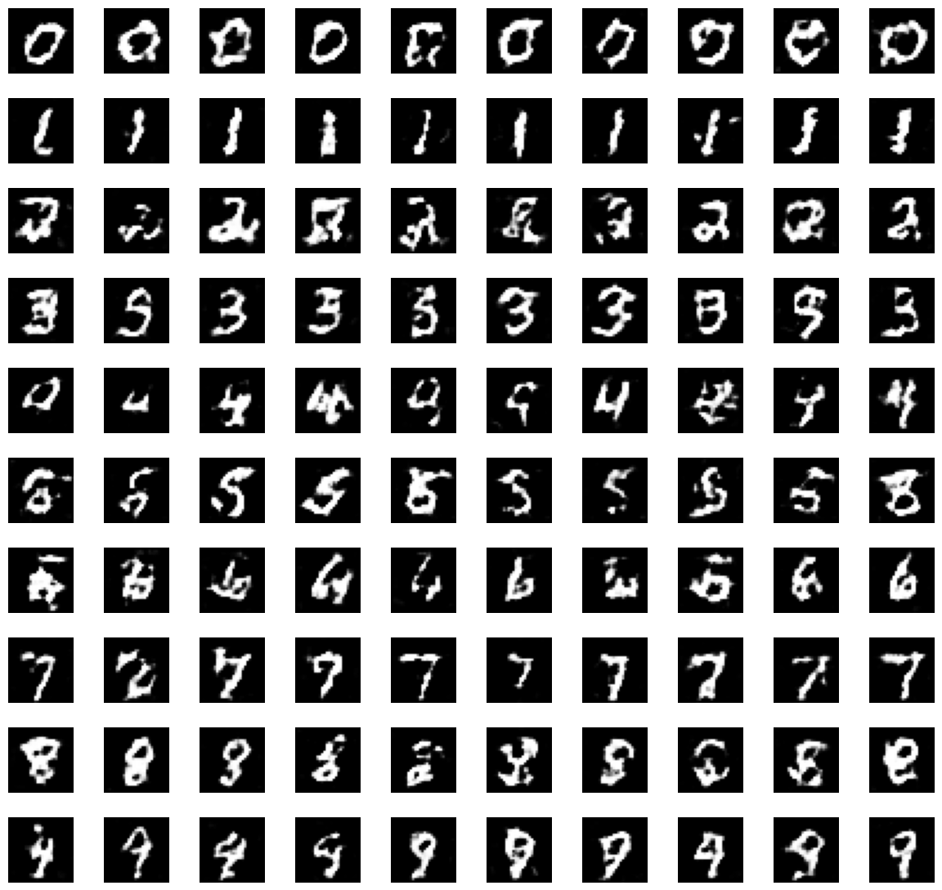
GAN Class 4: DCGAN and Conditional GAN
LINE 3 · APPLIED GENERATIVE VISION + MULTIMODAL
Revise Class 2 & 3, then teach the generator to see in convolutions and to draw the digit you ask for.
Row r: "draw a digit r". Our conditional DCGAN, 2 epochs
85 min concepts + 85 min notebook + 5 min exit ticket · Notebook: GAN-Class-4-DCGAN-cGAN.ipynb
Notes:
BEFORE CLASS: share GAN-Class-4-DCGAN-cGAN.ipynb with students (Colab or local). If you use Colab, ask students to switch the runtime to GPU (Runtime › Change runtime type): the whole notebook then runs in about a minute. On a CPU it takes about 7–10 minutes of training in total (2-core test machine: classifier 30 s, MLP 20 s, DCGAN 2.5 min, conditional DCGAN 3.3 min). Run Part 0 once on the classroom machines so MNIST is already downloaded. Every animated slide advances on click; notes mark each [CLICK]. TIME: 0:00–1:00. SAY: "In Class 1 we built a GAN. In the last two classes we found out why training one is so hard. Today we start with a solid revision of that, because everything else depends on it. Then two upgrades: a convolutional GAN, which is how real image GANs are built, and a conditional GAN, which lets us choose what it draws." Point at the picture: "Each row here was a request. Row zero: 'draw me a zero'. Row seven: 'draw me a seven'. This model was trained in a few minutes on a laptop, and you'll train it yourselves in the second half."

Slide 2
Revise Class 2 & 3, then two upgrades to our GAN
TODAY'S ROUTE · ABOUT 175 MINUTES
01
02
03
04
05
Revision of Class 2 & 3: why training is hard
Why convolutions?
DCGAN: a convolutional GAN
Conditional GAN: choose the digit
Notebook: build and train both
min 5–30
min 30–40
min 40–61
min 61–85
min 85–170
Same game, same diagnostics. We change how G and D see images (convolutions) and what G is told (the label). Exit ticket at min 170–175.
GAN Class 4 · min 1–3
Notes:
TIME: 1:00–3:00. SAY: "Today has a long revision block first. Classes 2 & 3 were the hardest GAN classes: equilibrium, instability, mode collapse. Everything we build today depends on it, so we spend the first 25 minutes making sure it is solid. Then two upgrades." [CLICK 1] 01: Revision of Class 2 & 3. Retrieval quiz, then a fast visual tour of each idea, then a diagnosis activity. [CLICK 2] 02: why the fully connected generator from Class 1 makes speckled, blurry digits, and what a convolution does differently. [CLICK 3] 03: DCGAN, the deep convolutional GAN. Strided convolutions, transposed convolutions, and the recipe that made convolutional GANs train reliably. [CLICK 4] 04: conditional GAN. So far we cannot ask for a particular digit. Today we can. [CLICK 5] 05: the notebook. Students build and train both models and measure them with the Class 2 & 3 tools. [CLICK 6] The one-line summary: same game, same tools, two upgrades.

Slide 3
By the end of today you can…
LEARNING OUTCOMES
1
Diagnose a GAN run as healthy, unstable or collapsed, using the three Class 2 & 3 tools together.
2
Compute output sizes of Conv2d and ConvTranspose2d layers, and trace a DCGAN from noise to image.
3
Explain the DCGAN design rules and why convolutions give cleaner images than a fully connected generator.
4
Build a conditional GAN: feed the label to both players, and measure whether G draws the digit you asked for.
5
Separate content from style: what the label controls and what the noise controls.
GAN Class 4 · min 3–5
Notes:
TIME: 3:00–5:00. Read each outcome as a question students should be able to answer at the end. The exit ticket tests outcomes 1, 2, 4 and 5. [CLICK 1] Outcome 1 is the revision goal. "If you can look at a grid, a D plot and a histogram and say what is wrong, you have understood Class 2 & 3." [CLICK 2] Outcome 2: a small piece of arithmetic everybody will need for any convolutional generator, including diffusion U-Nets later in the course. [CLICK 3] Outcome 3: the DCGAN recipe, and the reason it works. [CLICK 4] Outcome 4: conditional GAN. The Class 1 notebook's assignment, done properly. [CLICK 5] Outcome 5: content versus style, a theme that comes back in VAEs and diffusion.

Slide 4
Revision of Class 2 & 3
01
Equilibrium, instability, mode collapse, the fixes, and how to tell which problem you have.
GAN Class 4 · min 5–30
Notes:
TIME: 5:00. Section 01 runs from minute 5 to minute 30: the longest single block of the theory half, on purpose. SAY: "Classes 2 & 3 had a lot of new ideas. Before we add anything, let's check they stuck. First you answer from memory, then we walk through each idea once more with the real results from the Class 2 & 3 notebook, then you diagnose some runs yourselves." If you collected Class 2 & 3 exit tickets, mention the top one or two "muddiest points" now and say which slide below answers them.

Slide 5
Five questions from Class 2 & 3
REVISION · RETRIEVAL QUIZ · WRITE FIRST, THEN ANSWER ALOUD
1. What is a GAN's Nash equilibrium? What does the best D output there?
p_g = p_data: G's samples are indistinguishable. D outputs ½ for everything.
2. Why did gradient steps circle the x·y equilibrium?
Each player's step depends on the other's position, so the combined motion rotates around (0, 0).
3. Mean D(x) ≈ 1.0, D(G(z)) ≈ 0.0 for a long time. What happens to G?
D wins easily, its output is flat around the fakes, G's gradient vanishes: G stops learning.
4. Every sample looks real, but they are all the same digit. Name it and one targeted fix.
Mode collapse. Minibatch standard deviation: lets D see the batch's lack of variety.
5. Name the three diagnostics. Which one alone can fool you?
Fixed-noise grid, D(x) vs D(G(z)), digit histogram. The histogram: it labels junk as some digit.
GAN Class 4 · 01 Revision · min 5–11
Notes:
TIME: 5:00–11:00. Retrieval practice: students write answers on paper FIRST (2 minutes for all five, no notes), then you take answers aloud, one question at a time, and click to reveal. [CLICK 1] Q1. Equilibrium: p_g = p_data, and the best discriminator D*(x) = p_data / (p_data + p_g) = ½ everywhere. Ask: "Does the theory say gradient training will reach it?" (No. It says it exists.) [CLICK 2] Q2. The x·y game: x's gradient is y, y's gradient is x. At every point the two steps combine into a sideways push, a rotation. Simultaneous updates spiral outwards; alternating updates orbit. [CLICK 3] Q3. D too strong. A near-perfect D is flat (≈ 0) around the fakes, so its gradient with respect to the image is ≈ 0, and G only learns through that gradient. The non-saturating loss softens this but does not remove it. [CLICK 4] Q4. Mode collapse. Targeted fixes: minibatch standard deviation or minibatch discrimination. If a student says "label smoothing", ask what problem label smoothing targets (an over-confident D, not missing variety). [CLICK 5] Q5. Grid (quality and variety by eye), who-is-winning plot (balance), digit histogram (variety). The histogram alone fooled us in Class 2 & 3: Run A was labelled "1,000 eights", but the grid showed pure noise blobs. Count how many students got 4 or 5 right. If fewer than half, slow down on the next slides; if most did, move faster and spend the saved minutes on the diagnosis activity.

Slide 6
A GAN chases a moving target, so its losses don't measure quality
REVISION · IDEA 1 · THE ROOT OF EVERY PROBLEM
Classifier
GAN
Fixed labels. One loss. Loss down = better. Stop when it is low.
G's "label" is D's opinion, and D changes every batch. Two players, two losses: one's gain is the other's loss. Losses wobble even in a good run.
Rule from Class 2 & 3: never judge a GAN by its loss curve alone. Look at the samples.
GAN Class 4 · 01 Revision · min 11–13
Notes:
TIME: 11:00–13:00. Quick revision of Class 2 & 3 section 01. [CLICK 1] Classifier: the correct answers never change, so gradient descent walks down a landscape that stays still. [CLICK 2] GAN: the generator learns from the discriminator, which is updated every batch, so the landscape moves under G's feet. D faces the same problem: its fakes keep changing. And because the game is zero-sum, both losses cannot be low at the same time. [CLICK 3] The practical rule. Remind them of the Class 2 & 3 baseline ring GAN: losses wobbled in a normal-looking range while the generator covered only 1 of 8 clusters. ASK: "If G's loss goes up between two epochs, has G got worse?" Expected: not necessarily; D may have improved while G stayed the same.

Slide 7
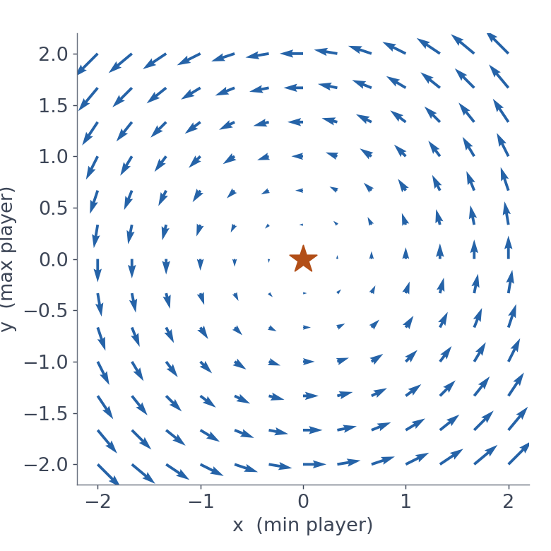
The balance point exists, but gradient steps circle it
REVISION · IDEA 2 · NASH EQUILIBRIUM · CLASS 2 & 3 NOTEBOOK PART 1
Nash equilibrium: no player can do better by changing only its own choice.
For a GAN: p_g = p_data and D(x) = ½ everywhere. D loss = 2 ln 2 ≈ 1.386, G loss = ln 2 ≈ 0.693.
The x·y game: x descends, y ascends. The arrows go around (0, 0), not into it. Simultaneous steps spiral out (1.41 → 3.83); alternating steps orbit.
A smaller learning rate only slows the circling.
GAN Class 4 · 01 Revision · min 13–16 · plot from the Class 2 & 3 notebook
Notes:
TIME: 13:00–16:00. This is the picture from the Class 2 & 3 cover: the gradient field of V(x, y) = x·y. [CLICK 1] Definition. Ask a student to say it in their own words before you click. [CLICK 2] The GAN's equilibrium (Goodfellow et al. 2014): when G's distribution equals the data distribution, the best D can only output ½. The reference lines on our loss plots, 1.386 for D and 0.693 for G, are the loss values at that point. They are reference lines, not stopping rules. [CLICK 3] The x·y game. ∂V/∂x = y, ∂V/∂y = x, so each step is x ← x − lr·y and y ← y + lr·x. In the Class 2 & 3 notebook: simultaneous updates spiral outwards (distance 1.41 → 3.83 after 200 steps at lr 0.1), alternating updates (our GAN loop: D step then G step) orbit for ever. [CLICK 4] Exercise 1 of Class 2 & 3: lr 0.01 still spirals out, just slowly (1.428); lr 0.5 explodes. Fixes have to change the game or the optimiser, not just the step size. Bridge: "This is why GAN training oscillates. The next two ideas are what that oscillation looks like in practice."

Slide 8
Two causes of instability, and the fix for each
REVISION · IDEA 3 · INSTABILITY
D too strong
Too much momentum
Real and fake look nothing alike, so D separates them perfectly. A perfect D is flat around the fakes: ≈ 0 gradient. G only learns through D's gradient, so G stalls.
Adam's β1 keeps part of the previous direction. With β1 = 0.9 a player keeps chasing where the opponent used to be, and overshoots.
Fixes: non-saturating G loss, label smoothing, instance noise, WGAN-GP, spectral norm.
Fix: β1 = 0.5, as recommended by the DCGAN paper. Today we meet that paper properly.
GAN Class 4 · 01 Revision · min 16–18 · Arjovsky and Bottou 2017; Radford et al. 2015
Notes:
TIME: 16:00–18:00. [CLICK 1] Cause 1, D too strong (Arjovsky and Bottou 2017). Early in training the real and fake sets barely overlap, so D can separate them almost perfectly. A saturated D says "fake" with full confidence everywhere near the fakes; nudging a fake changes nothing, so the gradient is ~0. G never sees real data; its only teacher is D's gradient. The non-saturating loss −log D(G(z)) from Class 1 keeps the gradient steep where D(G(z)) is near 0, but a D far ahead can still stall G. [CLICK 2] Cause 2, momentum. With β1 = 0.9, each Adam step is mostly the average of past steps. In a game where the opponent keeps moving, that means reacting to an old position. β1 = 0.5 reacts faster. In Class 2 & 3's Part 5, Run A (β1 = 0.9) collapsed completely; Run B (β1 = 0.5 + label smoothing) produced all ten digits. We will see those images again in two slides. Point out: "The β1 = 0.5 recommendation comes from the DCGAN paper, which is today's main topic. Every model in today's notebook uses it."

Slide 9
"Who is winning?": read D's average opinion
REVISION · DIAGNOSTIC TOOL 2 · WE USE IT AGAIN TODAY
mean D(x) | mean D(G(z)) | Meaning | What to check next
≈ 1 | ≈ 0 | D is winning easily | Are samples still changing? Vanishing gradient risk
≈ 0.6–0.9 | ≈ 0.1–0.4 | D ahead, contest still alive | Are samples improving epoch by epoch?
≈ 0.5 | ≈ 0.5 | D can't tell, or D is broken | Look at samples: good and varied?
swinging | swinging | Oscillation | β1 = 0.5 or a smaller learning rate
Every row ends with "look at the samples". These are rules of thumb: the plot tells you where to look, the grid tells you what is true.
GAN Class 4 · 01 Revision · min 18–19
Notes:
TIME: 18:00–19:00. The same table as Class 2 & 3 section 03, with the middle row widened slightly because today's DCGAN sits in it (D(x) near 0.9, D(G(z)) near 0.1–0.2) while still learning well. Walk the rows quickly. Ask: "Which row is the ideal equilibrium, and why is it also a warning?" (Both near 0.5: either G is perfect or D has stopped learning. Only the samples can tell.) [CLICK 1] Rules of thumb, not thresholds. Today we will see a case where D is clearly ahead but the samples keep improving; the gradient is not vanishing because D(G(z)) is not stuck at 0.

Slide 10
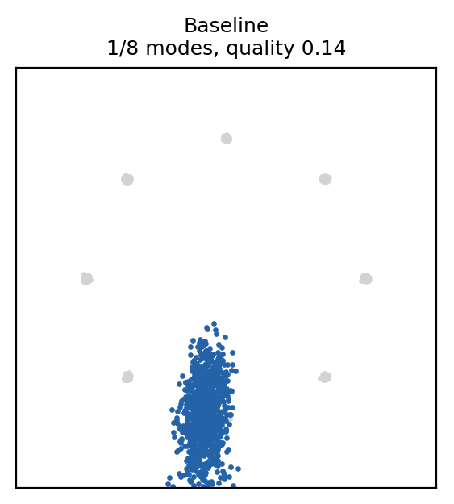
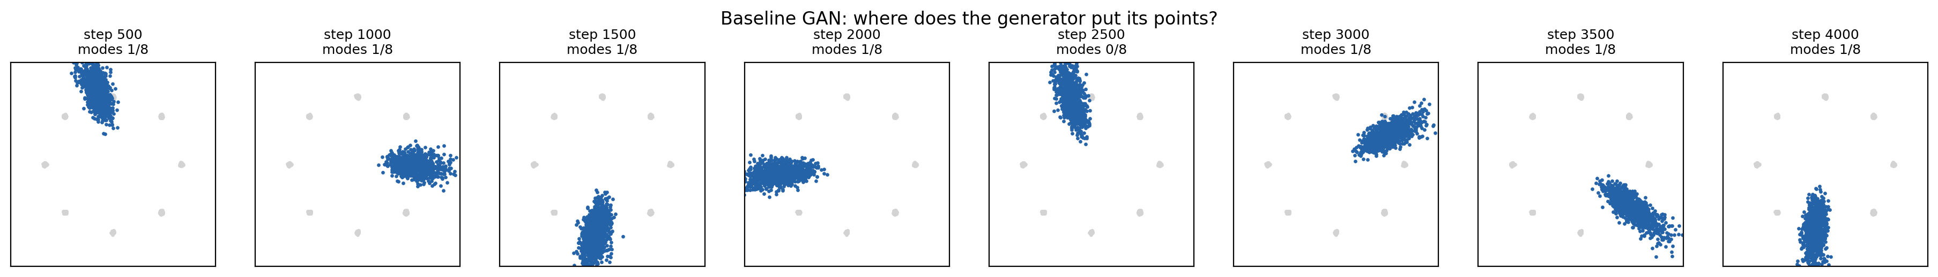
Mode collapse: one kind of output, hopping around
REVISION · IDEA 4 · MODE COLLAPSE · CLASS 2 & 3 NOTEBOOK PART 3
1,000 different noise vectors, one region of output. G found an answer D accepts and stopped exploring. Real data has 8 modes; G covers 1.
Why? D judges one sample at a time. A single image says nothing about variety, so nothing in the loss rewards spreading out.
GAN Class 4 · 01 Revision · min 19–22 · bottom: snapshots every 500 steps, the blob hops from cluster to cluster
Notes:
TIME: 19:00–22:00. Images from the Class 2 & 3 notebook, Part 3 (8 Gaussians on a ring, baseline settings, seed 0). Top-left: the final snapshot. Grey = real data in 8 clusters, blue = 1,000 generated points. Nearly all in one place. This is the "Helvetica scenario" from the original GAN paper: G collapses many values of z to the same x. [CLICK 1] Why it happens: D scores each image on its own. A batch of 128 identical, realistic-looking sevens gets 128 good scores. Nothing penalises the missing variety. [CLICK 2] Mode hopping: the same run, snapshots every 500 steps. G sits on a cluster, D learns "points here are fake", G jumps to another cluster, D follows. It is the circling from the x·y game, happening inside a real GAN. ASK: "Could a conditional GAN, where we tell G which digit to make, still collapse?" Leave it open; it comes back in section 04 and in the notebook.

Slide 11
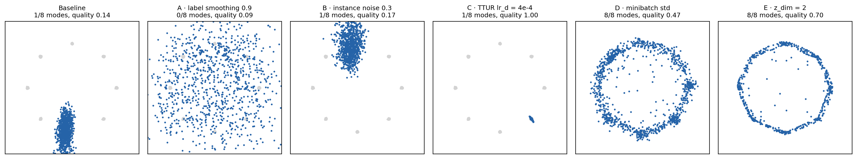
Match the fix to the cause
REVISION · IDEA 5 · THE TOOLBOX · CLASS 2 & 3 NOTEBOOK PART 4
Fix | Problem it targets | Fixed collapse on the ring?
Label smoothing, instance noise | Over-confident D | No (0/8 and 1/8 modes)
TTUR (D learns faster) | Keep D near its best reply | No (1/8, but sharper)
Minibatch std | D can't see variety | Yes, 8/8
GAN Class 4 · 01 Revision · min 22–24 · one run each, seed 0, 4,000 steps; the 6th panel is z_dim = 2 (also 8/8)
Notes:
TIME: 22:00–24:00. Results of Class 2 & 3's Part 4: five fixes tested on the collapsed ring GAN, seed 0, 4,000 steps. Panels left to right: baseline (one blob), A label smoothing (scattered everywhere, 0/8), B instance noise (one blob), C TTUR (one sharp dot, 1/8; 1–3 modes on other machines), D minibatch std (all 8), E z_dim 2 (thin ring through all 8). [CLICK 1] The table is the lesson. A fix aimed at an over-confident D does not fix a variety problem. Minibatch standard deviation gives D one extra number, the spread of the batch, so a collapsed batch is easy to spot and G is punished for collapsing. Forward link: "DCGAN, today, is a different kind of fix. It doesn't target one symptom; it changes the architecture so the whole game is easier for both players."

Slide 12
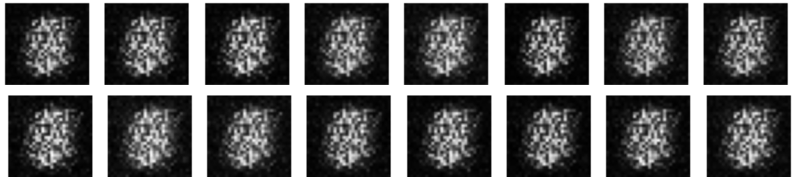
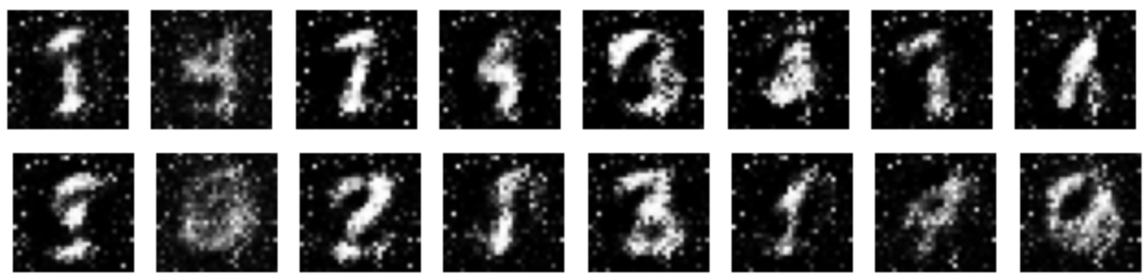
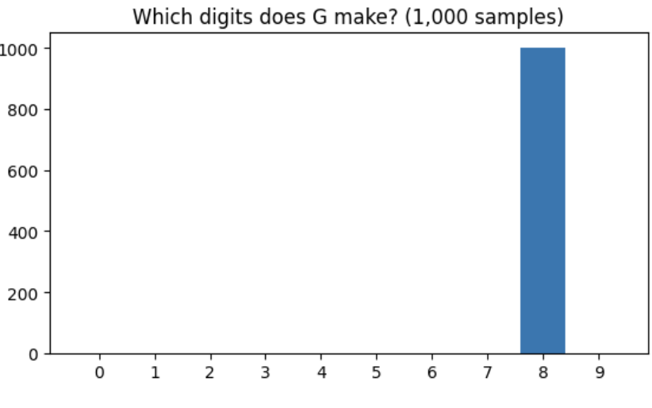
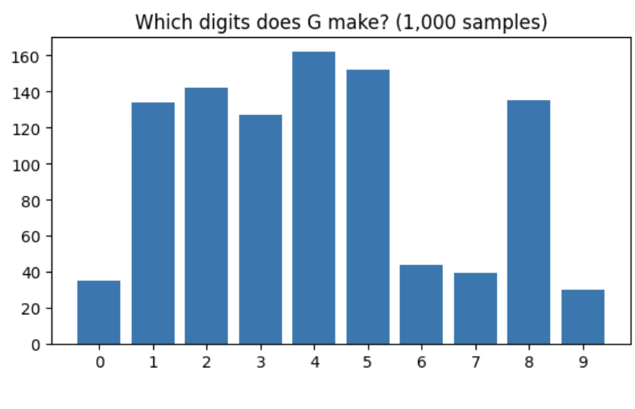
Grid + histogram together tell the truth
REVISION · THE THREE TOOLS ON REAL MNIST · CLASS 2 & 3 NOTEBOOK PART 5
Run A · β1 = 0.9 · 16 fixed-noise samples
Run B · β1 = 0.5 + smoothing · same noise
GAN Class 4 · 01 Revision · min 24–25 · Class 2 & 3 test run: 3 epochs, seed 0
Notes:
TIME: 24:00–25:00. The payoff slide from Class 2 & 3, shown again because it carries the two most important habits. Left, Run A (Class 1 settings, β1 = 0.9): 16 different noise vectors, the same grey blob every time. Complete collapse. [CLICK 1] Its histogram says "1,000 eights". Taken alone that is wrong: the grid shows it makes no digits at all. The counter always answers with some digit. [CLICK 2] Run B (β1 = 0.5 + one-sided label smoothing 0.9): varied, recognisable digits and all ten digits in the histogram. Habits to carry into today: (1) always use the three tools together; (2) β1 = 0.5 is now our default. Today's baseline in the notebook is the Class 1 network trained with β1 = 0.5.

Slide 13
Healthy, unstable, D too strong, or collapsed?
REVISION CHECKPOINT · DIAGNOSE IT · 4 MINUTES IN PAIRS
a. Losses calm. D(x) ≈ 0.6, D(G(z)) ≈ 0.4. Grid: 64 samples, all near-identical 1s.
Collapsed. Balanced D but no variety. Try minibatch std.
b. D(x) ≈ 0.99, D(G(z)) ≈ 0.01 for 2,000 steps. The grid hasn't changed in an epoch.
D too strong. G's gradient has vanished. Smoothing, noise, or a gradient penalty.
c. Both D scores swing between 0.2 and 0.9. Grid quality gets better, then worse, then better.
Unstable (oscillating). Lower β1 or learning rate.
d. D(x) ≈ 0.85, D(G(z)) ≈ 0.2. Grid: varied digits, sharper every epoch. Histogram: all ten digits.
Healthy. D ahead, but G keeps learning. Train longer.
GAN Class 4 · 01 Revision · min 25–29
Notes:
TIME: 25:00–29:00. Pairs discuss all four for 2 minutes, then cold-call one pair per case before revealing. [CLICK 1] a. Collapse. The D scores look balanced and the losses look calm; only the grid shows the problem. This is the Class 2 & 3 lesson that losses and D plots do not measure variety. [CLICK 2] b. D far ahead for a long time AND samples frozen: G is starving. Both conditions matter. Fixes that soften D: one-sided label smoothing, instance noise, a gradient penalty (WGAN-GP) or spectral normalisation. [CLICK 3] c. Oscillation: both players overshoot. β1 = 0.5 (if not already), smaller learning rates. [CLICK 4] d. Healthy. Some students will call this "D too strong" because 0.85 vs 0.2 is a big gap. The difference from case b: D(G(z)) is not stuck at 0, and the samples keep improving. Case d is almost exactly what our DCGAN does in today's notebook, so this answer matters later. If time is short, do a, b and d only.

Slide 14
Class 2 & 3 in four sentences
REVISION · WHAT WE CARRY FORWARD
1. A GAN is a game with a moving target, so its losses don't show quality.
2. The equilibrium (p_g = p_data, D = ½) exists, but gradient steps tend to circle it.
3. Two failures: instability (D too strong, overshooting) and mode collapse (no variety).
4. Diagnose with grid + D plot + histogram together, then pick the fix that targets the cause.
Today: same game, same tools. We change how G and D see images, and what G is told.
GAN Class 4 · 01 Revision · min 29–30
Notes:
TIME: 29:00–30:00. Close the revision block. Ask students to copy these four sentences; they are the Class 2 & 3 summary for exam revision. [CLICK 1–4] Reveal one at a time; ask a student to give one example for each from the slides they just saw. [CLICK 5] Bridge: "Everything you just revised still applies. Today's notebook re-uses all three diagnostics on the new models. Now, the first upgrade: why does the Class 1 generator make such speckled digits?"

Slide 15
Why convolutions?
02
The Class 1 generator treats an image as 784 unrelated numbers. Images are not like that.
GAN Class 4 · min 30–40
Notes:
TIME: 30:00. Section 02 runs from minute 30 to minute 40. SAY: "You have used convolutions in the CV part of the course for classifiers. Today we put them inside both GAN players. First, let's see exactly what goes wrong without them."

Slide 16
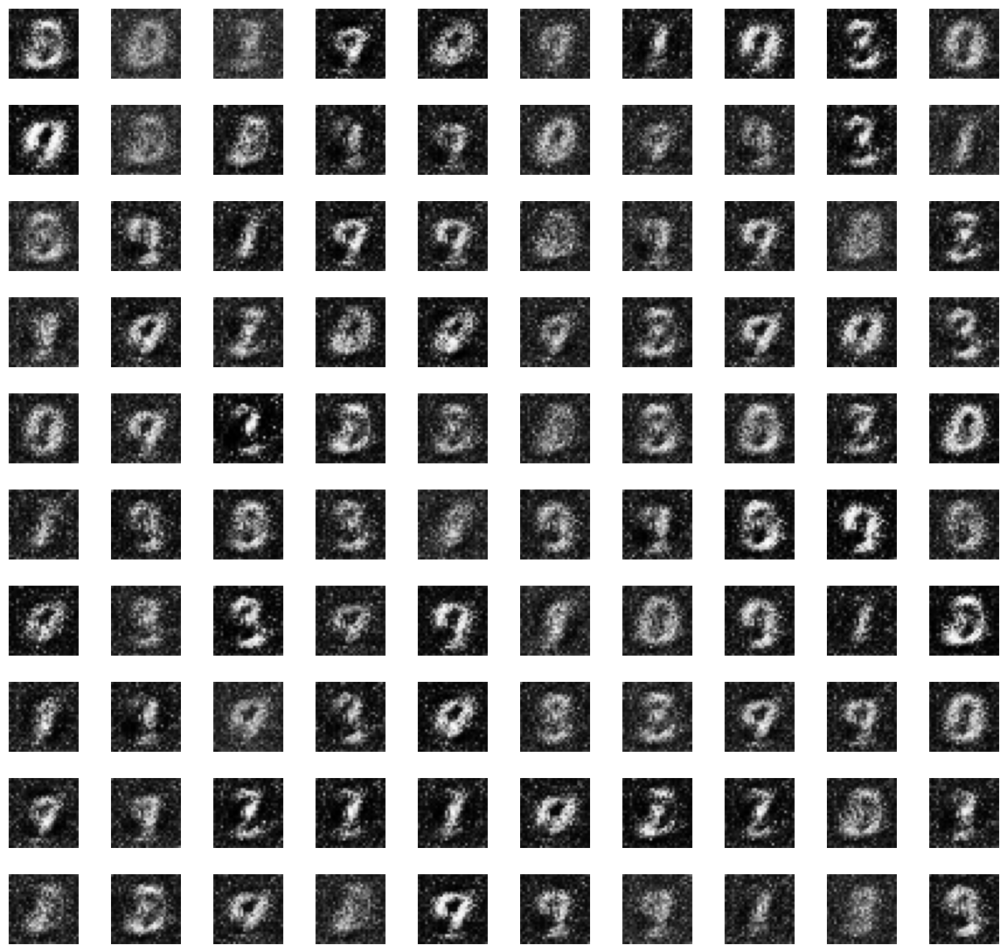
The fully connected generator makes grey, speckled digits
02 · TODAY'S BASELINE · CLASS 1 NETWORK, Β1 = 0.5, 2 EPOCHS
Background: grey speckle, never clean black. Each of the 784 outputs is learned on its own; no pixel knows its neighbours are black.
Strokes: blurry and broken. "A stroke" is a pattern of neighbouring pixels, but a Linear layer has no idea which pixels are neighbours.
Variety: no 6s at all in 1,000 samples; 8s and 3s dominate. Evenness 0.79 (1.0 = perfect).
GAN Class 4 · 02 Why convolutions · min 30–33 · test run of today's notebook, Part 1.3, seed 0
Notes:
TIME: 30:00–33:00. Real output from today's notebook, Part 1.3: the Class 1 networks (100 → 256 → 784 generator, 784 → 256 → 1 discriminator) trained for 2 epochs with batch 128 and Adam β1 = 0.5. 100 samples from fixed noise. [CLICK 1] Background. A real MNIST digit has a pure black background. The generator has to learn, separately for each of 784 output units, to output −1 where there is no ink. It never quite manages it, so we get grey speckle. [CLICK 2] Strokes. Shift a digit one pixel to the right and, to a Linear layer, it is a completely different input. It has to learn "a vertical stroke at column 10" and "a vertical stroke at column 11" as unrelated facts. [CLICK 3] Variety: the digit counter from the notebook found zero 6s and 362 eights out of 1,000. Evenness is the notebook's measure: normalised entropy of the histogram, 1.0 when all ten digits appear equally often. ASK: "What property of images is this network ignoring?" Expected: that nearby pixels are related, and that the same pattern can appear anywhere.

Slide 17
Two assumptions that fit images
02 · WHAT A CONVOLUTION ASSUMES ABOUT IMAGES
Locality
Weight sharing
Each output pixel is computed from a small neighbourhood (a 4×4 window), not from all 784 pixels. Neighbours decide together, so backgrounds come out smooth.
The same filter slides over the whole image. A "curve" detector learned in one corner works everywhere, so a stroke is learned once, not once per position.
You used both in CNN classifiers. A DCGAN uses them in both players: D shrinks the image down to one score, G grows noise up to an image.
GAN Class 4 · 02 Why convolutions · min 33–37
Notes:
TIME: 33:00–37:00. Connect to the CNN lectures from the CV half of the course (sliding-window convolution, kernel, stride, padding). [CLICK 1] Locality. A 4×4 kernel means each output value depends on 16 input values per channel, not on everything. For a generator this matters a lot: the output pixel at a background position is computed from features that already "know" they are in a background region. [CLICK 2] Weight sharing. One kernel, applied at every position. Far fewer parameters per layer, and the same pattern is recognised (in D) or drawn (in G) wherever it appears. Translation is free. [CLICK 3] DCGAN = these ideas in both players. D is basically a CNN classifier with one output. G is the same structure run backwards: start small, grow the image. ASK: "A classifier shrinks the image. How do we make a network that grows one?" That's the next section: the transposed convolution.

Slide 18
The convolutional D is smaller, yet a much better critic
02 · SIZE IS NOT THE POINT · COUNTED IN THE NOTEBOOK
Network | Fully connected | DCGAN | Change
Generator G | 227,344 | 759,680 | 3.3× larger
Discriminator D | 201,217 | 138,624 | 31% smaller
D's convolutions reuse each small filter across the whole image, so it gets more useful features from fewer weights.
A better critic is a better teacher: G only learns through D's gradient. That is the Class 2 & 3 idea again, now used in our favour.
GAN Class 4 · 02 Why convolutions · min 37–40 · parameter counts printed by today's notebook
Notes:
TIME: 37:00–40:00. Numbers printed by the notebook (n_params). MLP: G 227,344 / D 201,217. DCGAN: G 759,680 / D 138,624. Common misconception to defuse: "the DCGAN is better because it is bigger". The generator is bigger, yes, mostly because of the first layer (100 noise channels × 128 filters × 7 × 7). But the discriminator is smaller, and the improvement comes from the structure, not the count. [CLICK 1] Weight sharing in numbers. [CLICK 2] Link to Class 2 & 3: G never sees real data, it learns only from D's gradient. A discriminator that recognises strokes and shapes gives G gradients that say "make this stroke smoother", not just "change these pixels". Caveat from Class 2 & 3: a critic that is too strong can stall G. In our run the DCGAN's D is clearly ahead, and we'll check whether that is a problem.

Slide 19
DCGAN: Deep Convolutional GAN
03
Radford, Metz and Chintala, 2015: the recipe that made convolutional GANs train reliably.
GAN Class 4 · min 40–61
Notes:
TIME: 40:00. Section 03 runs from minute 40 to minute 61. SAY: "DCGAN stands for Deep Convolutional Generative Adversarial Network. Before 2015, people had tried putting CNNs into GANs and mostly failed: training was unstable. This paper found a set of architecture rules that worked, and almost every image GAN since then starts from it. It is also the paper where β1 = 0.5 comes from." Plan for this section: how convolutions shrink and grow images, what a transposed convolution does, the full DCGAN for MNIST, the rules, and our results.

Slide 20
Stride 2 halves the image; a transposed stride 2 doubles it
03 · SHRINK IN D, GROW IN G · NOTEBOOK PART 2
Conv2d (in D)
ConvTranspose2d (in G)
out = (n + 2p − k) // s + 1
out = (n − 1)·s − 2p + k
k = 4, s = 2, p = 1:
28 → 14 → 7. Each layer halves.
k = 4, s = 2, p = 1:
7 → 14 → 28. Each layer doubles.
Try it: ConvTranspose2d(100, 128, kernel 7, stride 1, padding 0) on a 1×1 input gives…? (1 − 1)·1 − 0 + 7 = 7. That is how G turns a noise vector into a 7×7 feature map.
GAN Class 4 · 03 DCGAN · min 40–44 · n = input size, k = kernel, s = stride, p = padding
Notes:
TIME: 40:00–44:00. These are the two formulas students compute in Part 2 of the notebook (conv_out and convT_out). [CLICK 1] Conv2d: the formula from the CNN lectures. Work one example on the board: n = 28, k = 4, s = 2, p = 1 → (28 + 2 − 4) // 2 + 1 = 13 + 1 = 14. Again: (14 + 2 − 4) // 2 + 1 = 7. [CLICK 2] ConvTranspose2d: the formula runs the other way. (7 − 1)·2 − 2 + 4 = 14. (14 − 1)·2 − 2 + 4 = 28. Point out why k = 4, s = 2, p = 1 is so popular: it exactly doubles (or halves) for any even input size, so the generator and discriminator can be exact mirror images. [CLICK 3] Let a student compute it before you reveal. The noise vector is reshaped to [B, 100, 1, 1]: a 1×1 "image" with 100 channels. A 7×7 kernel with stride 1 and no padding stamps a 7×7 map from it. Note: "transposed convolution" is sometimes called "deconvolution" in older papers and blog posts. It is not the inverse of a convolution; it is a learnable upsampling layer.

Slide 21
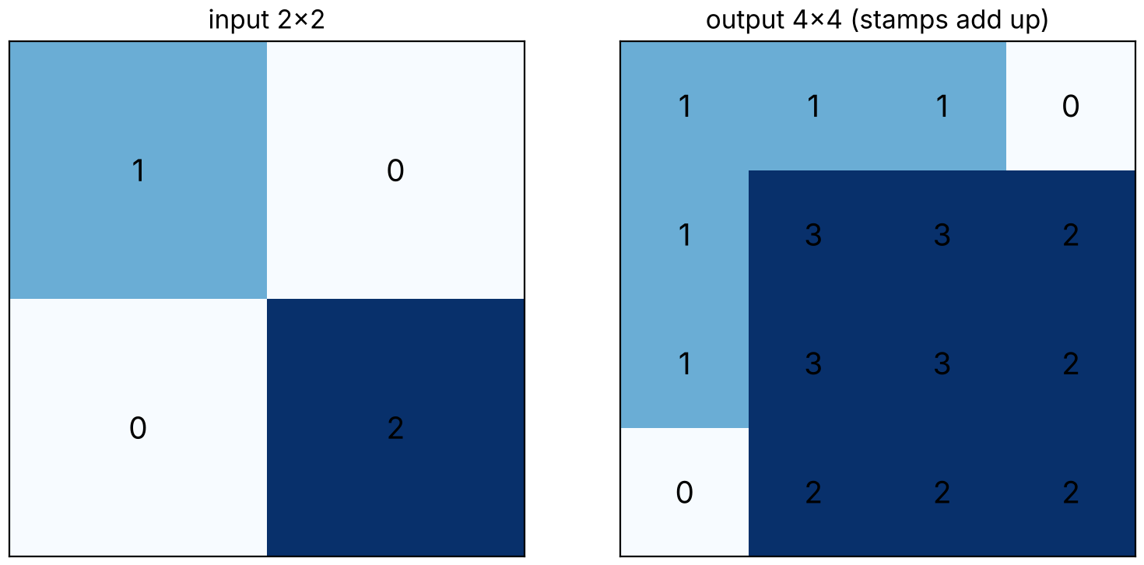
Each input pixel stamps a copy of the kernel
03 · WHAT A TRANSPOSED CONVOLUTION DOES · NOTEBOOK PART 2
Kernel = 4×4 of ones, stride 2, padding 1. Top-left pixel (1) stamps 1s; bottom-right pixel (2) stamps 2s, 2 pixels further along.
Where stamps overlap they add: the centre is 1 + 2 = 3.
In G the kernel is learned: each feature stamps a learned patch of strokes.
Uneven overlaps can leave a faint grid pattern: checkerboard artifacts. Kernel 4 with stride 2 overlaps evenly, which helps.
GAN Class 4 · 03 DCGAN · min 44–47 · real nn.ConvTranspose2d output · Odena et al. 2016 (Distill)
Notes:
TIME: 44:00–47:00. This picture is produced by a real nn.ConvTranspose2d in Part 2 of the notebook, with its weights set to ones so the arithmetic is visible. [CLICK 1] Mental model: for every input pixel, take the kernel, multiply it by the pixel value, and paste it onto the output. With stride 2 the paste positions are 2 output pixels apart for every 1 input pixel. That's why the output is twice as big. Padding 1 trims one row and column from each edge. [CLICK 2] Overlaps: with kernel 4 and stride 2, neighbouring stamps overlap by 2 pixels, and their values add up. The printed output is [[1,1,1,0],[1,3,3,2],[1,3,3,2],[0,2,2,2]]. [CLICK 3] In a trained generator the kernels are learned patterns. A 7×7 map of "there is a loop here" features can stamp out the strokes of a loop at 14×14. [CLICK 4] Checkerboard artifacts (Odena, Dumoulin and Olah, Distill 2016): if the kernel size is not divisible by the stride, some output pixels receive more stamps than others, leaving a grid pattern. Kernel 4 / stride 2 is divisible, so the overlaps are even in the middle of the image. A common alternative is "upsample, then ordinary convolution". Exercise 2, question 3 asks students to think about this.

Slide 22
G grows noise into an image; D is its mirror
03 · OUR DCGAN FOR 28×28 MNIST · NOTEBOOK PART 3
ConvT 7×7
ConvT ×2
ConvT ×2, Tanh
G
image
z 100×1×1
128×7×7
64×14×14
1×28×28
Conv ÷2
Conv ÷2, BN
Conv 7×7
D
image
64×14×14
128×7×7
1 score
GAN Class 4 · 03 DCGAN · min 47–52 · box height = image size, box width ≈ number of channels
Notes:
TIME: 47:00–52:00. This is exactly the DCGenerator and DCDiscriminator classes in Part 3 of the notebook. [CLICK 1] Generator, left to right. z: 100 random numbers, reshaped to [B, 100, 1, 1]. ConvTranspose2d(100, 128, 7, 1, 0) + BatchNorm + ReLU → [B, 128, 7, 7]. ConvTranspose2d(128, 64, 4, 2, 1) + BN + ReLU → [B, 64, 14, 14]. ConvTranspose2d(64, 1, 4, 2, 1) + Tanh → [B, 1, 28, 28], values in [−1, 1] like our normalised MNIST images. Notice the pattern: the image gets bigger while the number of channels gets smaller. Coarse "what goes where" first, fine strokes last. [CLICK 2] Discriminator, the mirror. Conv2d(1, 64, 4, 2, 1) + LeakyReLU(0.2) → [B, 64, 14, 14]. Conv2d(64, 128, 4, 2, 1) + BatchNorm + LeakyReLU → [B, 128, 7, 7]. Conv2d(128, 1, 7, 1, 0) → [B, 1, 1, 1]: one raw score (a logit). No Sigmoid, because we use BCEWithLogitsLoss, which applies it inside the loss (same as Class 2 & 3). Compare with the Class 1 skeleton for CelebA faces (ConvT 100→512 with k4 s1 p0, then three k4 s2 p1): 1 → 4 → 8 → 16 → 32. Exercise 2 asks students to trace it and to add the extra layer for 64×64 faces. ASK: "Where does the generator's first layer get a 7 from?" (k = 7, s = 1, p = 0 on a 1×1 input.)

Slide 23
Seven rules, and the problem each one solves
03 · THE DCGAN RECIPE · RADFORD, METZ AND CHINTALA 2015
Rule | Why it helps
Strided convs, no pooling | The network learns how to shrink and grow
BatchNorm in G and D | Stable activations; helps stop G collapsing to one output
No BN on G output, D input | BN on every layer made samples oscillate
ReLU in G, Tanh output | Output in [−1, 1], the range of our images
LeakyReLU(0.2) in D | Gradients still flow for negative inputs
Adam 0.0002, β1 = 0.5 | Less momentum in a moving game (Class 2 & 3)
Weights from N(0, 0.02) | A small, standard starting point
GAN Class 4 · 03 DCGAN · min 52–55 · also: no fully connected hidden layers
Notes:
TIME: 52:00–55:00. The architecture guidelines from Section 3 of the DCGAN paper (Radford, Metz, Chintala 2015, arXiv 1511.06434), plus their training details from Section 4. In the notebook they are in the table at the top of Part 3, and the init_weights function. Go row by row; for each, ask "which Class 2 & 3 problem does this connect to?" - Strided convolutions: learned downsampling in D, learned upsampling in G. - BatchNorm: the paper says it helped deal with poor initialisation, helped gradients flow, and was critical to stop the generator collapsing all samples to a single point. That is mode collapse, from Class 2 & 3. - Not on G's output or D's input: the paper reports that applying BN to all layers caused sample oscillation and instability. - ReLU + Tanh in G: a bounded output that matches the data range. - LeakyReLU in D: from Class 1. A plain ReLU would pass no gradient for negative inputs. - Adam with lr 0.0002 and β1 = 0.5: the paper found the default 0.9 caused oscillation and instability. That is Class 2 & 3's Run A vs Run B. Weights from a normal distribution with standard deviation 0.02. Footer: the paper also removes fully connected hidden layers. Our D ends in a 7×7 convolution, which plays the role of the final linear layer.

Slide 24
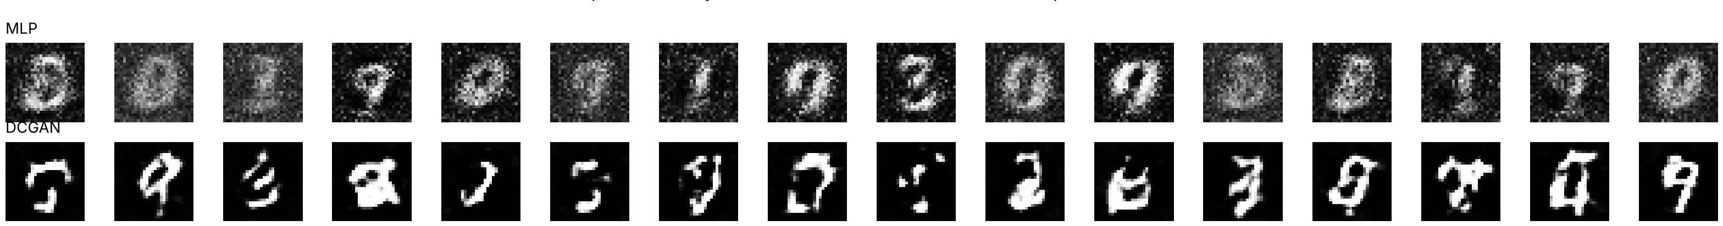
Same data, same epochs: clean strokes on black
03 · REAL RUN FROM TODAY'S NOTEBOOK · PART 3 · 2 EPOCHS EACH
Better
Not yet good
Lesson
Black backgrounds, solid connected strokes. No speckle.
Some shapes are malformed. 2 epochs is a few minutes; real runs train 25+.
The architecture changed what kind of mistakes G makes. Undertrained, not broken.
GAN Class 4 · 03 DCGAN · min 55–57 · top: fully connected (Class 1) · bottom: DCGAN · same 16 fixed noise vectors, seed 0
Notes:
TIME: 55:00–57:00. Real output from the side-by-side cell in Part 3 of the notebook. Both models: 2 epochs, batch 128, Adam lr 0.0002 β1 0.5, seed 0, same fixed noise. On the 2-core test machine the MLP took about 20 seconds and the DCGAN about 2.5 minutes. Let students look for 20 seconds before clicking. ASK: "Describe the difference in one word." Usual answers: "sharper", "cleaner", "darker". [CLICK 1] What improved: the background problem from section 02 is gone. Strokes are thick and connected. [CLICK 2] Be honest: several DCGAN samples are not recognisable digits yet. Two epochs is very short. The DCGAN paper trained much longer on far bigger datasets. In the notebook, Exercise 3 asks students to compare the epoch-1 and epoch-2 grids to see how fast it is improving. [CLICK 3] The kind of error changed: the MLP's errors are noise (pixel-level), the DCGAN's are shape errors (structure-level). Shape errors shrink with more training; pixel noise from a fully connected generator tends to persist.

Slide 25
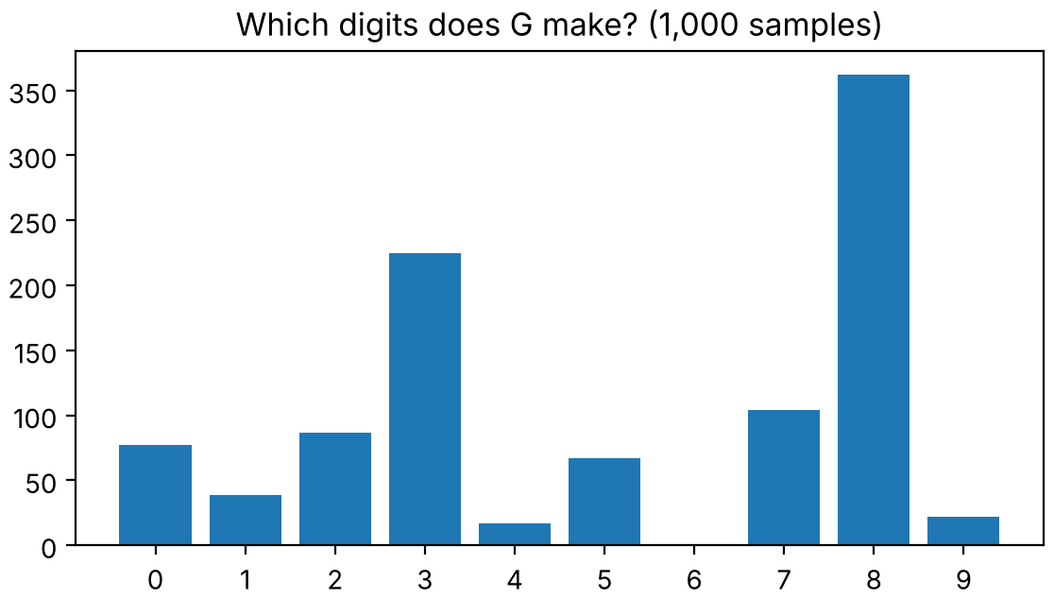
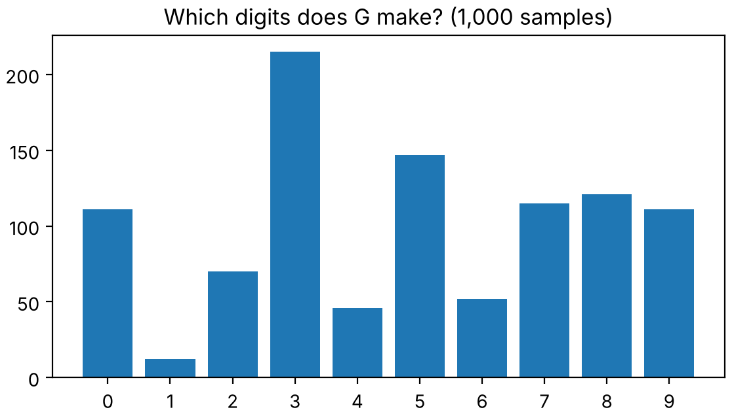
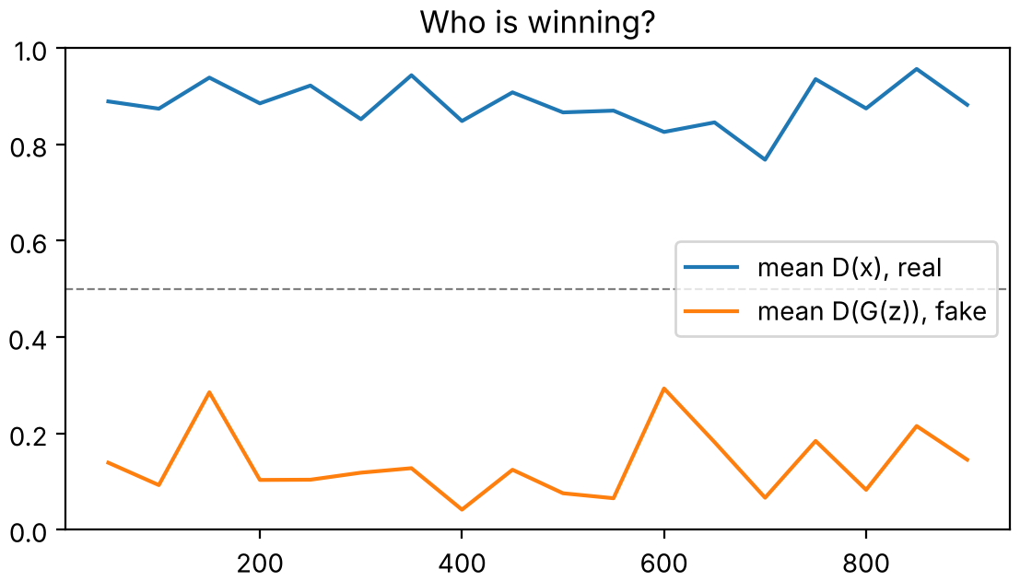
More even variety, and a confident D that still teaches
03 · THE CLASS 2 & 3 TOOLS ON THE DCGAN RUN
Fully connected · digit counts
DCGAN · digit counts
DCGAN · who is winning?
Model | Evenness (1.0 = equal) | Rarest digit | D(x) / D(G(z))
Fully connected | 0.79 | 6: none at all | ≈ 0.7 / 0.4
DCGAN | 0.93 | 1: 12 of 1,000 | ≈ 0.9 / 0.15
GAN Class 4 · 03 DCGAN · min 57–59 · 1,000 samples each, labelled by the notebook's CNN digit counter (98.1% test accuracy)
Notes:
TIME: 57:00–59:00. The diagnostics from today's notebook (Parts 1.3 and 3). The digit counter is a small CNN classifier trained for one epoch: 98.1% on the MNIST test set in our run. Left: fully connected GAN. 362 eights, 225 threes, zero sixes. Partial mode collapse. [CLICK 1] DCGAN: every digit appears. Still uneven (215 threes, only 12 ones), but much better. Evenness is normalised entropy: 0.79 → 0.93. [CLICK 2] Who is winning? D(x) stays near 0.9 and D(G(z)) between about 0.05 and 0.3. By the Class 2 & 3 table, D is clearly ahead. Remember case d from the revision checkpoint: D ahead, but D(G(z)) is not pinned at 0 and the samples improve. So G is still getting gradient. Not a problem to fix yet; a reason to watch. [CLICK 3] Summary table. Why are 1s rare? A "1" is a single stroke; the generator may be producing thicker shapes that the classifier reads as other digits. Exercise 4 in the notebook asks students to think about this kind of question for the cGAN. Honesty note: one run, one seed. Students' numbers will differ.

Slide 26
Trace the shapes
CHECKPOINT · ON PAPER · 2 MINUTES
a. ConvTranspose2d(k = 4, s = 2, p = 1) on a 16×16 input. Output size?
32×32. (16 − 1)·2 − 2 + 4 = 32.
b. Conv2d(k = 4, s = 2, p = 1) on 64×64, three times. Output size?
8×8. 64 → 32 → 16 → 8.
c. Why is there no BatchNorm on G's last layer?
G's output must match real pixel values; BN there caused instability.
d. Which DCGAN rule did we already use in Class 2 & 3, and why?
β1 = 0.5: less momentum in a moving game.
GAN Class 4 · 03 DCGAN · min 59–61
Notes:
TIME: 59:00–61:00. Individual, on paper. Then reveal. [CLICK 1] a. 32. Same pattern as 7 → 14 → 28: k4 s2 p1 doubles. [CLICK 2] b. 8. k4 s2 p1 halves each time. [CLICK 3] c. The DCGAN paper: batch normalisation on every layer caused sample oscillation and instability; leaving it off G's output and D's input avoided that. Intuition: the output layer has to produce actual pixel values in [−1, 1]; normalising them by batch statistics would fight that. [CLICK 4] d. Adam β1 = 0.5 (Class 2 & 3, Run B). The paper reports that 0.9 led to oscillation and instability. Bridge: "Now we can generate cleaner digits. But which digit? We still have no say. That's the second upgrade."

Slide 27
Conditional GAN: choose the digit
04
Mirza and Osindero, 2014: give the label to both players.
GAN Class 4 · min 61–82
Notes:
TIME: 61:00. Section 04 runs from minute 61 to minute 82. SAY: "Everything so far is unconditional: we put in noise and get some digit, and we have no say in which. The Class 1 notebook ended with an assignment: extend the GAN so it generates digits conditioned on labels. Today we do that, on top of the DCGAN."

Slide 28
We have the labels. We have been throwing them away.
04 · THE PROBLEM
for real, _ in train_loader: # Classes 1, 2 and 3
The _ is the digit label: MNIST gives it to us with every image. An unconditional GAN ignores it, so G(z) gives some digit, chosen by chance.
To get a 7 you would have to sample, classify, and throw away nine out of ten. And if G has partly collapsed, a rare digit may never come out.
Goal: G(z, y) = "draw digit y, in the style z".
GAN Class 4 · 04 Conditional GAN · min 61–63
Notes:
TIME: 61:00–63:00. Point at the code line: this is the exact training loop line from the Class 1 and Class 2 & 3 notebooks. The underscore is a Python convention for "a value I'm ignoring". It's the label. [CLICK 1] Without the label, the only control we have over the output is z, and we don't know which z gives which digit. [CLICK 2] The workaround (generate lots, keep the ones the classifier says are 7) wastes 90% of samples, and fails completely if G has collapsed away from a digit. Our fully connected baseline made zero 6s in 1,000 samples. [CLICK 3] The goal. The label says WHAT to draw (content); the noise says HOW to draw it (style). We will test that split directly at the end of this section. ASK: "If we give the label only to G, will that work?" Let them guess; the next slide answers it.

Slide 29
Give the label y to both players
04 · THE IDEA · MIRZA AND OSINDERO 2014
min_G max_D E[log D(x, y)] + E[log(1 − D(G(z, y), y))]
G(z, y)
D(x, y)
"Draw a digit y, in style z."
"Is x a real image of digit y?" Two ways to fail: looks fake, or wrong digit.
If only G had the label, D would accept a perfect 3 labelled "7", and G would learn to ignore y.
GAN Class 4 · 04 Conditional GAN · min 63–67 · Mirza and Osindero, "Conditional Generative Adversarial Nets", 2014
Notes:
TIME: 63:00–67:00. Source: Mirza and Osindero (2014), arXiv 1411.1784. The objective is the Class 1 minimax objective with y added to every network call. [CLICK 1] The generator receives the noise z AND the label y. [CLICK 2] The discriminator receives the image AND the label. Its question is sharper: not "is this a real digit?" but "is this a real 7?" A beautiful 3 presented with the label 7 should be rejected. [CLICK 3] The key point, and the answer to the question from the last slide. If D never sees y, D has no way to punish G for drawing the wrong digit. Any realistic digit passes. G gets no gradient that says "you were asked for a 7", so it learns to ignore y. The condition only matters because the critic checks it. ASK: "In the training loop, which labels should the fake images get?" Expected: the same labels we asked G for. The notebook simply reuses the real batch's labels, so real and fake batches have the same mix of digits. That keeps the comparison fair: D can't tell fakes from reals just by the label distribution.

Slide 30
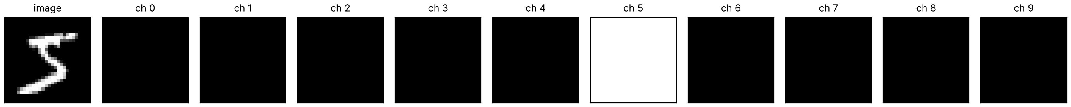
One-hot label, concatenated to the input
04 · HOW A NETWORK "READS" A LABEL · NOTEBOOK PART 4
Into G: 100 + 10 numbers
Into D: 1 + 10 channels
y = 7 → [0,0,0,0,0,0,0,1,0,0]. Glue it to z: G's first layer gets 110 input channels.
Spread the one-hot over 10 image-sized maps and stack them on the image: 11 input channels.
torch.cat([z, y_onehot], dim=1)
torch.cat([x, y_maps], dim=1)
GAN Class 4 · 04 Conditional GAN · min 67–70 · bottom: what D receives for a real "5" (from the notebook)
Notes:
TIME: 67:00–70:00. Code from CondDCGenerator and CondDCDiscriminator in Part 4 of the notebook. Everything else is the DCGAN unchanged; only the first layer's input channel count changes (100 → 110 in G, 1 → 11 in D). [CLICK 1] Generator side. One-hot encoding: a vector of ten zeros with a single 1 at the label's position. Concatenated to the 100 noise numbers, then reshaped to [B, 110, 1, 1] exactly like before. The first ConvTranspose2d now has 110 input channels. [CLICK 2] Discriminator side. D works on images, so the label has to look like an image. We make 10 maps of size 28×28; the map for the true label is all ones, the rest all zeros. Stack them on the image channel. Now every filter in D's first layer sees, at every pixel, both the ink and "this is supposed to be a 5". [CLICK 3] The real picture from the notebook: a real "5" and its 10 label channels. Channel 5 is white (all ones). Mention alternatives without going deep: a learned embedding (nn.Embedding(10, 50)) instead of one-hot in G (that is assignment option C), or the "projection discriminator" (Miyato and Koyama 2018) used in larger models. Same idea: both players must see the label.

Slide 31
Row r: "draw a digit r"
04 · REAL RUN FROM TODAY'S NOTEBOOK · PART 4 · 2 EPOCHS
Same DCGAN, same 2 epochs, plus the label. Almost every row is the digit we asked for.
Within a row the samples differ: thick, thin, slanted, open, closed. That variety comes from z.
Weakest rows: 4 and 9. Some 4s look like 9s; some 9s like 7s.
Shapes look cleaner than the unconditional DCGAN. Knowing the digit makes G's job easier.
GAN Class 4 · 04 Conditional GAN · min 70–72 · 100 fixed noise vectors, seed 0 · about 3.3 min on a 2-core CPU
Notes:
TIME: 70:00–72:00. The fixed-noise grid after epoch 2 of the conditional DCGAN in Part 4 (seed 0, batch 128, lr 0.0002, β1 0.5). Row r uses label r; there are 100 different noise vectors. Let students study it for 20 seconds. ASK: "Which row would you send back?" [CLICK 1] The label works: rows are the right digits. [CLICK 2] Variety within a row: that is z doing its job. This is also the answer to "can a cGAN collapse?" Yes: if all ten 7s in row 7 looked identical, that would be collapse within a class. Here they don't. [CLICK 3] Weak rows. In our run, requested 4s were sometimes read as 9s, and requested 9s as 7s or 3s (next slide has the numbers). These are digit pairs that share strokes. [CLICK 4] A useful observation: with the same architecture and training time, the conditional model's digits look more clearly formed than the unconditional DCGAN's. The label removes one decision G has to make. This is one reason conditioning is used almost everywhere in modern generative models.

Slide 32
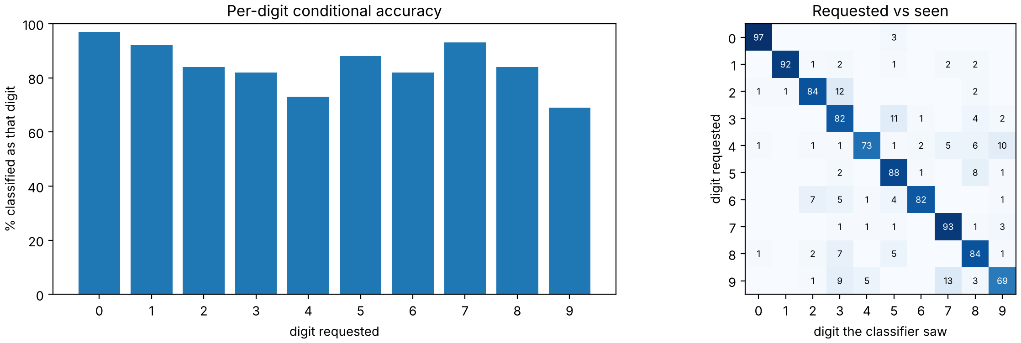
Conditional accuracy: did G obey the label?
04 · A NEW MEASUREMENT · NOTEBOOK PART 4.1
84.4%
of 1,000 samples (100 per digit) were classified as the digit we asked for.
Best: 0 (97%), 7 (93%).
Worst: 9 (69%), 4 (73%).
Off the diagonal: asked 9, seen 7 (13×); asked 2, seen 3 (12×); asked 4, seen 9 (10×). Digits that share strokes get confused.
GAN Class 4 · 04 Conditional GAN · min 72–75 · measured with the notebook's CNN digit counter (98.1% test accuracy)
Notes:
TIME: 72:00–75:00. From the conditional_accuracy function in Part 4.1. For each digit d we generate 100 samples with label d, classify them, and count how many the classifier also reads as d. This is why the notebook trains a CNN classifier (98.1% test accuracy) instead of Class 2 & 3's quick MLP: if the measuring instrument is often wrong, conditional accuracy would be meaningless. Even so, part of the 15.6% "errors" are the classifier's mistakes on unusual handwriting, not G's. [CLICK 1] Per-digit bars and the "requested vs seen" matrix. A perfect conditional generator has everything on the diagonal. [CLICK 2] Best and worst digits in our run. [CLICK 3] The confusions make sense: a 9 with a short tail looks like a 7; a 4 with a closed top looks like a 9; a 2 with a curly bottom looks like a 3. Connect to Class 2 & 3: the unconditional histogram measured VARIETY ("which digits does G make?"). Conditional accuracy measures CONTROL ("does G make the digit I asked for?"). A cGAN needs both: high conditional accuracy and variety within each digit. ASK: "Could conditional accuracy be 100% while the generator is collapsed?" Yes: ten perfect but identical 7s per row would score 100%. You still need the grid.

Slide 33
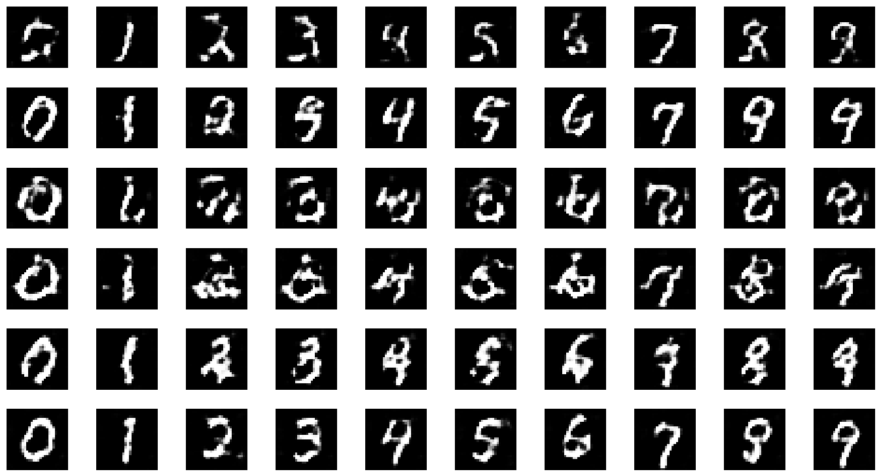
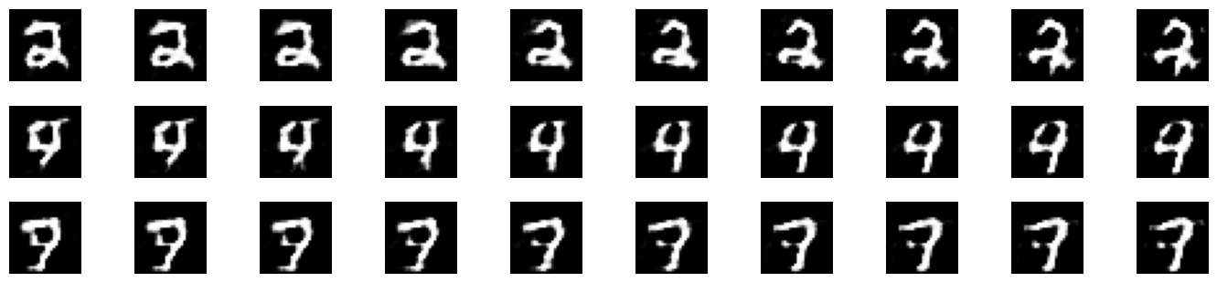
The label picks the digit; the noise picks the handwriting
04 · CONTENT AND STYLE · NOTEBOOK PARTS 4.2 AND 4.3
Each row: one fixed z. Columns: labels 0–9
Fixed label, z moves from z_a to z_b
Same z → same style across all ten digits. Small steps in z → small, smooth changes. G has learned a style space.
GAN Class 4 · 04 Conditional GAN · min 75–78 · real output of style_vs_content() and interpolate()
Notes:
TIME: 75:00–78:00. Two experiments from the notebook. Left (Part 4.2, style_vs_content): six noise vectors, each used with all ten labels. Read across a row: the thickness, size and slant stay roughly the same while the digit changes. Row 2 is thin and neat, the last row upright and clean, rows 3 and 4 thick and messy (some of those styles produce poor digits after only 2 epochs: be honest about it). The label has taken over "which digit", so z only has to encode "how it is written". [CLICK 1] Right (Part 4.3, interpolate): fix the label (2, 4 and 7) and walk in a straight line between two noise vectors. The digit changes gradually: in our run the 4 slowly closes its top, and the 7's crossbar and stem change shape step by step. No sudden jumps means G maps nearby z to similar images: a smooth latent space. [CLICK 2] Name the idea: content (label) vs style (noise). It comes back in the next module: a VAE learns a latent space by design, and interpolating in it is one of the curriculum topics. Diffusion models with text prompts use the same split: the prompt is the condition, the random noise decides the details.

Slide 34
The condition can be anything you can encode
04 · THE SAME IDEA, BIGGER CONDITIONS
Condition y | Example task | Known model
Class label | "Draw a 7" | cGAN (today), AC-GAN
An image | Sketch → photo, map → satellite | pix2pix (paired images)
Another domain | Horse ↔ zebra, no pairs | CycleGAN
Text | "A small yellow bird" | Text-to-image GANs; later diffusion
Always the same two moves: encode y as numbers, and give it to both G and D, so the critic can check the match.
Stable Diffusion's text prompt (module 8) is a condition too.
GAN Class 4 · 04 Conditional GAN · min 78–80 · Odena et al. 2017; Isola et al. 2017; Zhu et al. 2017; Reed et al. 2016
Notes:
TIME: 78:00–80:00. A wide view, no details needed. The point: today's mechanism scales up. Rows: - Class label: our cGAN. AC-GAN (Odena, Olah, Shlens 2017) makes D also predict the class, an alternative to feeding the label in. - Image as condition: pix2pix (Isola et al. 2017). G gets an input image (an edge map, a segmentation map) and produces a matching photo; D sees the input/output pair and judges whether it is a real pair. Needs paired training data. - Another domain, unpaired: CycleGAN (Zhu et al. 2017) learns horse → zebra with no matching pairs, using two generators and a "cycle-consistency" loss. Mention only. - Text: Reed et al. 2016, "Generative Adversarial Text to Image Synthesis", encodes a sentence and conditions both networks on it. Today this job is mostly done by diffusion models. [CLICK 1] The general recipe. [CLICK 2] Forward link to the diffusion module: in Stable Diffusion the text prompt is encoded and fed into the denoising network; it is a conditional generative model.

Slide 35
True or false?
CHECKPOINT · THINK, PAIR, SHARE · 2 MINUTES
a. In a cGAN, only the generator needs the label.
False. Without it D can't punish the wrong digit, and G ignores y.
b. A cGAN cannot suffer mode collapse.
False. It can collapse within a class: every 7 identical.
c. In our test, D scored generated 7s higher when labelled "7" than when labelled "1".
True. 0.315 vs 0.141: D checks the match, not only realism.
d. 100% conditional accuracy proves the cGAN is perfect.
False. It measures control, not variety or quality. Check the grid.
GAN Class 4 · 04 Conditional GAN · min 80–82
Notes:
TIME: 80:00–82:00. Pairs vote thumbs up/down for each, then reveal. [CLICK 1] a. False. This is the single most important point of section 04. [CLICK 2] b. False. Conditioning removes "between-class" collapse (G can't skip a digit, because we ask for each one), but within a class G can still map every z to the same 7. Detect it by looking along a row of the grid, or with style_vs_content. [CLICK 3] c. True. This is Exercise 4, question 3 in the notebook: 200 generated 7s, scored by D with the correct label and with a wrong label. In our run 0.315 vs 0.141. D has learned the image–label match, which is exactly the signal that teaches G to obey y. [CLICK 4] d. False. Same lesson as the digit histogram in Class 2 & 3: one number never tells the whole story.

Slide 36
Today's theory in five sentences
RECAP · END OF THE THEORY
1. Class 2 & 3's tools (grid, D plot, histogram) diagnose any GAN; use them together.
2. Convolutions add locality and weight sharing: clean backgrounds, connected strokes.
3. DCGAN: k4 s2 p1 convs halve in D, transposed convs double in G; BatchNorm, ReLU/LeakyReLU, Tanh, β1 = 0.5.
4. cGAN: give y to both players. G concatenates a one-hot; D stacks label maps.
5. The label controls content; the noise controls style. Check control with conditional accuracy.
GAN Class 4 · Recap · min 82–85
Notes:
TIME: 82:00–85:00. Ask a different student to say each sentence in their own words before you click it in. Then a 2–3 minute break before the notebook if your class usually takes one. These five sentences plus Class 2 & 3's four (the r-bridge slide) are the GAN module summary so far.

Slide 37
Hands-on: GAN-Class-4-DCGAN-cGAN.ipynb
05
85 minutes. Rebuild the Class 2 & 3 tools, then build and measure a DCGAN and a conditional DCGAN.
GAN Class 4 · min 85–170
Notes:
TIME: 85:00. The notebook half. Setup reminders: students open the notebook; on Colab, switch to a GPU runtime first (the whole notebook then trains in about a minute). On a laptop CPU the training cells total roughly 7–10 minutes (2-core test machine: classifier 30 s, MLP 20 s, DCGAN 2.5 min, cGAN 3.3 min). Students should START the DCGAN and cGAN training cells and read the explanation cells while they run. Pairing: individual for Parts 0–2, pairs for Parts 3–4.

Slide 38
Six parts, 85 minutes
05 · MAP OF THE NOTEBOOK
Part | What you do | Time | CPU run time
0 | Setup, load MNIST | 4 min | seconds
1 | Revision: quiz, rebuild the 3 tools, baseline GAN | 14 min | ≈ 1 min
2 | Convolution shapes and the stamp picture | 12 min | instant
3 | DCGAN: build, train, compare | 20 min | ≈ 2–4 min
4 | Conditional DCGAN: choose the digit | 25 min | ≈ 3–5 min
5 | Wrap-up, reflection, assignment | 6 min | —
Run top to bottom. At every ✏️ Predict, write your guess before running. Start long training cells, then read while they run.
GAN Class 4 · 05 Notebook · min 85–87 · on a GPU (e.g. Colab) every cell runs in seconds
Notes:
TIME: 85:00–87:00. Same structure as Class 2 & 3's notebook: predict, run, explain. Timings measured on a 2-core cloud CPU: classifier 29 s, MLP baseline 18 s, DCGAN 2 epochs 153 s, cGAN 2 epochs 199 s. Laptops with more cores are usually faster; Colab GPU is much faster. If a student's machine is very slow: let them run Part 3 with epochs=1 and still do Part 4 with 2 epochs; or pair them with someone whose run is finished.

Slide 39
Revision in code: rebuild the toolkit, train the baseline
PARTS 0 AND 1 · 18 MINUTES · INDIVIDUALLY
Revision quiz
The 3 tools
Baseline + Exercise 1
Five questions in the notebook. Answer from memory, then compare with what we just did.
A CNN digit counter (≈ 98% accurate), the "who is winning?" log, and a fixed-noise grid, in one train_gan() function.
The Class 1 network with β1 = 0.5, 2 epochs. Diagnose it: quality, variety, balance, edges.
Look for the # cGAN lines in train_gan(). They do nothing yet; in Part 4 they pass the label to G and D.
GAN Class 4 · 05 Notebook · min 87–105
Notes:
TIME: 87:00–105:00. Parts 0 and 1. [CLICK 1] The revision quiz cell repeats the five r-quiz questions. Students who struggled in section 01 should write full answers here; others can be brief. [CLICK 2] The CNN classifier trains for one epoch (≈ 30–60 s on CPU) and is checked on the 10,000 test images (98.1% in our run). train_gan() is the Class 1 / Class 2 & 3 loop with BCEWithLogitsLoss, logging of mean D(x) and D(G(z)) every 50 steps, and a 100-image fixed-noise grid after every epoch. [CLICK 3] Baseline. Expected (our run): grey speckled digits, digit counts {0: 77, 1: 39, 2: 87, 3: 225, 4: 17, 5: 67, 6: 0, 7: 104, 8: 362, 9: 22}, D(x) about 0.7 and D(G(z)) about 0.4. Exercise 1 answers: speckle and blur; 6 missing, 8 and 3 dominant (partial collapse); balanced contest; noisy edges and background where real digits have pure black. [CLICK 4] Point out the cGAN lines now so Part 4 feels like a small change, which it is. Circulate. The most common problem: forgetting to run the setup cell, or a slow MNIST download.

Slide 40
Convolution shapes: predict, then check with PyTorch
PART 2 · 12 MINUTES · INDIVIDUALLY
1
Predict the sizes, then run conv_out / convT_out and two real PyTorch layers.
2
Run the 2×2 → 4×4 stamp demo. Change the input values and predict the output first.
3
Exercise 2: trace the Class 1 CelebA DCGAN skeleton (1 → 4 → 8 → 16 → 32). How many layers for 64×64? Why are the stamp centres larger?
Answers: 32×32 · one more ConvTranspose2d(k4, s2, p1) · centres get two overlapping stamps (1 + 2 = 3).
GAN Class 4 · 05 Notebook · min 105–117
Notes:
TIME: 105:00–117:00. Fast part, no training. 1. Expected printout: 7, 14, 28 for the transposed layers; 14, 7, 1 for the convolutions; PyTorch agrees: (1, 128, 7, 7) and (1, 64, 14, 14). [CLICK 1] 2. Encourage experimenting: set the input to [[1, 1], [1, 1]] and predict the output (the centre becomes 4, edges 2, corners 1). [CLICK 2] 3. Exercise 2. [CLICK 3] Answers. Q1: 1 → 4 (k4 s1 p0) → 8 → 16 → 32, final [B, 3, 32, 32]. Q2: one more k4 s2 p1 layer gives 64 (this is the standard 64×64 DCGAN). Q3: each centre output pixel is covered by stamps from both input pixels, so the values add. If some pixels receive more overlaps than others (kernel size not divisible by stride), the result is a regular grid pattern: checkerboard artifacts.

Slide 41
Build and train the DCGAN, then compare
PART 3 · 20 MINUTES · IN PAIRS
Shape check
Train 2 epochs
Exercise 3
One batch through G and D, printing every layer's shape and the parameter counts.
init_weights first. ≈ 2–4 min on CPU. Write your prediction while it runs.
Fill in the MLP vs DCGAN table. Compare epoch 1 and epoch 2 grids. Optional: β1 = 0.9, or no BatchNorm.
Our run: evenness 0.79 → 0.93; D(x) ≈ 0.9, D(G(z)) ≈ 0.1–0.2, yet samples kept improving. Which revision case is that? Case d: healthy.
GAN Class 4 · 05 Notebook · min 117–137
Notes:
TIME: 117:00–137:00. Part 3. [CLICK 1] Shape check output: G (4,128,7,7) → (4,64,14,14) → (4,1,28,28); D (4,64,14,14) → (4,128,7,7) → (4,1,1,1). G 759,680 parameters, D 138,624. [CLICK 2] Training: 153 s on the 2-core test machine. Epoch-end losses in our run: D 0.213 / G 2.739, then D 0.258 / G 2.147. G's loss is high because D is confident; remind them losses don't measure quality. [CLICK 3] Exercise 3. Expected table (our run): MLP: 227k / 201k parameters, speckled, evenness 0.786, rarest 6 (0). DCGAN: 760k / 139k, clean strokes with some malformed shapes, evenness 0.929, rarest 1 (12). Epoch 1 vs 2: visible improvement in shape; still clearly undertrained. Optional β1 = 0.9: results vary by machine and seed; the point is to connect with Class 2 & 3's Run A. Do not promise that it collapses. Optional no-BatchNorm in G: often slower or blotchier learning. Again, let them report what they see. [CLICK 4] Tie back to the revision checkpoint's case d. If time is short: skip the optional runs; they make good homework.

Slide 42
Conditional DCGAN: train it, then test what it learned
PART 4 · 25 MINUTES · IN PAIRS
Step | What you do | Our run
4.0 | Look at D's 11 input channels; train 2 epochs | ≈ 3.3 min on CPU
4.1 | Conditional accuracy and "requested vs seen" | 84.4%; worst 9 and 4
4.2 | One z, ten labels: content vs style | style holds across a row
4.3 | Interpolate z with a fixed label | smooth changes
Ex. 4 | Mismatch test: D on generated 7s, labelled 7 vs 1 | 0.315 vs 0.141
Exercise 4, question 4: can a cGAN still collapse? Which of today's plots would show it?
GAN Class 4 · 05 Notebook · min 137–162
Notes:
TIME: 137:00–162:00. Part 4, the main event of the notebook. Before they start the training cell, ask them to write the ✏️ Predict answer: what if D scored each fake with a different random label from the one G was asked to draw? (D would mostly see fakes paired with the wrong label and could learn "label mismatch = fake", a shortcut. Worse, G's gradient would then push its drawing towards the random label D used, not the one G was given, so G could never learn to obey y. The label G draws and the label D checks must be the same. Reusing the real batch's labels also gives real and fake piles the same digit mix.) Training: 199 s on the 2-core test machine. Epoch-end losses in our run: D 1.413 / G 2.623, then D 0.856 / G 0.844. Expected results (our run): conditional accuracy 84.4%; per digit 0 97%, 1 92%, 7 93% best; 9 69%, 4 73% worst. Main confusions: 9 → 7 (13), 2 → 3 (12), 3 → 5 (11), 4 → 9 (10). Exercise 4 answers: 1. Students report their own number; ~80–90% after 2 epochs is typical. Discuss why the confused pairs share strokes. 2. One z holds thickness, slant, size and stroke style across all ten digits. 3. Mismatch test: D gives a higher score with the correct label (0.315 vs 0.141 in our run). D has learned the image–label match. 4. Yes, within a class. A row of the 10×10 grid (or the style_vs_content grid) would show near-identical digits. Conditional accuracy would not catch it. [CLICK 1] Use question 4 as the bridge into the wrap-up.

Slide 43
What did your models show?
PART 5 · WRAP-UP AND DEBRIEF · 8 MINUTES
Share around the room: your evenness (MLP vs DCGAN), your conditional accuracy, and your hardest digit.
A · Fashion-MNIST
B · DCGAN faces
C · Embedding
Same DCGAN on clothing images. Submit the grid after each epoch and what improved.
The Class 1 mini-project: extend the skeleton to 64×64, mirror a D, train on CelebA (GPU).
Swap G's one-hot for nn.Embedding(10, 50). Compare conditional accuracy.
GAN Class 4 · 05 Notebook · min 162–170 · assignment: choose one of A, B, C
Notes:
TIME: 162:00–170:00. Part 5 of the notebook: summary, four reflection questions (homework), and the assignment. Debrief (3–4 minutes): collect three or four numbers from different pairs. Point out the spread; GANs vary by run, which is why we always compare patterns. Reflection questions (in the notebook, finish at home): 1. Why speckle in FC generators and not in convolutional ones? (Locality and weight sharing.) 2. ConvTranspose2d(k4, s2, p1) on 16×16 → 32×32; it doubles exactly for any size and mirrors Conv2d(k4, s2, p1). 3. Why must D get the label? (Otherwise it can't penalise a wrong digit and G learns to ignore y.) 4. cGAN collapse: within a class; seen along a row of the grid. [CLICK 1–3] The assignment options. A is the easiest (change one line: datasets.FashionMNIST). B is the original Class 1 mini-project and needs a GPU and the CelebA download. C is a small architecture change with a measurable result.

Slide 44
Before you leave, answer four questions
EXIT TICKET · 3 MINUTES · ON PAPER, NO NOTES
1
D(x) ≈ 0.99 and D(G(z)) ≈ 0.01 for 2,000 steps; the grid is frozen. Name the problem.
2
A generator has ConvTranspose2d(k4, s2, p1) layers after a 7×7 start. What size after two of them?
3
In a cGAN, what does D receive, and why does it need the label?
4
Fixed z, labels 0 to 9: what stays the same across the row? One "muddiest point".
Answers: 1 D too strong, vanishing gradient · 2 28×28 · 3 image + label maps; else G ignores y · 4 the style (thickness, slant)
GAN Class 4 · min 170–173
Notes:
TIME: 170:00–173:00. Collect slips before revealing. Expected answers: 1. D is winning completely; its output is flat around the fakes, so G's gradient vanishes. Fixes: label smoothing, instance noise, gradient penalty, spectral normalisation. (This is a revision question on purpose.) 2. 7 → 14 → 28: 28×28. 3. The image stacked with 10 label channels (one-hot maps). Without the label D can't reject a realistic digit of the wrong class, so G gets no signal to obey y and learns to ignore it. 4. The handwriting style: thickness, slant, size, stroke shape. The digit identity comes from the label. Muddiest point: read before the VAE class and open with the top one or two. [CLICK 1] Reveal short answers after collecting.

Slide 45
Next: autoencoders and VAEs
NEXT CLASS AND FURTHER STUDY
NEXT CLASS
FURTHER STUDY: READ AND TRY AT HOME
A different generative model: encoder, bottleneck, decoder and a reconstruction loss.
PyTorch DCGAN tutorial (64×64 faces, assignment B) · Deconvolution and Checkerboard Artifacts (Distill) · A guide to convolution arithmetic
PAPERS BEHIND TODAY'S SLIDES
Radford et al. 2015, DCGAN · Mirza and Osindero 2014, Conditional GAN · Odena et al. 2017, AC-GAN · Isola et al. 2017, pix2pix · Zhu et al. 2017, CycleGAN · Reed et al. 2016, Text-to-image GAN · Miyato and Koyama 2018, Projection discriminator · Class 2 & 3: Goodfellow et al. 2014, GANs; Arjovsky and Bottou 2017, Principled Methods
HOMEWORK
Part 5 reflections. Assignment: one of A, B or C.
GAN Class 4 · min 173–175
Notes:
TIME: 173:00–175:00. Next class: the VAE module starts (curriculum: autoencoder with encoder, bottleneck, decoder and reconstruction loss; then the VAE and the reparameterisation trick; then latent interpolation). Today's interpolation experiment is a good hook: "Next time we build a model whose latent space is designed to be smooth." Homework: reflection questions in Part 5 of the notebook, and one assignment option. Further study (all optional): - PyTorch's official DCGAN tutorial trains a 64×64 face generator on CelebA. It is the natural next step for assignment B. - Odena, Dumoulin and Olah (Distill 2016), on why transposed convolutions can create checkerboard patterns. - Dumoulin and Visin (2016), "A guide to convolution arithmetic for deep learning": pictures of every padding and stride case. Papers: Radford, Metz, Chintala 2015 (DCGAN); Mirza and Osindero 2014 (cGAN); Odena, Olah, Shlens 2017 (AC-GAN); Isola et al. 2017 (pix2pix); Zhu et al. 2017 (CycleGAN); Reed et al. 2016 (text-to-image GAN); Miyato and Koyama 2018 (cGANs with projection discriminator). Revision: Goodfellow et al. 2014; Arjovsky and Bottou 2017.

