Slide 1
BLUESTOCK FINTECH
Mutual Fund Analytics Capstone
From raw data to an interactive dashboard: ETL, performance analytics,
and risk insights across 40 mutual fund schemes
40 SCHEMES • 10 FUND HOUSES • ~5,000 INVESTORS • JAN 2022 – MAY 2026

Slide 2
THE CHALLENGE
Problem & Objective
The Problem
The Objective
Fund performance, risk, and investor behaviour data live in 10 disconnected raw files No single view exists to compare funds, track industry trends, or flag at-risk investors Manual analysis doesn't scale across 40 schemes and ~33,000 transactions
Build one reproducible pipeline: ingest → clean → analyse → visualise → recommend Rank all 40 funds on risk-adjusted performance with a transparent scorecard Deliver an interactive dashboard + risk analytics stakeholders can act on

Slide 3
FOUNDATION
Data Sources
40
10
~5,000
~33,000
Fund Schemes
Fund Houses
Investors
Transactions
10 raw source files, Jan 2022 – May 2026
fund_master · nav_history · aum_by_fund_house
monthly_sip_inflows · category_inflows · industry_folio_count
scheme_performance · investor_transactions
portfolio_holdings · benchmark_indices

Slide 4
HOW IT FITS TOGETHER
Pipeline Architecture
Raw CSVs
ETL Pipeline
SQLite DB
Analytics
Dashboard
→
→
→
→
10 source files
clean + validate
5-table model
notebooks + scripts
Power BI, 4 pages
Full run: python3 run_pipeline.py — under 3 seconds, no manual steps

Slide 5
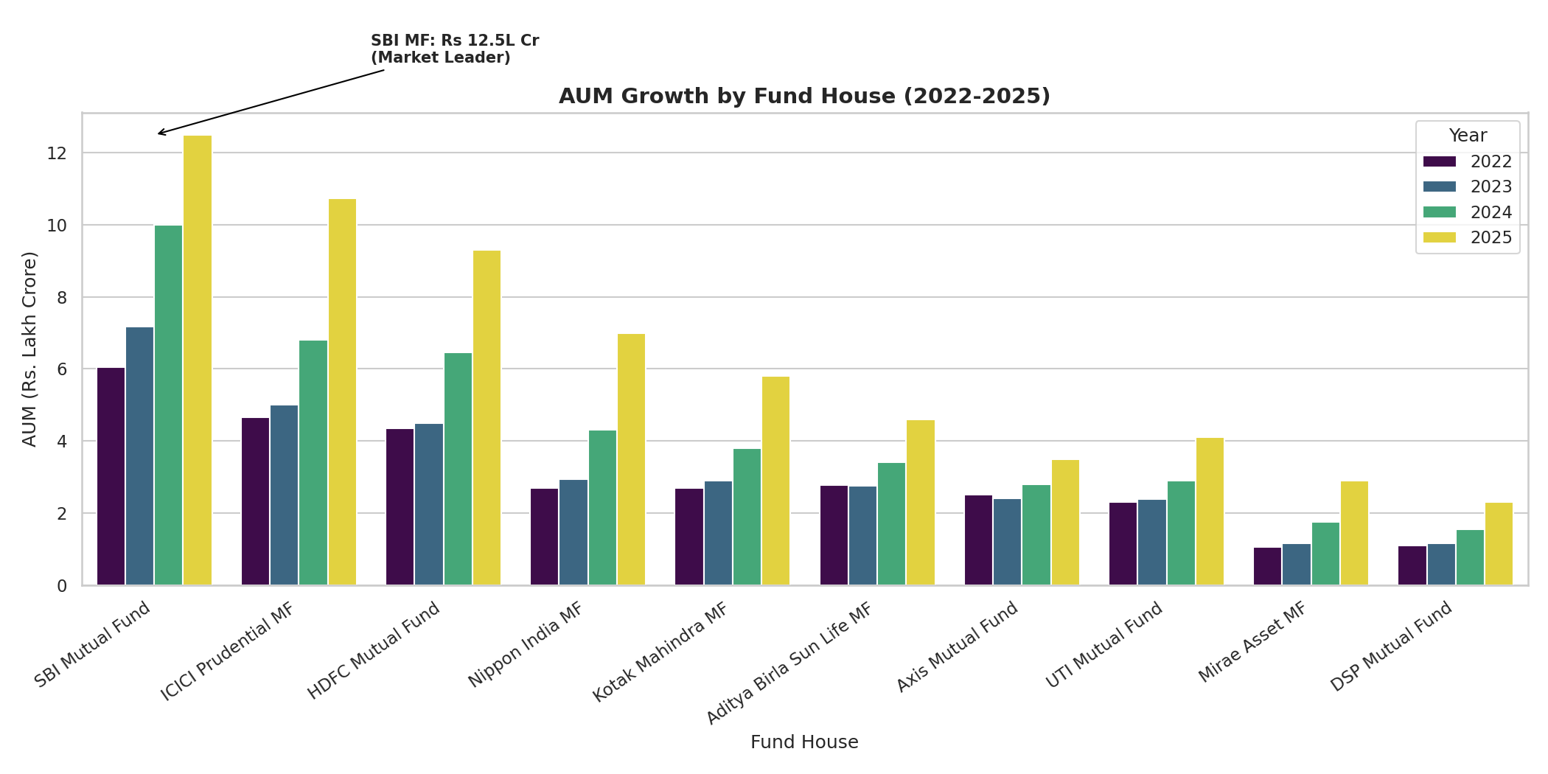
EDA HIGHLIGHT
Industry AUM Growth
₹62.7L Cr
total industry AUM by Dec 2025
₹12.5L Cr
SBI Mutual Fund — market leader
AUM nearly doubled
in 4 years

Slide 6
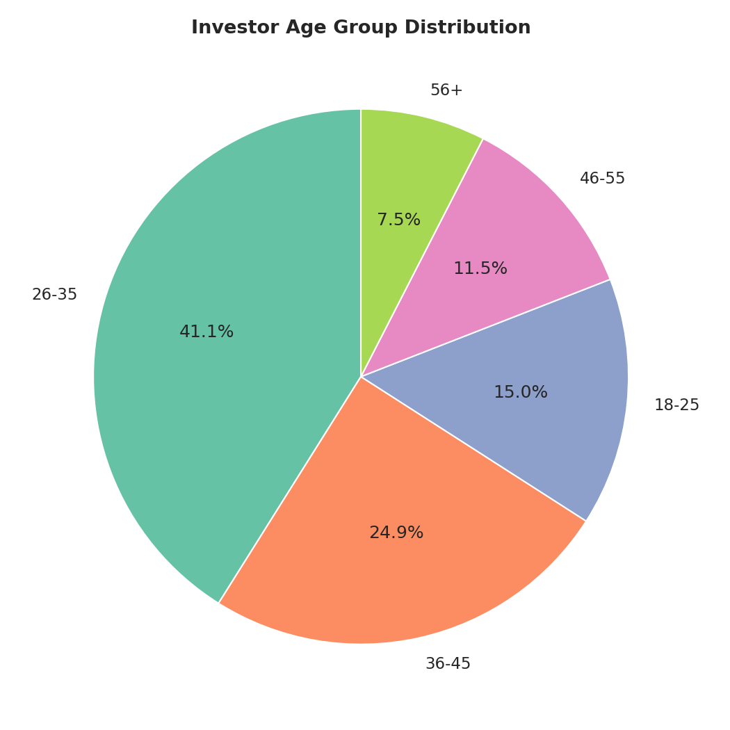
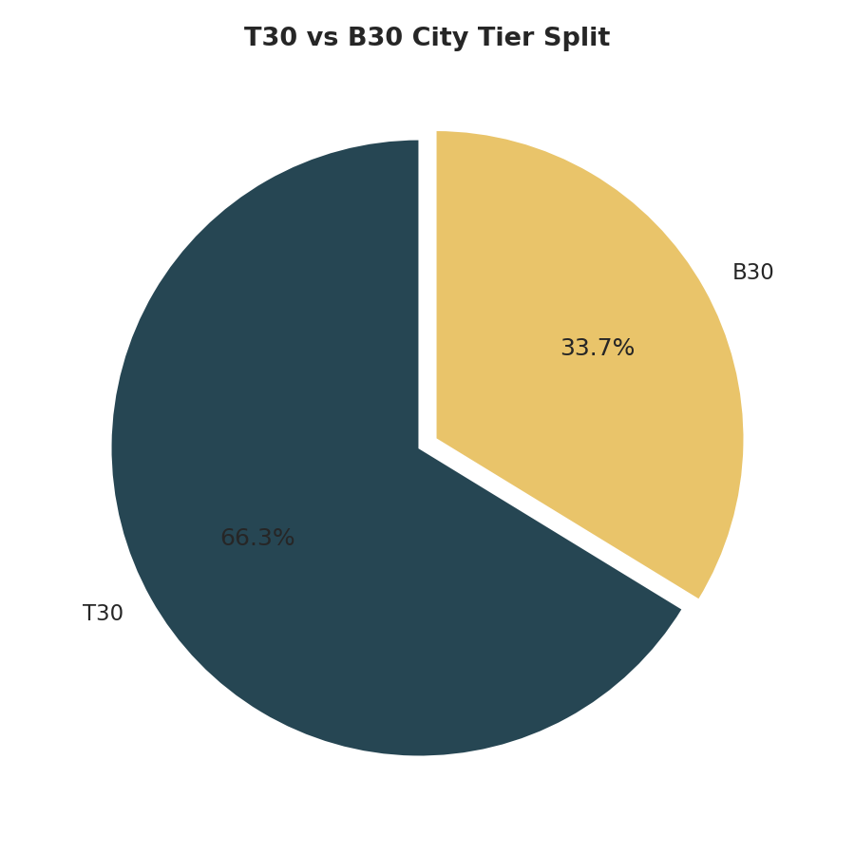
EDA HIGHLIGHT
SIP Inflows & Investor Base
₹31,002 Cr
all-time high monthly SIP inflow, Dec 2025
26.12 Cr
total industry folios, up from 13.26 Cr in 2022

Slide 7
PERFORMANCE ANALYTICS
Risk-Adjusted Return Metrics
Computed for all 40 funds
CAGR
1/3/5yr, annualised on a 252-trading-day basis
Sharpe Ratio
(Rp − Rf) / σ(Rp) × √252, Rf = 6.5%
Sortino Ratio
downside-deviation-only variant of Sharpe
Alpha / Beta
OLS regression vs Nifty 100
Max Drawdown
worst peak-to-trough decline, with date range

Slide 8
PERFORMANCE ANALYTICS
Composite Fund Scorecard
30% 3yr return + 25% Sharpe + 20% Alpha + 15% inverse expense ratio + 10% inverse max drawdown
Rank | Scheme | Score | Sharpe
1 | Mirae Asset Large Cap Fund | 85.88 | 1.45
2 | ICICI Pru Midcap Fund | 81.88 | 1.18
3 | Kotak Flexicap Fund | 81.62 | 1.31
Full 40-fund ranking: data/outputs/fund_scorecard.csv

Slide 9
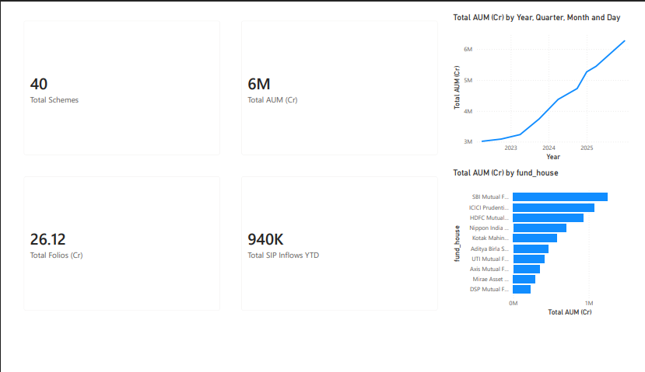
DELIVERABLE
Dashboard — Industry Overview

Slide 10
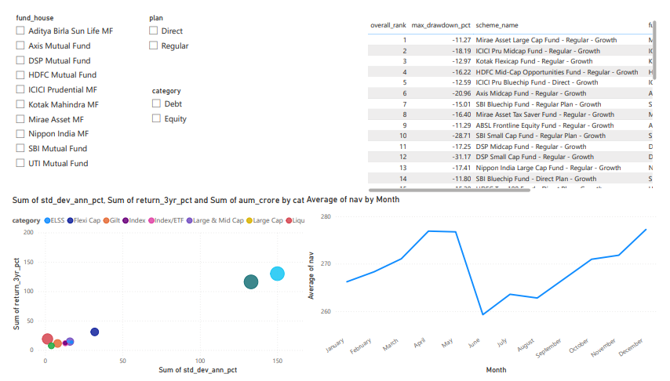
DELIVERABLE
Dashboard — Fund Performance

Slide 11
SUMMARY
Key Findings
1
SBI Mutual Fund leads industry AUM at ₹12.5L Cr, nearly double its 2022 level
2
SIP inflows hit an all-time high of ₹31,002 Cr in December 2025
3
Mirae Asset Large Cap Fund tops the composite scorecard at 85.88/100
4
Most large-cap funds show >0.8 return correlation — limited diversification within category
5
Sector concentration (HHI) varies widely across equity funds — useful risk-comparison signal

Slide 12
Thank You
Bluestock Fintech — Mutual Fund Analytics Capstone
Full code, notebooks, and dashboard: see project README.md

