Slide 1
Natural Language Processing
Data Science Hack

Slide 2
What is NLP?
Natural Language Processing, or NLP for short, is broadly defined as the automatic manipulation of natural language, like speech and text, by software. The aim of a linguistic science is to be able to characterize and explain the multitude of linguistic observations circling around us, in conversations, writing, and other media.
What natural language is and how it is different from other types of data?
What makes working with natural language so challenging?
Where the field of NLP came from and how it is defined by modern practitioners?
Reference: https://machinelearningmastery.com/natural-language-processing/

Slide 3
Applications of NLP
The field of natural language processing is shifting from statistical methods to neural network methods.
Text Classification (e.g. sentiment analysis: positive/negative, spam filtering, identifying genre)
Language Modelling (e.g. predicting the next word given history, generating news headline)
Speech Recognition (e.g. transcribing speech, voice-activated-assistants)
Caption Generation (e.g. captioning photos or videos)
Machine Translation (e.g. translating text/audio from one language to another)
Document Summarization (e.g. generating an abstract or heading for document)
Question Answering (e.g. answering questions around Wikipedia, medical records, news articles)
Reference: https://machinelearningmastery.com/applications-of-deep-learning-for-natural-language-processing/
Also see the reference link for datasets related to each different application

Slide 4
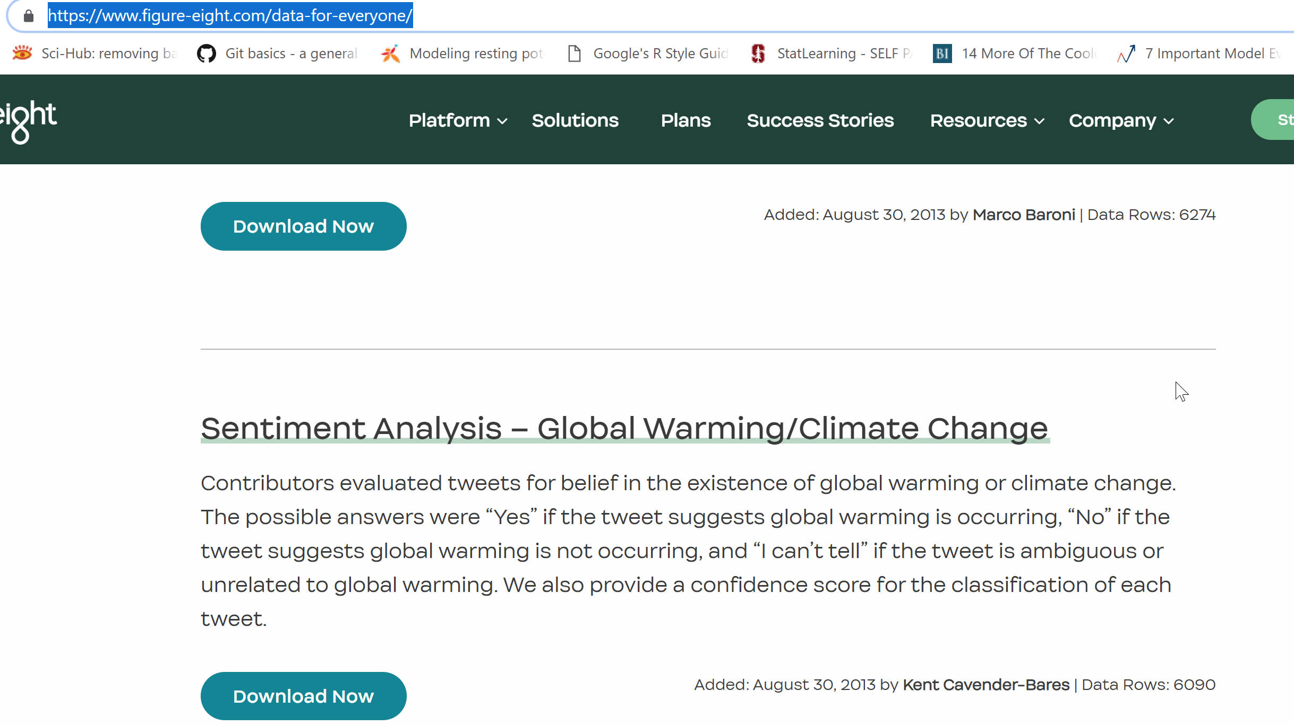
Data Sources
https://machinelearningmastery.com/datasets-natural-language-processing/
https://www.figure-eight.com/data-for-everyone/
Understand how sentiment changes with time

Slide 5
Aims
Pick a data source an approach and get started with NLP
You can choose a simple problem and data set or a more challenging problem. The idea being you learn something and have can brainstorm on how to take it further.
Create your own gitHub branch
At the end we can present back what we have found.

Slide 6
More resources
Books on NLP
Datasets for NLP:
https://machinelearningmastery.com/datasets-natural-language-processing/
https://www.figure-eight.com/data-for-everyone/
Mini course on getting started with nlp
A series of great blogs on NLP

