Slide 1
Smart Conversations: AI-Powered Customer Support Chatbot for Banking IT Support
GROUP 1
Darsini Lakshmiah
Hari Prasannaa Thangavel ravi
Tycho Gromley
Notes:
Good afternoon, everyone. We are Group 1, and today we’re excited to present "Smart Conversations" – our AI-powered customer support chatbot designed specifically for Banking IT support.

Slide 2
Scope of the project
AI-Powered Customer Support: Developed an intelligent chatbot to handle banking IT-related customer queries via natural language understanding.
AWS-Powered Infrastructure: Utilized AWS services (Lex, Lambda, DynamoDB, CloudFront, CloudWatch and Amazon ECR) to build a scalable, serverless backend for real-time automation.
Continuous Learning: Integrated the machine learning model (deployed via Lambda layer) trained externally to improve response accuracy over time.
Data-Driven Insights: Logged chat history in DynamoDB to enable analytics, pattern recognition, and future optimization for support efficiency.
Notes:
At a high level, our chatbot solution is designed to handle Banking related customer queries in the banking sector using natural language understanding.
We used AWS services like Lex, Lambda, DynamoDB, and others to build a scalable, serverless backend.
Integrated the machine learning model (deployed via Lambda layer) trained externally to improve response accuracy over time.
Finally, all chats are logged, which allows us to generate insights and continuously optimize the system.

Slide 3
Features Implemented
AWS Lex: Natural language understanding, 8 intents implemented
AWS Lambda: Processes input/output, connects services, handles logic.
Amazon DynamoDB: Stores Chat history and user session storage.
Amazon IAM: Fine grained permission control
Amazon Cloud Watch: Trouble Shooting and Log tracking
Amazon ECR: Hosted Docker Image to Bypass Lamda layer size restriction in S3
Amazon SNS: Sends notifications triggering human escalation if needed
Notes:
We’ve implemented several AWS features
• AWS Lex handles intent recognition and user input.
• Lambda processes that input and triggers different logic paths if lex is not confident about the intent.
• DynamoDB stores chat history and sessions.
• IAM enforces fine-grained access controls.
• CloudWatch helps us debug and track performance.
• ECR lets us package the model in Docker, bypassing Lambda’s size limits.
• SNS sends alerts to human support if needed.

Slide 4
Data Sources
BANKING77 (by PolyAI on Hugging Face)
13,083 labeled banking-related queries
Covers 77 distinct fine-grained intents
Intent categories include card issues, top-ups, transfers, identity verification, etc
Manual Intent – Added 8 manual Intents including Greetings , Balance Check, Transfers etc
Sample Entry:
Text: "I am still waiting on my card?”
Label: 11 → card_arrival
Notes:
The core of our chatbot is powered by the BANKING77 dataset from huggingface, which has over 13,000 labeled queries across 77 intents covering everything from card issues to identity verification.
In addition, we’ve added 8 custom intents like greetings, balance checks, and transfers to better match IT-specific contexts.
Here’s a quick example: the query “I’m still waiting on my card?” will be labeled as card_arrival.
These labeled data points helped us train our model to classify user intents accurately, when AWS Lex’s confidence score was low.

Slide 5
Expected Outcomes
🤖 Deployable Chatbot for Banking IT Support: A fully functional chatbot capable of assisting with banking-related IT queries using natural language understanding.
🔐 Secure & Scalable AWS Architecture: Deployed on a robust, serverless AWS stack (Lex, Lambda, DynamoDB, ECR, etc.), ensuring security, flexibility, and cost efficiency.
📈 Logged Interactions for Continuous Improvement: All user interactions are stored in DynamoDB, enabling future enhancements through analytics and ML-driven insights.
Notes:
Our goal was to build a chatbot that’s:
✅ Deployable in real-world banking scenarios
✅ Backed by a secure and scalable AWS infrastructure
✅ Able to log and learn from interactions for long-term improvement
This makes our system not just functional, but future-ready and continuously improving.

Slide 6
ML Model for Intent Classification
🎯 Objective: Build a cost-effective, high-accuracy ML model to classify banking support queries into predefined intent categories, enhancing chatbot intelligence without relying on AWS Sage Maker.
Dataset: Banking77 (77 real-world banking intents)
Notes:
To improve accuracy, we trained a custom ML model to classify intents using the BANKING77 dataset.
We focused on building a cost-effective alternative to Sage Maker, deploying the model inside a Docker container in Lambda via ECR.
This keeps our architecture lightweight and cost-efficient.

Slide 7
Model Architecture and Training
Preprocessing:
Text cleaning: lowercasing, punctuation removal
Tokenization & lemmatization (nltk package)
Stop word removal
Vectorization: Tf-Idf vectorizer (bi gram , max 5000 features
Model: Logistic Regression Model from Scikit-learn
Label Encoding: Applied for Multi class classification
Notes:
We used classic NLP preprocessing of cleaning text, tokenizing, applying lemmatization to identify the root stem word, removing stop words and punctuations, and vectorizing with TF-IDF (bi-gram).

Slide 8
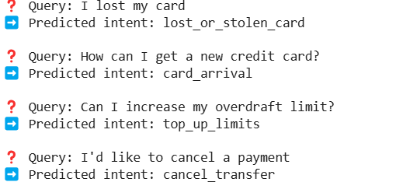
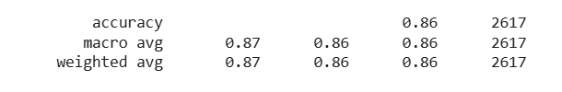
Performance and Output
Test Accuracy: 86%
Macro F1score: 0.86
Precision/ Recall: High across most common banking intents.
Notes:
For modeling, we used Logistic Regression, which gave us 86% accuracy and a Macro F1-score of 0.86.
This showed strong performance across diverse banking intents making it a solid backbone for fallback predictions when Lex isn’t confident.

Slide 9








AWS Cloud Architecture
Log function calls, errors, and performance metrics
Sends intent + user message for processing
Capturing User Input
Fallback notification for user
Pulls container image for model inference
Handles permissions
Store Chat history
Retrieve past interactions
Notes:
Let me walk you through our AWS Cloud Architecture.
Everything begins with the user input, which is captured through a front-end interface. That input is passed to Amazon Lex, which uses natural language processing to understand the intent behind the message.
Once the intent is identified, Lex forwards both the intent and the user message to an AWS Lambda function. Lambda handles all the backend logic and serves as the brain of the system—completely serverless and highly scalable.
For model inference, Lambda pulls a container image from Amazon ECR, where we’ve stored our custom-built model. This allows us to run our own machine learning model inside the Lambda function, giving us full control over the logic and behavior.
AWS IAM manages all the permissions in this flow, ensuring secure access between services.
We use Amazon DynamoDB to store user chat history and retrieve past interactions, which helps us maintain context and deliver more personalized responses.
Throughout this process, Amazon CloudWatch logs function activity, errors, and performance metrics so we can monitor and fine-tune the system.
Finally, if a message can’t be processed properly, Lambda triggers a fallback notification, letting the user know there was an issue and helping maintain a smooth experience.
This architecture leverages AWS-managed services along with our own custom model to create a powerful, flexible, and intelligent conversation system.

Slide 10
Data Flow
Fallback Escalation: Low-confidence responses trigger alerts via Amazon SNS
Data Ingestion: Real-time user input captured via Amazon Lex
Data Processing: Lex identifies intent Low-confidence queries routed to ML model (via Lambda + Amazon ECR)
Data Release: Response sent back to user through Lex Logged in CloudWatch for monitoring
Monitoring: Logs + metrics tracked using Amazon CloudWatch
Data Cleanup: Standardize input using AWS Lambda
Data Storage: Chat logs + metadata saved in Amazon DynamoDB
Notes:
This slide illustrates the complete data flow of our system, from user input to monitoring.
We start with Data Ingestion, where real-time user input is captured through Amazon Lex. Lex acts as our conversational interface and the first point of interaction.
The input is then passed to a Data Cleanup stage, where we use AWS Lambda to standardize and format the input. This ensures consistency before further processing.
Next is Data Processing. Lex attempts to identify the user's intent. If it’s a low-confidence query, it gets routed to our custom-built ML model, which is containerized and deployed via Lambda and Amazon ECR.
In parallel, we have a Fallback Escalation mechanism. If a response remains uncertain even after model inference, we trigger alerts using Amazon SNS. This ensures we’re notified of edge cases or issues in real time.
All user interactions—chat logs and metadata—are stored in Amazon DynamoDB as part of Data Storage. This gives us persistent context for future conversations.
Once processing is complete, we move to Data Release. The response is sent back to the user through Lex, and at the same time, it’s logged in CloudWatch.
Finally, in the Monitoring stage, we use Amazon CloudWatch to track logs and performance metrics. This helps us audit, troubleshoot, and continuously improve the system.
Together, this flow shows a seamless integration of AWS services to create a robust, intelligent, and responsive conversational pipeline.

Slide 11
Cloud Services in Action
AWS Service | Role | In Action (Demo)
Amazon Lex | Handles natural language understanding (text/voice) | Captures user query like "Where is my card?"
Amazon CloudWatch | Tracks Lambda execution time, errors, and logs | Helps with monitoring model predictions, debugging failures, and optimizing performance
AWS Lambda | Orchestrates logic, connects services | Routes input, calls ML model (intent not captured by lex), formats response
Amazon DynamoDB | Stores conversation logs | Saves: {user_id, timestamp, intent, message}
Amazon ECR | Used to deploy the Lambda function with ML capabilities | Stores Lambda ZIP, demo inputs/outputs if needed
Amazon SNS | Sends alerts/notifications | Sends alert email to support: "High priority issue"
Amazon IAM | Manages service access and security | Ensures authorized actions

Slide 12
Inputs and Outputs
Step | Input | Output
User Query | Text: "Activate my card" | Text passed to Amazon Lex
Lex Intent Recognition | Text | Intent: activate_my_card + confidence score
Lambda Processing | Intent + User Metadata | Response string: "Your card will be activated shortly."
DynamoDB Logging | Intent, Query, Timestamp | Stored record for future analytics
SNS Trigger | Flagged queries like fraud, blocked card | Alert to support team via email/SMS
Notes:
This table breaks down the key steps along with the inputs and outputs at each stage.
It starts with the User Query—for example, 'Activate my card'—which is passed to Amazon Lex.
Lex performs intent recognition, outputting something like activate_my_card along with a confidence score.
Next, the Lambda function processes that intent, along with any user metadata, and returns a response—like 'Your card will be activated shortly.'
All interactions, including the intent, query, and timestamp, are logged in Amazon DynamoDB for future analytics.
Finally, for sensitive or flagged queries—like suspected fraud or blocked cards—Amazon SNS triggers alerts to notify the support team via email or SMS.
This input-output mapping gives a clear view of how user messages are handled and tracked throughout the system.

Slide 13
Key Challenges & Solution
Lambda Layer Memory Limit: Used ECR to deploy Docker image with all dependencies (bypassing ~250MB unzipped limit and S3 import issues).
Avoiding SageMaker Costs: Embedded the ML model directly in Lambda via Docker, eliminating need for costly SageMaker inference endpoints.
Web UI Deployment Conflict: API Gateway didn’t allow both HTTP and HTTPS due to permission overlap resolved by routing through CloudFront with HTTPS-only.
Numpy Import Error in Lambda: Rebuilt all Python dependencies (NumPy, etc.) inside Docker using a Python 3.9 base image to ensure compatibility with Amazon Linux 2. Rebuilt and redeployed via ECR.

Slide 14
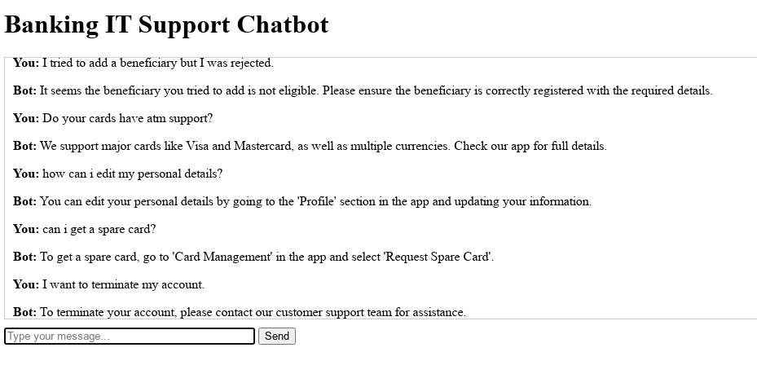
Demo of the Project !!!

Slide 15
Conclusion
Successfully delivered a scalable, AWS-powered chatbot with integrated voice and text support, enhancing accessibility and convenience for users.
Significantly improved customer experience by automating support processes and providing quicker, more efficient responses.
Designed as a cloud-native, modular solution that is future-ready, enabling easy scaling and integration of additional services as business needs evolve.

