Slide 1
Architecture Approach Dashboard
DLP DNX Initiative Phase II & III
Bruce Francois

Slide 2
Project Overview
Key Stats
Project Start Date: Q2 FY 2014
Planned Deployment Date: Q3 FY 2015
Total Planned Budget: TBD
Current CM Phase: Pre-Concept Definition (G0)
Sponsoring Business Units: DLP
Project Scope Highlights
Project Purpose (Goals and Objectives)
The DNX (Dlp/Digital New eXperience) aims at the implementation of the WDPRO digital platform @ DLP.
This implementation will be in 3 phases
Phase 1 : Digital Marketing platform
Replacement of “web re-launch”: Replacing digital marketing site with Wdpro finder+
Phase 2 : Digital ticket sales platform
Replacement of current ticket module “PLUTO” and associated “product enabler” SAM with the ticket, package and lodging modules within Wdpro’s web platform)
Phase 3 : Digital package sales platform
Replacement of “DDS1” and associated “product enabler” PSE
Project Assumptions and Constraints
DLP DNX Initiative prelim timeline is Nov 2013 start date with a 15-18 month duration.

Slide 3
Enterprise Architecture Dashboard
Assumptions | Risks
Option 1: Approach with major Product Program Integration including (Inventory and Pricing) Option 1A: Excluding Inventory and Pricing Both the Internal Facing and External Facing UIs will be adapted to support migration to the “One UI Framework”. Accovia-DLP will be retained for product setup only and other back office functions. Accovia-DLP will feed the Product Hub with the defined product Inventory, Pricing and Product augmentation i.e. Product eligibility, combinability, applicability, etc. will be done in the new Product Mgmt UI with integrated modules to Asset Mgmt UI and Inventory Mgmt UI which will feed the Product service data store Option 2: Approach with No or LIMITED Product Program Integration EAI will be leveraged to provide integration to Accovia-DLP. | Option 1 Availability and stability of the Product Program’s components i.e. Sales Order Service, Sales Offer Service, Product Services, Entitlement Services, etc in time for project delivery. DLP Business impacts as a result of new UI components DLP Business impacts as a result of the changes to SBC adapting to new Product Program components Multiple CMS applications (Tridion, Hippo, OneSource) and integrations . Option 2 Web Client leveraging “antiquated” EAI MQ Series integration technology See Appendix A11 for detailed risk analysis.
Constraints | Impacts
Accovia-DLP will continue to be SOR for Product definition, bookings (orders) and payments in both option 1 and option 2 SBC will remain the booking client for call center sales operations in both option 1 and option 2 | Option 1 New Internal Facing UIs: Product Mgmt, Asset Mgmt UI, Inventory Mgmt, Sales Order Mgmt Option 2 SBC, PMA, PCS, Travel Order Service (Travel Wish) Recommender, DTS, Web Client
Recommendations
Engage with Enterprise Architecture at gate G3 to conduct a compliance assessment against the proposed recommendations. Project will leverage and/or implement Enterprise Service standards as referenced Appendix A9 specifically for implementing and classifying services. Project will Implement solution in accordance to proposed architecture approaches and referenced architectures as illustrated in Appendix A1-1 and A1-2. Recommended approach is Option 1 (Approach with major Product Program Integration ) with Option 2 (Approach with limited or no Product Program Integration )as a secondary or fall back option to mitigate risks.

Slide 4
Approach Justification
Overall
Implement WDPR Segment Architecture
Implement/leverage/share key WDPR enterprise components
Product Hub: Limited to persisting the product definition data from Accovia-DLP to support the product augmentation processes with WDPR product components
Sales Order Service
Sales Offer Service
Entitlement Service
Asset Hub: Limited to persisting the facility data for DLP Hotels and equipments
Interface Facing UI
Product Mgmt UI, Asset Mgmt UI, Inventory Mgmt UI, Sales Offer UI
External Facing UI
Web Client
Minimize transitional impacts for DLP realizing their target architecture
Align to the DLP and WDPR target reference architectures
Rationalize the service implementations across WDPR with emphasis on GBTS and WDPRO
Implement/leverage the “One UI Framework” for both Internal and External Facing UIs

Slide 5

Alignment with Architecture Principles
Principles
Enterprise Architecture Drives Alignment
Structured Investment Management Process
Metrics & Measurements
Business Architecture
Information is a Strategic Asset
Compliance with the Law
Globalization Support
Solution Interoperability
Independence of Applications from Underlying Technology
Scalability
Auditability
Configurability
Business Service Availability
Security Controls
Contemporary Technology Approach
Principle | Comments
Contemporary Technology Approach | The proposed application architecture within Option 2 leverages antiquated EAI (MQSeries) technology. The EAI architecture is not consistent with the future direction for service components
Metrics & Measurements | The project does not provide metrics for formal measurement.
Principle | Comments

Slide 6

Alignment with Strategic Programs
Consumer/Guest
Not Applicable.
Product
The proposed components within this project align and/or complement the foundational components of the product program target architecture. This project will leverage Product Hub (if available) as a key WDPR component for persisting and retrieving product definition data sourced from Accovia-DLP.
Cast Support Services
Not Applicable.
Information Management
This project will leverage the emerging analytical reference architecture and MDM platform.
Strategic Programs
Execution method by
which we align
business and
technology
objectives
Consumer/Guest
Product
Cast Support Services
Information Management

Slide 7
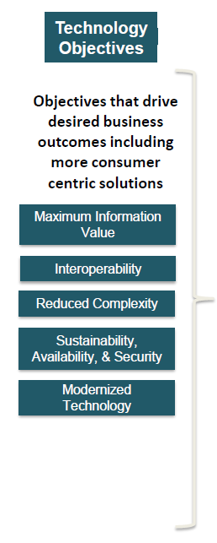
Alignment with Technology Objectives
Maximum Information Value
Existing level of value, given the use of existing WDPR components.
Interoperability
The project introduces and leverages components i.e. Sales Offer Service, Sales Order Service, Product Service, Entitlement Service, etc. that are interoperable with other WDPR and DLP components.
Reduced Complexity
TBD
Sustainability, Availability, & Security
Consistent with current WDPR standards
Modernized Technology
The project will leverage WDPR modernized technology

Slide 8
Business Architecture Dashboard
Assumptions | Risks
For Option 1, the new internal user interfaces will be user friendly with the functionality required to perform their work effectively and the processes will be improved to reflect the most efficient way for the business to manage their work. Business rules which are business relevant and have business volatility for eligibility, applicability, combinability and pricing will be exposed to be managed by business rule administrator through a UI. The improved sales offer and order functionalities and improved business rule structure will be available for all WDPR sites for an enhanced global guest experience. | Option 1: Risk to business user experience if the new UIs is not available at project go-live. Risk to the business if the UI does not effectively support the sequencing of tasks and the required functionality. Option 2: Risk to the business of not being able to share cleansed and governed business data across business for DLP. (See Risk Assessment Analysis)
Constraints | Impacts
1. Call Center workflow will not change. | Option 1: There are business user and process changes to leverage the new User Interfaces for Product Management, Asset Management and Inventory Management. All Options: All Options are expected to boost ticket and package sales through improved sales offer and order functionalities and simplified user experience through the web. DLP is in business alignment with the WDPR Enterprise from a business strategy and functionality perspective.
Recommendations
Collaborate with Business Architecture on changes to business process to ensure we are gaining business alignment in processes and functionality across the WDPR Enterprise. Follow-up with Business Architecture to discuss measurable objectives for DLP strategies based on the metrics that were provided by WDPRO. (See Business Architecture Appendix)

Slide 9
Information Architecture Dashboard
Assumptions | Risks
Option 1 + 2: Existing D3 stores will be leveraged - -no new components of the IMS Reference Architecture are required for analytics Product Configuration will reside inside Accovia-DLP Option 1: Product Hub will be used for persistence & retrieval of Product Data only Asset Hub will be store DLP Facility data for Hotels as well as any reference data to support Accovia Product Configuration Any new Master data sources will leverage MDM components including Enterprise Staging Area (ESA), Central Data Repository (CDR) and MDM Areas (see Appendix A2 – MDM Context Diagram) Product Hub & CMS Integration is required to support WEB DLP Data stores retired: Package Merge Agent (PMA), Product Combinability (PCS) DLP Recommender, Travel Wish Option 2: Travel Wish (shops) schema will need enhancement | Option 1: Ability to hire qualified Data Modelers and ramp up in time for FY14, 2Q (start of Project) Some information models are at Conceptual level only ( Rate Plan, Combinability, Eligibility) High dependency on Master Data Hubs readiness High dependency on ESA, CDR readiness Integration with Product Hub and CMS All Product / Asset data in Accovia-DLP will need early profiling, mapping and Data Quality checks Option 2: Tactical Solution incurring more technical debt instead of building out new Product Program Architecture As more capabilities are built leveraging the Product Program, data integration for analytics will become an issue
Constraints | Impacts
Option 1: Timelines + IA Resource Availability | Option 1: New Product Program foundational components are built Asset and Product Hub will be bringing on new data sources ESA & CDR will be bringing in new master reference data
Recommendations
Align with Industry standards as well as Disney established standards for data modeling for both Options Option 1 (Appendix A2 Future State) ) Leverage the Product Program : ensure complete and generalized data models are created to support foundational implementation of Product Pricing (Rate Plan, Eligibility, Combinability), Asset Service, Inventory, Sales Order, Sales Offer, Payment (Folio), Entitlement Ensure MDM readiness (for new products + assets) and proper integration with Content Management System Leverage and extend the IMS Reference Architecture (CDR) to contain all mastered reference data not specific to the hubs Decommission the legacy data stores for DLP only including: Recommender schema, PMA , Travel Wish Option 2 - (Appendix A2 – Current State) Enhance legacy models + schemas: Product Merge Agent (PMA) , Product Combinability Schemas (PCS), Travel Wish schema

Slide 10
Solution Architecture Dashboard WDPRO
Assumptions | Risks
Options 1&2: Tridion will provide multi-lingual data for tickets, packages, resorts and attractions. Logitours will provide core pricing information for resorts and packages. Gateway will provide pricing and codes for tickets. Option 1: The product Hub and associated services will provide all pricing related information, combinability rules, sales offer rules and product eligibility for DLP channel/market combinations. Integration with Logitours is assumed. The WDPRO local storage for catalog data will not be required as the new segment services, data stores and MDM hubs will contain the data. Option 2: PMA/PCS /Recommender will provide pricing and offer recommendations for resort packages | Option1: The timelines for product program services and components seems very aggressive to be included in this solution. A big bang approach to product program integration is a large risk for this project. The new internal facing UI’s identified do not have an agreed on technology stack/UI framework for design/build. The new web client behavior analytics service/component has not been investigated by WDPRO for scope, architecture and effort. Option 1&2: Integration with Tridion, Gateway and Logitours for multi-lingual catalog and pricing information may be complex and difficult, posing a schedule/cost risk. Transfer of PSE and DDS1 business rules to WDPRO/GBTS services poses an architecture, cost and schedule risk. Integration of MyDLP profiles and travel wishes poses an architecture, cost and schedule risk
Constraints | Impacts
WDPRO services need to evolve in a pragmatic fashion to avoid de-stabilizing the web platform for WDW and DLR while working towards DLP integration. WDPRO web platform must evolve simultaneously to support WDW, DLR, DLP, SHDR and HKDR. This will make any large re-factorings or major changes difficult. Small, incremental changes must be used to evolve the platform for DLP. | WDPRO interaction services need to be built out to provide the flexibility to integrate with multiple back-end systems and services to provide a segment-wide solution.
Recommendations
Option 1 is the recommended approach for DLP DNX phase 2&3 with a fall-back to option 2 if product program services & components are not available for integration (completed and tested) within a time-frame that is practical for WDPRO to adopt them. The new/enhanced WDPRO Interaction service components will support this evolutionary approach to product program adoption.

Slide 11
Solution Architecture Dashboard GBTS
Assumptions | Risks
Application Option 1 Product definition setup will continue in Accovia-DLP. CDR will be the SOR for reference data. PMA , PVS ,PCS , EAI and Travel Wish components will be retired. Product augmentation will be done in the new Product UI. Sales Order Services will leverage the existing EAI's Accovia DLP adapter. Asset Services will be used for facility data including good neighbor hotels. Option 1: Inventory and Pricing setup will be outside of Accovia-DLP Option 1A: Inventory and Pricing setup will continue in Accovia-DLP. Option 2: DLP to continue product definition, pricing and inventory setup in Accovia. DLP will continue Product Augmentation using PMA/PVS and PCS. PMA, PCS, PVS and Travel Order services will need enhancement to support new attributes and to expose as a web service. Please refer Appendix A5 Information New data stores for DLP will not be consumed by IMS. Decommissioning of the DLP Recommender will not impact IMS. | Application Option 1: Aggressive timeline for Scope. High dependency on Product Program. Dependency on CDR for reference data. Dependency on IA for logical and physical data models readiness. Dependency on MDM Hubs readiness. Option 2: WDPRO using EAI MQ integration. Tactical solution which does not align with the foundational components of the product program target and transition architecture. Information Awaiting Accovia decisions that could impact assumptions and estimates. Internationalization of any data will impact downstream uses of the data.
Constraints | Impacts
Application Product definition setup will continue in Accovia-DLP for option 1 and 2. SBC will remain the sales client for call center operations for option 1 and 2. Accovia will remain the SOR for room and package bookings. Information no new Analytic or Reporting requirements for DLP There are no changes to Accovia for DLP. DLP Travel wish will remain consistent. Any services used by DTS will already be implemented in WDW. The Current DTS will stay stable. | Application Option 1: Product Program components : Asset, Product, Inventory, Pricing, Sales Order, Sales Offer and Accovia DLP Adapter. Option 1A: Product Program components : Asset, Product, Sales Order, Sales Offer and Accovia DLP Adapter. Option 2: Sales Order (For entitlement), SBC, PMS/PVS, PCS, EAI, Travel Order Service and Recommender. Information All changes that have been implemented at WDW for service changes related to SBC or Recommender will be required for DLP DTS. Loads into, and out of, the MDM Product hub will be required for the new Product UI to support DLP.
Recommendations
Application Recommends the Option#1 (option with Major Product Program Integration including Inventory and Pricing). Option 1 and 1A: Align with Industry standards as well as Disney Enterprise standards for modeling and implementing services. Leverage the existing EAI DLP adapter which supports TAP based communication with Accovia-DLP. Retire or deprecate the Recommender, PMA. PVS, PCS , Travel Order Service, and EAI (DLP instance excluding the DLP Accovia Adapter) Option 2: Recommends leveraging the global services layer from product program to reduce the transitional impact. Information Insure alignment with Product program and validate assumptions about Accovia prior to proceeding. Implement as much of WDW architecture as possible to minimize custom coding.

Slide 12
Technology Architecture Dashboard
Assumptions | Risks
New components will utilize preferred technologies Minimal (or no) expansion of existing non-preferred technologies | As old technology goes out of support, stability and recoverability of solutions is weakened
Constraints | Impacts
 | Our technology catalog can support expected needs of new components Some costs to acquire new servers, software
Recommendations
Migrate to preferred technologies Retire old, unsupported technologies

Slide 13
Appendix

Slide 14
Appendix A0: EA Project Team
Role | Name
Enterprise Architect | Bruce Francois
Business Architect | Elizabeth Holubek
Information Architect | Rosanne Vezzi
GBTS Infrastructure /Security Architect | Dave MacLean
WDPRO Infrastructure /Security Architect | Anthony Florendo
Information Solution Architect | Chris Ebaugh
GBTS Application Solution Architect | Siva Govindarajan, Nag Muvva
WDPRO Application Solution Architect | David Raal
DLP Solution Architect | Fernando Iafrate

Slide 15
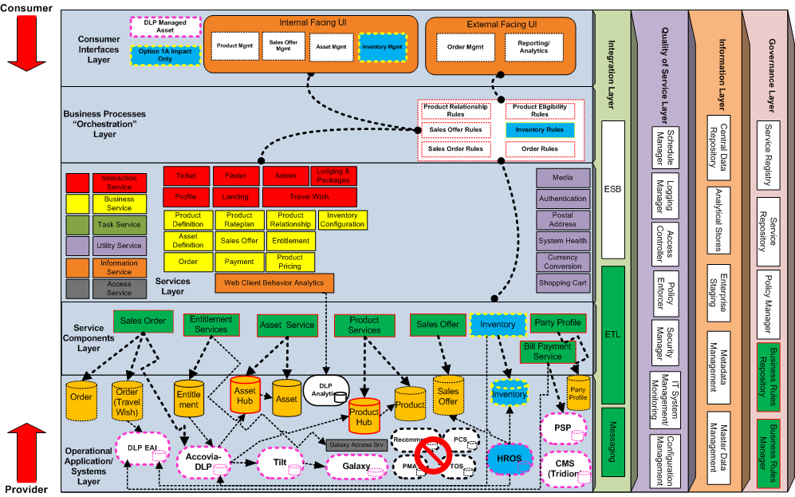
Appendix A1-1: Proposed Project Architecture Reference Model Option 1

Slide 16
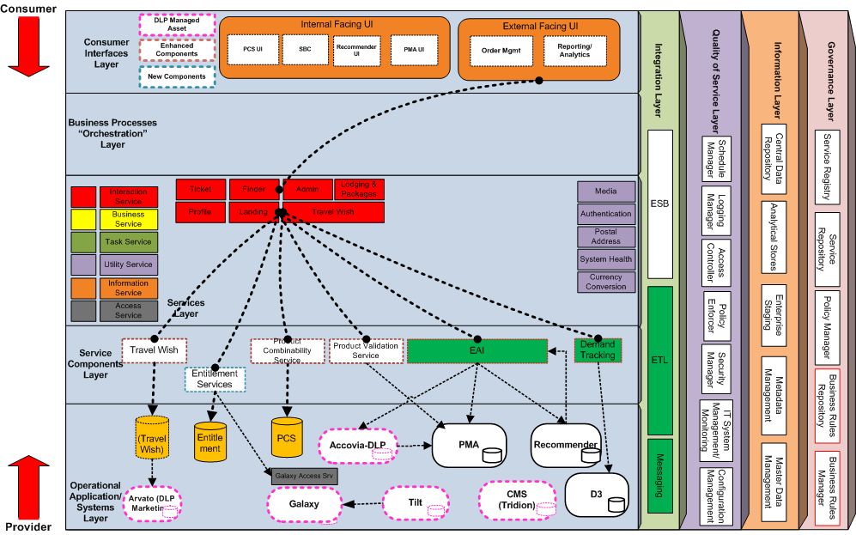
Appendix A1-2: Proposed Project Architecture Reference Model Option 2

Slide 17
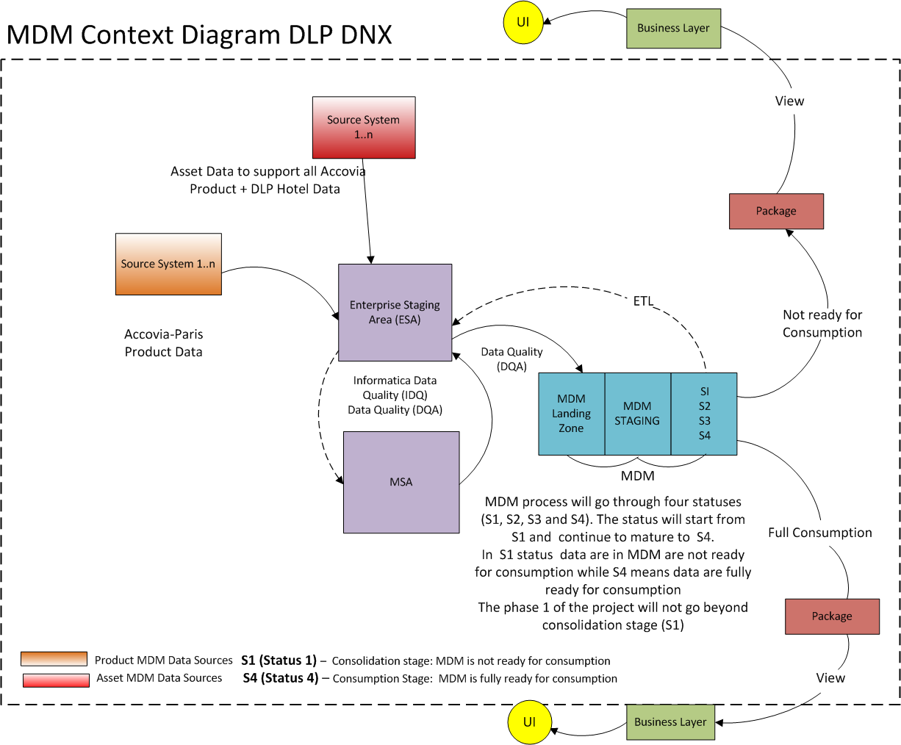
Appendix A2: Information Architecture

Slide 18
Appendix A2: Information Architecture

Slide 19
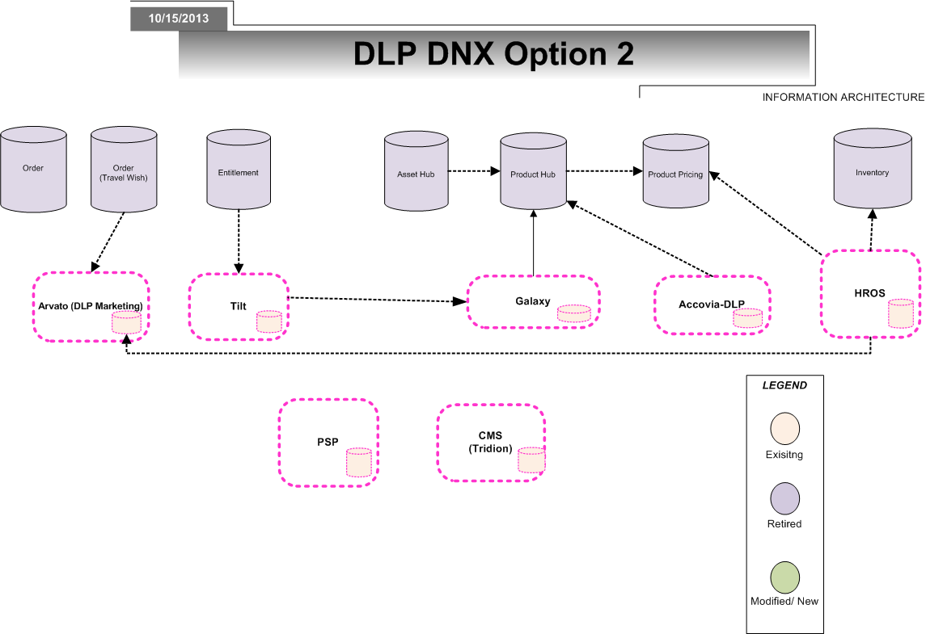
Appendix A2: Information Architecture Option 1

Slide 20
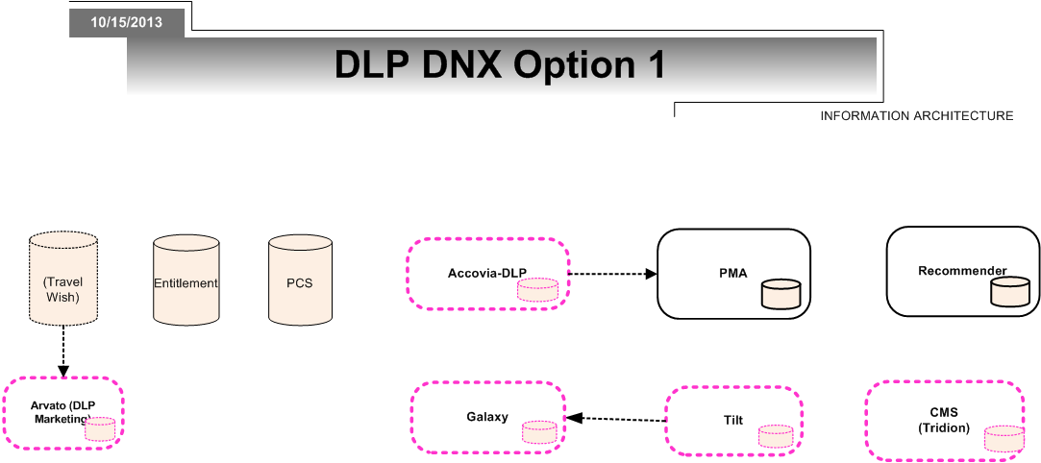
Appendix A2: Information Architecture Option 2

Slide 21
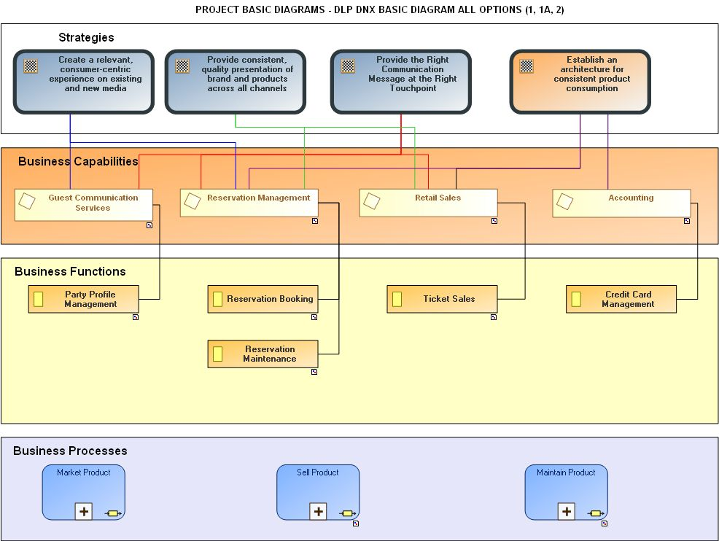
Appendix A3: Business Architecture Models

Slide 22
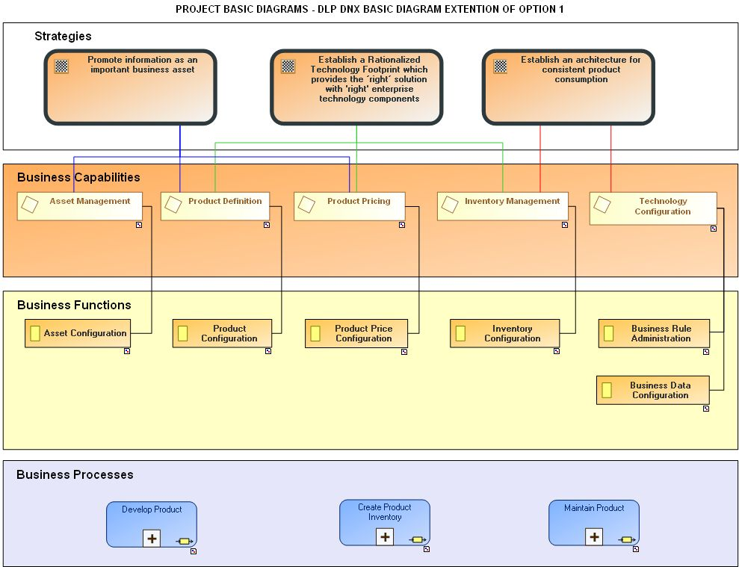
Appendix A3: Business Architecture Models

Slide 23
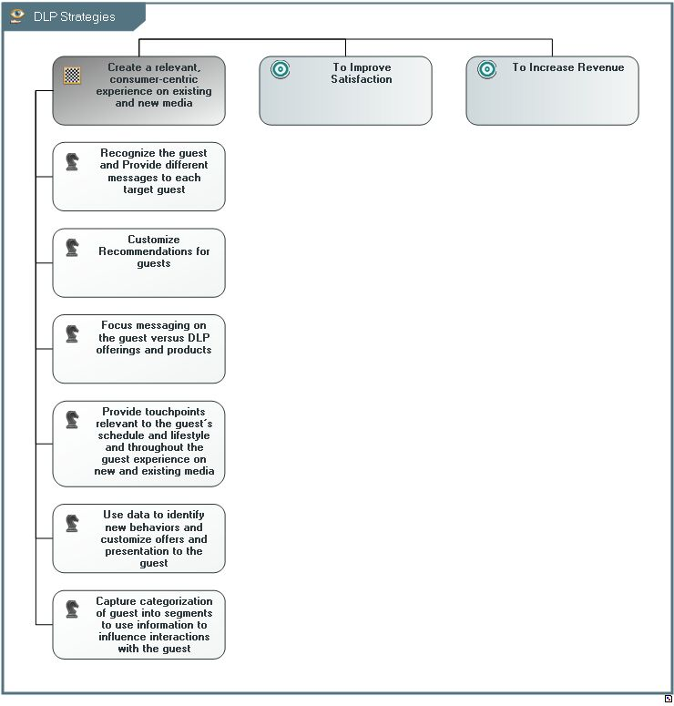
Appendix A3: Business Architecture Models

Slide 24
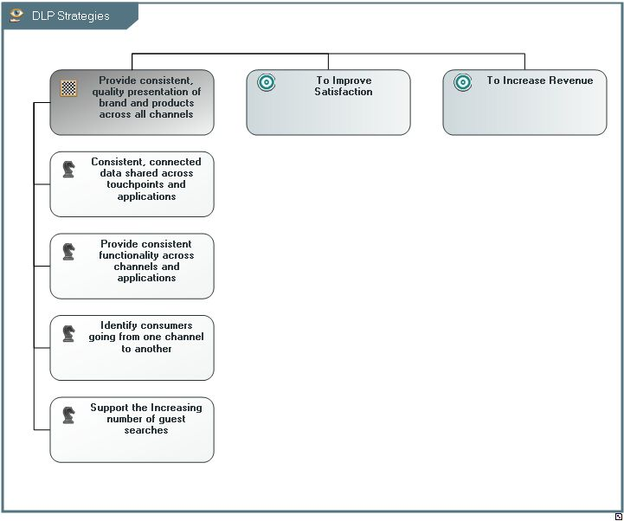
Appendix A3: Business Architecture Models

Slide 25
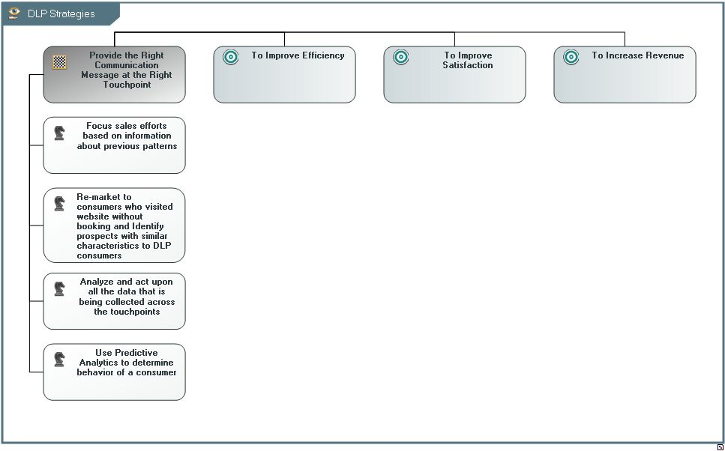
Appendix A3: Business Architecture Models

Slide 26
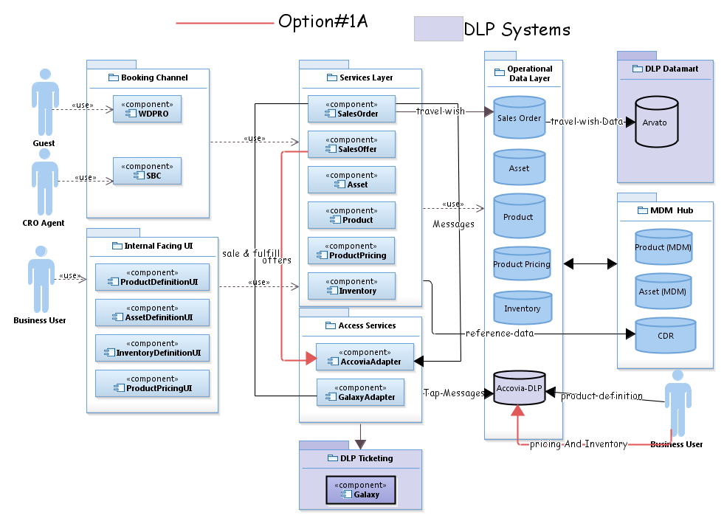
Appendix A5: GBTS Application Service Model

Slide 27

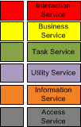


Appendix A8: Proposed WDPRO Architecture Reference Model - Option 1
Web
Apps
Web Platform (Redaptive UI modules)
Internal Facing UI
Tickets
Lodging & Packages
Finder +
Landing
Product Mgmt UI
Sales Offer Mgmt UI
Routing and re-direct
Dine
Login & Profile
Personal Magic
Admin
Asset Mgmt UI
InventoryMgmt UI
DLP UI Configs (Site/Market/Channel/Store)
REST Svc API calls
(site/channel/market/language context)
Retired/ N/A component
Requires enhancements
New component
Interaction Services
Biz Services & SORs
msgs
Cart Svc
Context aware API
Tickets
Lodging & Packages
Finder +
Landing
Admin
Login & Profile
Review Svc
Inventory Svc
Inventory
REST
DLP business rules
Asset Hub
In-memory cache with query API
Personal Magic Svc
Product Svc
Order Svc
Product Hub
Sales Offer Svc
Asset Svc
Orders
Search
Svc
Savings Svc
Config
Svc
Rules
Svc
Product Rate Svc
Payment Svc
Payments
Bulk Svc
Expands Svc
Media
Svc
Content
Svc
Product Rel. Svc
Entitlement Svc
Galaxy connector
Arvato connector
DLP Svc Configs (Site/Market/Channel/Store)
DLP business rules
XML/ flat
File
Connectors & Adapters to back end systems
DLP SORs
OSDL
Tridion connector
Bio connector
Biz Svc connectors
Logitours
Galaxy
Tridion
Arvato
REST
Key-value
lookup
SQL
WDPRO SORs
Stratus
BIO
OPM (Special offers)
Hippo CMS
Endeca Search Engine
Couchbase
Oracle
MySQL
MySQL
Config Manager App
Facilities
Product Data
Config Data
MDEX
Sessions
Carts

Slide 28
Appendix A8: Proposed WDPRO Architecture Reference Model - Option 2
Web
Apps
Web Platform (Redaptive UI modules)
Internal Facing UI
Tickets
Lodging & Packages
Finder +
Landing
PCS UI
Recommender UI
Routing and re-direct
Dine
Login & Profile
Personal Magic
Admin
PMA UI
SBC UI
DLP UI Configs (Site/Market/Channel/Store)
REST Svc API calls
(site/channel/market/language context)
Requires enhancements
New component
WDPRO Services
Context aware API
GBTS Services & SORs
Tickets
Lodging & Packages
Finder +
Landing
Admin
Login & Profile
REST/ SOAP/
MQ
In-memory cache with query API
Recommender
Payment Svc
Recommendation Svc
Personal Magic Svc
Cart Svc
Config
Svc
EAI
PCS
Availability Svc
Product Svc
Booking Svc
Search
Svc
Savings Svc
Review Svc
Rules
Svc
PMA/PVS
Reservation Svc
Pricing Svc
Facility Svc
Bulk Svc
Expands Svc
Media
Svc
Content
Svc
Entitlement Svc
DLP Svc Configs (Site/Market/Channel/Store)
DLP business rules
XML/ flat
File/ TAP/
REST/SOAP
DLP SORs
Connectors & Adapters to back end systems
Logitours
Arvato
Galaxy
Tridion
OSDL
Tridion connector
Bio connector
GBTS connectors
Galaxy connector
Arvato connector
REST
Key-value
lookup
SQL
Stratus
BIO
OPM (Special offers)
WDPRO SORs
Hippo CMS
Endeca Search Engine
Couchbase
Oracle
MySQL
MySQL
Config Manager App
Facilities
Product Data
Config Data
MDEX
Sessions
Carts

Slide 29
Appendix A9: EA Application & Services Standards
Reference Link:
https://backlot.disney.com/docs/DOC-54933

Slide 30
A11: Risk Assessment Analysis
Risk Category | Risk | Risk Name /Description | Risk Level (estimate) | Likelihood of Impact | Impact Level | Mitigation
Information Architecture |  | Option 1: Ability to hire qualified Data Modelers and ramp up in time for FY14, 2Q (start of Project) Some information models are at Conceptual level only ( Rate Plan, Combinability, Eligibility) High dependency on Master Data Hubs readiness High dependency on ESA, CDR readiness Integration with Product Hub and CMS All Product / Asset data in Accovia-DLP will need early profiling, mapping and Data Quality checks Option 2: Tactical Solution incurring more technical debt instead of building out new Product Program Architecture As more capabilities are built leveraging the Product Program, data integration for analytics will become an issue | Medium High High High High Low Low | High High Medium Medium Medium Low Low | High High High High High Medium Medium | Start interviewing for contractor Data Modeler resources now to ramp up Accelerate the detailed Conceptual Design to facilitate the next step to Logical Design. Consider separate data stores outside the Hubs as an interim step until Hub readiness Begin the Accovia profiling/mapping/data quality checks effort now. Define smaller steps toward Product Program adoption
Business Architecture |  | In Option 1, there is a risk to business user experience if the new UIs is not available at project go-live. | High | Low | Medium | Determine a backup solution and process that would allow business users to update asset definition, product definition and inventory changes.
 |  | In Option 1, there is a risk to the business if the UI does not effectively support the sequencing of tasks and the required functionality. | Low | Low | Low | The target business process and UI wireframes should be defined and reviewed prior to solution design and development.
 |  | In Option 2, there is a risk to the business of not being able to share cleansed and governed business data across business for DLP. | High | Medium | Medium | Determine a backup solution and process for governing business data for DLP.

Slide 31
A11: Risk Assessment Analysis (Contd)
Risk Category | Risk | Risk Name /Description | Risk Level (estimate) | Likelihood of Impact | Impact Level | Mitigation
Solution Architecture – Information |  | Option 1 and 1A: Aggressive timeline for Scope. High dependency on Product Program for: Services Evolution Dependency on CDR for reference data. Dependency on IA for logical and physical data models readiness. Dependency on MDM Hubs readiness. Option 2: WDPRO using EAI MQ integration. Tactical solution which does not align with the foundational components of the product program target and transition architecture. | High Medium | Medium High | High Medium | Appropriate planning and contingency to counter the aggressive timeline. Monitor progress of Product Program and take necessary tactical steps if necessary in case of delays or other deviations from the proposed approach. To avoid temporary throw away work and preventing WDPRO from integrating to End of Life services, recommended to use Option 1 instead.
Enterprise Architecture |  | Option 1:Availability and stability of the Product Program’s components i.e. Sales Order Service, Sales Offer Service, Product Services, Asset Services, Entitlement Services, etc in time for project delivery. | High | High | High | Delay DLP DNX initiative until Product Program components become available and or stabilized. Implement fallback option 2 as last resort.
 |  | Option 2: Web Client leveraging “antiquated” EAI MQ Series integration technology | Medium | Medium | Medium | Delay DLP DNX initiative until it is feasible to integrate with Product Program components
 |  | Option 1: DLP Business impacts as a result of new UI components | High | High | High | If project is approved, engage with the DLP business team early to plan and train for the user impacts
 |  | Option 1: DLP Business impacts as a result of the changes to SBC adapting to new Product Program components | Medium | High | Medium | If project is approved, engage with the DLP business team early to plan and train for the user impacts
 |  | Multiple CMS applications (Tridion, Hippo, OneSource) and integrations . | Medium | Medium | Medium

Slide 32
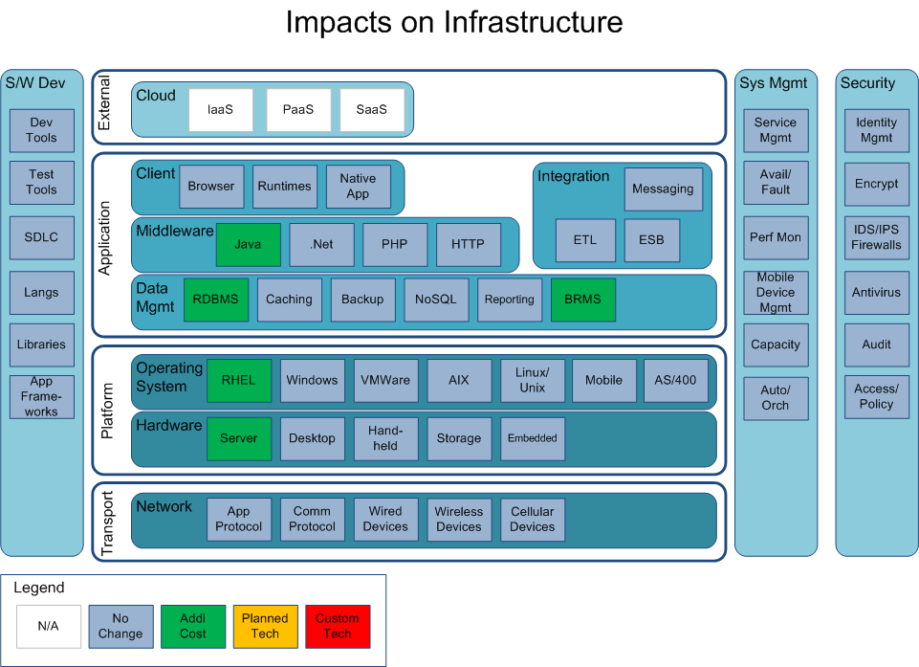
Appendix A13: GBTS Infrastructure Impacts

Slide 33
Appendix C1: Acronyms Terms and Definitions
Term | Definition
Access Service | Services that are dedicated to integrating legacy and/or third party applications and functions into the SOA solution. Implementation of Access services is analogous to an “adapter”. Ex Accovia “Access” Service.
Business Service | Services that are of a business-centric (domain specific) nature derived from one or more business entities. Business (entity) services support business capabilities through explicitly defined interfaces and are agnostic and highly reusable. Ex. Customer Service, Facility Service, Product Service
D3 | This represents the Disney Central Data Warehouse
ETL | Extract Transformation Load
ESB | Enterprise Service Bus
Component | A software program designed to be part of a distributed system. It provides a technical interface comparable to an application programmable interface (API) through which it exposes public capabilities. Components typically rely on platform-specific development and runtime technologies. For example, components can be built using Java or .NET tools.
Service Component | This represents the single atomic runtime deployable software component unit that realizes the service interface
Service | A service is a unit of solution logic to which service-orientation has been applied to a meaningful extent under the following design principles: Standardize Service Contract Service Loose Coupling Service Abstraction Service Reusability Service Autonomy Service Statelessness Service Discoverability Service Composability. A service can be considered a container of capabilities associated with a common purpose

Slide 34
Appendix C2: Acronyms Terms and Definitions
Term | Definition
Consumer Interface Layer | This application layer represents the point where consumers interact with the SOA. It enables an SOA to support a client-independent, channel-agnostic set of functionality which is separately consumed and rendered through one or more channels (client platforms or devices).
Business Process “Orchestration” Layer | This layer covers process representation and composition and provides the backbone flow and orchestration of a business.
Services Layer | This layer consists of all the services defined within the SOA. This layer contains the service descriptions for business capabilities and services, the IT manifestation during design time and the service contract and description that will be used during runtime.
Services Component Layer | This layer contains software components, each of which provides the implementation or “realization” for the services and their operations.
Operational Application/System Layer | This layer describes the runtime and deployment infrastructure; the programs, platforms, application servers, databases, packaged application, virtual machines, etc.
Integration Layer | This layer is the key enabler for an SOA and it provides the capability to mediate which includes transformation, routing, and protocol conversion
Quality of Service Layer | This layer provided solution QoS management of various aspects, such as availability, reliability, security and safely as well as mechanisms to support, track, monitor and manage solution QoS control
Information Layer | This layer is responsible for manifesting a unified representation of the information aspect of an organization. This layer includes information architecture, business analytics and intelligence
Governance Layer | This layer ensures that the services and SOA solutions within an organization are adhering to the defined policies, guidelines and standards that are defined as a function of the objectives, strategies and regulations applied within the organization.
Utility Service | Services that provide generic processing logic that is not classified as domain specific business logic i.e. no business context. It is often referred to as “cross-cutting” logic because it is ideally agnostic and reusable. Ex. Postal Address Utility Service, Media Resizing & Transcoding Service, Bulk Request Service
Information Service | Services that contain the data logic of a business design. Services within this classification manages data access, data composition and data flow. Ex. ETL data services. Information services are most closely aligned with the Information Layer. This may involve the use of Extract-Transform-Load (ETL) mechanisms to process and enrich data in bulk, batch processing activities involved in bulk transaction processing, and migrating data from master-data-of-record databases to information warehouses that can be used to perform post-processing and business intelligence, analytics, and content management functions – which in turn are made available to the business application as services.

Slide 35
Appendix C3: Acronyms Terms and Definitions
Term | Definition
Consumer Interface Layer | This application layer represents the point where consumers interact with the SOA. It enables an SOA to support a client-independent, channel-agnostic set of functionality which is separately consumed and rendered through one or more channels (client platforms or devices).
Business Process “Orchestration” Layer | This layer covers process representation and composition and provides the backbone flow and orchestration of a business.
Services Layer | This layer consists of all the services defined within the SOA. This layer contains the service descriptions for business capabilities and services, the IT manifestation during design time and the service contract and description that will be used during runtime.
Services Component Layer | This layer contains software components, each of which provides the implementation or “realization” for the services and their operations.
Operational Application/System Layer | This layer describes the runtime and deployment infrastructure; the programs, platforms, application servers, databases, packaged application, virtual machines, etc.
Integration Layer | This layer is the key enabler for an SOA and it provides the capability to mediate which includes transformation, routing, and protocol conversion
Quality of Service Layer | This layer provided solution QoS management of various aspects, such as availability, reliability, security and safely as well as mechanisms to support, track, monitor and manage solution QoS control
Information Layer | This layer is responsible for manifesting a unified representation of the information aspect of an organization. This layer includes information architecture, business analytics and intelligence
Governance Layer | This layer ensures that the services and SOA solutions within an organization are adhering to the defined policies, guidelines and standards that are defined as a function of the objectives, strategies and regulations applied within the organization.
Utility Service | Services that provide generic processing logic that is not classified as domain specific business logic i.e. no business context. It is often referred to as “cross-cutting” logic because it is ideally agnostic and reusable. Ex. Postal Address Utility Service, Media Resizing & Transcoding Service, Bulk Request Service
Information Service | Services that contain the data logic of a business design. Services within this classification manages data access, data composition and data flow. Ex. ETL data services. Information services are most closely aligned with the Information Layer. This may involve the use of Extract-Transform-Load (ETL) mechanisms to process and enrich data in bulk, batch processing activities involved in bulk transaction processing, and migrating data from master-data-of-record databases to information warehouses that can be used to perform post-processing and business intelligence, analytics, and content management functions – which in turn are made available to the business application as services.

Slide 36
Appendix C3: Acronyms Terms and Definitions
Term | Definition
Consumer Interface Layer | This application layer represents the point where consumers interact with the SOA. It enables an SOA to support a client-independent, channel-agnostic set of functionality which is separately consumed and rendered through one or more channels (client platforms or devices).
Business Process “Orchestration” Layer | This layer covers process representation and composition and provides the backbone flow and orchestration of a business.
Services Layer | This layer consists of all the services defined within the SOA. This layer contains the service descriptions for business capabilities and services, the IT manifestation during design time and the service contract and description that will be used during runtime.
Services Component Layer | This layer contains software components, each of which provides the implementation or “realization” for the services and their operations.
Operational Application/System Layer | This layer describes the runtime and deployment infrastructure; the programs, platforms, application servers, databases, packaged application, virtual machines, etc.
Integration Layer | This layer is the key enabler for an SOA and it provides the capability to mediate which includes transformation, routing, and protocol conversion
Quality of Service Layer | This layer provided solution QoS management of various aspects, such as availability, reliability, security and safely as well as mechanisms to support, track, monitor and manage solution QoS control
Information Layer | This layer is responsible for manifesting a unified representation of the information aspect of an organization. This layer includes information architecture, business analytics and intelligence
Governance Layer | This layer ensures that the services and SOA solutions within an organization are adhering to the defined policies, guidelines and standards that are defined as a function of the objectives, strategies and regulations applied within the organization.
Utility Service | Services that provide generic processing logic that is not classified as domain specific business logic i.e. no business context. It is often referred to as “cross-cutting” logic because it is ideally agnostic and reusable. Ex. Postal Address Utility Service, Media Resizing & Transcoding Service, Bulk Request Service
Information Service | Services that contain the data logic of a business design. Services within this classification manages data access, data composition and data flow. Ex. ETL data services. Information services are most closely aligned with the Information Layer. This may involve the use of Extract-Transform-Load (ETL) mechanisms to process and enrich data in bulk, batch processing activities involved in bulk transaction processing, and migrating data from master-data-of-record databases to information warehouses that can be used to perform post-processing and business intelligence, analytics, and content management functions – which in turn are made available to the business application as services.

