Slide 1
Gait Recognition
Group Members: Fahad Khalid, Abdullah Mujeeb, Neha Nadeem
(K163670,K163700,K163677)

Slide 2
What is Gait Recognition?
Gait recognition refers to automated vision methods that use video of human gait to recognize or to identify a person
It is the only involuntary verification methodology that exists to identify someone.
China has begun to implement it country wide to ID people.

Slide 3
How Are we doing it
Videos of fellow friends
Videos transformed into silhouettes
Video broken down to N number of frames
Frames are fed to our Conv Neural Network
Our Model learns the features of our Person

Slide 4

MOCKUP 1

Slide 5
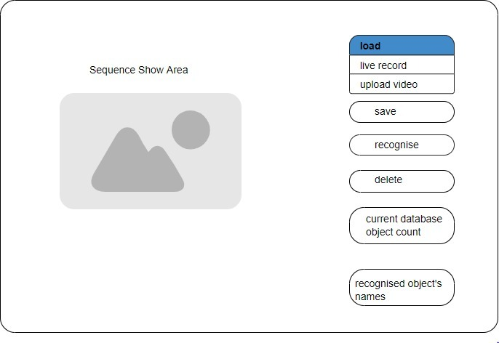
MOCKUP 2

Slide 6
Demo of the basic

Slide 7
Find us on
https://github.com/DarthAmk97/GaitRecognition

Slide 8
References:
https://github.com/Milittle/GaitSystem
https://github.com/marian-margeta/gait-recognition

