Slide 1
Works document
KWEZI LOUIS

Slide 2
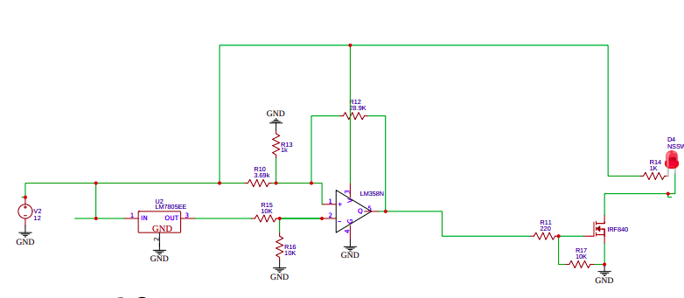
BATTERY DISCHARGE PROTECTION CIRCUIT
Schematic
EasyEDA schematic

Slide 3
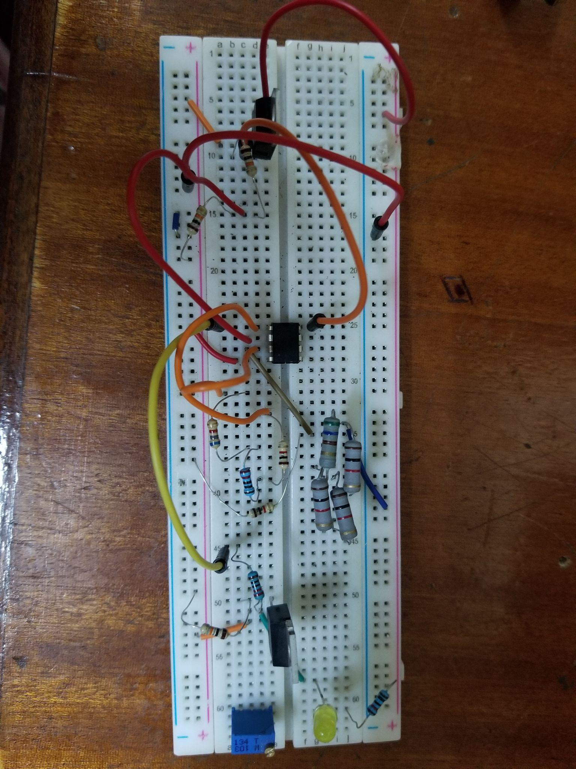
Circuit tried out on breadboard

Slide 4
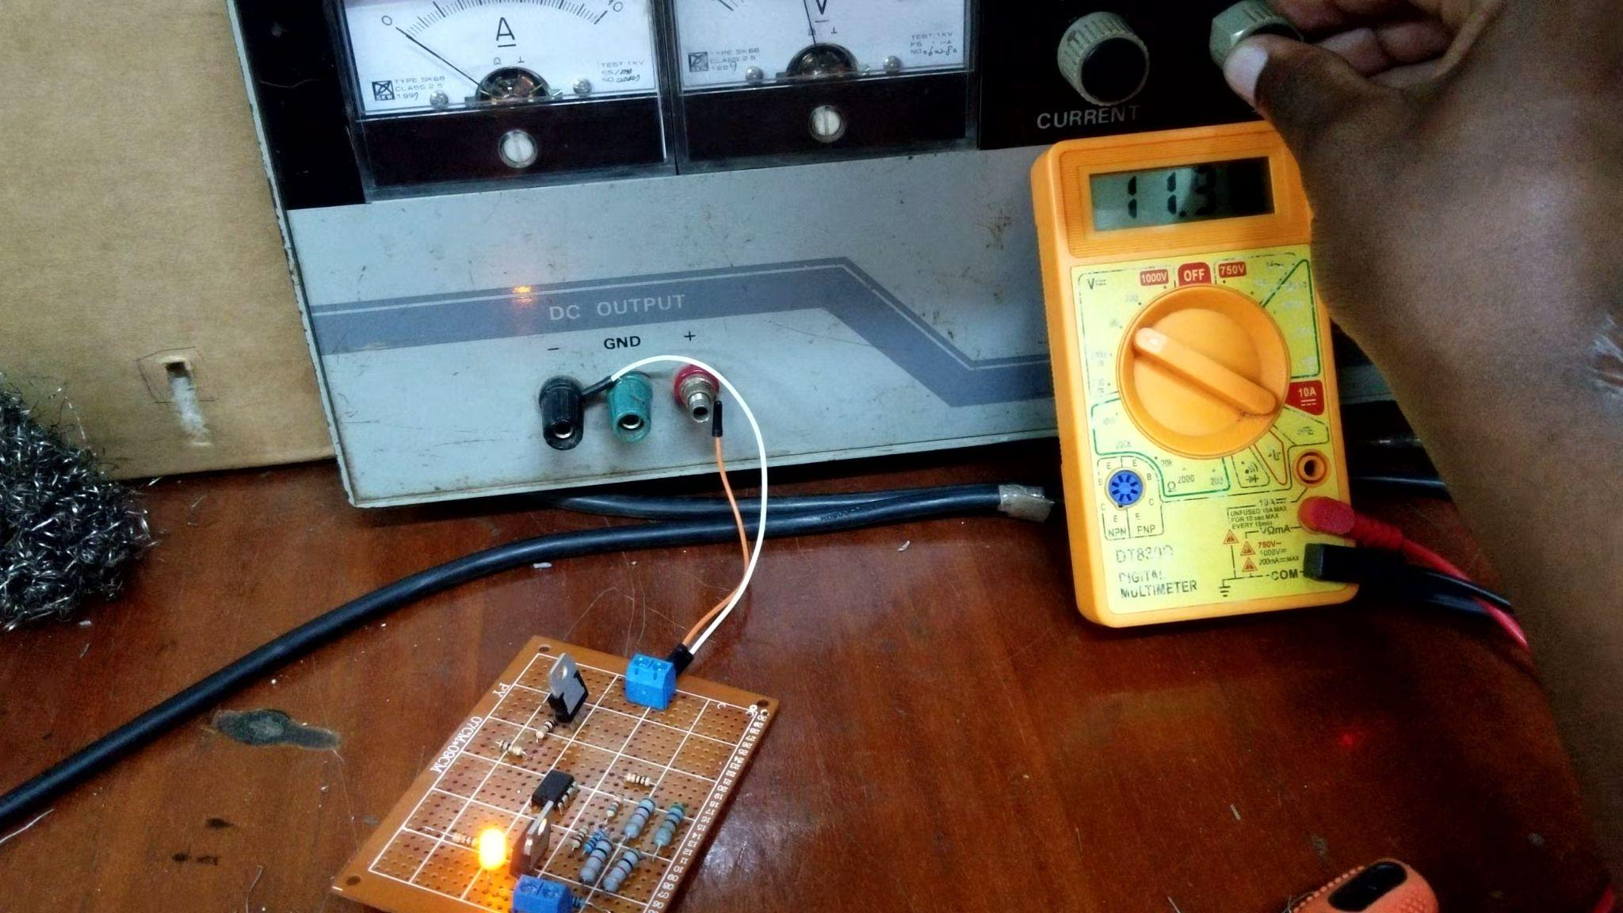
Testing the soldered circuit using a variable power supply

Slide 5
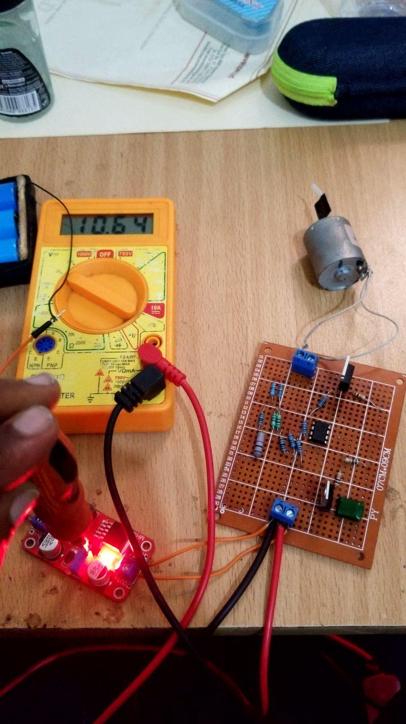
Testing circuit with batteries below the Lower and Upper Trip points

Slide 6
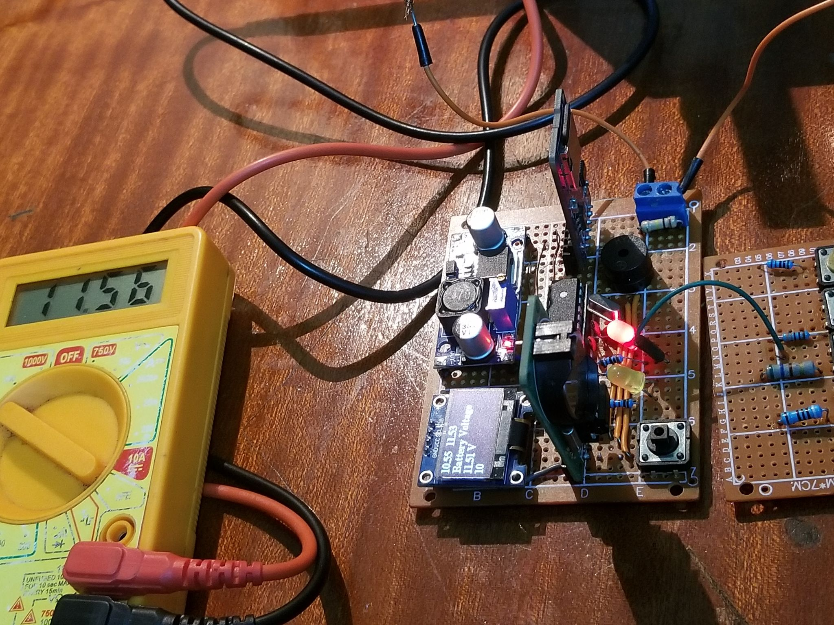
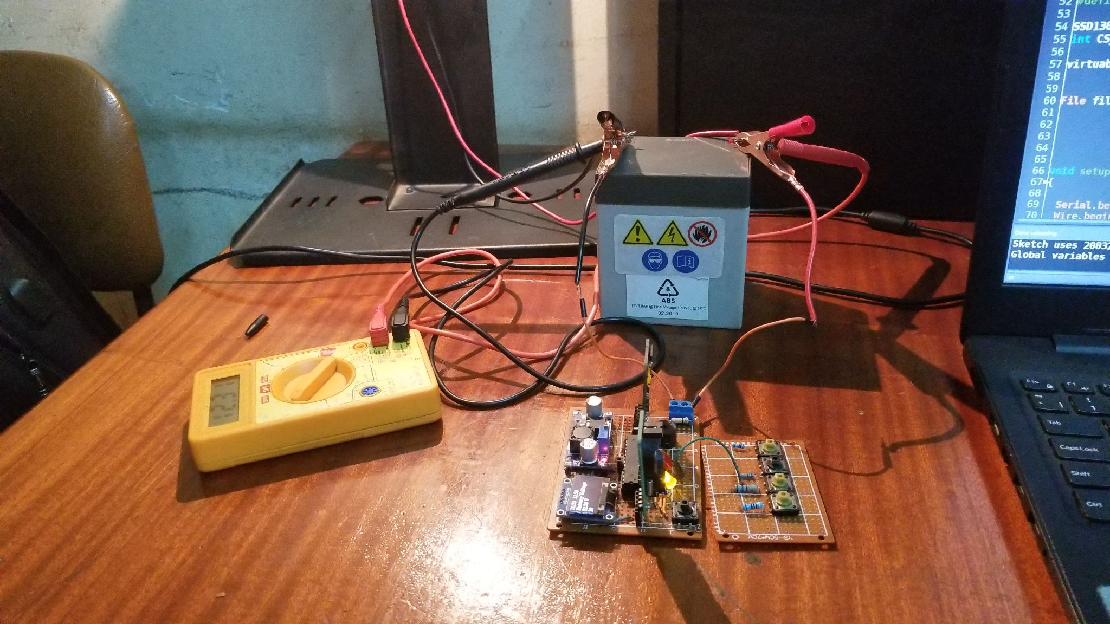
LEAD ACID BATTERY MONITORING CIRCUIT

Slide 7
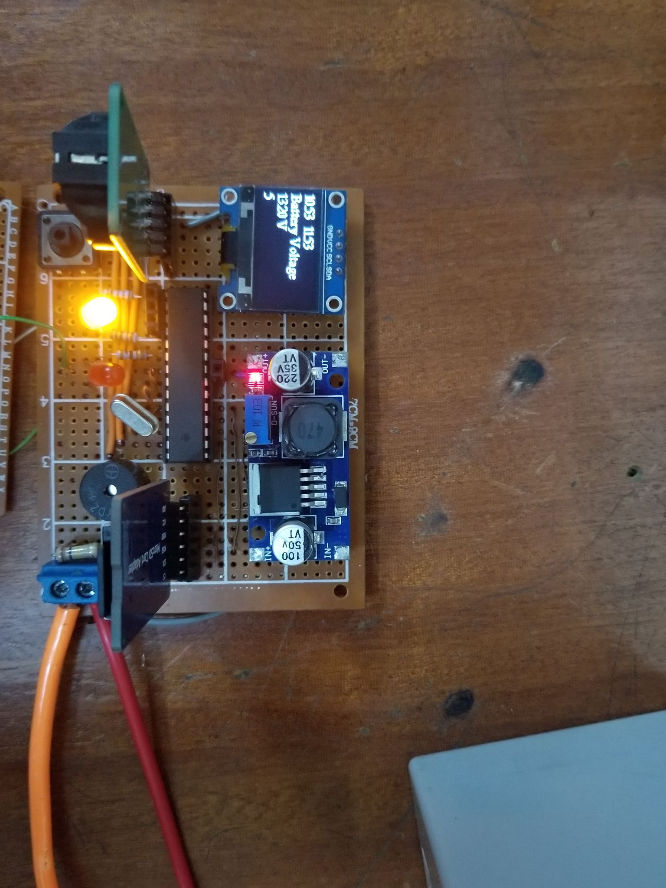
LEAD ACID BATTERY MONITORING CIRCUIT

Slide 8

LEAD ACID BATTERY MONITORING CIRCUIT

