Slide 1

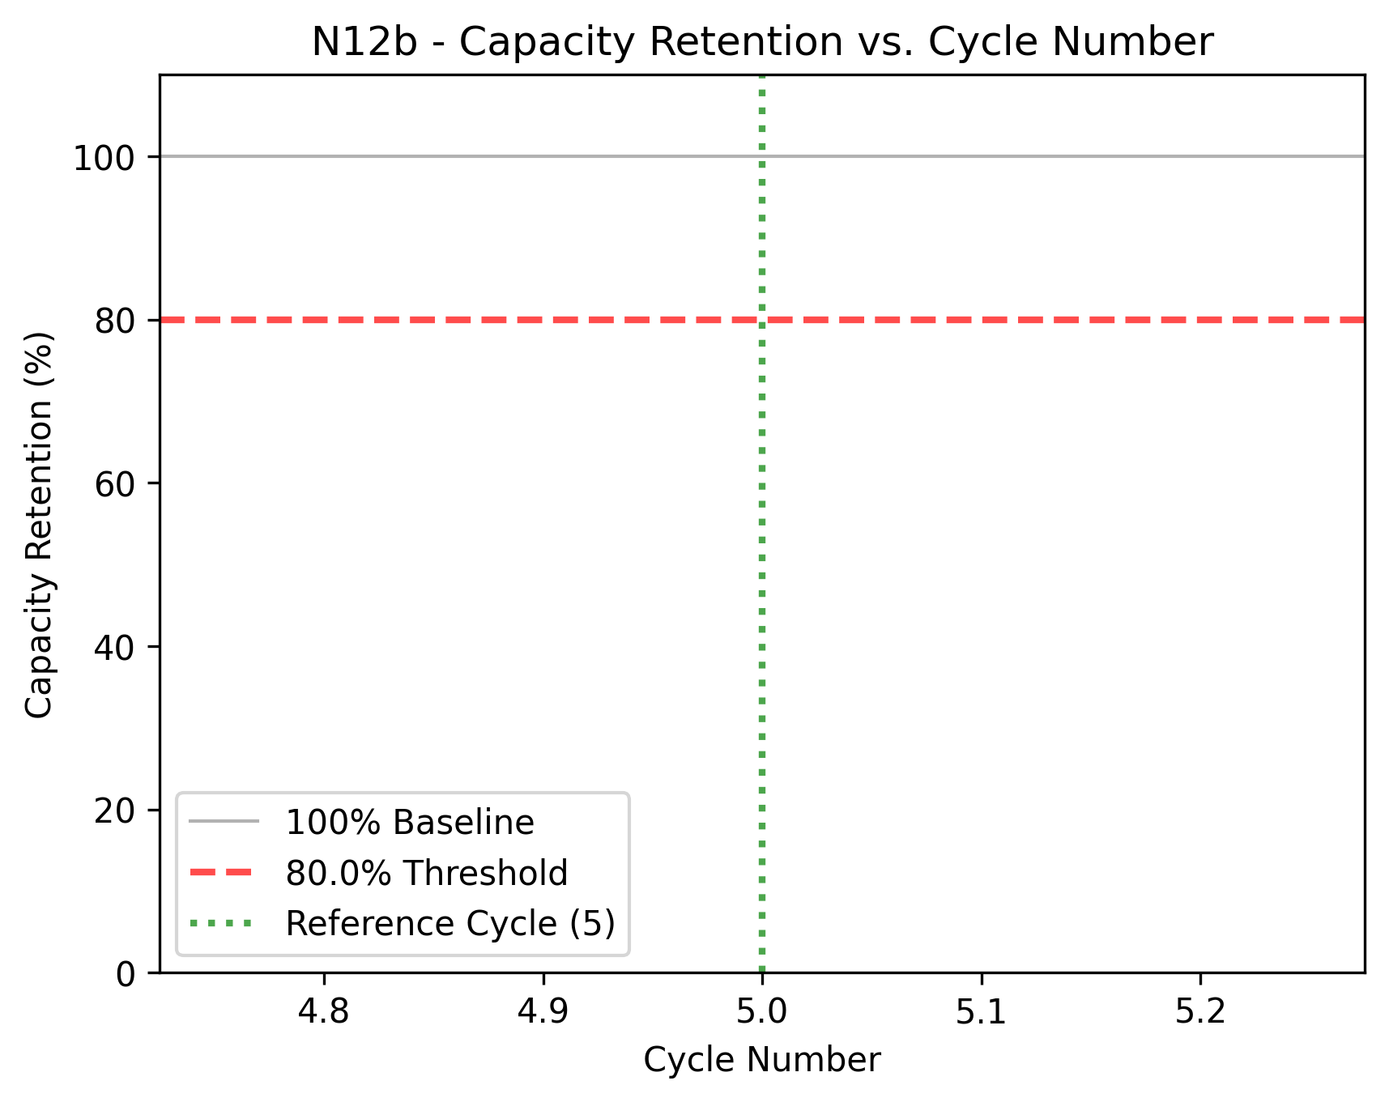
Project: NMC Cathode – EXP ID: N12b
CHEMISTRY: NMC811(Half) | KEY VARIABLES: Custom
SPECIFICATIONS & PROTOCOL:
KEY RESULTS
1. Cell & Electrode Metadata
Cathode: NMC811(BASF) (94%) | PVDF (3%) | Super P (3%)
Loading: 7.61 mg/cm²; 49 µm thick
Current Collector: Al
Electrolyte: 1M LiPF6 1:1:1, 5% FEC, 2% VC
E/C Ratio: Not recorded in DB
Separator: CC, 2+12+2µm
2. Testing Protocol
Voltage Window: 3.0-4.2V vs. Li/Li+
Formation: 3 cycles
Cycling Rate: Not recorded in DB
3. Conclusion
Active material successfully increased.
Capacity could be pushed with higher cutoff voltages.
Metric | Benchmark | Value | Score
1st Discharge Cap. (mAh/g) | >200 | 201.3
Reversible Capacity (mAh/g) | >180 | 191.4
Areal Cap. (mAh/cm2) | N/A | 1.53
FCE (%) | >95 | 90.1%
Capacity Retention(%) | >80 | 20 cycles
Avg. Post-Form. CE (%) | >99.9 | 99.9%

