Slide 1
Practical Excellence
ACCU - 2004
A Perspective on Code Quality
Chuck Allison

Slide 2
The Nature of Software
Many skills are required to produce quality software
These skills are not possessed by a single individual

Slide 3
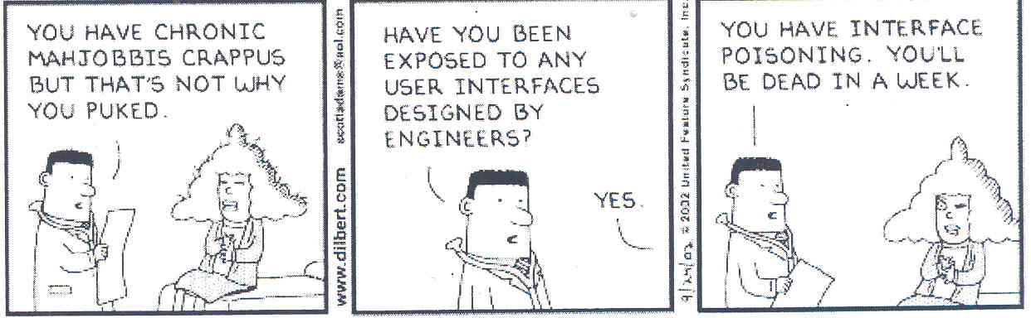

Slide 4
BANGKOK (Reuters – May 12, 2003) – Security guards smashed their way into an official limousine with sledgehammers on Monday to rescue Thailand’s finance minister after his car’s computer failed… All doors and windows had locked automatically when the computer crashed, and the air-conditioning stopped, officials said. “We could hardly breathe for over 10 minutes… It took my guard a long time to realize that we really wanted the window smashed so that we could crawl out. It was a harrowing experience.”

Slide 5
“Malfunctions caused by bizarre and frustrating glitches are becoming harder and harder to escape now that software controls everything from stoves to cell phones, trains, cars, and power plants.”
-- “Spread of buggy software raises new questions”, CNN.com, April 27, 2003.

Slide 6
Summit on Code Quality
Portland, Oregon, January 15-17, 2003
Agenda:
  How bad are things now?
  How did they get that way?
  How can they be fixed?

Slide 7
Attendees
Scott Meyers
Bruce Eckel
Chuck Allison
Bill Venners
Joshua Bloch
Alistair Cockburn
Matt Gerrans
Kevlin Henney
Andrew Hunt
Angelika Langer
Pete McBreen
Chris Sells
Randy Stafford
Dave Thomas

Slide 8
How Bad Are Things Now?
Scott Meyers is Upset
  that should be enough to get our attention!

Slide 9
How Bad Are Things Now?
Scott Meyers is Upset
  that should be enough to get our attention!
So are a lot of other people:
  ~50% of projects never get deployed
  too many programs hang or fail to meet spec.
  schedule/budget overruns are a cliche’
  help desks are woefully understaffed and overworked
  NIST* estimates the cost of software bugs in the U.S. is $60 billion annually
  * (National Institute of Standards and Technology)
  http://www.nist.gov/director/prog-ofc/report02-3.pdf

Slide 10
Software Disasters
Mars Polar Lander
  www.nasa.gov/newsinfo/marsreports.html
American Airlines Flight 965, Dec. 1995
  see “The Inmates are Running the Asylum” by Alan Cooper
$60,000,000,000 wasted annually is a disaster!

Slide 11
How Did Things Get So Bad?
The effect of:
  Management
  Development tools
  Programmer skill level
  … among other things

Slide 12
Haste Makes Waste
“The purpose of publishing this piece of code is to let you see that working under pressure can result in a marked deterioration of code quality.”
-- Francis Glassborow, You Can Do It!, page 307.

Slide 13
Stupid Management Tricks
Expect the impossible from the under-supported
  micro-manage scheduling and technical decisions
  demand overtime

Slide 14
Stupid Management Tricks
Expect the impossible from the under-supported
  micro-manage scheduling and technical decisions
  demand overtime
Rush to meet a market window
  Not always a bad thing
  But don’t allow for periodic code “clean-up”

Slide 15
Stupid Management Tricks
Expect the impossible from the under-supported
  micro-manage scheduling and technical decisions
  demand overtime
Rush to meet a market window
  Not always a bad thing
  But don’t allow for periodic code “clean-up”
Don’t support needed training/mentoring
  My experiences with NASA, Hughes Aircraft

Slide 16
“I have met managers who would rather fail knowing whom to blame rather than succeed without knowing whom to credit.”
-- Gerald Weinberg, Keynote Address, Agile Development conference, August 2003

Slide 17
You are very, very scary
People have been trying to eliminate programmers for years
  It’s Black Magic
COBOL
4GLs
Visual BASIC

Slide 18
The Deception of Visual, Event-driven Programming
Only deals with UI
Seems simple, but encourages poor practice
  Prototypes become products before their time
  UI should be totally separate from object model
  Programming is not Mouse Engineering
“Who Moved My State”, C/C++ Users Journal, April 2003, Miro Samek
Programmers don’t need to design GUIs
  Let the users do it!

Slide 19
“I Click, Therefore I Program”
Tools like Visual BASIC have “lowered the bar” for entering the field of programming
  “90-day wonders” have filled the ranks
    thanks in part to the dot-com boom
  They build screens, not software
Their numbers exceed our capacity to properly mentor them
  We’re losing this “Battle of the Exponents”
  “Dumbing down” programming has back-fired

Slide 20



The Tidal Wave of Trainees
(from Alistair Cockburn)
Training:
3 weeks of training per person @ $2,000 /week
6 work months / person relearning
Programmers in company:
6 200 3,000 programmers
36K$ 1.2M$ 18M$ direct training cost
5 100 1,500 work-yrs spent relearning

Slide 21
Programming is more than Visual
“The effective exploitation of his powers of abstraction must be regarded as one of the most vital activities of a competent programmer.” -- Dijkstra

Slide 22
Programming will always be difficult
“Programming will remain very difficult, because once we have freed ourselves from the circumstantial cumbersomeness, we will find ourselves free to tackle the problems that are now well beyond our programming capacity.” -- Dijkstra

Slide 23
The Degradation of Software Quality
“Architecture degradation begins simply enough. When market pressures for key features are high and the needed capabilities to implement them are missing, an otherwise sensible engineering manager may be tempted to coerce the development team into implementing the requested features without the requisite architectural capabilities.”
-- Luke Hohmann, Beyond Software Architecture

Slide 24
Technical Debt
Market and budget pressures can “require” cutting corners
  This shouldn’t be the “norm”, but it is
This constitutes a technical “debt”
  The software is not in a state suitable for long-term maintenance
  Such a system must be abandoned before its time

Slide 25
Software Entropy
Entropy:
  A measure of the disorder in a closed system.
  Inevitable and steady deterioration of a system.
Software Entropy
  Code can easily become an unmanageable patchwork
  Complexity encourages disorder
How do you fight entropy?

Slide 26
Rearchitecting/Refactoring
Paying-off your Technical Debt
Improving the internal design of existing code
Examples:
  Add parameter
  Extract class
  Extract hierarchy
  Extract method
  Substitute algorithm
  Replace parameter with method…

Slide 27
Post-release Entropy Reduction
(Luke Hohmann)
No time for refactoring near release
  Quick hacks pay off near release time
  Market windows are important
There must be time to refactor after release
  Otherwise entropy kills you prematurely
  Yes, there is a short-term cost
  The long-term reduction of technical debt is worth it!

Slide 28

Code Quality without PRER
(suggested by Randy Stafford)
Code Quality
Time

Slide 29

Code Quality with PRER
(suggested by Randy Stafford)
Code Quality
Time

Slide 30
Technical Debts Interact
(from Alistair Cockburn)
First maintenance visit: 1 + u
Second visit: 1 + u + v + uv (interaction)
  approximates 1 + 2u + u²
Third visit: 1 + u + v + w + uv + uw + vw + uvw
  approximates 1 + 3u + 3u² + u³ = (1 + u)³

Slide 31
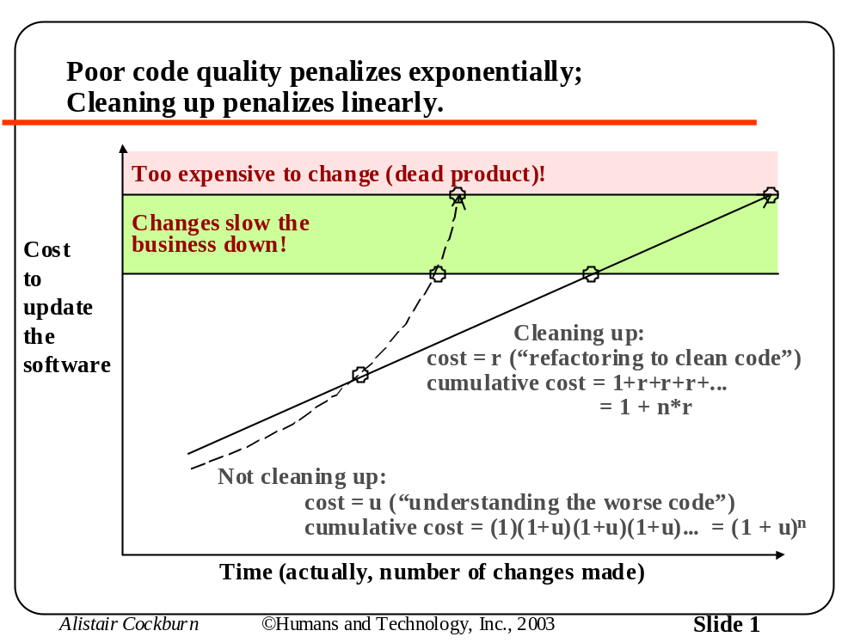

Slide 32
True or False?
“It is just as easy to write good software as it is to write bad software”

Slide 33
True or False?
“It is just as easy to write good software as it is to write bad software”…
It is if you know how!

Slide 34
Don’t prevent bugs, avoid them
“Those who want really reliable software will discover that they must find means of avoiding the majority of bugs to start with, and as a result the programming process will become cheaper. If you want more effective programmers, you will discover that they should not waste their time debugging, they should not introduce the bugs to start with.” – Dijkstra

Slide 35
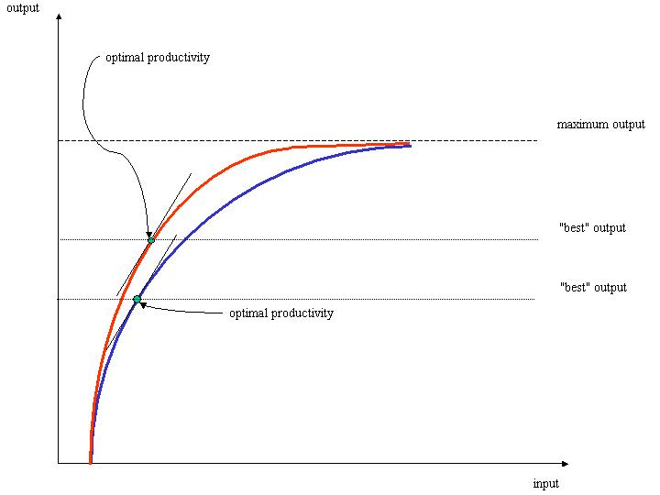
The Productivity Curve
(from Angelika Langer)

Slide 36
The Cost of Competence
Less than the cost of incompetence
  Assertion: Changing curves is cheaper than the consequences of producing poor quality
    Proof: Japanese Auto Industry

Slide 37
The Cost of Competence
Less than the cost of incompetence
  Assertion: Changing curves is cheaper than the consequences of producing poor quality
    Proof: Japanese Auto Industry
Mentoring vs. Training
  A trainer loves ‘em and leaves ‘em
    “drinking from the fire hose” approach
    although this can be a good “jump start”
  A mentor takes an apprentice under his wing
    “Expert within earshot”

Slide 38
Stupid Programmer Tricks
Poor design
  poor choice of algorithm or data structure
  not enough critical thinking up front
    bug prevention is better than cure

Slide 39
Stupid Programmer Tricks
Poor design
  poor choice of algorithm or data structure
  not enough critical thinking up front
    bug prevention is better than cure
Reinventing the Proverbial Wheel
  insufficient mastery of library, tools, and techniques

Slide 40
Stupid Programmer Tricks
Poor design
  poor choice of algorithm or data structure
  not enough critical thinking up front
    bug prevention is better than cure
Reinventing the Proverbial Wheel
  insufficient mastery of library, tools, and techniques
Many don’t continue to learn
  stuck in their initial “imprint”

Slide 41
Stupid Programmer Tricks
Poor design
  poor choice of algorithm or data structure
  not enough critical thinking up front
    bug prevention is better than cure
Reinventing the Proverbial Wheel
  insufficient mastery of library, tools, and techniques
Many don’t continue to learn
  stuck in their initial “imprint”
Copy-and-paste “reuse”
  automated bug replication!

Slide 42
Stupid Programmer Tricks
Poor design
  poor choice of algorithm or data structure
  not enough critical thinking up front
    bug prevention is better than cure
Reinventing the Proverbial Wheel
  insufficient mastery of library, tools, and techniques
Many don’t continue to learn
  stuck in their initial “imprint”
Copy-and-paste “reuse”
  automated bug replication!
Inadequate testing/error handling

Slide 43
The Evils of Code Duplication
Two Forms
  Explicit:
    You copy and paste code (bugs)
    You should’ve extracted a function to call
  Implicit:
    You create similar functions
    You should extract the common part
Becomes a maintenance nightmare
Example: Manifest constants, C++ string class

Slide 44
Manifest Constants
Better to use symbols instead of magic numbers
  Only have to change them in one place
  No risk of getting one of the values wrong
All code should follow this pattern:
  Have only one definition
  A form of “automation”
    Because you’re not repeating yourself!

Slide 45
A C++ String Class
Constructor allocates memory
Destructor releases it:
class String
{
char* data;
public:
String(const char* str = "") {
data = new char[strlen(str) + 1];
strcpy(data,str);
}
~String() {
delete [] data;
}
};

Slide 46
A C++ String Class
What about copying strings?
Need a Copy and Assignment:
String(const String& s) {
data = new char[strlen(s.data) + 1];
strcpy(data, s.data);
}
String& operator=(const String& s) {
if (this != &s) {
char* newData = new char[strlen(s.data) + 1];
strcpy(newData, s.data);
delete [] data;
data = newData;
}
return *this;
}

Slide 47
A C++ String Class
Factor out common code into a private member function:
char* dup(const char* from) {
char* to = new char[strlen(from) + 1];
return strcpy(to, from);
}
An aside: C++0x will have delegating constructors

Slide 48
A C++ String Class
Now call it from all 3 places:
String(const char* str = "") {
data = dup(str);
}
String(const String& s) {
data = dup(s.data);
}
String& operator=(const String& s) {
if (this != &s) {
char* newData = dup(s.data);
delete [] data;
data = newData;
}
return *this;
}

Slide 49
Practices that Work
Big List!
Takes wisdom born of experience to apply:
  DRY (don’t repeat yourself)
  find invariants and assert them
  design in terms of interfaces
    separate interface and implementation
  minimize coupling, maximize cohesion
  test-first programming
  pair programming (review as you go)
  automate builds, tests, deployments
  study good code
  keep a technical diary

Slide 50
Practices that Work
(Continued…)
  write to be read
    use a consistent style
    publish your code somewhere
  avoid premature optimization
    use a profiler
  have post-partum reviews
  design in public places (white board)
  refactor mercilessly
    “remove to improve” (omit needless code)
  take pride in your work

Slide 51
Revealing Questions
Are any of the practices news to you?
  probably not
Do you employ them?
Do your colleagues employ them?
  mentor them

Slide 52
Pride Implies Ownership
“[The Company] shall not be liable in any manner whatsoever for results obtained for using this software. THESE MATERIALS ARE PROVIDED ‘AS-IS’ WITHOUT WARRANTY OF ANY KIND… [THE COMPANY] AND ITS SUPPLIERS DISCLAIM ANY AND ALL WARRANTIES AND CONDITIONS, EITHER EXPRESS OR IMPLIED.”
“Bugs would be greatly reduced if software makers were held legally responsible for defects. ‘Software is being treated in a way that no other consumer products are,’ said Barbara Simons, former president of the ACM. 'We all know that you can’t produce 100% bug-free software. But to go to the other extreme, and say that software makers should have no liability whatsoever, strikes me as absurd.'” (CNN.com)

Slide 53
Talent vs. Knowledge
The practices just mentioned are more valuable than understanding the technology du jour
You can know Java, XML, XSLT, Jini, JNI, J2EE, C++, STL, Bluetooth, SOAP, … and still produce low quality
Master the enduring fundamentals first
  Technology is a vehicle for quality, not its substance

Slide 54
The Great Programmer
(from Gerald Weinberg)
Has a Service Posture
Learns continually, no matter how skilled he is today
Openly shares his code, insights and expertise
Gives credit where credit is due
  colleagues, vendors, good management, staff, family)
Does not sacrifice quality or integrity for job security
Takes care of his whole self (he rests, plays…)

Slide 55
Practical Excellence
Be True to your Inner Programmer
Highly ethical programmers do things as correctly as they can all the time. They fight management’s stupid decisions. To an ethical programmer, some things (e.g., buffer overrun vulnerabilities) just cannot happen.”
-- Jack Ganssle

Slide 56
Practical Excellence
Care, Be Connected
“When one isn't dominated by feelings of separateness from what he's working on, then one can be said to "care'' about what he's doing. That is what caring really is, a feeling of identification with what one's doing. When one has this feeling then he also sees the inverse side of caring, Quality itself.”
-- Robert Pirsig, Zen and the Art of Motorcycle Maintenance

Slide 57
Practical Excellence
Persist in working at Meaningful Change
“You cannot undo a [or introduce a new] habit by any single act of willpower; only a time-consuming training process can undo a habit.”
-- Jef Raskin

Slide 58
Practical Excellence
Keep Current
"In times of change learners inherit the earth while the learned find themselves beautifully equipped to work in a world that no longer exists." -- Eric Hoffer
“He who learns from one who is learning drinks from a running stream.”

Slide 59
A Challenge for ACCU Delegates
You are the best of developers
Set the example
Mentor others

Slide 60
Announcement
C++ Online
An Authoritative online C++ Journal
Hosted at www.artima.com
Articles, tutorials, archives, and more
  peer reviewed
Editorial Board:
  Bjarne Stroustrup, Andrew Koenig, Scott Meyers, Bruce Eckel, Angelika Langer, Kevlin Henney, Jeremy Siek, David Abrahams, Greg Colvin, Andrei Alexandrescu, Stephen Dewhurst, Bjorn Karlsson…
Editor: Me!
Launch in Summer 2004

