Slide 1
Automatic Integration

Slide 2
Quadrature
Fancy name for integration by calculating areas
  Remember the Riemann Integral definition?
  You take the limit of rectangles that “cover” the area under a curve
With numeric integration (quadrature), we calculate these areas by summing the areas of subsets (rectangles, trapezoids, etc.) of the entire area
  When the computations “converge”, we quit

Slide 3
The Midpoint Rule
Divides [a, b] into n (evenly-spaced) segments
Calculates the area of the rectangle where:
  Width is the segment length, h = (b-a)/n
  Height is f((x_{i} + x_{i+1})/2) (f(segment midpoint))
Essentially, we’re passing a zero-degree interpolating polynomial through ((x_{i} + x_{i+1})/2, f((x_{i} + x_{i+1})/2))
See riemann.cpp

Slide 4
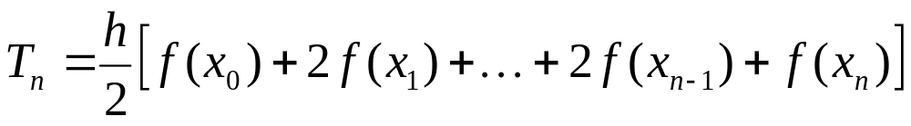
The Trapezoidal Rule
Uses the 1-degree polynomial passing through the points (x_{i}, f(x_{i})), (x_{i+1}, f(x_{i+1}))
This is a trapezoid
  Area = h((f(x_{i}) + f(x_{i+1}))/2)
Composite formula:
See trapezoid.cpp

Slide 5
Error of Trapezoidal Rule
We talk about local and total (“global”) truncation error when doing quadrature
Local truncation error is the error of approximating the integral on [x_{i},x_{i+1}] by the trapezoid there
  It’s O(h³) for the Trapezoidal Rule
Total truncation error is the error after all the trapezoids are summed
  It’s O(h²)

Slide 6
Truncation vs. Roundoff Error
As we increase the number of trapezoids, h decreases, therefore the truncation error decreases (because h < 1)
Theoretically, we could get arbitrary accuracy by increasing n (decreases h)
  Alas, roundoff takes over
  We have to find other ways of increasing accuracy
    FYI: We will skip Romberg extrapolation

Slide 7
Simpson’s Rule
Instead of a straight line (curve of degree 1), we use a parabola (curve of degree 2) passing through 3 points (endpoints and midpoint of each interval)
Has some interesting error properties
  It is much better than expected
  A property of odd-point rules

Slide 8
Simpson Formula
Midpoint Formula was c*f(x_{m})
  c = h
Trapezoid Formula was c*f(x_{i}) + d*f(x_{i+1})
  c = d = h/2
For Simpson’s:
  Use 3 points in c*f(x_{i}) + d*f(x_{m}) + e*f(x_{i+1})
  How to find c, d, and e?
  Two approaches
    Interpolating polynomial
    Use special f’s to more easily solve for c, d, and e

Slide 9
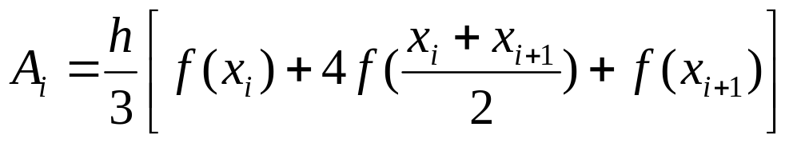
Simpson Formula
Local formula:
Composite formula:
n must be even!
See simpson.cpp

Slide 10
Error of Simpson’s Rule
Local truncation error is O(h⁵)
Total (global) truncation error is O(h⁴)
  We can really get some mileage out of this
  See next slide

Slide 11
An Improved Simpson Formula
Based on the fact that truncation error is O(h⁴)
Let S₁ be a Simpson estimate with n panels
  Call the panel width h
Let S₂ be an estimate using 2n panels
  The panel width is therefore h/2
Since the error is O(h⁴):
  The error of S₂ is 1/16-th the error of S₁
  See next slide

Slide 12
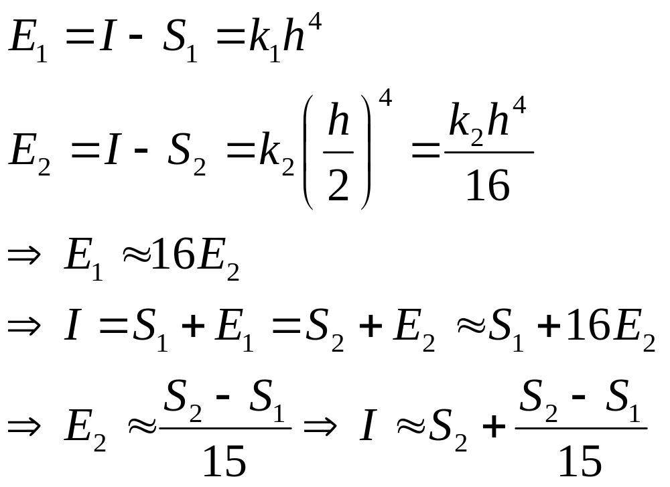
An Improved Simpson Formula

Slide 13
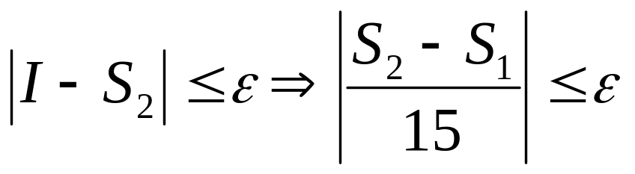
An Improved Simpson Formula
We can iterate until the absolute error reaches ε
  But we’ll return the improved estimate:
    S₂ + (S₂ – S₁) / 15
Note: As before, ε may need to be bigger than machine epsilon
  Roundoff may make ultimate precision unlikely
  Use a user-supplied tolerance instead

Slide 14
Automatic Integration
AKA “Adaptive Integration”
Continually refines mesh until accuracy is achieved
  Avoids needless computation (and therefore, roundoff)
Refines mesh selectively
  Refines only when it needs to!
  Determines at runtime when/where it needs to refine
  Certain intervals will need more refinement than others
    The steep or wiggly ones

Slide 15
Program 4
We will use an adaptive Simpson’s Rule
We will refine automatically according to our error estimate
  If |S₂ ₋ S₁ | < 15 * tol, that interval is “finished”
It is a recursive algorithm
  Which we’ll have to do very carefully!
  The tolerance will be spread out over the intervals

Slide 16
Pseudocode for Program 4
(See spec. and p. 241 for more details)
area(f, a, b) {
compute S₁ and S₂
if |S₂ – S₁|/15 <= tol
return S₂ + (S₂ – S₁)/15
else
return area(f, a, (a+b)/2, tol/2) +
area(f,(a+b)/2,b,tol/2)
}

