Slide 1
Maximizing Software Development Investments
Productivity, Reliability, Portability, and Performance
David Burggraaf
Microsoft Visual C++

Slide 2
C/C++ & Java in Academia
Q: What programming language do you use most often?
Base: Students taking CS/CE/MIS Courses
Source: Internal Microsoft Research
C/C++ Java
US 46% 28%
Germany 37% 45%
India 81% 8%
Japan 35% 27%
Notes:
C++ skills required in workforce.
Never hired, nor known of anyone hired with just Java or C# experience alone.
C++ is the required language for upper level courses in CS.

Slide 3
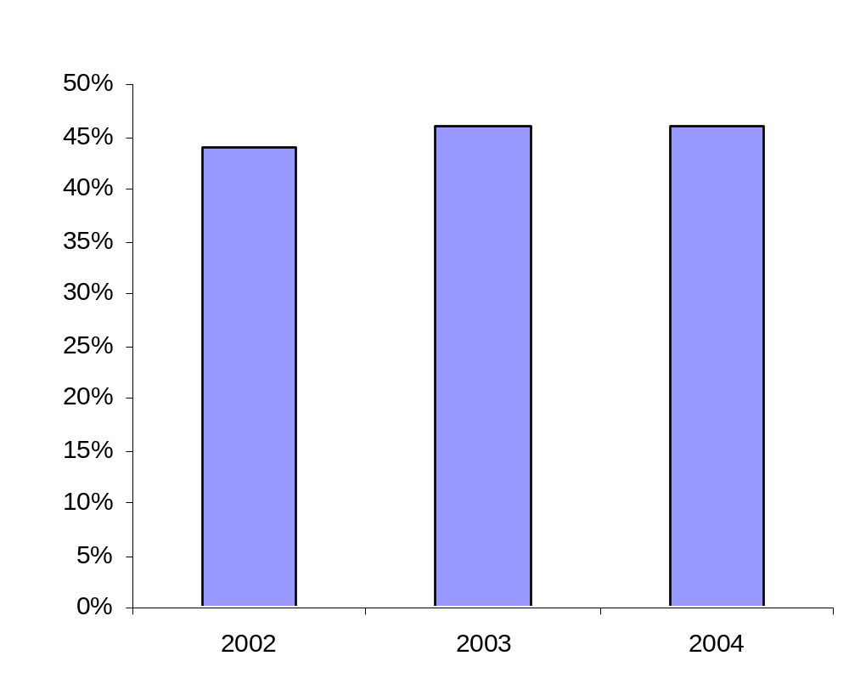
C++ Academic Trends
US CS/CE/MIS Students
Question: What programming language do you use most often?
Base: Students taking CS/CE/MIS courses
Source: Internal Microsoft Research

Slide 4
Choosing a Language
Q: Which language should you use?
Microsoft’s answer, in our Whidbey release:
  C++ is the recommended path to .NET and Longhorn.
  If you have an existing C++ code base:
  Keep using C++.
  If you want to make frequent use of native code/libs:
  Use C++. It’s far simpler (seamless) and faster.
  If you want to write brand-new pure-.NET apps that rarely or never interop with native code:
  Use whatever language you’re already comfortable with, and pick based on language features. The .NET features and Frameworks library are available equally through all languages.

Slide 5
2002/3: Managed Extensions
2004/5: C++ in Whidbey
  Deterministic cleanup, destructors.
  Templates.
  Native types.
  Multiple inheritance.
  STL, generic algorithms, lambda expressions.
  Pointer/pointee distinction.
  Copy construction, assignment.
  Garbage collection, finalizers.
  Generics.
  Reference and value types.
  Interfaces.
  Verifiability.
  Security.
  Properties, delegates, events.
C++ CLR

Slide 6
Storage and Pointer Model
Create objects on the native heap, CLR (gc) heap, or on the stack:
  On the native heap (native types): T* t1 = new T;
    As usual, pointers (*) are stable, even during GC.
    100% backward compatible with all standard and nonstandard stupid pointer tricks.
    As usual, failure to explicitly call delete will leak.
  On the gc heap (CLR types): T^ t2 = gcnew T;
    Handles (^) are object references (to whole objects).
    Calling delete is optional: "Destroy now, or finalize later.“
  On the stack, or as a class member: T t3;
    Q: Why would you? A: Deterministic destruction/dispose is automatic and implicit, hooked to stack unwinding or to the enclosing object’s lifetime.

Slide 7
T::~T()
destroy now
or
T:: !T()
finalize later

Slide 8
Side By Side: Using a StreamReader
  C++ String^ ReadFirstLineFromFile( String^ path ) {
  StreamReader r(path);
  return r.ReadLine();
  }
  C# String ReadFirstLineFromFile( String path ) {
  using ( StreamReader r = new StreamReader(path) ) {
  return r.ReadLine();
  }
  }
  Java String ReadFirstLineFromFile( String path ) {
  StreamReader r = null;
  String s = null;
  try {
  r = new StreamReader(path);
  s = r.ReadLine();
  } finally {
  if ( r != null ) r.Dispose();
  }
  return s;
  }

Slide 9
Basic Class Declaration Syntax
Type are declared “adjective class”:
  class N { /*…*/ }; // native
  ref class R { /*…*/ }; // CLR reference type
  value class V { /*…*/ }; // CLR value type
  interface class I { /*…*/ }; // CLR interface type
  enum class E { /*…*/ }; // CLR enumeration type
  C++ & CLR fundamental types are mapped to each other (e.g., int and System::Int32 are the same type).
Examples:
  ref class A abstract { }; // abstract even w/o pure virtuals
  ref class B sealed : A { }; // no further derivation is allowed
  ref class C : B { }; // error, B is sealed

Slide 10
Properties
Basic syntax:
  ref class R {
  int mySize;
  public:
  property int Size {
  int get() { return mySize; }
  void set( int val ) { mySize = val; }
  }
  };
  R r;
  r.Size = 42; // use like a field; calls r.Size::set(42)
Trivial properties:
  ref class R {
  public:
  property int Size; // compiler-generated
  }; // get, set, and backing store

Slide 11
Indexed Properties
Indexed syntax:
  ref class R { // …
  map<String^,int>* m;
  public:
  property int Lookup[ String^ s ] {
  int get() { return (*m)[s]; }
  protected:
  void set( int ); // defined out of line below
  }
  property String^ default[ int i ] { /*…*/ }
  };
  void R::Lookup::set( String^s, int v ) { (*m)[s] = v; }
Call point:
  R r;
  r.Lookup["Adams"] = 42; // r.Lookup[“Adams”].set(42)
  String^ s = r[42]; // r.default[42].get()

Slide 12
Virtual Functions and Overriding
Explicit, multiple, and renamed overriding:
  interface class I1 { int f(); int h(); };
  interface class I2 { int f(); int i(); };
  interface class I3 { int i(); int j(); };
  ref class R : I1, I2, I3 {
  public:
  virtual int e() override; // error, there is no virtual e()
  virtual int f() new; // new slot, doesn’t override any f
  virtual int f() sealed; // overrides & seals I1::f and I2::f
  virtual int g() abstract; // same as “= 0” (for symmetry
  with class declarations)
  virtual int x() = I1::h; // overrides I1::h
  virtual int y() = I2::i; // overrides I2::i
  virtual int z() = j, I3::i; // overrides I3::i and I3::j
  };
Notes:
“virtual” is required, except for cases where ISO C++ doesn’t require it

Slide 13
Delegating Constructors
Can delegate to one peer constructor.
No cycle detection is required.
  ref class R {
  S s;
  T t;
  R( int i, const U& u ) : s(i), t(u) { /* init */ }
  public:
  R() : R( 42, 3.14 ) { }
  R( int i ) : R( i, 3.14 ) { }
  R( U& u ) : R( 53, u ) { }
  };

