Slide 1
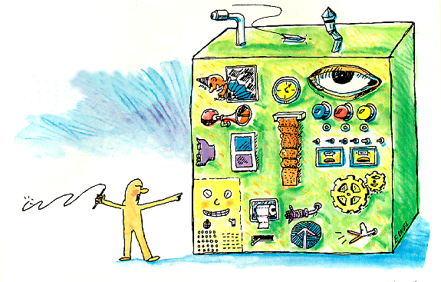
Hands-On Java CD ROM
Hands-On Java CD ROM
Second Edition
©2000 by Bruce Eckel
MindView, Inc.
Java Consulting, Training, Mentoring & Walkthroughs
5343 Valle Vista
La Mesa, CA 91941
HOJCD2@MindView.net
Notes:
$#1#$

Slide 2


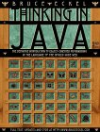
Introduction
For this seminar (not the book) I assume you have programmed in some language that gives you comfort with C syntax
Book includes Thinking in C Seminar-on-CD which teaches essential C syntax to prepare you for Java
Thinking in Java is the text; adds additional information not in class, including coverage of C syntax in Chapter 3. Zipped source code on web site and CD ROM
Coverage of Java 2, in particular Containers & JFC (Swing)
Notes:
$#2#$

Slide 3
Sections
1: Introduction to Objects
2: Everything is an Object
3: (Controlling Program Flow)
4: Initialization & Cleanup
5: Hiding the Implementation
6: Reusing Classes
7: Polymorphism
8: Interfaces & Inner Classes
9: Holding Your Objects
10: Error Handling with Exceptions
11: The Java I/O System
12: Run-time Type Identification
13: Creating Windows & Applets
14: Multiple Threads
15: Distributed Computing
A: Passing & Returning Objects
Notes:
$#3#$

Slide 4

Java Is Designed For:
A fresh start (no backwards compatibility)
Pure OOP: C++ syntax, Smalltalk style
Improvements over C++, near guarantee
that you can’t run a bad program
Internet programming: probably can’t create viruses, programmability at the browser end, easier client/server programming
Larger, more complex programs;
smaller teams, less time
There is the ongoing
speed issue
Notes:
$#4#$

Slide 5


What Java Isn’t
An operating system … but it’s trying
Simple. “Saying Java is simpler than C++ is like saying K2 is shorter than Everest” (Larry O’Brien)
Perfect.
It has strengths and
weaknesses – we’ll talk
about these
Notes:
$#5#$

