Slide 1

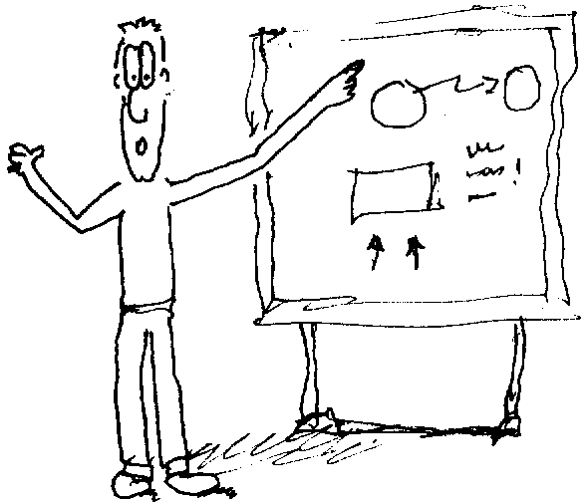
1: Introduction to Objects
Notes:
$#1#$

Slide 2
The Progress of Abstraction
Problem space & solution space
Alan Kay’s 5 rules for a pure OOP language (Xerox/PARC)
1) Everything is an object
2) A program is a bunch of objects telling each other what to do by sending messages
3) Each object has its own memory made up of other objects
4) Every object has a type
5) All objects of a particular type can receive the same messages
Notes:
$#2#$

Slide 3

An Object has an interface
Type name
Light
on()
off()
brighten()
dim()
Interface
Characteristics + Behavior
Object
Light lt = new Light();
Request
lt.on();
That’s programming with objects!
Notes:
$#3#$

Slide 4
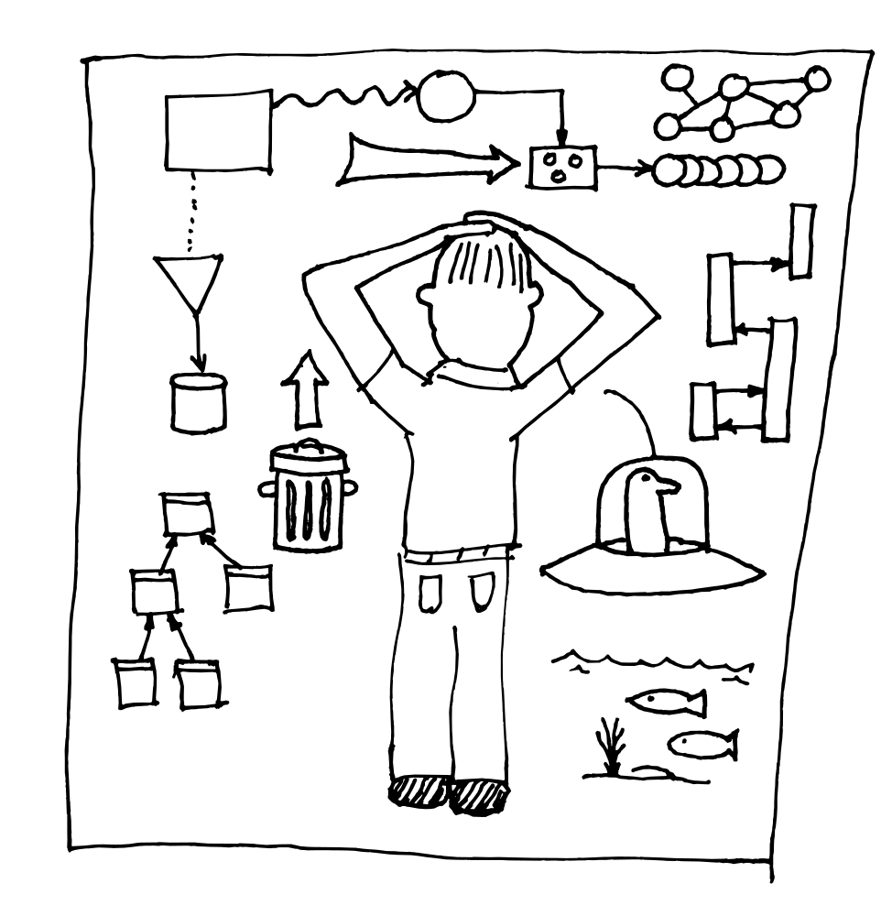
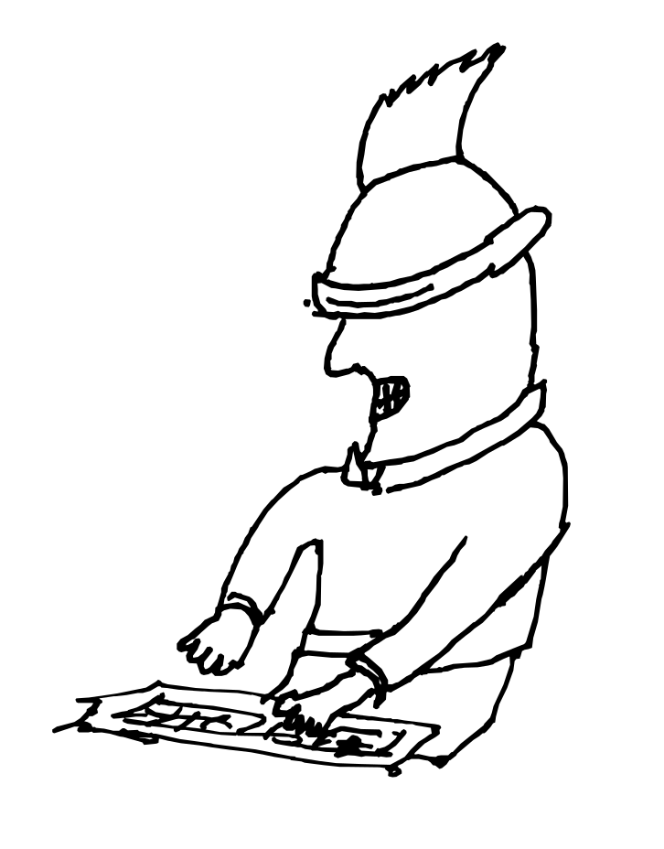
The Hidden Implementation
public, private, protected, and package
Class User
(Client Programmer)
Class Creator
Notes:
$#4#$

Slide 5
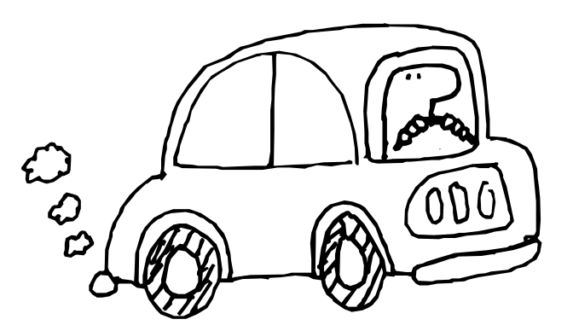
Reusing the Implementation
Composition: make new objects by combining other objects
Type name
Car
start();
drive();
etc...
Interface
Engine
Wheel[4]
Door[2]
etc...
Implementation
Notes:
$#5#$

Slide 6
Inheritance: Reusing the interface
Inheritance: automatically duplicates the interface
Objects related by inheritance all have the same type (interface)
Shape
draw()
erase()
Circle
Square
Line
draw()
erase()
draw()
erase()
draw()
erase()
(This shows the UML style of drawing diagrams)
Notes:
$#6#$

Slide 7
Polymorphism
One piece of code ...
... works with all these objects!
a Circle
draw()
erase()
Shape
a Square
a Line
Notes:
$#7#$

Slide 8
An Amazing Trick
void doStuff(Shape s) {
s.erase();
// ...
s.draw();
}
Circle c = new Circle();
Triangle t = new Triangle();
Line l = new Line();
doStuff(c); // "Dynamic binding"
doStuff(t);
doStuff(l);
Notes:
$#8#$

Slide 9
Object-Oriented programs
object
message
object
message
message
object
Made up of objects sending messages to each other’s interfaces
Notes:
$#9#$

Slide 10
OOP Design
Most designs can be simplified by adding another level of indirection/abstraction
Things
that
Change
Things
that
Stay the Same
In the design
At compile-time
At run-time
In the environment
Etc.
Hard part: decomposing system into objects
What interfaces do you need?
Notes:
$#10#$

Slide 11

Object Landscapes & Lifetimes
How are objects created and destroyed?
Created in a pool of memory called the heap
Memory (only) is released by the garbage collector
Most flexible, simple way to build
a system
Can also cost performance – but
not necessarily
Notes:
$#11#$

Slide 12
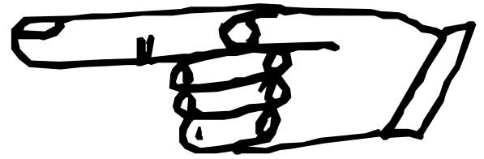
Containers & Iterators
You don’t know how many, what type, lifetime of objects you need
Where to put objects when you make them?
Container:
generic holder
Iterator: sequentially
selects items in the
container (called
Enumeration
in Java 1.0/1.1,
Iterator in Java 2)
Notes:
$#12#$

Slide 13
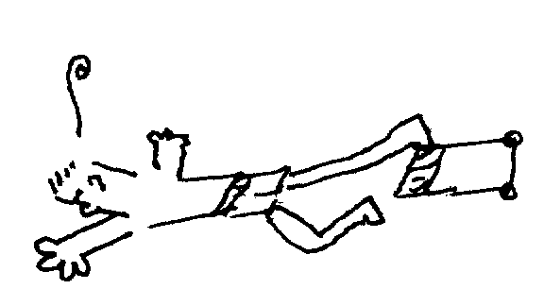
Exception Handling for Errors
Error handling
wired in
Can’t ignore the error
Recover to a known good state
Java stands out: you’re forced to use exceptions
Notes:
$#13#$

Slide 14
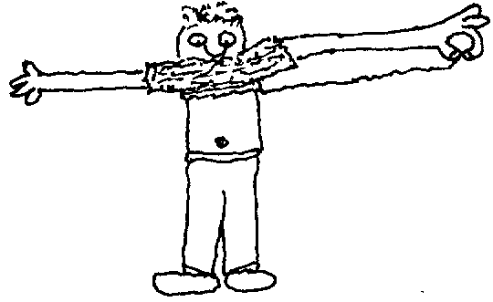
Multithreading
For responsiveness
For running multiple tasks (animation & networks)
We’ll cover this in Chapter 14
Notes:
$#14#$

Slide 15

Persistence
Objects that live between program invocations
Convenient, Java has object serialization built in, supports “lightweight persistence.” Primarily added to support remote method invocation (RMI) across networks.
JDBC could be thought of as
another form of persistence
JavaSpaces, further
evolution
Notes:
$#15#$

Slide 16


Java & the Internet
A client-server system:
  Delivers centralized information on demand
  Also accepts new information, typically into a database (customer info, orders, etc.)
The web is a big client-server system
  All the servers are on the same network
  Client software is a universal “browser”
  Has been a dumb receiver of information
  Server-side Java
Notes:
$#16#$

Slide 17

Where Java Fits on the Web
Designed to make interactive client programs, so the Web server doesn’t have to do all the work
Nicer UI, animation, data validation before sending it across the web, provide local answers.
Example: Plotting data
  Make a GIF on the server, send it on the net
  Send a few data points on the net, applet plots them
The problem of client-side programming on the Web
Java servlets, JSPs as the solution
Notes:
$#17#$

Slide 18
Summary
Procedural
Java
Abstract data type
Data
Data
“Message”
or
“Request”
Function
Function
Member
function
or
“method”
Function
Function
Function
Function
“Encapsulation” (?)
Notes:
$#18#$

