Slide 1

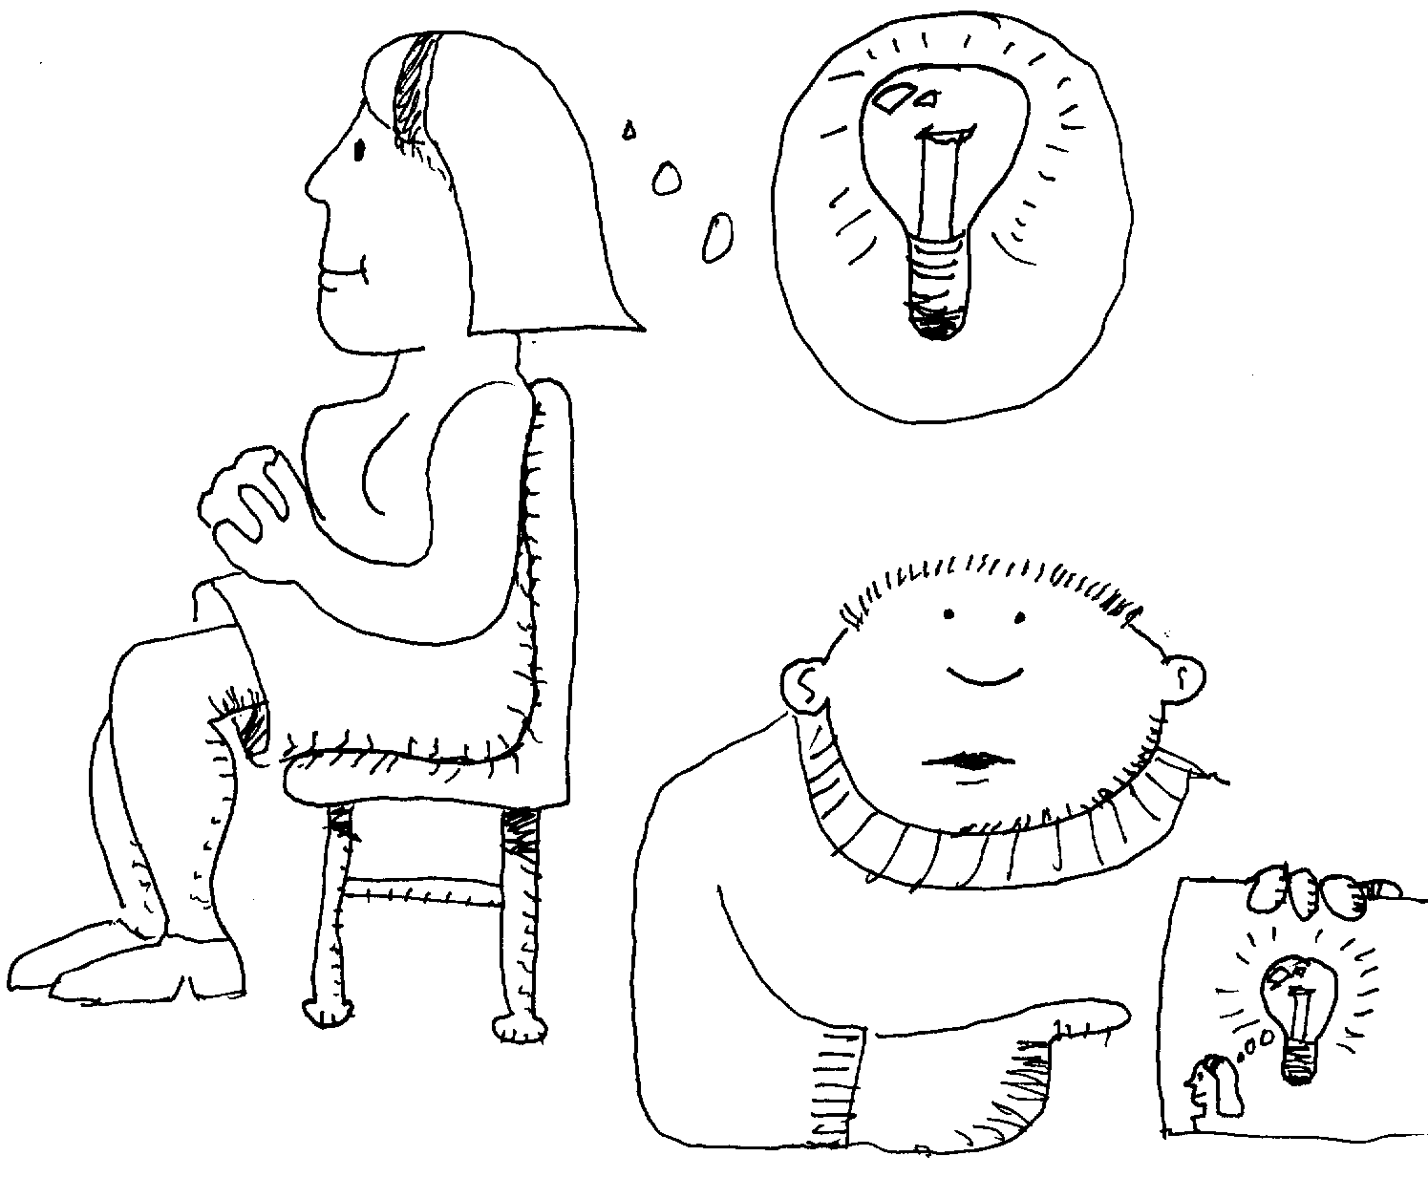
2: Everything is an Object
Notes:
$#1#$

Slide 2
You Manipulate Objects
Using References
String s; // Reference only
// Normal object creation:
String s = new String("asdf");
// Special string initialization:
String s = "asdf";
Notes:
$#2#$

Slide 3

Primitives
Built-in types: not object references, but variables on the stack like C. boolean, char (Unicode), byte, short, int, long, float, double
Same operations as C/C++, same syntax
Size of each data type is machine independent!
Portability & performance implications
To create objects, wrapper classes are provided: Boolean, Character, Byte, Short, Integer, Long, Float, Double. Read only!
Notes:
$#3#$

Slide 4
Example
char ch = 'x';
Character c = new Character(ch);
Or
Character c = new Character('x');
Notes:
$#4#$

Slide 5
Arrays in Java
Not pointers, like C, but first-class objects
Checked at run-time for safety
Covered later
Notes:
$#5#$

Slide 6
Scoping
{ // <-- Beginning of scope 1
int x = 12;
// Only x available
{ // <-- Beginning of scope 2
int q = 96;
// Cannot redefine x here!
// Both x & q available
} // <-- End of scope 2
// Only x available
// q "out of scope"
} // <-- End of scope 1
Notes:
$#6#$

Slide 7
You Never Destroy Objects
Scope of objects
{ // <–- Beginning of scope
String s = new String("a string");
} // <-- End of scope
// Reference has gone "out of scope"
// but the object itself still exists
Notes:
$#7#$

Slide 8
Creating New Data Types: class
Class keyword defines new data type
  class ATypeName { /* class body goes here */ }
  ATypeName a = new ATypeName();
Fields
      class DataOnly {
      int i;
      float f;
      boolean b;
      }
Each instance of DataOnly gets its own copy of the fields
In a class, primitives get default values.
Notes:
$#8#$

Slide 9
Methods, Arguments, and Return Values
Methods: how you get things done in an object
  Traditionally called “functions”
  Can only be defined inside classes
Example method call:
      int x = a.f(); // For object a
      ReturnType methodName(/* Argument list */) {
      // Method body
      }
Notes:
$#9#$

Slide 10
The Argument List
Types of the objects to pass in to the method
Name (identifier) to use for each one
Whenever you seem to be passing objects in Java, you’re actually passing references
    int size(String s) {
    return s.length();
    }
Notes:
$#10#$

Slide 11
Naming Conventions
Part of JavaSoft programming standard
Words run together, no underscores
Intermediate words capitalized
Classes: first letter capitalized
Methods and variables (including references): first letter lowercase
Constants: all caps with underscores to separate words (like C).
Notes:
$#11#$

Slide 12
Building a Java Program
Before you can build your first Java program you need to understand:
  Name visibility
  Using other components
  The static keyword
Notes:
$#12#$

Slide 13
Name Visibility
Preventing name clashes: methods and fields are already nested within classes
What about class names?
Produce an unambiguous name for each library using your reversed domain name and library path
My domain: BruceEckel.com:
com.bruceeckel.utility.foibles
Notes:
$#13#$

Slide 14
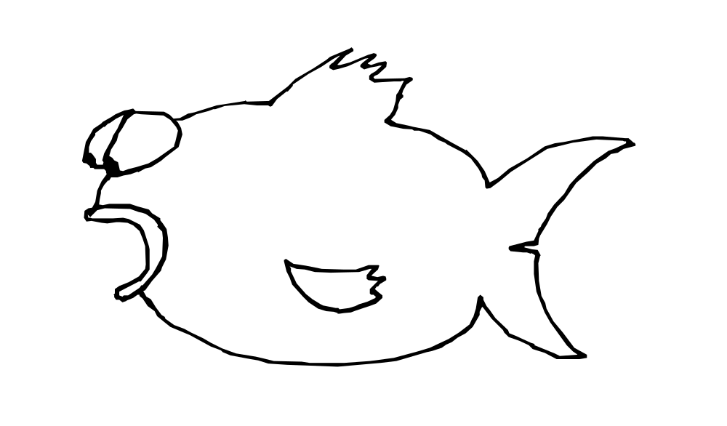

Using Other Components
Bring in a library of components using
import keyword
To specify particular element in library:
  import com.bruceeckel.utility.MyClass;
To specify entire library:
  import java.util.*;
Notes:
$#14#$

Slide 15
static Data (“class data”)
Normally each object gets its own data
What if you want only one piece of data shared between all objects of a class?
a
b
class WithStaticData {
static int x;
int y;
}
WithStaticData
a = new WithStaticData(),
b = new WithStaticData(),
c = new WithStaticData();
y
y
x
y
c
Notes:
$#15#$

Slide 16
static Methods
What if you want a method that can be called for the class, without an object? (“class method”)
class StaticFun {
static void incr() {
WithStaticData.x++;
}
}
StaticFun.incr();
Notes:
$#16#$

Slide 17
Your First Java Program
// HelloDate.java
import java.util.*;
public class HelloDate {
public static void main(String[] args) {
System.out.println("Hello, it's: ");
System.out.println(new Date());
}
}
Notes:
$#17#$

Slide 18
Comments & Embedded Documentation
Javadoc: nice comment-documentation system, extracts tagged comments and turns them into HTML pages
Used to create Javasoft documentation
Covered in book
Notes:
$#18#$

