Slide 1

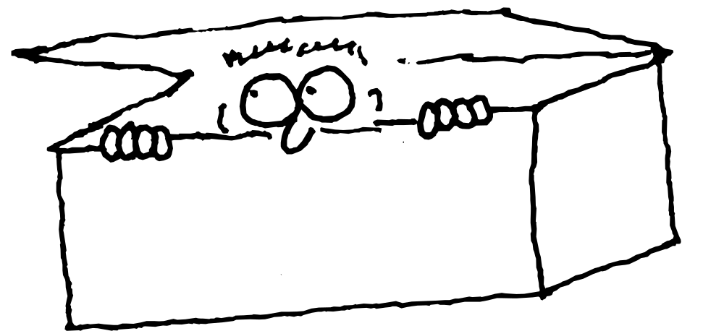
5: Hiding the Implementation
Notes:
$#1#$

Slide 2

Package: the Library Unit
      import java.util.*;
      import java.util.Vector;
Managing “name spaces”
  Class members are already hidden inside class
  Class names could clash
  Need completely unique name even over the Internet
Compilation units (.java files)
  Name of .java file == name of single public class
  Other non-public classes are not visible
  Each class in file gets its own .class file
  Program is a bunch of .class files (no .obj or .lib)
Notes:
$#2#$

Slide 3
Creating a Library of Classes
      package mypackage;
  public class is under the umbrella mypackage
  Client programmer must import mypackage.*;
Creating unique package names
  Location on disk encoded into package name
  Convention: first part of package name is Internet domain name of class creator (reversed)
  Java interpreter uses CLASSPATH environment variable as starting point for search
  My domain: bruceeckel.com
      package com.bruceeckel.util;
      (Note change to lowercase ‘com’)
Notes:
$#3#$

Slide 4
A Simple Library
      package com.bruceeckel.util;
      public class Vector {
      public Vector() {
      System.out.println(
      "com.bruceeckel.util.Vector");
      }
      }
      ////////////////////////////////////
      package com.bruceeckel.util; // Separate file
      public class List {
      public List() {
      System.out.println(
      "com.bruceeckel.util.List");
      }
      }
Notes:
$#4#$

Slide 5
Library Location
      C:\DOC\JavaT\com\bruceeckel\util
CLASSPATH takes care of first part:
      CLASSPATH=.;D:\JAVA\LIB;C:\DOC\JavaT
Programs can be in any directory
      import com.bruceeckel.util.*;
      public class LibTest {
      public static void main(String args[]) {
      Vector v = new Vector();
      List l = new List();
      }
      }
Compiler starts search at CLASSPATH
(Java 2 has improved things)
Notes:
$#5#$

Slide 6



Java Access Control
Interface
Access
public
Only Accessible
Within the class
private
protected
“Sort of private”
Notes:
$#6#$

Slide 7

“Friendly”
Default access, has no
keyword
public to other members of
the same package, private to anyone outside the package
Easy interaction for related classes (that you place in the same package)
Also referred to as “package access”
Notes:
$#7#$

Slide 8
public: Interface Access
package c05.dessert;
public class Cookie {
public Cookie() {
System.out.println("Cookie constructor");
}
void foo() { System.out.println("foo"); }
}
// Separate file in separate package:
import c05.dessert.*;
public class Dinner {
public Dinner() {
System.out.println("Dinner constructor");
}
public static void main(String args[]) {
Cookie x = new Cookie();
//! x.foo(); // Can't access
}
}
Notes:
$#8#$

Slide 9
private: Can’t Touch That!
class Sundae {
private Sundae() {}
static Sundae makeASundae() {
return new Sundae();
}
}
public class IceCream {
public static void main(String args[]) {
//! Sundae x = new Sundae();
Sundae x = Sundae.makeASundae();
}
}
Notes:
$#9#$

Slide 10
protected
Finer grained, deals with inheritance
Generally: when you need it, you’ll know
Covered in book; we’ll see it later
Notes:
$#10#$

Slide 11
Class Access
Classes as a whole can be public or “friendly”
Only one public class per file, usable outside the package
All other classes “friendly,” only usable within the package
Notes:
$#11#$

Slide 12
Summary
Access control tells users what they can & can’t use (shows the area of interest)
Also separates interface & implementation
Allows the class creator to change the implementation later without disturbing client code
An important design & implementation flexibility
Design guideline: always make elements “as private as possible”
Notes:
$#12#$

Slide 13
Return to Home Page
Click Here
to Return to Home Page

