Slide 1

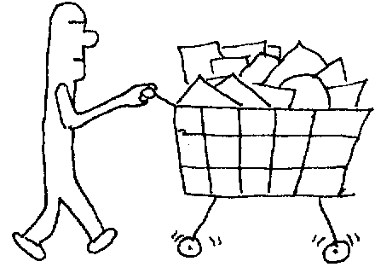
9: Holding Your Objects
Normally don’t know quantity or exact type of objects
Need convenient ways to hold objects while your program works with them
Java has built-in arrays and a library of containers
Notes:
$#1#$

Slide 2
Arrays
Most efficient way to hold references to objects
Limitation: size of an array is fixed
Benefits
  Array knows what type it holds, compile-time type checking
  Knows its size, you can ask
cat
Not generic
Object
cat
cat
cat
cat
Notes:
$#2#$

Slide 3
Arrays are First-Class Objects
class Weeble {} // A small mythical creature
Weeble[] a; // Null reference
Weeble[] b = new Weeble[5]; // Null references
Weeble[] c = new Weeble[4];
for(int i = 0; i < c.length; i++)
c[i] = new Weeble();
// Aggregate initialization:
Weeble[] d = {
new Weeble(), new Weeble(), new Weeble()
};
// Dynamic aggregate initialization:
a = new Weeble[] {
new Weeble(), new Weeble()
};
Also works with arrays of primitives
Notes:
$#3#$

Slide 4
Returning an Array
C/C++ only allows returning a pointer
  Responsibility problems, memory leaks
Returning Java array == returning a reference
  Reference knows the type of the array
  Doesn’t matter where or how array is created
  Array is around as long as needed, GC cleans up
Notes:
$#4#$

Slide 5


Example
public class IceCream {
static String flav[] = {
"Chocolate", "Strawberry",
"Vanilla Fudge Swirl", "Mint Chip",
"Mocha Almond Fudge", "Rum Raisin",
"Praline Cream", "Mud Pie"
};
Notes:
$#5#$

Slide 6
Example cont.
static String[] flavorSet(int n) {
// Force it to be positive & within bounds:
n = Math.abs(n) % (flav.length + 1);
String[] results = new String[n];
boolean[] picked =
new boolean[flav.length];
for (int i = 0; i < n; i++) {
int t;
do
t = (int)(Math.random() * flav.length);
while (picked[t]);
results[i] = flav[t];
picked[t] = true;
}
return results;
}
Notes:
$#6#$

Slide 7
Example cont.
public static void main(String args[]) {
for(int i = 0; i < 20; i++) {
System.out.println(
"flavorSet(" + i + ") = ");
String fl[] = flavorSet(flav.length);
for(int j = 0; j < fl.length; j++)
System.out.println("\t" + fl[j]);
}
}
}
Notes:
$#7#$

Slide 8

Arrays of Primitives
Arrays can hold primitive types directly
Containers can only hold references
Can use “wrapper” classes to put primitives into containers, but that’s read only
Notes:
$#8#$

Slide 9
java.util.Arrays
Algorithms for array processing:
  binarySearch( )
  equals( )
  fill( )
    The same object duplicated
  sort( )
    Unstable Quicksort for primitives
    Stable merge sort for Objects
Overloaded for Object and all primitives
Notes:
$#9#$

Slide 10
Tools for Testing Arrays
A “generator” for filling arrays
package com.bruceeckel.util;
public interface Generator {
Object next();
} ///:~
package com.bruceeckel.util;
public interface BooleanGenerator {
boolean next();
} ///:~
// Etc...
Notes:
$#10#$

Slide 11
com.bruceeckel.util.Arrays2
To print( ) all types of arrays (not provided with standard Java library)
To fill( ) all types of arrays using generators:
public static void
fill(Object[] a, Generator gen)
public static void
fill(Object[] a, int from, int to,
Generator gen)
public static void
fill(boolean[] a, BooleanGenerator gen)
public static void
fill(boolean[] a, int from, int to,
BooleanGenerator gen)
// Etc...
Notes:
$#11#$

Slide 12
Generator implementations
package com.bruceeckel.util;
public class Arrays2
RandBooleanGenerator
RandByteGenerator
RandCharGenerator
RandStringGenerator
RandShortGenerator
RandIntGenerator
RandLongGenerator
RandFloatGenerator
RandDoubleGenerator
Notes:
$#12#$

Slide 13
Example
import com.bruceeckel.util.*;
public class TestArrays2 {
public static void main(String[] args) {
int size = 6;
int a5[] = new int[size];
String a9[] = new String[size];
Arrays2.fill(a5,
new Arrays2.RandIntGenerator());
Arrays2.print(a5);
Arrays2.fill(a9,
new Arrays2.RandStringGenerator(7));
Arrays2.print(a9);
}
} ///:~
Notes:
$#13#$

Slide 14
Sorting
No support for sorting in Java 1.0/1.1
  Explain this one to me. They forgot??
Your class must implement Comparable
Single method, compareTo(Object rv)
Negative value if the argument is less than the current object
Zero if the argument is equal
Positive if the argument is greater
Notes:
$#14#$

Slide 15
Example
//: c09:CompType.java
// Implementing Comparable in a class.
import com.bruceeckel.util.*;
import java.util.*;
public class CompType implements Comparable {
int i;
int j;
public CompType(int n1, int n2) {
i = n1;
j = n2;
}
public String toString() {
return "[i = " + i + ", j = " + j + "]";
}
public int compareTo(Object rv) {
int rvi = ((CompType)rv).i;
return (i < rvi ? -1 : (i == rvi ? 0 : 1));
}
Notes:
$#15#$

Slide 16
Example cont.
private static Random r = new Random();
private static int randInt() {
return Math.abs(r.nextInt()) % 100;
}
public static Generator generator() {
return new Generator() {
public Object next() {
return new CompType(randInt(),randInt());
}
};
}
public static void main(String[] args) {
CompType[] a = new CompType[10];
Arrays2.fill(a, generator());
Arrays2.print("before sorting, a = ", a);
Arrays.sort(a);
Arrays2.print("after sorting, a = ", a);
}
} ///:~
Notes:
$#16#$

Slide 17
Imposing a Different Order
If a class doesn’t implement Comparable or you’d like a different order
Create a Comparator class
Two methods, compare( ) and equals( )
  Don't have to implement equals( ) except for special performance needs
  Just use the default Object equals( )
The compare( ) method must return a negative integer, zero, or a positive integer if the first argument is less than, equal to, or greater than the second, respectively
Primitives can only sort in ascending order
Notes:
$#17#$

Slide 18
Example
//: c09:ComparatorTest.java
// Implementing a Comparator for a class.
import com.bruceeckel.util.*;
import java.util.*;
class CompTypeComparator implements Comparator {
public int compare(Object o1, Object o2) {
int j1 = ((CompType)o1).j;
int j2 = ((CompType)o2).j;
return (j1 < j2 ? -1 : (j1 == j2 ? 0 : 1));
}
}
public class ComparatorTest {
public static void main(String[] args) {
CompType[] a = new CompType[10];
Arrays2.fill(a, CompType.generator());
Arrays2.print("before sorting, a = ", a);
Arrays.sort(a, new CompTypeComparator());
Arrays2.print("after sorting, a = ", a);
}
} ///:~
Notes:
$#18#$

Slide 19
See book for…
Sorting Strings alphabetically (as opposed to lexicographically)
Binary searching of arrays
Copying and comparing arrays
Notes:
$#19#$

Slide 20
Java 2 Containers
Divides the issue of "holding your objects":
1. Collection: a group of individual elements, often with some rule applied to them
  List holds elements in a particular sequence
  Set has no duplicates
2. Map: a group of key-value object pairs
  Can return a Set of its keys
  A Collection of its values
  Set of its pairs
  Maps can easily be expanded to multiple dimensions
Notes:
$#20#$

Slide 21

Printing containers
Unlike arrays, built-in functionality
Example introduces basic container types
Notes:
$#21#$

Slide 22
Example
import java.util.*;
public class PrintingContainers {
static Collection fill(Collection c) {
c.add("dog");
c.add("dog");
c.add("cat");
return c;
}
static Map fill(Map m) {
m.put("dog", "Bosco");
m.put("dog", "Spot");
m.put("cat", "Rags");
return m;
}
public static void main(String[] args) {
System.out.println(fill(new ArrayList()));
System.out.println(fill(new HashSet()));
System.out.println(fill(new HashMap()));
}
} ///:~
[dog, dog, cat]
[cat, dog]
{cat=Rags, dog=Spot}
Notes:
$#22#$

Slide 23
Filling Containers
Containers.fill( ) duplicates a single object into the container
Still a problem to add interesting data
Will use another generator
For Maps, it needs to produce an object containing two objects: Pair
Notes:
$#23#$

Slide 24
Example
//: com:bruceeckel:util:Pair.java
package com.bruceeckel.util;
class Pair {
public Object key, value;
Pair(Object k, Object v) {
key = k;
value = v;
}
} ///:~
//: com:bruceeckel:util:MapGenerator.java
package com.bruceeckel.util;
public interface MapGenerator {
Pair next();
} ///:~
Notes:
$#24#$

Slide 25
Tools for Data Generation
geography, countries, and capitals contain predefined data (see book)
package com.bruceeckel.util;
public class Collections2 {
fill(Collection c, Generator gen, int count) {
fill(Map m, MapGenerator gen, int count) {
RandStringPairGenerator implements MapGenerator
RandStringPairGenerator rsp
StringPairGenerator implements MapGenerator
StringPairGenerator geography
class StringGenerator implements Generator
StringGenerator countries
StringGenerator capitals
Notes:
$#25#$

Slide 26
Example
//: c09:FillTest.java
import com.bruceeckel.util.*;
import java.util.*;
public class FillTest {
static Generator sg =
new Arrays2.RandStringGenerator(7);
public static void main(String[] args) {
List list = new ArrayList();
Collections2.fill(list, sg, 25);
System.out.println(list + "\n");
List list2 = new ArrayList();
Collections2.fill(list2,
Collections2.capitals, 25);
System.out.println(list2 + "\n");
Notes:
$#26#$

Slide 27
Example cont.
Set set = new HashSet();
Collections2.fill(set, sg, 25);
System.out.println(set + "\n");
Map m = new HashMap();
Collections2.fill(m, Collections2.rsp, 25);
System.out.println(m + "\n");
Map m2 = new HashMap();
Collections2.fill(m2,
Collections2.geography, 25);
System.out.println(m2);
}
} ///:~
Notes:
$#27#$

Slide 28
Container Disadvantage
Unknown type
Containers all hold Object, so they
hold anything
Collection of Cat will also hold a Dog
You must cast back to the correct type
An exception is thrown if you try to cast to the wrong type
Problem because you don’t know until the program is running
Notes:
$#28#$

Slide 29
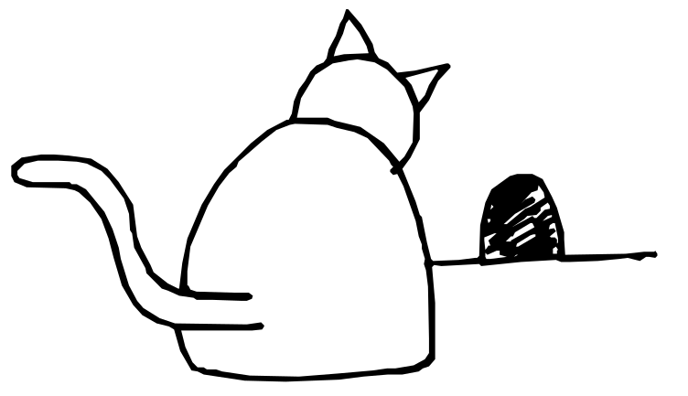

Example
public class Cat {
private int catNumber;
Cat(int i) { catNumber = i; }
void print() {
System.out.println(
"Cat # " + catNumber);
}
}
public class Dog {
private int dogNumber;
Dog(int i) { dogNumber = i; }
void print() {
System.out.println("Dog # " + dogNumber);
}
}
Notes:
$#29#$

Slide 30

Example cont.
public class CatsAndDogs {
public static void main(String[] args) {
ArrayList cats = new ArrayList();
for(int i = 0; i < 7; i++)
cats.add(new Cat(i));
// Not a problem to add a dog to cats:
cats.add(new Dog(7));
for(int i = 0; i < cats.size(); i++)
((Cat)cats.get(i)).print();
// Dog is detected only at run-time
}
}
Notes:
$#30#$

Slide 31
A Type-Conscious ArrayList
//: c09:MouseList.java
// A type-conscious ArrayList.
import java.util.*;
public class MouseList {
private ArrayList list = new ArrayList();
public void add(Mouse m) {
list.add(m);
}
public Mouse get(int index) {
return (Mouse)list.get(index);
}
public int size() { return list.size(); }
} ///:~
Notes:
$#31#$

Slide 32
Example
class MouseTrap {
static void caughtYa(Object m) {
Mouse mouse = (Mouse)m; // Cast from Object
System.out.println("Mouse: " +
mouse.getNumber());
}
}
//: c09:MouseListTest.java
public class MouseListTest {
public static void main(String[] args) {
MouseList mice = new MouseList();
for(int i = 0; i < 3; i++)
mice.add(new Mouse(i));
for(int i = 0; i < mice.size(); i++)
MouseTrap.caughtYa(mice.get(i));
}
} ///:~
Notes:
$#32#$

Slide 33

Iterators
The abstraction: selecting each element in a sequence (traverse a Collection)
  Can make many iterators,
  and select more than
  one element at a time
  Hides underlying
  collection, so you can
  easily change from
  one type to another
  A design pattern
Notes:
$#33#$

Slide 34
Iterators
Java 2 Iterator interface:
Interface Iterator {
boolean hasNext();
Object next();
void remove();
}
“Fail Fast” Operation
  Exception thrown if container is modified externally (i.e., not via the iterator itself)
Notes:
$#34#$

Slide 35
Example
//: c09:CatsAndDogs2.java
// Simple container with Iterator.
import java.util.*;
public class CatsAndDogs2 {
public static void main(String[] args) {
ArrayList cats = new ArrayList();
for(int i = 0; i < 7; i++)
cats.add(new Cat(i));
Iterator e = cats.iterator();
while(e.hasNext())
((Cat)e.next()).print();
}
} ///:~
Notes:
$#35#$

Slide 36

Example cont.
class Hamster {
private int hamsterNumber;
Hamster(int i) {
hamsterNumber = i;
}
public String toString() {
return "This is Hamster #" + hamsterNumber;
}
}
Notes:
$#36#$

Slide 37
Example cont.
class Printer {
static void printAll(Iterator e) {
while(e.hasNext())
System.out.println(e.next());
}
}
public class HamsterMaze {
public static void main(String[] args) {
ArrayList v = new ArrayList();
for(int i = 0; i < 3; i++)
v.add(new Hamster(i));
Printer.printAll(v.iterator());
}
}
Notes:
$#37#$

Slide 38
Container Taxonomy
Collections and Maps may be implemented in different ways, according to your programming needs
It’s helpful to look at a diagram of the Java 2 containers:
Notes:
$#38#$

Slide 39
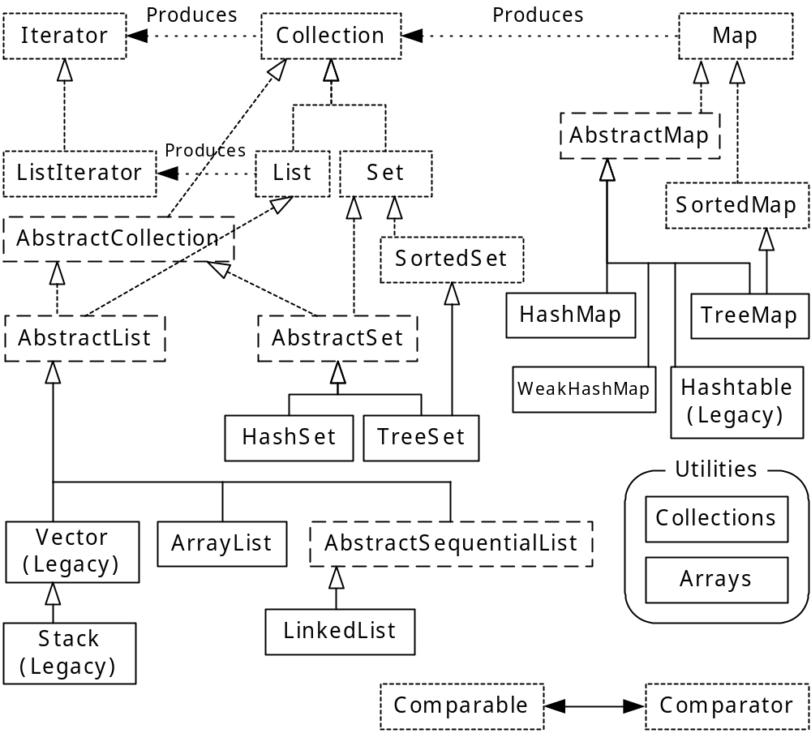
Java 2 Collections
Notes:
$#39#$

Slide 40
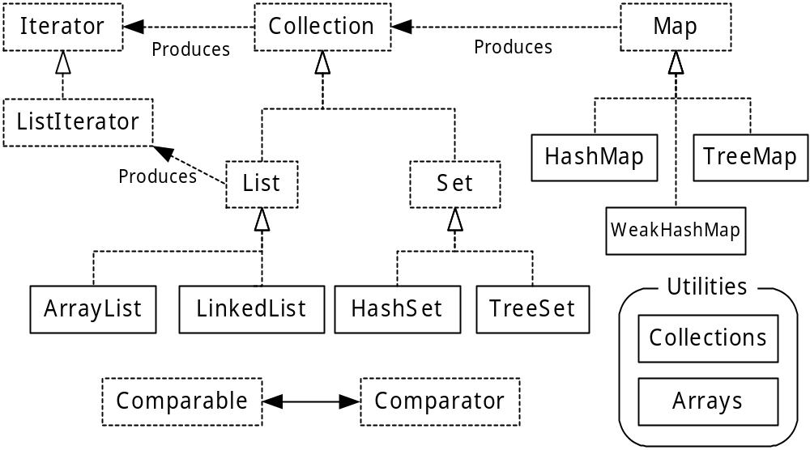
Simplified Taxonomy
Simplified Taxonomy
Notes:
$#40#$

Slide 41
The Collection Interface
boolean add(Object)
boolean addAll(Collection)
void clear( )
boolean contains(Object)
boolean containsAll(Collection)
boolean isEmpty( )
Iterator iterator( )
boolean remove(Object)
boolean removeAll(Collection)
boolean retainAll(Collection)
int size( )
Object[ ] toArray( )
Object[ ] toArray(Object[ ] a)
(Other methods in
derived classes)
Notes:
$#41#$

Slide 42
Lists have additional abilities
void add(index, Object)
boolean addAll(index, Collection)
Object get(index)
int indexOf(Object)
int lastIndexOf(Object)
ListIterator listIterator()
ListIterator listIterator(index)
Object remove(index)
Object set(index, Object) // Means: “replace”
List subList(fromIndex, toIndex)
Notes:
$#42#$

Slide 43
Lists produce ListIterators
boolean hasNext()
Object next()
boolean hasPrevious()
Object previous()
int nextIndex()
int previousIndex()
add(Object)
void remove()
void set(Object) // “Replace”
Notes:
$#43#$

Slide 44
ArrayList
Default choice for a simple sequence
Optimal for rapid random access
ListIterator should be used only for back-and-forth traversal of an ArrayList, but not for inserting and removing elements
Notes:
$#44#$

Slide 45
LinkedList
Optimal sequential access with inexpensive insertions and deletions from the middle of the list
Can be used as a stack, a queue, and a deque
  addFirst( ), addLast( ), getFirst( ), getLast( ), removeFirst( ), and removeLast( )
ListIterator can be used for insertion and removal
Notes:
$#45#$

Slide 46
Queues, Stacks and Deques
Not there
Use LinkedList
  addFirst( ), addLast( )
  removeFirst( ), removeLast( )
  getFirst( ), getLast( )
Or you can make your own:
Notes:
$#46#$

Slide 47
Examples
public class StackL {
private LinkedList list = new LinkedList();
public void push(Object v) {
list.addFirst(v);
}
public Object top() {
return list.getFirst();
}
public Object pop() {
return list.removeFirst();
}
public static void main(String args[]) {
StackL stack = new StackL();
for(int i = 0; i < 10; i++)
stack.push(Collections2.countries.next());
System.out.println(stack.top());
System.out.println(stack.top());
System.out.println(stack.pop());
System.out.println(stack.pop());
System.out.println(stack.pop());
}
} ///:~
Notes:
$#47#$

Slide 48
Examples cont.
//: c09:Queue.java
// Making a queue from a LinkedList.
import java.util.*;
public class Queue {
private LinkedList list = new LinkedList();
public void put(Object v) { list.addFirst(v); }
public Object get() {
return list.removeLast();
}
public boolean isEmpty() {
return list.isEmpty();
}
public static void main(String args[]) {
Queue queue = new Queue();
for(int i = 0; i < 10; i++)
queue.put(Integer.toString(i));
while(!queue.isEmpty())
System.out.println(queue.get());
}
} ///:~
Notes:
$#48#$

Slide 49
Sets
Mathematical set abstraction
No duplicates
Two interfaces
  Set (identical to Collection)
  SortedSet
Notes:
$#49#$

Slide 50
Set implementations
HashSet for maximally fast lookups
TreeSet to maintain sorted order
  Order determined by Comparable or Comparator)
  You can extract an ordered sequence from a TreeSet:
    Comparator comparator()
    Object first()
    Object last()
    SortedSet subSet(fromElement, toElement)
    SortedSet headSet(toElement)
    SortedSet tailSet(fromElement)
Notes:
$#50#$

Slide 51
Example
public class Set1 {
static Collections2.StringGenerator gen =
Collections2.countries;
public static void testVisual(Set a) {
Collections2.fill(a, gen.reset(), 10);
Collections2.fill(a, gen.reset(), 10);
Collections2.fill(a, gen.reset(), 10);
System.out.println(a); // No duplicates!
a.addAll(a); // Add another set to this one
a.add("one"); a.add("one"); a.add("one");
System.out.println(a);
System.out.println("a.contains(\"one\"): " +
a.contains("one")); // Look something up
}
public static void main(String[] args) {
System.out.println("HashSet");
testVisual(new HashSet());
System.out.println("TreeSet");
testVisual(new TreeSet());
} } ///:~
Notes:
$#51#$

Slide 52
Maps
Alternately termed a map, a dictionary or an associative array
Like an ArrayList, but instead of using an integral index to look something up, another object is used as a key
Store key/value pairs of Objects
Duplicate Keys not allowed
Returns keys as a Set view
Returns values as a Collection
Notes:
$#52#$

Slide 53
TreeMap
SortedMap with elements stored in a tree
    Comparator comparator( )
    Object firstKey( )
    Object lastKey( )
    SortedMap subMap(fromKey, toKey)
    SortedMap headMap(toKey)
    SortedMap tailMap(fromKey)
Viewing keys or pairs will be in sorted order
Order determined by Comparable or Comparator
Notes:
$#53#$

Slide 54
HashMap
HashMap is a Map with very fast lookup: uses a hash code to organize the objects
Should typically be your first choice for a Map
Program counts occurrences of “random” numbers:
Notes:
$#54#$

Slide 55
Example
class Counter {
int i = 1;
public String toString() {
return Integer.toString(i);
}
}
public class Statistics {
public static void main(String[] args) {
HashMap hm = new HashMap();
for(int i = 0; i < 10000; i++) {
// Produce a number between 0 and 20:
Integer r =
new Integer((int)(Math.random() * 20));
if(hm.containsKey(r))
((Counter)hm.get(r)).i++;
else
hm.put(r, new Counter());
}
System.out.println(hm);
}
} ///:~
Notes:
$#55#$

Slide 56
Output
{19=526, 18=533, 17=460, 16=513, 15=521, 14=495,
13=512, 12=483, 11=488, 10=487, 9=514, 8=523,
7=497, 6=487, 5=480, 4=489, 3=509, 2=503, 1=475,
0=505}
Notes:
$#56#$

Slide 57


HashMap “key” classes
A common pitfall: if a class is to be used as a key for a HashMap, you must override hashCode( ) and equals( ) from the common root class Object
Consider a weather-forecasting system that matches Groundhogs with Predictions:
Notes:
$#57#$

Slide 58


Example
public class SpringDetector2 {
public static void main(String[] args) {
HashMap ht = new HashMap();
for(int i = 0; i < 10; i++)
ht.put(new Groundhog2(i),new Prediction());
System.out.println("ht = " + ht + "\n");
System.out.println(
"Looking up prediction for groundhog #3:");
Groundhog2 gh = new Groundhog2(3);
if(ht.containsKey(gh))
System.out.println((Prediction)ht.get(gh));
}
}
Notes:
$#58#$

Slide 59
Example cont.
class Groundhog2 {
int ghNumber;
Groundhog2(int n) { ghNumber = n; }
public int hashCode() { return ghNumber; }
public boolean equals(Object o) {
return (o instanceof Groundhog2)
&& (ghNumber == ((Groundhog2)o).ghNumber);
}
}
class Prediction {
boolean shadow = Math.random() > 0.5;
public String toString() {
if(shadow)
return "Six more weeks of Winter!";
else
return "Early Spring!";
}
}
Notes:
$#59#$

Slide 60
How hashing works
Hash into fixed array using hashCode( )
Resolve collisions with equals( )
Element
Element
Element
Element
Element
Element
Element
Element
Notes:
$#60#$

Slide 61
Book contains more details
A simple hash table implementation
Guidelines for writing your hashCode( )
  Must generate the same value every time
  Must be meaningful, based on information that “identifies” the object
  Must work in concert with equals( )
  Should be fast
  For example:
Notes:
$#61#$

Slide 62
Example
public class CountedString {
private String s;
private int id = 0;
private static ArrayList created =
new ArrayList();
public CountedString(String str) {
s = str;
created.add(s);
Iterator it = created.iterator();
// Id is the total number of instances
// of this string in use by CountedString:
while(it.hasNext())
if(it.next().equals(s))
id++;
}
public String toString() {
return "String: " + s + " id: " + id +
" hashCode(): " + hashCode() + "\n";
}
Notes:
$#62#$

Slide 63
Example cont.
public int hashCode() {
return s.hashCode() * id;
}
public boolean equals(Object o) {
return (o instanceof CountedString)
&& s.equals(((CountedString)o).s)
&& id == ((CountedString)o).id;
}
public static void main(String[] args) {
HashMap m = new HashMap();
CountedString[] cs = new CountedString[10];
for(int i = 0; i < cs.length; i++) {
cs[i] = new CountedString("hi");
m.put(cs[i], new Integer(i));
}
System.out.println(m);
for(int i = 0; i < cs.length; i++) {
System.out.print("Looking up " + cs[i]);
System.out.println(m.get(cs[i]));
}}} ///:~
Notes:
$#63#$

Slide 64
Choosing an implementation
Code in book tests performance, to give you an idea of which particular container to use for a specific problem
Verifies the guidelines I’ve given
Notes:
$#64#$

Slide 65

Vestigial Containers from 1.0/1.1
Java 1.0, 1.1: meager but usable set:
  Vector
  BitSet
  Stack
  Hashtable
Notes:
$#65#$

Slide 66
Old 1.0/1.1 Containers
They’ll appear in older standard libraries
  And sometimes new ones
Don’t use them in
new code
Vector -> ArrayList
BitSet (maybe use)
Stack -> LinkedList
Hashtable -> Map
Notes:
$#66#$

Slide 67
Enumeration: old Iterator
Smaller interface than Iterator, longer method names
  nextElement( ) moves to and produces the next item
  hasMoreElements( ) indicates the end
Can actually appear quite a bit, even in new library code
Treat it just like an Iterator without a remove( ) method
Notes:
$#67#$

Slide 68
Summary
Array associates numerical indices to objects
  Holds objects of a known type
  Fixed size
Sequence (List) associates numerical indices to objects
  Only holds Object references
  Automatically resizes itself
Set only holds one of each object
  HashSet for speed, TreeSet for sorted order
Map associates objects with other objects
  Provides rapid random access
  HashMap orders with hashCode( ) & equals( )
  TreeMap keeps sorted order
Notes:
$#68#$

Slide 69
Return to Home Page
Click Here
to Return to Home Page

