Slide 1

11: The Java I/O System
Goal: to provide abstractions of all aspects of IO
  Directory structure, File, Memory, Network, etc.
Express all possible configurations
  Character, binary, buffered, reading lines, transparent data transfer, etc.
Notes:
$#1#$

Slide 2
Representing the File System
File systems vary between OSes
  Features like permissions exist on Unix but not on most others
  Directories are represented differently on the Mac
  Path separators differ, etc.
Need an abstraction to represent the file system
  So you can ignore these details in your code
Notes:
$#2#$

Slide 3
The File class
Deceiving: refers to one or more file names, not a handle to a file itself
  Composite design pattern: to represent tree-structured hierarchy (node and leaf)
Set of file names: list( ) gives an array of String
For a subset of file names, you hand list( ) an object that implements FilenameFilter
Simple directory lister program is shown here
  Book shows modifications using anonymous inner classes
Notes:
$#3#$

Slide 4
Example
import java.io.*;
import java.util.*;
import com.bruceeckel.util.*;
public class DirList {
public static void
main(String[] args) throws Exception {
File path = new File(".");
String[] list;
if(args.length == 0)
list = path.list();
else
list = path.list(new DirFilter(args[0]));
Arrays.sort(list,
new AlphabeticComparator());
for(int i = 0; i < list.length; i++)
System.out.println(list[i]);
}
}
Notes:
$#4#$

Slide 5
Example cont.
class DirFilter implements FilenameFilter {
String afn;
DirFilter(String afn) { this.afn = afn; }
public boolean accept(File dir, String name) {
// Strip path information:
String f = new File(name).getName();
return f.indexOf(afn) != -1;
}
} ///:~
Notes:
$#5#$

Slide 6
Reading/Manipulating Directories
public class MakeDirectories {
private final static String usage =
"Usage:MakeDirectories path1 ...\n" +
"Creates each path\n" +
"Usage:MakeDirectories -d path1 ...\n" +
"Deletes each path\n" +
"Usage:MakeDirectories -r path1 path2\n" +
"Renames from path1 to path2\n";
private static void usage() {
System.err.println(usage);
System.exit(1);
}
Notes:
$#6#$

Slide 7
Example
private static void fileData(File f) {
System.out.println(
"Absolute path: " + f.getAbsolutePath() +
"\n Can read: " + f.canRead() +
"\n Can write: " + f.canWrite() +
"\n getName: " + f.getName() +
"\n getParent: " + f.getParent() +
"\n getPath: " + f.getPath() +
"\n length: " + f.length() +
"\n lastModified: " + f.lastModified());
if(f.isFile())
System.out.println("it's a file");
else if(f.isDirectory())
System.out.println("it's a directory");
}
Notes:
$#7#$

Slide 8
Example cont.
public static void main(String args[]) {
if(args.length < 1) usage();
if(args[0].equals("-r")) {
if(args.length != 3) usage();
File
old = new File(args[1]),
rname = new File(args[2]);
old.renameTo(rname);
fileData(old);
fileData(rname);
return; // Exit main
}
int count = 0;
boolean del = false;
if(args[0].equals("-d")) {
count++;
del = true;
}
Notes:
$#8#$

Slide 9
Example cont.
for( ; count < args.length; count++) {
File f = new File(args[count]);
if(f.exists()) {
System.out.println(f + " exists");
if(del) {
System.out.println("deleting..." + f);
f.delete();
}
} else { // Doesn't exist
if(!del) {
f.mkdirs();
System.out.println("created " + f);
}
}
fileData(f);
}
}
}
Notes:
$#9#$

Slide 10
I/O Fundamentals
Different kinds of I/O
  Files, the console, blocks of memory, network connections
Different kinds of operations
  Sequential, random-access, binary, character, by lines, by words, etc.
Notes:
$#10#$

Slide 11
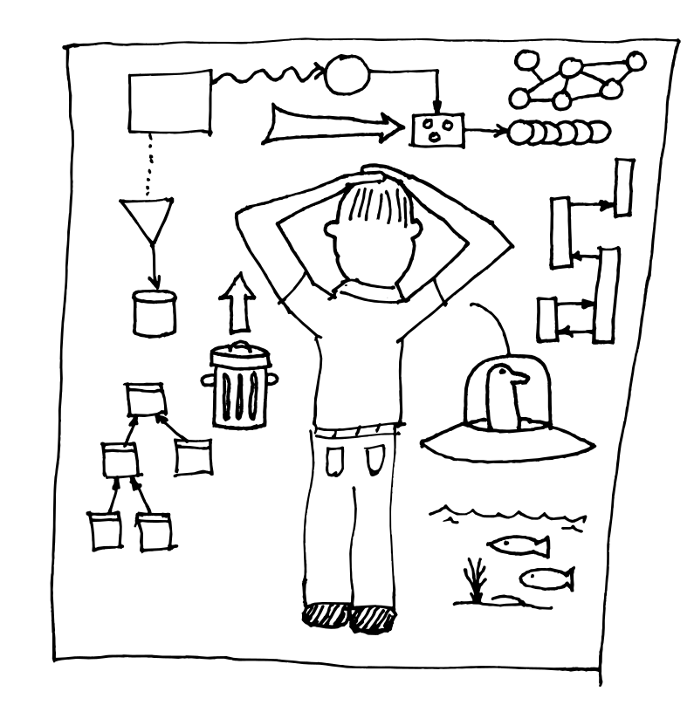
The Java I/O Library Design
Seems like a lot of classes
Also seems at first like an odd design
  Not typically how you think of using classes
  Can require a lot of typing
There is a plan
  A learning experience
  in class design
  The “Decorator”
  Design Pattern
Notes:
$#11#$

Slide 12
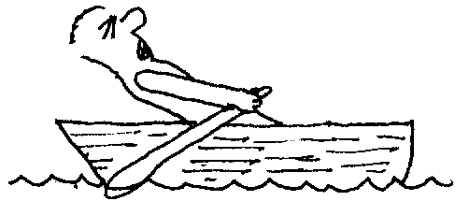
Binary Input and Output
InputStream
  All have read( ) methods you won’t usually use
  Sometimes tricky to tell when you’re at the end
OutputStream
  All have write( ) methods you won’t usually use
Wrap classes in “decorators” to add functionality. More work while coding.
Notes:
$#12#$

Slide 13
Types of InputStream
Reads from:
ByteArrayInputStream
Block of memory
StringBufferInputStream
String (not StringBuffer)
FileInputStream
File
PipedInputStream
“Pipe” (from another thread)
SequenceInputStream
Combined Input Streams
FilterInputStream
Not for reading. Abstract class for decorators
that add functionality to other streams
Notes:
$#13#$

Slide 14
Types of OutputStream
Writes to:
ByteArrayOutputStream
Block of memory
FileOutputStream
File
PipedOutputStream
“Pipe” (to another thread)
FilterOutputStream
Not for writing. Abstract class for decorators
that add functionality to other streams
Notes:
$#14#$

Slide 15
Adding Attributes
& Useful Interfaces
Two issues with I/O streams:
  What you’re talking to
  The way you talk to it
One approach: make a class for every possible combination
Alternative: Java’s “filter” streams (decorators) dynamically create the functionality you need
Input: FilterInputStream
Output: FilterOutputStream
Notes:
$#15#$

Slide 16
The “Decorator” Pattern
The use of layered objects to dynamically and transparently add responsibilities to individual objects is referred to as the decorator pattern (patterns: separate book)
Used when subclassing creates too many (& inflexible) classes
All decorators that wrap around the original object must have the same interface
This accounts for the odd inheritance structure
Tradeoff: coding is more complicated
Notes:
$#16#$

Slide 17
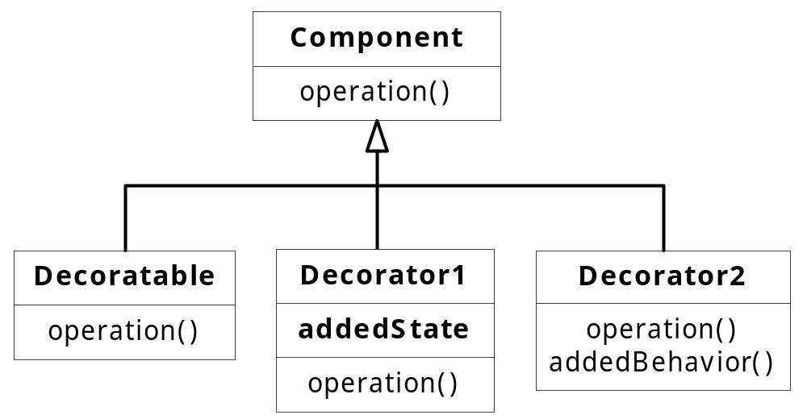
Basic Decorator Design
Adds state and/or operations to basic component
Notes:
$#17#$

Slide 18
FilterInputStreams
DataInputStream
  Full interface for reading primitive and built-in types
BufferedInputStream
  Adds buffering to the stream (usually do this)
LineNumberInputStream
  Adds line numbering functionality (nothing else; you’ll probably add another filter)
PushbackInputStream
  Implements a one-character push back, for scanners. You probably won’t use this.
Notes:
$#18#$

Slide 19
FilterOutputStreams
DataOutputStream
  Full interface for writing primitive and built-in types; complements DataInputStream for portable reading & writing of data
PrintStream
  Allows primitive formatting for data display; DataOutputStream is for storage
BufferedOutputStream
  Adds a buffer to the output stream (usually do this)
Notes:
$#19#$

Slide 20
Off by Itself: RandomAccessFile
Can move around using seek( ), then read and write records
Not part of the InputStream or OutputStream hierarchy!
  Happens to implement the DataInput and DataOutput interfaces
  No other association
  Very different behavior: other streams are “forward” only, no concept of movement
  Some talk of more fully integrating it in a later release of Java (not Java 2)
Notes:
$#20#$

Slide 21
Character I/O Streams
Added in Java 1.1
Can appear that they are intended to replace InputStream and OutputStream
  Not the case, but causes confusion
Reader and Writer classes
  Internationalization: uses 16-bit char (capable of holding Unicodes) instead of 8-bit byte
  Also designed to improve speed
Notes:
$#21#$

Slide 22
Sources & Sinks of Data
Binary
Character
InputStream
OutputStream
FileInputStream
FileOutputStream
StringBufferInputStream
(no corresponding class)
ByteArrayInputStream
ByteArrayOutputStream
PipedInputStream
PipedOutputStream
Reader
converter: InputStreamReader
Writer
converter: OutputStreamWriter
FileReader
FileWriter
StringReader
StringWriter
CharArrayReader
CharArrayWriter
PipedReader
PipedWriter
Notes:
$#22#$

Slide 23
Modifying Stream Behavior
Binary
Character
FilterInputStream
FilterOutputStream
BufferedInputStream
BufferedOutputStream
DataInputStream
PrintStream
LineNumberInputStream
StreamTokenizer
PushBackInputStream
FilterReader
FilterWriter (abstract class with no subclasses)
BufferedReader
(also has readLine( ) )
BufferedWriter
Use DataInputStream (except when you must use readLine( ), then use a BufferedReader)
PrintWriter
LineNumberReader
StreamTokenizer
(Use constructor that takes a Reader instead)
PushBackReader
Notes:
$#23#$

Slide 24

Classes with no Character Versions
DataOutputStream
File
RandomAccessFile
SequenceInputStream
Notes:
$#24#$

Slide 25

Typical Uses of I/O Streams
Reading & writing files
Manipulating blocks of memory
Notes:
$#25#$

Slide 26
Example
//: c11:IOStreamDemo.java
// Typical I/O stream configurations.
import java.io.*;
public class IOStreamDemo {
// Throw exceptions to console:
public static void main(String[] args)
throws IOException {
// 1. Reading input by lines:
BufferedReader in =
new BufferedReader(
new FileReader("IOStreamDemo.java"));
String s, s2 = new String();
while((s = in.readLine())!= null)
s2 += s + "\n";
in.close();
Notes:
$#26#$

Slide 27
Example cont.
// 1b. Reading standard input:
BufferedReader stdin =
new BufferedReader(
new InputStreamReader(System.in));
System.out.print("Enter a line:");
System.out.println(stdin.readLine());
// 2. Input from memory
StringReader in2 = new StringReader(s2);
int c;
while((c = in2.read()) != -1)
System.out.print((char)c);
Notes:
$#27#$

Slide 28
Example cont.
// 3. Formatted memory input
try {
DataInputStream in3 =
new DataInputStream(
new ByteArrayInputStream(s2.getBytes()));
while(true)
System.out.print((char)in3.readByte());
} catch(EOFException e) {
System.err.println("End of stream");
}
Notes:
$#28#$

Slide 29
Example cont.
// 4. File output
try {
BufferedReader in4 =
new BufferedReader(
new StringReader(s2));
PrintWriter out1 =
new PrintWriter(
new BufferedWriter(
new FileWriter("IODemo.out")));
int lineCount = 1;
while((s = in4.readLine()) != null )
out1.println(lineCount++ + ": " + s);
out1.close();
} catch(EOFException e) {
System.err.println("End of stream");
}
Notes:
$#29#$

Slide 30
Example cont.
// 5. Storing & recovering data
try {
DataOutputStream out2 =
new DataOutputStream(
new BufferedOutputStream(
new FileOutputStream("Data.txt")));
out2.writeDouble(3.14159);
out2.writeUTF("That was pi");
out2.writeDouble(1.41413);
out2.writeUTF("Square root of 2");
out2.close();
DataInputStream in5 =
new DataInputStream(
new BufferedInputStream(
new FileInputStream("Data.txt")));
Notes:
$#30#$

Slide 31
Example cont.
// Must use DataInputStream for data:
System.out.println(in5.readDouble());
// Only readUTF() will recover the
// Java-UTF String properly:
System.out.println(in5.readUTF());
// Read the following double and String:
System.out.println(in5.readDouble());
System.out.println(in5.readUTF());
} catch(EOFException e) {
System.err.println("End of stream");
}
Notes:
$#31#$

Slide 32
Example cont.
// 6. Reading/writing random access files
RandomAccessFile rf =
new RandomAccessFile("rtest.dat", "rw");
for(int i = 0; i < 10; i++)
rf.writeDouble(i*1.414);
rf.close();
rf = new RandomAccessFile("rtest.dat", "rw");
rf.seek(5*8);
rf.writeDouble(47.0001);
rf.close();
rf = new RandomAccessFile("rtest.dat", "r");
for(int i = 0; i < 10; i++)
System.out.println(
"Value " + i + ": " +
rf.readDouble());
rf.close();
}
} ///:~
Notes:
$#32#$

Slide 33
Other Tools
Data compression: built-in Zip & Gzip libraries
JAR files: (Java ARchive) compressed (via Zip) multi-file storage
  Reduces server hits, speeds Internet access
Both are covered in book
Notes:
$#33#$

Slide 34
Object Serialization
Class must implement Serializable
Wrap a binary stream in a ObjectOutputStream (for writing) or ObjectInputStream (for reading)
Use writeObject( ) and readObject( )
All relevant parts of an Object magically stored and retrieved; even “web of objects”
Save to disk for “lightweight persistence,” send across network (important for RMI)
Notes:
$#34#$

Slide 35

Object Serialization
Writing an object:
  ObjectOutputStream out =
  new ObjectOutputStream(
  new FileOutputStream("X.file"));
  Alien zorcon = new Alien();
  out.writeObject(zorcon);
Reading an object:
  ObjectInputStream in =
  new ObjectInputStream(
  new FileInputStream("X.file"));
  Alien zorcon = (Alien)in.readObject();
Many more details in book
Notes:
$#35#$

Slide 36
Summary
I/O stream library satisfies basic requirements:
  Can read or write to console, file, block of memory
  Can treat URLs and Sockets as streams
Decorator pattern may seem strange at first
  Very flexible, but requires extra coding
No support for the kind of output formatting that almost every other language I/O package supports (printf-style in JDK 1.4)
Connects well with networking, exec( )
Notes:
$#36#$

Slide 37
Return to Home Page
Click Here
to Return to Home Page

