Slide 1
EasyAndroid: Developers’ Tool for Android Beginners
Android Development Made Easy
Mark Ha ‘13 Adviser: Brian Kernighan

Slide 2
Brief Outline
Problem & Motivation
Related Works (one detailed preview)
Big Picture
Main Points of EasyAndroid
Evaluations
Conclusions

Slide 3

Problem & Motivation
Mobile + Android = awesome
Learning to make Android apps is not the best experience
Barrier to entry is relatively high
I just want to “try out” Android…
Android library

Slide 4

I want to make an Android app...

Slide 5
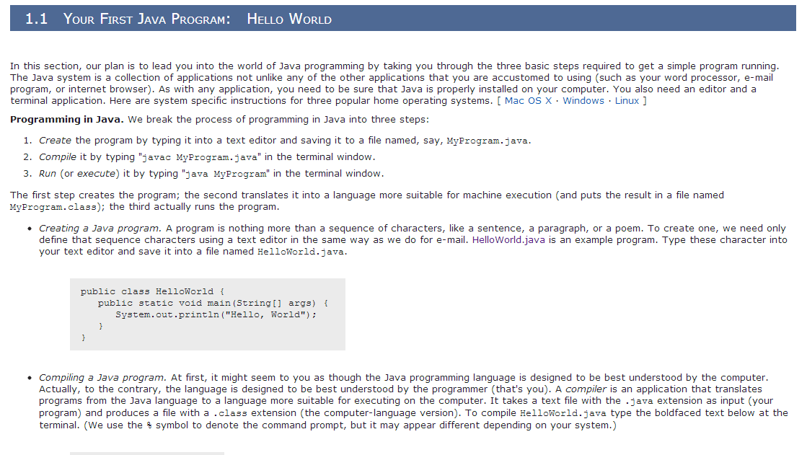
Hello World?
http://introcs.cs.princeton.edu

Slide 6

Related Works
If This Then That (https://ifttt.com/)
“Droid Dev”
App Inventor (http://appinventor.mit.edu/)
Andromo (http://www.andromo.com)

Slide 7
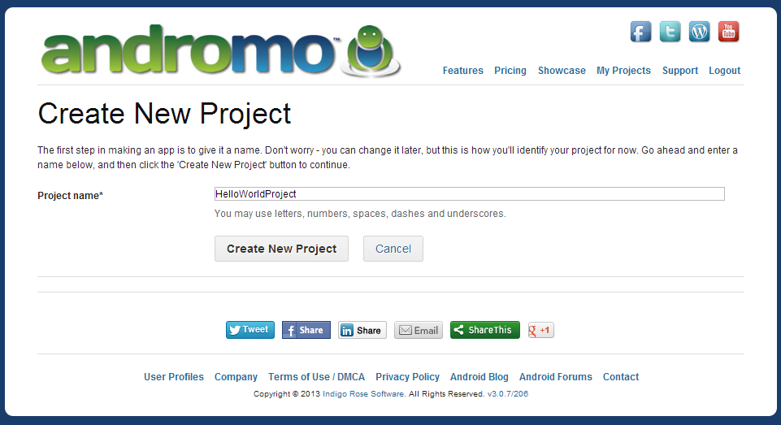
Andromo

Slide 8
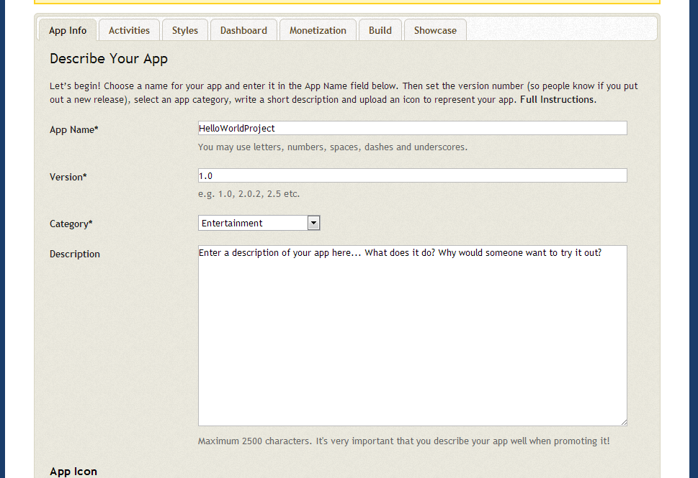
Andromo

Slide 9
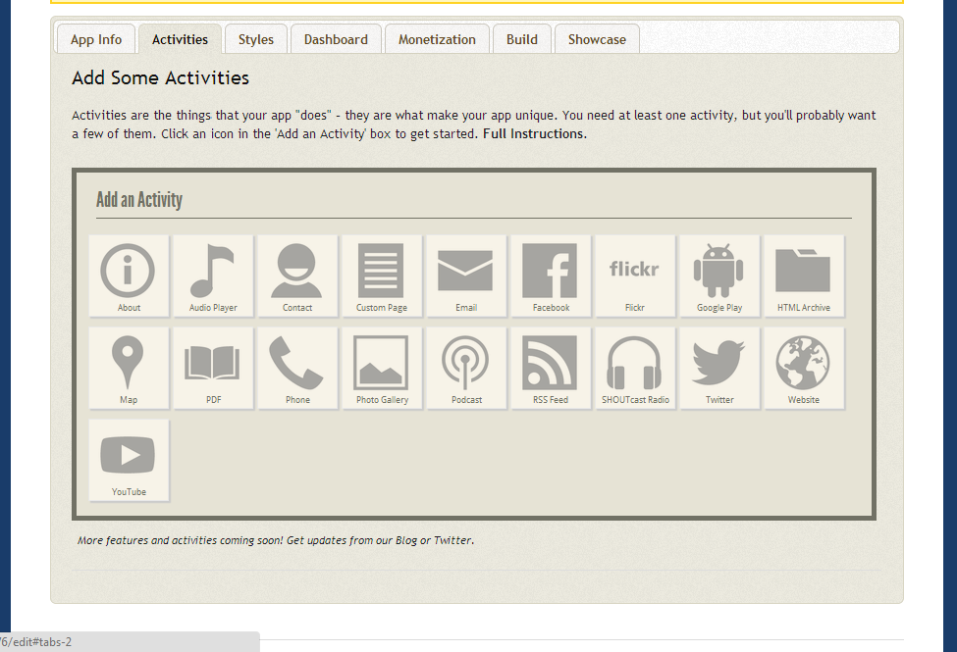
Andromo

Slide 10
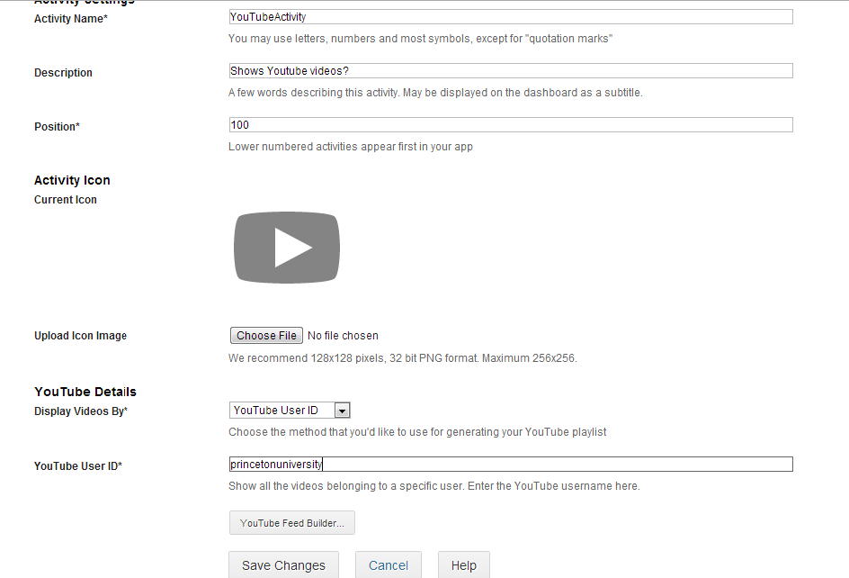
Andromo

Slide 11
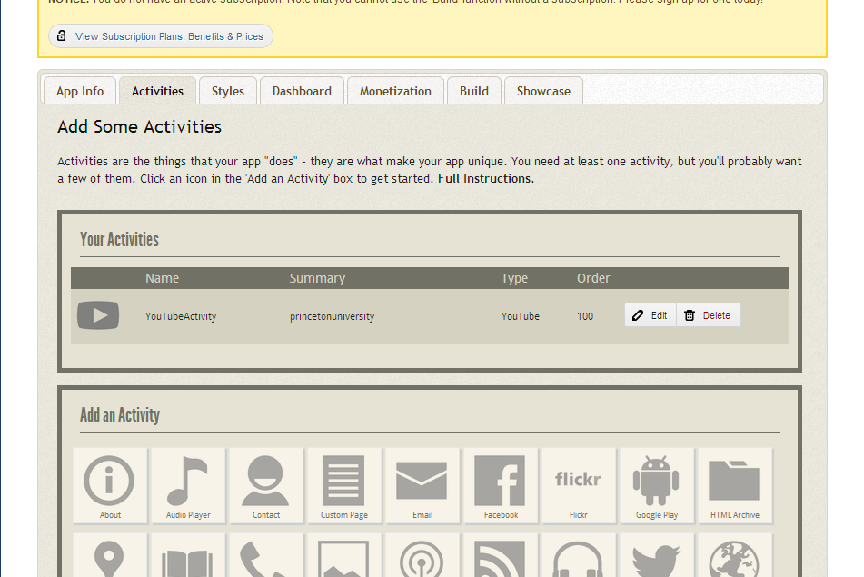
Andromo

Slide 12
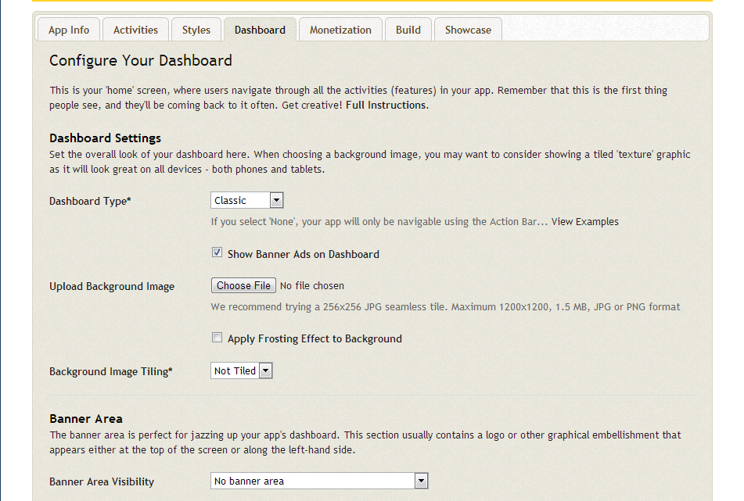
Andromo

Slide 13
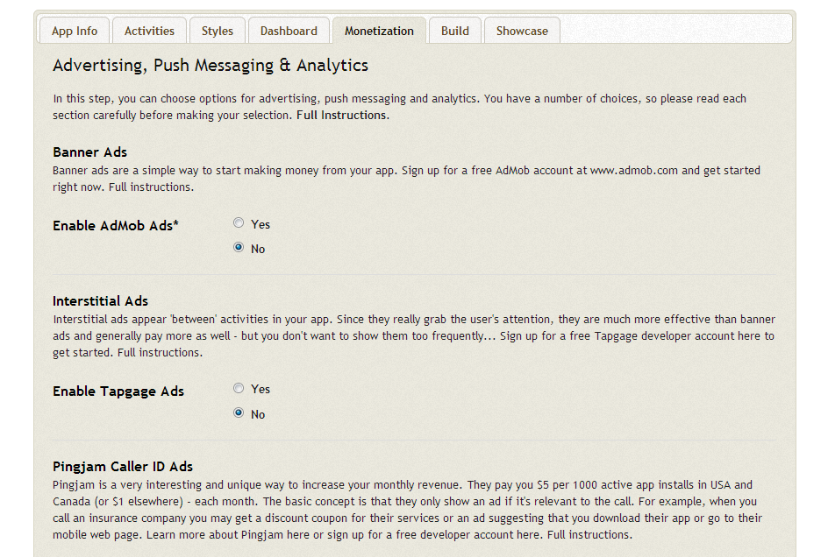
Andromo

Slide 14
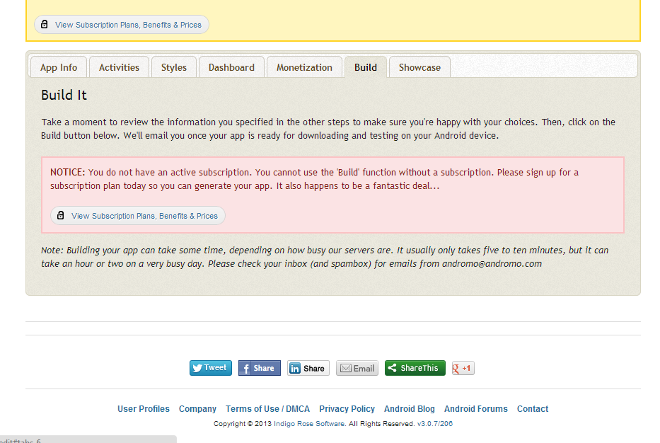
Andromo

Slide 15
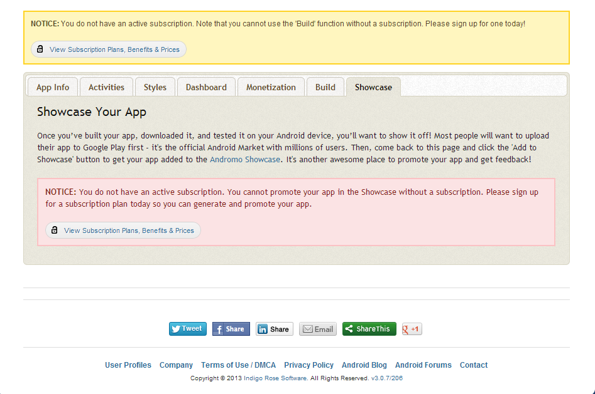
Andromo

Slide 16
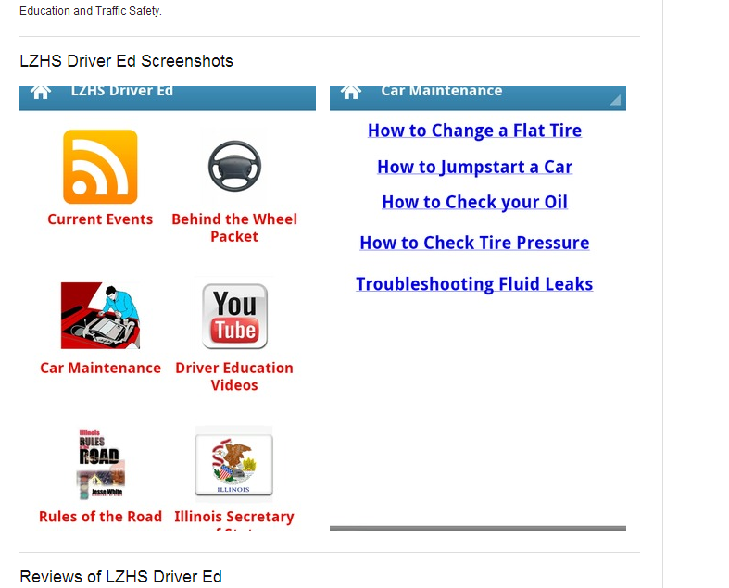
Andromo

Slide 17

So what’s my angle?
Learning aspect
A truly “customizable” app
Big gap between copy/paste “HelloAndroid” app and a real Android app.

Slide 18

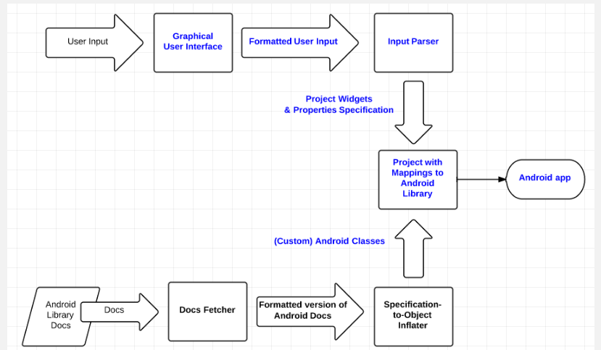
The Big Picture

Slide 19

Core Functionality
Command Line Interface
(Input Parser)
End-to-end: from user input to Android app
Be able to make Hello World or TipCalculator app, etc.

Slide 20
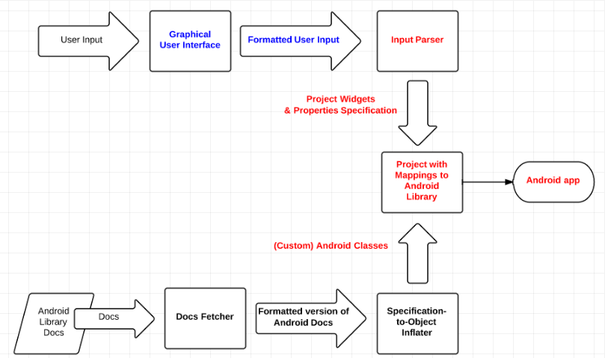
Core Functionality

Slide 21
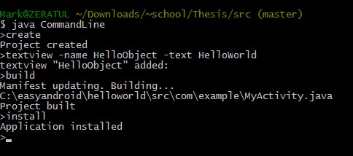
Core Functionality

Slide 22
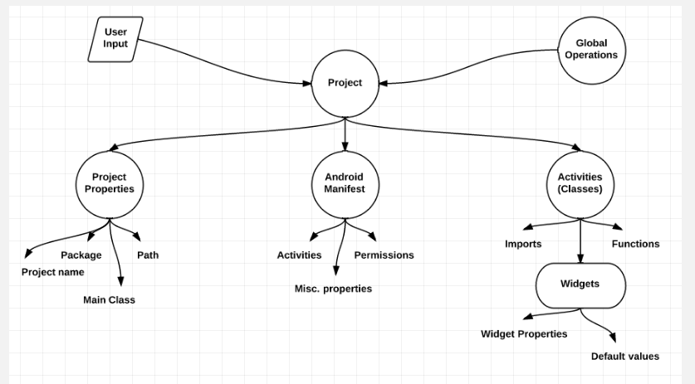
Project Structure

Slide 23
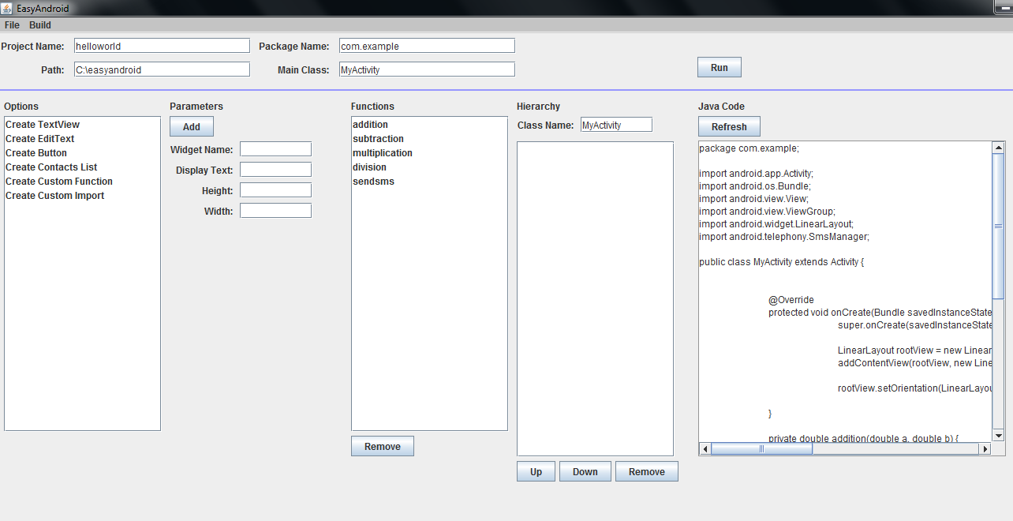
Graphical User Interface

Slide 24
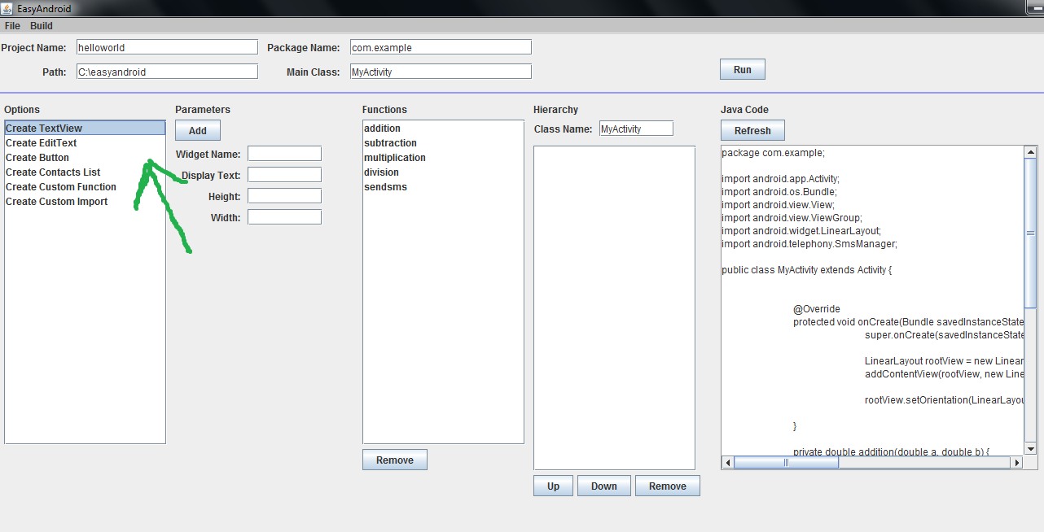
Graphical User Interface

Slide 25
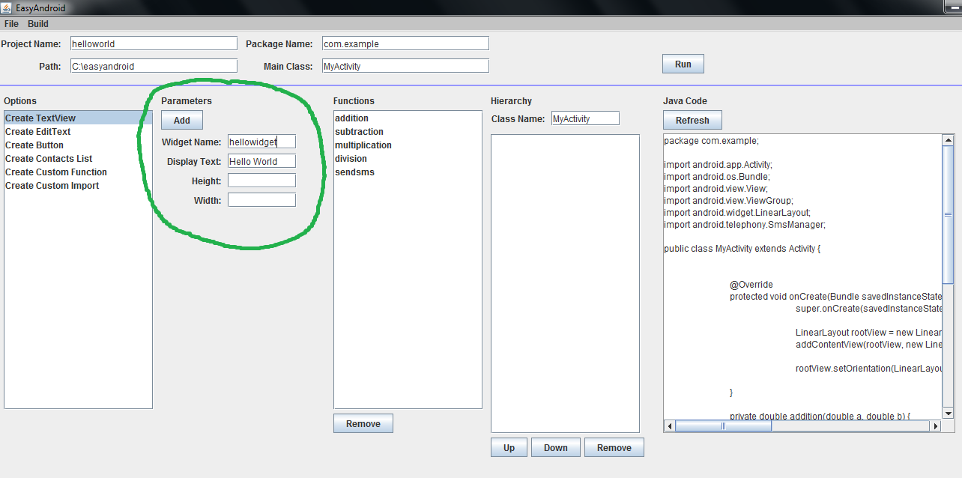
Graphical User Interface

Slide 26
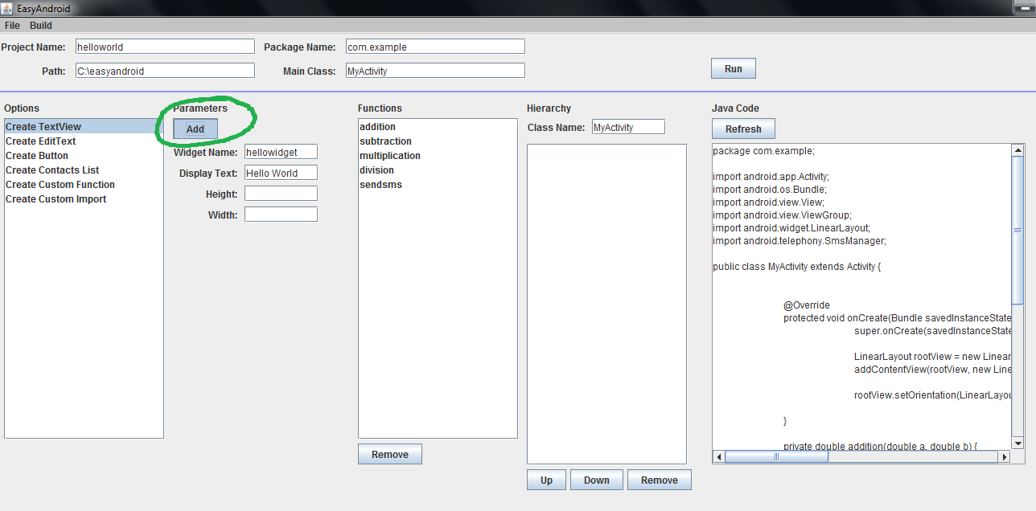
Graphical User Interface

Slide 27
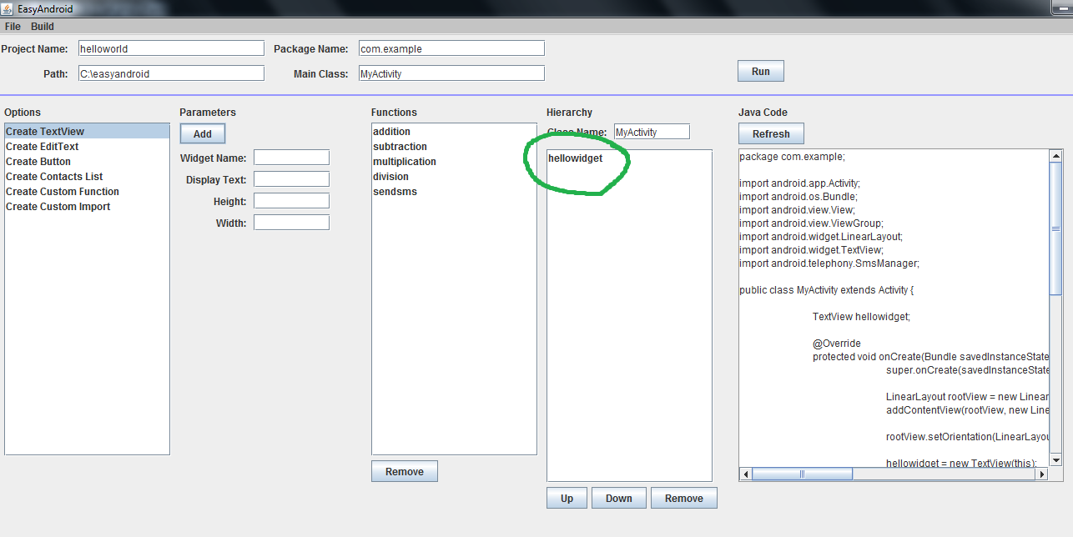
Graphical User Interface

Slide 28
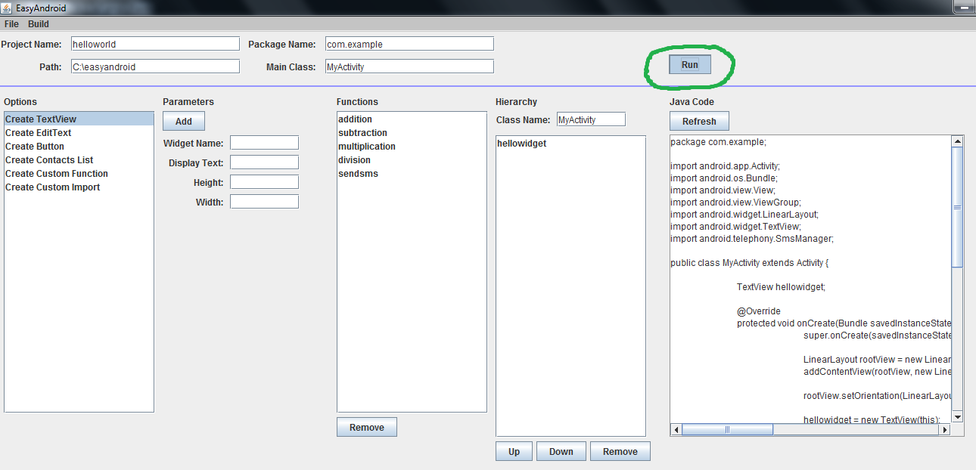
Graphical User Interface

Slide 29
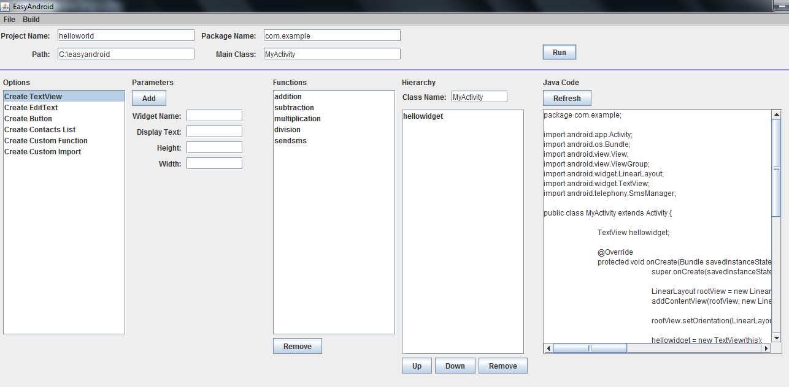
Graphical User Interface

Slide 30
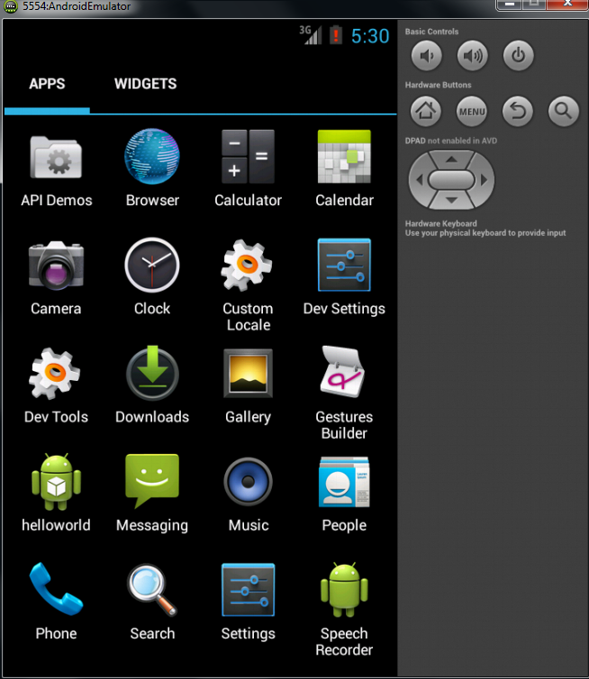
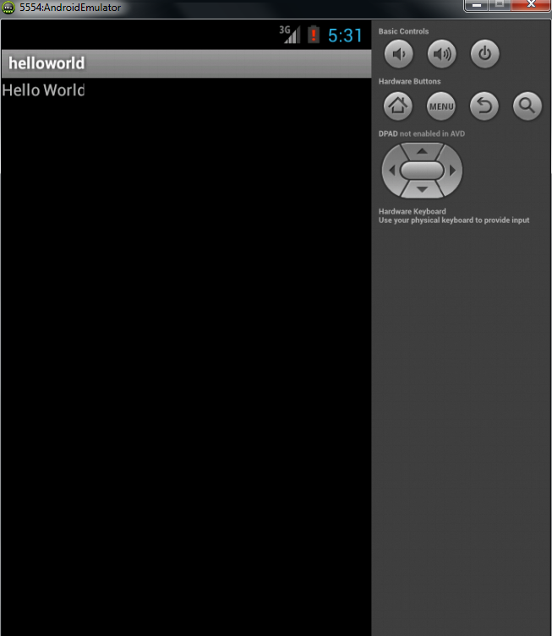
The Result

Slide 31

Evaluations
Usability Testing
Make a HelloWorld app
Then, make an app that texts yourself a hardcoded String
Then, make an app that texts yourself dynamic text, pulled from a text field (object).

Slide 32
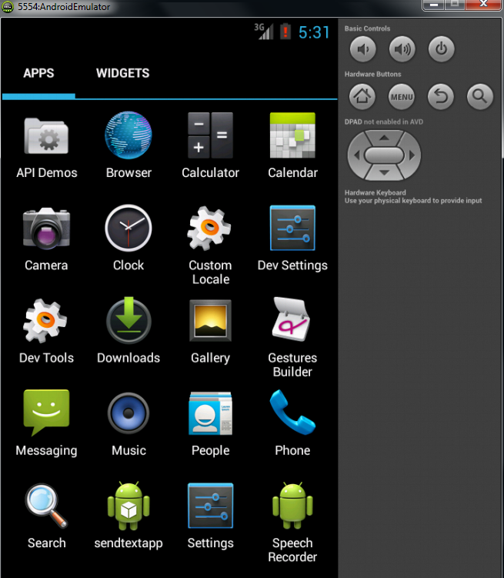
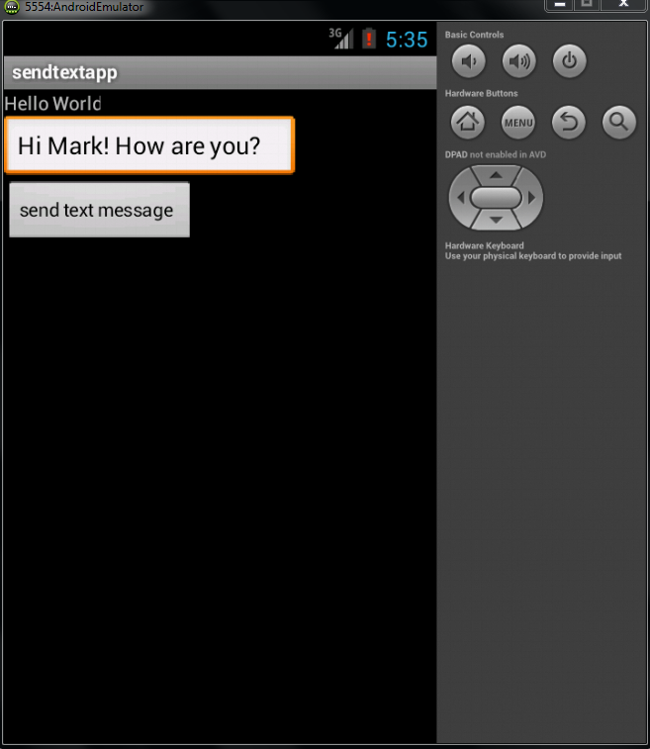
What Users Had to Build

Slide 33
Evaluations
Quantitative Results
All three tests in total took between 12 minutes and 37 minutes.
Step 1 took the longest, then Step 2, then step 3.
All positive results (rated 5 out of 5).

Slide 34
Evaluations
Takeaways
Plenty of room for improvement
Ambiguity of terminology / function
Some things hard to find
Some parts plain text, some parts Java = confusing
Still, positive responses (“I made an Android app!”)

Slide 35

Conclusion
There’s a market for this kind of this kind of programming tool.
The importance of project structure and design
The value of usability testing
“Don’t need to be a COS major to make an Android app.” – success!

Slide 36

Thanks for listening!
Questions? Comments?

