Slide 1
Development Tool for the Android Beginners
Android Development Made Simple
Mark Ha ‘13 Adviser: Brian Kernighan

Slide 2
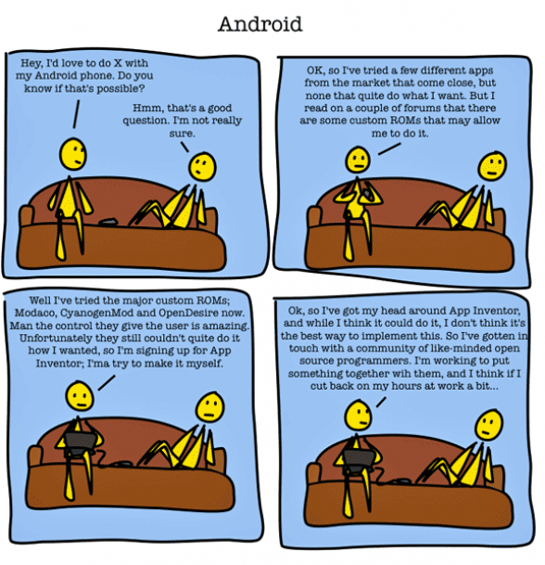
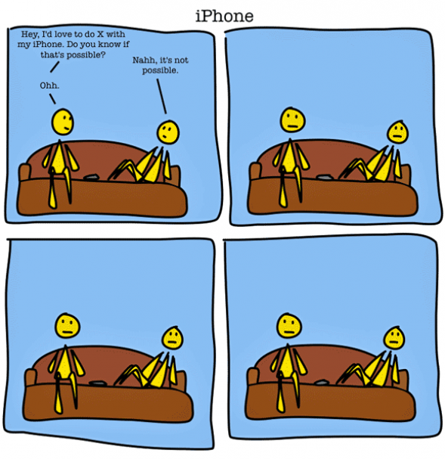
(from cubiclebot.com)

Slide 3

Motivation
Mobile is hot
“Entry” cost as an Android developer is relatively high
No good way to just “try out” Android
Working with the Android library can be a hassle

Slide 4

Related Work
App Inventor (http://appinventor.mit.edu/)
“Droid Dev”
Twill (http://twill.idyll.org)

Slide 5
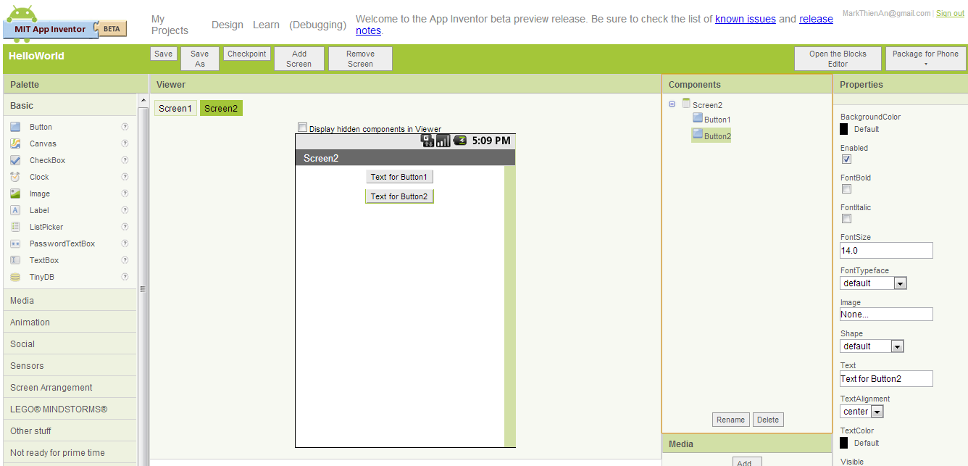
(appinventor.mit.edu)

Slide 6
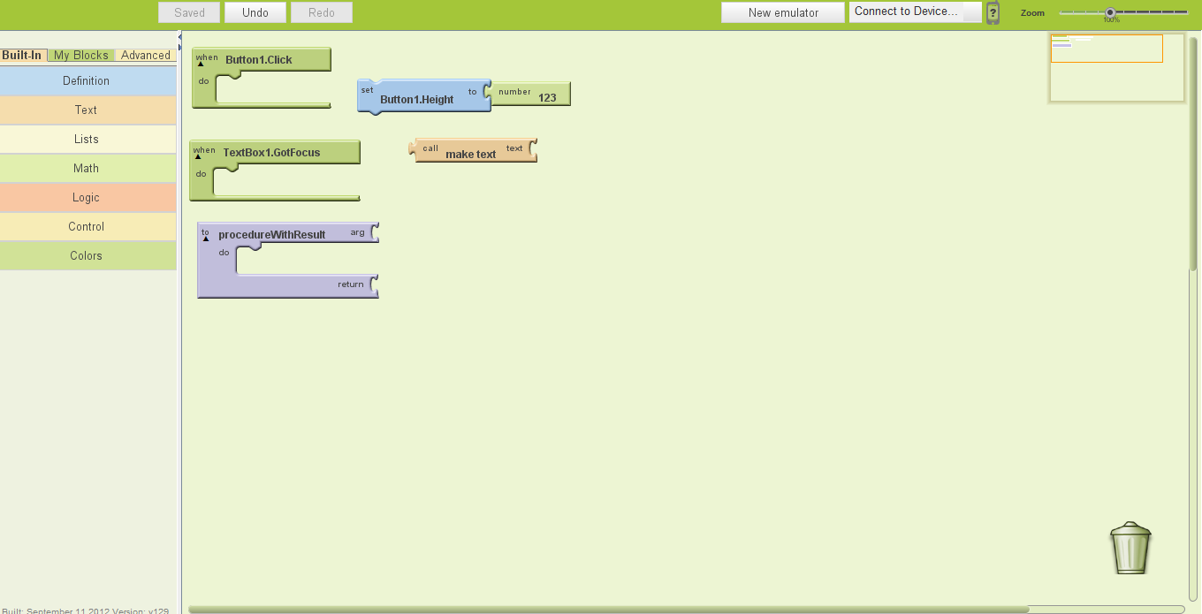
(appinventor.mit.edu)

Slide 7

Plan of Attack
Related material – how do they do it?
Core functionality first (cmd line input -> output apk) in a generalized fashion (scalability)
After that, features (ie. preview emulator screen, beginner demos, GUI)
Improve based on either user testing or experience
Repeat

Slide 8

Timeline
October: “core functionality” for 1-3 simple examples (ie. Button, text field)
November: “end to end” – from the command line to a generated apk file
December: “compile and preview” feature
January: GUI feature (as opposed to command line)
February + March: Improvements, more features TBD
April: Wrap up + Report

Slide 9

Evaluation
User tests + feedback
How many users succeed to make a simple program, and how long does it take them?
Do the users have a positive or negative experience using the tool?
How many would use it again?

Slide 10
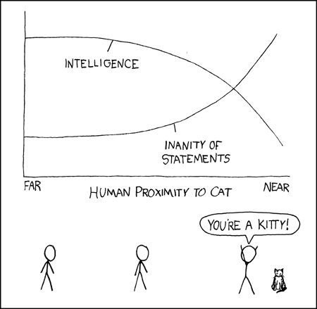
Quantifying my results
(xkcd.com)

Slide 11
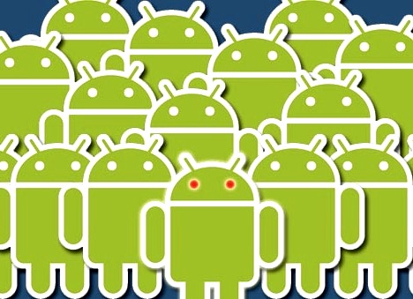
Conclusion
Getting into Android is difficult
For beginners with no Android experience, but with some programming experience.
Main functionality is to take some text input and output corresponding code/apk file

Slide 12

Thanks for listening!
Questions? Comments?

