Slide 1

IN PURSUIT OF HAPPYNESS
Navigating Life in IIT Delhi
A GAME BY :: Samyak Jain (2020CS50667) , Viraj Agashe (2020CS10567)

Slide 2

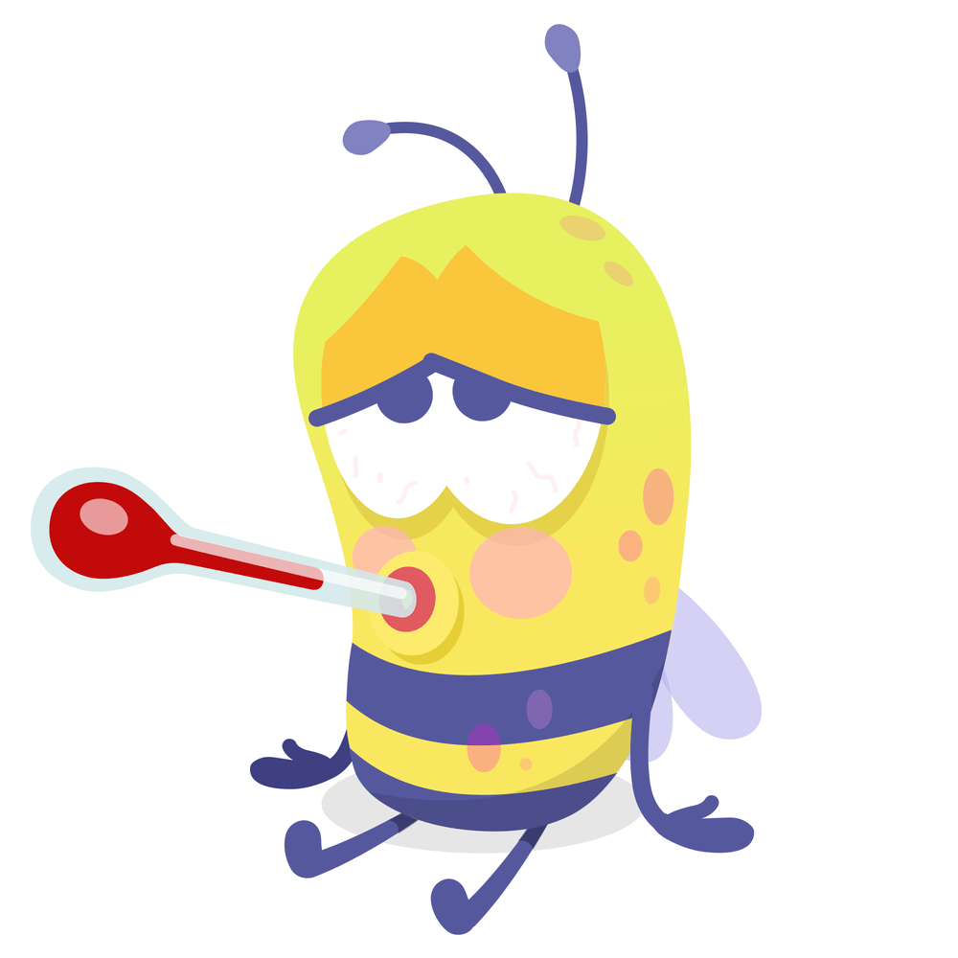


THEME OF THE GAME
It’s Rendezvous all over again! But wait, it’s not all fun and games - You’ve got a ton of responsibilities to take care of to ensure RDV’22 goes off smoothly.
Your mission, should you choose to accept it – complete the given set of tasks before the Pronite comes around, while keeping up your own happiness happyness.
Oh, and before we forget – your rival for that POR next year’s going to be trying to do so as well. Of course, you don’t want them to get all the credit for a successful RDV, do you?

Slide 3
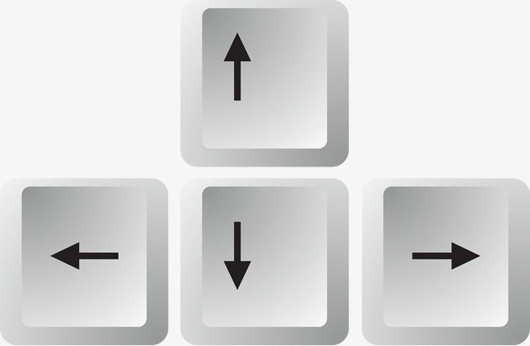










GAME CONTROLS
For Movement
(Left-Right-Up-Down)
Activate Yulu
(At Yulu Stand)
Deactivate Yulu
(At Yulu Stand)
Deactivate Yulu
(At Yulu Stand)
Eat (near restaurant)
Open Tasks
Open Inventory
Close Interfaces
Collect Item
(At Task Site)
Deposit Item
(At Task Site)
For using power ups

Slide 4
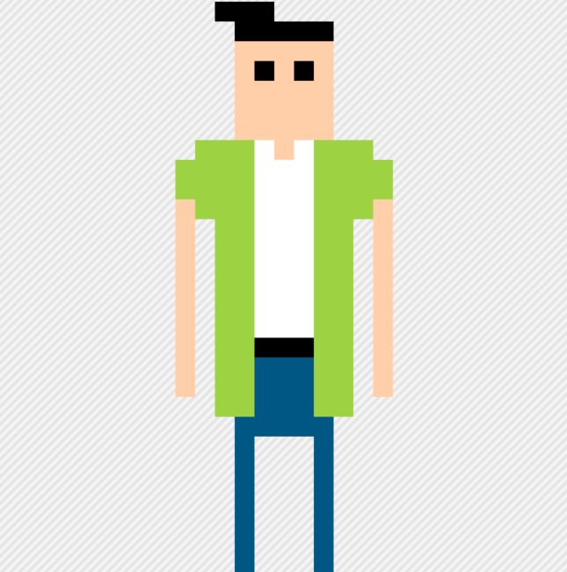
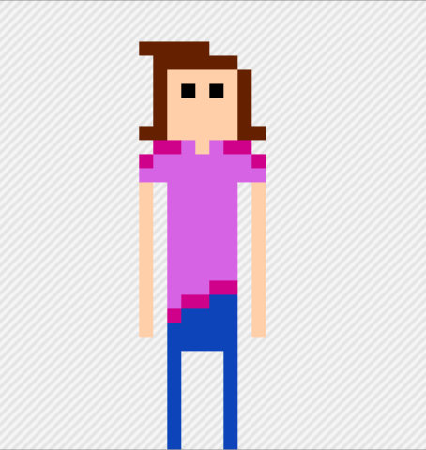
MEET THE PLAYERS
Player1
Player2

Slide 5
YOU KNOW THE RULES… (OR DO YOU?)
The game objective is simple: To maximize the overall happyness index of your player. The happyness index is a complex function of 3 parameters: Hunger, Money & Tasks Completed. It is part of the game strategy for the player to figure out how these parameters affect the happiness index and plan their strategy accordingly.
Note that whichever player has the maximum happiness after 7.5 minutes wins.
You will encounter obstacles along your way, along with many surprises… More on this later!

Slide 6
PROFESSOR AND OBSTACLES
The professor roams the campus and reduces your happiness if you encounter him. He will randomly spawn at locations across the map throughout the time of the game.
Mystery Boxes also spawn at random locations throughout the map. If you’re lucky, you’ll get a score boost. But beware, it can lead to a lot of surprises and sorrow as well…
Power Ups are rarer than mystery boxes but are also scattered throughout the map. There is a phone which you can use to ask a friend to complete one of your tasks. The teleporter can be used to mess up your opponent’s game by teleporting them to a random location. Hammer can be used to kill your opponent in case you a

Slide 7
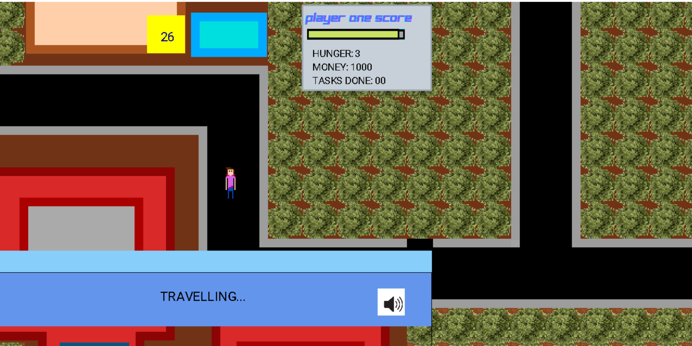
SOME SNIPPETS FROM THE GAME

Slide 8
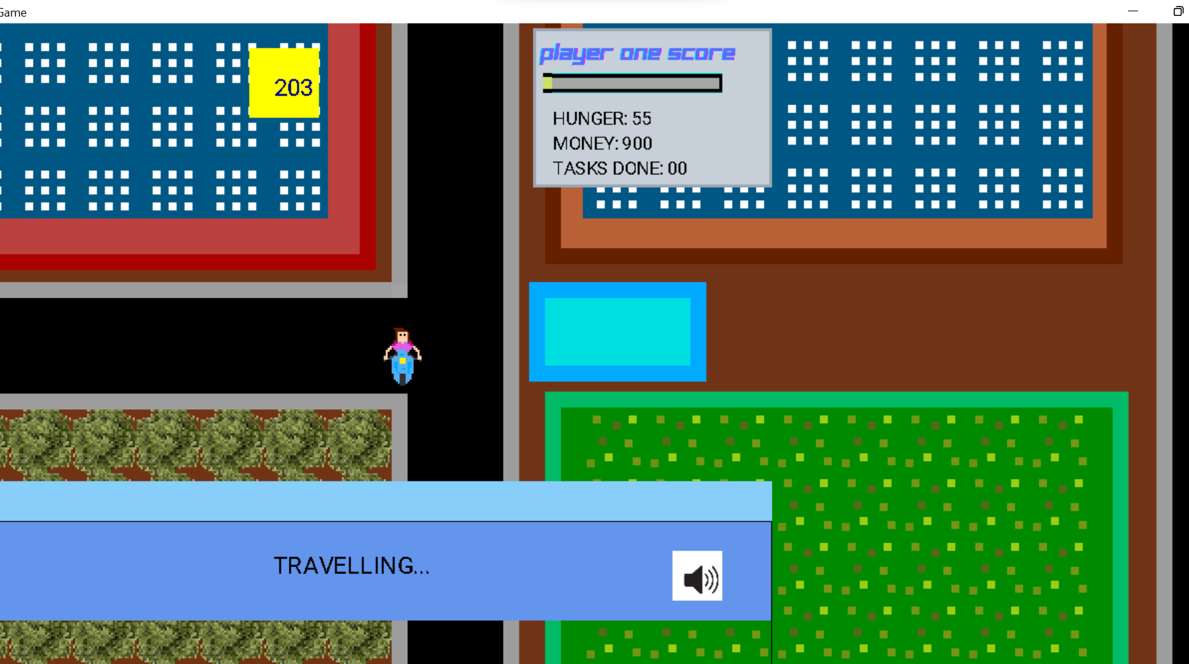
SOME SNIPPETS FROM THE GAME

Slide 9
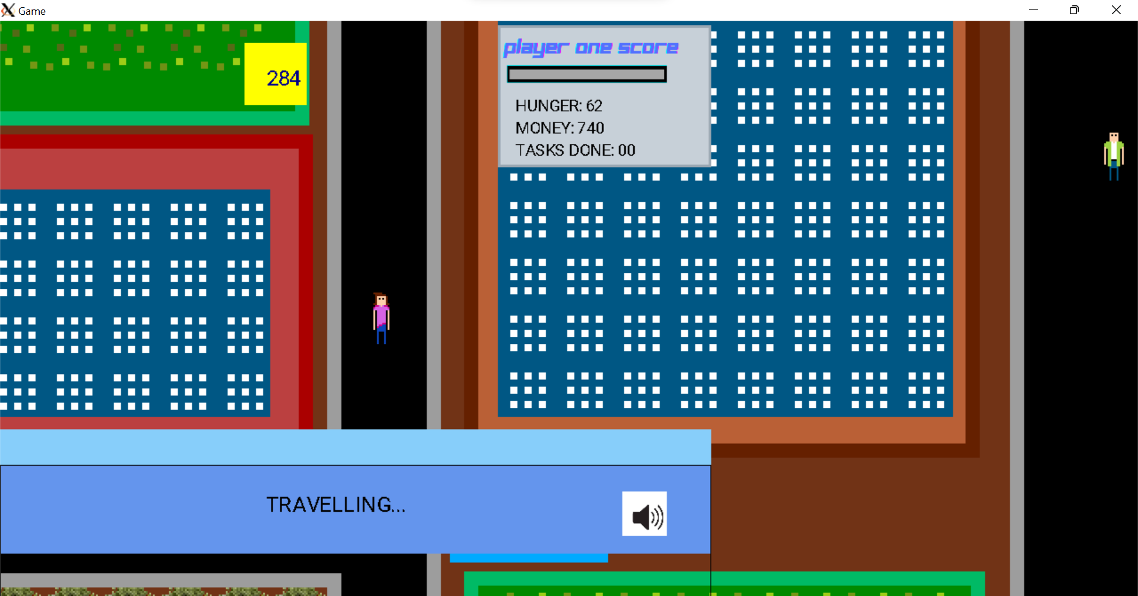
SOME SNIPPETS FROM THE GAME

Slide 10
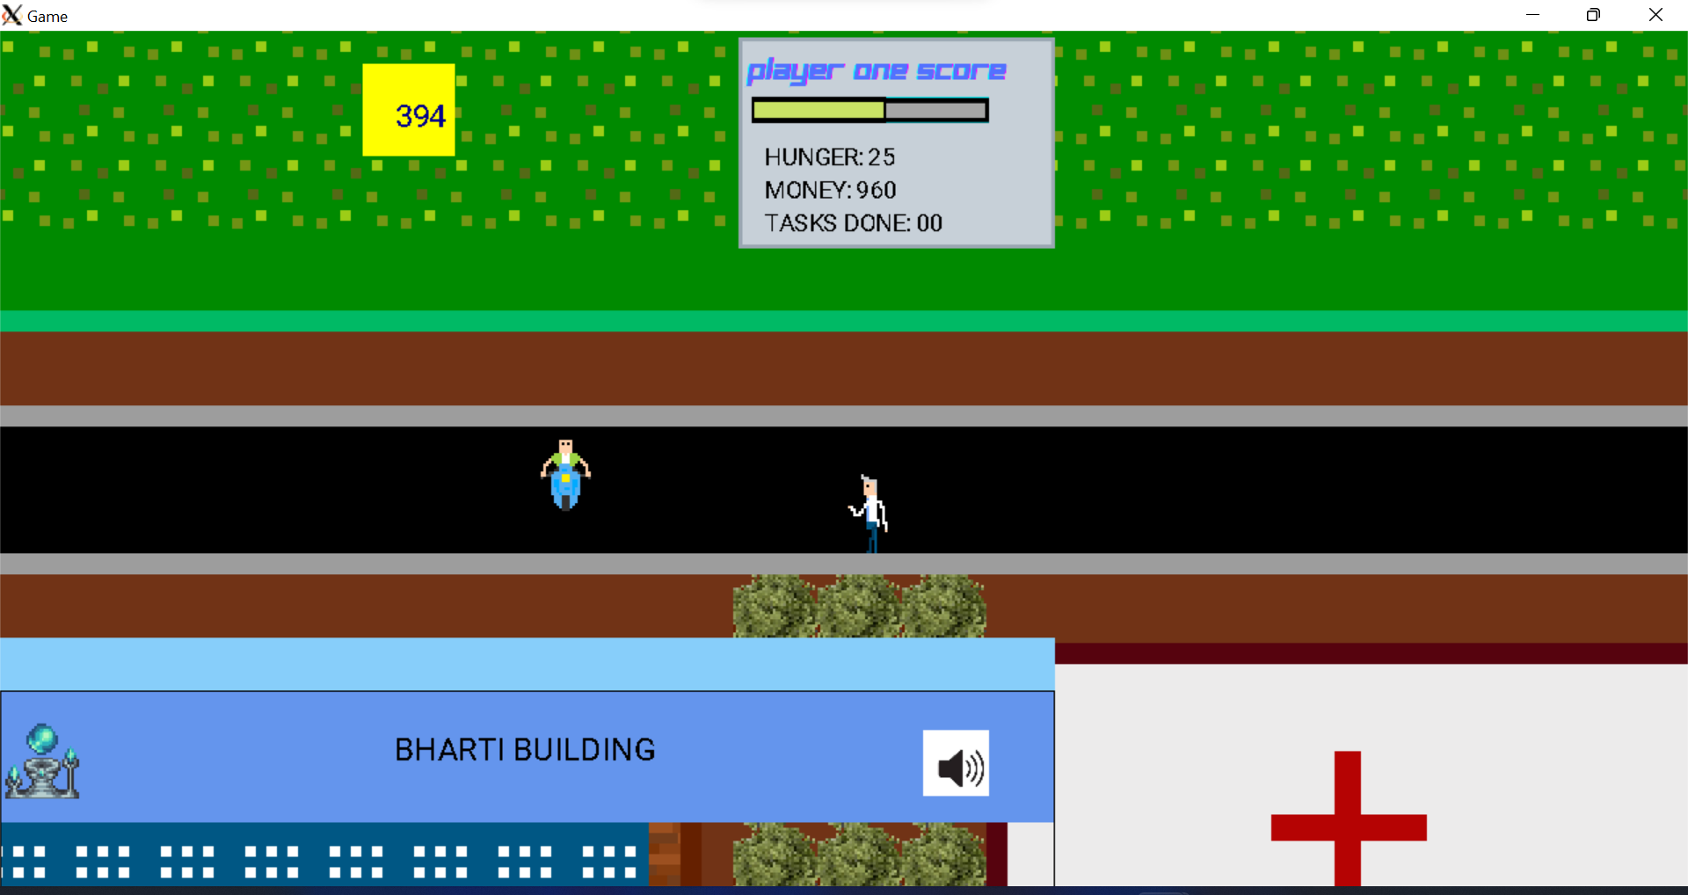
SOME SNIPPETS FROM THE GAME

Slide 11

Thank You
someone@example.com

