Slide 1

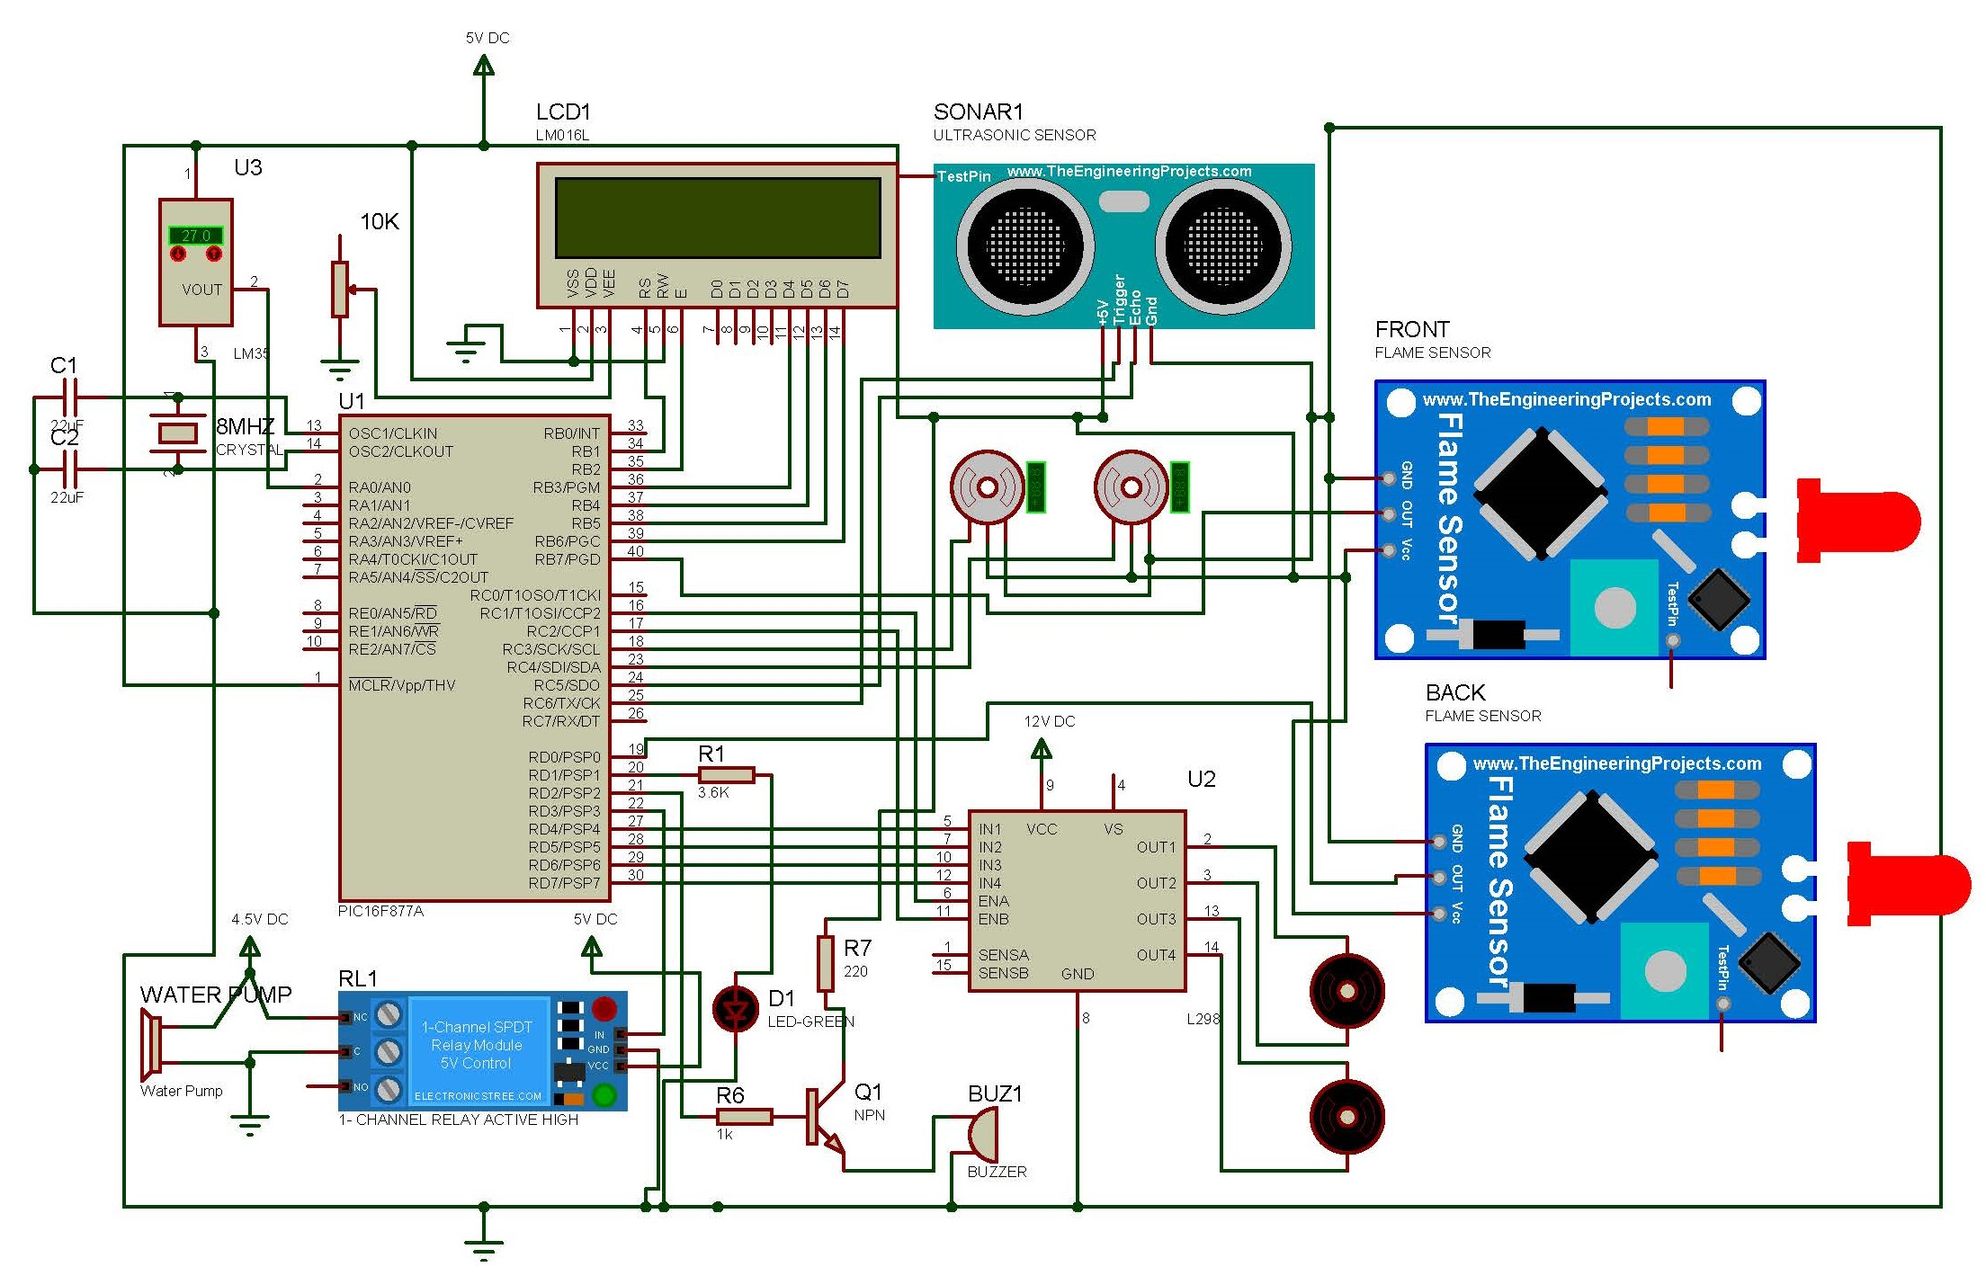
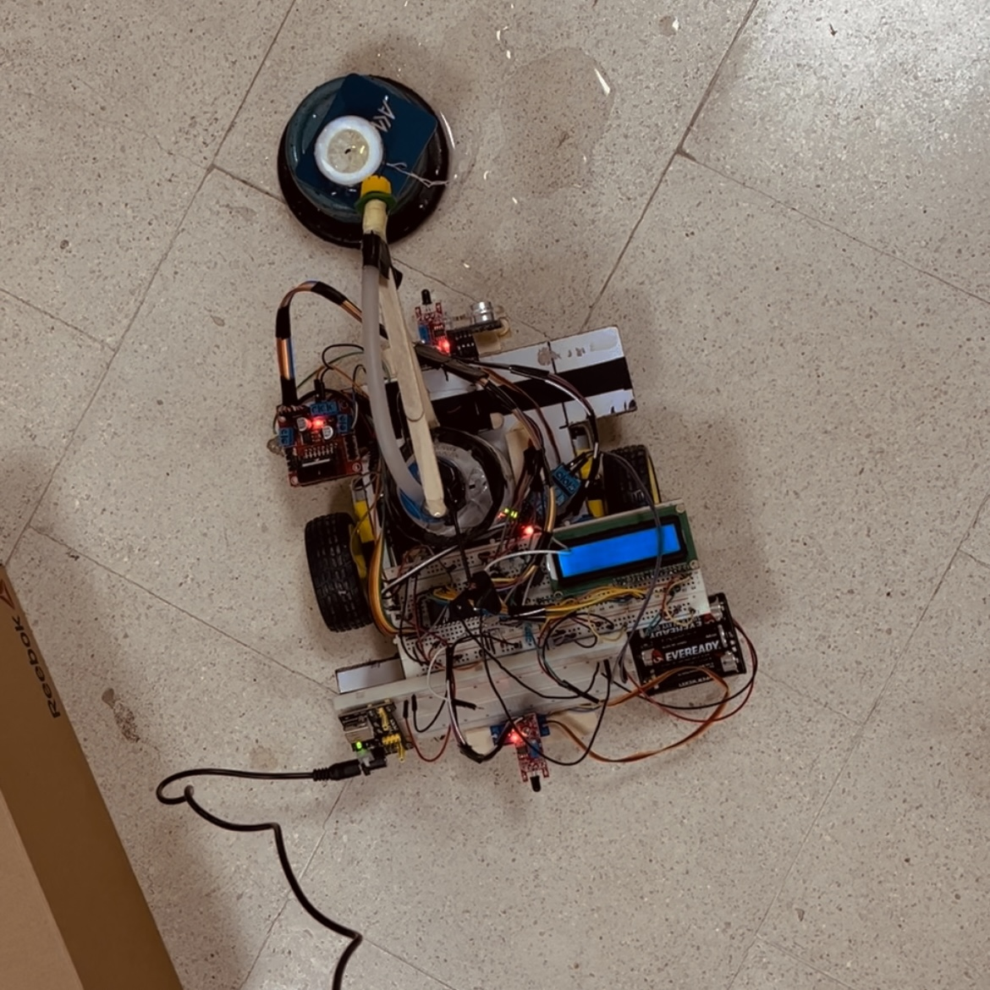
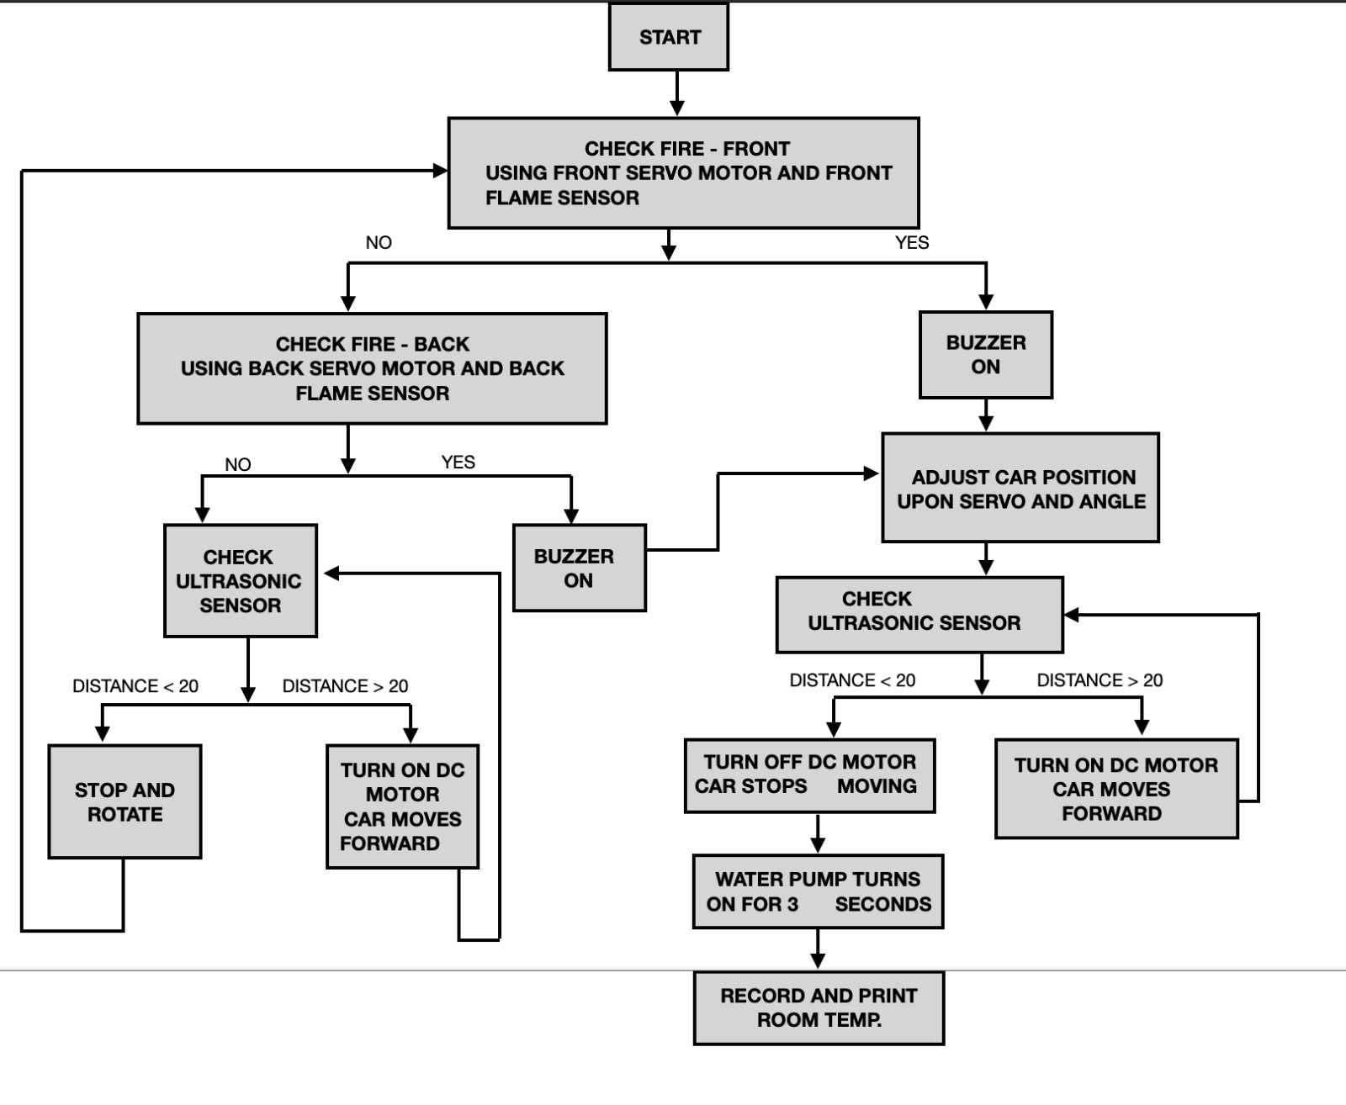
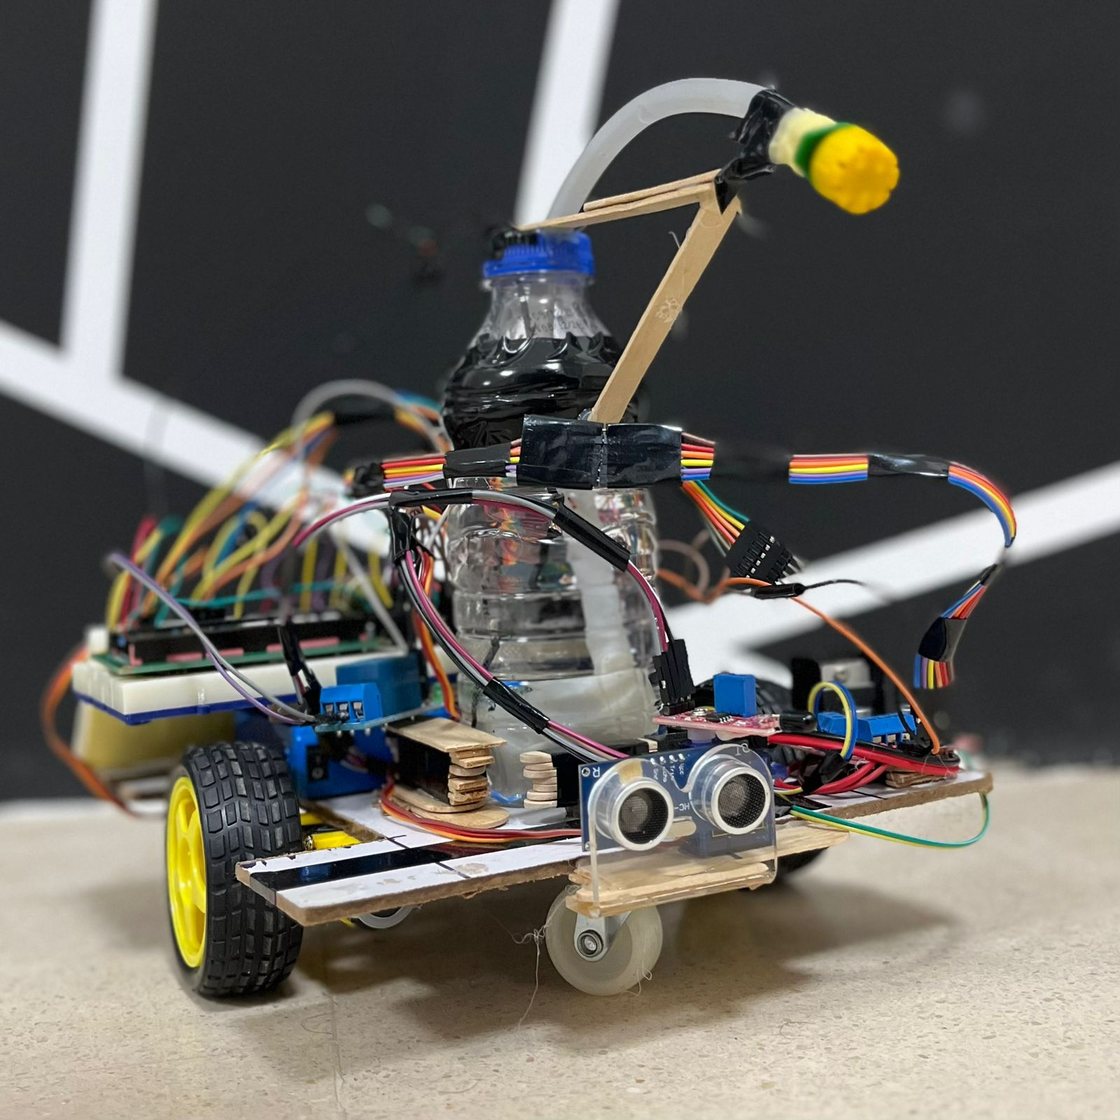
Firefighter Car using PIC16F877A Microcontroller
H. Suboh, O. Al-Haj Hasan, Z. Abu-Nijem
Supervisors: Dr. Belal Sababha & Dr. Anastasia Gharib
Embedded Systems Final Design Project, Fall 2023
King Abdullah II School of Engineering
Princess Sumaya University for Technology
Introduction
A PIC16F877A microcontroller, an ultrasonic sensor, a water pump, a DC motor, servo motors, flame sensors are used in this project to demonstrate an automated firefighting system. The technology is utilized by a mobile firefighting truck that can reach the fire scene.
This research aims to provide an efficient and automated method for controlling fires by creating a mobile firefighting unit that can arrive at the scene of the fire swiftly and effectively. Test results show that the system is capable of successfully and detecting and suppressing fire..
Results
The firefighter arrived in response to the signal from the control unit; the interruption went according to plan and extinguished the fire in the room.
Design
This project is designed as a Mobile Automated Fire-Fighting Car, Using PIC16F877a; A flame sensor mounted on a servo motor positioned at the front & another one at the back checks the whole area for fire, if the robot senses any fire in the room an alert is given, then the robot rotates & adjusts till the fire is perfectly ahead. Next, an Ultrasonic Sensor measures the distance between the fire and the robot, moves forward accordingly using the DC Motors until the Ultrasonic Sensor value falls below 20 cm. A water pump is turned ON for 3 seconds using a relay to take out the fire. At the end the Temperature Sensor displays the Room Temperature on the LCD just to indicate no fire is left in the room.
Conclusion
In summary, the firefighting robot created for this project shows how to detect and put out a fire using a PIC16F877A microcontroller, an H-bridge, a flame sensor, an ultrasonic sensor, a DC motors, and a water pump. The robot uses an ultrasonic sensor to determine its distance from the fire, and a flame sensor is utilized to determine how intense the fire is. The temperature of the surrounding air is measured using the temperature (LM35) sensor. The findings of testing the robot's capacity to recognize and put out a fire in a simulated setting show that it is capable of carrying out its intended task .The robot's software is user-friendly and effective, while its hardware is dependable and strong. The process of experimenting and testing yielded useful information on the robot's functionality and possible applications in real-world settings. The project demonstrated the possibilities of utilizing PIC16F877A microcontroller in firefighting robots and was successful in accomplishing its goals overall. The findings of this study may serve as a foundation for further advancements in the field of autonomous firefighting robots.

