Slide 1
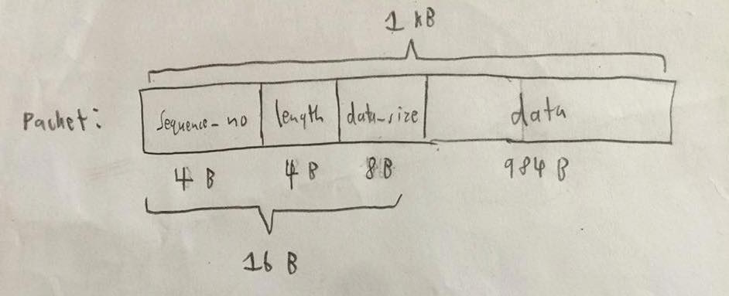
Design and Implementation
typedef struct window {
int start; // start index of the window
int window_length; // window size
int send_next; // index of what to send next
int packet_count; // number of packets in total
int* ACK; // 0 - not sent; 1 - sent but no ACK; 2 - sent
char** packets; // pointer to a packet
int end_command; // a checker for checking if we are at end of window
int* resend_command; // pointer to check if we need to resend a packet
int* timer; // keep track of remaining time for each packet
}* window_t;

