Slide 1
February 22, 2023

Slide 2

Text Classification
Text Analysis with Python series
A Reproducible Research Workshop
Simon Stone
Research Data Services
Dartmouth College

Slide 3
About the Reproducible Research Group
Joint venture of Research Computing @ ITC and Research Data Services @ Library
Consult with experts on
research data management,
data visualization,
biomedical research support,
spatial data and GIS,
high performance and research computing,
statistical analysis,
economics and social sciences data
Meet the people on campus that support your reproducible research lifecycle
Engage in community discussions to learn from other researchers on campus
Attend a workshop to learn practical tools and tips

Slide 4
About Research Data Services
Research Data Management
Data Management Plans (DMPs) for sponsored projects
Finding and using 3rd party data
Collection and cleaning of data
Organization and documentation
Publishing and Repositories
Data Analysis/Visualization
Textual, numeric, spatial data
Reproducible research workflows
Scripting in R: tidyverse core package (i.e. ggplot, dplyr, tydr, tibble, etc.)
Scripting in Python: NumPy, SciPy, Pandas, Scikit-learn, Matplotlib, Seaborn, (OpenCV, PyTorch, TensorFlow, Tesseract, NLTK, etc.)
Computational Scholarship
Computational project planning
Collections as Data
Storytelling with data and visualizations
Text and data mining
Digital Humanities support
Computational Pedagogy

Slide 5
Work with us
ResearchDataHelp@groups.dartmouth.edu
Jeremy Mikecz Research Data Science Specialist jeremy.m.mikecz@dartmouth.edu dartgo.org/jeremyappts | Simon Stone Research Data Science Specialist simon.stone@dartmouth.edu dartgo.org/meetwithsimon
Lora Leligdon Head of Research Data Services lora.c.leligdon@dartmouth.edu dartgo.org/lora

Slide 6



What is Text Classification?
accounts
cash flow
profit
Example: Assign incoming mails to the right department
How would you approach this?
Accounting
Customer Service
R&D
Document by Ali Burhan from Noun Project (CCBY3.0)
Magnifying Glass by IYIKON from Noun Project (CCBY3.0)
Inbox by Nicolas Vicent from Noun Project (CCBY3.0)

Slide 7
What is Text Classification?
Example: Assign incoming mails to the right department
How would you approach this?
Example workflow:
Define categories
Look for important terms or topics in the documents
Assign the document to a category associated with these terms or topics

Slide 8




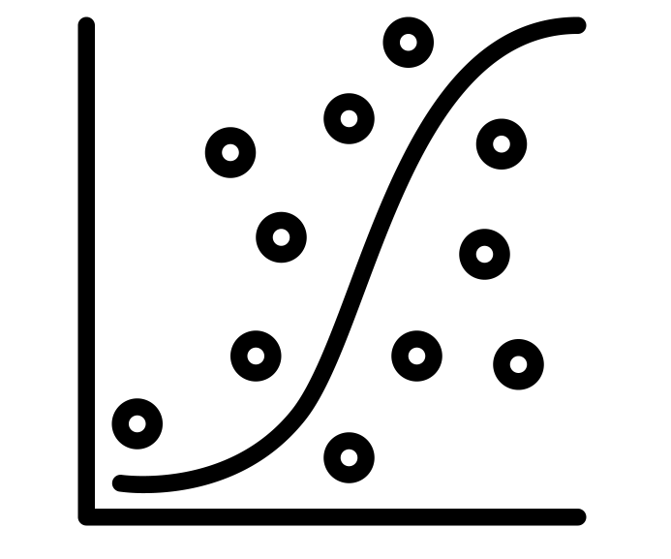
Text Classification using Machine Learning
Training:
Get a lot of categorized examples
Extract discriminative features
Train a classification model
Document by Ali Burhan from Noun Project (CCBY3.0)
Tag by andriwidodo from Noun Project (CCBY3.0)
Filter by Anuvab Sikder from Noun Project (CCBY3.0)
matrix by Jino from Noun Project (CCBY3.0)
Scatter Plot by Flowicon from Noun Project (CCBY3.0)

Slide 9
Text Classification using Machine Learning
Production:
Document of unknown category
Extract features
Feed through model to obtain label
Document by Ali Burhan from Noun Project (CCBY3.0)
Tag by andriwidodo from Noun Project (CCBY3.0)
matrix by Jino from Noun Project (CCBY3.0)
Scatter Plot by Flowicon from Noun Project (CCBY3.0)

Slide 10
What you will learn in this workshop
Basic workflow of text classification
Extract simple features to describe documents
Build and train a simple classifier
Test the classifier
Interpret the results

Slide 11




What we will work with in this workshop
We will use Python, a teeny bit of Pandas, and scikit-learn
As a programming environment, we will use our JupyterHub: https://jhub.dartmouth.edu

Slide 12
Let’s get started…

