Slide 1
2024-10-16
https://dartgo.org/ai-advanced-applications

Slide 2

AI @ Dartmouth for Research Use: Advanced Applications and Customization
Simon Stone
Research Data Services
Dartmouth Libraries

Slide 3
Goals of this session
How do ITC and the Libraries support AI at Dartmouth?
What is the high-level overview of our homegrown AI ecosystem?
How can we leverage this ecosystem to build novel applications?

Slide 4
AI user framework
Our AI support is designed around a mental framework of our Dartmouth community’s needs:
Level 1: The Consumer
Using AI through applications. This includes web interfaces, e.g. ChatGPT or Bing Image Creator, and plug-ins or integrations into other tools (e.g., Copilots in VS Code or Microsoft Outlook).
Level 2: The Integrator
Using AI through Application Programming Interfaces (APIs). This includes the integration of existing, well-defined AI tools into other applications or websites without much customization.
Level 3: The Creator
Using AI tools as building blocks that may be heavily customized and combined into new tools and applications. This may include training or fine-tuning new and existing models, as well as deploying novel tools on appropriate resources.
Note: Each user may use AI at a different level at any given time and move freely between them from use case to use case!

Slide 5
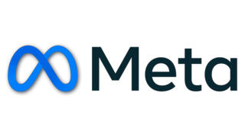






Overview of our AI ecosystem
Dartmouth Cloud
Level 1: The Consumer
RESTful interface
ai.dartmouth.edu
- tool hub
api.dartmouth.edu
chat.dartmouth.edu
open-source models
commercial models
Now Leaving
Dartmouth College
Someone else's cloud

Slide 6
Overview of our AI ecosystem
Level 2: The Integrator
Dartmouth Cloud
Level 1: The Consumer
RESTful interface
ai.dartmouth.edu
- tool hub
Documentation
api.dartmouth.edu
chat.dartmouth.edu
open-source models
commercial models
Now Leaving
Dartmouth College
Someone else's cloud

Slide 7


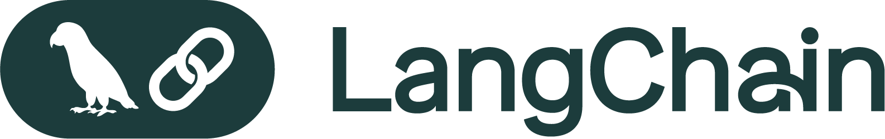
Overview of our AI ecosystem
Level 2: The Integrator
Dartmouth Cloud
Level 1: The Consumer
RESTful interface
deploy
ai.dartmouth.edu
Level 3: The Creator
- tool hub
Documentation
api.dartmouth.edu
- project showcase platform
Build your own!
chat.dartmouth.edu
open-source models
langchain_dartmouth
commercial models
Now Leaving
Dartmouth College
Someone else's cloud

Slide 8
Overview of our AI ecosystem
Dartmouth Cloud
Rollout this Fall:
Supported by training events covering all levels of use
Walk-in sessions to hear and learn from our users
Today:
Get started!
Get inspired!
Hands-on building time!
RESTful interface
deploy
ai.dartmouth.edu
- tool hub
Documentation
api.dartmouth.edu
- project showcase platform
Build your own!
chat.dartmouth.edu
open-source models
langchain_dartmouth
commercial models
Now Leaving
Dartmouth College
Someone else's cloud

Slide 9
Hands on Two sides of the same coin
Examples:
Basic prompting
System message
Multiple models
Text transformation
Basic RAG: Website and YouTube video
Tools:
chat.dartmouth.edu: No code, great for one-off tasks
langchain_dartmouth: Python code, great for automated processing at scale
Both use the same models and infrastructure!

Slide 10
Wrap-up
Any experiences, feedback, or comments to share?
More documentation and examples:
https://dartmouth-libraries.github.io/langchain-dartmouth/
https://dartmouth-libraries.github.io/langchain-dartmouth-cookbook

Slide 11
Summary
Dartmouth’s own AI ecosystem is a real alternative to commercial offerings
Infrastructure, tools, and expertise are available through Research Computing and the Dartmouth Libraries
We aim to support the widest possible spectrum of users and use cases
Talk to us:
research.computing@dartmouth.edu
researchdatahelp@groups.dartmouth.edu

Slide 12
Thank you

