Slide 1
October 9, 2023

Slide 2

Let there be Data! APIs in Python
A Reproducible Research Workshop
Simon Stone
Research Data Services
Dartmouth College

Slide 3
About the Reproducible Research Group
Joint venture of Research Computing @ ITC and Research Data Services @ Library
Consult with experts on
research data management,
data visualization,
biomedical research support,
spatial data and GIS,
high performance and research computing,
statistical analysis,
economics and social sciences data
Meet the people on campus that support your reproducible research lifecycle
Engage in community discussions to learn from other researchers on campus
Attend a workshop to learn practical tools and tips

Slide 4
About Research Data Services
Research Data Management
Data Management Plans (DMPs) for sponsored projects
Finding and using 3rd party data
Collection and cleaning of data
Organization and documentation
Publishing and Repositories
Data Analysis/Visualization
Textual, numeric, spatial data
Reproducible research workflows
Scripting in R: tidyverse core package (i.e. ggplot, dplyr, tydr, tibble, etc.)
Scripting in Python: NumPy, SciPy, Pandas, Scikit-learn, Matplotlib, Seaborn, (OpenCV, PyTorch, TensorFlow, Tesseract, NLTK, etc.)
Computational Scholarship
Computational project planning
Collections as Data
Storytelling with data and visualizations
Text and data mining
Digital Humanities support
Computational Pedagogy

Slide 5
Work with us
ResearchDataHelp@groups.dartmouth.edu
Jeremy Mikecz Research Data Science Specialist jeremy.m.mikecz@dartmouth.edu dartgo.org/jeremyappts | Simon Stone Research Data Science Specialist simon.stone@dartmouth.edu dartgo.org/meetwithsimon
Lora Leligdon Head of Research Data Services lora.c.leligdon@dartmouth.edu dartgo.org/lora

Slide 6
What is an API?
API stands for Application Programming Interface

Slide 7
What is an interface? (in software design)
A piece of software can be thought of in two parts:
How it does what it does (the implementation)
What the user of the software needs to put in and what they can get out (the interface)
The implementation rarely matters to a user
The interface is all we need to know to use the software
The implementation may change, as long as the interface stays the same
The interface is a contract between the program and the user

Slide 8
What is an interface? (in software design)
Interface
Example:
print(*objects, sep=' ', end='\n', file=None, flush=False)
Print objects to the text stream file, separated by sep and followed by end. sep, end, file, and flush, if present, must be given as keyword arguments.
All non-keyword arguments are converted to strings like str() does and written to the stream, separated by sep and followed by end. Both sep and end must be strings; they can also be None, which means to use the default values. If no objects are given, print() will just write end.
The file argument must be an object with a write(string) method; if it is not present or None, sys.stdout will be used. Since printed arguments are converted to text strings, print() cannot be used with binary mode file objects. For these, use file.write(...) instead.
Output buffering is usually determined by file. However, if flush is true, the stream is forcibly flushed.
Changed in version 3.3: Added the flush keyword argument.
Source: https://docs.python.org/3/library/functions.html#print
No imple-mentation details!
Description of the interface
Notification of a change in the “contract”

Slide 9
What is an API?
API stands for Application Programming Interface
It allows us to use someone else’s “code blocks” to build applications/programs/scripts
Many APIs are used to bring in functionality (e.g., processing images)
Here, we will focus on APIs that are used to bring in data!

Slide 10
Why use an API over the web?
An API lets us search, filter, query, and retrieve data using someone else’s code
Such an API is usually used via the internet (a Web API):
Only download the data you actually want
Data is always current

Slide 11
What you will learn in this workshop
How does software communicate via the web
What is a RESTful web API
How do you use a RESTful web API
What is an API wrapper
How using a Python wrapper can make your life easier

Slide 12
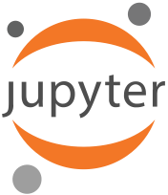

What we will work with in this workshop
Platform: https://jhub.Dartmouth.edu
Python
Materials: www.dartgo.org/rr-apis-in-python

Slide 13
Let’s get started…

Slide 14
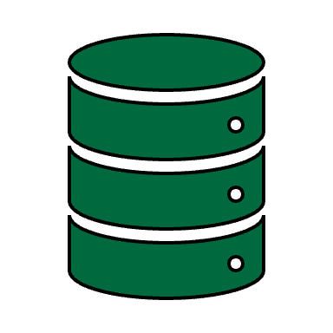

RESTful communication on the internet
REpresentational State Transfer (REST)
A way to structure network-based applications
An application is RESTful, if:
Resources are being transferred (e.g., a web page, images, list of names, sensor data, …)
The user interacts with the application using a limited set of actions
The application is stateless
I have data!
Can I have some?
Here you go!

Slide 15
RESTful communication on the internet
REpresentational State Transfer (REST)
A way to structure network-based applications
An application is RESTful, if:
Resources are being transferred (e.g., a web page, images, list of names, sensor data, …)
The user interacts with the application using a limited set of actions
The application is stateless
Has resources
Stateless
Actions
request
response
HyperText Transfer Protocol (HTTP)
The protocol governing communication on the web
A (mostly) RESTful application

Slide 16
Let’s see that in action…

Slide 17
Takeaways
APIs are a great way to automate data retrieval
APIs allow specific and structured data access (cf. scraping)
If a Python wrapper is available, we can write clear, concise, and reproducible code
Whenever you need data from a source on the web:
Check if it offers an API
Check if there is a Python wrapper

Slide 18
Next steps
Try things!
NASA: https://api.nasa.gov/
ChatGPT: https://github.com/openai/openai-python
Spotify: https://spotipy.readthedocs.io/
Web of Science: https://researchguides.dartmouth.edu/c.php?g=59725&p=9910244

Slide 19
Thank you.

