Slide 1
December 1, 2023

Slide 2

Next Steps Computational Text Analysis Week
A Reproducible Research Workshop
Simon Stone
Research Data Services
Dartmouth College

Slide 3
You made it!
Three days of intense Python taming and Text Analysis are behind you!
Where to go from here?

Slide 4
Code local!
Dartmouth’s JupyterHub is a great place to teach, but:
Computational resources and storage space are limited
Working with datasets can get tedious (uploading and managing files)
The Hub gets regularly reset to “factory settings” at the end of a term
For your own projects, we recommend working on your own computer
The following slides will walk you through our recommended setupTM

Slide 5
Steps
The Python interpreter and standard libraries
A code editor: Visual Studio Code
Support for Jupyter notebooks
A well-organized project folder
???
Success!

Slide 6
Python interpreter and standard library
Python is available in many distributions
Anaconda, for example, bundles many third-party data science libraries and some additional tools with the official basic Python
To get started, we recommend against using such bundles:
They can contain a lot of advanced features or libraries you may not need (Anaconda: 5 GB versus “vanilla” Python: 0.09 GB)
They can make it more difficult to understand your programming environment
Note: If you already have Anaconda installed and are comfortable using it, that’s great, too!

Slide 7
Python interpreter and standard library
Download the official Python distribution for your system:
https://www.python.org/downloads/
Consider using one version older than the most recent one
For example, use 3.11 instead of 3.12 (as of December 2023)
Not all third-party libraries may have already been made compatible with a brand-new version of Python
Install as normal for your system

Slide 8
A code editor: Visual Studio Code
A code editor is a text editor with coding-related superpowers
Many such editors are available for Python (Spyder, PyCharm, …)
Our recommendation: Visual Studio Code
Free, open-source
Huge user base
Modular design using extensions (“There is an extension for that!”)
Simple to use, yet many powerful (but entirely optional) features

Slide 9
A code editor: Visual Studio Code
Download the version for your system from the official website:
https://code.visualstudio.com/
Install as normal for your system
Open VS Code from your applications menu (or desktop shortcut)

Slide 10
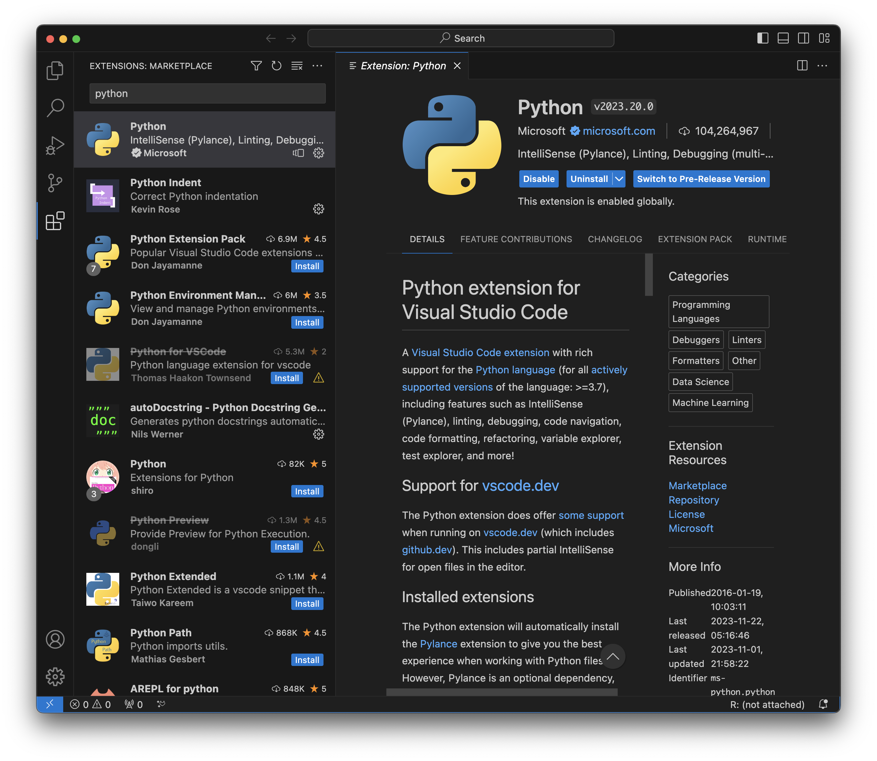
Support for Python and Jupyter notebooks
Go to the Extensions tab
Search for “python”
Install the Python extension (by Microsoft)
Search for “jupyter”
Install the Jupyter extension

Slide 11
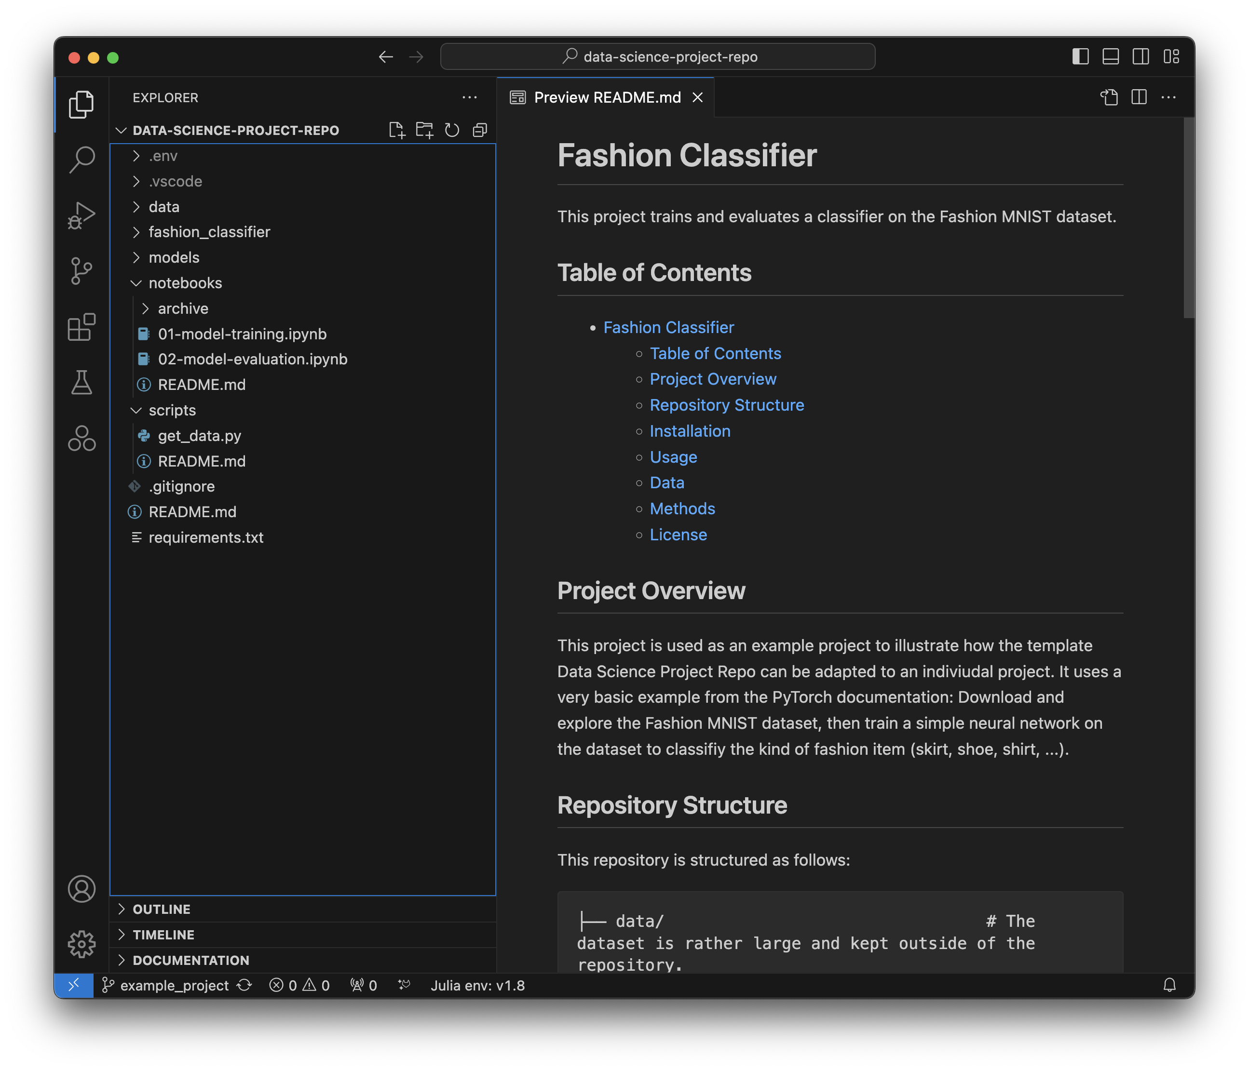
A well-organized project folder
Subfolder
Notebooks
Project folder
VS Code works best if you use a dedicated project folder:
Create a folder for your project
Open the folder in VS Code
File -> Open Folder
Create subfolders and code files as required
Example: https://dartgo.org/rds-example-project

Slide 12
More next steps
Setting up a virtual environment for your project
Debugging Python in VS Code (watch this space for an upcoming workshop on this topic!)
Automatically format your code (and flag potential problems)
More on our Research Guide

Slide 13
About the Reproducible Research Group
Joint venture of Research Computing @ ITC and Research Data Services @ Library
Consult with experts on
research data management,
data visualization,
biomedical research support,
spatial data and GIS,
high performance and research computing,
statistical analysis,
economics and social sciences data
Meet the people on campus that support your reproducible research lifecycle
Engage in community discussions to learn from other researchers on campus
Attend a workshop to learn practical tools and tips

Slide 14
About Research Data Services
Research Data Management
Data Management Plans (DMPs) for sponsored projects
Finding and using 3rd party data
Collection and cleaning of data
Organization and documentation
Publishing and Repositories
Data Analysis/Visualization
Textual, numeric, spatial data
Reproducible research workflows
Scripting in R: tidyverse core package (i.e. ggplot, dplyr, tydr, tibble, etc.)
Scripting in Python: NumPy, SciPy, Pandas, Scikit-learn, Matplotlib, Seaborn, (OpenCV, PyTorch, TensorFlow, Tesseract, NLTK, etc.)
Computational Scholarship
Computational project planning
Collections as Data
Storytelling with data and visualizations
Text and data mining
Digital Humanities support
Computational Pedagogy

Slide 15
Work with us
ResearchDataHelp@groups.dartmouth.edu
Jeremy Mikecz Research Data Science Specialist jeremy.m.mikecz@dartmouth.edu dartgo.org/jeremyappts | Simon Stone Research Data Science Specialist simon.stone@dartmouth.edu dartgo.org/meetwithsimon
Lora Leligdon Head of Research Data Services lora.c.leligdon@dartmouth.edu dartgo.org/lora

Slide 16
Thank you! https://www.library.dartmouth.edu/research-data-services

