Slide 1
February 12, 2024

Slide 2

Data Visualization in Python: Matplotlib
A Reproducible Research Workshop
Simon Stone
Research Data Services
Dartmouth College

Slide 3
About the Reproducible Research Group
Joint venture of Research Computing @ ITC and Research Data Services @ Library
Consult with experts on
research data management,
data visualization,
biomedical research support,
spatial data and GIS,
high performance and research computing,
statistical analysis,
economics and social sciences data
Meet the people on campus that support your reproducible research lifecycle
Engage in community discussions to learn from other researchers on campus
Attend a workshop to learn practical tools and tips

Slide 4
About Research Data Services
Research Data Management
Data Management Plans (DMPs) for sponsored projects
Finding and using 3rd party data
Collection and cleaning of data
Organization and documentation
Publishing and Repositories
Data Analysis/Visualization
Textual, numeric, spatial data
Reproducible research workflows
Scripting in R: tidyverse core package (i.e. ggplot, dplyr, tydr, tibble, etc.)
Scripting in Python: NumPy, SciPy, Pandas, Scikit-learn, Matplotlib, Seaborn, (OpenCV, PyTorch, TensorFlow, Tesseract, NLTK, etc.)
Computational Scholarship
Computational project planning
Collections as Data
Storytelling with data and visualizations
Text and data mining
Digital Humanities support
Computational Pedagogy

Slide 5
Work with us
ResearchDataHelp@groups.dartmouth.edu
Jeremy Mikecz Research Data Science Specialist jeremy.m.mikecz@dartmouth.edu dartgo.org/jeremyappts | Simon Stone Research Data Science Specialist simon.stone@dartmouth.edu dartgo.org/meetwithsimon
Lora Leligdon Head of Research Data Services lora.c.leligdon@dartmouth.edu dartgo.org/lora

Slide 6






The Data Visualization Ecosystem in Python
Tabular data
Geospatial data
Dashboards
Folium
and many, many more…

Slide 7
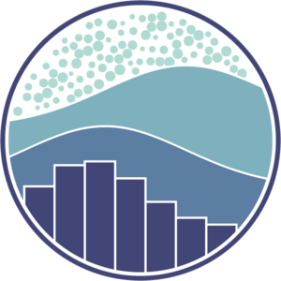
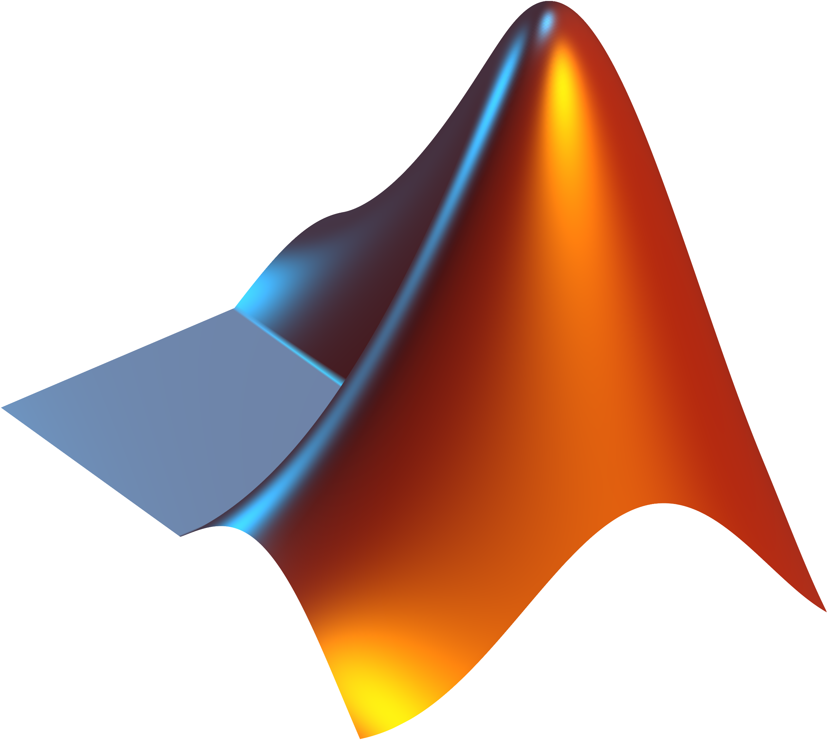
Matplotlib is…
…a Python library for creating static, animated, and interactive visualizations.
…designed after MATLAB’s plotting interface (hence the name).
…an extremely popular choice for scientific, publication-ready visualizations.
…versatile, efficient, and performant.
…used by other visualization libraries “under the hood” (e.g., seaborn).
…starting to show its age a little bit and can be a bit bland (sometimes verbose interface, not great for dashboarding).

Slide 8
What you will learn in this workshop
How matplotlib is organized
How to get started with matplotlib’s interface(s)
How to compose a visualization
How to choose the right kind of plot for your data

Slide 9
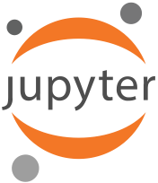
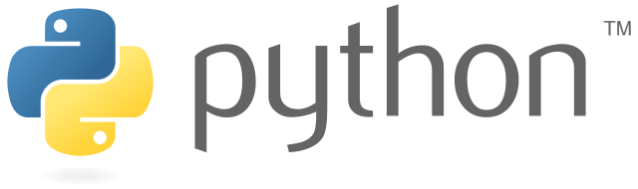
What we will work with in this workshop
Platform: https://jhub.Dartmouth.edu
Python
matplotlib
Materials: www.dartgo.org/rr-matplotlib

Slide 10
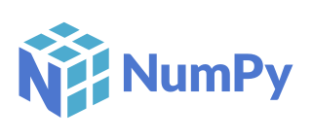
What we will not work with in this workshop
Matplotlib is ideally used together with NumPy
Numpy is a Python library for numerical computing (arrays, matrices, lots of fancy math)
Here, we want to focus on matplotlib itself and will thus only use Python’s built-in list type as our data structure

Slide 11
Let’s start plotting…

Slide 12
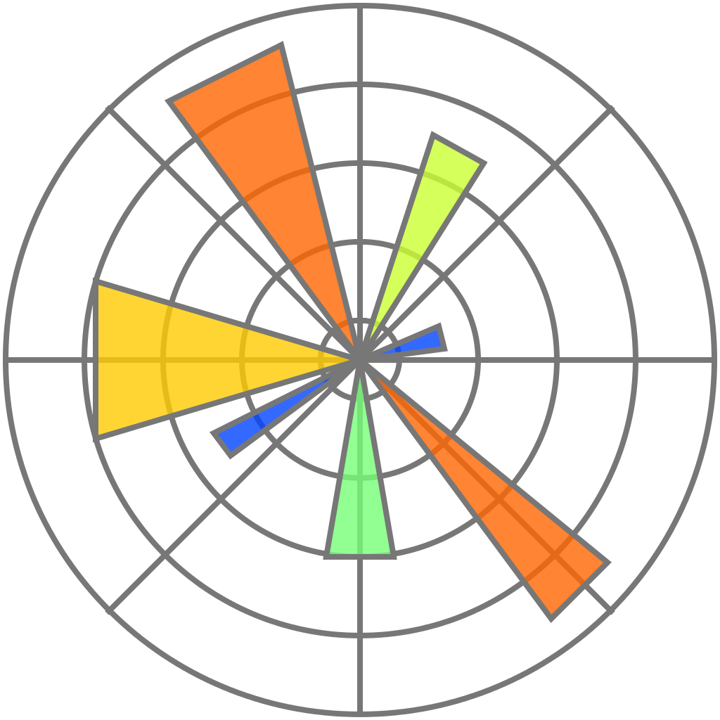
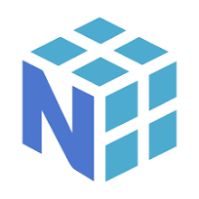
Next steps
Explore matplotlib’s many official tutorials covering a vast array of topics from basic to advanced!
Learn more about NumPy and how to use it with matplotlib
Use your new knowledge to learn more about your visualizations in pandas and seaborn (which are both built on matplotlib)

Slide 13
Thank you.

