Slide 1
February 26, 2024

Slide 2

Data Visualization in Python: Seaborn
A Reproducible Research Workshop
Simon Stone
Research Data Services
Dartmouth College

Slide 3
About the Reproducible Research Group
Joint venture of Research Computing @ ITC and Research Data Services @ Library
Consult with experts on
research data management,
data visualization,
biomedical research support,
spatial data and GIS,
high performance and research computing,
statistical analysis,
economics and social sciences data
Meet the people on campus that support your reproducible research lifecycle
Engage in community discussions to learn from other researchers on campus
Attend a workshop to learn practical tools and tips

Slide 4
About Research Data Services
Research Data Management
Data Management Plans (DMPs) for sponsored projects
Finding and using 3rd party data
Collection and cleaning of data
Organization and documentation
Publishing and Repositories
Data Analysis/Visualization
Textual, numeric, spatial data
Reproducible research workflows
Scripting in R: tidyverse core package (i.e. ggplot, dplyr, tydr, tibble, etc.)
Scripting in Python: NumPy, SciPy, Pandas, Scikit-learn, Matplotlib, Seaborn, (OpenCV, PyTorch, TensorFlow, Tesseract, NLTK, etc.)
Computational Scholarship
Computational project planning
Collections as Data
Storytelling with data and visualizations
Text and data mining
Digital Humanities support
Computational Pedagogy

Slide 5
Work with us
ResearchDataHelp@groups.dartmouth.edu
Jeremy Mikecz Research Data Science Specialist jeremy.m.mikecz@dartmouth.edu dartgo.org/jeremyappts | Simon Stone Research Data Science Specialist simon.stone@dartmouth.edu dartgo.org/meetwithsimon
Lora Leligdon Head of Research Data Services lora.c.leligdon@dartmouth.edu dartgo.org/lora

Slide 6






The Data Visualization Ecosystem in Python
Tabular data
Geospatial data
Dashboards
Folium
and many, many more…

Slide 7
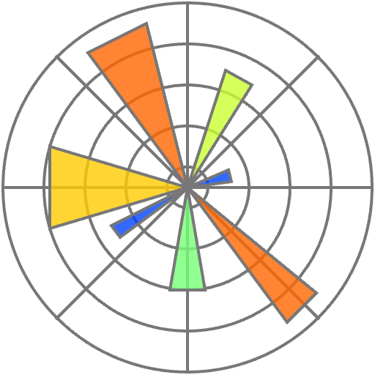
Seaborn is…
…a data visualization library with a high-level interface specializing in statistical graphics.
…built on matplotlib.
…the perfect match if you work with tabular data in pandas.
…a popular choice to create publication-ready visualizations.

Slide 8
What you will learn in this workshop
How seaborn is organized
How to best organize your data to work with seaborn
How to get started with seaborn’s interface
How to create visualizations showing multiple facets of your data

Slide 9
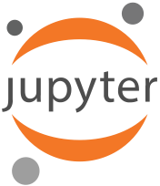
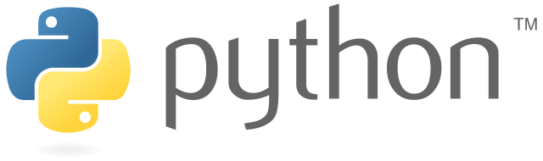
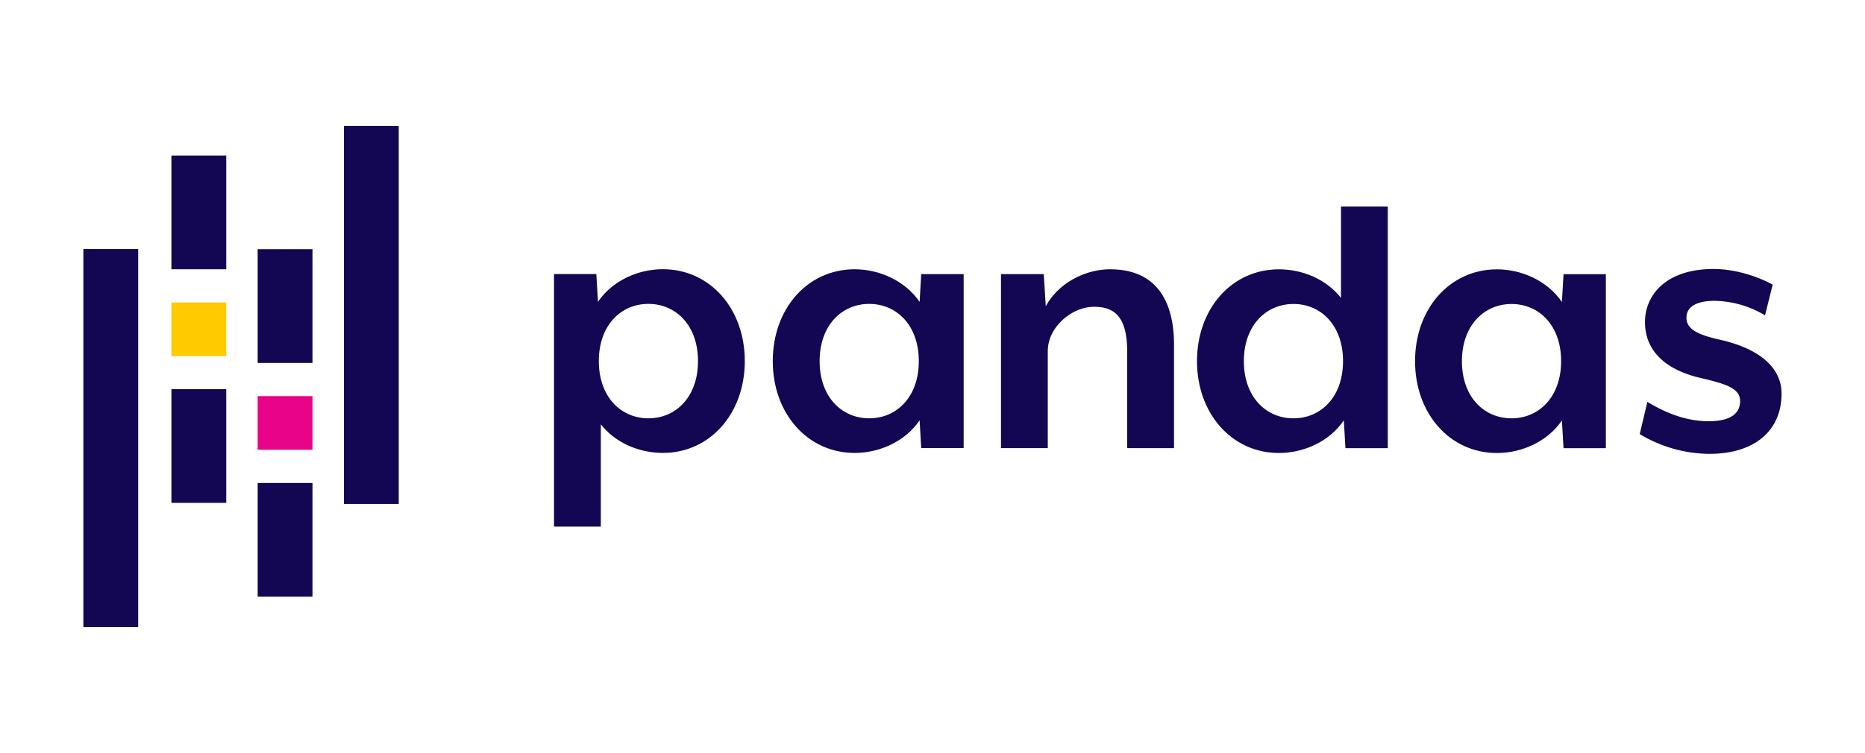
What we will work with in this workshop
Platform: https://jhub.Dartmouth.edu
Python
Pandas (data storage)
Seaborn
Materials: www.dartgo.org/rr-seaborn

Slide 10
Let’s start plotting…

Slide 11
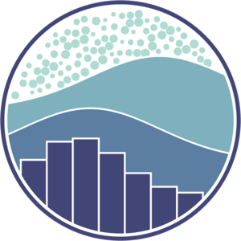
Next steps
Explore seaborn’s official tutorials and example gallery, covering a vast array of topics from basic to advanced!
Learn more about styling and theming in seaborn!
Go interactive and explore dashboarding with plotly express!

Slide 12
Thank you.

