Slide 1
November 8, 2022

Slide 2

Dirty Data
A Reproducible Research Workshop
Dr. Simon Stone
Research Data Services
Dartmouth College

Slide 3
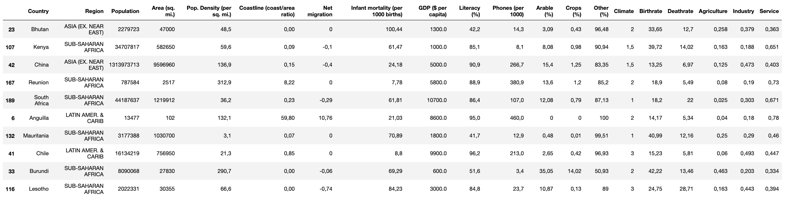
Why is my data dirty?!
Data processing needs consistently structured data
Excerpt from: https://www.kaggle.com/datasets/fernandol/countries-of-the-world (CC0)

Slide 4
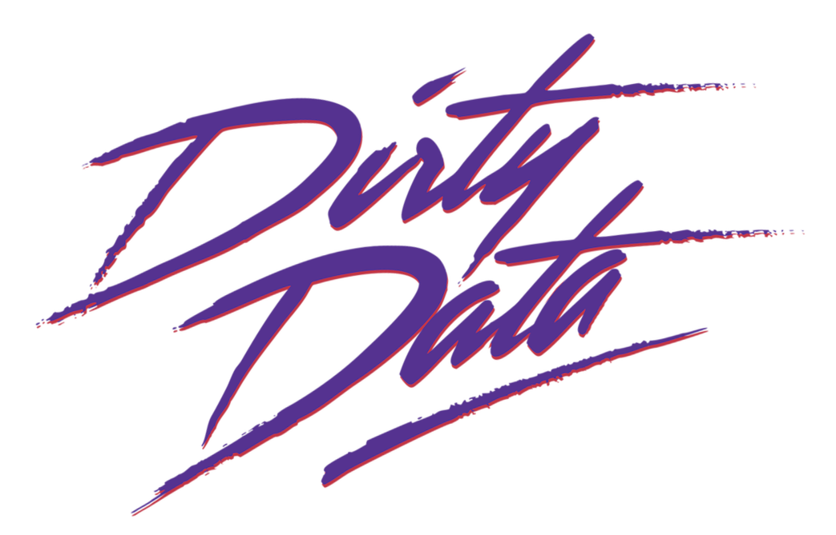
Why is my data dirty?!
Data processing needs consistently structured data
Published datasets are (usually) tidy
But data “in the wild” can be messy:
Different sources with different formats
Missing or incomplete data
Inconveniently formatted and/or structured

Slide 5
What you will learn in this workshop
Importing and consolidating data from inconsistent sources
Cleaning up inconsistent or inconveniently formatted entries
Dealing with missing values
Data Wrangling,
Data Munging

Slide 6



What we will work with in this workshop
Our example data was scraped from the product catalog on www.lego.com
We will use Python and Pandas to clean it up
Techniques are universal!

Slide 7

We better get started…
Photo by Rick Mason on Unsplash

