Slide 1
March 1, 2023

Slide 2

Massively parallel computing with MPI in Python
A Reproducible Research Workshop
Simon Stone
Research Data Services
Dartmouth College

Slide 3
About the Reproducible Research Group
Joint venture of Research Computing @ ITC and Research Data Services @ Library
Consult with experts on
research data management,
data visualization,
biomedical research support,
spatial data and GIS,
high performance and research computing,
statistical analysis,
economics and social sciences data
Meet the people on campus that support your reproducible research lifecycle
Engage in community discussions to learn from other researchers on campus
Attend a workshop to learn practical tools and tips

Slide 4
About Research Data Services
Research Data Management
Data Management Plans (DMPs) for sponsored projects
Finding and using 3rd party data
Collection and cleaning of data
Organization and documentation
Publishing and Repositories
Data Analysis/Visualization
Textual, numeric, spatial data
Reproducible research workflows
Scripting in R: tidyverse core package (i.e. ggplot, dplyr, tydr, tibble, etc.)
Scripting in Python: NumPy, SciPy, Pandas, Scikit-learn, Matplotlib, Seaborn, (OpenCV, PyTorch, TensorFlow, Tesseract, NLTK, etc.)
Computational Scholarship
Computational project planning
Collections as Data
Storytelling with data and visualizations
Text and data mining
Digital Humanities support
Computational Pedagogy

Slide 5
Work with us
ResearchDataHelp@groups.dartmouth.edu
Jeremy Mikecz Research Data Science Specialist jeremy.m.mikecz@dartmouth.edu dartgo.org/jeremyappts | Simon Stone Research Data Science Specialist simon.stone@dartmouth.edu dartgo.org/meetwithsimon
Lora Leligdon Head of Research Data Services lora.c.leligdon@dartmouth.edu dartgo.org/lora

Slide 6

Thought experiment I
Task:
Find Waldo as fast as possible!
Resources:
8 people in the same room
1 laptop
What would be a good strategy to perform this task?
Have each person focus on one section of the image
P0 | P1 | P2 | P3
P4 | P5 | P6 | P7

Slide 7
Thought experiment II
Task:
Find Waldo as fast as possible!
Resources:
64 people in 64 different places
64 laptops
What would be a good strategy to perform this task?
Send each person a section of the image
Have each person search through their section
Wait for the results to come back
Crowdsourced edition!!!

Slide 8
Comparison
Comparison
of shared-memory and distributed parallelism
CPUs,
node
CPUs,
nodes
Version I: Multiple workers, single room
Pros:
Simple implementation
Low overhead
Cons:
Limited by finite local resources
Version II: Multiple workers, multiple rooms
Pros:
Virtually unlimited scaling
Cons:
More complex implementation
Communication between workers causes overhead
OpenMP, C++11 threads, joblib, …
MPI

Slide 9
What is MPI?
MPI: Standard for a Message Passing Interface (currently version 4)
Defines:
Ways for exchanging messages between processes
Messages can contain flow control signals, data, and additional info
Implemented by various C/C++/Fortran libraries
OpenMPI, MPICH, MVAPICH2, Intel MPI, …
CPUs, cores, threads, HPC nodes

Slide 10
What you will learn in this workshop
Basic concepts of MPI
Core communication paradigms:
One-to-one, one-to-many, many-to-one
How to run MPI-powered programs on Discovery
Quick poll: HPC/SLURM experience
Some Pitfalls and good practices
A working mental model of the core MPI concepts

Slide 11



What we will work with in this workshop
We will use the Python wrapper mpi4py (around OpenMPI)
Run on Dartmouth’s Discovery cluster
Focus on concepts over implementation details
Materials: www.dartgo.org/rr-mpi

Slide 12
Let’s get started…

Slide 13
Getting started with mpi4py on Discovery
Pick an MPI version (and stick with it!)
Make the conda command available in your shell
Create and activate a conda environment (change the Python version at your own risk)
Install mpi4py (ignoring cached files, just to be safe)
#!/bin/bash
module load openmpi/4.1.2
source /optnfs/common/miniconda3/etc/profile.d/conda.sh
conda create --name mpi-env python=3.8 -y
conda activate mpi-env
pip install mpi4py --no-cache-dir
setup-mpi4py.sh
This order is important, because mpi4py is built for the currently loaded MPI distribution!

Slide 14


How MPI communication works (basically)
Node 0
Node 1
Node 2
Communicator “World”
CPU 0
CPU 1
CPU 0
CPU 1
CPU 0
CPU 1
CPU by Maciej Świerczek from Noun Project (CCBY3.0)
CPU by Bestdesignmarket from Noun Project (CCBY3.0)
Rank 0
Rank 1
Rank 4
Rank 5
Rank 8
Rank 9
CPU 2
CPU 3
CPU 2
CPU 3
CPU 2
CPU 3
Rank 2
Rank 3
Rank 6
Rank 7
Rank 10
Rank 11

Slide 15
How MPI communication works (basically)
You write your program once
MPI starts the requested number of processes and copies the program to each
By checking the assigned rank and flow control, your program can behave differently
Example:
Rank 0 manages the workflow (distribute data, collect results) and I/O
Other ranks do number crunching

Slide 16
“Hello, Parallel Worlds!”
import os
# Import the mpi4py module (internally calls MPI_Init())
from mpi4py import MPI
# Get a handle of the `World` communicator
comm = MPI.COMM_WORLD
# Obtain the rank of this process in the `World` communicator
rank = comm.Get_rank()
print(Hello, world! I am rank {rank} running on {os.environ["SLURMD_NODENAME"]}!'
00-hello-world.py

Slide 17
How to run an MPI-enabled program (on Discovery)
#!/bin/bash
#SBATCH --job-name=”hiworld"
#SBATCH --time=00:05:00
#SBATCH --nodes=20
#SBATCH --ntasks-per-node=1
#SBATCH --cpus-per-task=1
#SBATCH --mem-per-cpu=100M
#SBATCH --output=../out/00-hello-world-%j.out
module load openmpi/4.1.2
source /optnfs/common/miniconda3/etc/profile.d/conda.sh
conda activate mpi-env
mpiexec -np 20 python ..src/00-hello-world.py --mca mpi_cuda_support 0
00-hello-world.sh
Number of nodes
Number of MPI processes per node
Number of CPUs available in each MPI process
Load the same MPI module used before
Turn off CUDA support to avoid warnings
Make sure our conda environment is active
Our program to run
The MPI executable
Total number of processes (number of nodes times processes per node)

Slide 18
Demo
Hello World!

Slide 19


One-to-One communication send() and recv()
from mpi4py import MPI
comm = MPI.COMM_WORLD
rank = comm.Get_rank()
if rank == 0:
data = {'Dartmouth': 1769}
print(f'I am {rank=} and about to send {data=}.')
comm.send(data, dest=1, tag=42)
if rank == 1:
data = comm.recv(source=0, tag=42)
print(f'I am {rank=} and have received {data=}’)
print(f'I am {rank=} and I have {data=}.’)
01-send-and-receive.py
Rank 0
Rank 1
CPU by Maciej Świerczek from Noun Project (CCBY3.0)

Slide 20
Demo
Send and receive

Slide 21

One-to-Many: One message, many receivers broadcasting using bcast()
from mpi4py import MPI
comm = MPI.COMM_WORLD
rank = comm.Get_rank()
if rank == 0:
data = {'Dartmouth': 1769}
else:
data = None
print(f'I am process {rank} and my data is {data=} before the broadcast!')
# Broadcast the object from the process with rank 'root’
# to all other processes in the communicator
data = comm.bcast(data, root=0)
print(f'I am process {rank} and my data is {data=} after the broadcast!’)
02-broadcast.py
Rank 0
…
Rank 1
Rank 2
Rank N
CPU by Maciej Świerczek from Noun Project (CCBY3.0)
broadcast by Andri Graphic from Noun Project (CCBY3.0)

Slide 22
Demo
Broadcast

Slide 23

One-to-Many: Different message for each receiver scatter()
from mpi4py import MPI
import numpy as np
comm = MPI.COMM_WORLD
size = comm.Get_size()
rank = comm.Get_rank()
if rank == 0:
print(f'I am process {rank} and I am preparing to scatter an array’
f'of size={size * 3 + 1} across {size} processes.')
data = [i for i in range(size * 3 + 1)]
# The number of elements in 'data' has to match the number of receiving processes
# We therefore slice the list into 'size' (not necessarily equally long) slices
data = np.array_split(data, size)
else:
data = None
print(f'I am process {rank} and before the scatter I have {data=}.’)
data = comm.scatter(data, root=0)
print(f'I am process {rank} and after the scatter I have {data=}.’)
03-scatter.py
Rank 0
Rank 1
Rank 2
Rank 3
CPU by Maciej Świerczek from Noun Project (CCBY3.0)
Puzzle by Edwin PM from Noun Project (CCBY3.0)

Slide 24
Demo
Scatter

Slide 25
Many-to-One: Different messages from each sender gather()
from mpi4py import MPI
comm = MPI.COMM_WORLD
rank = comm.Get_rank()
data = rank
data = comm.gather(data, root=0)
print(f'I am process {rank} and my data is {data=}.’)
04-gather.py
Rank 0
Rank 1
Rank 2
Rank 3
CPU by Maciej Świerczek from Noun Project (CCBY3.0)
Puzzle by Edwin PM from Noun Project (CCBY3.0)

Slide 26
Demo
Gather

Slide 27
What about embarrassingly parallel* problems?
MPI requires changes to your source code
It also introduces overhead
So how about sections like this:
Just leave them in and use shared memory and distributed processing together!
#!/bin/bash
#SBATCH --job-name="mpi+mp"
#SBATCH --time=00:05:00
#SBATCH --output=../out/05-parallel-%j.out
#SBATCH --nodes=8
#SBATCH --ntasks-per-node=1
#SBATCH --cpus-per-task=4
#SBATCH --mem-per-cpu=100M
module load openmpi/4.1.2
source /optnfs/common/miniconda3/etc/profile.d/conda.sh
conda activate mpi-env
mpiexec -np 8 python ../src/05-parallel.py --mca mpi_cuda_support 0
05-parallel.sh
Managed using MPI
Can be used for shared memory!
from multiprocessing import Pool
n_workers = 16
with Pool(n_workers) as p:
result = p.map(something_taking_1ms, arr)
Only the MPI processes
* https://en.wikipedia.org/wiki/Embarrassingly_parallel

Slide 28
What about embarrassingly parallel problems?
Will run on each node on as many CPUs as allocated
from mpi4py import MPI
import numpy as np
from multiprocessing import Pool
import os
import time
comm = MPI.COMM_WORLD
rank = comm.Get_rank()
def cpu_count():
return int(os.environ['SLURM_CPUS_PER_TASK'])
def node_count():
return comm.size
def something_taking_1ms(value):
""" A dummy function that takes about 1 millisecond to run"""
start = time.perf_counter()
while (time.perf_counter() - start) < 0.001:
continue
return value
def something_that_takes_a_long_time(arr, n_workers):
with Pool(n_workers) as p:
result = p.map(something_taking_1ms, arr)
return result
if __name__ == "__main__":
n_nodes = node_count()
n_cpus = cpu_count()
data = None
if rank == 0:
array_size = 20_000
data = [x for x in range(array_size)]
data = np.array_split(data, n_nodes)
data = comm.scatter(data, root=0)
data = something_that_takes_a_long_time(data, n_cpus)
data = comm.gather(data, root=0)
05-parallel.py (edited for clarity)
Will scatter the data to all allocated nodes

Slide 29
Demo
Distributed and shared-memory

Slide 30
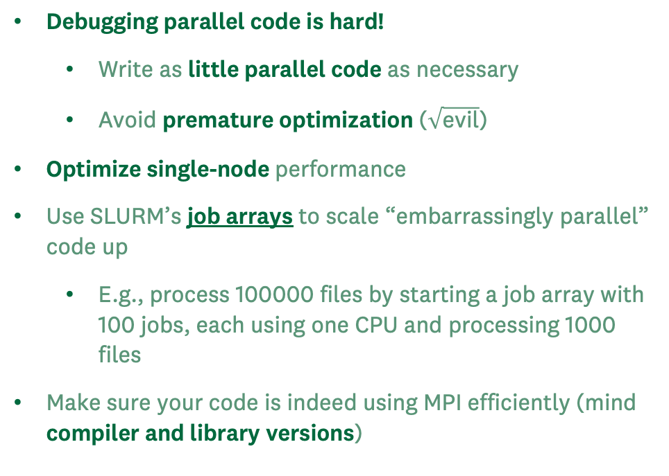
Pitfalls and best practices
Deadlocks:
At least two processes are waiting for each other
Be mindful of blocking MPI commands!
Race conditions:
Code is (unintentionally) written in a way that the execution timing affects the result
Be mindful of nonblocking MPI commands!
Use blocking MPI commands to corral your processes (e.g., barrier(), fences(), locks())
Debugging parallel code is hard!
Write as little parallel code as necessary
Avoid premature optimization ($\sqrt{\text{evil}}$)
Optimize single-node performance
Use SLURM’s job arrays to scale “embarrassingly parallel” code up
E.g., process 100000 files by starting a job array with 100 jobs, each using one CPU and processing 1000 files
Make sure your code is indeed using MPI efficiently (mind compiler and library versions)

Slide 31
Next steps
Try stuff!
Great collection of learning resource: https://researchcomputing.princeton.edu/education/external-online-resources/mpi
Tell us (researchdatahelp@groups.dartmouth.edu) how it went!

Slide 32
EOF

